Slide 1
Program Structure and Development Mingzheng Michael Huang
Translating Algorithm Components
Repetition: for loops: for loops: Execute over particle and collision arrays for initial setup and recalculations post-collision. Specifically, they enable efficient checking and updating of every particle's potential collisions with walls and other particles after an event; while loops: Employs a primary loop to continuously process the earliest collision until all predicted events are resolved or a simulation end condition is met.
Decision Making: if/else statements: Determine collision types, with separate logic paths for particle-wall (updateWC) and particle-particle (updatePC) interactions. They are crucial in applying appropriate physical laws for momentum and energy transfer.
Math: Collision detection relies on predicting when and where two particles or a particle and a wall will intersect based on their current velocities and positions, involving calculations of trajectories and relative speeds.
Names: particles: Stores the dynamic state of each particle, including position, velocity, and collision count, offering a comprehensive snapshot of the system at any given time; collisions: Records potential future collision events, each with a timestamp indicating when it will occur if no other collision alters the involved particles' paths.
Altering Values: Particles' states (position, velocity) are continuously updated following collisions. The system's entropy and energy dispersion are indirectly represented through these changes.
Complicated Steps: Functions like updateWC and updatePC abstract away the complexity of resolving collisions and updating velocities; processNext: Determines and processes the next collision based on the sorted collision list.
And the answer is...!: At the end, the simulation reveals dynamics of the system such as total number of collisions and final particle positions.

Slide 2
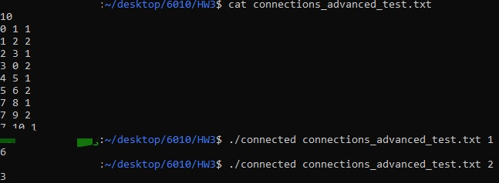
Program Validation
Stress Testing Approach (See README.TXT)
Comprehensive testing of complex graph structures with varying connected components.
Ensured detection of distinct connected components with alternating edge weights.
Validation of correct weight interpretation.
Validation Criteria
Depth-First Search must correctly identify separate connected components in the graph.
Accurate reading and processing of edge weights.
Handling of repeated edges and unique vertex identifiers.
Results
All tests, including the advanced graph structure test (connections_advanced_test.txt), were successfully executed, verifying the accurate and robust operation of the connectivity detection program. The algorithm effectively determines connected components and respects given edge weights, even in complex scenarios.

