Slide 1
Program Structure and Development Mingzheng Michael Huang
Initial Setup: File Reading (read function): Opens input file, reads simulation parameters (number of particles, arena size, etc.), and initializes global particles and collisions arrays with simulation data.
Main Simulation Loop (main function):Collision Sorting (sortColArr function): Implements insertion sort to prioritize upcoming events, ensuring the next collision processed is always the earliest. Event Processing (jumpCol function): Determines the type of the earliest collision (particle-wall or particle-particle) and delegates to the respective update function.
Collision Handling: Particle-Wall Collisions (updatePW function): Updates particle state after a wall collision, inverts velocity if it collides with the boundary. Particle-Particle Collisions (updatePP function): Swaps velocities between particles post-collision to simulate elastic interaction.
Dynamic Collision Updating: Array Updates (updateColArr function): After a collision, recalculates potential collisions involving the affected particles and updates the collision array accordingly.
Advancement and Finalization: Position Updates (updateParArr function): Adjusts positions of all particles to the time of the last processed collision. Simulation Completion: Finalizes particle positions at user-specified end time, prints final states, and releases resources.
Flow Control Constructs: Loops: Used to process events in time order and update the state of all particles and potential collisions continuously. Conditional Statements: Guide the logic flow, distinguishing between collision types and ensuring correct updates only where necessary.

Slide 2
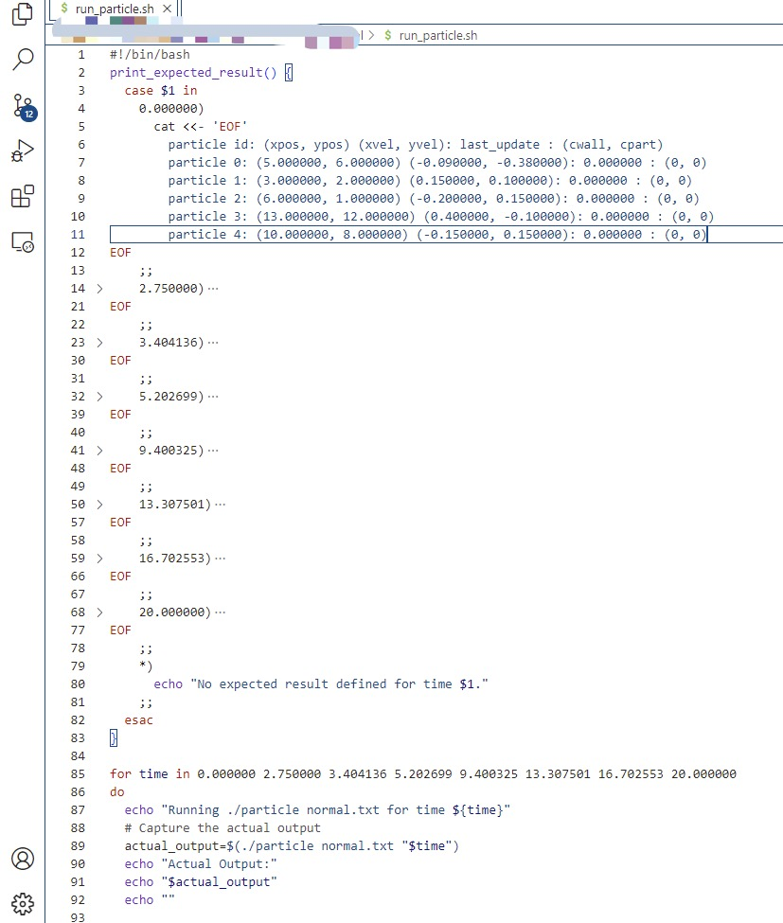
Automated Validation with Bash Script - Overview
Script Functionality:
A Bash script is designed to run the particle simulation program at predefined times.
For each time value, the script compares the actual output of the program with the expected results.
Efficiency in Testing:
Automating the process allows for multiple test cases to be run sequentially without manual intervention.
This ensures comprehensive coverage over a range of different scenarios.
Precision of Evaluation:
The script captures the actual output of the simulation and displays it alongside pre-defined expected outcomes for verification.
Any discrepancies are easily noted, allowing for quick debugging and validation.

Slide 3
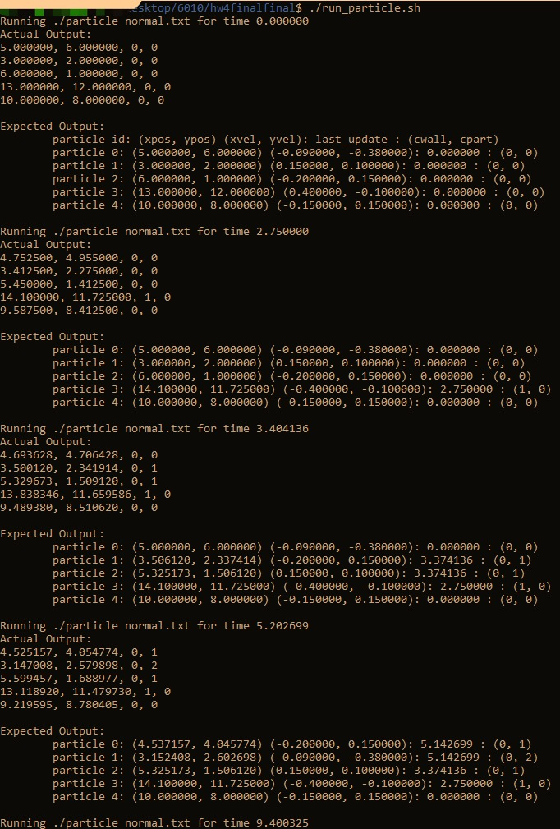
Automated Validation with Bash Script - Execution and Results
Execution Process:
The script loops through an array of time values, running the particle simulation for each.
After each run, it captures the simulation's output and invokes a function to print the expected results.
Case-by-Case Validation:
Each case within the print_expected_result function corresponds to a time value where the output is known.
The expected output for each time value would be filled in the script, corresponding to theoretical or previously confirmed results.
Outcome and Insights:
The actual output is echoed on the console, followed by the expected output, facilitating direct comparison.
This comparison serves as a regression test to ensure that any changes in the code do not alter the correct behavior of the program.
By confirming the actual output matches the expected results at various times, we validate the program's consistent performance across multiple scenarios.

