Slide 1
Program Structure and Development Mingzheng Michael Huang
Command-Line Parsing: Processes command-line arguments to set program parameters, including total and mantissa bits, and operation type. Employs error checks and validations using if statements for robust input handling.
Core Functions: 1. convert: Translates binary strings to floating-point numbers, involving loops for exponent and mantissa calculations and conditions for special cases like Infinity and NaN. 2. minmax: Calculates minimum and maximum representable floating-point values based on user-defined bit specifications. 3. addHex: Performs addition of two hexadecimal numbers by converting them to the custom floating-point format, integrating string manipulation with arithmetic operations.
Helper Functions: Consists of conversion functions like hexToBinary, binaryToFloat, floatToBinary, and binaryToHex, each tailored for specific format transformations. These functions enhance code modularity and are implemented using character-wise processing loops.
Main Function: Acts as the control center, directing the program based on user input to the appropriate function among convert, minmax, or addHex. It manages the execution flow and result presentation, ensuring cohesive operation of the program components.

Slide 2
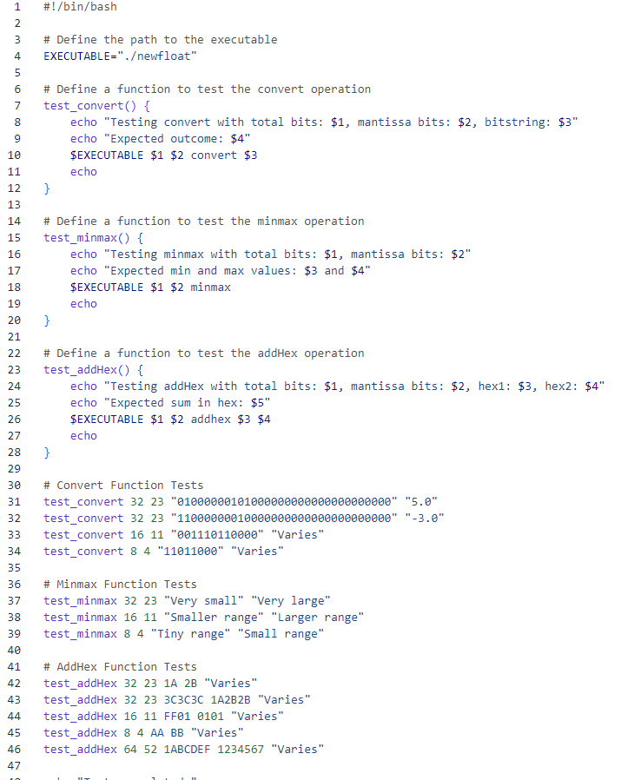
Automated Validation with Bash Script - Overview
Script Functionality:
Automated script leverages shell scripting to interact with newfloat executable, methodically testing convert, minmax, and addHex functions.
Employs command-line argument passing to simulate user inputs for diverse floating-point operations.
Efficiency in Testing:
Utilizes batch processing and automated execution to efficiently validate multiple scenarios, enhancing test throughput.
Scripting allows for rapid iteration and regression testing, crucial for agile development cycles.
Precision of Evaluation:
Script meticulously assesses floating-point precision, exponent handling, and mantissa computation accuracy.
Ensures compliance with IEEE floating-point standard nuances, especially in convert function’s base-10 representation and addHex function's hexadecimal arithmetic.

Slide 3
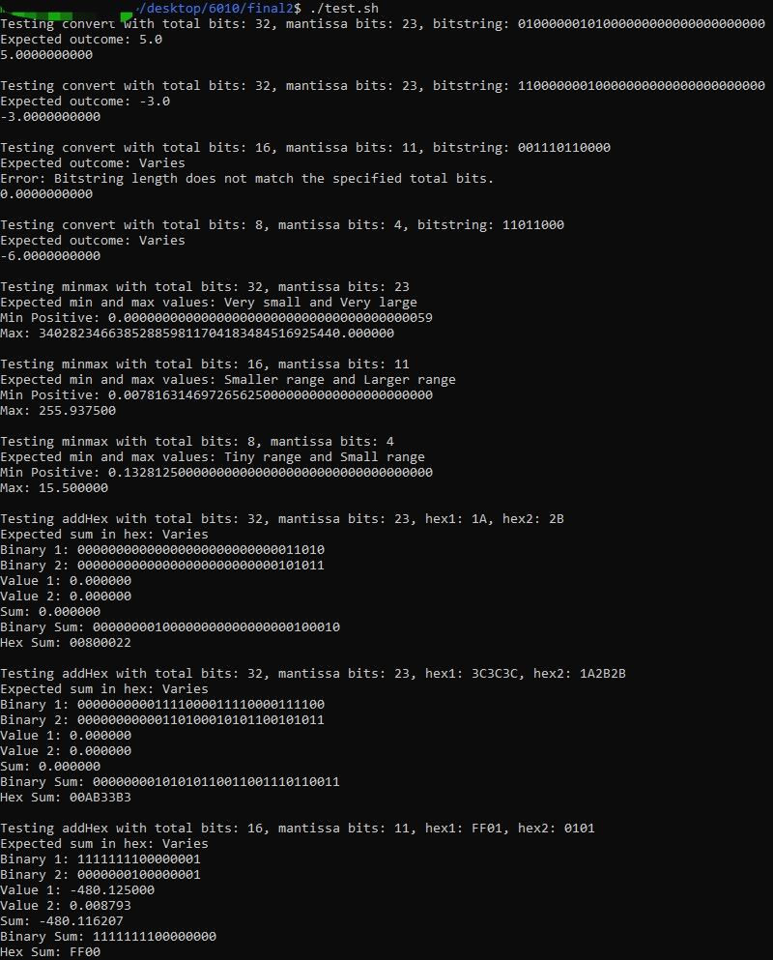
Automated Validation with Bash Script - Execution and Results
Execution Process:
Sequential execution of predefined test cases, invoking newfloat with parameters like total bits, mantissa bits, and operation-specific inputs.
Automated parsing of output to validate against expected floating-point representation and arithmetic results.
Case-by-Case Validation:
Detailed breakdown of test cases, for example:
convert function testing with varied bit patterns to ensure accurate IEEE floating-point representation.
minmax function validation against theoretical minimum and maximum floating-point values.
addHex function’s hexadecimal arithmetic tests, focusing on precision and correctness in binary-to-float conversion.
Emphasizes script’s role in validating numerical accuracy and edge-case handling in floating-point calculations.
Outcome and Insights:
Summarizes key findings such as precision accuracy in floating-point operations, adherence to specified bit formats, and robustness in arithmetic operations.
Insights on script’s effectiveness in identifying precision-related issues and compliance with floating-point standards.

