Slide 1
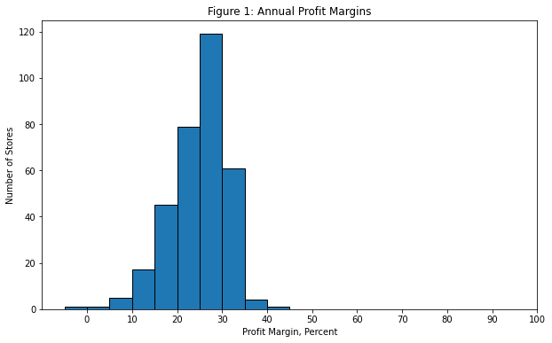
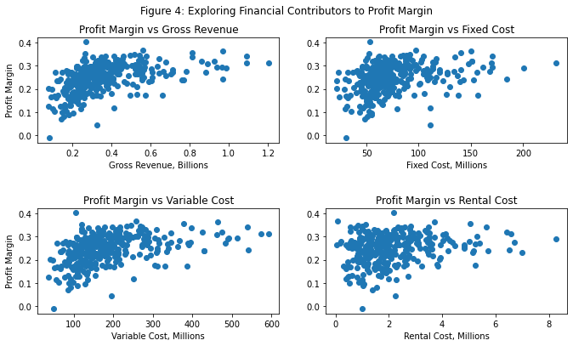
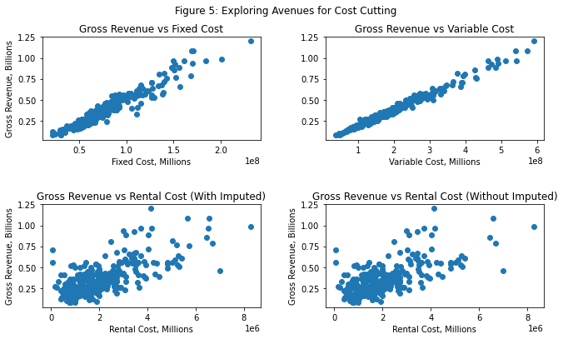
Key Takeaways
Start small:
low revenue, low cost locations have potential
Focus on rent, then fixed costs:
cutting variable costs may hurt revenues
Where and when matter:
profit margins vary widely between
states and months
There’s always more to do:
detailed data and experiments can help determine causality

Slide 2
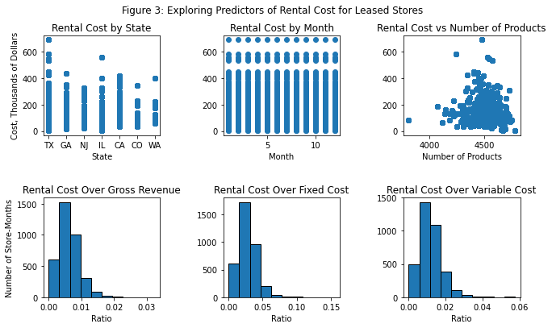
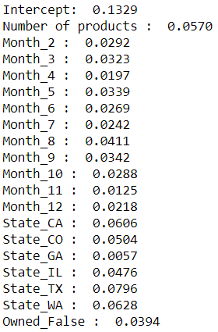
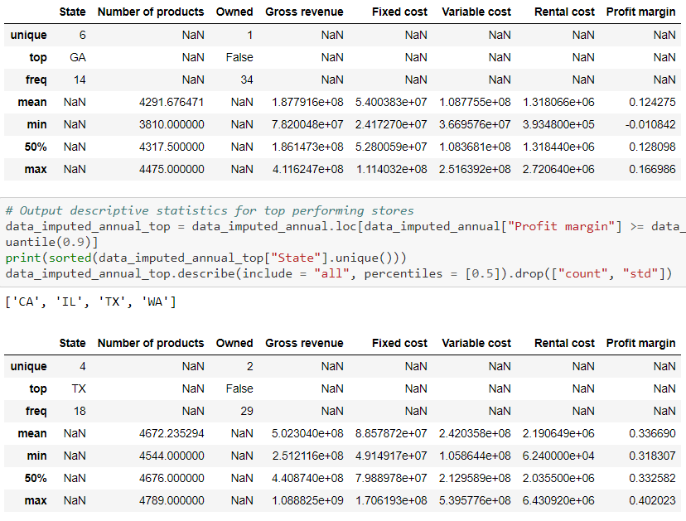
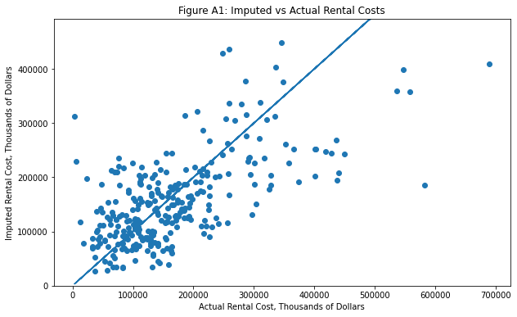
Cleaning
Modeling
Comparing
Rental costs vary with state and gross revenue, so impute as store’s mean monthly revenue * (state’s median rent/revenue ratio)
Linear regression with normalized numeric data and one-hot encoding of categorical variables leads to a host of insights
The worst-performing stores have few products, are leased, and are in NJ or GA
January and November are bad for profit
Low rents with high revenues are achievable
Top 10% locations:
Bottom 10% locations:

