Slide 1




End-to-end Case-based Reasoning for Commonsense Knowledge Base Completion
Zonglin Yang, Xinya Du, Erik Cambria, Claire Cardie
Paper: https://aclanthology.org/2023.eacl-main.255.pdf
Code: https://github.com/ZonglinY/ECBRF_Case_Based_Reasoning_with_PLM

Slide 2
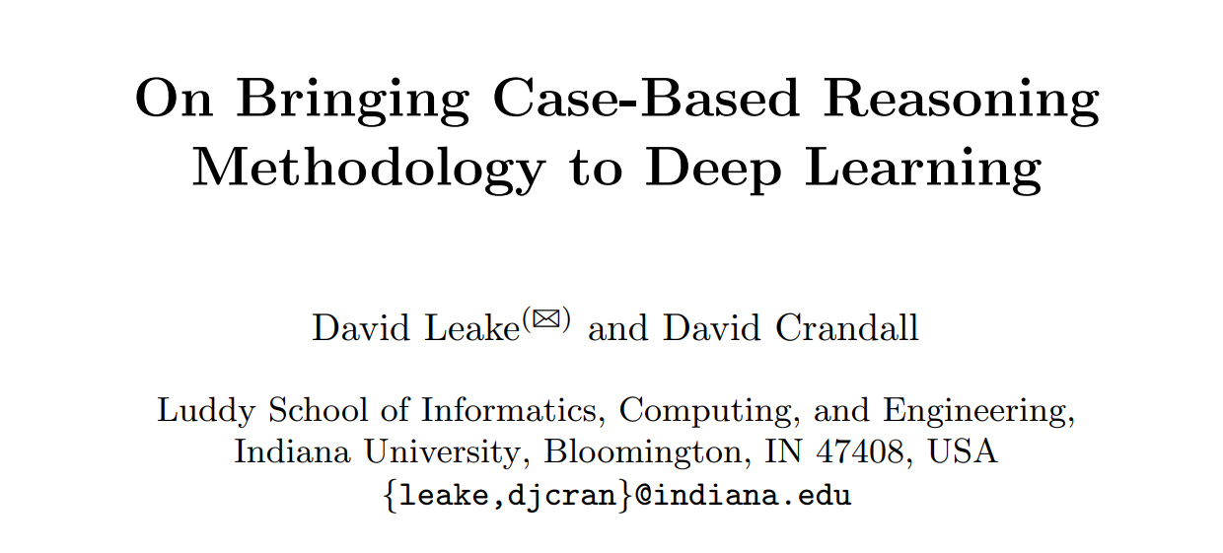
Two Main Motivations
Bridging CBR with Deep Learning could be beneficial, but how to bridge them remains challenging.
Published on ICCBR 2020

Slide 3
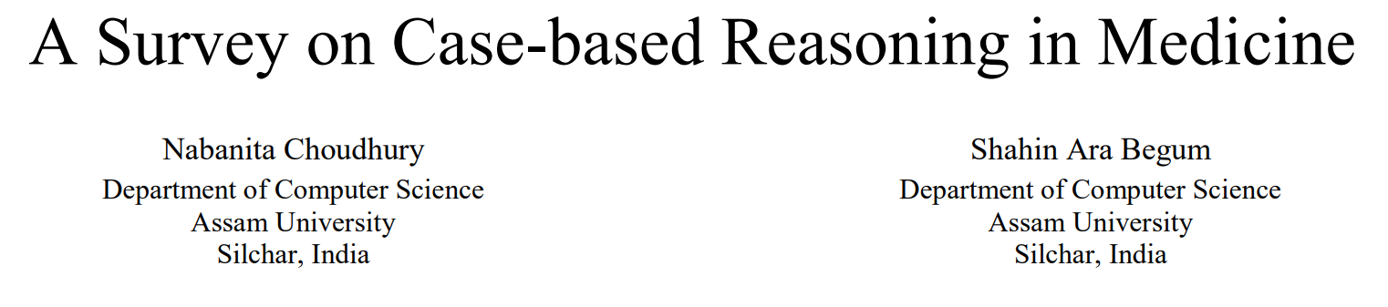
Two Main Motivations
The “reuse” step is very challenging that in many practical fields the CBR methodology is only used as a retriever.
E.g., medical systems

Slide 4
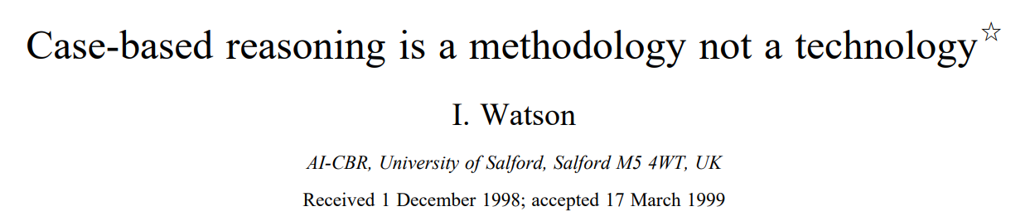
How to bridge CBR to Deep Learning
We treat CBR as a methodology that adopts pretrained language models as a specific technology for “reuse” step.
Bridging CBR with deep learning
Helping the adaptation of retrieved cases in “reuse” step
Notes:
Our framework is inspired by Watson’s proposal that compared to CBR being described as an artificial intelligence technology, it is better to describe CBR as a methodology for problem solving, that may use any appropriate technology.

Slide 5
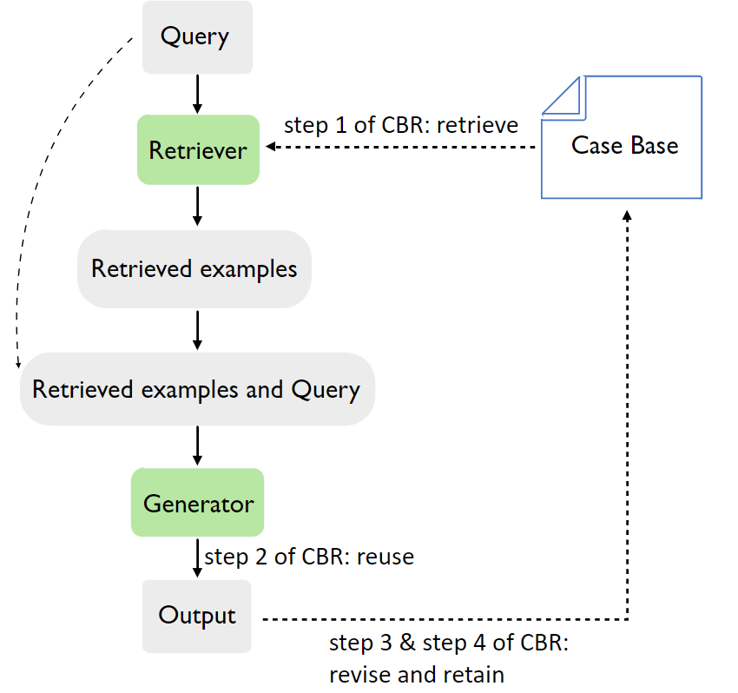
Method
Suppose the task is to
return a text answer
given a text query
Pretrained Language Models

Slide 6
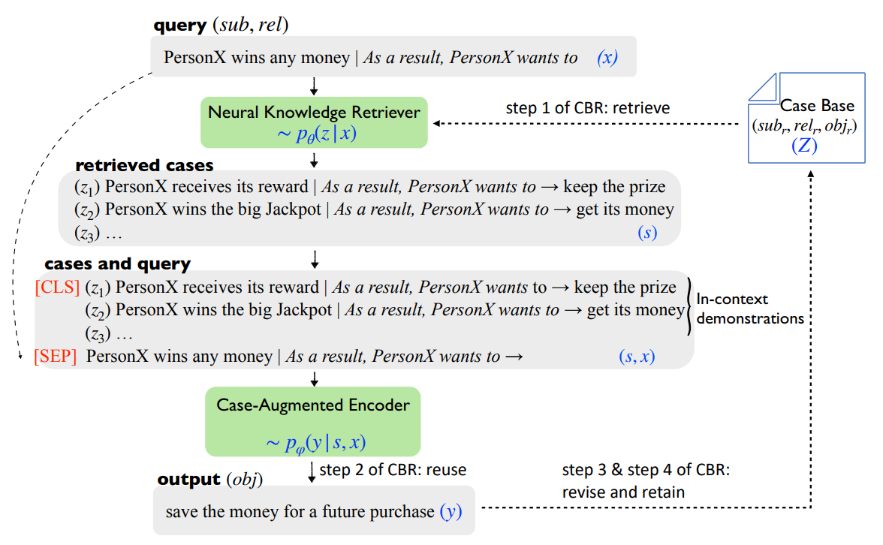
Method

Slide 7
One Sentence Contribution
We show the connection between in-context demonstration and Case-based Reasoning, and that bridging them is beneficial to both fields.

Slide 8
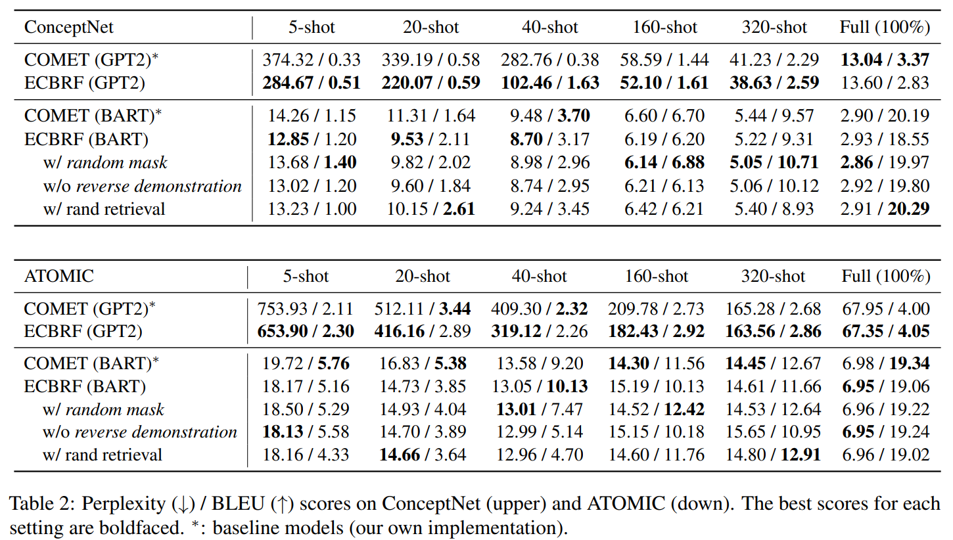
Experiments
Compared with baseline (COMET), more improvements can be achieved under few-shot setting, where CBR typically has advantages and deep learning typically fails.

Slide 9
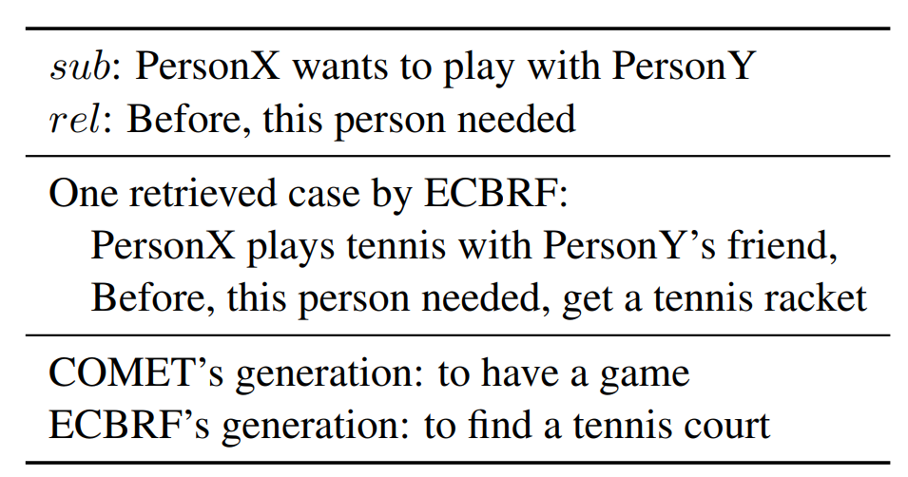
Effect of retrieved cases
Notes:
We found that in many examples, the retrieved cases can influence the current answer generation.

Slide 10
Analyses of the Method from CBR perspective
Retrieve
Reuse
Revise and Retain

Slide 11
Analysis from Retrieve Step
Less sensitive to the “retrieve” step compared to classic CBR methods

Slide 12
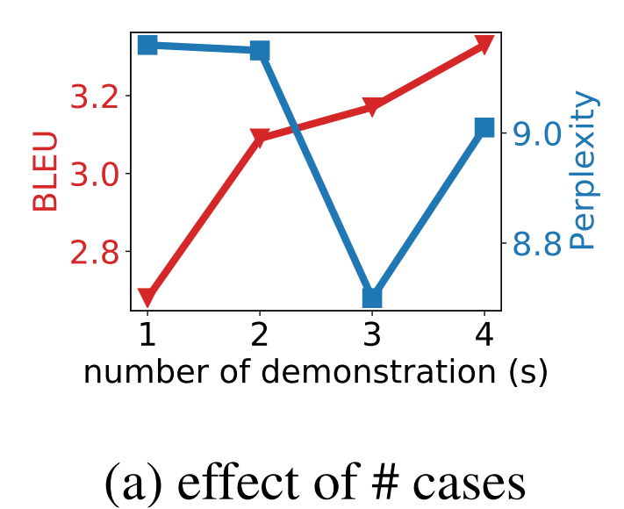
Analysis from Reuse Step

Slide 13
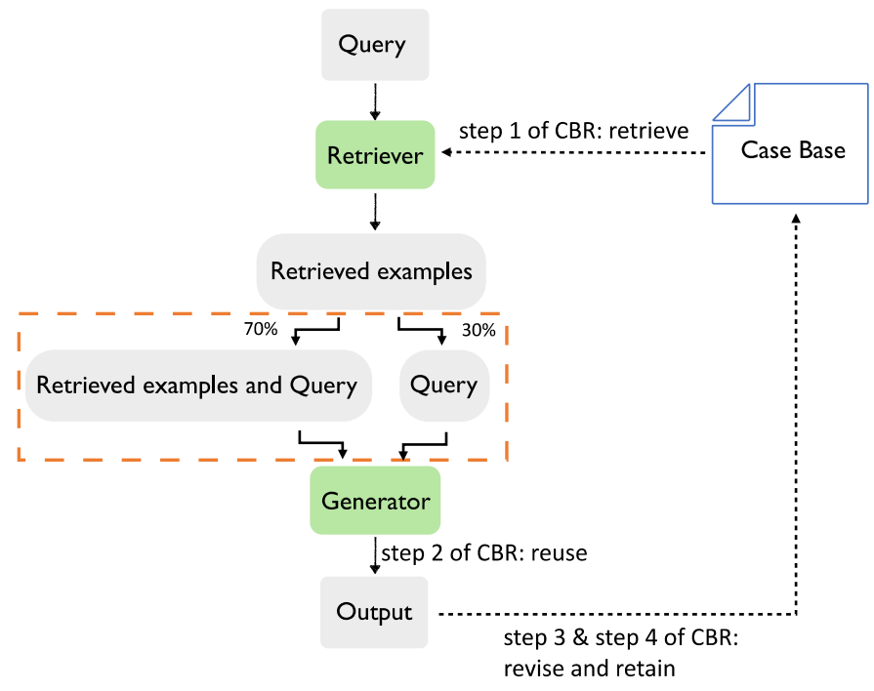
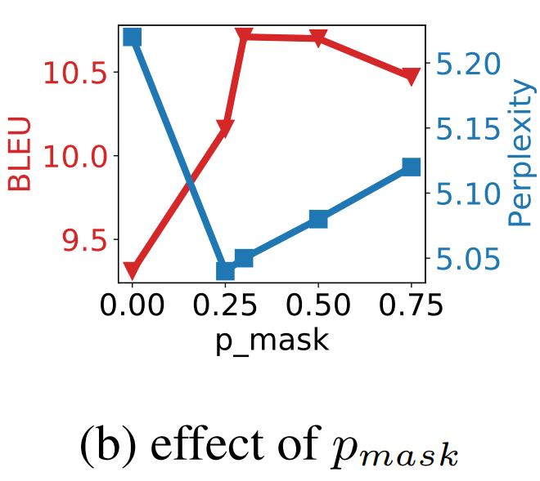
Analysis from Reuse Step
p_mask = 0.3

Slide 14
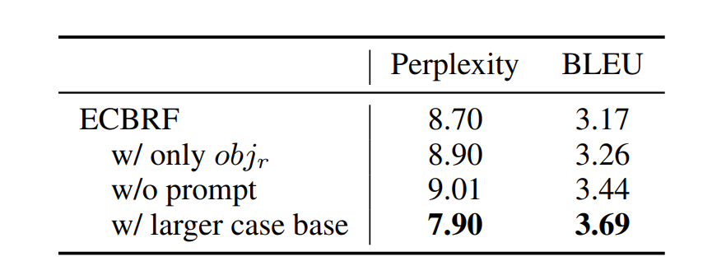
Analysis from Reuse Step
In this example,
sub (subject): PersonX wins any money
rel (relation): As a result, PersonX wants to
obj (object): save the money for a future purchase
The same
Prompt:
Here are three past relevant cases and a current query, try to generate an answer for the current query utilizing the three cases.
(z1) xxx
(z2) xxx
(z3) …
PersonX wins any money | …

Slide 15
Analysis from Revise and Retain Step

Slide 16
Future Works and Challenges
In general, we hope this work could
provide some insights to bridge CBR and deep learning together
advance the research of both fields from each other's research developments.
From the aspect of CBR, this work provides a tentative answer to the two long-remaining challenges
whether CBR can be used to complement DL
Implementation of the “reuse” step
How to further answer these two questions could be a challenging research topic.

Slide 17
Thank you!
Paper: https://aclanthology.org/2023.eacl-main.255.pdf
Code: https://github.com/ZonglinY/ECBRF_Case_Based_Reasoning_with_PLM
Twitter: https://twitter.com/Yang_zy223

