Slide 1

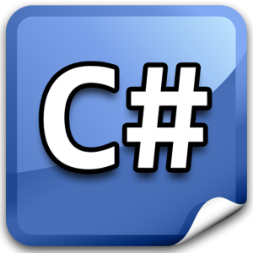

C# Expression Trees
What? C# Could Do That?
C# Expression Trees
Telerik Academy Plus
http://academy.telerik.com

Slide 2

Table of Contents
C# Core - The New Reflection API
What Are Expression Trees?
Parsing Expressions
Creating Expressions
Run-time Delegates
With Expressions
With Pure Reflection

Slide 3
C# Core – The New Reflection API

Slide 4
The New Reflection API
In .NET Core most of the methods found on System.Type are not available
You need to use GetTypeInfo() to retrieve them
// old way
typeof(MyClass).GetMethods();
// new way
typeof(MyClass).GetTypeInfo().DeclaredMethods;

Slide 5
What Are Expression Trees

Slide 6
What Are Expression Trees
Expression Trees are data structure to represent code syntax
Sounds easier than it is, right?
Commonly used with lambda expressions
Where will you need it?
Most probably nowhere ☺
At least not directly
Typically frameworks use expression trees
ASP.NET MVC
Entity Framework
You own custom-never-heard-of-framework ☺

Slide 7
Parsing Expressions

Slide 8
Parsing Expressions
Lets parse some expression trees
Constant Expression
Convert Expression (Unary)
Method Call – Instance or Static
Expression Lambda Parameters
Variables
Operator Expressions (Binary)
Method Arguments
Property Getters (Nested Two)
Object With Default And Normal Constructor
Object With Member Initialization

Slide 9
Creating Expressions

Slide 10
Creating Expressions
Lets create some expression trees
Caching Expressions - normal, in method
New Object Expressions
Method Call – Instance
Method Call With Parameters
MVC Style Fast Property Getters

Slide 11
BONUS: Run-time Delegates With Pure Reflection

Slide 12
C# Expression Trees
http://academy.telerik.com

Slide 13




Free Trainings @ Telerik Academy
C# Programming @ Telerik Academy
csharpfundamentals.telerik.com
Telerik Software Academy
academy.telerik.com
Telerik Academy @ Facebook
facebook.com/TelerikAcademy
Telerik Software Academy Forums
forums.academy.telerik.com

