Slide 1
Introduction
Hello! My name is Michaela Kemp, student number: 231001.
I am a second-year student at Open Window Institute, majoring in Interactive Development and User Experience Design.
I will be showcasing the following two projects:
Orbiting Eyes: An interactive application that provides detailed information on celestial bodies using NASA's Horizons API.
2. PawPrints: A collaborative project on a pet adoption application built with the MERN stack, aimed at connecting potential adopters with shelters.

Slide 2
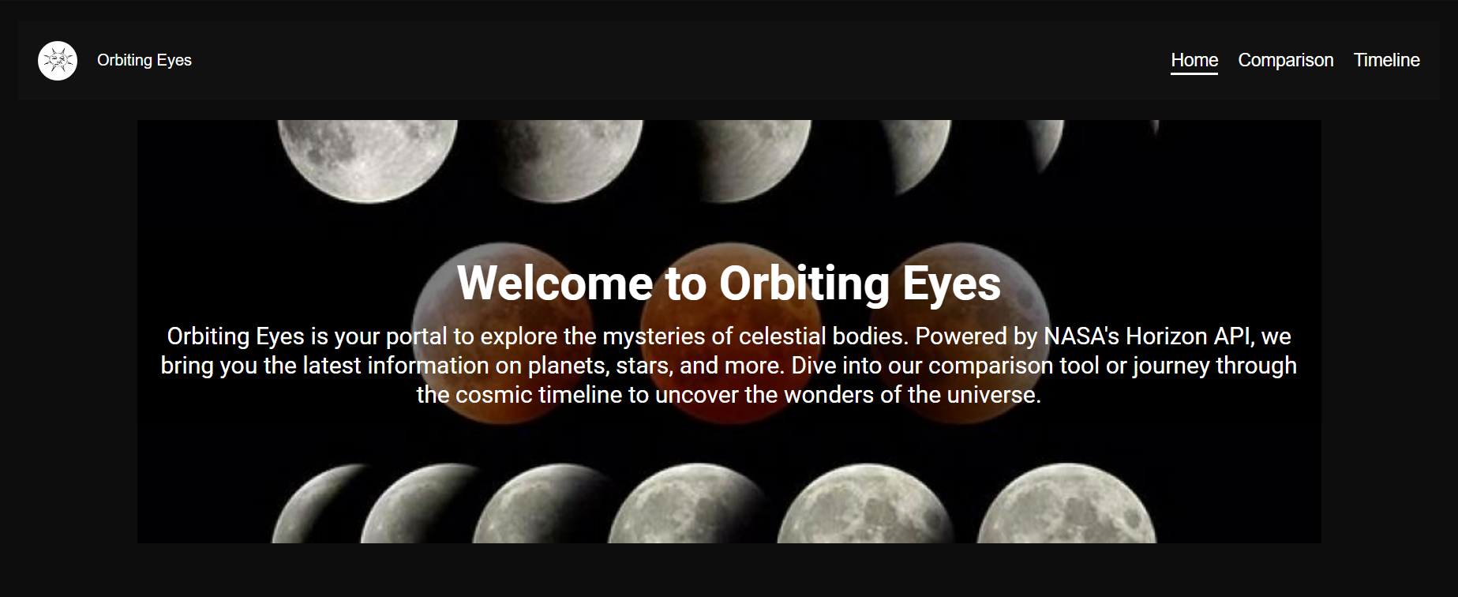
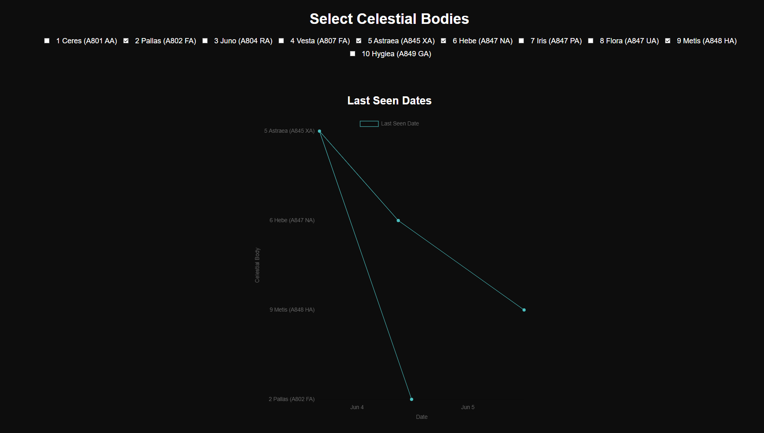
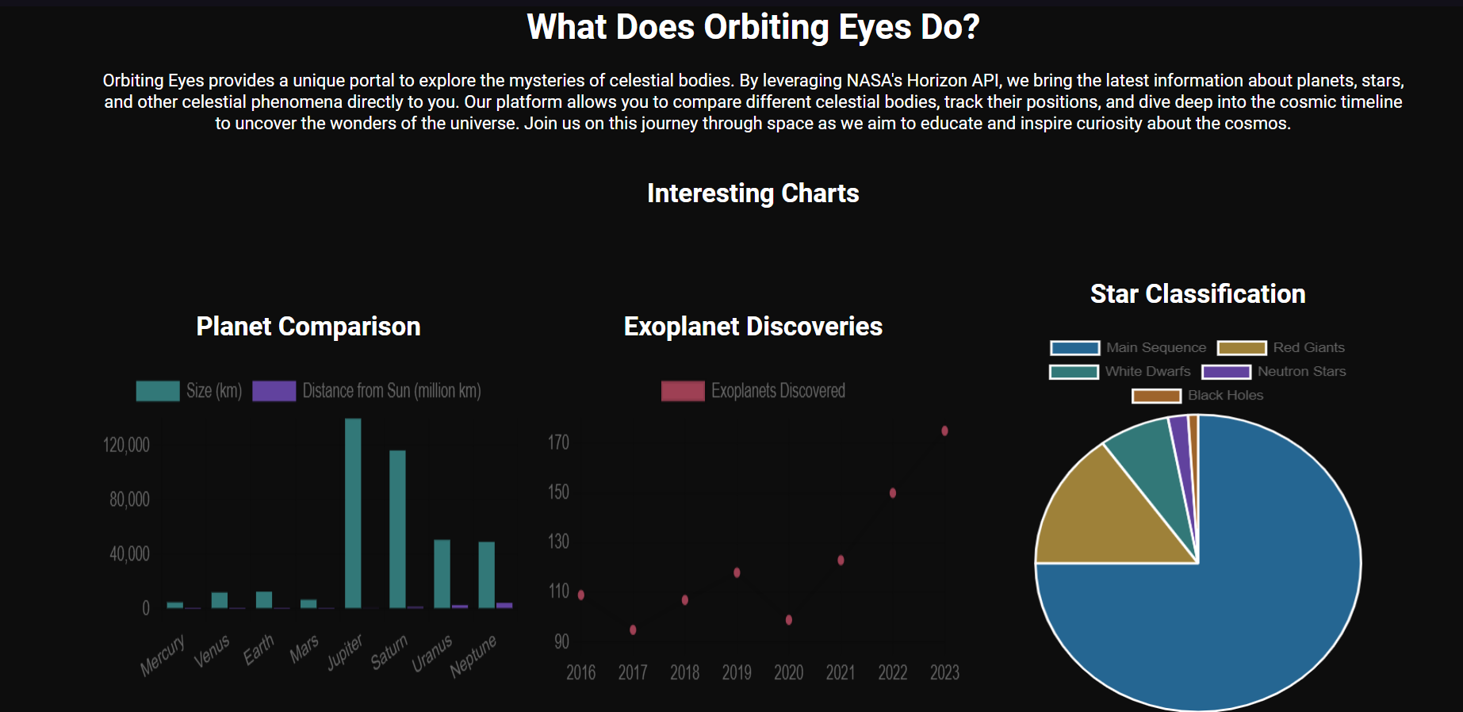
Orbiting Eyes
Project Title: Orbiting Eyes
Description: Orbiting Eyes is an application that provides detailed information on celestial bodies using the Horizons API from NASA. The application allows users to explore data about planets, moons, and other celestial objects in an interactive and visually engaging manner. Key features include real-time data updates, interactive visualizations, and an intuitive user interface.
Technologies Used: HTML, CSS, JavaScript, NASA Horizons API
Repository Link
Screenshots:
Home Page of Orbiting Eyes, showing the initial interface and navigation options.
Interactive charts displaying various celestial data comparisons.

Slide 3
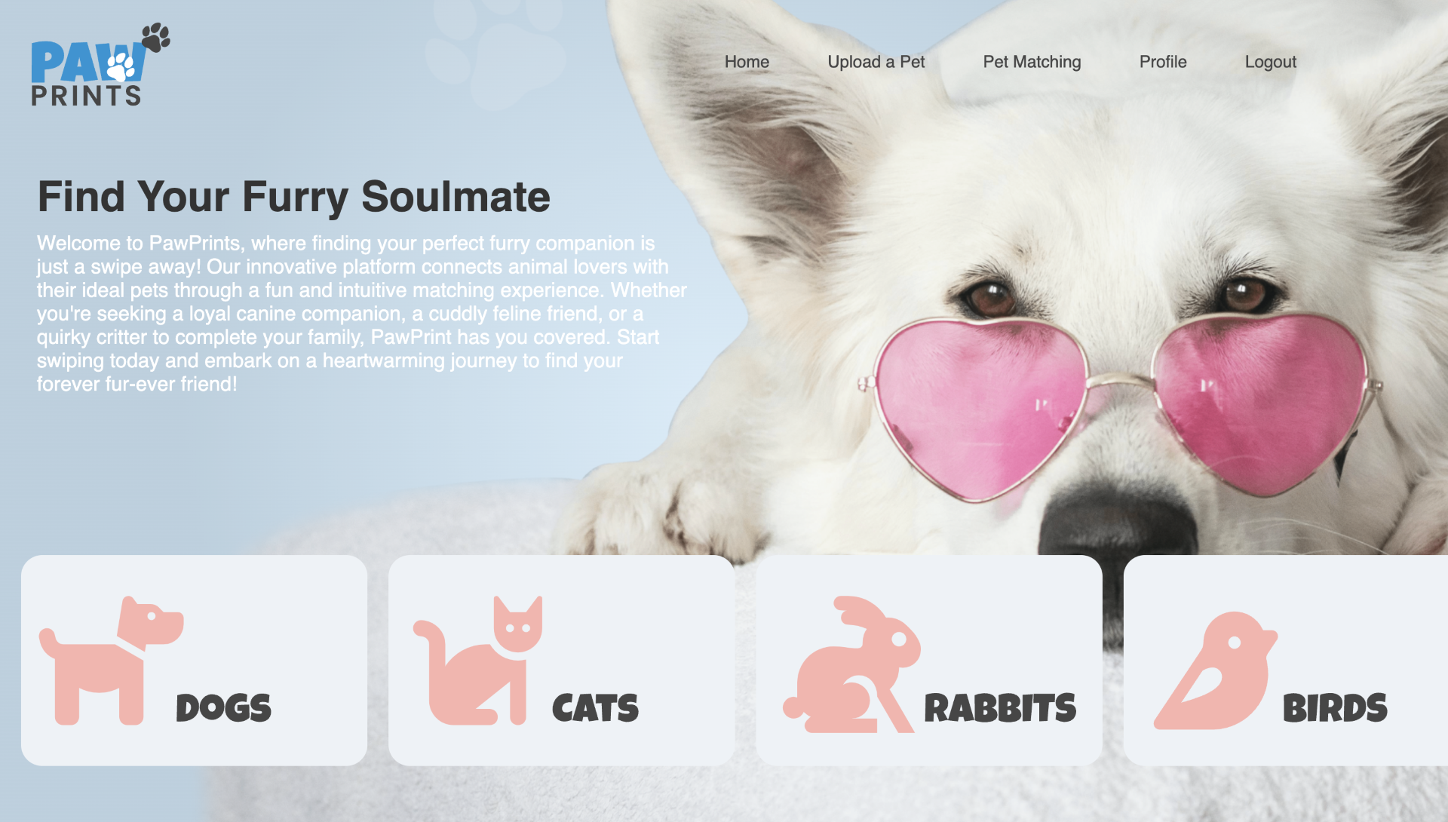
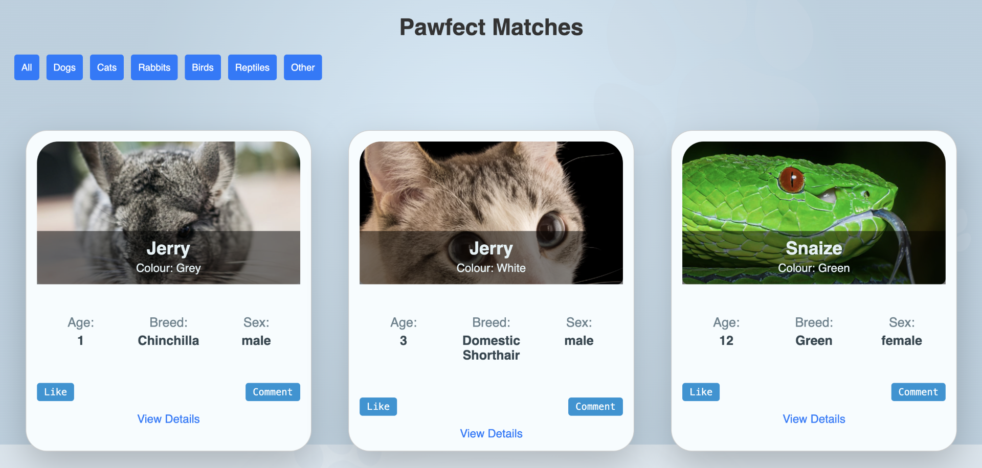
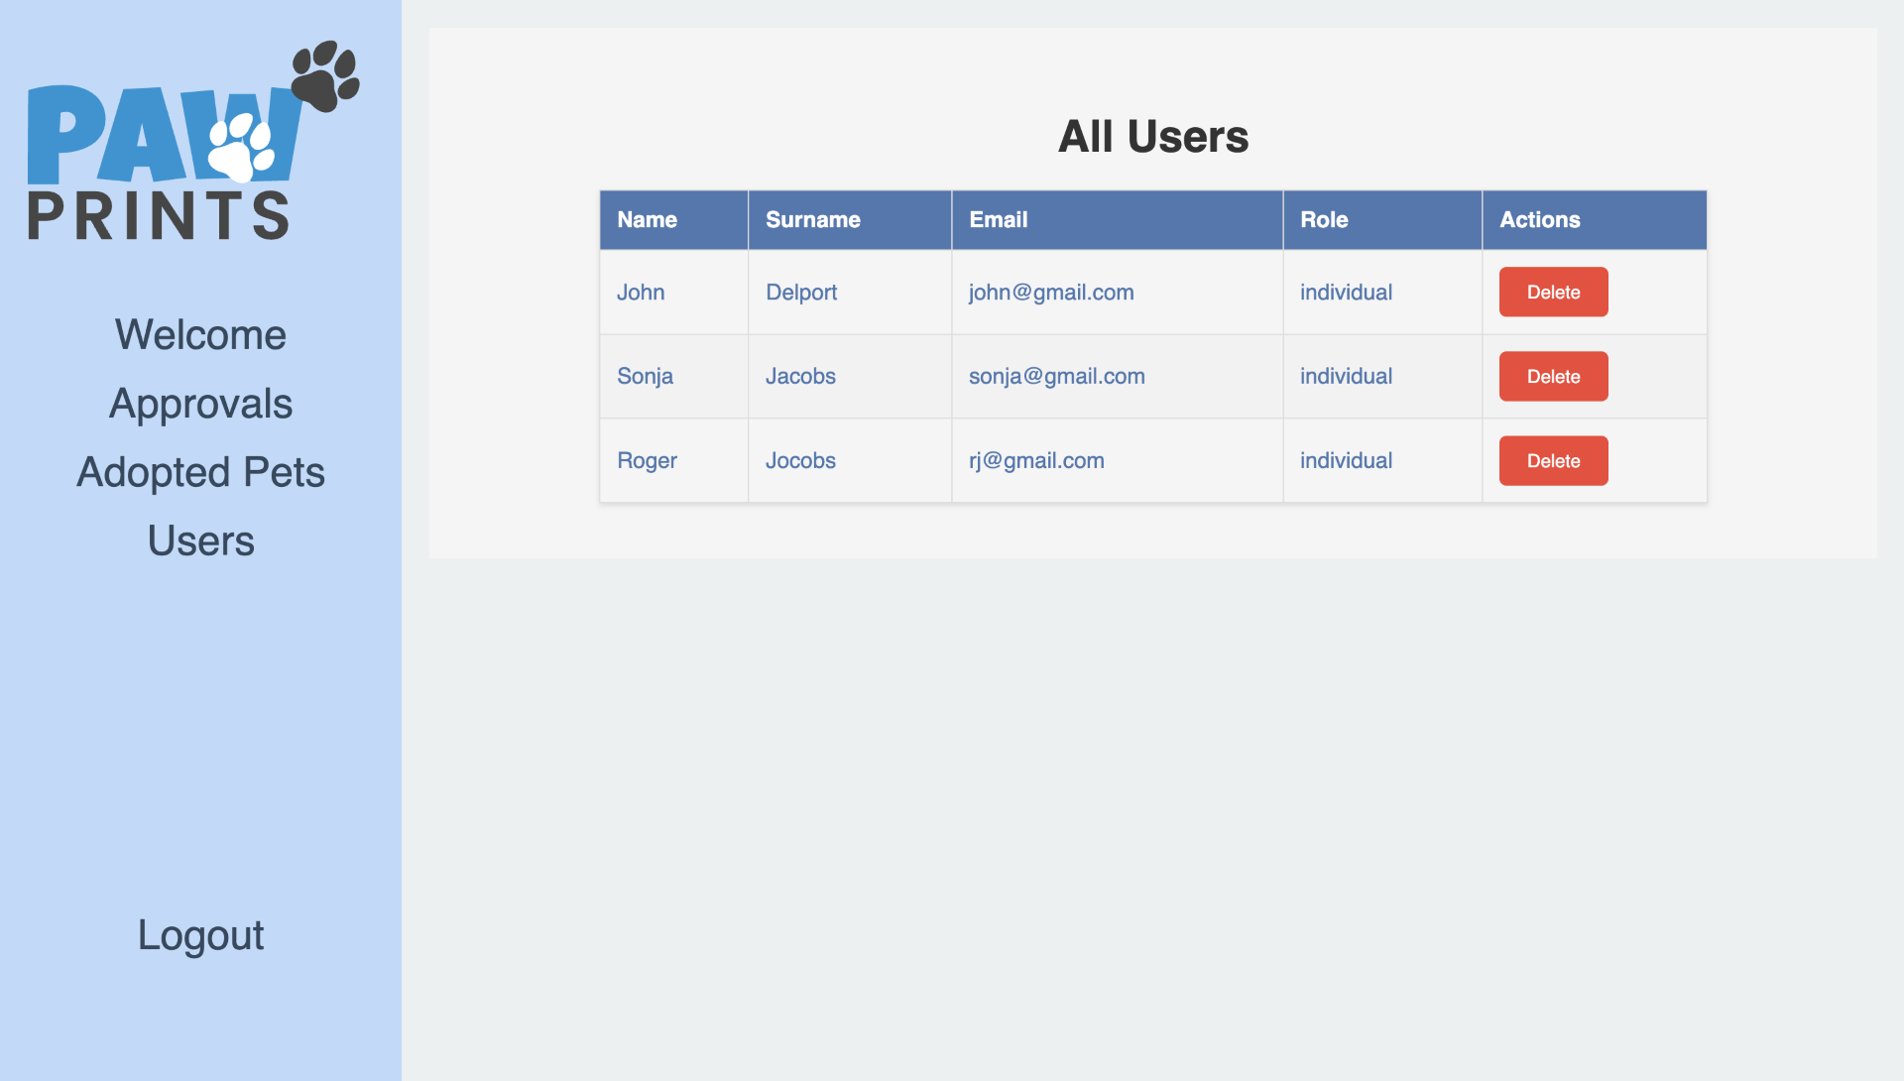
Pawprints
Project Title: PawPrints
Description: PawPrints is a pet adoption application built using the MERN stack. The application aims to connect potential pet adopters with shelters and provide a seamless adoption process. Key features include a searchable database of adoptable pets, user authentication, and real-time updates on pet availability.
Technologies Used: MongoDB, Express.js, React, Node.js
Repository Link
Screenshots:
Homepage of PawPrints, introducing the purpose and main features of the application.
Pet matching feature showing profiles of adoptable pets and a user-friendly interface.
Admin panel for managing user roles and viewing user details.

