Slide 1
Thoughts from the front line: Current issues in real-time graphics and areas where Geometric Algebra can help
Chris Doran
Founder, Geomerics chris.doran@geomerics.com
AGACSE 2010
AGACSE 2010

Slide 2

Introduction
In 2005 I decided to take a break from academic research and formed Geomerics
Looking for a new challenge
Looking for other ways to win people over to GA
AGACSE 2010

Slide 3

Geomerics Timeline
PPARC / RSE Enterprise Fellow
Roadtrip
Development 1
Product Development
Jan 05
Jan 06
Jan 07
Jan 08
First demos
First radiosity demo
GDC 2007
New offices
ANGLE first meeting
Team complete
New CEO
Series A funding
Geomerics established
Radiosity proof of concept
TSB Grant
DTI Grant
Management team complete
AGACSE 2010

Slide 4
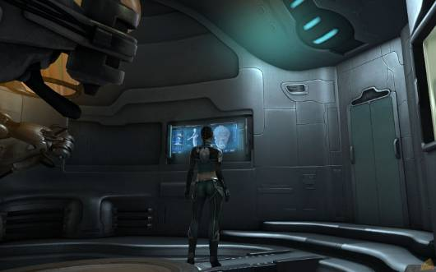
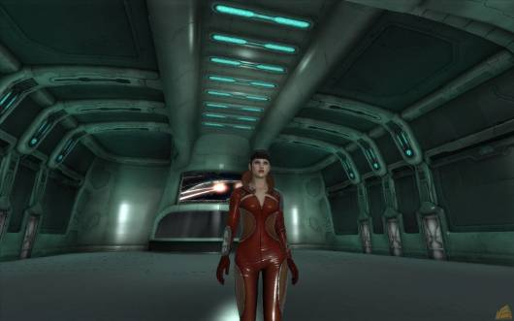
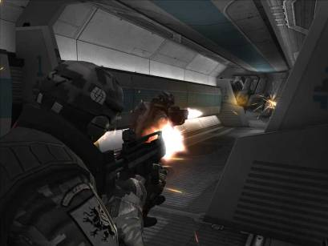
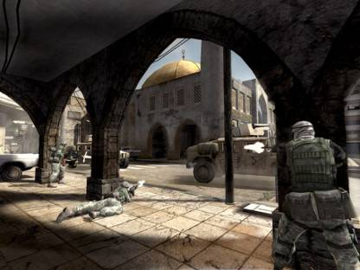
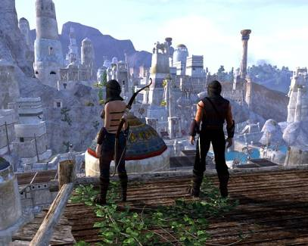

What we do
Enlighten is a revolutionary lighting technology available for PC, Xbox 360 and PS3
Enlighten is being used in games by EA Dice (Battlefield), CCP, Funcom, all pushing for the highest quality lighting and graphics
AGACSE 2010

Slide 5
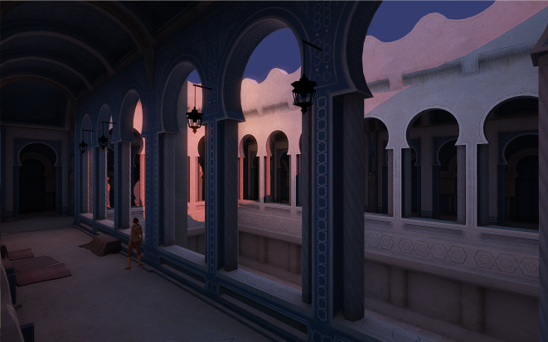
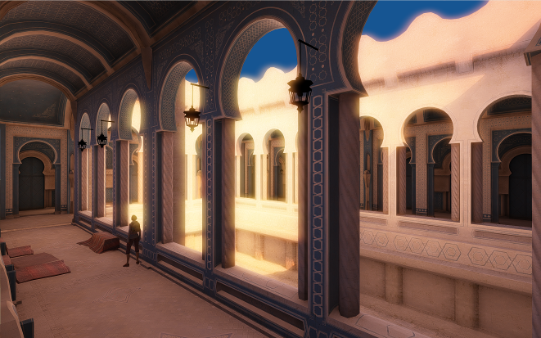
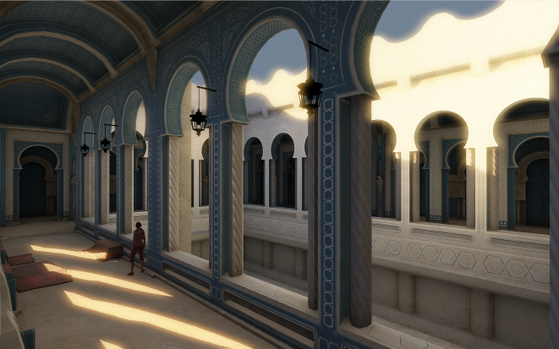
What we do
All images here are re-lit in real time at 30 fps, using Enlighten
AGACSE 2010

Slide 6
This talk
Three areas which look interesting for future work on GA
  Graphics
  Discrete exterior calculus
  Functional programming
These are chosen not for their academic interest
Areas where there is a real opportunity for GA to make an impact on a wider stage
Also throwing in 3 puzzles / hobbyist topics
AGACSE 2010

Slide 7
Graphics
An enormous topic, covered in depth in this conference
  Radiosity
  Global Illumination
  Photon mapping
  Ray tracing
  Shadowing
  Visibility
  Ambient Occlusion
  BRDF
  Pre-computed radiance transfer
AGACSE 2010

Slide 8
The biggest problems?
For games, the key problems are:
Shadowing dynamic objects from direct lights
  Shadow maps …
Soft shadows from area lights
  Convolution shadow maps …
Dynamic object radiosity
  Dynamic ambient occlusion, screen-space techniques …
AGACSE 2010

Slide 9
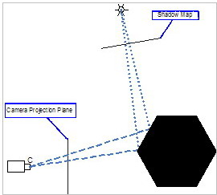
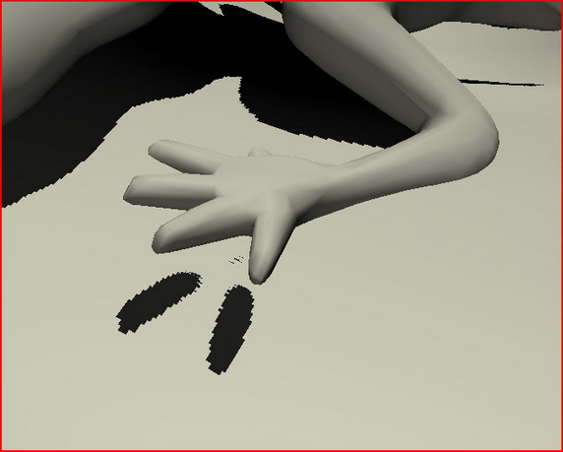
Shadows from Direct Lights
A solved problem to some extent:
Create a shadow map for each light source by rendering depth information
Use this to look up whether or not a point is in shadow
Gives rise to jaggies, aliasing artifacts …
AGACSE 2010

Slide 10
Refinements
Many ways to improve basic shadow maps
  Deform the geometry so that the shadow map better reflects the camera orientation (paraboidal SMs)
  Introduce a ‘cascade’ of shadow maps to prevent horrible blocky shadows from distant sources
But basic problems remain:
  High quality results using shadow maps requires high resolution maps
  These are slow and limit the number of direct light sources that can be used in real time
  Not obvious how to filter
AGACSE 2010

Slide 11
What we would like!
A solution based on rendering from light sources that:
  Massaged the geometry in a useful way before rendering
  Stored more than just depth (a plane, point + line …)
  Ideally in a form that could be low resolution and amenable to filtering
  Implemented as a simple screen-space step (potentially where filtering came in)
Remember:
  Will always trade off accuracy for speed
  A nicely blurred approximate answer often works well
AGACSE 2010

Slide 12

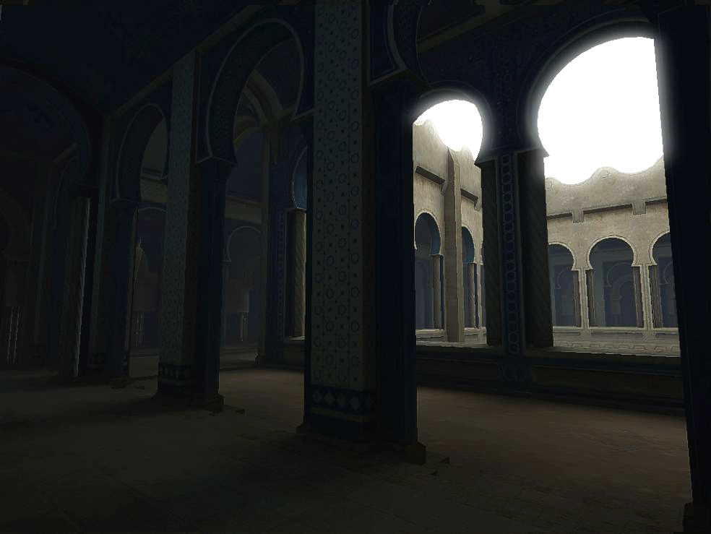
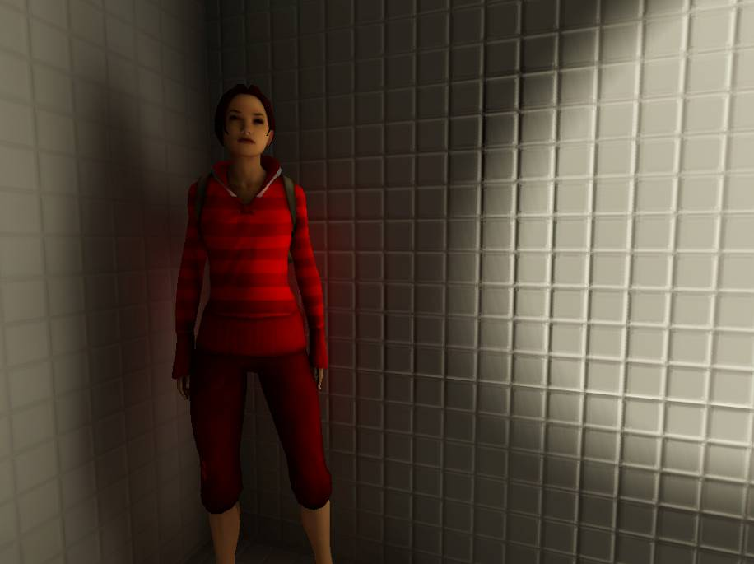
Soft Shadows
Soft shadows are generated by area lights and are everywhere
AGACSE 2010

Slide 13
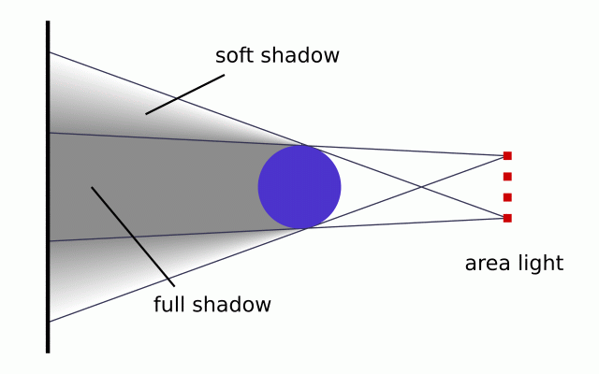
Soft Shadows
This is a really hard problem!
Can break into two aspects
  Area lights
  Full blown radiosity
We have made good progress with radiosity
But accurate area lights are unsolved for real-time graphics
AGACSE 2010

Slide 14
Area Lights
The ability for an artist to dynamically place area lights with correct soft shadows would revolutionise work flow
Any GA tricks?
  Light sources as circles
  Fractional / approximate visibility
  Ability to blur simple shadows in an appropriate texture (see eg convolutions shadow maps)
AGACSE 2010

Slide 15
Dynamic object radiosity
In Enlighten we make a number of compromises:
Radiosity is computed for static geometry
  Involves an off-line pre-compute
Light sources can move and change in real time
Dynamic objects are lit by the radiosity
  Appear to be rooted in their world
But dynamic objects do not shadow the radiosity or bleed colour
AGACSE 2010

Slide 16
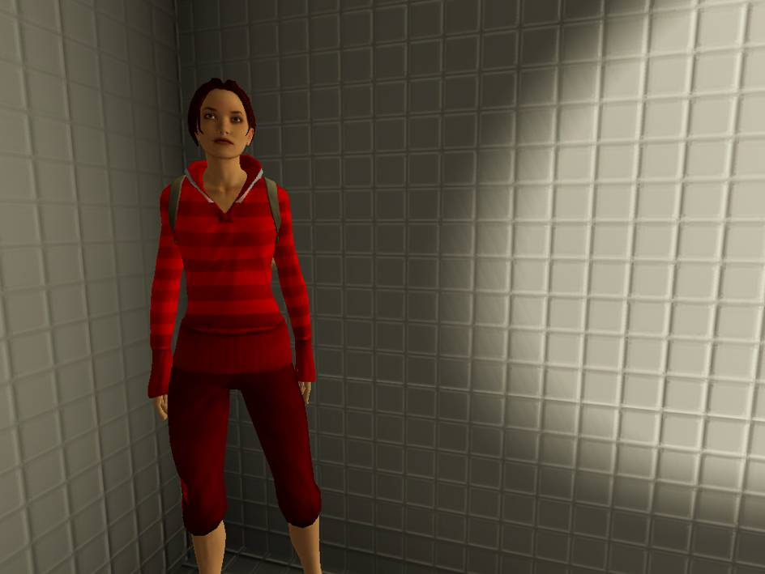
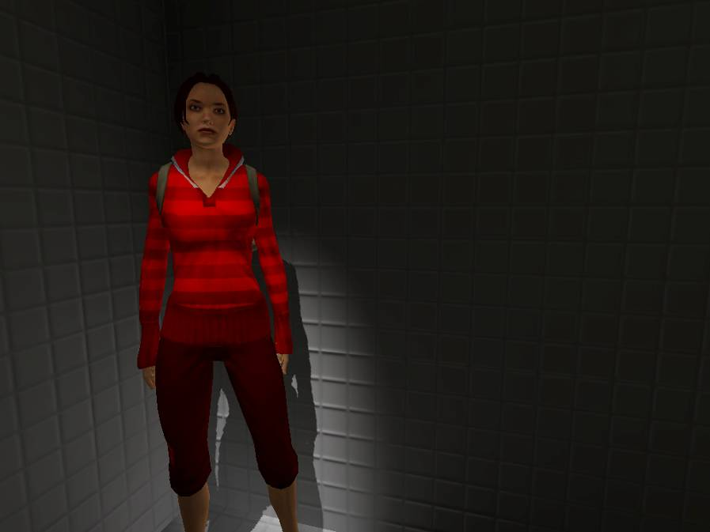
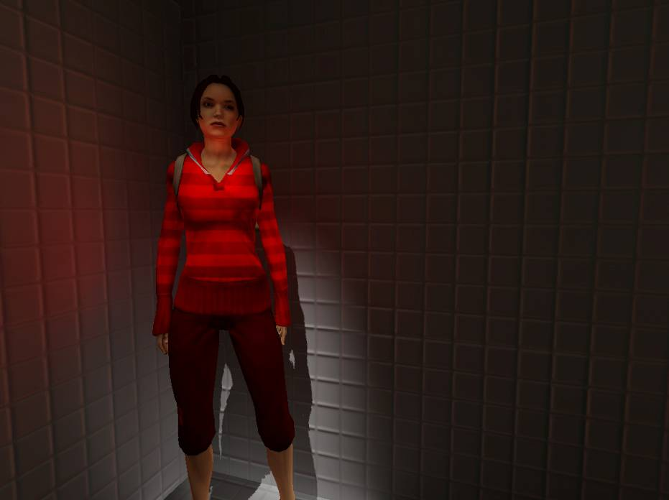
Dynamic object radiosity
AGACSE 2010

Slide 17
Dynamic Radiosity
The big unsolved problem
Need fast, approximate visibility updates
Re-creation of form factors is less important
Need to replace hierarchical data structures with something more malleable
Incorporation of surface reflection properties
Possibly screen-space type approach (caution!)
Volume based or surface based?
AGACSE 2010

Slide 18
Interlude 1
Occasional frustrations with conformal GA
Often want to drop back to affine or projective framework
Somehow this is never easy
Elementary pieces of geometry turn into lengthy un-inspired algebra
Consider same basic triangle results:
AGACSE 2010

Slide 19
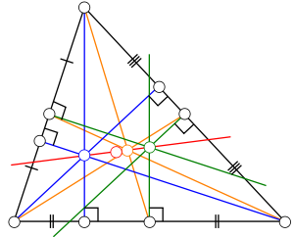
Simple Triangle
Circumcenter (green) is easy
Centroid (orange) is (after some work):
Tricky, but at least it is transparently symmetric
Orthocentre (blue) is yet more difficult
Anyone got a simple proof of the Euler line?
AGACSE 2010

Slide 20

Discrete exterior calculus
Work of Desbrun, Marsden, Hirani and others
An attempt to develop a formal discrete theory of differential forms
  Every continuous concept has a discrete analog
We MUST develop a GA version of this theory
  Otherwise the graphics community will be lost to exterior geometry for good!
AGACSE 2010

Slide 21
Objects in DEC
Discrete versions of each of
  Differential forms
  wedge product
  Vector fields (and higher dimensions)
  exterior derivative
  Codifferential
  Hodge star
  Flat and sharp operators
  Contraction
  Lie derivative, Laplace – deRham operator, etc…
AGACSE 2010

Slide 22

Foundations of DEC
All defined in such a way that the main theorems are automatically true
All very reminiscent of Hestenes and Sobczky’s approach to the foundations of geometric calculus
Chose your definitions carefully so that the key result is transparent
AGACSE 2010

Slide 23
Concepts in DEC
1-forms are numbers attached to edges
2-forms are numbers attached to planes
And so on. All seems utterly obvious.
But no useful notion of direction – the 1-form has to have the direction of the edge
We need a notion of a vector field to discretise Maxwell equations (or anything else useful)
At this point a dual manifold is introduced, based on either barycentric duals or centroids
AGACSE 2010

Slide 24
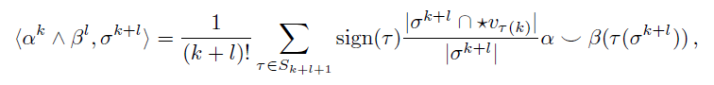
Dual Manifold
The dual manifold is the first point where things go awry
  Vector fields look un-natural
The wedge product is quite horrific
It takes pages to prove the main results of the product
  They should be obvious by definition
From then on it all feels like a struggle
AGACSE 2010

Slide 25
Hasn’t this all been done?
NO!
Discrete exterior calculus is a recent development and actively ongoing
Despite its difficulties it is comfortably the most complete and impressive theory we have
With work, discrete analogs of most continuum results can be found
We have no equivalent discrete theory within GA
  This was not what Hestenes and Sobczyk were after
AGACSE 2010

Slide 26

Simple Example
2D vector derivative (aka the Cauchy-Riemann equations)
This is surprisingly hard to discretise
Partly because the operator only propagates the part of the boundary data consistent with analyticity
Can start from the Cauchy integral formula
But then lose the ability to extend to curved surfaces
And this is a problem of real practical significance!
AGACSE 2010

Slide 27
The right approach
Some wild speculation:
  The idea of defining scalars at points, 1-forms on lines, 2-forms on surfaces etc may not be the way to go
  Instead, should we be defining a complete GA at discrete points?
  Then need an operator for connecting adjacent algebras
  This approach is more in the spirit of jet theory (see Olver: Equivalence, Invariants and Symmetry)
  In jet theory differential equations are reduced to algebraic equations at a point, plus contact relations
AGACSE 2010

Slide 28
What is required
A discrete vector manifold theory
Based on the geometric product in the obvious way
With a discrete vector derivative, and a discrete version of the fundamental theorem
The applications for such a theory would be vast
  EMM, elasticity, re-meshing, numerical pdes …
This is the problem I would be focussing all efforts on!
AGACSE 2010

Slide 29
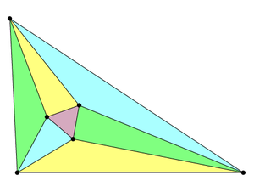
Interlude 2
The Morley triangle, formed from angle tri-sectors
Alain Connes has an algebraic proof of the result at www.alainconnes.org/docs/morley.pdf
This proof involves
  Complex projective geometry
  Rotations from reflections
  Fixed points of twists
A conformal GA version please!
AGACSE 2010

Slide 30
Functional Programming
Recently become interested in the functional programming language Haskell
Will talk through its main features, and why it looks perfect for GA
Functional languages are currently generating considerable interest:
  Haskell, ML, ocaml …
  Microsoft developing F#, and supporting Haskell
AGACSE 2010

Slide 31
Haskell is a functional language
Key objects are functions that take in arguments and return values (or functions)
Mathematically this is simple, but far removed from modern object-oriented programming
Means we give up on mutable objects
  Never change a variable
  Always create a new variable, then let garbage collector free up memory
Focussing on functions gives compiler much better chance of parallelising code
AGACSE 2010

Slide 32
Haskell is a ‘pure’ language
Pure functions have no I/O side effects
Un-used results can be discarded
Compiler can use tricks like memoization
Evaluations are thread-safe
  Good for parallelisation again
Pure functional code can have various compiler optimisations applied
In practice, Haskell code is mostly pure with a small amount of I/O
AGACSE 2010

Slide 33
Haskell is strongly typed
Haskell contains a powerful type system
Everything has a type
  Functions map types to types, eg Int -> Int
All code is checked for type integrity before compilation
A lot of bugs are caught this way!
Ties in with the concept that GA multivectors can remove ambiguity
  Are 4 numbers are quaterion, a projective vector …
  Tracking blades removes all ambiguity
AGACSE 2010

Slide 34
Haskell has recursive functions
In functional programming traditional for .. from ..to loops are replaced by other constructs
Recursive functions are particularly useful
Use of recursion can shrink code dramatically
Driving recursive definitions of functions is a powerful pattern matching framework
Again, for mathematicians this is all natural!
qsort [] = []
qsort (x:xs) = qsort (filter (< x) xs) ++ [x] ++ qsort (filter (>= x) xs)
AGACSE 2010

Slide 35
Haskell is a higher-order language
Functions can take functions as arguments
Functions can return functions as results
Under the hood, functions are curried
  Concept due to Haskell Curry
All functions take in one parameter, and return a function / parameter
Great for mapping functions to lists, etc
AGACSE 2010

Slide 36
Haskell is ‘lazy’
A defining property of Haskell is that function evaluation is lazy
Functions are only evaluated when the result is needed elsewhere
  Avoids unnecessary computation
  Ensures programmes terminate where possible
  Encourages good programming style
  Allows for infinite lists
Eg can define the ‘infinite’ list of all integers, and at a later date ask for the 10th element
AGACSE 2010

Slide 37
Haskell and GA
This combination of properties makes Haskell uniquely suitable for GA
Define blade and multivector data types
Says that a multivector is a list of blades
Define a geometric product of blades, trivial to build up everything else
Write code that mirrors hand-written algebra
type GaBlade = (Float, GaBasis)
type GaMulti = [GaBlade]
AGACSE 2010

Slide 38

Laziness and GA
Laziness is the key to Haskell’s suitability
Lazy evaluation ensures that only terms of grade zero are actually computed
Can avoid vast amounts of hand optimisation this way
Haskell will never be as fast as hand optimised C++ or intrinsics
But it is far easier to write and debug, and promised much on multicore devices
AGACSE 2010

Slide 39
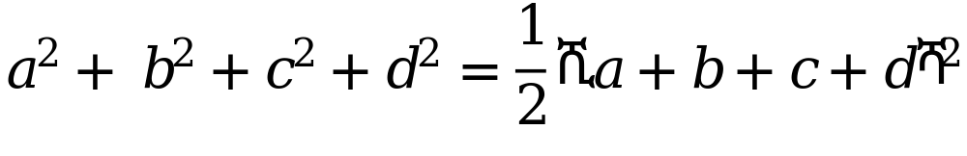
One final problem
A fun problem from Martin Gardner’s mathematical recreations
Given three kissing circles:
  Can always find two circles to kiss all three
Inverse radii satisfy
A neat problem in conformal GA!
AGACSE 2010

Slide 40
Conclusions
Many interesting open problems to explore with GA
Opportunities to make a real difference in areas that will get GA widely noticed
  Graphics, discrete theory, functional programming
Plenty of drive from industry in setting the problem space, if people are interested
And please come and talk to me if you make serious progress in any of these areas!
AGACSE 2010

Slide 41
Contact Details
Chris Doran
Geomerics Ltd
City House
Hills Road
Cambridge
chris.doran@geomerics.com
c.doran@mrao.cam.ac.uk
www.geomerics.com
AGACSE 2010

