Slide 1
Sort-Independent
Alpha Blending
Houman Meshkin
houmany@hotmail.com

Slide 2
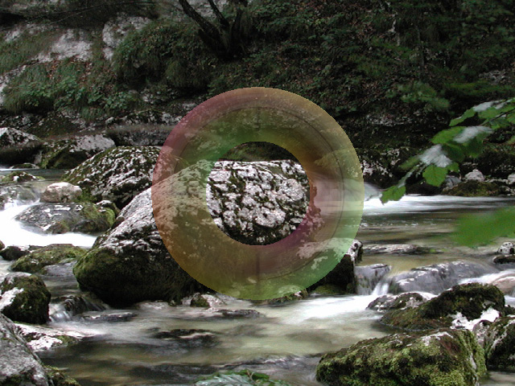
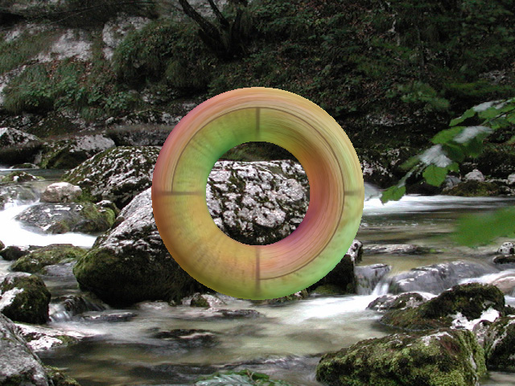
Alpha blending
Alpha blending is used to show translucent objects
Translucent objects render by blending with the background
Opaque objects just cover the background

Slide 3
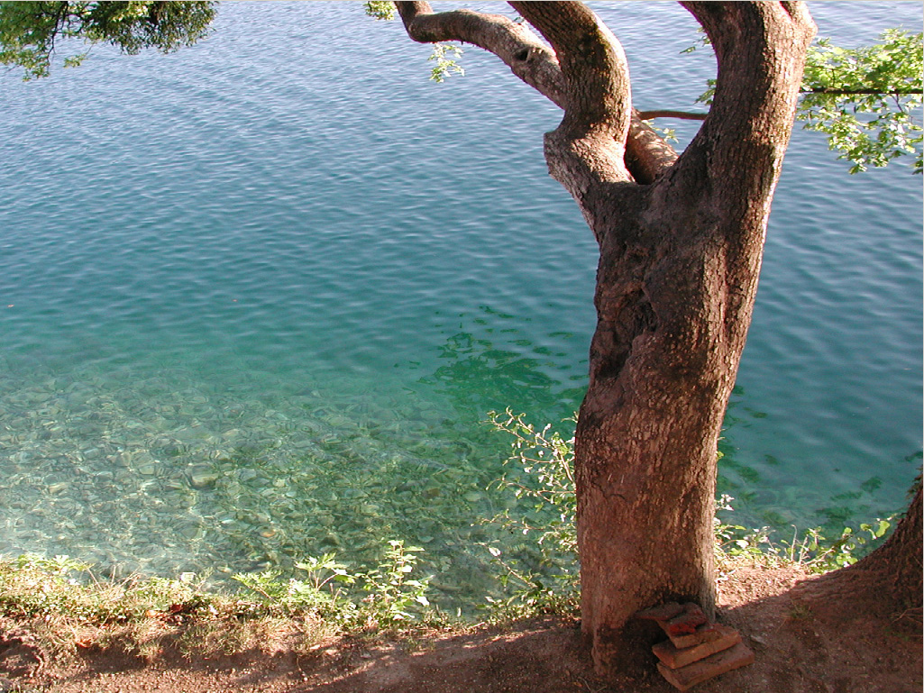
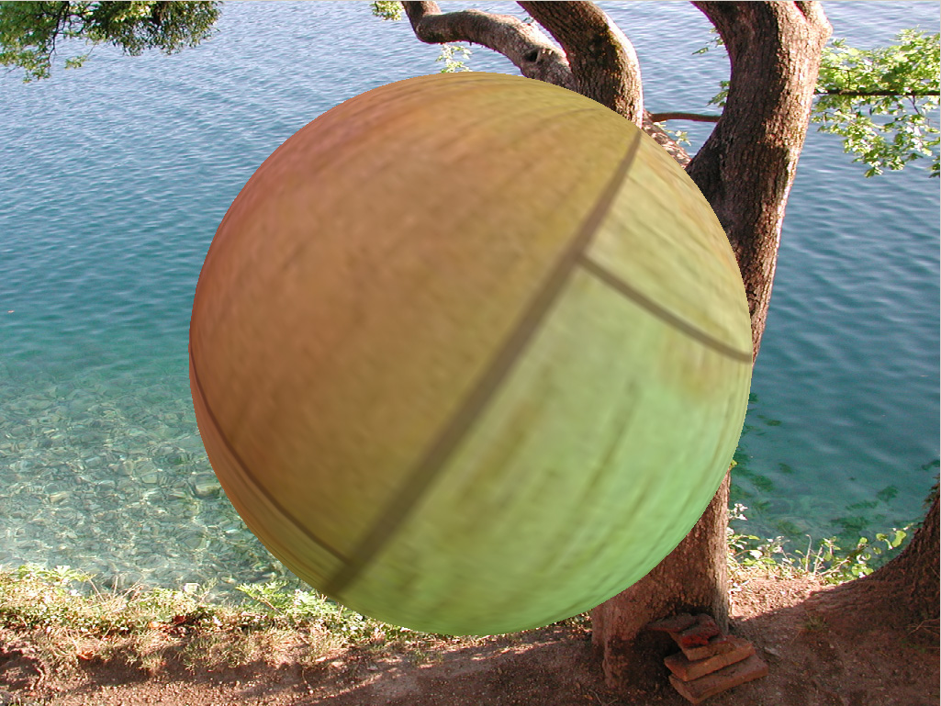
Varying alpha

Slide 4
Blending order
The color of a translucent pixel depends on the color of the pixel beneath it
  it will blend with that pixel, partially showing its color, and partially showing the color of the pixel beneath it
Translucent objects must be rendered from far to near

Slide 5
Challenge
It’s very complex and complicated to render pixels from far to near
Object-center sorting is common
  still can be time consuming
Object sorting doesn’t guarantee pixel sorting
  objects can intersect each other
  objects can be concave
  pixel sorting is required for correctness

Slide 6
The Formula
C0: foreground RGB color
A0: alpha representing foreground’s translucency
D0: background RGB color
FinalColor = A0 * C0 + (1 – A0) * D0
  as A0 varies between 0 and 1, FinalColor varies between D0 and C0

Slide 7
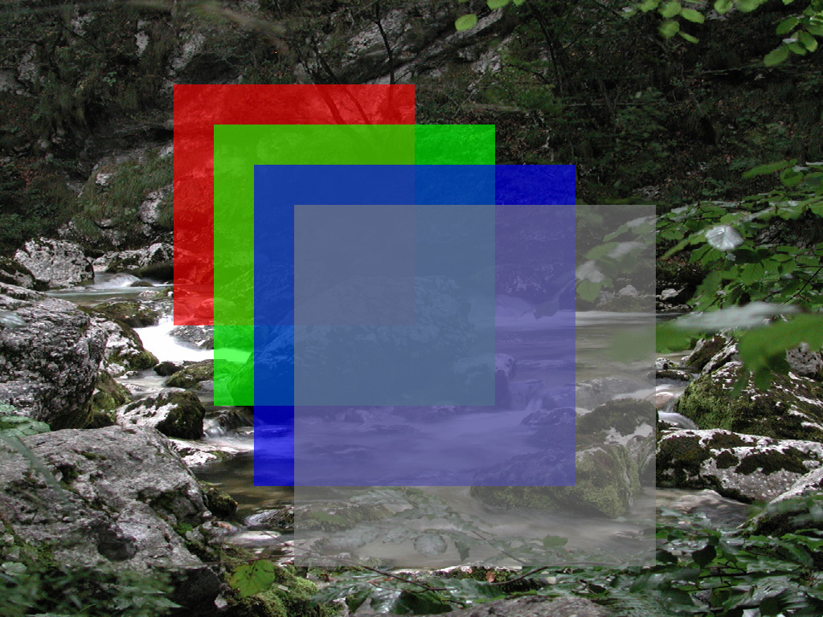
Multiple translucent layers

Slide 8
Formula for multiple translucent layers
Cn: RGB from n^{th} layer
An: Alpha from n^{th} layer
D0: background
D1 = A0*C0 + (1 - A0)*D0
D2 = A1*C1 + (1 - A1)*D1
D3 = A2*C2 + (1 - A2)*D2
D4 = A3*C3 + (1 - A3)*D3

Slide 9
Expanding the formula
D4 = A3*C3
+ A2*C2*(1 - A3)
+ A1*C1*(1 - A3)*(1 - A2)
+ A0*C0*(1 - A3)*(1 - A2)*(1 - A1)
+ D0*(1 - A3)*(1 - A2)*(1 - A1)*(1 - A0)

Slide 10
Further expanding…
D4 = A3*C3
+ A2*C2 - A2*A3*C2
+ A1*C1 - A1*A3*C1 - A1*A2*C1 + A1*A2*A3*C1
+ A0*C0 - A0*A3*C0 - A0*A2*C0 + A0*A2*A3*C0
- A0*A1*C0 + A0*A1*A3*C0 + A0*A1*A2*C0 - A0*A1*A2*A3*C0
+ D0 - A3*D0 - A2*D0 + A2*A3*D0 - A1*D0
+ A1*A3*D0 + A1*A2*D0 - A1*A2*A3*D0 - A0*D0
+ A0*A3*D0 + A0*A2*D0 - A0*A2*A3*D0 + A0*A1*D0
- A0*A1*A3*D0 - A0*A1*A2*D0 + A0*A1*A2*A3*D0

Slide 11
Rearranging…
D4 = D0
+ A0*C0 + A1*C1 + A2*C2 + A3*C3
- A0*D0 - A1*D0 - A2*D0 - A3*D0
+ A0*A3*D0 + A0*A2*D0 + A0*A1*D0
+ A1*A3*D0 + A1*A2*D0 + A2*A3*D0
- A0*A3*C0 - A0*A2*C0 - A0*A1*C0
- A1*A3*C1 - A1*A2*C1 - A2*A3*C2
+ A0*A1*A2*C0 + A0*A1*A3*C0 + A0*A2*A3*C0 + A1*A2*A3*C1
- A0*A1*A2*D0 - A0*A1*A3*D0 - A0*A2*A3*D0 - A1*A2*A3*D0
+ A0*A1*A2*A3*D0
- A0*A1*A2*A3*C0

Slide 12
Sanity check
Let’s make sure the expanded formula is still correct
case where all alpha = 0
  D4 = D0
    only background color shows (D0)
case where all alpha = 1
  D4 = C3
    last layer’s color shows (C3)

Slide 13
Pattern recognition
D4 = D0
+ A0*C0 + A1*C1 + A2*C2 + A3*C3
- A0*D0 - A1*D0 - A2*D0 - A3*D0
+ A0*A3*D0 + A0*A2*D0 + A0*A1*D0
+ A1*A3*D0 + A1*A2*D0 + A2*A3*D0
- A0*A3*C0 - A0*A2*C0 - A0*A1*C0
- A1*A3*C1 - A1*A2*C1 - A2*A3*C2
+ A0*A1*A2*C0 + A0*A1*A3*C0 + A0*A2*A3*C0 + A1*A2*A3*C1
- A0*A1*A2*D0 - A0*A1*A3*D0 - A0*A2*A3*D0 - A1*A2*A3*D0
+ A0*A1*A2*A3*D0
- A0*A1*A2*A3*C0
There’s clearly a pattern here
  we can easily extrapolate this for any number of layers
There is also a balance of additions and subtractions with layer colors and background color

Slide 14
Order dependence
D4 = D0
+ A0*C0 + A1*C1 + A2*C2 + A3*C3
- A0*D0 - A1*D0 - A2*D0 - A3*D0
- A0*A1*A2*D0 - A0*A1*A3*D0 - A0*A2*A3*D0 - A1*A2*A3*D0
+ A0*A1*A2*A3*D0
- A0*A3*C0 - A0*A2*C0 - A0*A1*C0
- A1*A3*C1 - A1*A2*C1 - A2*A3*C2
+ A0*A3*D0 + A0*A2*D0 + A0*A1*D0
+ A1*A3*D0 + A1*A2*D0 + A2*A3*D0
+ A0*A1*A2*C0 + A0*A1*A3*C0 + A0*A2*A3*C0 + A1*A2*A3*C1
- A0*A1*A2*A3*C0
← order independent part
← order dependent part

Slide 15
Order independent Part
D4 = D0
+ A0*C0 + A1*C1 + A2*C2 + A3*C3
- A0*D0 - A1*D0 - A2*D0 - A3*D0
- A0*A1*A2*D0 - A0*A1*A3*D0 - A0*A2*A3*D0 - A1*A2*A3*D0
+ A0*A1*A2*A3*D0
…
Summation and multiplication are both commutative operations
  i.e. order doesn’t matter
    A0 + A1 = A1 + A0
    A0 * A1 = A1 * A0
    A0*C0 + A1*C1 = A1*C1 + A0*C0

Slide 16
Order independent Part
D4 = D0
+ A0*C0 + A1*C1 + A2*C2 + A3*C3
- A0*D0 - A1*D0 - A2*D0 - A3*D0
- A0*A1*A2*D0 - A0*A1*A3*D0 - A0*A2*A3*D0 - A1*A2*A3*D0
+ A0*A1*A2*A3*D0
…
Highlighted part may not be obvious, but here’s the simple proof:
- A0*A1*A2*D0 - A0*A1*A3*D0 - A0*A2*A3*D0 - A1*A2*A3*D0
=
- D0*A0*A1*A2*A3 * (1/A0 + 1/A1 + 1/A2 + 1/A3)

Slide 17
Order dependent Part
D4 = …
- A0*A3*C0 - A0*A2*C0 - A0*A1*C0
- A1*A3*C1 - A1*A2*C1 - A2*A3*C2
+ A0*A3*D0 + A0*A2*D0 + A0*A1*D0
+ A1*A3*D0 + A1*A2*D0 + A2*A3*D0
+ A0*A1*A2*C0 + A0*A1*A3*C0 + A0*A2*A3*C0 + A1*A2*A3*C1
- A0*A1*A2*A3*C0
These operations depend on order
  results will vary if transparent layers are reordered
  proof that proper alpha blending requires sorting

Slide 18
Can we ignore the order dependent part?
Do these contribute a lot to the final result of the formula?
  not if the alpha values are relatively low
  they’re all multiplying alpha values < 1 together
    even with just 2 layers each with alpha = 0.25
      0.25 * 0.25 = 0.0625 which can be relatively insignificant
  more layers also makes them less important
  as do darker colors

Slide 19
Error analysis
Let’s analyze the ignored order dependent part (error) in some easy scenarios
  all alphas = 0
    error = 0
  all alphas = 0.25
    error = 0.375*D0 - 0.14453125*C0 - 0.109375*C1 - 0.0625*C2
  all alphas = 0.5
    error = 1.5*D0 - 0.4375*C0 - 0.375*C1 - 0.25*C2
  all alphas = 0.75
    error = 3.375*D0 - 0.73828125*C0 - 0.703125*C1 - 0.5625*C2
  all alphas = 1
    error = 6*D0 - C0 - C1 - C2

Slide 20
Simpler is better
A smaller part of the formula works much better in practice
  = D0
  + A0*C0 + A1*C1 + A2*C2 + A3*C3
  - A0*D0 - A1*D0 - A2*D0 - A3*D0
The balance in the formula is important
  it maintains the weight of the formula
This is much simpler and requires only 2 passes and a single render target
  1 less pass and 2 less render targets
This formula is also exactly correct when blending a single translucent layer

Slide 21
Error analysis
Let’s analyze the simpler formula in some easy scenarios
  all alphas = 0
    error_{simple} = 0
    error_{prev} = 0
  all alphas = 0.25
    error_{simple} = 0.31640625*D0 - 0.14453125*C0 - 0.109375*C1 - 0.0625*C2
    error_{prev} = 0.375*D0 - 0.14453125*C0 - 0.109375*C1 - 0.0625*C2
  all alphas = 0.5
    error_{simple} = 1.0625*D0 - 0.4375*C0 - 0.375*C1 - 0.25*C2
    error_{prev} = 1.5*D0 - 0.4375*C0 - 0.375*C1 - 0.25*C2
  all alphas = 0.75
    error_{simple} = 2.00390625*D0 - 0.73828125*C0 - 0.703125*C1 - 0.5625*C2
    error_{prev} = 3.375*D0 - 0.73828125*C0 - 0.703125*C1 - 0.5625*C2
  all alphas = 1
    error_{simple} = 3*D0 - C0 - C1 - C2
    error_{prev} = 6*D0 - C0 - C1 - C2

Slide 22
Error comparison
Simpler formula actually has less error
  explains why it looks better
This is mainly because of the more balanced formula
  positives cancelling out negatives
  source colors cancelling out background color

Slide 23
Does it really work?
Little error with relatively low alpha values
  good approximation
Completely inaccurate with higher alpha values
Demo can show it much better than text

Slide 24
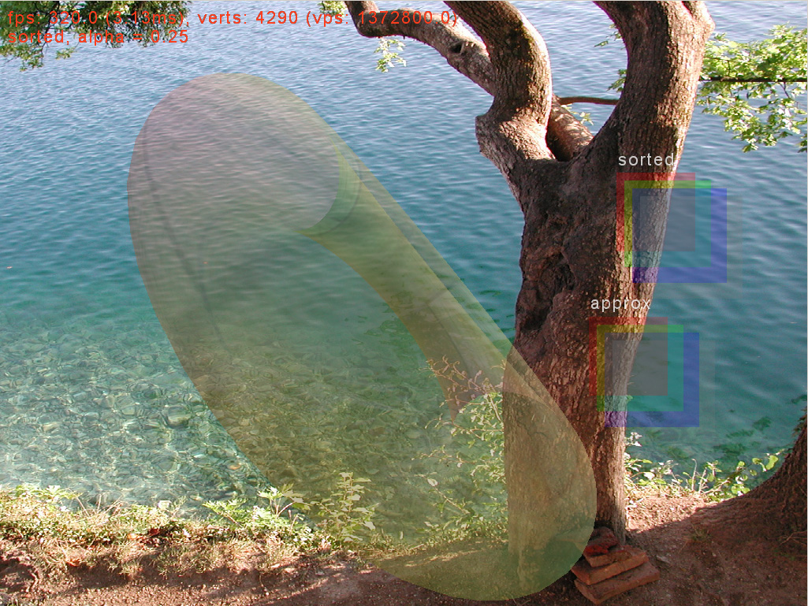
Sorted, alpha = 0.25

Slide 25

Approx, alpha = 0.25

Slide 26
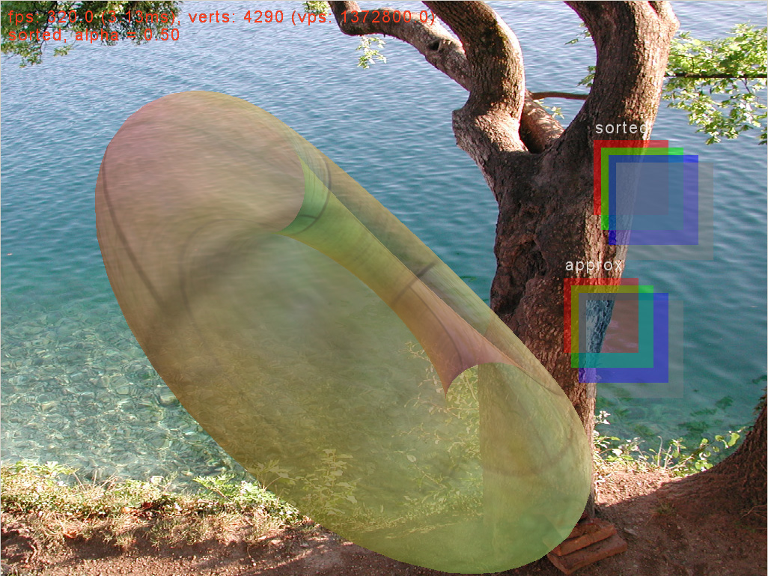
Sorted, alpha = 0.5

Slide 27
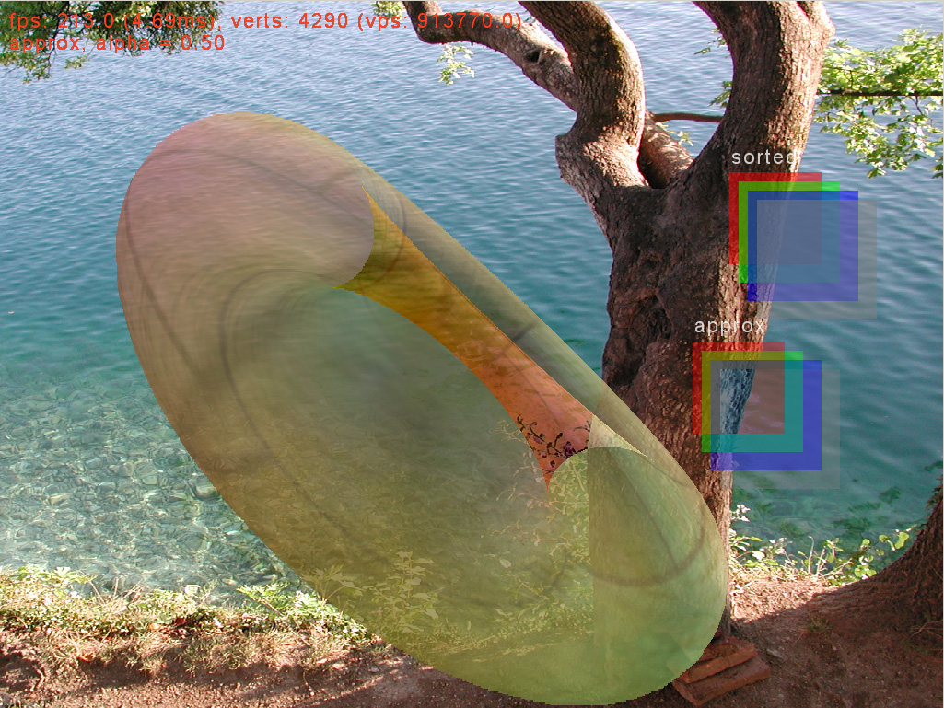
Approx, alpha = 0.5

Slide 28
Implementation
We want to implement the order independent part and just ignore the order dependent part
D4 = D0
+ A0*C0 + A1*C1 + A2*C2 + A3*C3
- A0*D0 - A1*D0 - A2*D0 - A3*D0
- A0*A1*A2*D0 - A0*A1*A3*D0 - A0*A2*A3*D0 - A1*A2*A3*D0
+ A0*A1*A2*A3*D0
8 bits per component is not sufficient
  not enough range or accuracy
Use 16 bits per component (64 bits per pixel for RGBA)
  newer hardware support alpha blending with 64 bpp buffers
We can use multiple render targets to compute multiple parts of the equation simultaneously

Slide 29
1st pass
Use additive blending
  SrcAlphaBlend = 1
  DstAlphaBlend = 1
  FinalRGBA = SrcRGBA + DstRGBA
render target #1, n^{th} layer
  RGB = An * Cn
  Alpha = An
render target #2, n^{th} layer
  RGB = 1 / An
  Alpha = An

Slide 30
1st pass results
After n translucent layers have been blended we get:
  render target #1:
    RGB1 = A0 * C0 + A1 * C1 + … + An * Cn
    Alpha1 = A0 + A1 + … + An
  render target #2:
    RGB2 = 1 / A0 + 1 / A1 + … + 1 / An
    Alpha2 = A0 + A1 + … + An

Slide 31
2nd pass
Use multiplicative blending
  SrcAlphaBlend = 0
  DstAlphaBlend = SrcRGBA
  FinalRGBA = SrcRGBA * DstRGBA
render target #3, n^{th} layer
  RGB = Cn
  Alpha = An

Slide 32
2nd pass results
After n translucent layers have been blended we get:
  render target #3:
    RGB3 = C0 * C1 * … * Cn
    Alpha3 = A0 * A1 * … * An
This pass isn’t really necessary for the better and simpler formula
  just for completeness

Slide 33
Results
We now have the following
  background
    D0
  render target #1:
    RGB1 = A0 * C0 + A1 * C1 + … + An * Cn
    Alpha1 = A0 + A1 + … + An
  render target #2:
    RGB2 = 1 / A0 + 1 / A1 + … + 1 / An
    Alpha2 = A0 + A1 + … + An
  render target #3:
    RGB3 = C0 * C1 * … * Cn
    Alpha3 = A0 * A1 * … * An

Slide 34
Final pass
Blend results in a pixel shader
RGB1 - D0 * Alpha1
  = A0*C0 + A1*C1 + A2*C2 + A3*C3
  - D0 * (A0 + A1 + A2 + A3)
D0 * Alpha3
  = D0 * (A0*A1*A2*A3)
D0 * RGB2 * Alpha3
  = D0 * (1/A0 + 1/A1 + 1/A2 + 1/A3) * (A0*A1*A2*A3)
  = D0 * (A1*A2*A3 + A0*A2*A3 + A0*A1*A3 + A0*A1*A2)
Sum results with background color (D0) and we get:
  = D0
  + A0*C0 + A1*C1 + A2*C2 + A3*C3
  - D0 * (A0 + A1 + A2 + A3)
  + D0 * (A0*A1*A2*A3)
  - D0 * (A1*A2*A3 + A0*A2*A3 + A0*A1*A3 + A0*A1*A2)
That’s the whole sort independent part of the blend formula

Slide 35
Application
This technique is best suited for particles
  too many to sort
  slight inaccuracy in their color shouldn’t matter too much
Not so good for very general case, with all ranges of alpha values
For general case, works best with highly translucent objects
  i.e. low alpha values

Slide 36
Can we do better?
I hope so…
Keep looking at the order dependent part of the formula to see if we can find more order independent parts out of it
D4 = D0
+ A0*C0 + A1*C1 + A2*C2 + A3*C3
- A0*D0 - A1*D0 - A2*D0 - A3*D0
- A0*A1*A2*D0 - A0*A1*A3*D0 - A0*A2*A3*D0 - A1*A2*A3*D0
+ A0*A1*A2*A3*D0
- A0*A3*C0 - A0*A2*C0 - A0*A1*C0
- A1*A3*C1 - A1*A2*C1 - A2*A3*C2
+ A0*A3*D0 + A0*A2*D0 + A0*A1*D0
+ A1*A3*D0 + A1*A2*D0 + A2*A3*D0
+ A0*A1*A2*C0 + A0*A1*A3*C0 + A0*A2*A3*C0 + A1*A2*A3*C1
- A0*A1*A2*A3*C0
Or use a completely different algorithm

Slide 37
Q&A
If you have any other ideas or suggestions I’d love to hear them
email: hmeshkin@perpetual.com

