Slide 1
Order Independent Transparency
Alessandro Rigazzi
Data Analysis and Visualization Group
July 1, 2008

Slide 2
INTRODUCTION
A brief summary of Order Independent Transparency

Slide 3
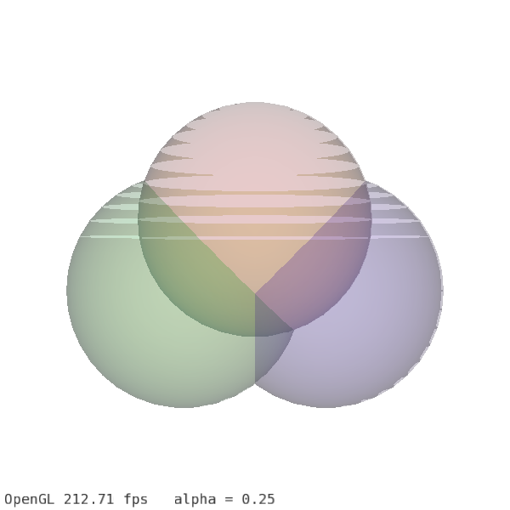
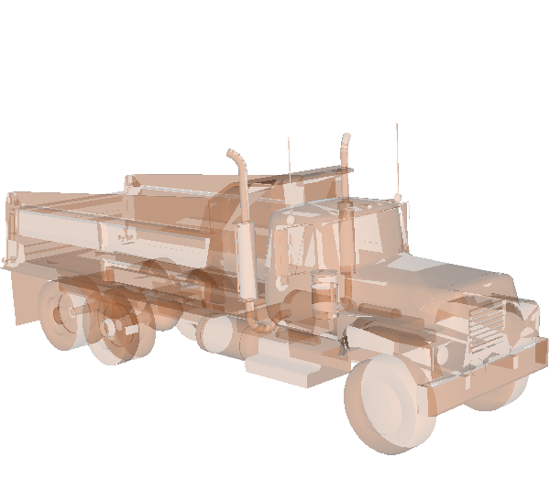
The Problem
No standard implementation for Order Independent Transparency (OIT) in OpenGL

Slide 4
Possible Solutions
Render Sorting
  Of objects: first opaque, then transparent objects from back to front
    Requires prior knowledge of objects to render and (pre-computed) BSP trees
  Of triangles: to have them all facing the right way
    Not trivial to determine
Alpha Buffer
  Keep linked list of all fragments which are covered by a certain pixel, along with their alpha values (and possibly other data)
    Never implemented

Slide 5
With new graphic cards
Possibility for advanced algorithms:
  Depth Peeling (Everitt 2001): at each pass “peel” a layer, i.e. only render what is farther from the camera than the last fragment belonging to that pixel. Blend the various layers.
  Weighted Sum (Meshkin 2007): expand alpha blending equation and discard terms which are order dependent.
  Weighted Average (Bavoil & Myers 2008): average all fragments belonging to a pixel and keep an index of “depth complexity” (number of fragments for that pixel).
  Dual Depth Peeling (Bavoil & Myers 2008): perform depth peeling, from front to back and from back to front at the same time.

Slide 6
Where should I look?
Lack of efficient OIT algorithms in high level libraries such as:
  Open Inventor
  VTK
  Open SG
  Open Scene Graph
  …
We did it!
  We ported to Open Scene Graph some GLUT code provided by NVidia for dual depth peeling and weighted average algorithms

Slide 7
Why complicate life?
We decided to implement both dual depth peeling and weighted average algorithms because of substantial differences between the two
Dual Depth Peeling
Weighted Average
Exact
  Math result identical to alpha blending equation
Slow
  Requires N/2+1 geometry passes, where N is the maximum depth complexity of the scene
Approximated
  Sum of fragment colors, fragment depth not used
Very fast
  Just one pass to sum all the fragments and one to render to a quad

Slide 8
DUAL DEPTH PEELING
Algorithm and OSG implementation overview

Slide 9
From classic to dual
Depth peeling is an OIT technique described by Everitt in 2001
The idea is to iteratively get the nearest layer of fragments, store their color, then look for the next layer. At each pass the color of the current layer is blended with the previous ones
Needs as many passes as maximum number of overlapping layers (depth complexity)
With support for multiple render targets, we can start depth peeling from two sides, front and back

Slide 10
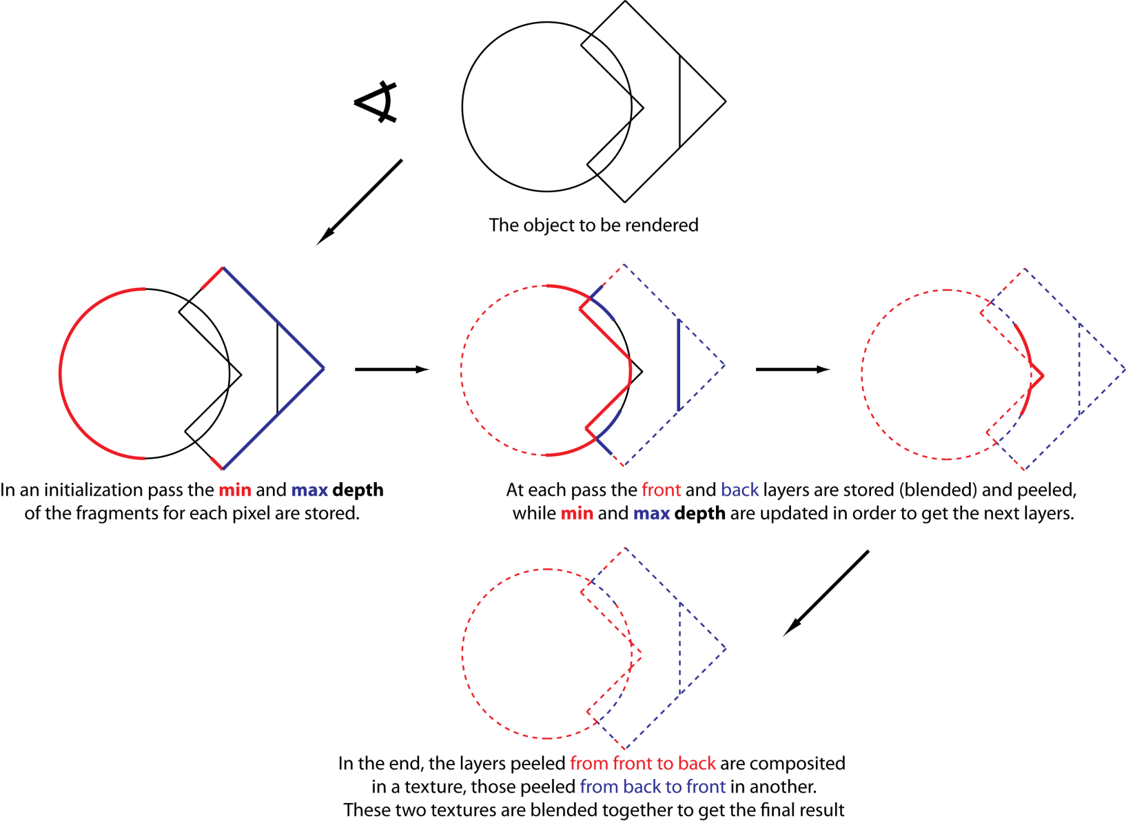
Dual Depth Peeling in a nutshell

Slide 11
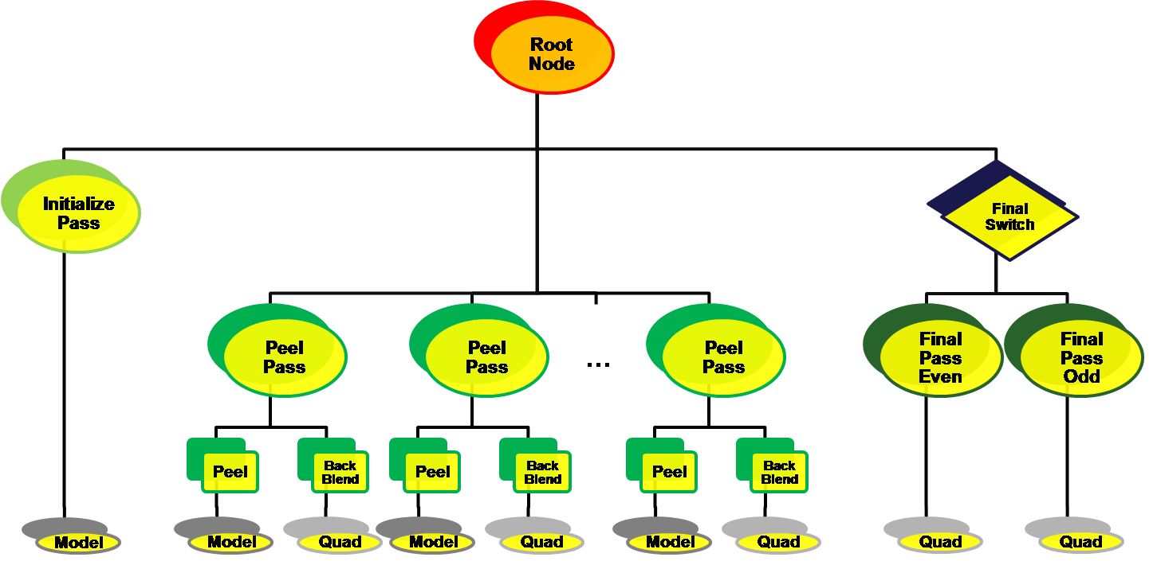
Dual Depth Peeling Complete Graph

Slide 12
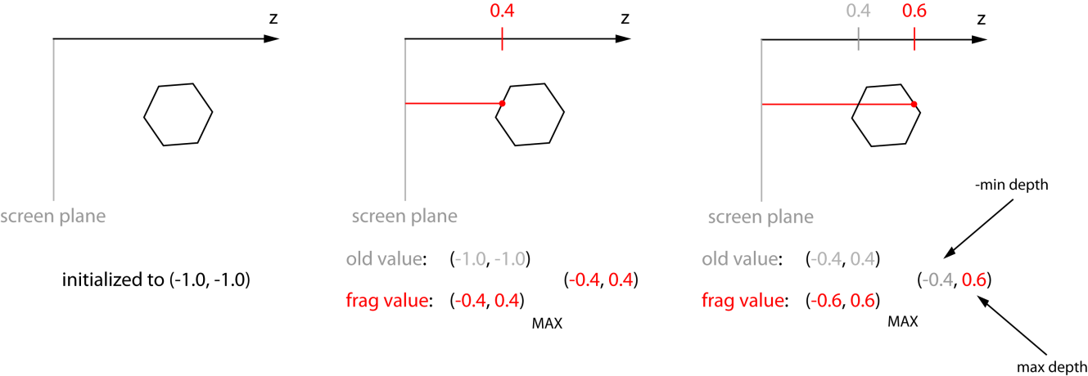
Step by step: initialization
Clear accumulated textures
Initialize the depth texture with (-minDepth, maxDepth)
  Since we need both the min and max depth of the fragments belonging to a pixel, we store for each fragment (–gl_FragCoord.z, gl_FragCoord.z) in the 32 bit depth texture and use MAX_BLEND: this keeps the smallest value saved as negative in the first component and the largest saved in the second component

Slide 13
Step by step: peel passes (I), idea
Basic idea: at each peel pass get the nearest and the farthest fragments which have not been peeled yet
Therefore: at each pass we must
  Update the depth texture
  Store the back and front fragment colors
Can we do it in one shader? Almost, but no.

Slide 14
Step by step: peel pass (II), MAX_BLEND
We update the depth texture the same way we initialized it, this time discarding fragments with depths which have already been peeled
  Similarly to the initialization pass, we use MAX_BLEND
We sum the contribute of the front layer fragments in the blended front texture
  Front to back alpha blend equation:
    dst_color = dst_color + src_color * src_alpha * dst_alpha
  This could be done with the OpenGL built in blend functions
  But GLSL only allows for one blend function per shader, we want to use the same shader for depth texture and front color
  We have to adapt alpha blend to MAX_BLEND!

Slide 15
Step by step: peel pass (III), front texture resolved
Idea: since front to back color can only increase at each layer, we load the previous colors (passed in a texture) and write in the texture the result of alpha blend in the shader
The new value will be greater than the previous one, MAX_BLEND will then overwrite the texture
We are not done, what about back to front blend?
  Back to front alpha blend equation
    dst_color =
      src_color * dst_alpha + (1-src_alpha) * dst_color
  This does not monotonically increase!
  We can not use MAX_BLEND, but we have to!

Slide 16
Step by step: peel pass (IV), back texture resolved
Since using MAX_BLEND we can not update the blended back texture, we need to find an alternative solution, i.e., we need another shader
In the peel shader we only write the current value of the back layer (clearing the texture to black, in order to overwrite it with MAX_BLEND)
We use a blend shader to get the texture and the OpenGL built in blend function to accumulate at each pass the current back layers in the blended back texture
To do the blend in a full screen pass, we render to a textured screen aligned quad

Slide 17
Step by step: final switch (I), swapping
After all the peel passes we have the blended front and back textures, we just have to blend them together and we get the final image that we draw on a second textured screen aligned quad
This should be easy, but:
  To avoid read-write hazards in the peel passes we have to use different textures to read from and write to the fragment colors
  This means that we have two depth, two front and two temporary back textures
  At each pass we swap destination and source for rendering
  Where should we read from in the final pass?

Slide 18
Step by step: final switch (II), why the switch
Since we allow for dynamic change of number of peel passes, we don’t know which frame buffer object will contain the final blended front texture
We have to set the render targets of each camera (i.e. the final camera too) at initialization time
  How?
We create a final pass for the case when the number of peel passes is even and one for the case it is odd
We switch to the correct final pass at run time, depending on the number of peel passes of the current traversal

Slide 19
Variable number of passes
The number of peel passes one decides to use determines the quality of the output
Depending on the point of view, for the same object we can need a different number of passes
The exact number of needed passes can be determined with an occlusion query
Scene graphs are rigid structures
  Adding or removing branches at run time is complicated
  We prefer to build the tree for a maximum number of passes and activate/deactivate some of them as needed.

Slide 20
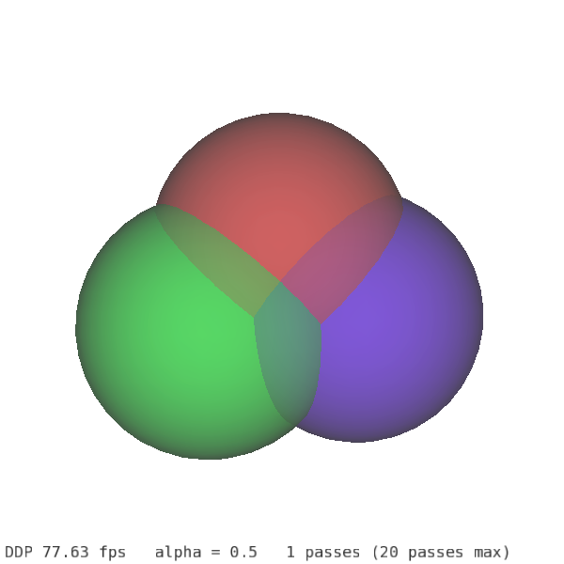
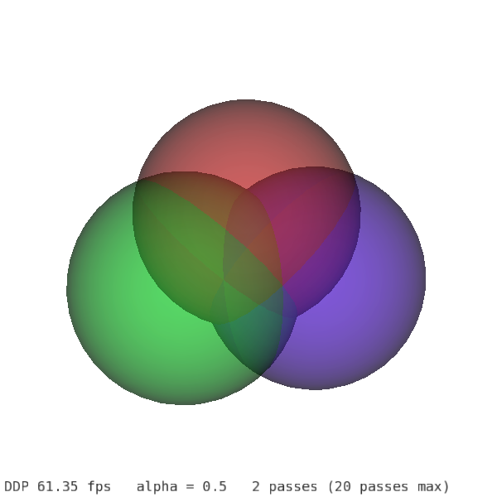
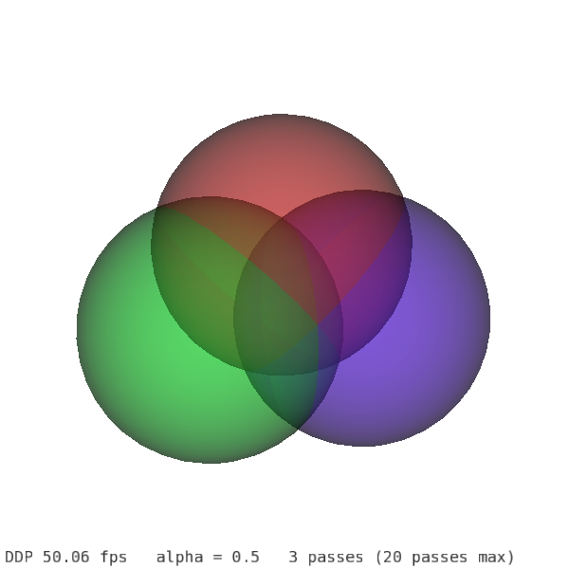
How many peel passes?
Since at each pass we peel one front and one back layer of fragments, we need N/2 passes, where N is the depth complexity of the scene
We also need one pass to initialize the depth texture
The result is that we need N/2+1 geometry passes
For the three spheres example, we need 4 passes, because the maximum complexity is 6

Slide 21
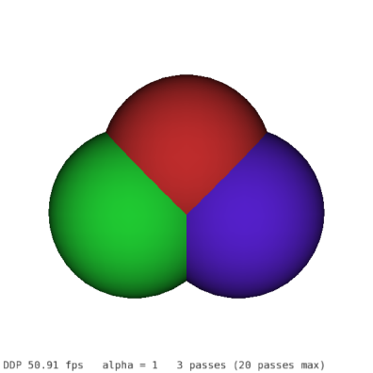

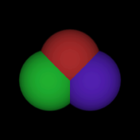
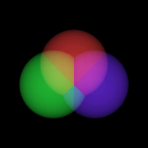
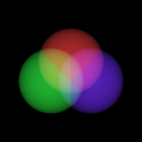
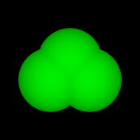

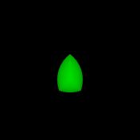

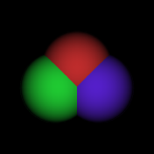

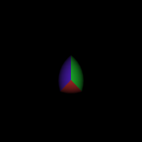
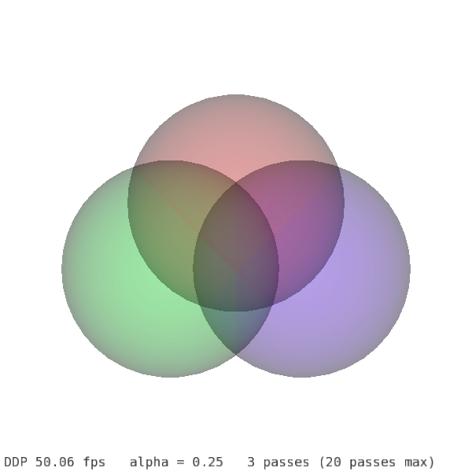
Dual Depth Peeling in a rendered nutshell
Memory
Content
Blended
Back
Texture
(not shown)
Blended
Front Texture
Depth
Texture
(min depth)
Current
Back Texture

Slide 22
WEIGHTED AVERAGE
Algorithm and OSG implementation overview

Slide 23
Weighted algorithms (I)
Meshkin in 2007 proposed an algorithm which is based on the expansion of the alpha blendequation.
Isolating and discarding the terms which are order dependent, the equation obviously becomes order independent
  dst_color =
  Σ (src_alpha * src_color)
  + background_color * (1 – Σ(src_alpha))
This method is fast (one geometry pass and one render on a quad), but for alpha values greater than 0.25 it tends to darken the image too much

Slide 24
Weighted algorithms (II)
Bavoil and Myers proposed the weighted average algorithm
It averages the color of all the fragments belonging to a certain pixel and substitute any color in the alpha blend equation with the average color
It takes into account the depth complexity for each fragment
It only needs one geometry pass and one render to a screen aligned quad, therefore it is very fast

Slide 25
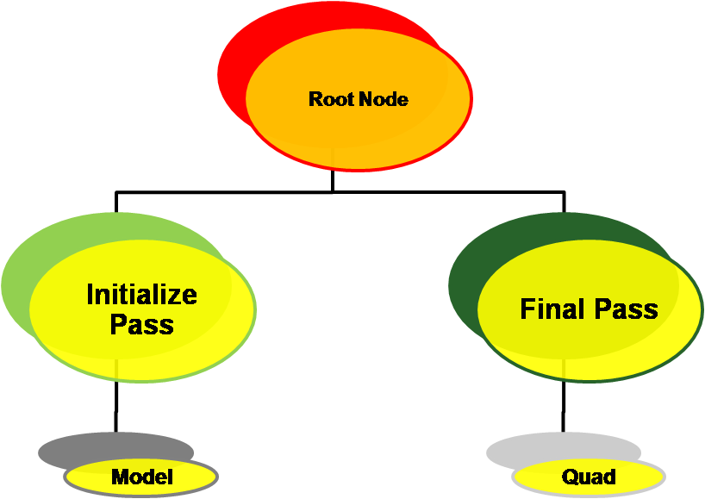
Weighted average complete graph

Slide 26
Step by step: initialize step
In the initialization step we sum all the fragment colors (rgb) multiplied by their alpha value in one texture and sum the alpha values, i.e.:
  dst_color = dst_color + (src_color * src_alpha)
  dst_alpha = dst_alpha + src_alpha
To do this we use an additive blending equation
  osg::BlendEquation(osg::BlendEquation::FUNC_ADD);
  blendFunction->setFunction(osg::BlendFunc::ONE, osg::BlendFunc::ONE);
In another texture we save the number of overlapping fragments for each pixel, with the same blend equation and blend function, therefore in the same shader

Slide 27
Step by step: final pass
In the final pass we average the pixel color, dividing the sum of all pixels by the number of overlapping fragments
For the final alpha value we do the same thing, then we need to mix the fragment color with the background
The simplified equation is
  dst_color = avg_color * (1-(1-avg_alpha)^n)
    + bg_color (1-avg_alpha)^n,
    where n is the depth complexity
Full explanation to be found in original whitepaper

Slide 28
RESULTS
Comparison of the two algorithms and OpenGL approach

Slide 29
Some words
We compared the three approaches on different datasets
OpenGL transparency without sorting gives wrong results
Weighted average is fast, but since it averages fragment colors, it gives no information about different layers depth and order
Dual depth peeling is correct, it is the slowest, but for most models it results in sufficiently high frame rates

Slide 30
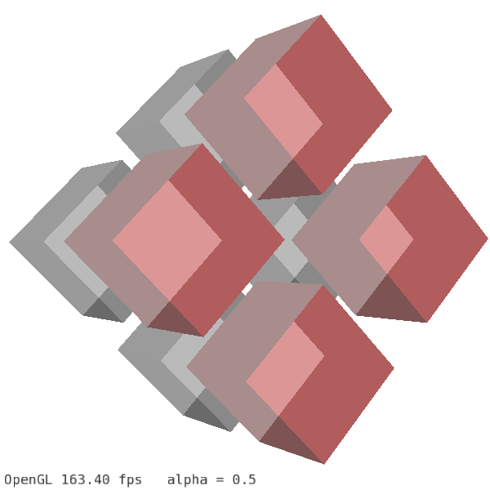
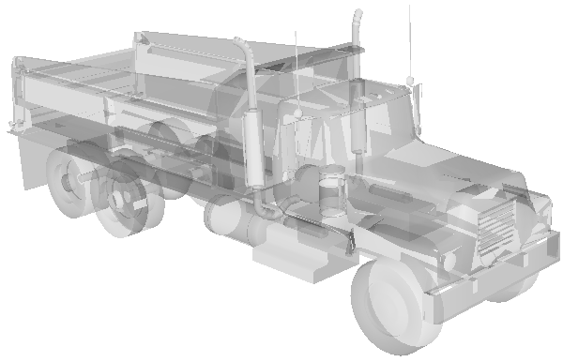
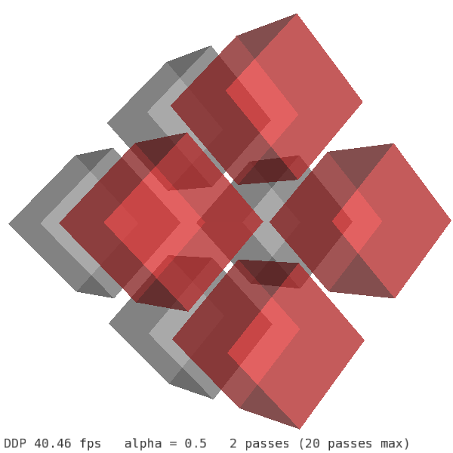
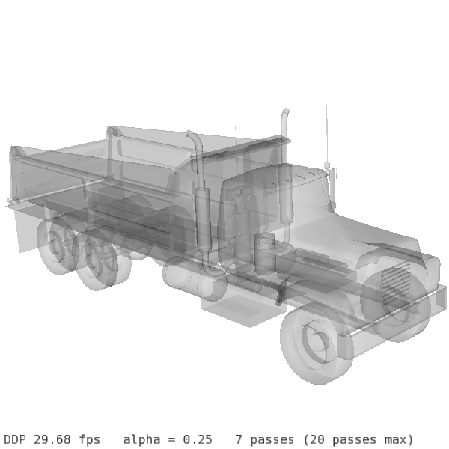
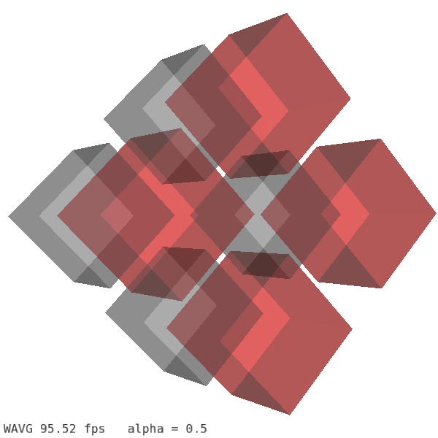
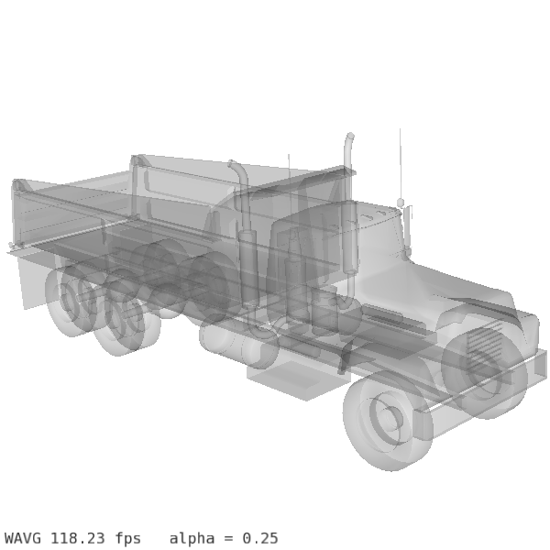
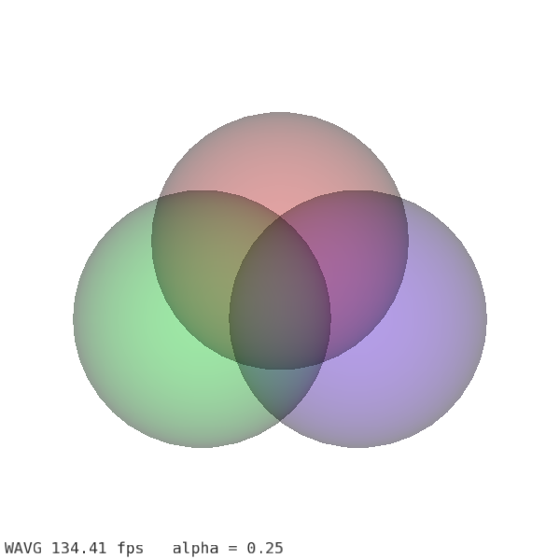
Some images
OpenGL
Dual Depth
Peeling
Weighted
Average

Slide 31
Some images: details (I)
Dual depth peeling
Weighted average

Slide 32
Some images: detail (II)
Dual depth peeling
Weighted average

Slide 33
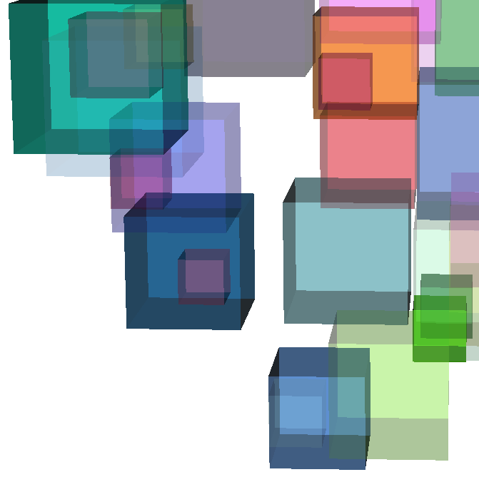
Problem with weighted average
Averaging the color disregarding the differences between depths creates uncertainty about the spatial ordering of different objects
In this example, we can not understand which cubes are in front of the others with respect to the camera
Orange?
Purple?
Blue?
Purple?

Slide 34
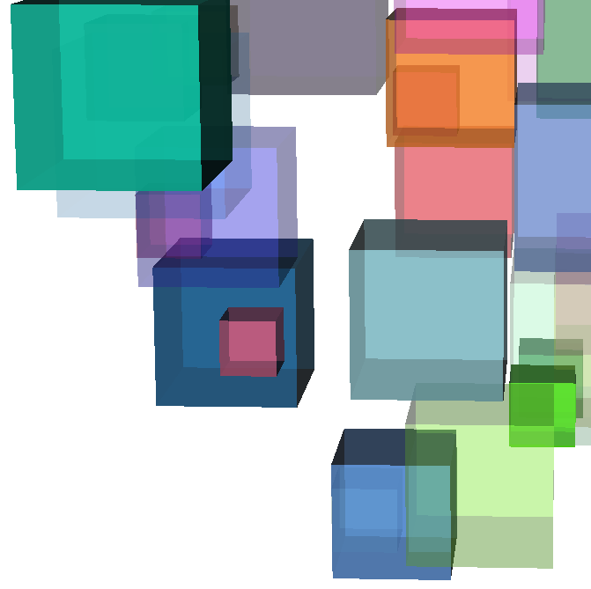
No problem with dual depth peeling
Since dual depth peeling effectively respects the alpha blend equation, those cubes which are in front of the others give a higher contribute to the pixel
All uncertainties can be easily clarified
Orange!
Purple?
Blue?
Purple!

