Slide 1
DirectX11 Performance
Reloaded
Nick Thibieroz, AMD
Holger Gruen, NVIDIA

Slide 2
Introduction
Update on DX11(.1) performance advice
Recommendations signed off by both IHVs
(Rare) exceptions will use color coding:
  AMD
  NVIDIA

Slide 3
CPU-Side Pipeline View
Notes:
Presentation divided in two parts: CPU-Side and GPU side pipeline view.
CPU-side pipeline view gives advice on how best to drive the API to maximize CPU performance of DX runtime and drivers.
GPU-side pipeline view gives advice on how best to drive the API to maximize GPU performance.

Slide 4
CPU-Side Pipeline View
Offline process
Runtime process
Prepare render list
Examine how best to drive the DX11 API for efficient performance
Separated in two stages:
  Offline process
  Runtime process
Create shaders
Create textures
Update dynamic textures
Create vertex +index buffers
Update dynamic buffers
Create constant buffers
Update constant buffers
Send data to graphics pipeline
Notes:
Offline process: lists the most common tasks needed at load-time. Makes sure resources are created optimally for best performance at run-time.
Runtime process: lists the most common tasks needed every frame.

Slide 5
Free-threaded Resource Creation
Offline process
…
Thread 1
Thread 2
Thread n
Scale resource creation time with number of cores
  Especially useful to optimize shader compiling time
  Can result in major reduction in load-time on modern CPUs
Check support with:
struct D3D11_FEATURE_DATA_THREADING
{
BOOL DriverConcurrentCreates;
BOOL DriverCommandLists;
} D3D11_FEATURE_DATA_THREADING;
Create shaders
Create textures
Create vertex +index buffers
Create constant buffers
Notes:
Most PC out there are running on multiple cores. 4 is fairly common.
Spread the cost of resource creation onto multiple threads to minimize load-time.
Especially important with shader compilation which can take a long time. Resource creation likely to be more subject to I/O limitation (unless running on SSD).

Slide 6
Offline Process: Create Shaders
Offline process
DirectX11 runtime compiles shaders from HLSL to D3D ASM
Drivers compile shaders from D3D ASM to binary ISA
  Drivers defer compilation onto separate threads
  Shaders should be created early enough to allow compilation to finish before rendering starts
Warm shader cache
  This guarantees deferred compilation has completed
Avoid D3DXSHADER_IEEE_STRICTNESS compiler flag
  Impact possible optimizations
NV: When using multiple threads to compile shaders:
  Driver might opt out of multi-threaded deferred compilation
  Compilation happens on the clock
    DO NOT USE the render thread to compile shaders to avoid stalls
Create shaders
Create textures
Create vertex +index buffers
Create constant buffers
Notes:
ISA = Instruction Set Architecture
Games should ship with pre-compiled D3DASM binary shaders to avoid HLSL compilation time.

Slide 7
Offline Process: Create Textures
Offline process
VidMM: OS video memory manager
  Responsible for storing textures and buffers into memory pools
  May need to “touch” memory before running to ensure optimal location
Use the right flags at creation time
  D3D11_USAGE_IMMUTABLE allows additional optimizations
Specify proper bind flags at creation time
  Only set those flags where required
    D3D11_BIND_UNORDERED_ACCESS
    D3D11_BIND_RENDER_TARGET
Create shaders
Create textures
Create vertex +index buffers
Create constant buffers
Notes:
Since Windows Vista all DX memory management is done by the OS (VidMM) instead of the drivers.
To ensure resources are stored in optimal location those need to be “touched”, i.e. included in a warm-up rendering phase where those resources are used. This would give enough time to VidMM to move those resources into optimal pools as needed (e.g. RT into local vid mem).
Specifying both UAV and RT flags may affect synchronization performance when switching from/to compute jobs.

Slide 8
Offline Process: Create Vertex and Index Buffers
Offline process
Optimize index buffers for index locality (or “index re-use”)
  E.g. D3DXOptimizeFaces
Then optimize vertex buffers for linear access
  E.g. D3DXOptimizeVertices
Should be an offline process, or performed at mesh export time
Includes procedural geometry!
  E.g. light volumes for deferred lighting
  Common oversight
Create shaders
Create textures
Create vertex +index buffers
Create constant buffers
Notes:
E.g. plug-ins are available for Maya and 3DSMax that will optimize your geometry.
Procedural geometry (sphere, spotlight) often does not go through geometry optimization phase.
Can be a significant performance impact especially if depth/stencil rendering is used (more load on GPU front-end).

Slide 9
Offline Process: Create Constant Buffers
Offline process
“Constants should be stored in Constant Buffers according to frequency of updates”
(You’ve heard this before)
Group constants by access patterns
  Constants used by adjacent instructions should be grouped together
Consider creating static CBs with per-mesh constant data
  No need to update them every frame (e.g. ViewProjection)
  Negligible VS ALU cost for extra transformation step required
DirectX11.1: large >64KB constant buffers now supported
  Specify CB range to use at draw time
Create shaders
Create textures
Create vertex +index buffers
Create constant buffers
Notes:
Grouping by access patterns helps with cache access for CB fetches.
Per-mesh static CB: means that those CBs can be created up-front and not modified. This reduces the need for CB updates.
DX11.1 (Windows 8 only): large CB creation used for CB rebasing. Allows NO_OVERWRITE style of CB update.

Slide 10
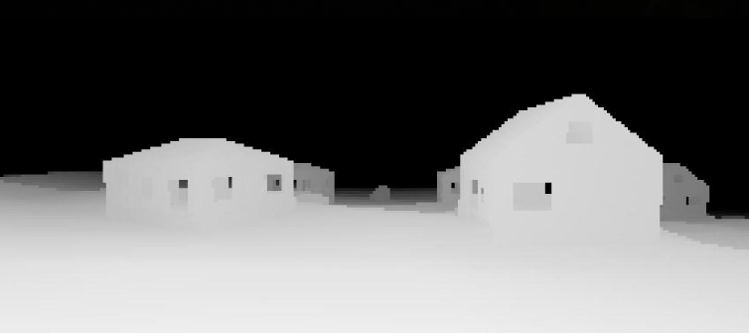
Runtime Process: Prepare Render List
Determine visible objects
Runtime process
Prepare render list
Only visible meshes should be sent to the GPU for rendering
GPU occlusion queries based culling
  Give at least a full frame (if not 2-3) before getting result back
  Round-robin queue of Occlusion Queries is recommended
  Stay conservative with the amount of queries you issue
GPU Predicated Rendering
  Save the cost of rendering but not processing the draw call
CPU-based culling
  Conservative software rasterizer
  Low-res, SSE2 optimized
  Good if you have free CPU cycles
Update dynamic textures
Update dynamic buffers
Update constant buffers
Send data to graphics pipeline
Image courtesy of DICE
Notes:
GPU occlusion queries need to be used properly to be effective. Large number of occlusion queries will impact performance.
All the usual trick of CPU-based occlusion should be used: convex hull visibility testing, occluder objects etc.
Conservative software render:
CPU rasterizer. SSE2 optimized. Store results in low-res buffer. Can limit number of triangles processed per frame to put an upper bound on cost.
Conservative render courtesy of DICE’s Johan Andersson.

Slide 11
Runtime Process: Prepare Render List
State Setting and Management
Runtime process
Prepare render list
Don’t create state objects at run-time
  Or create them on first use
  And pre-warm scene
Minimize number of state changes
  Check for dirty states
Set multiple resource slots in one call
  E.g. Make one call to :
  PSSetShaderResources(0, 4, &SRVArray);
  Instead of multiple calls:
  PSSetShaderResources(0, 1, &pSRV0);
  PSSetShaderResources(1, 1, &pSRV1);
  PSSetShaderResources(2, 1, &pSRV2);
  PSSetShaderResources(3, 1, &pSRV3);
Use geometry instancing to reduce draw calls!
Update dynamic textures
Update dynamic buffers
Update constant buffers
Send data to graphics pipeline
Notes:
From DX10 onwards a lot of validation work was moved from runtime to load-time. So creating state objects at run-time defeats this advantage.
The fewer state changes you send to the runtime the lower the overhead.
Multiple resources in one call: common oversight when porting from DirectX 9.

Slide 12
Runtime Process: Prepare Render List
Pushing Commands to Drivers 1/2
Driver is threaded internally on a producer-consumer model
  Application producer thread: driver just buffers each call very quickly
  Driver consumer thread: processes buffered calls to build command buffers
Application producer thread
Driver Consumer thread
Above example is application thread limited
  Not feeding draw commands to driver fast enough
  Not ideal way to drive performance
D3D API command
- Draw command, state setting etc.
Mapped buffer uploads
- Buffer updates
Non-D3D workloads
- Anything else
Notes:
App thread limited means the app is not able to push a higher number of API calls to the drivers. This will impact performance, especially on recent titles that are pushing high number of draw calls.

Slide 13
Runtime Process: Prepare Render List
Pushing Commands to Drivers 2/2
Application is only ‘driver limited’ if the consumer thread is saturated
To achieve this the application thread must be able to feed the driver consumer thread fast enough
  Work that is not directly feeding the driver should be moved to other threads
  Application producer thread should only send Direct3D commands
  Mapped buffer uploads should be optimized as much as possible
…
Application thread
…
Application thread
…
App Producer thread
D3D API command
- Draw command, state setting etc.
Mapped buffer uploads
- Buffer updates
Non-D3D workloads
- Anything else
…
Driver Consumer thread
Notes:
Having the driver consumer thread saturated with work is the best way to achieve the highest number of API calls.
For this to happen the app thread must be able to feed the driver thread fast enough.
Thus, application producer thread should only be sending API calls to the runtime.
Any other work should be moved onto other threads. This includes the processing of data when copying buffers. Only a pointer should be passed to Map/Unmap in the producer thread.

Slide 14
Runtime Process: Prepare Render List
What about Deferred Contexts?
Nothing magical about deferred contexts
If already consumer thread limited then deferred contexts will not help
D3D Deferred Contexts can present efficiency issues
  Immediate Context Consumer is often a bottleneck
  Deferred Contexts can limit performance due to redundant state setup
  Properly balance the amount of DCs and the workload for each
See Bryan Dudash’s presentation about Deferred Contexts
  Today at 5.30pm
Notes:
Deferred contexts would only help if app is producer-thread limited.

Slide 15
Runtime Process: Update Dynamic Textures
Runtime process
Update from ring of staging resources
  Update staging texture from next available one in ring
  Then CopyResource()
If creating new resources make sure creation is done free-threaded
UpdateSubresource() sub-optimal path for resource updates in general
  May require additional copies in the driver
Update full slice of texture array or volume texture rather than sub-rectangle
Avoid Map() on DYNAMIC textures
  Map returns a pointer to linear data that conflicts with HW tiling
Prepare render list
Update dynamic textures
Update dynamic buffers
Update constant buffers
Send data to graphics pipeline
Notes:
Update from ring of STAGING textures: because STAGING textures may still be in use to finish the copy operation in previous frames.
Ring ensures there is a next STAGING texture in ring available for copy.
Creating new resources should be avoided at run-time though, better to create during offline process.
UpdateSubresource() has additional copy overhead. May be ok for very small textures but should be avoided for anything else.
Better to perform all updates into STAGING and then upload new slice into Texture2DArray/Texture3D to avoid read/modify/write overhead.
DYNAMIC textures may be stored in video memory hence in swizzled format. But Map() requires linear data so additional copy/convert overhead.

Slide 16
Runtime Process: Update Dynamic Buffers 1/2
Runtime process
Prepare render list
Use DISCARD when infrequently mapping buffers
  Updating a buffer with DISCARD may cause a driver-side copy because of contention
  Multiple DISCARD updates/frame can cause stalls due to copy memory running out
    Especially with large buffers
    Smaller buffers allow better memory management
AMD: <4MB DYNAMIC buffers is best
NV: No optimal size as such but number of buffers in flight through discards/renaming is limited
Update dynamic textures
Update dynamic buffers
Update constant buffers
Send data to graphics pipeline
Notes:
AMD: limiting DYNAMIC buffers to 4Mb is best as it ensures buffer can be renamed at least once (allow parallelism).
NV: no optimal size but doing too many DISCARD a frame may run into rename memory limitation.

Slide 17
Runtime Process: Update Dynamic Buffers 2/2
Runtime process
Prepare render list
Frequently-updated data should use DISCARD + NO_OVERWRITE
  Only DISCARD when full
DirectX11.1: Dynamic buffers can now be bound as SRV
  Useful for advanced geometry instancing
Update dynamic textures
Update dynamic buffers
Update constant buffers
Send data to graphics pipeline
Notes:
Only DISCARD when full: Some apps insist to DISCARD once a frame. Only do it when full!
Not being able to bind DYNAMIC buffers as SRV was a major limitation of DX11.0. This allows the creation of instancing data with NO_OVERWRITE updates for best performance.

Slide 18
Runtime Process: Update Constant Buffers
Runtime process
Prepare render list
  From CB creation stage: store constants into CBs according to update frequency
Don’t bind too many CBs per draw (<5)
Share CBs across shader stages
  E.g. same CB bound in VS and PS
DirectX11.1: partial updates of CB now supported!
  Map() with NO_OVERWRITE or UpdateSubresource1()
DirectX11.1: XXSetConstantBuffers1() for CB re-basing
  Specify offset and range of constants within large CB
Update dynamic textures
Update dynamic buffers
Update constant buffers
Send data to graphics pipeline
Notes:
Constants stored according to update frequency allows optimal balance between API calls and memory transfers.
Too many CBs means fetching from different locations which can affect shader setup and cache re-use.
One way to reduce CB updates is to share some CBs between multiple shader stage if they contain a lot of values needed in both.
Partial updates of CB now supported: will help with CB management and reduce contention.
XXSetContantBuffers1(): allow the programmer to set a “sub-” CB from a large CB. Effectively reduces the API overhead for updating CBs (multiple sub-CBs can be updated in one call).

Slide 19
GPU-Side Pipeline View
Notes:
Will review how to drive DX11 API to enable maximal GPU efficiency and performance.

Slide 20
DX11 Graphics Pipeline
Input Assembly
Textures
Vertex Shader
Buffers
Hull Shader
  Just a quick recap
      Green: Fixed-function stage
      Blue: Programmable shader stage
      Purple: Memory resources
  Performance problems can happen at almost every stage or junction!
Render Targets
Tessellator
Domain Shader
Constants
Geometry Shader
Stream Out
UAVs
Rasterizer
Depthstencil
Pixel Shader
Depth Test
…
Output Merger
Notes:
Green – fixed function stage. Blue – programmable shader stage. Purple – memory resources.
Some stages are missing (e.g. clipping, scissoring etc.) for simplicity.

Slide 21
Input Assembly
IASetInputLayout()
IASetVertexBuffers()
IASetIndexBuffer()
IASetPrimitiveTopology()
Index Buffers
Input Assembly
Vertex Buffers
Only bind vertex streams containing required vertex data
  E.g. Depth-only rendering only requires position + texture coordinates
  Specify other vertex inputs in
  additional stream for color rendering
Binding too many streams may
impact fetch performance
  2 or 3 is often a good target
Position
Stream 0
Depth-only rendering
Texcoord
IASetInputLayout()
IASetVertexBuffers()
Input Assembly
Normal
Stream 1
Color rendering
Tangent
Notes:
Input Assembly defines how geometry buffers are bound to the GPU for processing.
Only bind vertex streams containing required vertex data: we’re still seeing some instances where the full vertex structure is bound for depth-only rendering.
Binding too many streams will result in at least one cache line fetch for every stream.
Perfectly valid to bind no geometry buffers and create geometry procedurally using SV_VertexID and/or by fetching data from resources manually in VS.

Slide 22
Vertex Shader
Input Assembly
Textures
Vertex Shader execution can be a bottleneck in some situations:
  Dependent fetches
    Indexed constant or textures fetches
  Poor vertex cache efficiency
    Remember to optimize your meshes
  Long and complex vertex shaders
    Advanced skinning, texture accesses…
Those bottlenecks become more apparent in transform-limited situations
Watch out for large vertex output size
  Minimize the amount of attributes to PS
    AMD: 4 float4 (or less) output size is ideal
Vertex Shader
Buffers
Hull Shader
Constants
Tessellator
Domain Shader
Geometry Shader
Stream
Out
Rasterizer
Pixel Shader
Depth Test
Output Merger
Notes:
Large VS output size: affects shader execution performance.
Also has the side-effect of reducing number PS attributes which is a good thing.
VS bottleneck can also be due to poor LOD (loads of vertices to transform but few pixels to rasterize).

Slide 23
Tessellation Stages
Input Assembly
Tessellation is a great feature of DirectX 11
Allows enhanced visual quality via different techniques and provides nice properties
  Smooth silhouettes
  Greater detail and internal silhouettes through Displacement mapping
  Natural LOD through tess factors
Tessellation has a cost
  Content creation pipeline changes
  Performance depending on amount of usage
Use it when and where it makes sense
Vertex Shader
Textures
Hull Shader
Buffers
Tessellator
Domain Shader
Constants
Geometry Shader
Stream
Out
Rasterizer
Pixel Shader
Depth Test
Output Merger
Notes:
One of the main feature of DX11 along with DirectCompute.
Direct correlation between amount of tessellation used and performance.

Slide 24
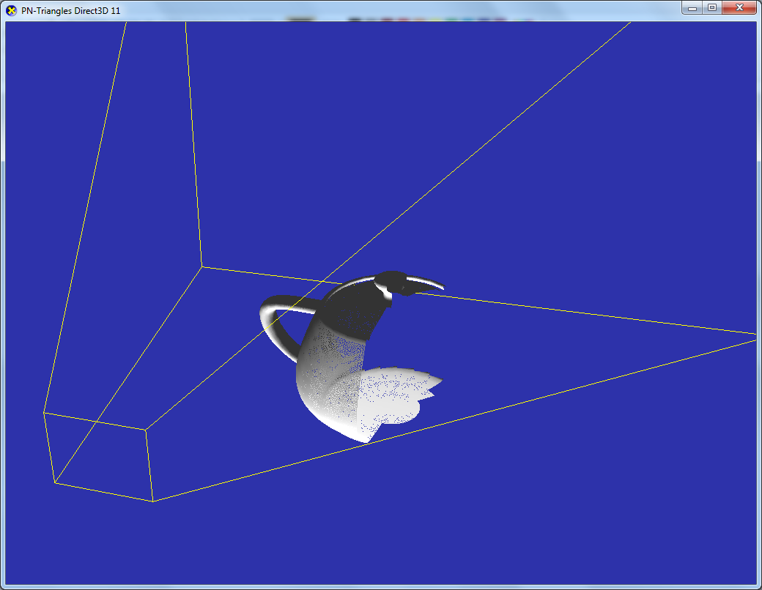
Tessellation basic performance tips
Disable tessellation completely when not needed
  After a certain distance models should revert to no tessellation
  When tessellation factors are too small
Use Frustum and Backface culling
  This is different than fixed-function
  hardware culling!
  Culling has to be done manually in the
  Hull Shader prior to tessellator stage
Minimize Hull and Domain Shader vertex output attributes
Notes:
Tessellation factor of 1 means no tessellation which is the same result as simply having VS/PS.
But significant overhead of tessellation stages being enabled.
Minimize Hull and Domain Shader vertex output attributes: packing data so that it uses less space. In some cases reconstructing data in later stages (e.g. PS) can be better than storing this data in HS/DS output. Need to try and see what works best.
Fixed-function HW culling occurs at the rasterization stage (just before PS) so by then all triangles are already tessellated. Instead BFC should be done at HS level to ensure triangles are killed before they reach the tessellator.

Slide 25
Tessellation factors 1/2
Undertessellation may produce visual artifacts
  Especially if using displacement maps (e.g. “swimming”)
Overtessellation and very tiny triangles will degrade performance
  AMD: tessellation factors above 15 have a large impact on performance
Strike the right balance between quality and performance
Notes:
Undertessellation can produce visual artefacts when not enough vertices are used to displace a height map. This can result in a swimming effect when adaptive tessellation is used.
Overtessellation on the other hand will affect performance: as mentioned before there is a direct correlation between amount of tessellation used and performance.
AMD: performance cliffs when tessellation factors are above 15.
As with everything in rendering it is important to strike a good balance between quality and performance.

Slide 26

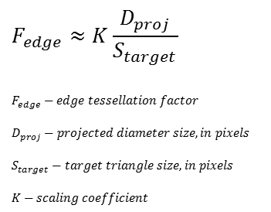
Tessellation factors 2/2
Use an appropriate metric to determine how much to tessellate based on the amount of detail or base mesh footprint you want
  Screen-space adaptive
  Distance-adaptive – if you don’t do screen-space adaptive
  Orientation-adaptive
$$F_{edge}≈K\frac{D_{proj}}{S_{target}}$$
$$F_{edge}−edge tessellation factor$$
$$D_{proj}−projected diameter size, in pixels$$
$$S_{target}−target triangle size, in pixels$$
$$K−scaling coefficient$$
$$A=πr^{2}$$
Screen
Orientation-independent
Target 10-16 pix/tri at minimum
Consider resolution into account
Projected
sphere
diameter
Δsize [
Edge
Eye
Triangle
Notes:
Screen-space adaptive (10-16 tris/pixel, also depends on resolution): some scaling of this value per resolution may be required to avoid high performance cost at higher screen resolutions.
Orientation-independence is important to minimize swimming.
Consider resolution into account: very large resolution (e.g. 1600p, SSAA, 4K) will produce higher tessellation factors with a fixed triangle size so need to adjust desired triangle size accordingly.

Slide 27
Geometry Shader
Input Assembly
Often, there is a faster, non-GS solution
  VS techniques can be a win (depending on VS cost)
Prefer fixed expansion
Variable expansion rate affects performance
  Divergent workload does not pipeline well
  Please note: Pass-through GS with RT index selection is a form of expansion
  AMD: OK if all primitives emitted from a given GS input all go to the same RT
Minimize input and output size and attributes to PS
Vertex Shader
Hull Shader
Tessellator
Textures
Domain Shader
Buffers
Geometry Shader
Stream
Out
Constants
Rasterizer
Pixel Shader
Depth Test
Output Merger
Notes:
VS instancing can be a win: especially if fixed expansion is used. For example quad or prism rendering.
OK if all primitives emitted from a given GS input all go to the same RT: alternative solutions to RT index selection are 3D UAV output from PS, render to texture atlases, or rewrite the algorithm to store data to one slice at a time. Light Propagation Volumes, Sparse Voxel Octrees etc.
Once again minimizing input and output size helps. Leads to better shader execution.

Slide 28
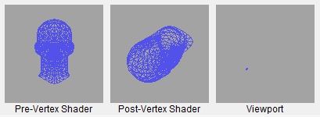
Rasterizer
Input Assembly
Turns triangles into pixels
Small triangles result in poor quad occupancy
  Causes poor utilization of shader units
Too small triangles can be caused:
  by over-tessellation
  by non-existing/poor LOD system (quite common!)
  Check triangle density by switching to wireframe
Vertex Shader
Hull Shader
Tessellator
Domain Shader
Geometry Shader
Stream
Out
!
Rasterizer
Pixel Shader
Depth Test
Output Merger
Notes:
There should be more triangles then edges: if all you’re seeing are edges then expect limited rendering performance (and possibly tessellation/small triangle bottleneck).

Slide 29
Pixel Shader
Input Assembly
Some pixel shaders are likely to be performance bottlenecks
  Often executed on more elements than other stages
  Per-sample PS execution is very costly
    Only perform it where required
In most cases moving work up the pipeline is a good thing (executed on fewer elements)
  There are exceptions to this
  Use IHV tools to understand your bottlenecks
PS supports scattered writes in DX11.0
  UAVs with or without counters
  Append/Consume UAVs
  Group UAV reads/writes together
    Help with memory access
Vertex Shader
Hull Shader
Tessellator
Textures
Domain Shader
Buffers
Geometry Shader
Stream
Out
Constants
Rasterizer
Pixel Shader
Depth Test
Output Merger
Notes:
PS often shows up as most likely bottleneck. Not always though (e.g. CS, tessellation).
Hence the importance to optimize PS as much as possible.
There are exceptions to this: for example to reduce outputs from previous stages (VS, HS, DS, GS).
PS UAV support in DX11.0: all shader stages support UAV output in DX11.1 but DX11.0 only for PS and CS.
UAV output great feature but consumes a lot of bandwidth so need to group reads and writes to help with memory accesses.

Slide 30
Pixel Shader
Execution Cost
Some ALU instructions cost more than others
  E.g. RCP, RSQ, SIN, COS, I2F, F2I
  Integer MUL and DIV are “slower” instructions, use float instead
Discard/clip can help performance by skipping remaining instructions
  Minimize sequence of instructions required to compute discard condition
Shader inputs: attribute interpolation contributes to total execution cost
  Minimize the number of attributes sent from VS/DS/GS
  Avoid sending constants! (use constant buffers)
  AMD : pack attributes into float4
Notes:
As mentioned before reducing outputs in the previous stage will help performance.
Don’t pass constant values from previous stage to PS as an interpolator, use CB instead.
AMD: packing will help performance.
Per-sample PS execution can be optimized by only doing it where required, e.g. on pixel edges on Deferred MSAA renderers.

Slide 31
Pixel Shader
GPR Pressure and Fetches
General Purpose Registers (GPR) are a limited resource
  Number of GPRs required by a shader affects execution efficiency
  Use register count in D3D asm as an indicator
GPR pressure is affected by:
  Long lifetime of temporary variables
  Fetch dependencies (e.g. indexed constants)
  Nested Dynamic Flow Control instructions
Watch out for dcl_indexableTemp in the D3D asm
  Replace by texture lookup or ALU for large constant arrays
Notes:
Shader tools: NV nSight or FXComposer, AMD GPUPerfStudio 2 or GPUShaderAnalyzer.
Long lifetime: declaring a temp variable that is used throughout the length of the shader.
Nested DFC means more GPRs to support all cases of divergences.
Fetch dependencies: more GPRs needed to hide latency.
Shader compilers will try to improve on those but there is a lot you can do by designing an efficient shader from the start.

Slide 32
Depth Test
Input Assembly
API places it logically after PS
HW executes depth/stencil at various points:
  Hi-Z/ZCull coarse rejection
  EarlyZ before PS when possible
  Late Z after PS
Ideal rendering order:
  Opaque first, then alpha test
NV: Use D24 whenever possible for performance
NV: don’t mix GREATER and LESS on same depth buffer
AMD: Prefer D16 for shadow maps
Vertex Shader
Rasterizer
Hull Shader
Hi-Z / ZCull Depth/Stencil Test
Tessellator
Domain Shader
“Early” Depth Stencil Test
Geometry Shader
Pixel Shader
Stream
Out
Rasterizer
“Late” Depth Stencil Test
Pixel Shader
Output Merger
Depth Test
Depth/Stencil Buffer
Output Merger
Notes:
Ideal rendering order: Opaque first, then alpha test. Opaque geometry will prime HiZ/Zcull more efficiently.
NV: Using D32F with normal projection matrices does not bring additional value.
AMD: D16 shadow map produce enough precision in most cases. All you need is correct projection matrix (high front clip plane). Enough for most ranges of CSM.

Slide 33
Depth Test – Early Z vs Late Z rules
Opaque primitives
[earlydepthstencil]
Clip()/Discard()
Alpha to Mask Output
Coverage Mask Output
Clip()/Discard()
Alpha to Mask Output
Coverage Mask Output
Depth Writes OFF
Depth Writes ON
oDepth output
UAV output
with
with
Rasterizer
Rasterizer
Rasterizer
Hi-Z / ZCull Depth/Stencil Test
Hi-Z / ZCull Depth/Stencil Test
Hi-Z / ZCull Depth/Stencil Test
“Early” Depth Stencil Test
“Early” Depth Stencil Test
“Early” Depth Stencil Test
Pixel Shader
Pixel Shader
Pixel Shader
“Late” Depth Stencil Test
“Late” Depth Stencil Test
“Late” Depth Stencil Test
Output Merger
Output Merger
Output Merger
Notes:
Opaque primitives: can be with depth writes on or off
May be affected by stencil.

Slide 34
Depth Test – Conservative oDepth
DX11 supports conservative depth output
Allows programmer to specify that depth output will only be GREATEREQUAL or LESSEQUAL than current depth buffer depth
  E.g. geometric decals, depth conversion etc.
In this case EarlyZ is still disabled
  Because it relies on knowing actual fragment depth
But Hi-Z/ZCull can be leveraged for early acceptance or rejection
Conservative oDepth output
SV_DEPTH_GREATER_EQUAL or
SV_DEPTH_LESS_EQUAL
Rasterizer
Hi-Z / ZCull Depth/Stencil Test
“Early” Depth Stencil Test
Pixel Shader
“Late” Depth Stencil Test
Output Merger
Notes:
Conservative oDepth not well documented in DX11 API.

Slide 35
Output Merger
Input Assembly
PS output: each additional color output increases export cost
Export cost can be more costly than PS execution
      If shader is export-bound then it is possible use “free” ALU for packing etc.
Watch out for those cases
  E.g. G-Buffer parameter writes
Clears:
MSAA: always clear to reset compression
Single-sample: use DX11.1 Discard*() API
Clear Z every time it is needed
Vertex Shader
Hull Shader
Tessellator
Domain Shader
Geometry Shader
Stream
Out
Rasterizer
Pixel Shader
Depth Test
Output Merger
Render Targets
Notes:
Clear is a sub-category of Output Merger
Clear is not free.
Discard is preferred to Clear() since a Clear doesn’t actually need to happen.
Clear Z every time it is needed: always fast, no Z trick needed.

Slide 36
Export Rates
Input Assembly
Full-rate
  Everything not mentioned below
Half-rate
  R16, RG16 with blending
  RG32F with blending
  RGBA32, RGBA32F
  RGBA16F, R11G11B10F
  sRGB8, A2R10G10B10 with blending
Quarter-rate
  RGBA16 with blending
  RGBA32F with blending
  RGBA32F
Vertex Shader
Hull Shader
Tessellator
Domain Shader
Geometry Shader
Stream
Out
Rasterizer
Pixel Shader
Depth Test
Output Merger
Render Targets
Notes:
Can vary depending on whether blending is enabled or not.
Stay away from 128bpp for best export performance.

Slide 37
Texture Filtering 1/3
Input Assembly
All shader stages can fetch textures
Point sampling filtering costs
  AMD: Full-rate on all formats
  NV: Avoid point + 3D + 128bpp formats
Bilinear costs - rate depends on format, see next slide
Trilinear costs - Up to twice the cost of bilinear
Anisotropic costs - Up to N times the cost of bilinear, where N is the # of aniso taps
Avoid RGB32 format in all cases
Vertex Shader
Hull Shader
Tessellator
Domain Shader
Textures
Geometry Shader
Stream
Out
Rasterizer
Pixel Shader
Depth Test
Output Merger
Notes:
RGB32 does not play well with memory alignment.

Slide 38
Texture Filtering 2/3
Bilinear Filtering
Input Assembly
Vertex Shader
Full-rate
  Everything not mentioned below
Quarter-rate
  RGBA32, RGBA32F
Half-rate
  RG32, RG32F,RGBA16, RGBA16F
  BC6
Hull Shader
Tessellator
Domain Shader
Textures
Geometry Shader
Stream
Out
Rasterizer
Pixel Shader
Depth Test
Output Merger
Notes:
Main difference here is that AMD HW is half-rate on RGBA16 filtering.

Slide 39
Texture Filtering 3/3
Input Assembly
Use MIPMapping
  Avoid cache trashing
  Avoid aliasing artifacts
  All textures including displacement maps
Texturing from multisampled surfaces
  Pre-resolve surfaces if only a single sample is needed for a draw operation
    SSAO is classic example of this
Use Gather() where possible
  NV: Gather with 4 offsets can result in speedups
Vertex Shader
Hull Shader
Tessellator
Domain Shader
Textures
Geometry Shader
Stream
Out
Rasterizer
Pixel Shader
Depth Test
Output Merger
Notes:
Use MIPMapping: should be obvious.
What is less obvious is that sometimes displacement maps are (e.g. for tessellation) are not MIPMapped – they should be.
MSAA decompression
Gather allows the fetching of 4 point sample values in a single texture instruction.
Should be used for operations not requiring fitering e.g. depth buffer downsizing, DOF, AO, bilateral filters etc.

Slide 40
Compute Shader 1/3
Hull Shader
Tessellator
Also known as DirectCompute
DirectX interface for general-purpose computing on the GPU (GPGPU)
Advanced shader stage giving a lot of control to programmer
  Explicit thread group execution
  Thread group shared memory
  Outputs to UAVs
  Supports atomic operations
  Explicit synchronizations
Domain Shader
Geometry Shader
Stream
Out
Rasterizer
Textures
Pixel Shader
Buffers
Depth Test
UAVs
Output Merger
UAV Buffers with counters
Compute Shader
Append/Consume UAV Buffers
Notes:
Great tool for achieving next-gen performance on new algorithms
But with great power comes great responsibility.

Slide 41
Compute Shader 2/3
Performance Recommendations
Consider the different IHV wavefront sizes
  64 (AMD)
  32 (NVIDIA)
Choose a multiple of wavefront for threadgroup size
  Threadgroups(1,1,1) is a bad idea!
  Don‘t hardcode thread group sizes
  Maximum thread group size no guarantee for best parallelism
  Check for high enough machine occupancy
  Potentially join compute passes for big enough parallel workloads
  Profile/analyze with IHV tools and adapt for GPUs of different IHVs
Notes:
A threadgroup with less than 64 threads will waste GPU resources and so will a non-multiple of 64.
IHV tools: NV nSight, AMD GPUPerfStudio 2.

Slide 42
Compute Shader 3/3
Performance Recommendations continued
Thread Group Shared Memory (TGSM)
Store the result of thread computations into TGSM for work sharing
  E.g. resource fetches
Only synchronize threads when needed
  GroupMemoryBarrier[WithGroupSync]
TGSM declaration size affects machine occupancy
Bank Conflicts
Read/writes to the same memory bank (bank=address%32) from parallel threads cause serialization
Exception: all threads reading from the same address is OK
Learn more in “DirectCompute for Gaming: Supercharge your engine with Compute Shaders” presentation from Stephan and Layla at 1.30pm
Notes:
TGSM declaration size affects latency hiding: declaring max amount of TGSM not necessarily the best solution for performance.

Slide 43
Unordered Access Views (UAVs)
Input Assembly
Vertex Shader
DirectX11.1 allows all shader stages to write to UAVs
  No longer limited to PS/CS
Coalesce all reads and writes from/to UAVs for better performance
Hull Shader
Tessellator
Domain Shader
UAVs
Geometry Shader
UAV Buffers with counters
Stream Out
Rasterizer
Append/Consume UAV Buffers
Pixel Shader
Depth Test
Output Merger
Compute Shader

Slide 44

Questions?
Nick Thibieroz, AMD
nicolas.thibieroz@amd.com @NThibieroz
Holger Gruen, NVIDIA
hgruen@nvidia.com

