Slide 1


10:30
Saturday, January 07
10:30 AM
01/07/2023

Slide 2


GROUP XI
SIGN IN
10:30 AM
01/07/2023

Slide 3




Home Page
MEMBERS
Blances, Edsel Ian
Camba, Michael
Mangilinan, Aizen
REPORT TITLE
INFORMATION WARFARE
Objectives
Introduction
Discussion
10:30 AM
01/07/2023
Information Warfare

Slide 4

OBJECTIVES
x
1
Home Page
Understand professional, ethical, legal, security and social issues and responsibilities in the utilization of information technology.
Objectives
Introduction
Discussion
10:30 AM
01/07/2023
Information Warfare

Slide 5
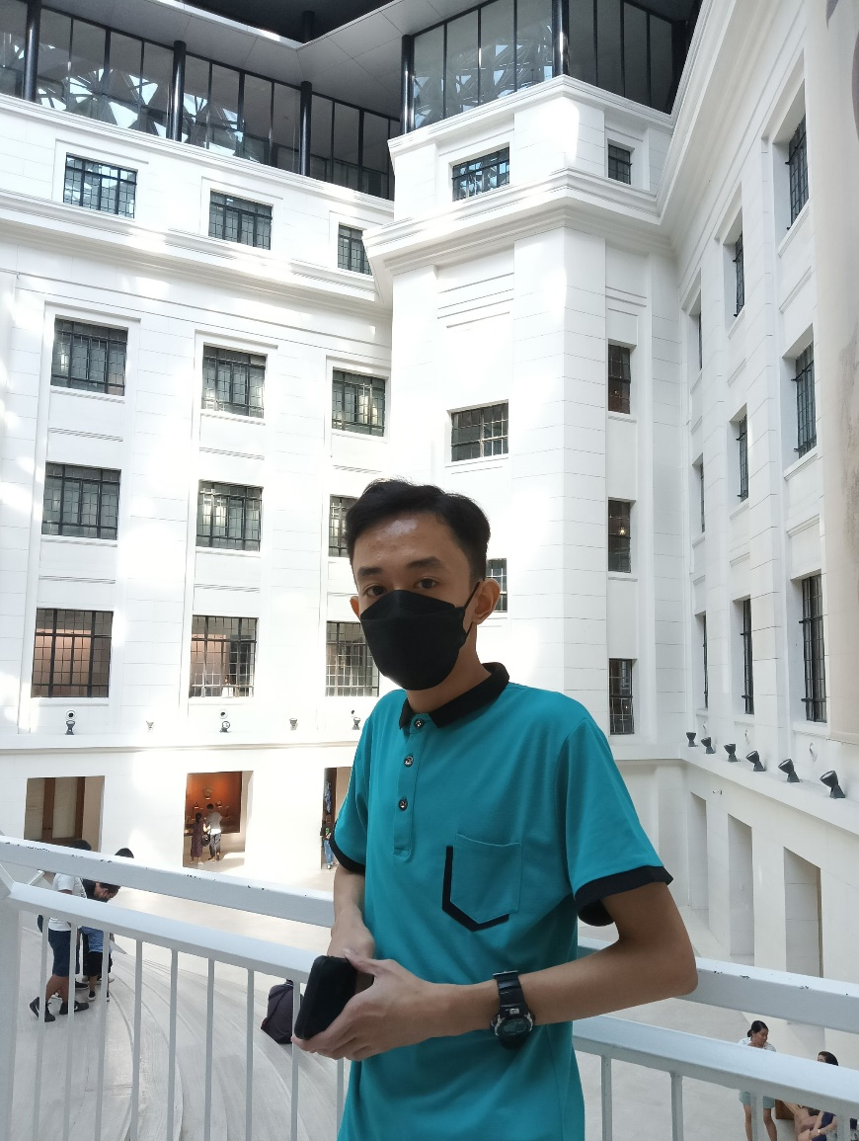
x
EDSEL IAN BLANCES
1
2
3
Home Page
Personal Information:
Age: 21 years old
Hometown: Mandaluyong City
Birthdate: May 5, 2001
Objectives
Hobbies:
Streaming Movies
Listening to Music
Playing Badminton
Introduction
Why I.T.?
I.T. can change the world.
I.T. can use as teaching profession.
Discussion
10:30 AM
01/07/2023
Information Warfare

Slide 6

x
MICHAEL CAMBA
1
2
3
Home Page
Personal Information:
Age: 21 years old
Hometown: Taguig City
Birthdate: April 27, 2001
Objectives
Hobbies:
Reading manga
Watching anime
Playing online games
Introduction
Why I.T.?
They say it’s in demand, and I.T. careers offer a great earning potential.
Competitive salary.
Discussion
10:30 AM
01/07/2023
Information Warfare

Slide 7
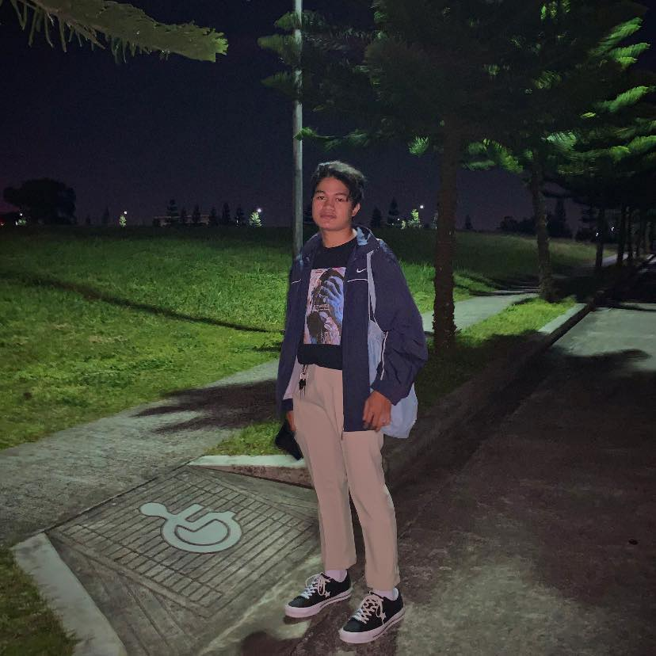
x
AIZEN LOUISE MANGILINAN
1
2
3
Home Page
Personal Information:
Age: 22 years old
Hometown: Quezon City
Birthdate: October 23, 2000
Objectives
Hobbies:
Online Games
Road trip
Playing Basketball
Introduction
Why I.T.?
Good Salary.
Career diversity.
Discussion
10:30 AM
01/07/2023
Information Warfare

Slide 8
INFORMATION WARFARE
x
Home Page
CYBER ESPIONAGE
PURPOSE OF CYBER ESPIONAGE
CYBER ESPIOGNAGE TACTICS
INTELLIGENCE GATHERING
PURPOSE OF INTELLIGENCE GATHERING
Objectives
Introduction
Discussion
10:30 AM
01/07/2023
Information Warfare

Slide 9
2
x
INFORMATION WARFARE
1
3
4
Information warfare (IW) represents a rapidly evolving and, yet imprecisely defined field of growing interest for defense planners and policymakers. The source of both the interest and the imprecision in this field is the so-called information revolution—led by the ongoing rapid evolution of cyberspace, microcomputers, and associated information technologies.
Information Warfare in its broadest sense is a struggle over the information and communications process, a struggle that began with the advent of human communication and conflict.
Home Page
Objectives
Introduction
Discussion
10:30 AM
01/07/2023
Information Warfare

Slide 10
2
x
ORIGINS OF I.W.
1
3
4
Home Page
Some historians hold that information warfare dates from the beginning of the 20th century, noting, for example, that the French army conducted IO activities in the First World War, using electronic warfare techniques that enabled the interception of wireless and telephone communications.
Objectives
Introduction
Discussion
10:30 AM
01/07/2023
Information Warfare

Slide 11
2
x
WHY IS I.W. CREATED?
1
3
4
Home Page
The chief objective of information warfare is to achieve information superiority over an adversary.
The playing field is "info-space" the collection of all things involved in generation, gathering, processing, storage, and transmission of information. IW holds that the information a nation's military has available to decide will, to a large extent, determine its activities. If that information can be controlled, so can the resulting military actions.
Objectives
Introduction
Discussion
10:30 AM
01/07/2023
Information Warfare

Slide 12
2
x
POLITICS, SECURITY, AND IT
1
3
4
Home Page
Talampas (2002), revealed in his study that the Politics, Security, and IT of the Philippines has a vibrant civil society and uncivil elements have both utilized the available technology to test the limits of expression and liability in the country.
Objectives
Introduction
Discussion
10:30 AM
01/07/2023
Information Warfare

Slide 13
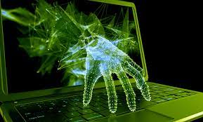
DISCUSSION
x
Home Page
CYBER ESPIONAGE
1
2
Cyber espionage, or cyber spying, is a type of cyberattack in which an unauthorized user attempts to access sensitive or classified data or intellectual property (IP) for economic gain, competitive advantage or political reasons.
Objectives
Introduction
Discussion
10:30 AM
01/07/2023
Information Warfare

Slide 14
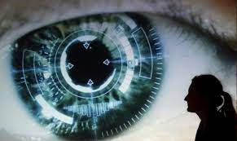
DISCUSSION
x
Home Page
CYBER ESPIONAGE TARGET
1
2
The most common targets of cyber espionage include large corporations, government agencies, academic institutions, or other organizations that possess valuable IP and technical data that can create a competitive advantage for another organization or government.
Objectives
Introduction
Discussion
10:30 AM
01/07/2023
Information Warfare

Slide 15

DISCUSSION
x
PURPOSE OF CYBER ESPIONAGE
1
Home Page
Cyber espionage attacks can be motivated by monetary gain; they may also be deployed in conjunction with military operations or as an act of cyber terrorism or cyber warfare.
Objectives
Introduction
Discussion
10:30 AM
01/07/2023
Information Warfare

Slide 16
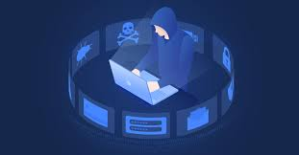
DISCUSSION
x
CYBER ESPIONAGE TACTICS
1
2
3
4
Home Page
Most cyber espionage activity is categorized as an advanced persistent threat (APT). An APT is a sophisticated, sustained cyberattack in which an intruder establishes an undetected presence in a network to steal sensitive data over a prolonged period.
Objectives
Introduction
Discussion
10:30 AM
01/07/2023
Information Warfare

Slide 17
DISCUSSION
x
CYBER ESPIONAGE TACTICS
1
2
3
4
Home Page
Most cyber espionage attacks also involve some form of social engineering to spur activity or gather needed information from the target in order to advance the attack.
Watering Hole
Spear-Phishing
Zero-day exploits
Inside actors
Objectives
Introduction
Discussion
10:30 AM
01/07/2023
Information Warfare

Slide 18
DISCUSSION
x
CYBER ESPIONAGE PENALTIES
1
2
3
4
Home Page
While many countries have issued indictments related to cyber espionage activity, the most serious cases usually involve foreign actors in countries that are not subject to extradition.
Objectives
Introduction
Discussion
10:30 AM
01/07/2023
Information Warfare

Slide 19
DISCUSSION
x
CYBER EPSIONAGE DETECTION, PREVENTION AND REMEDIATION
1
2
3
4
Home Page
The growing sophistication of cyber attackers and cyber spies has enabled them to bypass many standard cybersecurity products and legacy systems.
Sensor Coverage
Technical Intelligence
Threat Intelligence
Threat Hunting
Service Provider
Objectives
Introduction
Discussion
10:30 AM
01/07/2023
Information Warfare

Slide 20

DISCUSSION
x
Home Page
INTELLIGENCE GATHERING
1
2
3
4
5
6
Intelligence gathering can be dissected into different modes of which Human, Signal, Imagery, Measurement and Signatures, Open-Source Intelligence are the most viable for targeted attacks.
Objectives
Introduction
Discussion
10:30 AM
01/07/2023
Information Warfare

Slide 21

DISCUSSION
x
INTELLIGENCE GATHERING
1
2
3
4
Home Page
5
6
HUMINT is the process of gaining intelligence from humans or individuals by analyzing behavioral responses through direct interaction.
Objectives
Introduction
Discussion
10:30 AM
01/07/2023
Information Warfare

Slide 22

DISCUSSION
x
INTELLIGENCE GATHERING
1
2
3
4
5
6
Home Page
SIGINT refers to electronic transmissions that can be collected by ships, planes, ground sites, or satellites.
Objectives
Introduction
Discussion
10:30 AM
01/07/2023
Information Warfare

Slide 23

DISCUSSION
x
INTELLIGENCE GATHERING
1
2
3
4
5
6
Home Page
Objectives
IMINT is sometimes also refereed to as photo intelligence.
Introduction
Discussion
10:30 AM
01/07/2023
Information Warfare

Slide 24

DISCUSSION
x
INTELLIGENCE GATHERING
1
2
3
4
5
6
Home Page
Objectives
MASINT is a relatively little-known collection discipline that concerns weapons capabilities and industrial activities.
Introduction
Discussion
10:30 AM
01/07/2023
Information Warfare

Slide 25

DISCUSSION
x
Home Page
INTELLIGENCE GATHERING
1
2
3
4
5
6
Open Source Intelligence is the process of gathering intelligence from publicly available resources (including Internet and others). OSINT should not be confused with Open Source Software(OSS) as these are both different elements.
Objectives
Introduction
Discussion
10:30 AM
01/07/2023
Information Warfare

Slide 26
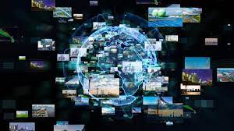
DISCUSSION
x
Home Page
Ethical Issues of Intelligence Gathering
1
2
The root of the ethical problem over the collection of intelligence lies in the need to overcome the determined will of the person with the secret not to allow it to be shown.
Objectives
Introduction
Discussion
10:30 AM
01/07/2023
Information Warfare

Slide 27

DISCUSSION
x
Home Page
PURPOSE OF INTELLIGENCE GATHERING
1
2
Intelligence gathering plays a major role in today's warfare as intelligence provides us with knowledge about what the enemy may be doing or is going to do in the future.
Objectives
Introduction
Discussion
10:30 AM
01/07/2023
Information Warfare

Slide 28

Home Page
MEMBERS
Blances, Edsel Ian
Camba, Michael
Mangilinan, Aizen
REPORT TITLE
INFORMATION WARFARE
Objectives
Introduction
Pictures
Shut down
10:30 AM
01/07/2023
Information Warfare

Slide 29
Home Page
MEMBERS
Blances, Edsel Ian
Camba, Michael
Mangilinan, Aizen
Are you sure you want to end the presentation?
REPORT TITLE
INFORMATION WARFARE
Objectives
Yes
No
Introduction
Discussion
10:30 AM
01/07/2023
Information Warfare

Slide 30
THANK YOU FOR LISTENING!
Shutting down….

