Slide 1
GROUP 21
ASSIGNMENT
MEMBERS
Michael Fajemilehin
Adebowale Akande
Oladele Opeyemi

Slide 2
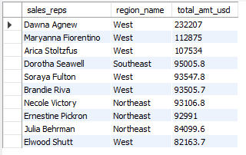
The top 10 sales reps by sales value
The sales rep with the most sales in USD was Dawna Agnew with a total of $232,207 and he is from the West region
Most of the top sales reps are from the West region followed bybthe Northeast region

Slide 3
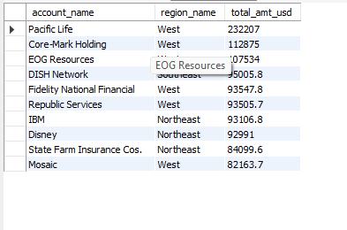
The top 10 Accounts by sales
Pacific Life is the company that made the most sales

Slide 4

In what day was the most sales made?
The most sales were made on the 26th of December 2016

Slide 5
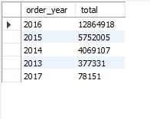
In what year was the most sales made?
The most sales were made on the 2016

Slide 6
THANK YOU

