Slide 1

INFORMATION SECURITY
DEPARTMENT OF INFORMATION TECHNOLOGY AND DECISION SCIENCES

Slide 2
WHAT IS INFORMATION SECURITY?
1

Slide 3
SECURITY
“The quality or state of being secure—to be free from danger”
A successful organization should have multiple layers of security in place:
Physical security
Personal security
Operations security
Communications security
Network security
Information security

Slide 4
SECURITY
The goal of a security plan is to find the balance between protection, usability, and cost.
Additionally, when securing an asset, system, or environment, we must also consider how the level of security relates to the value of the item being secured.

Slide 5
INFORMATION SECURITY
Information security: a “well-informed sense of assurance that the information risks and controls are in balance.” —Jim Anderson, Inovant (2002).
Information security is defined as protecting information and information systems from unauthorized access, use, disclosure, disruption, modification, or destruction.

Slide 6
INFORMATION SECURITY
The concepts, techniques, technical measures, and administrative measures used to protect information assets from deliberate or inadvertent(unintended) unauthorized acquisition, damage, disclosure, manipulation, modification, loss, or use.
Information security means protecting information and information systems from unauthorized access, use, disclosure, disruption (interruption/disorder), modification or destruction (damage).

Slide 7
INFORMATION SECURITY
Information security is defined as protecting information and information systems from unauthorized access, use, disclosure, disruption, modification, or destruction.
In a general sense, security means protecting our assets.
This may mean protecting them from attackers invading our networks, virus/worms, natural disasters, adverse environmental conditions, power failures, theft or vandalism, or other undesirable states

Slide 8
WHAT IS INFORMATION SECURITY?
The protection of information and its critical elements, including systems and hardware that use, store, and transmit that information.
Necessary tools: policy, awareness, training, education, technology

Slide 9
ASSIGNMENT
As we increase the level of security, we usually decrease the level of productivity. Discuss

Slide 10
WHEN ARE WE SECURE?
Defining the exact point at which we can be considered secure presents a bit of a challenge.
Are we secure if our systems are properly patched?
Are we secure if we use strong passwords?
Are we secure if we are disconnected from the Internet entirely?
From a certain point of view, all of these questions can be answered with a “no,” so the real question is are we reasonably secure.

Slide 11
WHEN ARE WE SECURE?
Defining when we are insecure is a much easier task, and we can quickly list a number of items that would put us in this state:
Not patching our systems or not patching quickly enough
Using weak passwords such as “password” or “12345678”
Downloading infected programs from the Internet
Opening dangerous e-mail attachments from unknown senders
Using wireless networks without encryption that can be monitored by anyone

Slide 12
MODELS FOR DISCUSSING SECURITY
When we discuss security issues, it is often helpful to have a model or framework that we can use as a foundation or a baseline.
This gives us a consistent set of terminology and concepts that we, as security professionals, can refer to when security issues arise.
CIA Triad

Slide 13
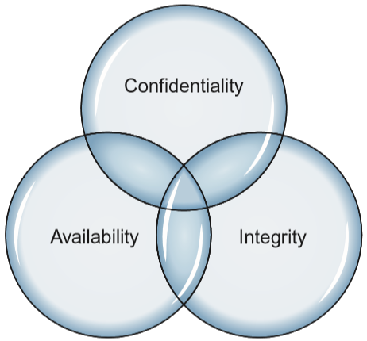
THE CONFIDENTIALITY, INTEGRITY, AND AVAILABILITY TRIAD
Three of the primary concepts in information security are Confidentiality, Integrity, and Availability

Slide 14
WHEN IS ANY SYSTEM SECURE?
Confidentiality: computer-related assets are accessed only by authorized parties. Confidentiality is sometimes called secrecy or privacy
Integrity: assets can be modified only by authorized parties or only in authorized ways
Availability: assets are accessible to authorized parties at appropriate times.

Slide 15
CONFIDENTIALITY
It is not trivial to ensure confidentiality.
For example,
Who determines which people or systems are authorized to access the current system?
By "accessing" data, do we mean that an authorized party can access a single bit? pieces of data out of context?
Can someone who is authorized disclose those data to other parties?

Slide 16
INTEGRITY
It is much harder to ensure integrity. One reason is that integrity means different things in different context
For example, if we say that we have preserved the integrity of an item, we may mean that the item is:
precise
accurate
unmodified
modified only in acceptable ways
modified only by authorized people and processes
consistent

Slide 17
AVAILABILITY
Availability applies both to data and to services (i.e., to information and to information processing).
We say a data item, service, or system is available if
There is a timely response to our request
There is a fair allocation of resources, so that some requesters are not favored over others

Slide 18
AVAILABILITY
The service or system involved are fault tolerant - hardware or software faults lead to graceful cessation of service or to work-a rounds rather than to crashes and abrupt loss of information.
The service or system can be used easily and in the way it was intended to be used

Slide 19
Explain Parkerian hexad in detail using it’s diagram

Slide 20
CRITICAL CHARACTERISTICS OF INFORMATION
The value of information comes from the characteristics it possesses:
Timeliness
No value if it is too late
Availability
No interference or obstruction
Required format
Accuracy
Free from mistakes
Authenticity
Quality or state of being genuine, i.e., sender of an email
Confidentiality
Disclosure or exposure to unauthorized individuals or system is prevented
Notes:
Critical Characteristics Of Information
The value of information comes from the characteristics it possesses.
Availability - enables users who need to access information to do so without interference or obstruction and in the required format. The information is said to be available to an authorized user when and where needed and in the correct format.
Accuracy- free from mistake or error and having the value that the end-user expects. If information contains a value different from the user’s expectations due to the intentional or unintentional modification of its content, it is no longer accurate.
Authenticity - the quality or state of being genuine or original, rather than a reproduction or fabrication. Information is authentic when it is the information that was originally created, placed, stored, or transferred.
Confidentiality - the quality or state of preventing disclosure or exposure to unauthorized individuals or systems.
Integrity - the quality or state of being whole, complete, and uncorrupted. The integrity of information is threatened when the information is exposed to corruption, damage, destruction, or other disruption of its authentic state.
Utility - the quality or state of having value for some purpose or end. Information has value when it serves a particular purpose. This means that if information is available, but not in a format meaningful to the end-user, it is not useful.
Possession - the quality or state of having ownership or control of some object or item. Information is said to be in possession if one obtains it, independent of format or other characteristic. While a breach of confidentiality always results in a breach of possession, a breach of possession does not always result in a breach of confidentiality.

Slide 21
CRITICAL CHARACTERISTICS OF INFORMATION
Integrity
Whole, completed, uncorrupted
Cornerstone
Size of the file, hash values, error-correcting codes, retransmission
Utility
Having value for some purpose
Possession
Ownership
Breach of confidentiality results in the breach of possession, not the reverse

Slide 22
COMPONENTS OF AN INFORMATION SYSTEM
Information System (IS) is entire set of software, hardware, data, people, procedures, and networks necessary to use information as a resource in the organization.
Software
Perhaps most difficult to secure
Easy target
Exploitation substantial portion of attacks on information
Hardware
Physical security policies
Securing physical location important
Laptops
Flash memory

Slide 23
COMPONENTS OF AN INFORMATION SYSTEM
Data
Often most valuable asset
Main target of intentional attacks
People
Weakest link
Social engineering
Must be well trained and informed
Procedures
Threat to integrity of data
Networks
Locks and keys won’t work

Slide 24
THREATS, VULNERABILITIES AND CONTROLS
Threats: Something that can potentially cause damage to information assets.
Vulnerabilities: A weakness in the organization, computer system, or network that can be exploited by threat.
Control: an action, device, procedure, or technique that remove or reduce a vulnerabilities.

Slide 25
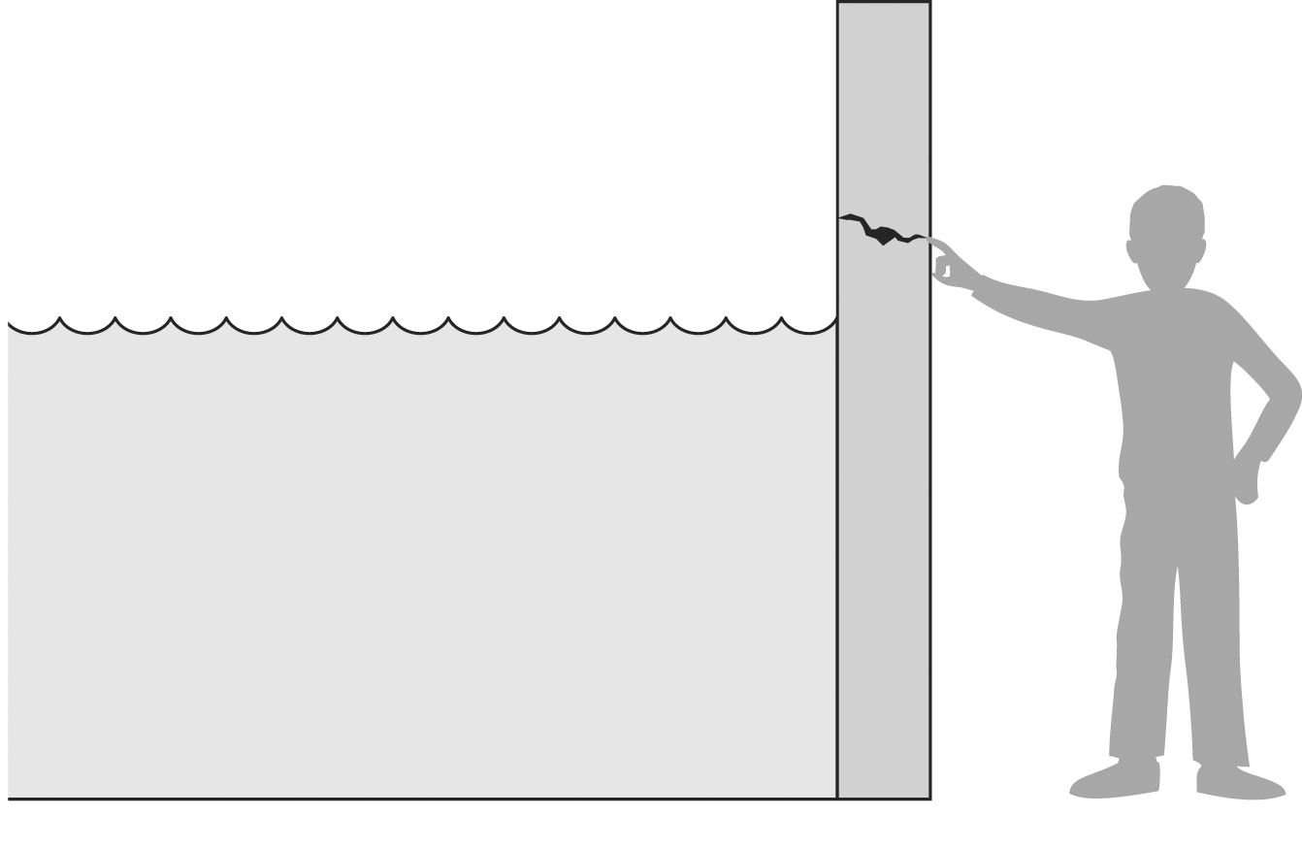
THREATS, VULNERABILITIES AND CONTROLS
A threat is blocked by control of a vulnerability

Slide 26
THREATS
Definition: Something that can potentially cause damage to information assets.
A malicious attacker must have three things:
Method: the skills, knowledge, tools, and other things with which to be able to pull off the attack.
Opportunity: the time and the access to accomplish the attack.
Motive: a reason to want to perform this attack against this system.

Slide 27
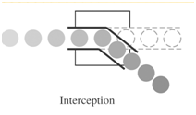
THREATS: TYPES
Interception: some unauthorized party has gained access to an asset, the outside party can be a person, a program, or computing system.
Example: illicit copying of program or data files, or wiretapping to obtain data in a network
~ an attack on confidentiality

Slide 28
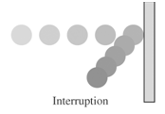
THREATS: TYPES
Interruption: an asset of the system becomes lost, unavailable, or unusable.
Example: malicious destruction of a hardware device, erasure of a program or data file, denial of service attacks
~ an attack on availability

Slide 29
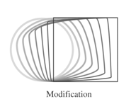
THREATS: TYPES
Modification: alteration the values in a database, or programs to perform additional computation, or modify data being transmitted electronically.
Example: someone might change the values in a database, alter a program so that it performs an additional computation
~ an attack on integrity

Slide 30
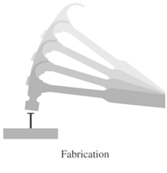
THREATS: TYPES
Fabrication: An unauthorized party might create a fabrication of counterfeit objects on a computing system.
Example: the intruder may insert spurious transactions to a network communication system, or add records to an existing database
~ an attack on authenticity

Slide 31
VULNERABILITIES
Definition: A weakness in the organization, computer system, or network that can be exploited by threat.
Examples:
Security policy is not set.
Roles and responsibilities are vague(unclear).
Security training of employees are inadequate (insufficient).
Building entrance are not checked thoroughly.
There is not protection against computer viruses.
A software bug exists in the server OS.
No password rules are set.
Confidential data are sent over the network.

Slide 32
CONTROLS
Definition: an action, device, procedure, or technique that remove or reduce a vulnerabilities.
Harm occurs when a threat is realized against a vulnerability. To protect against harm, we can neutralize the threat, close the vulnerability, or both.
The possibility for harm to occur is called risk

Slide 33
Controls: Methods of Defense
SOFTWARE/HARDWARE CONTROLS
ENCRYPTION
Encryption provides
~ confidentiality for data
~ integrity
~ basis for protocol
S/W controls:
~ Internal program ctrls
~ Operating system ctrls
~ Development ctrls
H/W controls:
~ h/w devices :
- smartcard (encryption)
- circuit board ctrl disk
drives in PCs
METHODS OF
DEFENSE
POLICIES
~ frequent changes
of password
~ training
~ codes of ethics
PHYSICAL CONTROLS
~ locks of doors
~ backup copies of important s/w and data
~ physical site planning (reduce natural disasters)

Slide 34
TERMINOLOGIES

Slide 35
RISK
Risk is the likelihood that something bad will happen.
In order for us to have a risk in a particular environment, we need to have both a threat and a vulnerability that the specific threat can exploit.

Slide 36
RISK MANAGEMENT
In order to compensate for risks that occur in our environment, the risk management process is very important to implement and follow.
This program must be managed at the senior leader level of the organization and implemented by everyone (not just the technical staff).
At a high level, we need to
identify our important assets
identify the potential threats against them
assess the vulnerabilities that we have present
steps to mitigate these risks.

Slide 37
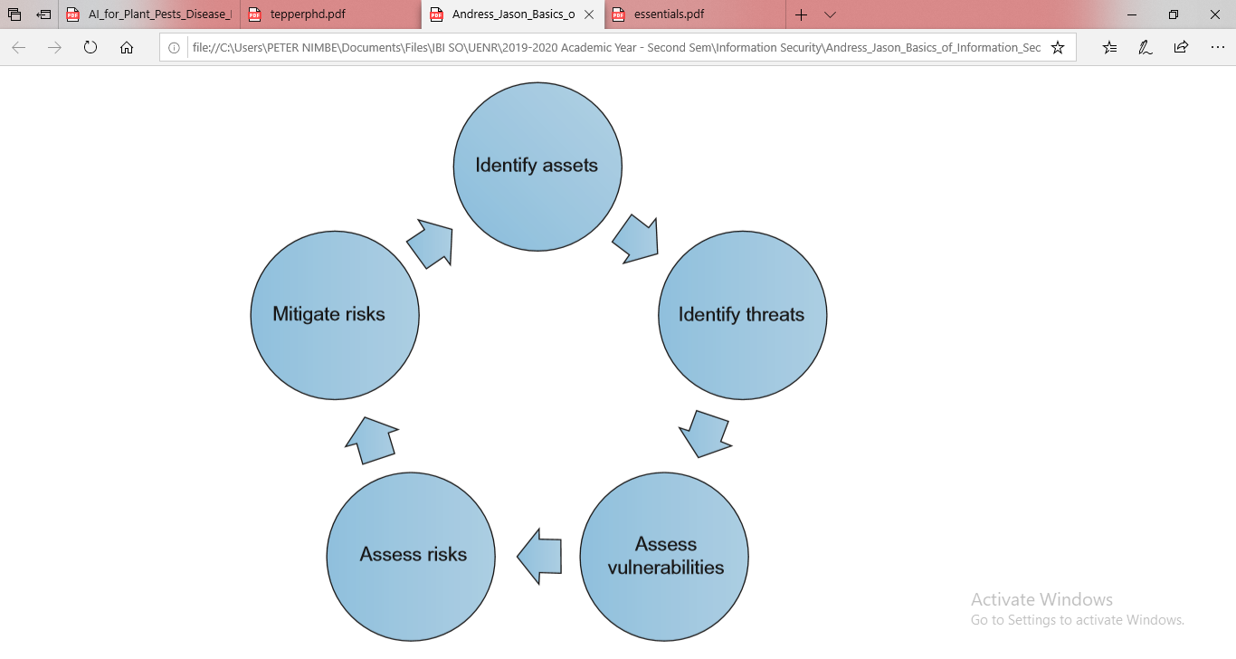
THE RISK MANAGEMENT PROCESS

Slide 38
IDENTIFY ASSETS
One of the first and, arguably, one of the most important parts of the risk management process is identifying and categorizing the assets that we are protecting.
If we cannot enumerate the assets that we have and evaluate the importance of each of them, protecting them can become a very difficult task indeed.
Although this may sound like an exceedingly simple task, in actuality in can be somewhat more complex a problem than it might seem to be on the surface.
Particularly in larger enterprises, merely producing a list of all of the assets with which we are concerned may be troublesome.

Slide 39
IDENTIFY THREATS
Once we have enumerated our critical assets, we can then begin to identify the threats that might affect them.
It is often useful to have a framework within which to discuss the nature of a given threat, and the CIA triad or Parkerian hexad that we discussed earlier serve nicely for this purpose.

Slide 40
ASSESS VULNERABILITIES
When we look at assess vulnerabilities, we need to do so in the context of potential threats.
Any given asset may have thousands or millions of threats that could impact it, but only a small fraction of these will actually be relevant.
The issue of identifying these is narrowed considerably by looking at potential threats first, as we discussed in the previous section.

Slide 41
ASSESS RISKS
Once we have identified the threats and vulnerabilities for a given asset, we can assess the overall risk.
As we discussed earlier, risk is the conjunction of a threat and a vulnerability.
A vulnerability with no matching threat or a threat with no matching vulnerability do not constitute a risk. For example, we looked at the following item as both a potential threat and an area of vulnerability:

Slide 42
ASSESS RISKS
Availability- If the system or application goes down, we cannot process payments. We do not have redundancy for the database on the back-end of our payment processing system.
In this case, we do have both a threat and a vulnerability that coincide, with the resulting risk being the loss of ability to process credit card payments due to a single point of failure on our database back-end.
Once we work through our threats and vulnerabilities in this manner, we can then proceed toward mitigating these risks.

Slide 43
MITIGATING RISKS
In order to help us mitigate risk, we can put measures in place to help ensure that a given type of threat is accounted for.
These measures are referred to as controls.
Controls are divided into three categories:
Physical
logical, and
administrative.

Slide 44
PHYSICAL
Physical controls are those controls that protect the physical environment in which our systems sit, or where our data is stored.
Such controls also control access in and out of such environments. Physical controls logically include items such as fences, gates, locks, bollards, guards, and cameras, but also include systems that maintain the physical environment such as heating and air-conditioning systems, fire suppression systems, and backup power generators.
Physical controls may not seem like they would be integral to information security, they are actually one of the more critical controls with which we need to be concerned

Slide 45
LOGICAL AND TECHNICAL CONTROLS
Logical controls, sometimes called technical controls, are those that protect the systems, networks, and environments that process, transmit, and store our data.
Logical controls can include items such as passwords, encryption, logical access controls, firewalls, and intrusion detection systems.
Logical controls enable us, in a logical sense, to prevent unauthorized activities from taking place.

Slide 46
ADMINISTRATIVE
Administrative controls are based on rules, laws, policies, procedures, guidelines, and other items that are “paper” in nature.
In essence, administrative controls set out the rules for how we expect the users of our environment to behave.
Depending on the environment and control in question, administrative controls can represent differing levels of authority.

Slide 47
ADMINISTRATIVE
We may have a simple rule such as “turn the coffee pot off at the end of the day,” aimed at ensuring that we do not cause a physical security problem by burning our building down at night.
We may also have a more stringent administrative control, such as one that requires us to change our password every 90 days.

Slide 48
INCIDENT RESPONSE
In the event that our risk management efforts fail, incident response exists to react to such events.
Incident response should be primarily oriented to the items that we feel are likely to cause us pain as an organization, which we should now know based on our risk management efforts.
Reaction to such incidents should be based, as much as is possible or practical, on documented incident response plans, which are regularly reviewed, tested, and practiced by those who will be expected to enact them in the case of an actual incident.

Slide 49
INCIDENT RESPONSE
The actual occurrence of such an emergency is not the time to (attempt to) follow documentation that has been languishing on a shelf, is outdated, and refers to processes or systems that have changed heavily or no longer exists.
The incident response process, at a high level, consists of:
Preparation
Detection and analysis
Containment
Eradication
Recovery
Post incident activity

Slide 50
Preparation
The preparation phase of incident response consists of all of the activities that we can perform, in advance of the incident itself, in order to better enable us to handle it.
This typically involves having the policies and procedures that govern incident response and handling in place, conducting training and education for both incident handlers and those who are expected to report incidents, conducting incident response exercises, developing and maintaining documentation, and numerous other such activities.
Without adequate preparation, it is extremely unlikely that response to an incident will go well and/or in the direction that we expect it to go.
The time determines what needs to be done, who needs to do it, and how to do it, is not when we are faced with a burning emergency.

Slide 51
Detection Analysis
The detection and analysis phase is where the action begins to happen in our incident response process.
In this phase, we will detect the occurrence of an issue and decide whether or not it is actually an incident so that we can respond to it appropriately.
The detection portion of this phase will often be the result of monitoring of or alerting based on the output of a security tool or service.
This may be output from an Intrusion Detection System (IDS), Anti Virus (AV) software, firewall logs, proxy logs, alerting from a Security Information and Event Monitoring (SIEM) tool if program is internal or Managed Security Service Provider (MSSP) if program is external, or any of a number of similar sources.
The analysis portion of this phase is often a combination of automation from a tool or service, usually an SIEM, and human judgment.

Slide 52
Detection Analysis
While we can often use some sort of thresholding to say that X number of events in a given amount of time is normal or that a certain combination of events is not normal (two failed logins followed by a success, followed by a password change, followed by the creation of a new account, for instance), we will often want human intervention at a certain point when discussing incident response.
Such human intervention will often involve review of logs output by various security, network, and infrastructure devices, contact with the party that reported the incident, and general evaluation of the situation.
This can be expensive if you’re running a team of analysts 243 7 so automation of as many functions as possible is key.
When the incident handler evaluates the situation, they will make a determination regarding whether the issue constitutes an incident or not, an initial evaluation as to the criticality of the incident (if any), and contact any additional resources needed to proceed to the next phase.

Slide 53
Containment, eradication and, recovery
The containment, eradication, and recovery phase is where the majority of the work takes place to actually solve the incident, at least in the short term.

Slide 54
Containment, eradication and, recovery
Containment involves taking steps to ensure that the situation does not cause any more damage than it already has, or to at least lessen any ongoing harm.
If the problem involves a malware infected server actively being controlled by a remote attacker, this might mean disconnecting the server from the network, putting firewall rules in place to block the attacker, and updating signatures or rules on an Intrusion Prevention System (IPS) in order to halt the traffic from the malware.
During eradication, we will attempt to remove the effects of the issue from our environment.
In the case of our malware infected server, we have already isolated the system and cut it off from its command and control network.
Now we will need to remove the malware from the server and ensure that it does not exist elsewhere in our environment.
This might involve additional scanning of other hosts in the environment to ensure that the malware is not present, and examination of logs on the server and activities from the attacking devices on the network in order to determine what other systems the infected server had been in communication with.
With malware, particularly very new malware or variants, this can be a tricky task to ensure that we have properly completed.

Slide 55
Containment, eradication and, recovery
The adversary is constantly developing countermeasures to the most current security tools and methodologies.
Whenever doubt exists as to whether malware or attackers have been truly evicted from our environment, we should err to the side of caution while balancing the impact to operations.
Each event requires a risk assessment.
Lastly, we need to recover to a better state that were in which we were prior to the incident, or perhaps prior to the issue started if we did not detect the problem immediately.
This would potentially involve restoring devices or data from backup media, rebuilding systems, reloading applications, or any of a number of similar activities. Additionally we need to mitigate the attack vector that was used.
Again, this can be a more painful task than it initially sounds to be, based on potentially incomplete or unclear knowledge of the situation surrounding the incident and what exactly did take place.
We may find that we are unable to verify that backup media is actually clean and free or infection, backup media may be bad entirely, application install bits may be missing, configuration files may not be available, and any of a number of similar issues.

Slide 56
Post Incident activity
Post incident activity, as with preparation, is a phase we can easily overlook, but should ensure that we do not.
In the post incident activity phase, often referred to as a postmortem (latin for after death), we attempt to determine specifically what happened, why it happened, and what we can do to keep it from happening again.
This is not just a technical review as policies or infrastructure may need to be changed.
The purpose of this phase is not to point fingers or place blame (although this does sometimes happen), but to ultimately prevent or lessen the impact of future such incidents.

Slide 57
Defense in depth
Defense in depth is a strategy common to both military maneuvers and information security.
In both senses, the basic concept of defense in depth is to formulate a multilayered defense that will allow us to still achieve a successful defense should one or more of our defensive measures fail.
In defense in depth diagram, we can see an example of the layers we might want to put in place to defend our assets from a logical perspective; we would at the very least want defenses at the external network, internal network, host, application, and data levels.
Given well-implemented defenses at each layer, we will make it very difficult to successfully penetrate deeply into our network and attack our assets directly.
One important concept to note when planning a defensive strategy using defense in depth is that it is not a magic bullet.
No matter how many layers we put in place, or how many defensive measures we place at each layer, we will not be able to keep every attacker out for an indefinite period of time, nor is this the ultimate goal of defense in depth in an information security setting.

Slide 58
Defense in depth
The goal is to place enough defensive measures between our truly important assets and the attacker so that we will both notice that an attack is in progress and also buy ourselves enough time to take more active measures to prevent the attack from succeeding.
We can see exactly such a strategy in the theater release of the Batman movie, The Dark Knight, in 2008.
The production company for the movie, Warner Bros., spent 6 months developing a multilayered defensive strategy to keep the movie from being pirated and placed on file-sharing networks for as long as possible.
These measures included a tracking system to monitor who had access to copies of the movie at any given time, shipping the film reels in multiple parts separately to theaters in order to keep the entire movie from being stolen in shipping, monitoring movie theaters with night-vision equipment to watch for those attempting to record the movie in the theater, and other measures.
Even with all the time and resources spent to prevent piracy of the movie, it was found on a file-sharing network 38 h after it was released.
For Warner Bros., this was considered a success, as the company was able to prevent the movie from being pirated for a long enough period that opening weekend sales were not significantly impacted.

Slide 59
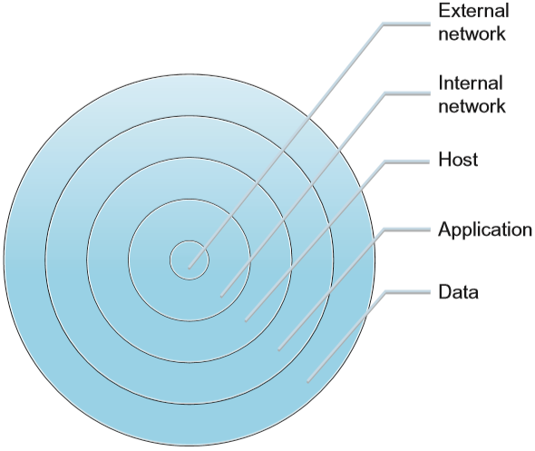
Defense in depth

Slide 60
Layers
When we look at the layers we might place in our defense in depth strategy, we will likely find that they vary given the particular situation and environment we are defending.
As we discussed, from a strictly logical information security perspective, we would want to look at the external network, network perimeter, internal network, host, application, and data layers as areas to place our defenses.
We could add complexity to our defensive model by including other vital layers such as physical defenses, policies, user awareness and training, and a multitude of others, but we will stay with a simpler example for the time being.
As we progress through the book, we will return to the concept of defense in depth as we discuss security for more specific areas.

Slide 61
Layers
As we can see in the figure in the next slide, some of the defenses we might use for each of the layers we discussed are listed.
In some cases, we see a defensive measure listed in multiple layers, as it applies in more than one area.
Just like the military has reconnaissance forces watching the front lines, they still have local patrols around the headquarters.
As we move through the book, we will discuss each of these areas in greater detail, and the specific defenses we might want to use for each.

Slide 62
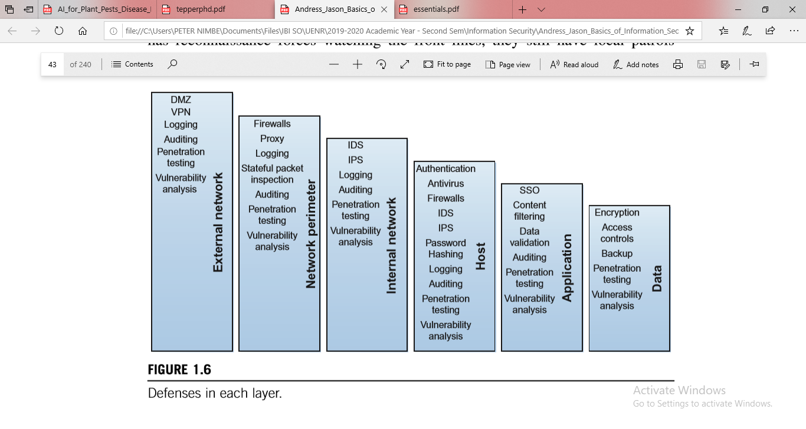
Defenses in each layer

Slide 63
Information security in the real world
The concepts we discussed in this chapter are foundational to information security and are used on a regular basis in the course of normal information security tasks in many organizations.
We will often find that security incidents are described in terms of their effects, such as breaches of confidentiality, or the authenticity of a given e-mail message.
Information security is a daily concern for organizations of any size, particularly those that handle any type of personal information, financial data, health-care data, educational data, or other types of data that are regulated by the laws of the country in which they operate.
In the case of an organization that does not take the time to properly put itself on a good footing as relates to information security, the repercussions can be severe in the sense of reputational impact, fines, lawsuits, or even the inability to continue conducting business if critical data is irretrievably lost.
In short, information security is a key component of the modern business world.

Slide 64
Summary
Information security is a vital component to the era in which data regarding countless individuals and organizations is stored in a variety of computer systems, often not under our direct control.
When discussing information security in a general sense, it is important to remember that security and productivity are often diametrically opposing concepts, and that being able to point out exactly when we are secure is a difficult task.
When discussing information security issues or situations, it is helpful to have a model by which to do so.
Two potential models are the CIA triad, composed of confidentiality, integrity, and availability, and the Parkerian hexad, composed of confidentiality, integrity, availability, possession or control, authenticity, and utility.
When we look at the threats we might face, it is important to understand the concept of risk.

Slide 65
Summary
When we look at the threats we might face, it is important to understand the concept of risk.
We only face risk from an attack when a threat is present and we have a vulnerability which that particular threat can exploit.
In order to mitigate risk, we use three main types of controls: physical, logical, and administrative.
Defense in depth is a particularly important concept in the world of information security.
To build defensive measures using this concept, we put in place multiple layers of defense, each giving us an additional layer of protection.
The idea behind defense in depth is not to keep an attacker out permanently but to delay him long enough to alert us to the attack and to allow us to mount a more active defense.

Slide 66
QUIZ 1
Phincolin Associates Limited’s email and file servers were encrypted in a ransomware attack.
Which element of the CIA triad is most affected?
What immediate steps would you take to restore and prevent the element in (i) for future incidents?

Slide 67
EXERCISES
6. Using the concept of defense in depth, what layers might we use to secure ourselves against someone removing confidential data from our office on a USB flash drive?
7. Based on the Parkerian hexad, what principles are affected if we lose a shipment of encrypted backup tapes that contain personal and payment information for our customers?
8. If the Web servers in our environment are based on Microsoft’s Internet Information Server (IIS) and a new worm is discovered that attacks Apache Web servers, what do we not have?
9. If we develop a new policy for our environment that requires us to use complex and automatically generated passwords that are unique to each system and are a minimum of 30 characters in length, such as !Hs4(j0qO$&zn1%2SK38cn^!Ks620!, what will be adversely impacted?
10. Considering the CIA triad and the Parkerian hexad, what are the advantages and disadvantages of each model?

