Slide 1

INFT 308: Information Security
Department of Information Technology and Decision Sciences
July, 2021

Slide 2
Identification and Authentication
2

Slide 3
QUIZ 1
An online retail business is facing increasing cyber threats, including DDoS attacks and phishing attempts. The company needs to identify these threats and implement appropriate controls.
Identify at least three major threats to the online retail business.
For each threat, describe the potential vulnerabilities that could be exploited.
Propose specific controls to mitigate each threat and explain how these controls would be implemented and monitored.

Slide 4
INTRODUCTION
When we are developing security measures, whether on the scale of a specific mechanism or an entire infrastructure, Identification and Authentication are likely to be key concepts.
Identification is the claim of what someone or some thing is.
Authentication establishes whether this claim is true.

Slide 5
INTRODUCTION
Example of an identification and authentication transaction
Use of payment cards that require a Personal Identification Number (PIN).
When we swipe the magnetic strip on the card, we are asserting that we are the person indicated on the card.

Slide 6
INTRODUCTION
At this point, we have given the identification but nothing more.
When we are prompted to enter the PIN associated with the card, we are completing the authentication portion of the transaction.
Some of the identification and authentication methods are fragile and depend largely on the honesty and diligence of those involved in the transaction.

Slide 7
INTRODUCTION
We can use a number of methods for identification and authentication, from the simple use of usernames and passwords, to purpose-built hardware tokens that serve to establish our identity in multiple ways.

Slide 8
IDENTIFICATION
Identification is simply an assertion of who we are.
This may include
who we claim to be as a person.
who a computer system claims to be over the network.
who the originating party of an e-mail claims to be.
what authority we claim to have, or similar transactions.

Slide 9
Who we claim to be
Who we claim to be is a tenuous concept, at best.
We can identify ourselves by our
full names
shortened versions of our names
images of ourselves
nicknames
account numbers
usernames
ID cards
fingerprints
DNA samples, and an enormous variety of other methods

Slide 10
Cont…
Unfortunately, with a few exceptions, such methods of identification are not unique, and even some of the supposedly unique methods of identification, such as the fingerprint, can be duplicated or spoofed in many cases.
Who we claim to be can, in many cases, be an item of information that is subject to change.
For instance, our names can change, as in the case of women who change their last name upon getting married, people who legally change their name to an entirely different name, or even people who simply elect to use a different name.

Slide 11
Cont…
In addition, we can generally change logical forms of identification very easily, as in the case of usernames and the like.
Even physical identifiers, such as height, weight, skin color, and eye color, can be changed.
One of the most crucial factors to realize when we are working with identification is that an invalidated claim of identity is not reliable information on its own.

Slide 12
Write short notes on Identity verification

Slide 13
FALSIFYING IDENTIFICATION
Methods of identification are subject to change as such they are also subject to falsification.
While many drivers’ licenses now have holograms or barcodes that make them harder to counterfeit, there is an underground industry that allows underage kids in America to buy very valid looking licenses from overseas companies.
falsified means of identification are also used by criminals and terrorists for a variety of tasks of a nefarious nature.

Slide 14
AUTHENTICATION
Authentication is, in an information security sense, the set of methods we use to establish a claim of identity as being true.
It is important to note that authentication only establishes whether the claim of identity that has been made is correct.
Authentication does not infer or imply anything about what the party being authenticated is allowed to do; this is a separate task known as authorization.

Slide 15
FACTORS
In terms of authentication, there are several methods we can use, with each category referred to as a factor.
When we are attempting to authenticate a claim of identity, the more factors we use, the more positive our results will be.
The different factors are
something you know (password)
something you are (Iris scan, fingerprints, etc)
something you have (swipe card)
something you do (gait (walking) recognition), and
the place you are (at a specific terminal).

Slide 16
FACTORS
Something you know is a very common authentication factor.
This can include
passwords
PINs
passphrases, or most any item of information that a person can remember.
We can see a very common implementation of this in the passwords we use to log in to our accounts on computers.
This is somewhat of a weak factor because if the information the factor depends on is exposed, this can nullify the uniqueness of our authentication method.

Slide 17
FACTORS
Something you are is a factor based on the relatively unique physical attributes of an individual, often referred to as biometrics.
This factor can be based on simple attributes, such as height, weight, hair color, or eye color, but these do not tend to be unique enough to make very secure identifiers.
More commonly used are more complex identifiers such as fingerprints, iris or retina patterns, or facial characteristics. These factor is a bit stronger, as forging or stealing a copy of a physical identifier is a somewhat more difficult, although not impossible, task.
There is some question as to whether biometrics truly is an authentication factor or whether it really only constitutes verification.

Slide 18
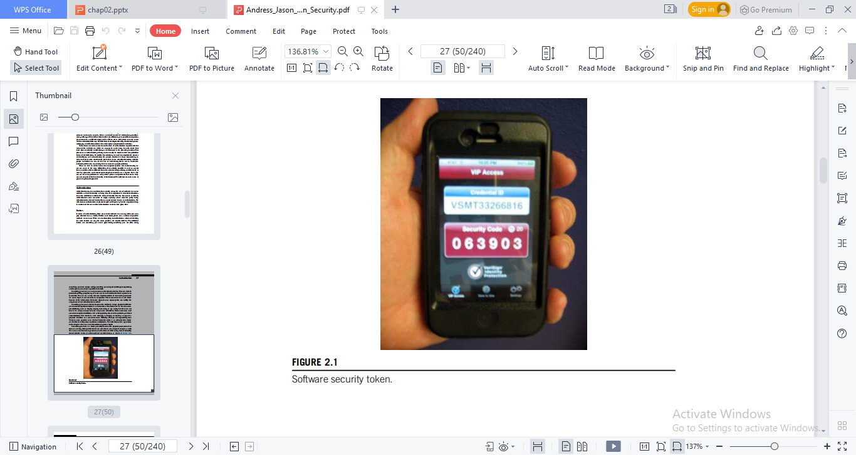
FACTORS
Something you have is a factor generally based on the physical possession of an item or a device, although this factor can extend into some logical concepts as well.
We can see such factors in general use in the form of ATM cards, state or federally issued identity cards, or software-based security tokens, as shown in the figure.

Slide 19
FACTORS
Some institutions, such as banks, have begun to use access to logical devices such as cell phones or e-mail accounts as methods of authentication as well.
This factor can vary in strength depending on the implementation.
In the case of a security token, we would actually need to steal a specific device in order to falsify the authentication method.
In the case of access to an e-mail address being used as this type of factor, we have a measure of considerably less strength.

Slide 20
FACTORS
Something you do, sometimes considered a variation of something you are, is a factor based on the actions or behaviors of an individual.
Such factors may include analysis of the individual’s gait, measurement of multiple factors in his or her handwriting, the time delay between keystrokes as he or she types a passphrase, or similar factors.
These factors present a very strong method of authentication and are very difficult to falsify or create false positive.
They do, however, have the potential to create false negative and incorrectly reject legitimate users at a higher rate than some of the other factors, resulting in denials for some users that should actually be authenticated.

Slide 21
FACTORS
Where you are is a geographically based authentication factor.
This factor operates differently than the other factors, as its method of authentication depends on the person being authenticated as being physically present at a particular location or locations.
The most common implementation of this is for servers to only be accessible from a terminal in the server room.
This factor, although potentially of less utility than some of the other factors, is very difficult to counter without entirely subverting the system performing the authentication or gaining physical access.

Slide 22
MULTIFACTOR AUTHENTICATION
Multifactor authentication uses one or more of the factors we discussed in the preceding section. This practice is also referred to as Two-factor Authentication when we are using only two factors, but multifactor authentication encompasses this term as well.
We can see a common example of multifactor authentication in using an ATM. In this case, we have something we know, our PIN, and something we have, our ATM card.
Our ATM card does double duty as both a factor for authentication and a form of identification

Slide 23
MULTIFACTOR AUTHENTICATION
We can see a similar example in writing checks that draw on a bank account—in this case, something we have, the checks themselves, and something we do, applying our signature to them. Here, the two factors involved in writing a check are rather weak, so we sometimes see a third factor, a fingerprint, applied to them.
We could also argue that the signature and fingerprint are, in this case, not actually authentication, but rather verification, a much less robust process that we discussed when talking about identity earlier.
Depending on the particular factors selected, we can assemble stronger or weaker multifactor authentication schemes in a given situation.

Slide 24
MULTIFACTOR AUTHENTICATION
For example, DNA makes for a very strong method of authentication but is not practical for regular use.
As we earlier, when discussing security, we need to be careful to build security that is reasonably proportionate to what we are protecting.
We could install iris scanners on every credit card terminal instead of having the customer sign his credit card receipt and certainly enhance our security, but this would be expensive, slow down transactions causing delays, and could upset our customers who don’t trust the technology.

Slide 25
THANK YOU

