Slide 1

INFT 308: INFORMATION SECURITY
DEPARTMENT OF INFORMATION TECHNOLOGY AND DECISION SCIENCES

Slide 2
CRYPTOGRAPHY
4

Slide 3
INTRODUCTION
The use of cryptography is an integral part of computing, networking, and the vast set of transactions that take place over such devices on a daily basis.
We depend on cryptography when we have conversations on our cell phones, check our e-mail, buy things from online retailers, file our taxes, and do other activities.
The chief security measure that allows us to make use of such technologies is cryptography—in the form of encryption.

Slide 4
INTRODUCTION
Cryptography is the science of keeping information secure (secure, in this case, in the sense of confidentiality and integrity.
Cryptography is also commonly and interchangeably referred to as encryption.
Encryption itself is actually a subset of cryptography, referring specifically to the transformation of unencrypted data, called plaintext or cleartext, into its encrypted form, called ciphertext.

Slide 5
TERMINOLOGIES
Encryption referring to the transformation of unencrypted data, called plaintext or cleartext, into its encrypted form, called ciphertext.
Decryption is the process of recovering the plaintext message from the ciphertext.
The plaintext and ciphertext may also be generically referred to as the message.

Slide 6
TERMINOLOGIES
The science of breaking through the encryption used to create the ciphertext is referred to as cryptanalysis.
The overarching field of study that covers cryptography and cryptanalysis is referred to as cryptology.

Slide 7
TERMINOLOGIES
The specifics of the process used to encrypt the plaintext or decrypt the ciphertext is referred to as a cryptographic algorithm.
Cryptographic algorithms generally use a key, or multiple keys, in order to encrypt or decrypt the message, this being roughly analogous to a password.

Slide 8
TERMINOLOGIES
The range of all possible values for the key is referred to as the keyspace.
The larger the keyspace, the harder it is to decrypt the message.
Cryptosystem is a concept that covers a given algorithm and all possible keys, plaintexts, and ciphertexts.

Slide 9
ASSIGNMENT
The history of cryptography and Modern cryptographic tools

Slide 10
CAESAR CIPHER
The Caesar cipher is a classic example of ancient cryptography and is said to have been used by Julius Caesar.
The Caesar cipher is based on transposition and involves shifting each letter of the plaintext message by a certain number of letters, historically three.
The ciphertext can be decrypted by applying the same number of shifts in the opposite direction. This type of encryption is known as a substitution cipher, due to the substitution of one letter for another in a consistent fashion.

Slide 11
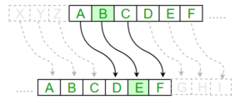
CAESAR CIPHER

Slide 12
QUESTIONS
Above we saw that "CAESAR" becomes "RPTHPG" using a key P. Can you find a key that will turn "RPTHPG" back into "CAESAR"?
2. A plaintext was encrypted with a Caesar cipher, resulting in the following:
DOOV ZHOO WKDW HQGV ZHOO
work out what the plaintext was?

Slide 13
QUESTION
You are provided with the ciphertext ZKDWH LV D PHVVDJH LQ FLSKHU WHAW. Assume the message is in English.
Determine the shift key using brute force methods and explain how you identified the key.
Decrypt the message.

Slide 14
KERCKHOFFS’ PRINCIPLE
The system must be substantially, if not mathematically, undecipherable.
The system must not require secrecy and can be stolen by the enemy without causing trouble.
It must be easy to communicate and remember the keys without requiring written notes, and it must be easy to change or modify the keys with different participants.
The system ought to be compatible with telegraph communication.
The system must be portable, and its use must not require more than one person.
Finally, regarding the circumstances in which such system is applied, it must be easy to use and must require neither the stress of mind nor the knowledge of a long series of rules.

Slide 15
SYMMETRIC VERSUS ASYMMETRIC CRYPTOGRAPHY

Slide 16
SYMMETRIC CRYPTOGRAPHY
Symmetric key cryptography, also known as private key cryptography, utilizes a single key for both encryption of the plaintext and decryption of the ciphertext.
The key itself must be shared between the sender and the receiver, and this process, known as key exchange.

Slide 17
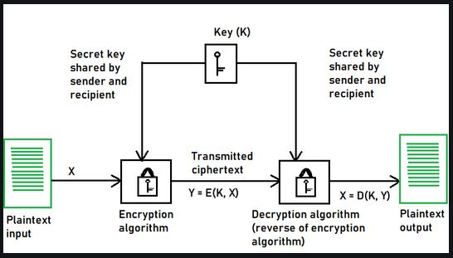
DIAGRAM OF SYMMETRIC ENCRYPTION

Slide 18
SYMMETRIC CRYPTOGRAPHY
One of the chief weaknesses of symmetric key cryptography lies in the use of one key.
If the key is exposed beyond the sender and the receiver, it is possible for an attacker who has managed to intercept it to decrypt the message or, alter it, then encrypt it once more and pass it on to the receiver in place of the original message.
Since such issues are present, symmetric key cryptography by itself provides only confidentiality, and not integrity, as we would not be aware that the message in our example had been altered.

Slide 19
BLOCK AND STREAM CIPHERS
A block cipher takes a predetermined number of bits, known as a block, in the plaintext message and encrypts that block.
Blocks are commonly composed of 64 bits but can be larger or smaller depending on the particular algorithm being used and the various modes in which the algorithm might be capable of operating.
A stream cipher encrypts each bit in the plaintext message, 1 bit at a time. It is also possible for a block cipher to act as a stream cipher by setting a block size of 1 bit.

Slide 20
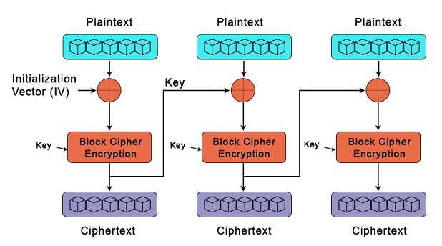
BLOCK CIPHER

Slide 21
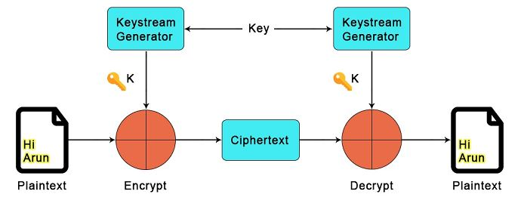
STREAM CIPHER

Slide 22
BLOCK AND STREAM CIPHERS
Block ciphers are often slower than stream ciphers, they tend to be more efficient.
Since block ciphers operate on larger blocks of the message at a time, they do tend to be more resource intensive and are more complex to implement in hardware or software.
Block ciphers are also more sensitive to errors in the encryption process as they are working with more data.

Slide 23
BLOCK AND STREAM CIPHERS
An error in the encryption process of a block cipher may render unusable a larger segment of data than what we would find in a stream cipher, as the stream cipher would only be working with 1 particular bit.
Typically, block ciphers are better for use in situations where the size of the message is fixed or known in advance, such as when we are encrypting a file or have message sizes that are reported in protocol headers.

Slide 24
BLOCK AND STREAM CIPHERS
Stream ciphers are often better for use in situations where we have data of an unknown size or the data is in a continuous stream, such as we might see moving over a network.

Slide 25
ASYMMETRIC CRYPTOGRAPHY
Asymmetric key cryptography, also known as public key cryptography, utilizes two keys: a public key and a private key.
The public key is used to encrypt data sent from the sender to the receiver and is shared with everyone.
Private keys are used to decrypt data that arrives at the receiving end and are very carefully guarded by the receiver.

Slide 26
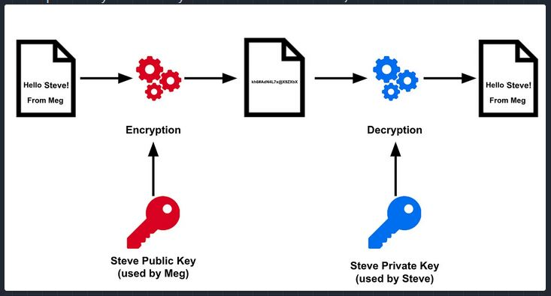
ASYMMETRIC CRYPTOGRAPHY
The main advantage of asymmetric key cryptography over symmetric key cryptography is the loss of the need to distribute the key.

Slide 27
When we use a symmetric algorithm, we need to distribute the key in some way. We might do this by exchanging keys in person, sending a key in e-mail, or repeating it verbally over the phone, but we generally need to communicate the key in an out-of-band manner, meaning that we do not want to send the key with the message, as this would leave our message easily available to an eavesdropper.
When we use asymmetric key cryptography, we have no need to share a single key. We simply make our public key easily available, and anyone who needs to send us an encrypted message makes use of it.

Slide 28
ASYMMETRIC KEY ALGORITHMS
The RSA algorithm, named for its creators Ron Rivest, Adi Shamir, and Leonard Adleman.
Elliptic curve cryptography (ECC)
ECC implemented in a variety of cryptographic algorithms, including Secure Hash Algorithm 2 (SHA-2) and Elliptic Curve Digital Signature Algorithm (ECDSA).
ElGamal, DiffieHellman, and Digital Signature Standard (DSS).

Slide 29
HASH FUNCTIONS
Hash functions, also referred to as message digests, do not use a key, but instead create a largely unique and fixed-length hash value, commonly referred to as a hash, based on the original message, something along the same lines as a fingerprint.
Any slight change to the message will change the hash.

Slide 30
HASH FUNCTIONS
Hashes cannot be used to discover the contents of the original message, or any of its other characteristics, but can be used to determine whether the message has changed.
In this way, hashes provide confidentiality, but not integrity.
The receiver simply hashes the message again using the same algorithm, then compares the two hashes. If the hashes match, the message has not changed. If they do not match, the message has been altered.

Slide 31
DIGITAL SIGNATURES
Digital signatures allow us to sign a message in order to enable detection of changes to the message contents, to ensure that the message was legitimately sent by the expected party, and to prevent the sender from denying that he or she sent the message, known as nonrepudiation.
The sender would then send the digital signature along with the message, usually by appending it to the message itself.

Slide 32
PROTECTING DATA AT REST, IN MOTION, AND IN USE
We can divide practical uses of cryptography into two major categories: protecting data at rest and protecting data in motion.
Protecting data at rest is important because of the large amount of stored data that can be found on devices such as backup tapes, flash drives, and hard drives in portable devices such as laptops.
Protecting data in motion is vital as well because of the enormous amount of business that is conducted over the Internet, including financial transactions, medical information, tax filings, and other similarly sensitive exchanges.

Slide 33
PROTECTING DATA AT REST
Data is generally considered to be at rest when it is on a storage device of some kind and is not moving over a network, through a protocol, and so forth.
Somewhat illogically, data at rest on media can also be in motion; for example, we might ship a load of backup tapes containing sensitive data, carry in our pocket a flash drive containing a copy of our tax forms, or leave in the back seat of our car a laptop containing the contents of a customer database.

Slide 34
PROTECTING DATA AT REST
The primary method we use to protect this type of data is encryption, particularly when we know that the storage media, or the media and the device in which it is contained, will be potentially exposed to physical theft, such as on a backup tape or in a laptop.
Physical security is another important step in protecting data at rest.

Slide 35
PROTECTING DATA IN MOTION
Another major concern to protecting our data comes when it is in motion over a network of some variety. This might be over a closed WAN or LAN, over a wireless network, over the Internet, or in other ways.
The primary method of securing data from exposure on network media is encryption, and we may choose to apply it in one of two main ways: by encrypting the data itself to protect it or by protecting the entire connection.

Slide 36
PROTECTING DATA IN USE
The last category of protecting data involves securing it while it is being used. Although we can use encryption to protect data while it is stored or moving across a network, we are somewhat limited in our ability to protect data while it is being used by those who legitimately have access to it.
Authorized users can print files, move them to other machines or storage devices, e-mail them, share them on peer-to-peer (P2P) file-sharing networks, and generally make a mockery of our carefully laid security measures.

Slide 37
THANK YOU

