Slide 1

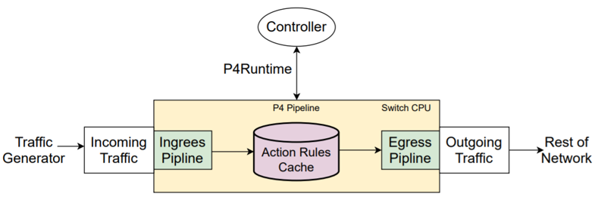
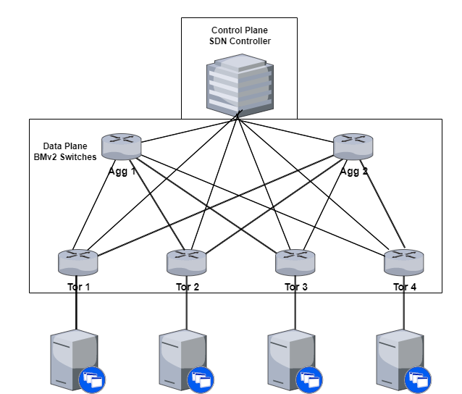
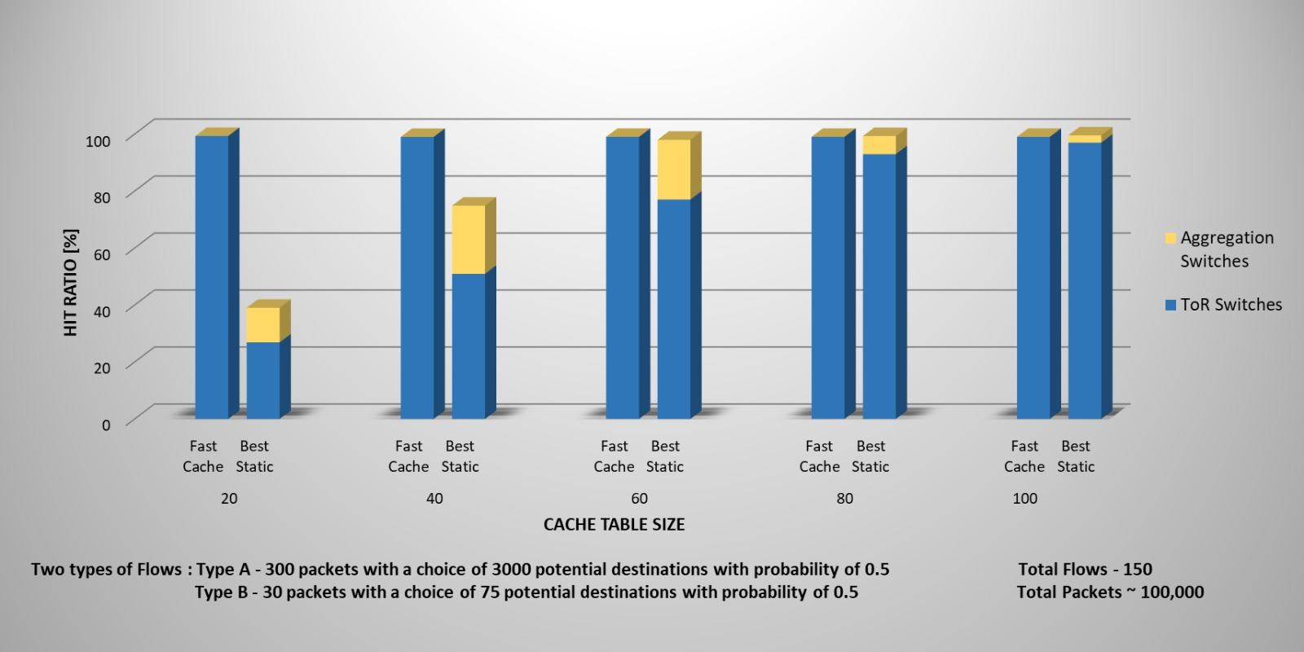



P-2023-035
Faculty of Engineering Sciences
School of Electrical & Computer Engineering
Dynamic Rule Caching in Datacenter Networks
Amit Nisani, Michael Kedik
Advisors: Prof. Avin Chen, Dr. Scalosub Gabriel
Our Method
In modern data centers, the number of network policies often exceeds the memory capacity of the switches.
The implementation of caching mechanisms is necessary to prioritize the storage of policies in switches.
Establishment Of The Environment: By connecting ONOS, Bmv2 switches, and Mininet, we created an integrated experimental environment.
Traffic Generator: With Python and Scapy, we built a traffic generator.
Caching Implementation: In Python, we implemented a caching algorithm on switches. It involves a dynamically adjusting rule table with limited capacity that stores rules for the most common flows.
Background
Emulate a management system for dynamic rule caching mechanisms in data center networks by leveraging an open-source SDN controller
Project Goal
Results
Mininet: Network emulator that creates virtual hosts, switches, controllers, and links.
P4: Domain-specific language for network devices, specifying packet processing in the data plane.
P4runtime: Control plane specification for managing data plane elements of a P4-programmed device.
BMv2 Switch: Software switch deployed on Mininet Switches, enabling control plane management through the data plane using P4Runtime.
ONOS: Open-source SDN controller for next-gen SDN solutions.
Technology
Algorithms
Fast Cache: Insert new policies dynamically, delete the least recently used policy if the cache is full.
Best Static: Insert the largest policies into the cache, with the cache remaining static.
In a fully emulated environment, we showcased the advantages of implementing a management system for dynamic rule caching mechanisms in data center networks
Conclusion

