Slide 1

P4 based Caching-based Acceleration Mechanisms in Datacenter Networks
Project number : p-2022-035
Students : Amit Nisani, Michael Kedik
Supervisors : Prof. Chen Avin, Dr. Gabriel Scalosub

Slide 2
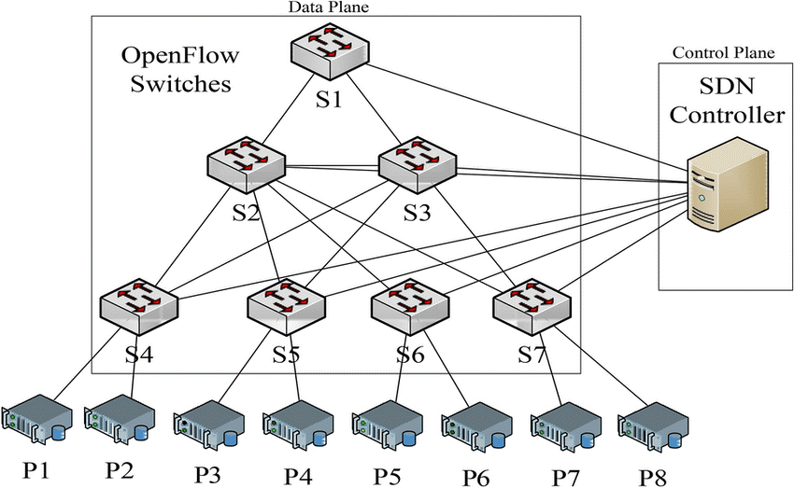
Introduction
The purpose of the project is to find a solution that decreases multiple access to an external device – controller, by using Caching-based Acceleration Mechanisms, to speed up the routing process.

Slide 3
Goals
Establishment of an environment that integrates the use of an SDN controller (ONOS), and bmv2 switches that can be configured using the P4 programming language.
Construction of a traffic generator to simulate network traffic.
Implementation of caching strategies and run experiments with various workloads to evaluate the network's performance with those mechanisms.

Slide 4
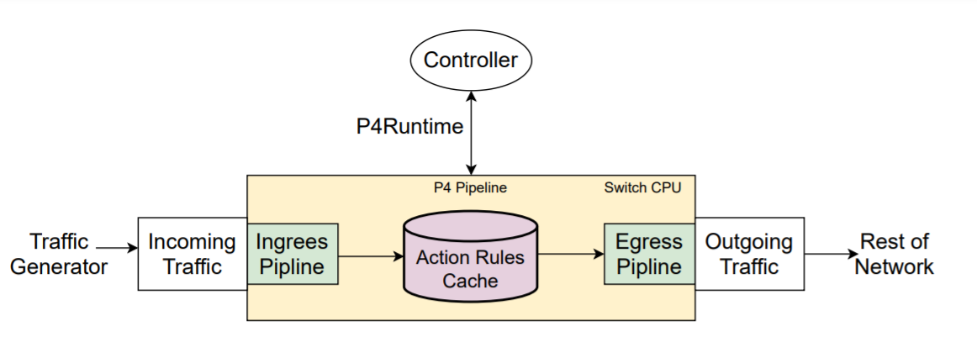
General flow

Slide 5
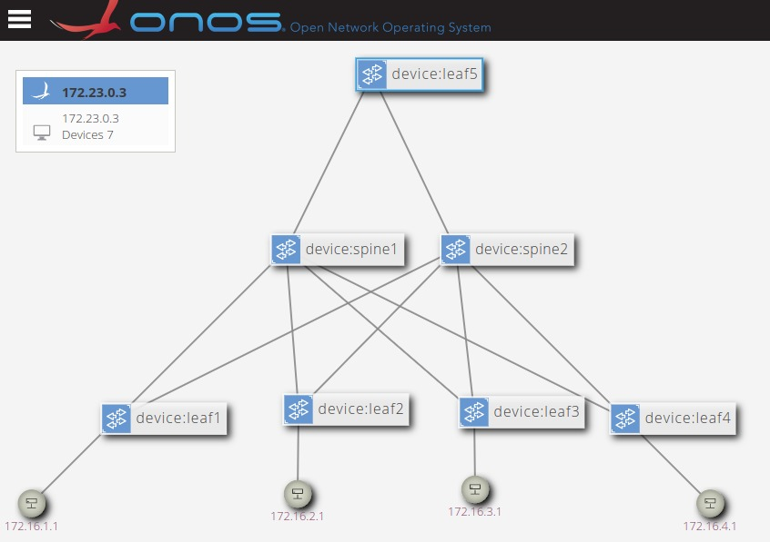
Our System
Topology that resembles data center in which we can conduct our experiments in the second part of the project

Slide 6
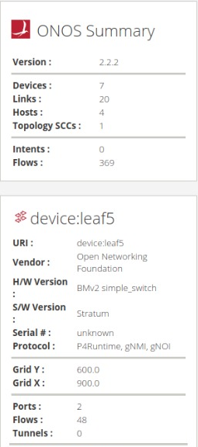
Results So Far
ONOS version : 2.2.2
BMv2 programmable switches
Switches can be configured using the P4 programming language
P4Runtime protocol

Slide 7
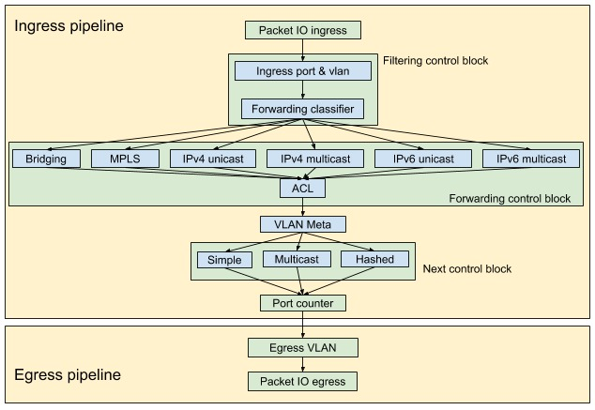
Current Stage
Comprehending the package progression process in the ONOS pipeline, from input to output, in order to construct a traffic generator to simulate network traffic.

Slide 8
Future Work
Implement both push and pull caching algorithms.
The pull algorithm allows each switch to identify frequently used rules and request them from the controller, which is then inserted into its caching table.
The push algorithm allows the controller to identify frequently used rules and insert them directly into the relevant switch's caching table.

Slide 9
Time Frames
Month | March | April | May | June
Timeframe | End of exam period | Spring Semester
Mandatory Assignment | Progress Submission. |  | Poster Submission. | Final Submission
 |  |  | Presentation Submission.
Top Tasks | Understanding the package progression process in ONOS pipeline | Implementation of push and pull caching algorithms |  | Run experiments (final results)
 | construct a traffic generator | Develop ONOS application

