Slide 1

Dynamic Rule Caching in Datacenter Networks
Project number : p-2022-035
Students : Amit Nisani, Michael Kedik
Supervisors : Prof. Chen Avin, Dr. Gabriel Scalosub

Slide 2

Introduction
Network policies in data centers often surpass switch memory limits.
SDN enables centralized control, dynamic provisioning, and efficient resource utilization in data centers.
Caching mechanisms are vital to prioritize policy storage in switches.

Slide 3



Technology
Mininet: Network emulator that creates virtual hosts, switches, controllers, and links.
P4: Domain-specific language for network devices, specifying packet processing in the data plane.
P4runtime: Control plane specification for managing data plane elements of a P4-programmed device.
BMv2 Switch: Software switch deployed on Mininet Switches, enabling control plane management through the data plane using P4Runtime.
ONOS: Open-source SDN controller for next-gen SDN solutions.

Slide 4
Project Goals
Creation of an emulation environment by integrating Mininet, ONOS, and P4-configured Bmv2 switches.
Construction of a traffic generator to simulate network traffic.
Emulation of dynamic rule caching mechanisms in data centers using an open-source SDN controller.

Slide 5
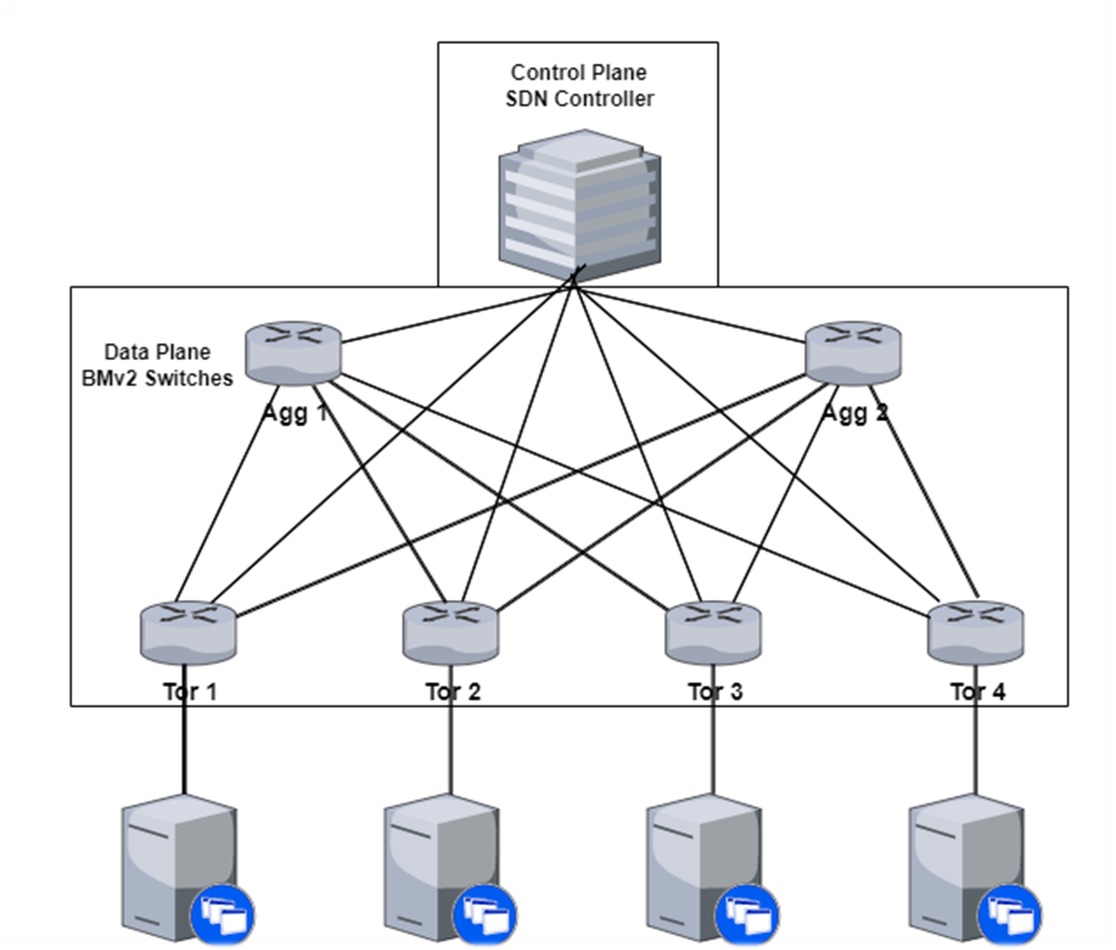
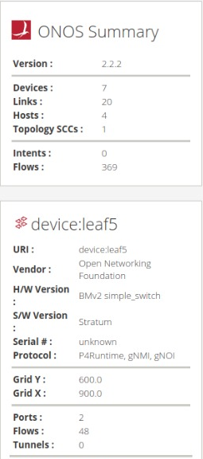
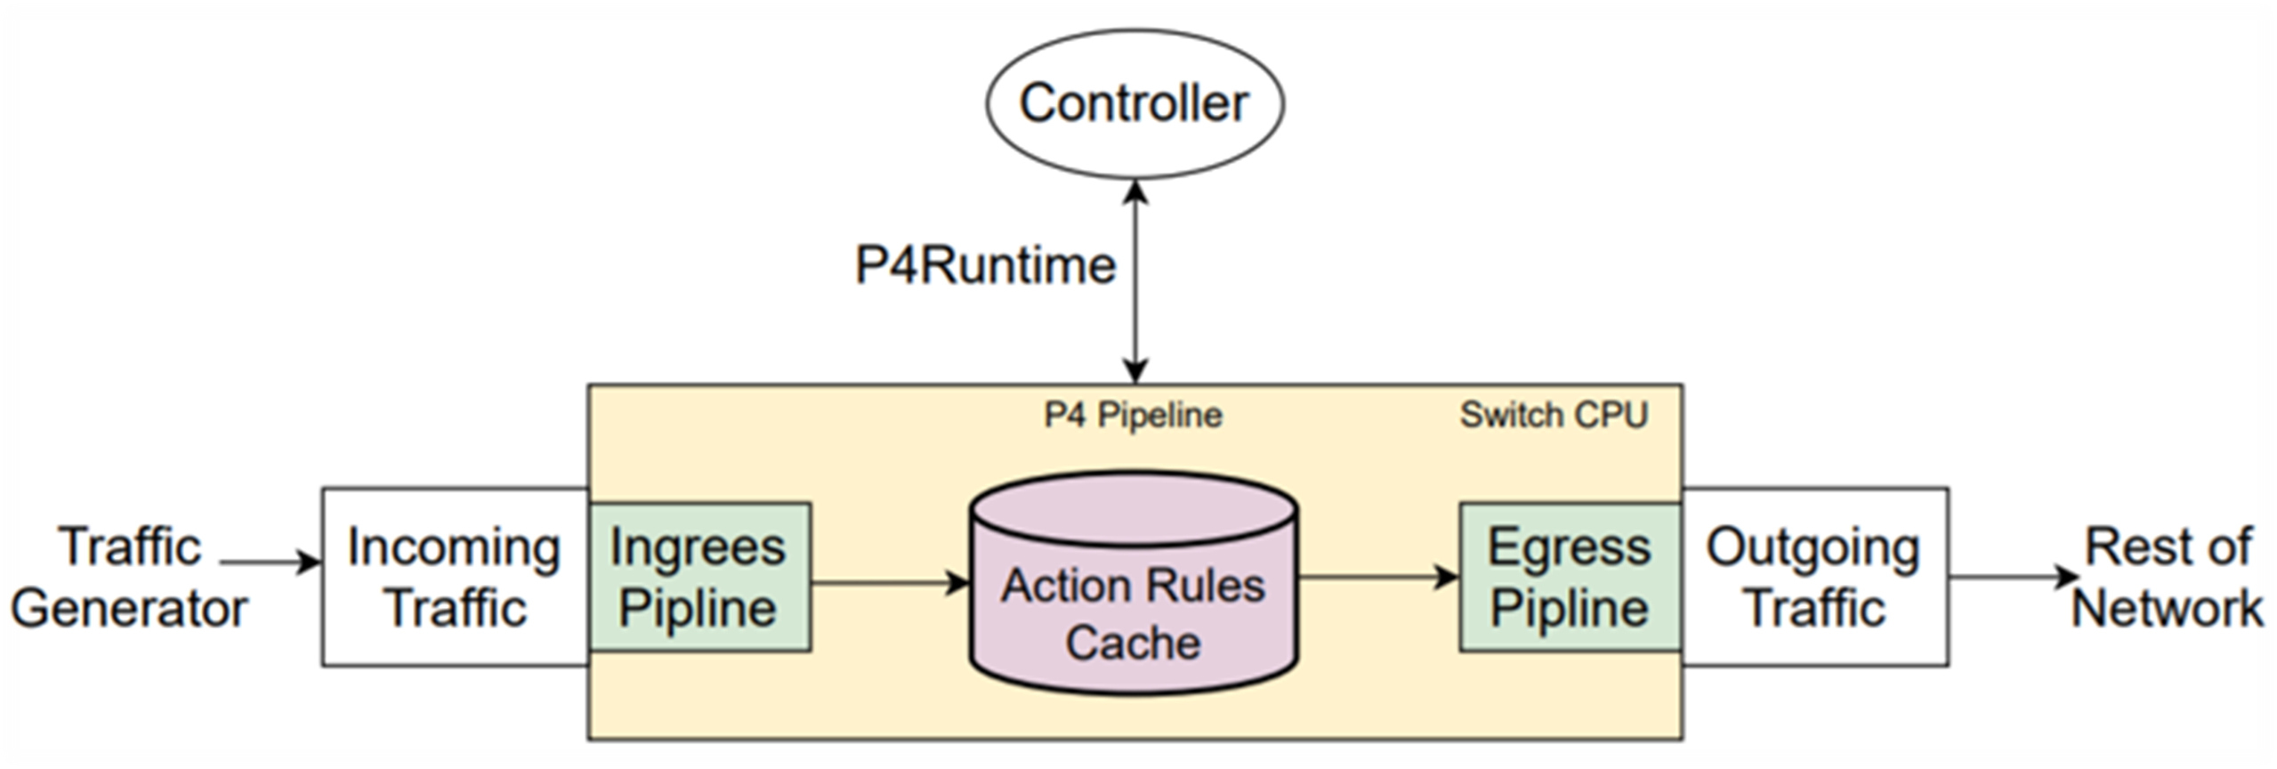
Our System
Topology that resembles a data center in which we conducted our experiments
ONOS version : 2.2.2
BMv2 programmable switches
Switches can be configured using the P4 programming language
P4Runtime protocol

Slide 6



Caching implementation
Python and Scapy were utilized to implement the caching mechanisms.
Traffic_Generator.py : Generates network traffic from a designated host.
ToR_Cache.py: Executes the caching algorithm in a designated ToR switch.
Agg_Cache.py: Executes the caching algorithm in a designated Aggregation switch.
Fast Cache and Best Static were employed as the two caching algorithm types.

Slide 7
Fast Cache
Implemented across all switches within the topology, including both Tor switches and Aggregation switches.
Upon packet arrival at a switch from a flow, the switch verifies if the flow's policy exists in the cache table.
If the policy is found, it results in a hit. otherwise, it leads to a miss.
Hit: The packet is directly forwarded to its destination without any intermediate steps.
Miss: The flow's policy is inserted into the cache table if there is available space, otherwise, it replaces the least recently used policy. The packet is then forwarded to the subsequent stage.

Slide 8
Best Static
Implemented across all switches within the topology, including both Tor switches and Aggregation switches.
The cache tables are statically populated with flow policies that achieved the highest hit ratio during a pre-run, prior to the experiment.
The contents of the cache tables remain static and do not change.
If the policy is found, it results in a hit. otherwise, it leads to a miss.
Hit: The packet is directly forwarded to its destination without any intermediate steps.
Miss: The packet is forwarded to the subsequent stage.

Slide 9
Experiments Setup
Each host within the topology generates traffic.
The cache table size of each switch in the topology varies between 20, 40, 60, 80, and 100.
Flows: Type A - Large flow of 300 packets with 3000 potential destinations. Type B - Small flow of 30 packets with 75 potential destinations.
The likelihood of a specific flow occurring is 0.5.
The flows were either sent sequentially or in parallel as a group of 50.
Total flows – 150
Total packets ~ 100,000

Slide 10
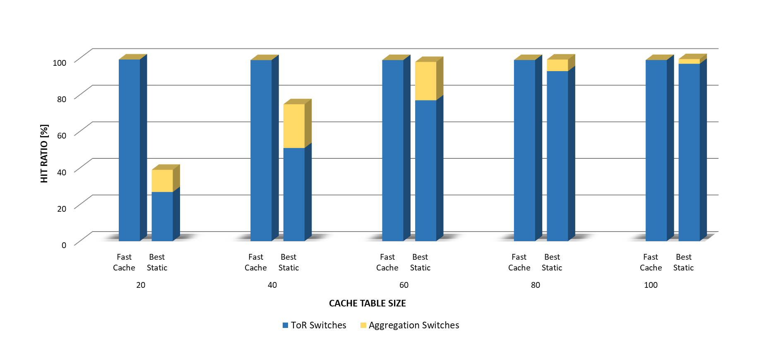
Results
Sequential Flows
Fast Cache:
ToR Switches: The hit ratio is exceptionally high, approaching 100%.
Aggregation Switches: The hit ratio is extremely low, nearing 0%.
Best static:
ToR Switches: Hit ratio rises with a larger cache table size.
Aggregation Switches: Larger cache size initially boosts hit ratio, then diminishes over time.

Slide 11
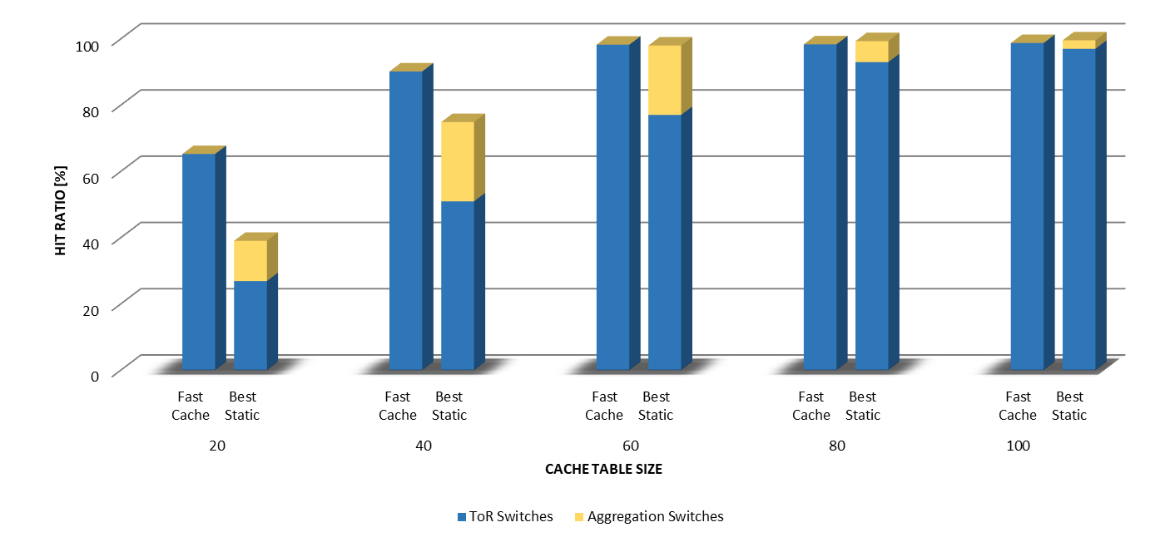
Results
Concurrent flows
Fast Cache:
ToR Switches: Hit ratio rises with a larger cache table size.
Aggregation Switches: The hit ratio is extremely low, nearing 0%.
Best static:
ToR Switches: Hit ratio rises with a larger cache table size.
Aggregation Switches: Larger cache size initially boosts hit ratio, then diminishes over time.

Slide 12
Results
Sequential Flows
Hit ratio in ToR switches drops with concurrent flows and smaller cache.
Aggregation switches result in hit ratios that are one order of magnitude higher when concurrent flows are present and smaller cache tables are used.
Hit ratio is consistent for subsequent and concurrent flows in ToR and Aggregation switches.
Concurrent Flows

Slide 13
Challenges
As ONOS is an open-source controller that is still under development, finding the necessary information to achieve our goals was challenging and potentially non-existent.
With our current tools, we do not possess the capability to fully emulate a real data center. However, we anticipate that the discussed results will reflect the behavior observed in real data centers.

Slide 14
Conclusion
As anticipated, implementing caching mechanisms, both static and dynamic, in data center networks reduces the number of unnecessary accesses to the controller.
The hit ratio for a given cache table size is influenced by both the algorithm used and the network flows. Therefore, it is crucial to select the table size appropriately.
Data centers can expand their infrastructure with minimal hardware modifications and attain improved performance.

Slide 15
Thank you for listening!

