Slide 1
Statistics for
Business and Economics (14e)
Anderson, Sweeney, Williams, Camm, Cochran, Fry, Ohlmann
© 2020 Cengage Learning
© 2020 Cengage. May not be scanned, copied or duplicated, or posted to a publicly accessible website, in whole or in part, except for use as permitted in a license distributed with a certain product or service or otherwise on a password-protected website or school-approved learning management system for classroom use.

Slide 2
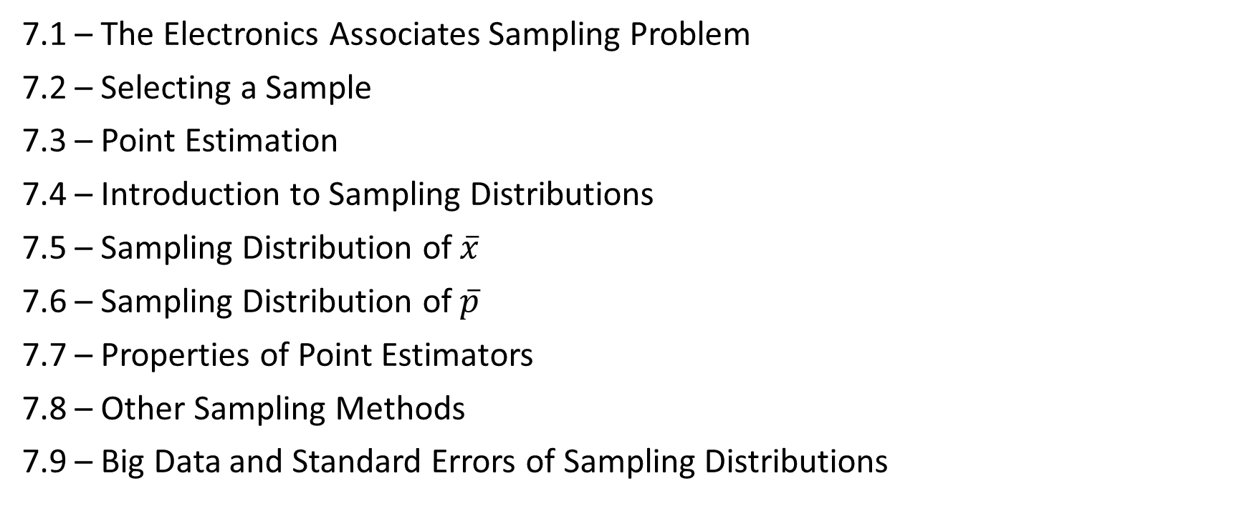
Chapter 7 - Sampling and Sampling Distributions
7.1 – The Electronics Associates Sampling Problem
7.2 – Selecting a Sample
7.3 – Point Estimation
7.4 – Introduction to Sampling Distributions
7.5 – Sampling Distribution of $\overline{x}$
7.6 – Sampling Distribution of $\overline{p}$
7.7 – Properties of Point Estimators
7.8 – Other Sampling Methods
7.9 – Big Data and Standard Errors of Sampling Distributions

Slide 3
Introduction (1 of 2)
An element is the entity on which data are collected.
A population is a collection of all the elements of interest.
A sample is a subset of the population.
The sampled population is the population from which the sample is drawn.
A frame is a list of the elements that the sample will be selected from.

Slide 4
Introduction (2 of 2)
The reason we select a sample is to collect data to answer a research question about a population.
The sample results provide only estimates of the values of the population characteristics.
The reason is simply that the sample contains only a portion of the population.
With proper sampling methods, the sample results can provide “good” estimates of the population characteristics.

Slide 5
Sampling from a Finite Population (1 of 2)
Finite populations are often defined by lists such as:
  Organization membership roster
  Credit card account numbers
  Inventory product numbers
A simple random sample of size n from a finite population of size N is a sample selected such that each possible sample of size n has the same probability of being selected.
Replacing each sampled element before selecting subsequent elements is called sampling with replacement. An element can appear in the sample more than once.
Sampling without replacement is the procedure used most often.
In large sampling projects, computer-generated random numbers are often used to automate the sample selection process.

Slide 6
Sampling from a Finite Population (2 of 2)
St. Andrew’s College received 900 applications for admission in the upcoming year from prospective students. The applicants were numbered, from 1 to 900, as their applications arrived. The Director of Admissions would like to select a simple random sample of 30 applicants.
Step 1: Assign a random number to each of the 900 applicants.
The random numbers generated by Excel’s RAND function follow a uniform probability distribution between 0 and 1.
Step 2: Select the 30 applicants corresponding to the 30 smallest random numbers.

Slide 7
Sampling from an Infinite Population (1 of 3)
Sometimes we want to select a sample, but find that it is not possible to obtain a list of all elements in the population.
As a result, we cannot construct a frame for the population.
Hence we cannot use the random number selection procedure.
Most often this situation occurs in the case of infinite population.

Slide 8
Sampling from an Infinite Population (2 of 3)
Populations are often generated by an ongoing process where there is no upper limit on the number of units that can be generated.
Some examples of on-going processes with infinite populations are:
  parts being manufactured on a production line
  transactions occurring at a bank
  telephone calls arriving at a technical help desk
  customers entering a store

Slide 9
Sampling from an Infinite Population (3 of 3)
In the case of an infinite population, we must select a random sample in order to make valid statistical inferences about the population from which the sample is taken.
A random sample from an infinite population is a sample selected such that the following conditions are satisfied.
  Each element selected comes from the population of interest.
  Each element is selected independently.

Slide 10
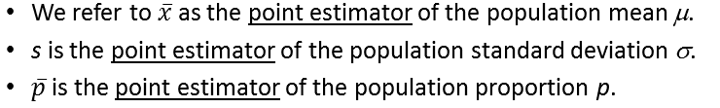
Point Estimation (1 of 4)
Point estimation is a form of statistical inference.
In point estimation we use the data from the sample to compute a value of a sample statistic that serves as an estimate of a population parameter.

Slide 11
Point Estimation (2 of 4)
St. Andrew’s College received 900 applications from prospective students. The application form contains a variety of information including the individual’s Scholastic Aptitude Test (SAT) score and whether or not the individual desires on-campus housing.
At a meeting in a few hours, the Director of Admissions would like to announce the average SAT score and the proportion of applicants that want to live on campus, for the population of 900 applicants.
The data on the applicants have not yet been entered in the college’s database. So the Director decides to estimate the values of the population parameters of interest based on sample statistics. A sample of 30 applicants is selected using computer-generated random numbers.

Slide 12
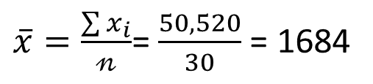
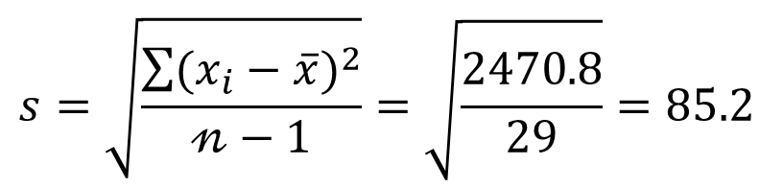
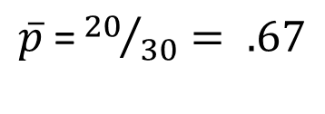
Point Estimation (3 of 4)
$\overline{x}$ is the point estimator of the population mean, $μ$
s is the point estimator of the population standard deviation, $σ$
$\overline{p}$ is the point estimator of the population proportion, p.
Note: Different random numbers would have identified a different sample which would have resulted in different point estimates.

Slide 13
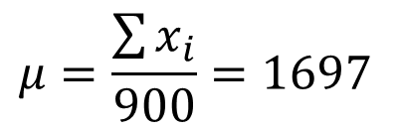
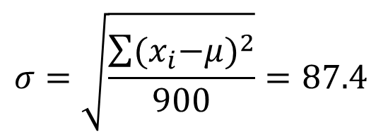

Point Estimation (4 of 4)
Once all the data for the 900 applicants were entered in the database of the college, the values of the population parameters of interest were calculated.
  Population Mean SAT Score:
  Population Standard Deviation for SAT Score:
  Population proportion wanting On-Campus Housing:

Slide 14
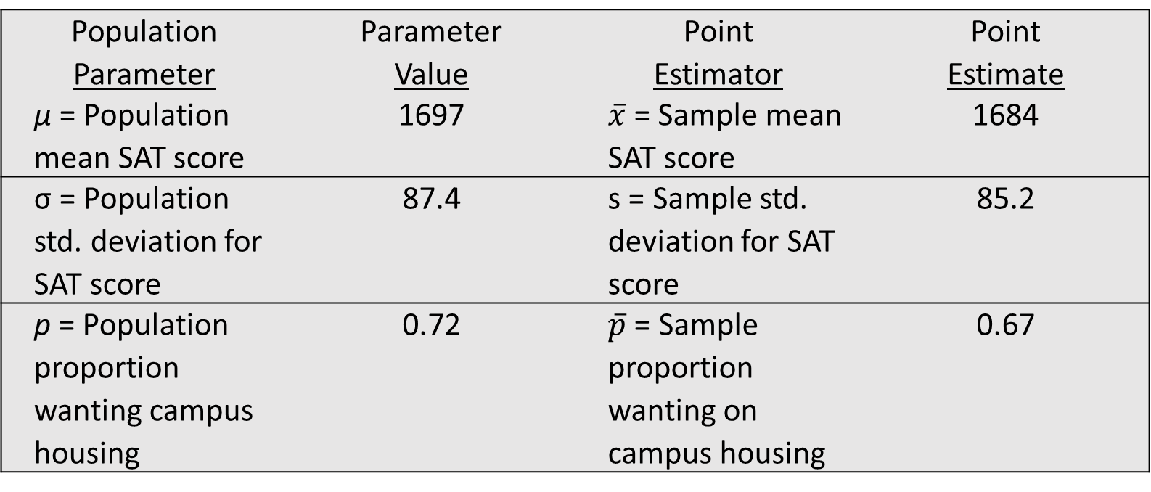
Summary of Point Estimates Obtained from a Simple Random Sample
Population Parameter | Parameter Value | Point Estimator | Point Estimate
μ = Population mean SAT score | 1697 | $\overline{x}$= Sample mean SAT score | 1684
σ = Population std. deviation for SAT score | 87.4 | s = Sample std. deviation for SAT score | 85.2
p = Population proportion wanting campus housing | 0.72 | $\overline{p}$ = Sample proportion wanting on campus housing | 0.67

Slide 15
Practical Advice
The target population is the population we want to make inferences about.
The sampled population is the population from which the sample is actually taken.
Whenever a sample is used to make inferences about a population, we should make sure that the targeted population and the sampled population are in close agreement.

Slide 16
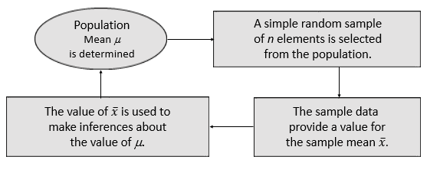
Sampling Distribution of $\overline{x}$ (1 of 10)
Process of Statistical Inference

Slide 17
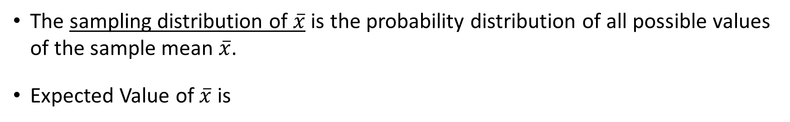
Sampling Distribution of $\overline{x}$ (2 of 10)
The sampling distribution of $\overline{x}$ is the probability distribution of all possible values of the sample mean $\overline{x}$.
Expected Value of $\overline{x}$ is
When the expected value of the point estimator equals the population parameter, we say the point estimator is unbiased.

Slide 18
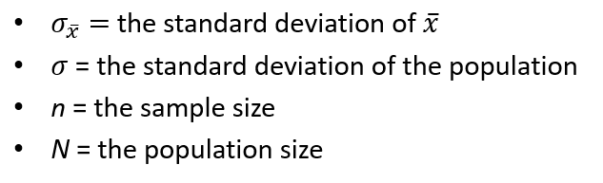
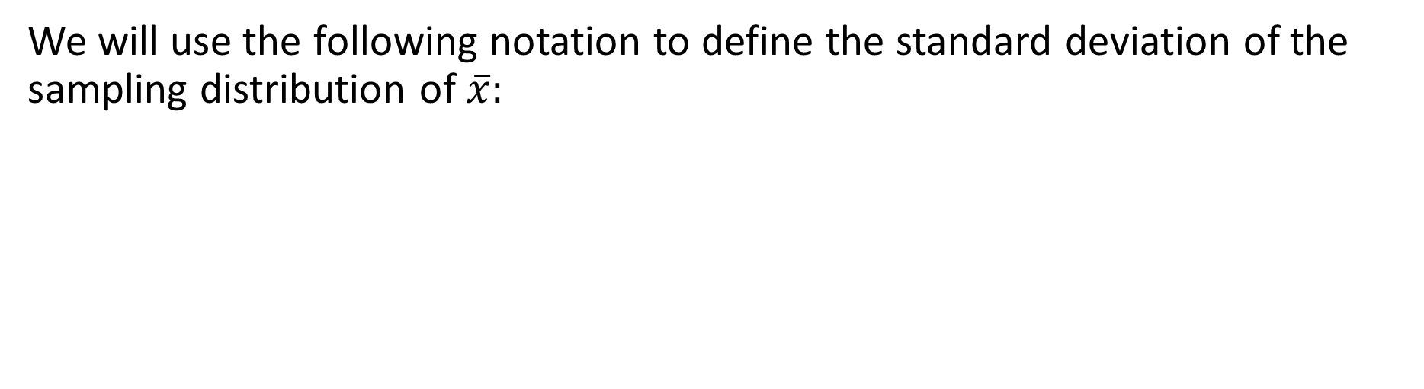
Sampling Distribution of $\overline{x}$ (3 of 10)
We will use the following notation to define the standard deviation of the sampling distribution of $\overline{x}:$

Slide 19





Sampling Distribution of $\overline{x}$ (4 of 10)
The standard deviation of $\overline{x},$ for a finite population is
The standard deviation of $\overline{x},$ for a finite population is
A finite population is treated as being infinite if
is the finite population correction factor.
is referred to as the standard error of the mean.

Slide 20
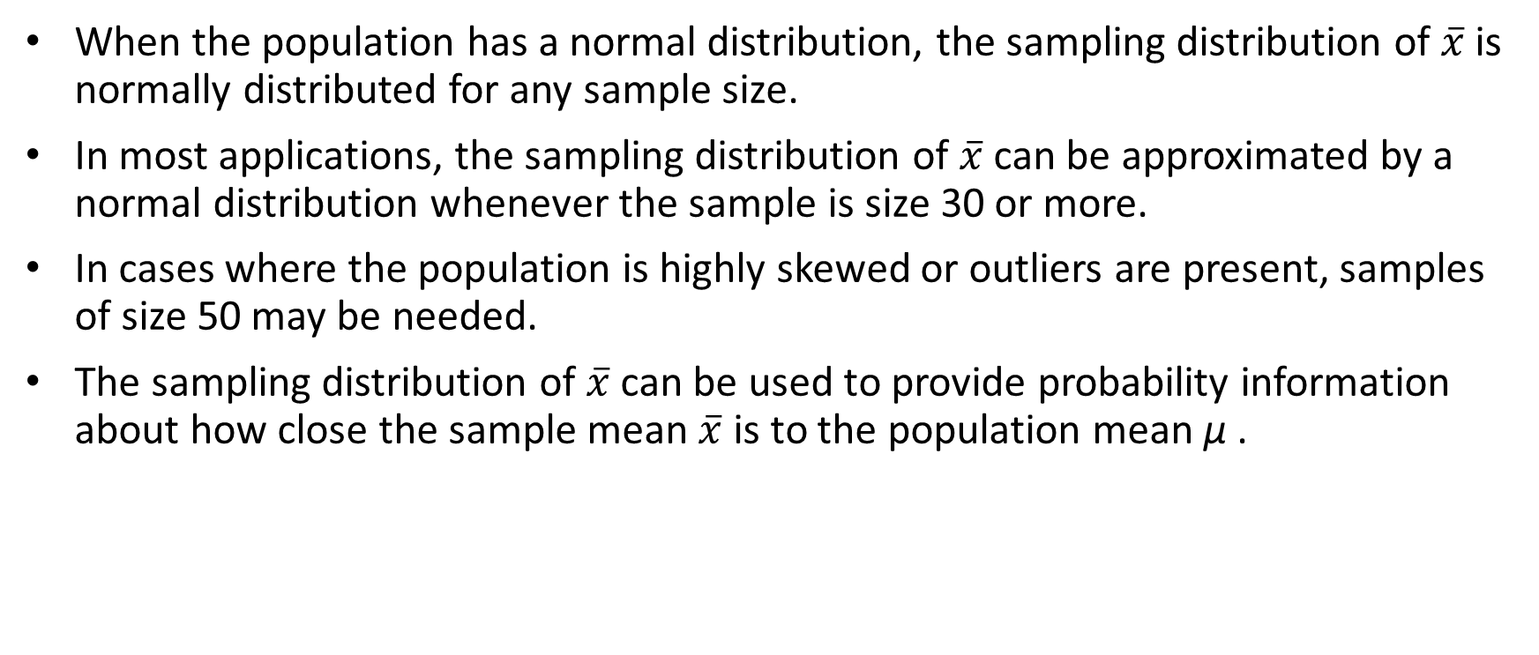
Sampling Distribution of $\overline{x}$ (5 of 10)
When the population has a normal distribution, the sampling distribution of $\overline{x}$ is normally distributed for any sample size.
In most applications, the sampling distribution of $\overline{x}$ can be approximated by a normal distribution whenever the sample is size 30 or more.
In cases where the population is highly skewed or outliers are present, samples of size 50 may be needed.
The sampling distribution of $\overline{x}$ can be used to provide probability information about how close the sample mean $\overline{x}$ is to the population mean μ .

Slide 21
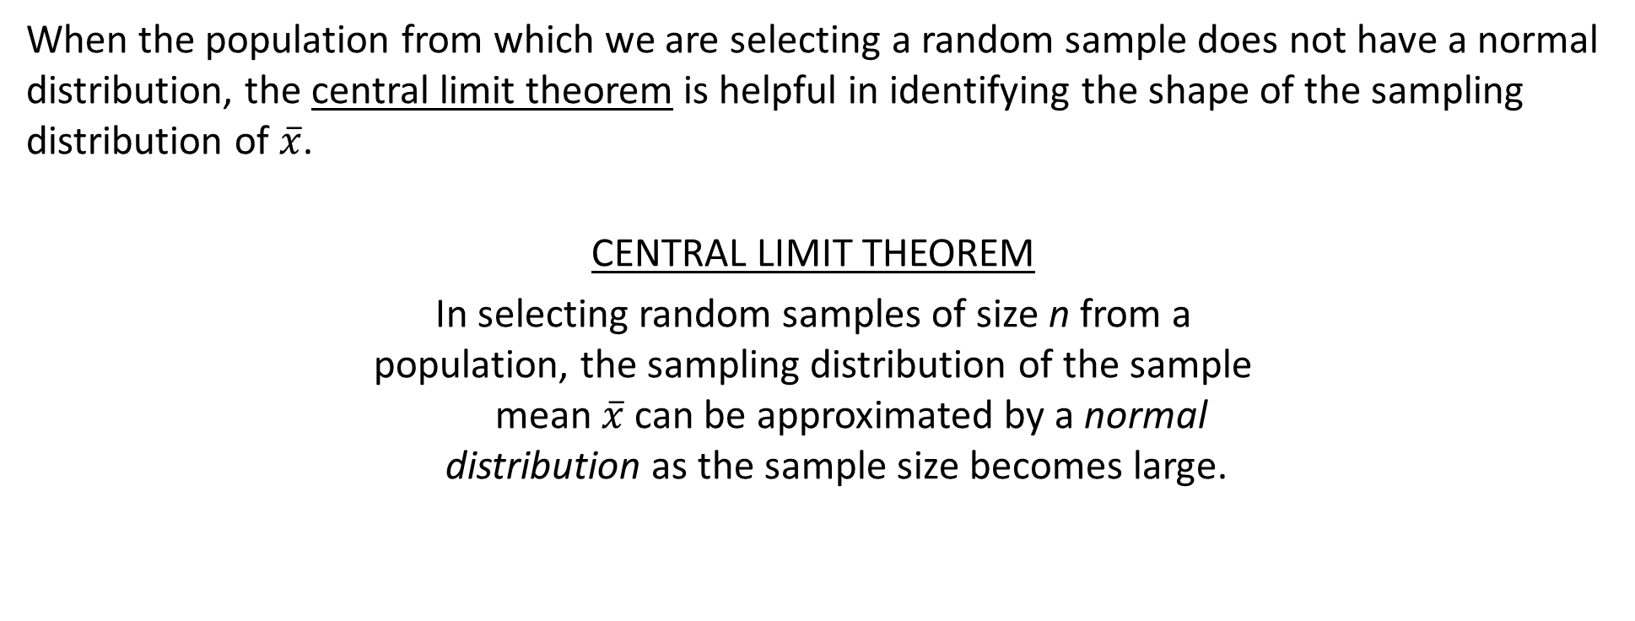
Central Limit Theorem
When the population from which we are selecting a random sample does not have a normal distribution, the central limit theorem is helpful in identifying the shape of the sampling distribution of $\overline{x}$.
CENTRAL LIMIT THEOREM
In selecting random samples of size n from a
population, the sampling distribution of the sample
mean $\overline{x}$ can be approximated by a normal
distribution as the sample size becomes large.

Slide 22
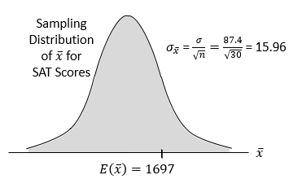
Sampling Distribution of $\overline{x}$ (6 of 10)
Example: St. Andrew’s College

Slide 23
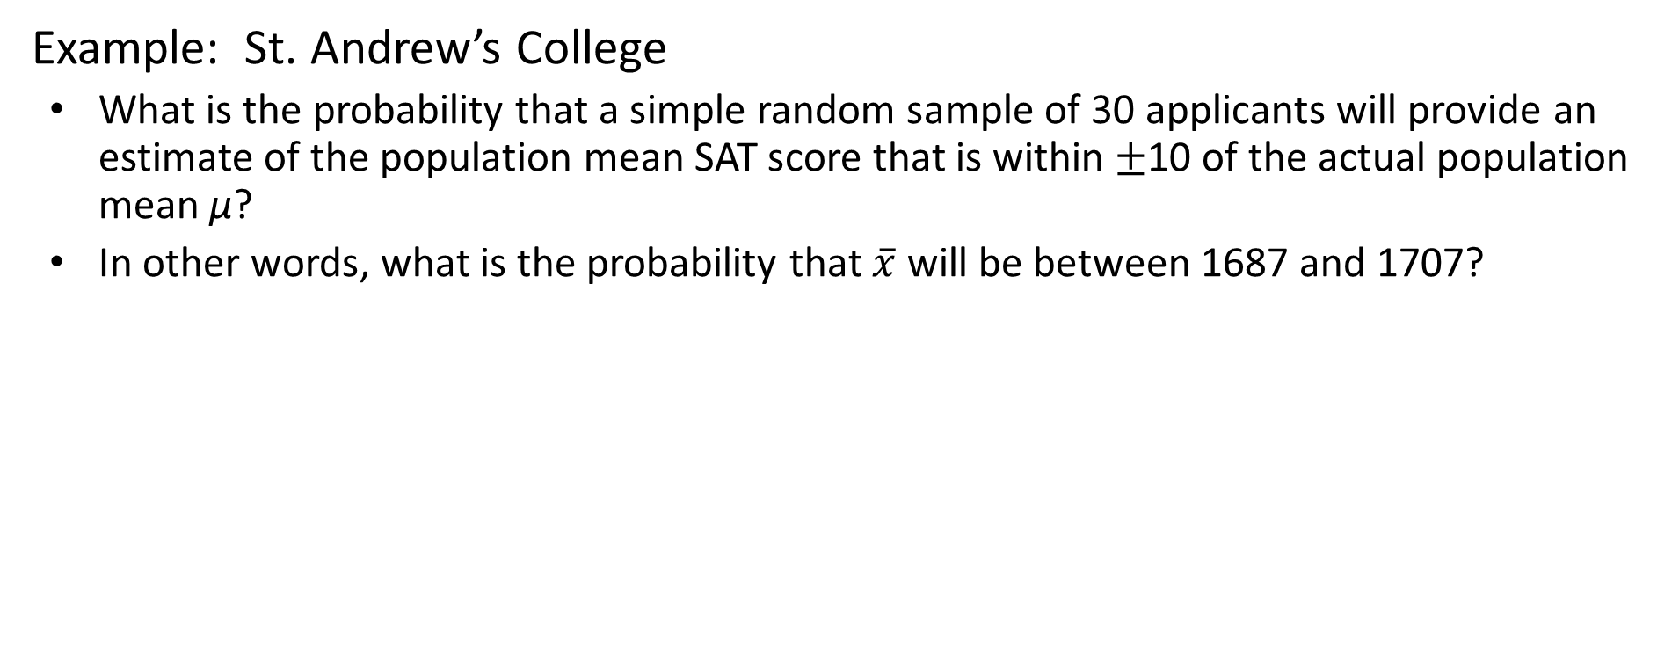
Sampling Distribution of $\overline{x}$ (7 of 10)
Example: St. Andrew’s College
  What is the probability that a simple random sample of 30 applicants will provide an estimate of the population mean SAT score that is within $±$10 of the actual population mean μ?
  In other words, what is the probability that $\overline{x}$ will be between 1687 and 1707?

Slide 24


Sampling Distribution of $\overline{x}$ (8 of 10)
Example: St. Andrew’s College
Step 1: Calculate the z-value at the upper endpoint of the interval.
Step 2: Find the area under the curve to the left of the upper endpoint.

Slide 25
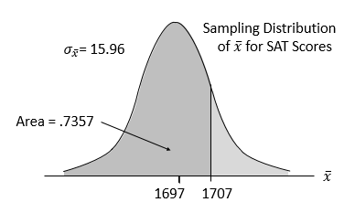
Sampling Distribution of $\overline{x}$ (9 of 10)
Example: St. Andrew’s College
Cumulative Probabilities for the Standard Normal Distribution
z | .00 | .01 | .02 | .03 | .04
. | . | . | . | . | .
.5 | .6915 | .6950 | .6985 | .7019 | .7054
.6 | .7257 | .7291 | .7324 | .737 | .7389
.7 | .7580 | .7611 | .7642 | .7673 | .7704
.8 | .7881 | .7910 | .7939 | .7967 | .7995
.9 | .8159 | .8186 | .8212 | .8238 | .8264

Slide 26


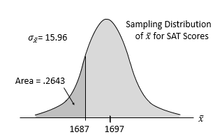
Sampling Distribution of $\overline{x}$ (10 of 10)
Example: St. Andrew’s College
Step 3: Calculate the z-value at the lower endpoint of the interval.
Step 4: Find the area under the curve to the left of the lower endpoint.

Slide 27
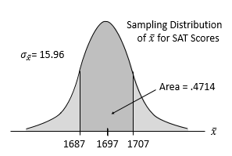


Sampling Distribution of $\overline{x}$ for SAT Scores
Example: St. Andrew’s College
Step 5: Calculate the area under the curve between the lower and upper endpoints of the interval.
The probability that the estimate of population mean SAT score will be between 1687 and 1707 is:

Slide 28

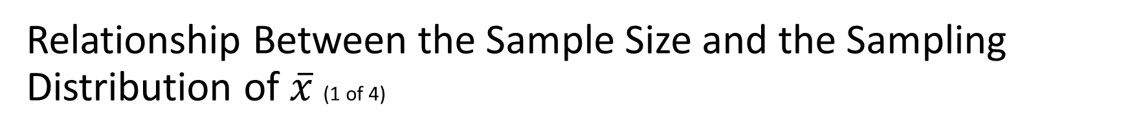
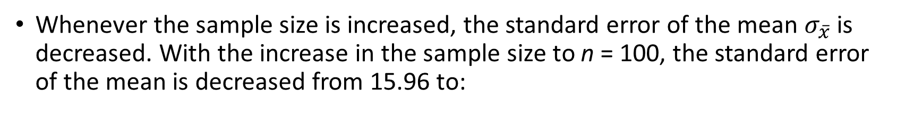
Relationship Between the Sample Size and the Sampling Distribution of $\overline{x}$ (1 of 4)
Example: St. Andrew’s College
  Suppose we select a simple random sample of 100 applicants instead of the 30 originally considered.
Whenever the sample size is increased, the standard error of the mean $σ_{\overline{x}}$ is decreased. With the increase in the sample size to n = 100, the standard error of the mean is decreased from 15.96 to:

Slide 29
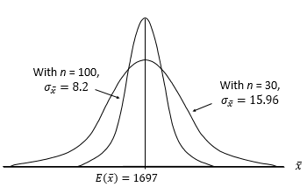
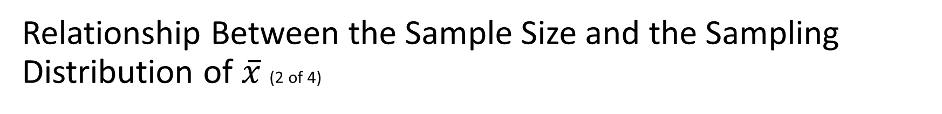
Relationship Between the Sample Size and the Sampling Distribution of $\overline{x}$ (2 of 4)
Example: St. Andrew’s College

Slide 30
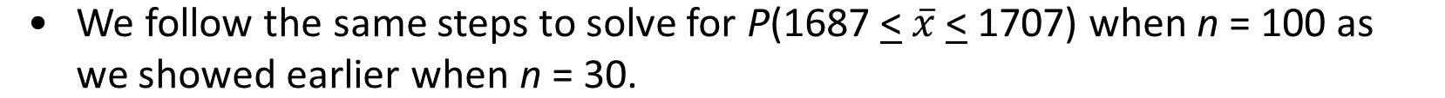
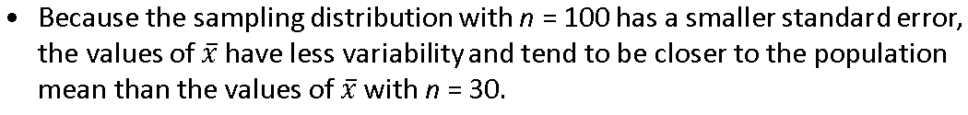
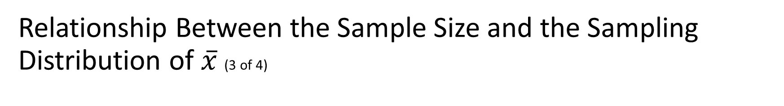
Relationship Between the Sample Size and the Sampling Distribution of $\overline{x}$ (3 of 4)
Example: St. Andrew’s College

Slide 31
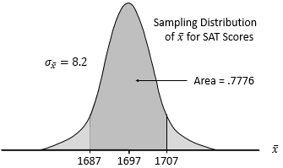
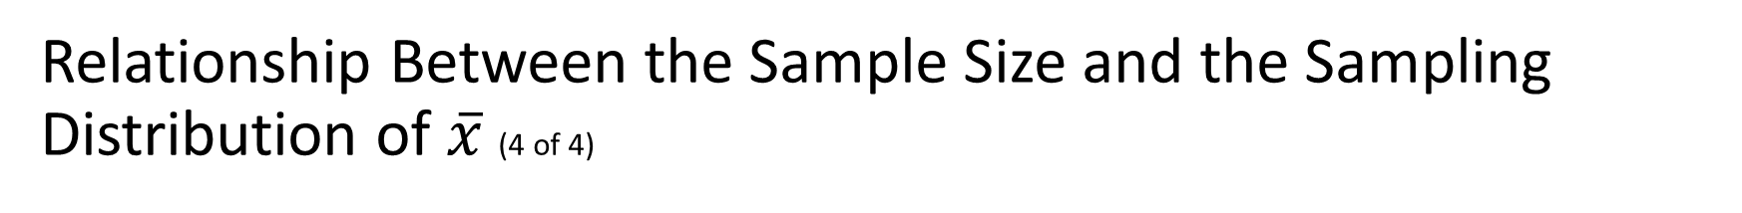
Relationship Between the Sample Size and the Sampling Distribution of $\overline{x}$ (4 of 4)
Example: St. Andrew’s College

Slide 32
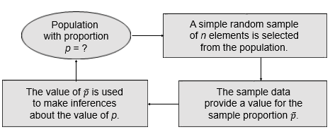
Sampling Distribution of $\overline{p}$ (1 of 10)
Making Inferences about a Population Proportion

Slide 33

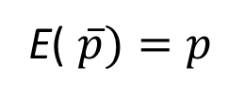
Sampling Distribution of $\overline{p}$ (2 of 10)
where: p = the population proportion

Slide 34
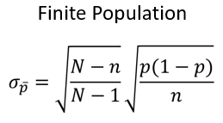
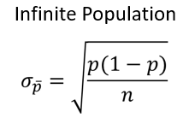

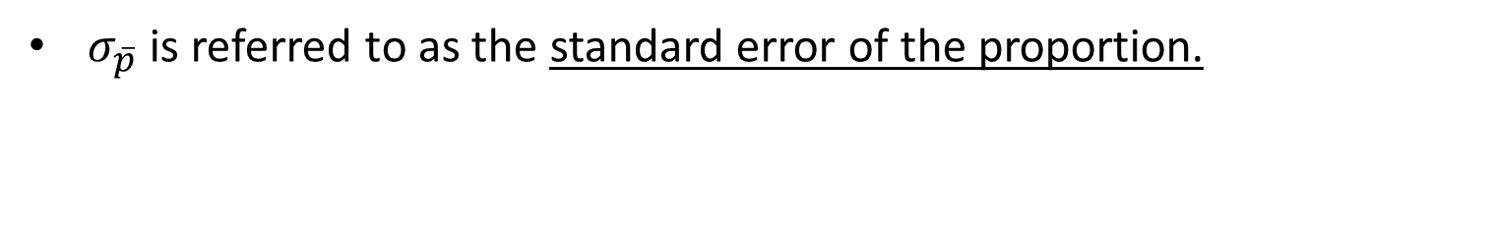
Sampling Distribution of $\overline{p}$ (3 of 10)
Standard Deviation of $\overline{p}$
$σ_{\overline{p}}$ is referred to as the standard error of the proportion.

Slide 35

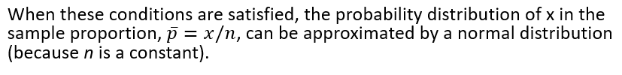
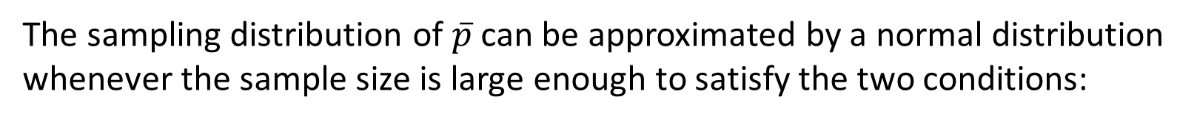
Sampling Distribution of $\overline{p}$ (4 of 10)
The sampling distribution of $\overline{p}$ can be approximated by a normal distribution whenever the sample size is large enough to satisfy the two conditions:

Slide 36
Sampling Distribution of $\overline{p}$ (5 of 10)
Example: St. Andrew’s College
Recall that 72% of the prospective students applying to St. Andrew’s College desire on-campus housing.
What is the probability that a simple random sample of 30 applicants will provide an estimate of the population proportion of applicant desiring on-campus housing that is within plus or minus .05 of the actual population proportion?

Slide 37
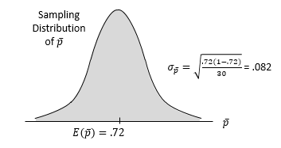
Sampling Distribution of $\overline{p}$ (6 of 10)
For our example, with n = 30 and p = .72, the normal distribution is an acceptable approximation because

Slide 38


Sampling Distribution of $\overline{p}$ (7 of 10)
Example: St. Andrew’s College
Step 1: Calculate the z-value at the upper endpoint of the interval.
  Step 2: Find the area under the curve to the left of the upper endpoint.

Slide 39
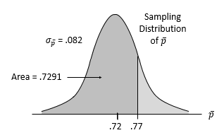
Sampling Distribution of $\overline{p}$ (8 of 10)
Example: St. Andrew’s College
Cumulative Probabilities for the Standard Normal Distribution
z | .00 | .01 | .02 | .03 | .04
. | . | . | . | . | .
.5 | .6915 | .6950 | .6985 | .7019 | .7054
.6 | .7257 | .7291 | .7324 | .7387 | .7389
.7 | .7580 | .7611 | .7642 | .7673 | .7704
.8 | .7881 | .7910 | .7939 | .7967 | .7995
.9 | .8159 | .8186 | .8212 | .8238 | .8264
. | . | . | . | . | .

Slide 40
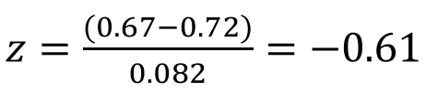

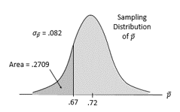
Sampling Distribution of $\overline{p}$ (9 of 10)
Example: St. Andrew’s College
Step 3: Calculate the z-value at the lower endpoint of the interval.
Step 4: Find the area under the curve to the left of the lower endpoint.

Slide 41
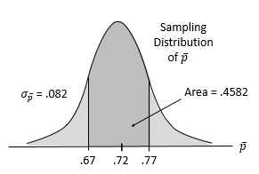
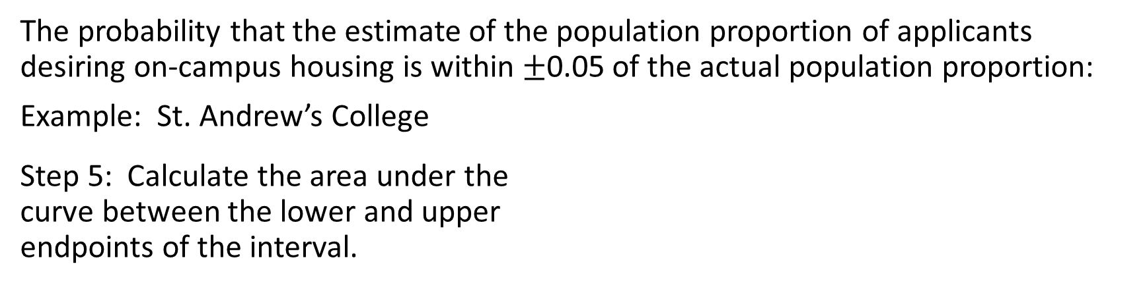
Sampling Distribution of $\overline{p}$ (10 of 10)
The probability that the estimate of the population proportion of applicants desiring on-campus housing is within $±$0.05 of the actual population proportion:
Example: St. Andrew’s College
Step 5: Calculate the area under the
curve between the lower and upper
endpoints of the interval.

Slide 42
Other Sampling Methods
Stratified Random Sampling
Cluster Sampling
Systematic Sampling
Convenience Sampling
Judgment Sampling

Slide 43
Stratified Random Sampling
The population is first divided into groups of elements called strata.
Each element in the population belongs to one and only one stratum.
Best results are obtained when the elements within each stratum are as much alike as possible (i.e. a homogeneous group).

Slide 44
Stratified Random Sampling, Part 2
A simple random sample is taken from each stratum.
Formulas are available for combining the stratum sample results into one population parameter estimate.
Advantage: If strata are homogeneous, this method provides results that is as “precise” as simple random sampling but with a smaller total sample size.
Example: The basis for forming the strata might be department, location, age, industry type, and so on.

Slide 45
Cluster Sampling (1 of 2)
The population is first divided into separate groups of elements called clusters.
Ideally, each cluster is a representative small-scale version of the population (i.e. heterogeneous group).
A simple random sample of the clusters is then taken.
All elements within each sampled (chosen) cluster form the sample.

Slide 46
Cluster Sampling (2 of 2)
Example: A primary application is area sampling, where clusters are city blocks or other well-defined areas.
Advantage: The close proximity of elements can be cost effective (i.e. many sample observations can be obtained in a short time).
Disadvantage: This method generally requires a larger total sample size than simple or stratified random sampling.

Slide 47
Systematic Sampling (1 of 2)
If a sample size of n is desired from a population containing N elements, we might sample one element for every N/n elements in the population.
We randomly select one of the first N/n elements from the population list.
We then select every N/nth element that follows in the population list.

Slide 48
Systematic Sampling (2 of 2)
This method has the properties of a simple random sample, especially if the list of the population elements is a random ordering.
Advantage: The sample usually will be easier to identify than it would be if simple random sampling were used.
Example: Selecting every 100th listing in a telephone book after the first randomly selected listing.

Slide 49
Convenience Sampling
It is a nonprobability sampling technique. Items are included in the sample without known probabilities of being selected.
The sample is identified primarily by convenience.
Example: A professor conducting research might use student volunteers to constitute a sample.
Advantage: Sample selection and data collection are relatively easy.
Disadvantage: It is impossible to determine how representative of the population the sample is.

Slide 50
Judgment Sampling
The person most knowledgeable on the subject of the study selects elements of the population that he or she feels are most representative of the population.
It is a nonprobability sampling technique.
Example: A reporter might sample three or four senators, judging them as reflecting the general opinion of the senate.
Advantage: It is a relatively easy way of selecting a sample.
Disadvantage: The quality of the sample results depends on the judgment of the person selecting the sample.

Slide 51
Recommendation
It is recommended that probability sampling methods (simple random, stratified, cluster, or systematic) be used.
For these methods, formulas are available for evaluating the “goodness” of the sample results in terms of the closeness of the results to the population parameters being estimated.
An evaluation of the goodness cannot be made with non-probability (convenience or judgment) sampling methods.

Slide 52

End of Chapter 7

