Slide 1
Statistics for
Business and Economics (14e)
Anderson, Sweeney, Williams, Camm, Cochran, Fry, Ohlmann
© 2020 Cengage Learning
© 2020 Cengage. May not be scanned, copied or duplicated, or posted to a publicly accessible website, in whole or in part, except for use as permitted in a license distributed with a certain product or service or otherwise on a password-protected website or school-approved learning management system for classroom use.

Slide 2
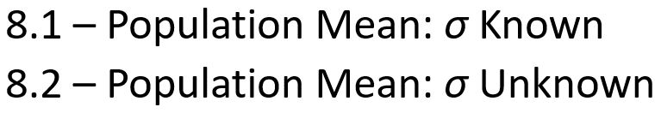
Chapter 8 - Interval Estimation
8.3 – Determining the Sample Size
8.4 – Population Proportion
8.5 – Big Data and Confidence Intervals

Slide 3

Margin of error and the Interval Estimate
A point estimator cannot be expected to provide the exact value of the population parameter.
An interval estimate can be computed by adding and subtracting a margin of error to the point estimate.
The purpose of an interval estimate is to provide information about how close the point estimate, is to the value of the parameter.

Slide 4

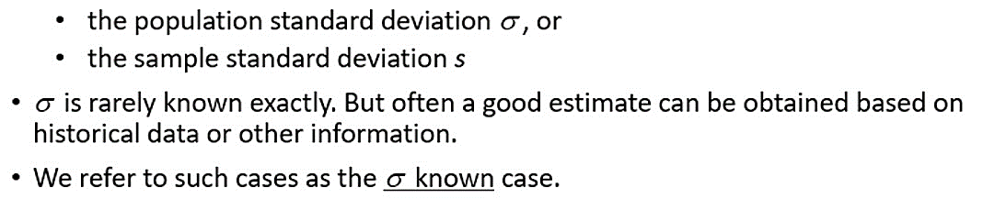
Interval Estimate of a Population Mean: σ Known (1 of 4)
The general form of an interval estimate of a population mean is
In order to develop an interval estimate of a population mean, the margin of error must be computed using either:

Slide 5
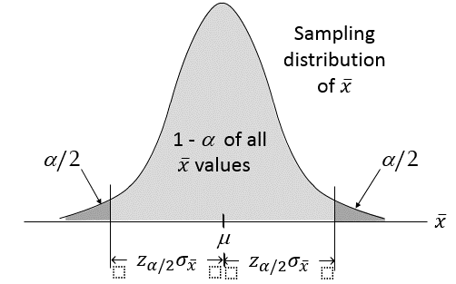
Interval Estimate of a Population Mean: σ Known (2 of 4)

Slide 6

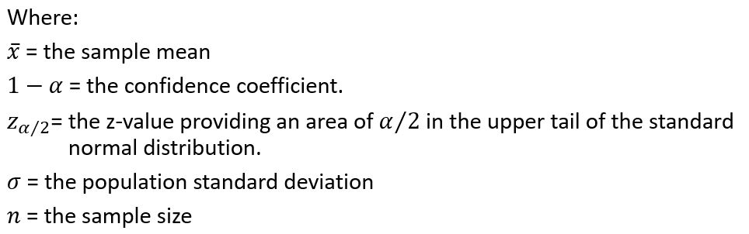
Interval Estimate of a Population Mean: σ Known (3 of 4)
Interval Estimate of μ:

Slide 7
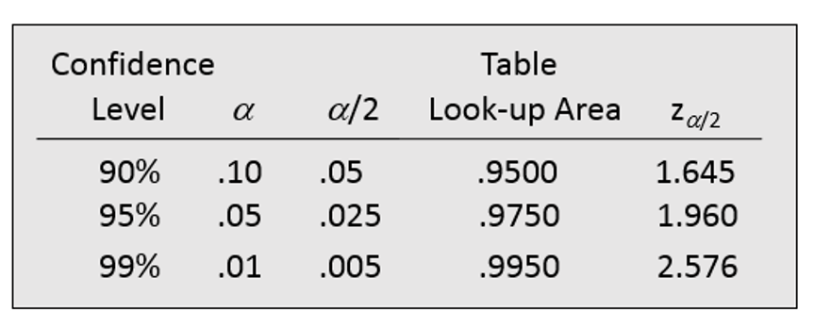
Interval Estimate of a Population Mean: σ Known (4 of 4)
Confidence Level | Alpha | Alpha divided by 2 | Table Look-up Area | 2 subscript alpha divided by 2 baseline
90% | .10 | .05 | .9500 | 1.645
95% | .05 | .025 | .9750 | 1.960
99% | .01 | .005 | .9950 | 2.576

Slide 8
Meaning of C% Confidence
We say that this interval has been established at the 90% confidence level.
The value 0.90 is referred to as the confidence coefficient.

Slide 9
Interval Estimate of a Population Mean: σ Known (1 of 5)
Example: Discount Sounds
Discount Sounds has 260 retail outlets throughout the United States. The firm is evaluating a potential location for a new outlet, based in part, on the mean annual income of the individuals in the marketing area of the new location.
A sample of size n = 36 was taken; the sample mean income is $41,100. The population is not believed to be highly skewed. The population standard deviation is estimated to be $4,500, and the confidence coefficient to be used in the interval estimate is 0.95.

Slide 10
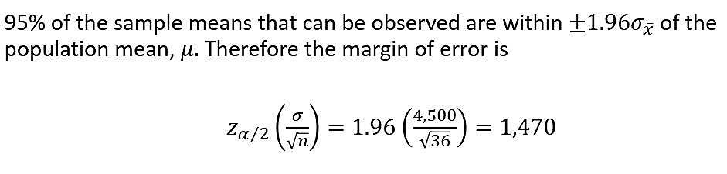
Interval Estimate of a Population Mean: σ Known (2 of 5)
Example: Discount Sounds
Thus at 95% confidence, the margin of error is $1,470.

Slide 11

Interval Estimate of a Population Mean: σ Known (3 of 5)
Example: Discount Sounds
$41,100 + $1,470
or
$39,630 to $42,570
We are 95% confident that the interval contains the population mean.

Slide 12
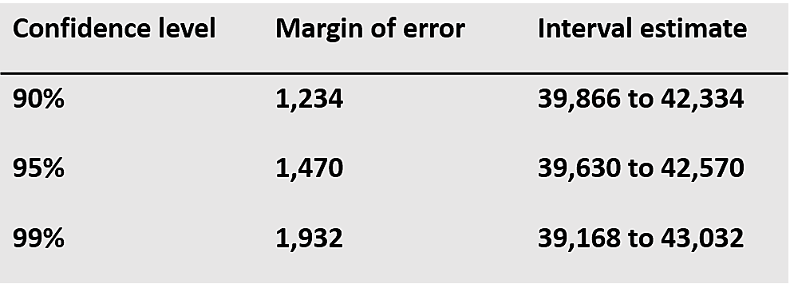
Interval Estimate of a Population Mean: σ Known (4 of 5)
Example: Discount Sounds
Confidence level | Margin of error | Interval estimate
90% | 1,234 | 39,866 to 42,334
95% | 1,470 | 39,630 to 42,570
99% | 1,932 | 39,168 to 43,032
In order to have a higher degree of confidence, the margin of error and thus the width of the confidence interval must be larger.

Slide 13
Interval Estimate of a Population Mean: σ Known (5 of 5)
Adequate Sample Size
  If the population distribution is highly skewed or contains outliers, a sample size of 50 or more is recommended.
  If the population is not normally distributed but is roughly symmetric, a sample size as small as 15 will suffice.
  If the population is believed to be at least approximately normal, a sample size of less than 15 can be used.

Slide 14
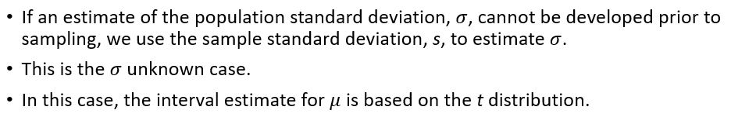
Interval Estimate of a Population Mean: σ unknown
We’ll assume for now that the population is normally distributed.

Slide 15
t Distribution (1 of 4)
William Gosset, writing under the name “Student,” is the founder of the t distribution.
Gosset was an Oxford graduate in mathematics and worked for the Guinness Brewery in Dublin.
He developed the t distribution while working on small-scale materials and temperature experiments.

Slide 16
t Distribution (2 of 4)
The t distribution is a family of similar probability distributions.
A specific t distribution depends on a parameter known as the degrees of freedom.
Degrees of freedom refer to the number of independent pieces of information that go into the computation of s.
A t distribution with more degrees of freedom has less dispersion.
As the degrees of freedom increases, the difference between the t distribution and the standard normal probability distribution becomes smaller and smaller.

Slide 17
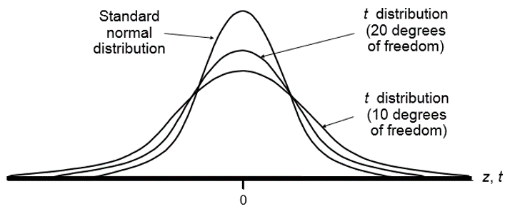
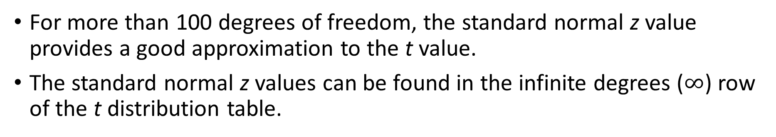
t Distribution (3 of 4)
For more than 100 degrees of freedom, the standard normal z value provides a good approximation to the t value.
The standard normal z values can be found in the infinite degrees ($∞$) row of the t distribution table.

Slide 18
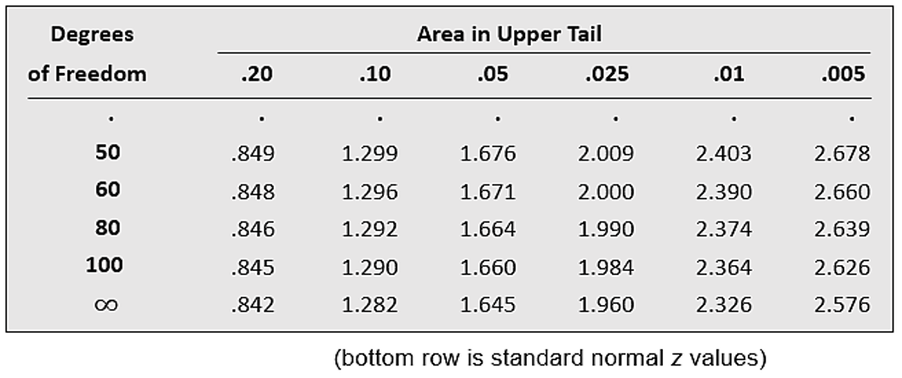
t Distribution (4 of 4)
Degrees of Freedom | .20 area in upper tail | .10 area in upper tail | .05 area in upper tail | .025 area in upper tail | .01 area in upper tail | .005 area in upper tail
50 | .849 | 1.299 | 1.676 | 2.009 | 2.403 | 2.678
60 | .848 | 1.296 | 1.671 | 2.000 | 2.390 | 2.660
80 | .846 | 1.292 | 1.664 | 1.990 | 2374 | 2.639
100 | .845 | 1.290 | 1.660 | 1.984 | 2.364 | 2.626
Infinite | .842 | 1.282 | 1.645 | 1.960 | 2.326 | 2.576

Slide 19
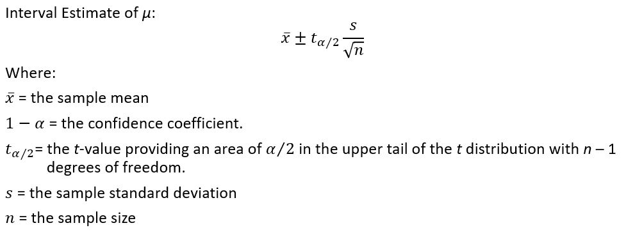
Interval Estimate of a Population Mean: σ Unknown (1 of 5)

Slide 20
Interval Estimate of a Population Mean: σ Unknown (2 of 5)
Example: Apartment Rents
A reporter for a student newspaper is writing an article on the cost of off-campus housing. A sample of 16 one-bedroom apartments within a half-mile of campus resulted in a sample mean of $750 per month and a sample standard deviation of $55.
Let us provide a 95% confidence interval estimate of the mean rent per month for the population of one-bedroom apartments within a half-mile of campus. We will assume this population to be normally distributed.

Slide 21

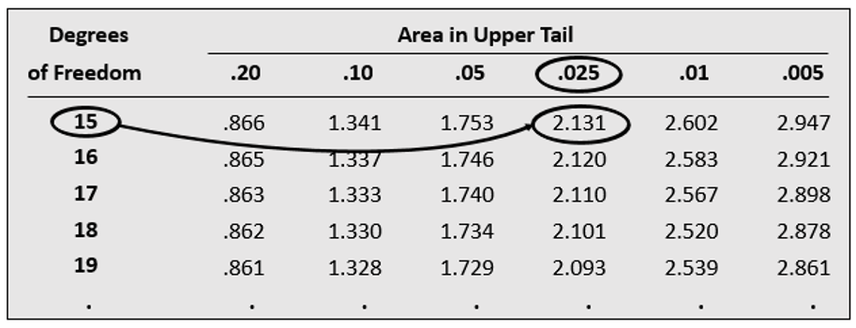
Interval Estimate of a Population Mean: σ Unknown (3 of 5)
Degrees of Freedom | .20 | .10 | .05 | .025 | .01 | .005
15 | .866 | 1.341 | 1.753 | 2.131 | 2.602 | 2.947
16 | .865 | 1.337 | 1.746 | 2.120 | 2.583 | 2.921
17 | .863 | 1.333 | 1.740 | 2.110 | 2.567 | 2.898
18 | .862 | 1.330 | 1.734 | 2.101 | 2.520 | 2.878
19 | .861 | 1.328 | 1.729 | 2.093 | 2.539 | 2.861

Slide 22
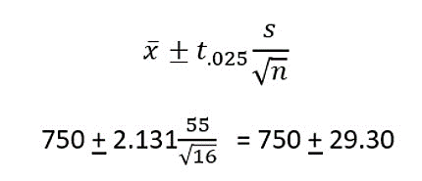
Interval Estimate of a Population Mean: σ Unknown (4 of 5)
Interval Estimate
We are 95% confident that the mean rent per month for the population of one-bedroom apartments within a half-mile of campus is between $720.70 and $779.30.

Slide 23
Interval Estimate of a Population Mean: σ Unknown (5 of 5)
Adequate Sample Size
Usually, a sample size of at least 30 is adequate when using a t interval to estimate a population mean.
If the population distribution is highly skewed or contains outliers, a sample size of 50 or more is recommended.
If the population is not normally distributed but is roughly symmetric, a sample size as small as 15 will suffice.
If the population is believed to be at least approximately normal, a sample size of less than 15 can be used.

Slide 24
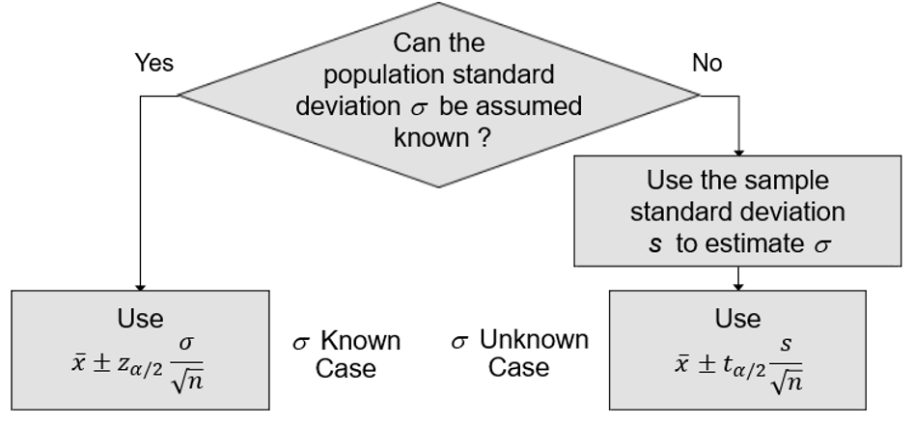
Summary of Interval Estimation Procedures for a Population Mean

Slide 25

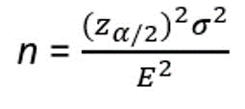
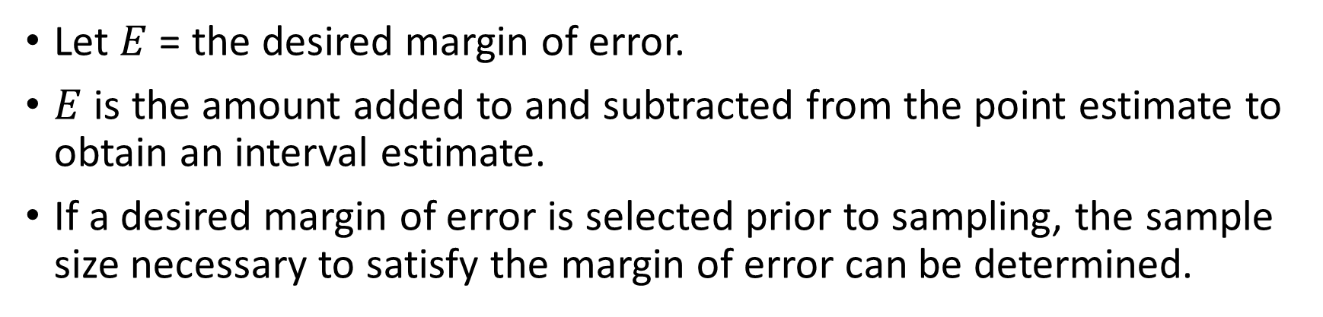
Sample Size for an Interval Estimate of a Population Mean (1 of 4)
Let $E$ = the desired margin of error.
$E$ is the amount added to and subtracted from the point estimate to obtain an interval estimate.
If a desired margin of error is selected prior to sampling, the sample size necessary to satisfy the margin of error can be determined.
Margin of error
Necessary sample size

Slide 26
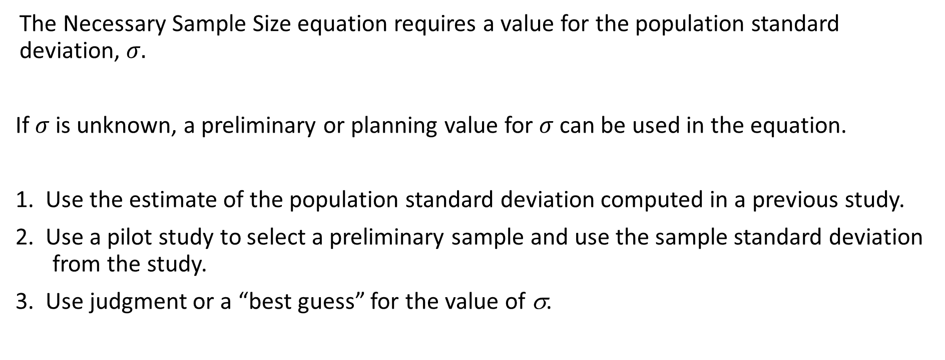
Sample Size for an Interval Estimate of a Population Mean (2 of 4)
The Necessary Sample Size equation requires a value for the population standard deviation, $σ.$
If $σ$ is unknown, a preliminary or planning value for $σ$ can be used in the equation.
1. Use the estimate of the population standard deviation computed in a previous study.
2. Use a pilot study to select a preliminary sample and use the sample standard deviation from the study.
3. Use judgment or a “best guess” for the value of σ.

Slide 27
Sample Size for an Interval Estimate of a Population Mean (3 of 4)
Example: Discount Sounds
Recall that Discount Sounds is evaluating a potential location for a new retail outlet, based in part, on the mean annual income of the individuals in the marketing area of the new location.
Suppose that Discount Sounds’ management team wants an estimate of the population mean such that there is a 0.95 probability that the sampling error is $500 or less.
How large a sample size is needed to meet the required precision?

Slide 28
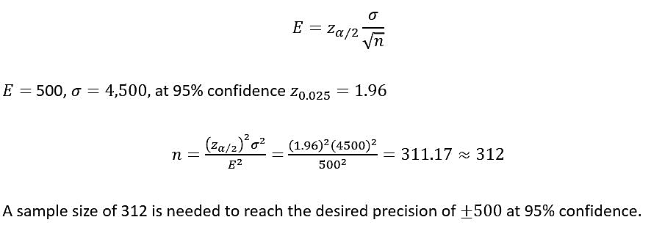
Sample Size for an Interval Estimate of a Population Mean (4 of 4)

Slide 29

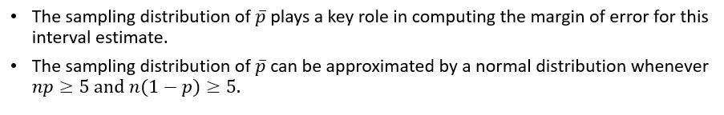
Interval Estimate of a Population Proportion (1 of 5)
The general form of an interval estimate of a population proportion is:

Slide 30
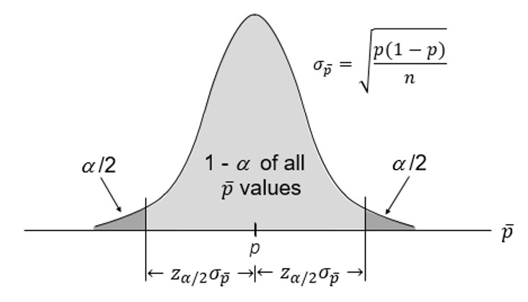
Interval Estimate of a Population Proportion (2 of 5)

Slide 31
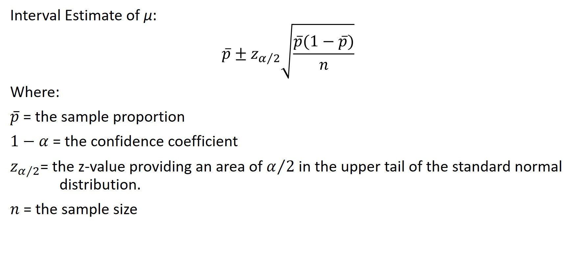
Interval Estimate of a Population Proportion (3 of 5)

Slide 32
Interval Estimate of a Population Proportion (4 of 5)
Example: Political Science, Inc.
Political Science Inc. (PSI) specializes in voter polls and surveys designed to keep political office seekers informed of their position in a race.
Using telephone surveys, PSI interviewers ask registered voters who they would vote for if the election were held that day.
In a current election campaign, PSI has just found that 220 registered voters, out of 500 contacted, favor a particular candidate. PSI wants to develop a 95% confidence interval estimate for the proportion of the population of registered voters that favor the candidate.

Slide 33
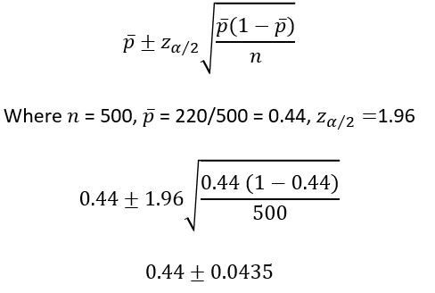
Interval Estimate of a Population Proportion (5 of 5)
PSI is 95% confident that the proportion of all voters that favor the candidate is between 0.3965 and 0.4835.

Slide 34


Sample Size for an Interval Estimate of a Population Proportion (1 of 4)
Margin of error
Solving for $n,$ the necessary sample size is

Slide 35

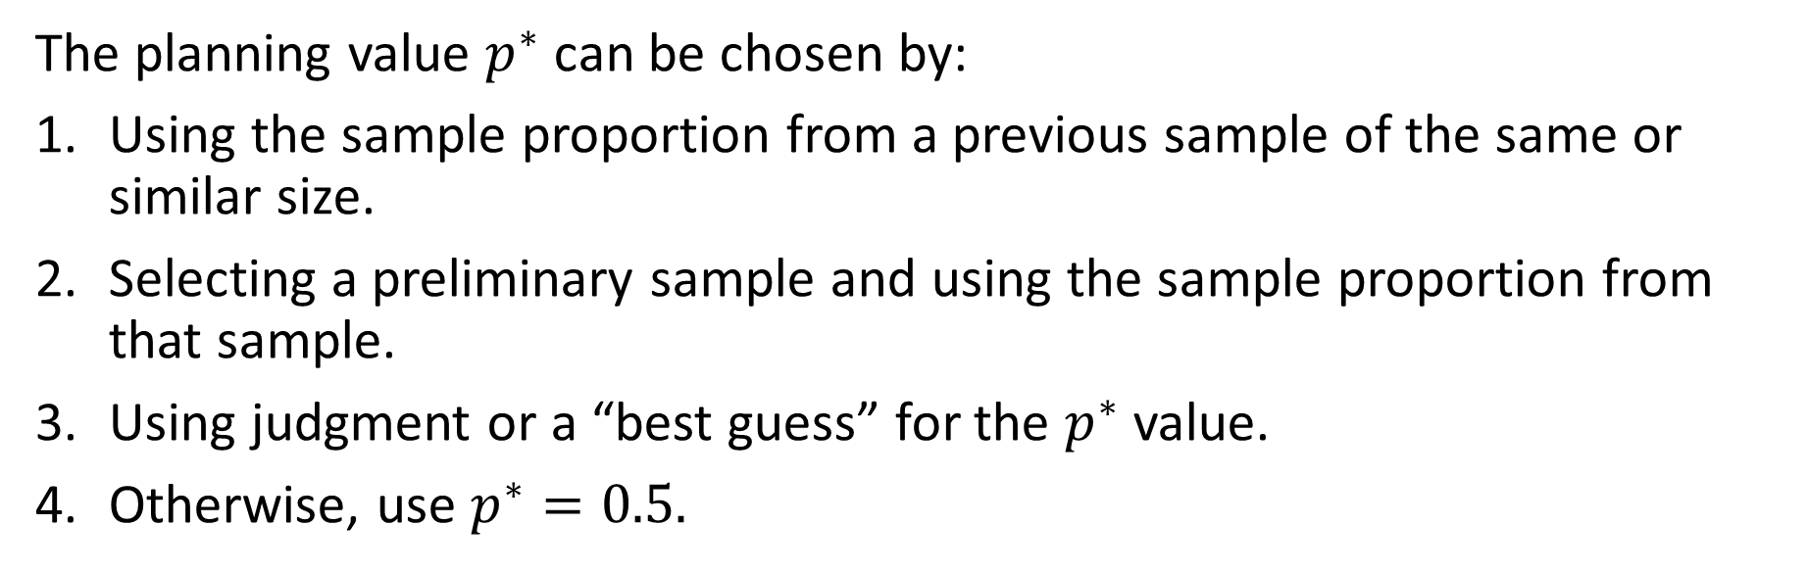
Sample Size for an Interval Estimate of a Population Proportion (2 of 4)
Necessary Sample Size
The planning value $p^{∗}$ can be chosen by:
Using the sample proportion from a previous sample of the same or similar size.
Selecting a preliminary sample and using the sample proportion from that sample.
Using judgment or a “best guess” for the $p^{∗}$ value.
Otherwise, use $p^{∗}=0.5.$

Slide 36
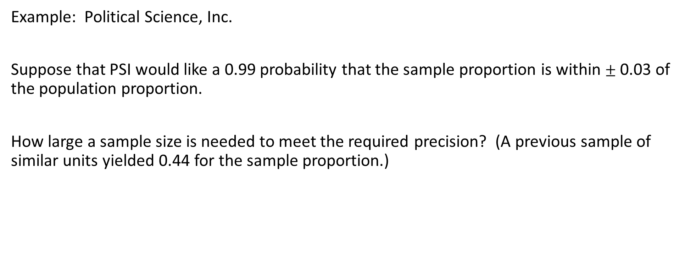
Sample Size for an Interval Estimate of a Population Proportion (3 of 4)
Example: Political Science, Inc.
Suppose that PSI would like a 0.99 probability that the sample proportion is within $±$ 0.03 of the population proportion.
How large a sample size is needed to meet the required precision? (A previous sample of similar units yielded 0.44 for the sample proportion.)

Slide 37
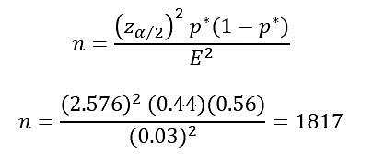
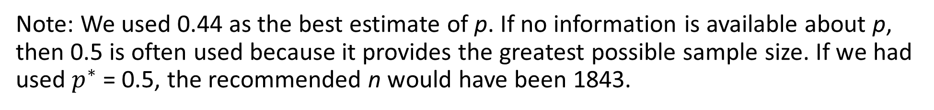
Sample Size for an Interval Estimate of a Population Proportion (4 of 4)
Note: We used 0.44 as the best estimate of p. If no information is available about p, then 0.5 is often used because it provides the greatest possible sample size. If we had used $p^{∗}$ = 0.5, the recommended n would have been 1843.

Slide 38

End of Chapter 8

