Slide 1
Statistics for
Business and Economics (14e)
Anderson, Sweeney, Williams, Camm, Cochran, Fry, Ohlmann
© 2020 Cengage Learning
© 2020 Cengage. May not be scanned, copied or duplicated, or posted to a publicly accessible website, in whole or in part, except for use as permitted in a license distributed with a certain product or service or otherwise on a password-protected website or school-approved learning management system for classroom use.

Slide 2
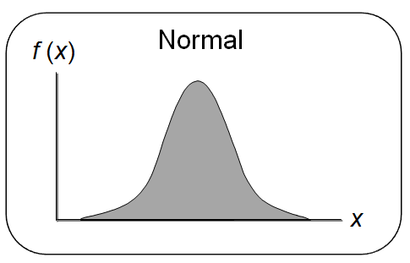
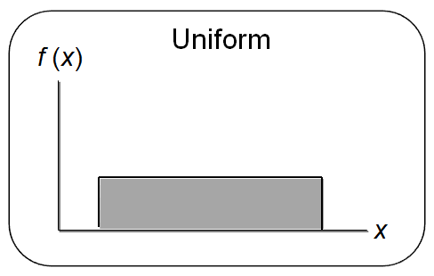
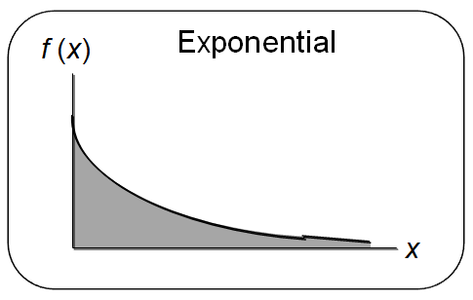
Chapter 6 - Continuous Probability Distributions
6.1 – Uniform Probability Distribution
6.2 – Normal Probability Distribution
6.3 – Normal Approximation of Binomial Probabilities
6.4 – Exponential Probability Distribution

Slide 3
Continuous Probability Distributions (1 of 2)
A continuous random variable can assume any value in an interval on the real line or in a collection of intervals.
It is not possible to talk about the probability of the random variable assuming a particular value.
Instead, we talk about the probability of the random variable assuming a value within a given interval.

Slide 4
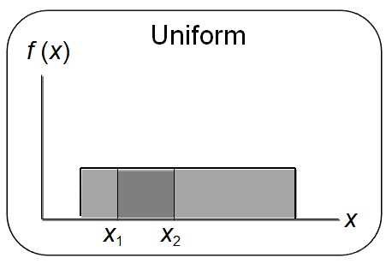
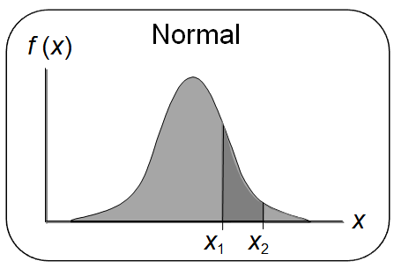
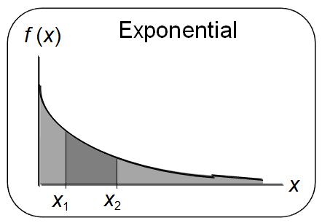
Continuous Probability Distributions (2 of 2)
The probability of the random variable assuming a value within some given interval from x₁ to x₂ is defined to be the area under the graph of the probability density function between x₁ and x₂.

Slide 5

Uniform Probability Distribution (1 of 5)
A random variable is uniformly distributed whenever the probability is proportional to the interval’s length.
The uniform probability density function is:
where: a = smallest value the variable can assume
b = largest value the variable can assume

Slide 6
Uniform Probability Distribution (2 of 5)
The expected value of x is E(x) = (a + b)/2.
The variance of x is Var(x) = (b – a)²/12.

Slide 7
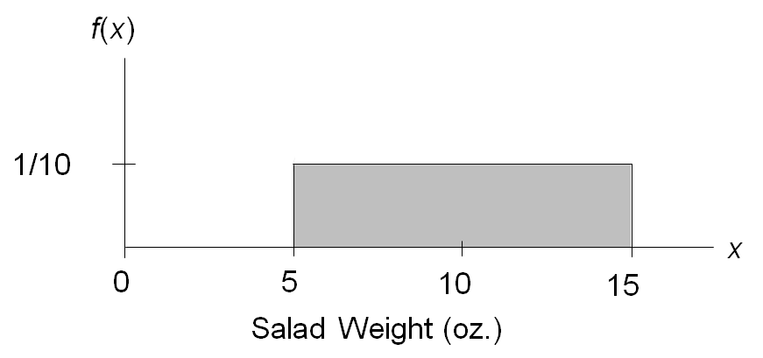

Uniform Probability Distribution (3 of 5)
Example: Slater's Buffet
  Slater’s customers are charged for the amount of salad they take. Sampling suggests that the amount of salad taken is uniformly distributed between 5 ounces and 15 ounces.
  The uniform probability density function is
where:
x = salad plate filling weight

Slide 8
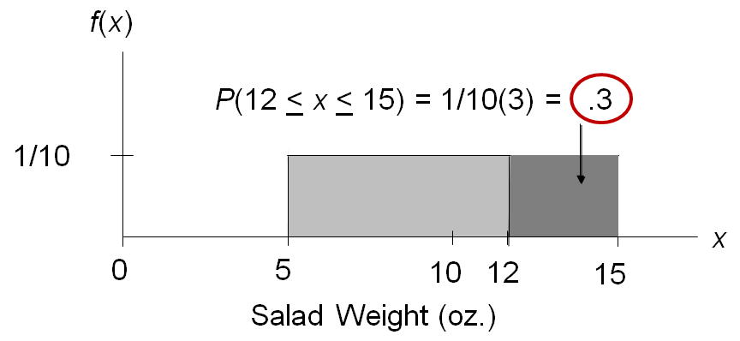
Uniform Probability Distribution (4 of 5)
What is the probability that a customer will take between 12 and 15 ounces of salad?

Slide 9
Uniform Probability Distribution (5 of 5)
The expected value of x is E(x) = (a + b)/2
= (5 + 15)/2
= 10
The variance of x is Var(x) = (b – a)²/12
= (15 – 5)²/12
= 8.33

Slide 10
Area as a Measure of Probability
The area under the graph of f(x) and probability are identical.
This is valid for all continuous random variables.
The probability that x takes on a value between some lower value x₁ and some higher value x₂ can be found by computing the area under the graph of f(x) over the interval from x₁ to x₂.

Slide 11
Normal Probability Distribution (1 of 7)
The normal probability distribution is the most important distribution for describing a continuous random variable.
It is widely used in statistical inference.
It has been used in a wide variety of applications including:
  Heights of people
  Amounts of rainfall
  Test scores
  Scientific measurements
Abraham de Moivre, a French mathematician, published The Doctrine of Chances in 1733.
He derived the normal distribution.

Slide 12
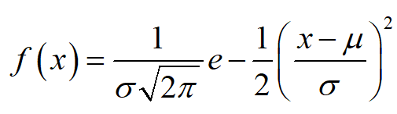
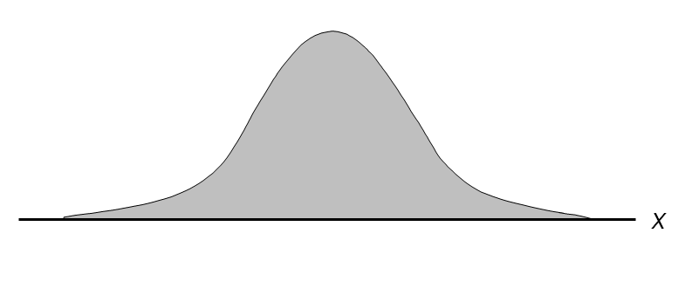
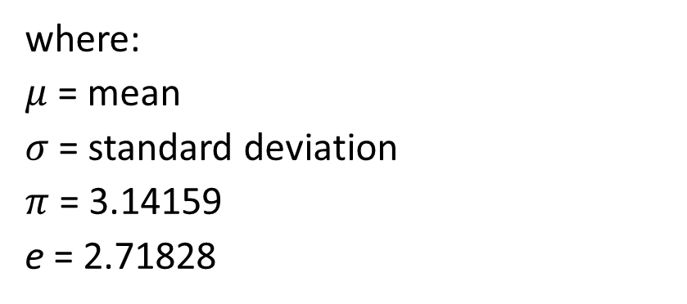
Normal Probability Distribution (2 of 7)
Normal Probability Density Function
where:
$μ$ = mean
$σ$ = standard deviation
$π$ = 3.14159
e = 2.71828

Slide 13
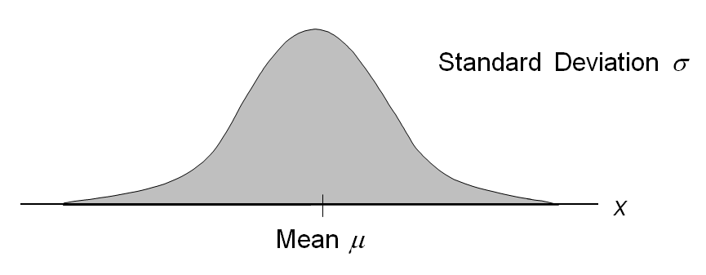
Normal Probability Distribution (3 of 7)
  The entire family of normal probability distributions is defined by its mean μ and its standard deviation σ.
  The highest point on the normal curve is at the mean, which is also the median and mode.

Slide 14
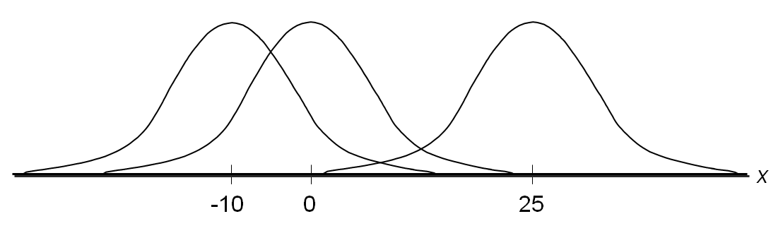
Normal Probability Distribution (4 of 7)
  The mean can be any numerical value: negative, zero, or positive.

Slide 15
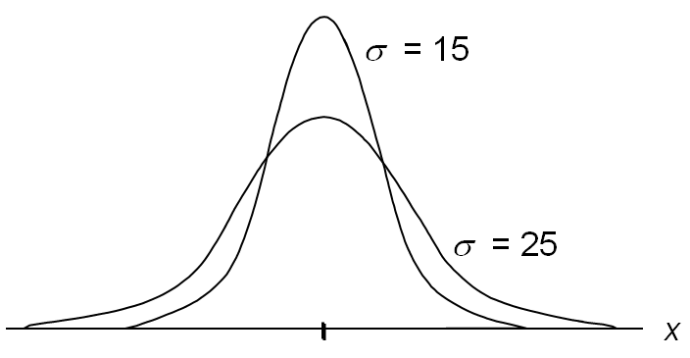
Normal Probability Distribution (5 of 7)
  The standard deviation determines the width of the curve: larger values result in wider, flatter curves.

Slide 16
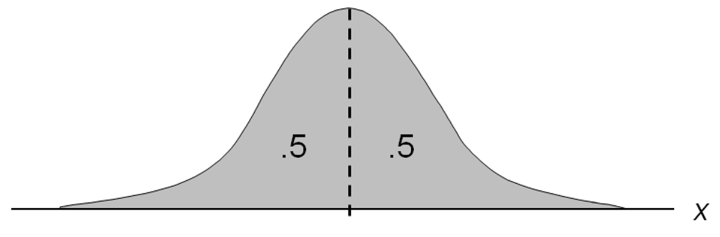
Normal Probability Distribution (6 of 7)
  Probabilities for the normal random variable are given by areas under the curve. The total area under the curve is 1 (0.5 to the left of the mean and 0.5 to the right).

Slide 17
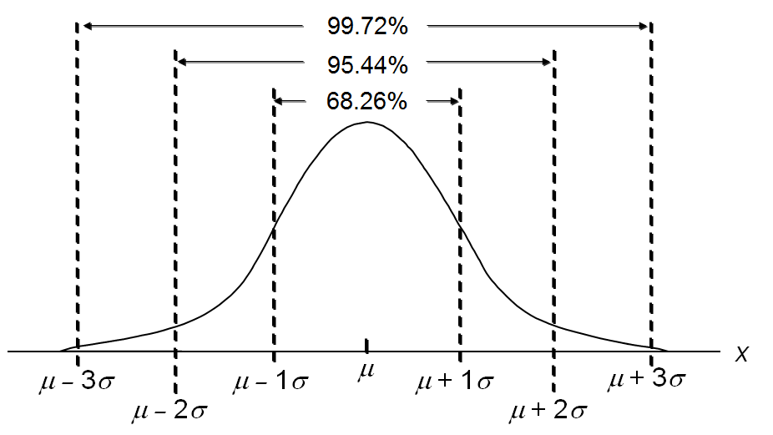
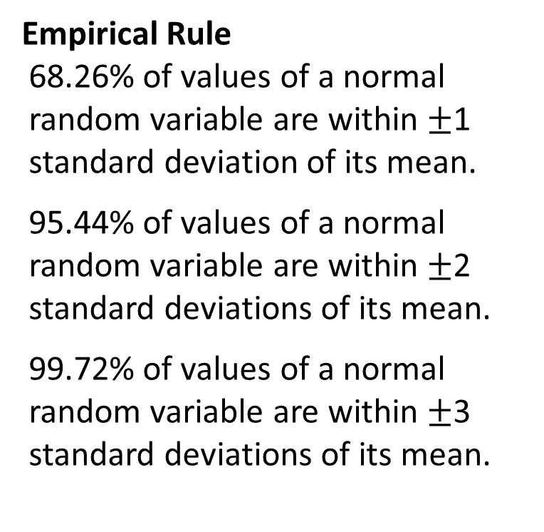
Normal Probability Distribution (7 of 7)
Empirical Rule
  68.26% of values of a normal random variable are within $±$1 standard deviation of its mean.
  95.44% of values of a normal random variable are within $±$2 standard deviations of its mean.
  99.72% of values of a normal random variable are within $±$3 standard deviations of its mean.

Slide 18
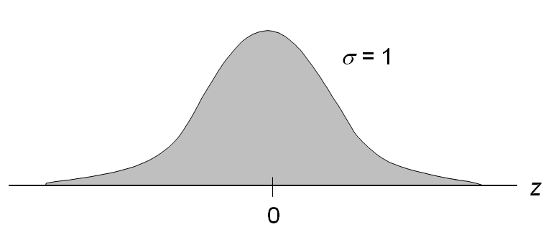
Standard Normal Probability Distribution (1 of 10)
  A random variable having a normal distribution with a mean of 0 and a standard deviation of 1 is said to have a standard normal probability distribution.
  The letter z is used to designate the standard normal random variable.

Slide 19
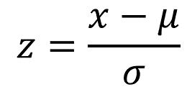
Standard Normal Probability Distribution (2 of 10)
Converting to the Standard Normal Distribution
We can think of z as a measure of the number of standard deviations x is from μ.

Slide 20
Standard Normal Probability Distribution (3 of 10)
Example: Pep Zone
  Pep Zone sells auto parts and supplies including a popular multi-grade motor oil. When the stock of this oil drops to 20 gallons, a replenishment order is placed.
  The store manager is concerned that sales are being lost due to stockouts while waiting for a replenishment order.
  It has been determined that demand during replenishment lead-time is normally distributed with a mean of 15 gallons and a standard deviation of 6 gallons.
  The manager would like to know the probability of a stockout during replenishment lead-time. In other words, what is the probability that demand during lead-time will exceed 20 gallons?

Slide 21
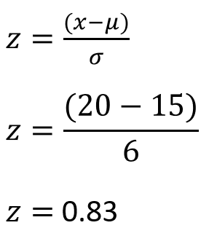
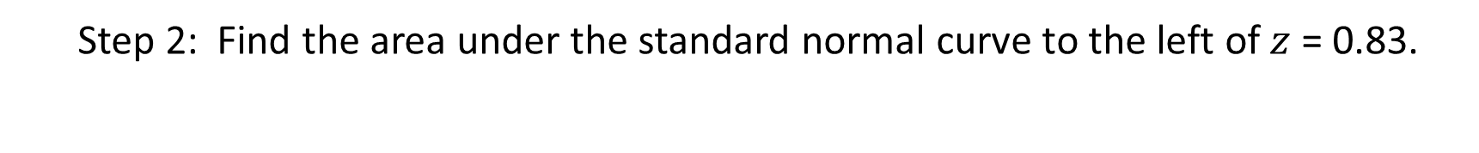
Standard Normal Probability Distribution (4 of 10)
Solving for the Stockout Probability
  Step 1: Convert x to the standard normal distribution.
  Step 2: Find the area under the standard normal curve to the left of $z$ = 0.83.

Slide 22

Standard Normal Probability Distribution (5 of 10)
Cumulative Probability Table for the Standard Normal Distribution
z | .00 | .01 | .02 | .03 | .04 | .05 | .06 | .07 | .08 | .09
. | . | . | . | . | . | . | . | . | . | .
.5 | .6915 | .6950 | .6985 | .7019 | .7054 | .7088 | .7123 | .7157 | .7190 | .7224
.6 | .7257 | .7291 | .7324 | .7357 | .7389 | .7422 | .7454 | .7486 | .7517 | .7549
.7 | .7580 | .7611 | .7642 | .7673 | .7704 | .7734 | .7764 | .7794 | .7823 | .7852
.8 | .7881 | .7910 | .7939 | .7967 | .7795 | .8023 | .8051 | .8078 | .8106 | .8133
.9 | .8129 | .8186 | .8212 | .8238 | .8264 | .8289 | .8315 | .8340 | .8365 | .8389
. | . | . | . | . | . | . | . | . | . | .

Slide 23
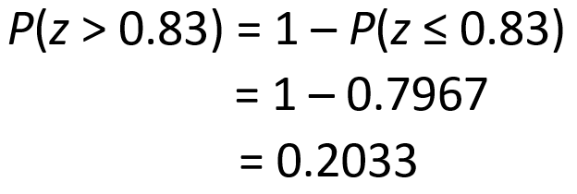
Standard Normal Probability Distribution (6 of 10)
Solving for the Stockout Probability
  Step 3: Compute the area under the standard normal curve to the right of z = 0.83.

Slide 24
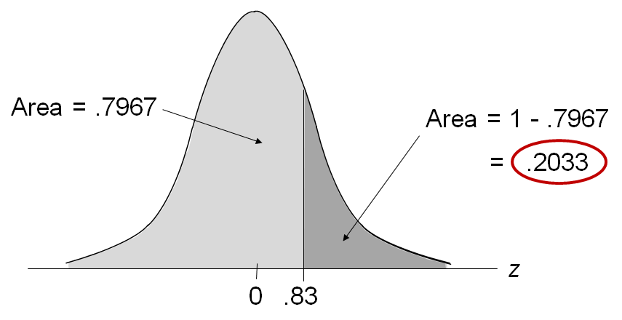
Standard Normal Probability Distribution (7 of 10)
Solving for the Stockout Probability

Slide 25
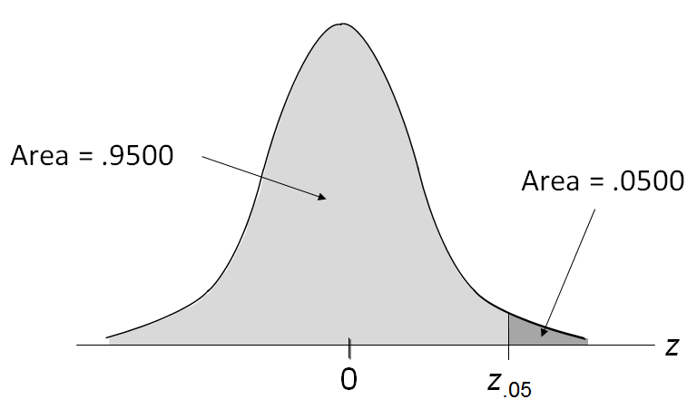
Standard Normal Probability Distribution (8 of 10)
If the manager of Pep Zone wants the probability of a stockout during replenishment lead-time to be no more than .05, what should the reorder point be?
(Hint: Given a probability, we can use the standard normal table in an inverse fashion to find the corresponding z value.)

Slide 26
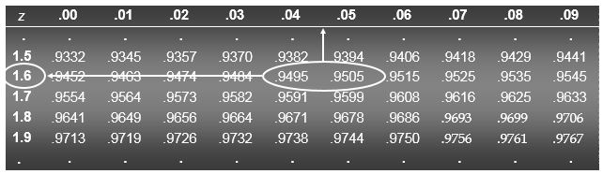
Standard Normal Probability Distribution (9 of 10)
Solving for the Reorder Point
  Step 1: Find the z-value that cuts off an area of .05 in the right tail of the standard normal distribution by looking up the complement of the right tail area 1 – 0.05 = 0.95.
z | .00 | .01 | .02 | .03 | .04 | .05 | .06 | .07 | .08 | .09
. | . | . | . | . | . | . | . | . | . | .
1.5 | .9332 | .9345 | .9357 | .9370 | .9382 | .9394 | .9406 | .9418 | .9429 | .9441
1.6 | .9452 | .9463 | .9474 | .9484 | .9495 | .9505 | .9515 | .9525 | .9535 | .9545
1.7 | .9554 | .9564 | .9573 | .9582 | .9591 | .9599 | .9608 | .9616 | .9625 | .9633
1.8 | .9641 | .9649 | .9656 | .9664 | .9671 | .9678 | .9686 | .9693 | .9699 | .9706
1.9 | .9713 | .9719 | .9726 | .9732 | .9738 | .9744 | .9750 | .9756 | .9761 | .9767
. | . | . | . | . | . | . | . | . | . | .

Slide 27
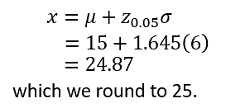
Standard Normal Probability Distribution (10 of 10)
Solving for the Reorder Point
  Step 2: Convert z_{.05} to the corresponding value of x.
A reorder point of 25 gallons will place the probability of a stockout during lead time at (slightly less than) 0.05.

Slide 28
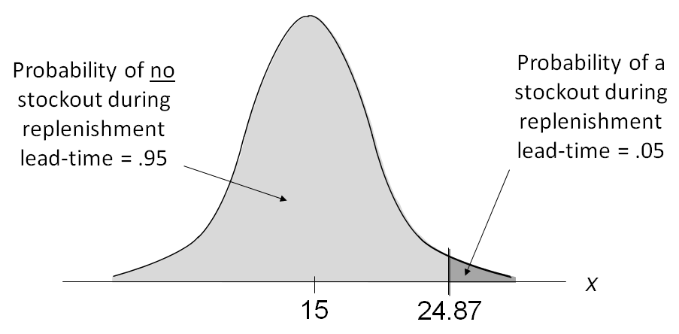
Normal Probability Distribution
Solving for the Reorder Point

Slide 29
Standard Normal Probability Distribution
Solving for the Reorder Point
  By raising the reorder point from 20 gallons to 25 gallons on hand, the probability of a stockout decreases from about .20 to .05.
  This is a significant decrease in the chance that Pep Zone will be out of stock and unable to meet a customer’s desire to make a purchase.

Slide 30
Using Excel to Compute Normal Probabilities
Excel has two functions for computing cumulative probabilities and x values for any normal distribution:
  NORM.DIST is used to compute the cumulative probability given an x value.
  NORM.INV is used to compute the x value given a cumulative probability.

Slide 31
Exponential Probability Distribution (1 of 4)
The exponential probability distribution is useful in describing the time it takes to complete a task.
The exponential random variables can be used to describe:
  Time between vehicle arrivals at a toll booth
  Time required to complete a questionnaire
  Distance between major defects in a highway
In waiting line applications, the exponential distribution is often used for service time.

Slide 32

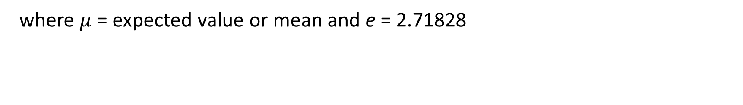
Exponential Probability Distribution (2 of 4)
A property of the exponential distribution is that the mean and standard deviation are equal.
The exponential distribution is skewed to the right. Its skewness measure is 2.
Density Function
where $μ$ = expected value or mean and e = 2.71828

Slide 33

Exponential Probability Distribution (3 of 4)
Cumulative Probabilities

Slide 34
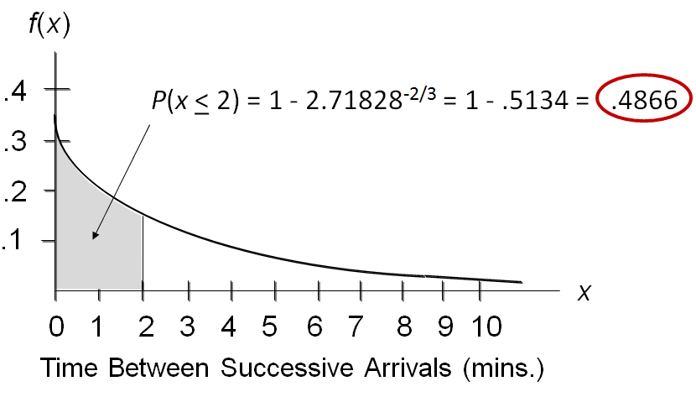
Exponential Probability Distribution (4 of 4)
Example: Al’s Full-Service Pump
  The time between arrivals of cars at Al’s full-service gas pump follows an exponential probability distribution with a mean time between arrivals of 3 minutes. Al would like to know the probability that the time between two successive arrivals will be 2 minutes or less.

Slide 35
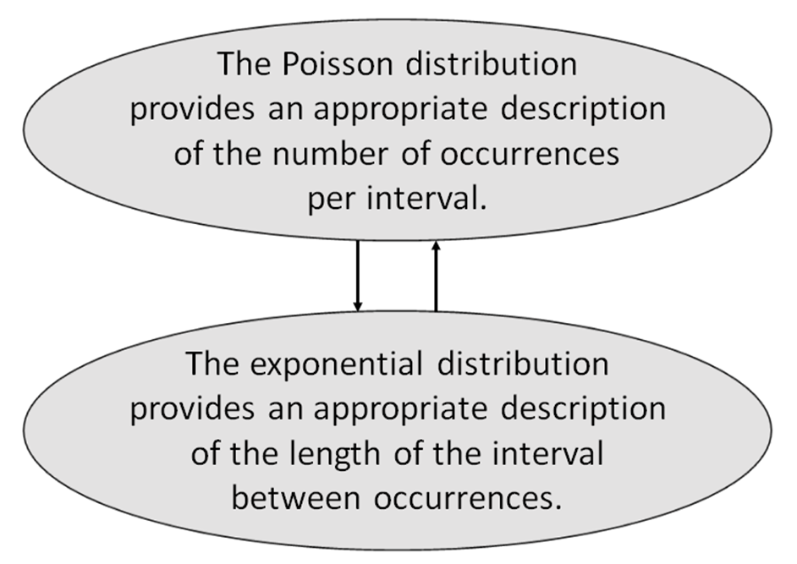
Relationship between the Poisson and Exponential Distributions

Slide 36

End of Chapter 6

