Slide 1

BC Code Review Tech Talk
1972
SCCS is created by Marc Rochkind
CVS is created by Dick Grune
2000
SVN is created Collabnet Inc.
2005
Git is created by Linus Torvalds
1986
MICHEAL Bloomquist
Travis lamb
Christina nguyen
Sarah rAMANAZI

Slide 2


What is Version control system?
Version control systems are a category of software tools that helps record changes to files by keeping a track of modifications done to the code.
Use of Version Control System:
A repository: It can be thought as a database of changes. It contains all the edits and historical versions of the project.
Copy of Work: It is the personal copy of all the files in a project. You can edit to this copy, without affecting the work of others and you can finally commit your changes to a repository when you are done making your changes.

Slide 3

First Generation: Source Code Control System (SCCS)
SCCS Commands
SCCS FILE
sccs create <filename.ext>: Check in a new file to SCCS and create a new history file
sccs get <filename.ext>: Check out a file from its corresponding history file and place it in the working directory in read-only mode.
sccs edit <filename.ext>: Check out a file from the corresponding history file for editing. Locks the history file so no other users can modify it.
Delta table
Access and tracking flags
Body of the text

Slide 4

Second Generation: 1. Concurrent Versions System (CVS)
CVS Commands
A central directory is known as a module
When a project is imported in CVS, each file is converted into a ,v history file.
export CVSROOT=<path/to/repo>: Set the CVS repository root directory.
cvs import -m 'Import module' <module-name> <vendor-tag> <release-tag>: Import files into a CVS module.
cvs checkout <module-name>: Copy a module
cvs commit <filename.ext>: Commit a changes.
cvs update: Update the module

Slide 5

Second Generation: 2. Apache Subversion (SVN)
An SVN repo layout has three folders in root:
trunk/
branches/
tags/
SVN Commands
svn create <path-to-repo>: Create an empty repository in the specified directory.
svn import <path-to-project> <svn-url>: Import a directory of files into a SVN repo path.
svn checkout <svn-path> <path-to-checkout>: Copy a stored repo path to a working directory.
svn commit -m 'Commit message': Commit changes
svn update: Update repo.

Slide 6

Third Generation: 1. Git
The Big 5 The Essential two
Status: Tells you the status of current working tree.
Log: Prints a history(log) of all commits in a repo.
Clone: Copy the entire source code repo locally.
Pull: Fetches change from remote server and merges with local copy.
Push: Publish changes to remote server.
Add: Adds files to the staging area.
Commit: Record changes to Git Repo.

Slide 7

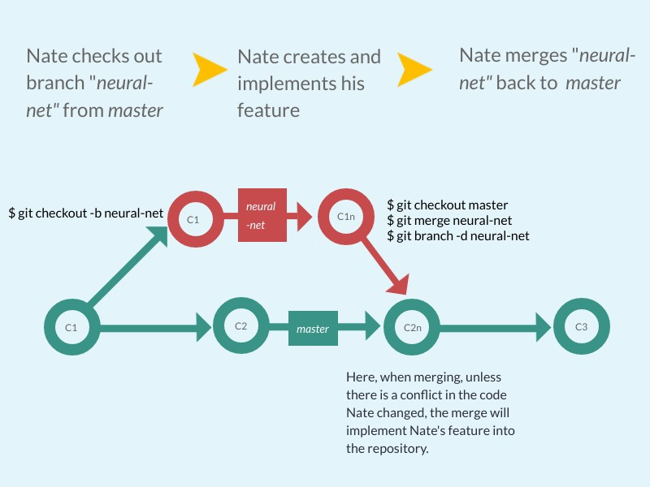
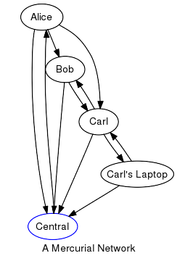
Third Generation: 1. Mercurial
Difference from git visualized
GIT:
Mercurial:

