Slide 1

BC Code Reviewer – Final Presentation
Christina Nguyen
Michael Bloomquist
Sarah Ramazani
Travis Lamb

Slide 2

DESCRIPTION OF THE PROJECT

Slide 3
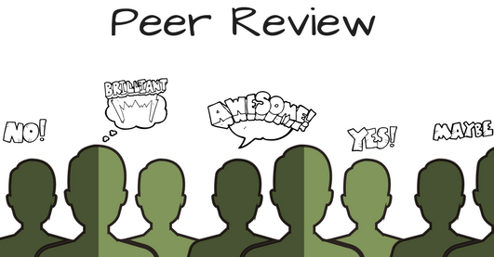

Slide 4
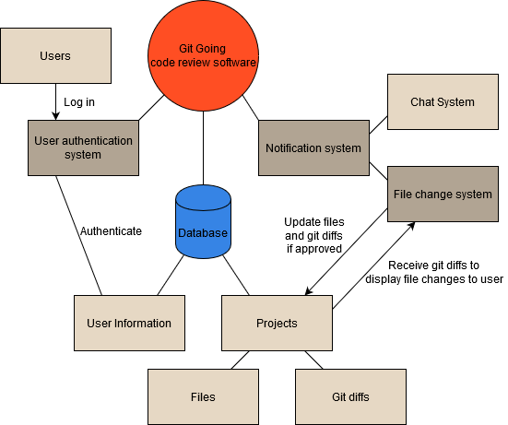
USER functional REQUIREMENTS
Registration
Login
Logout
Notification System
Chat System
File Change System

Slide 5
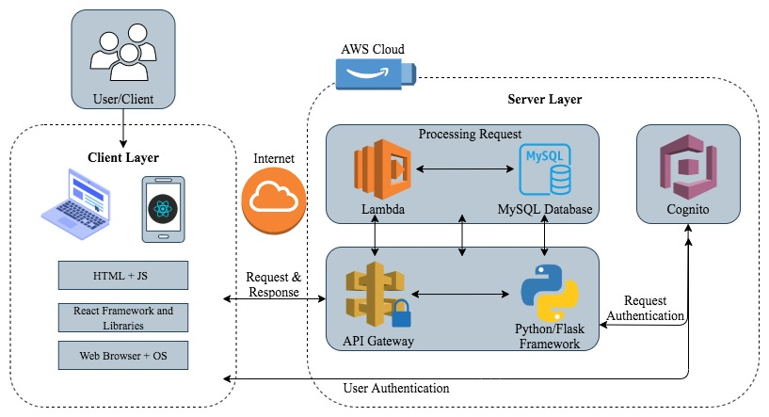
Architectural design
Client-Server pattern
Client layer: HTML, JS, React Frameworks etc.
Server layer: AWS cloud, API gateway, Python/Flask Framework
Processing Request: Lambda and a MySQL database
Output: PC, smartphone, or laptop.

Slide 6

Techniques and technologies
Create web applications (frontend)
Implement login/registration system, notification system
open source development platform for executing JavaScript code
Implement Node.js+Express API to connect to database
React, MYSQL
AWS, Congnito
Node.js, Express
Amazon authentication tool
Implement Cognito API on generic react for log-in functionality
AWS
Hosting MYSQL database/Web app
open source relational database management system
Storing user information, review info etc.

Slide 7
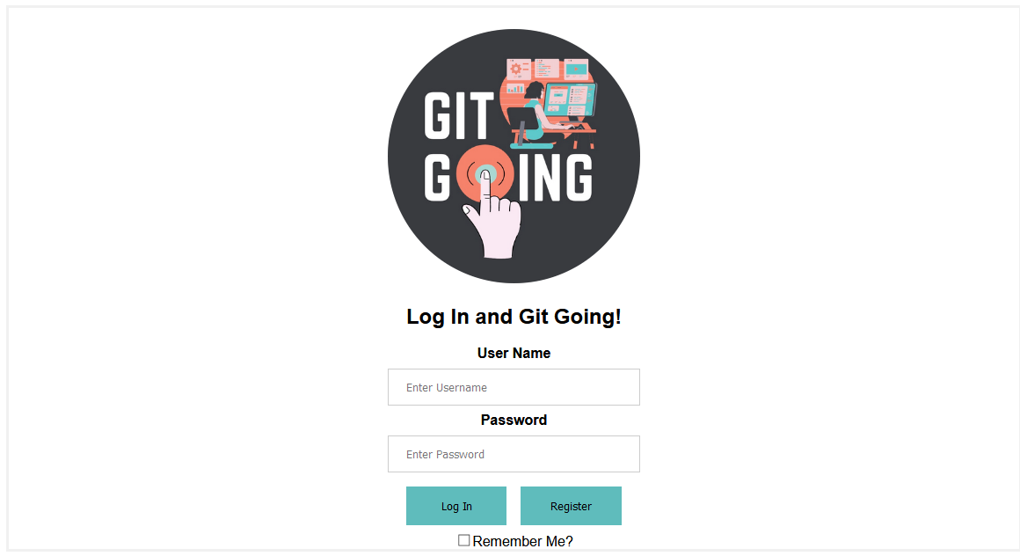
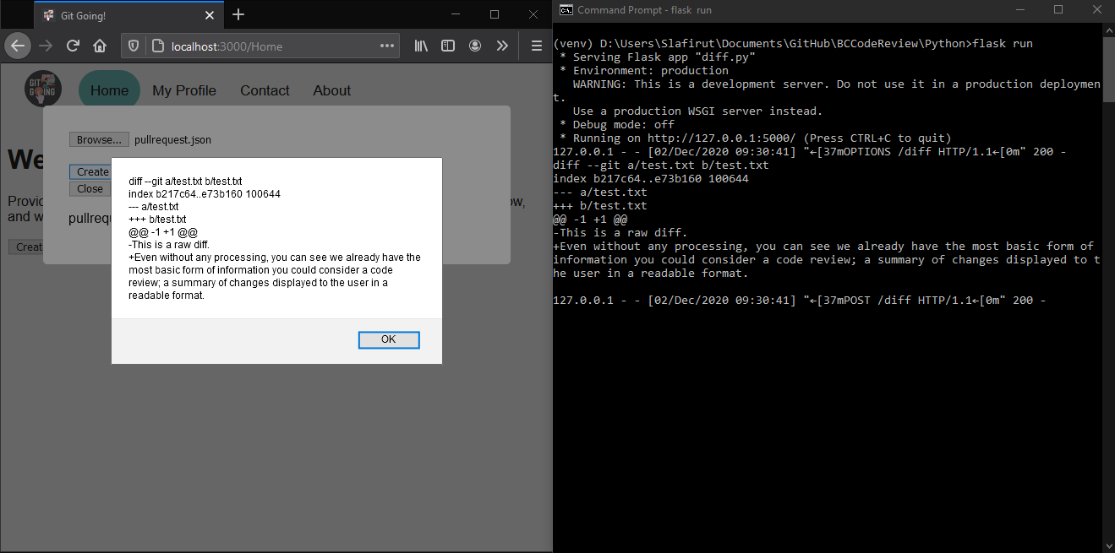
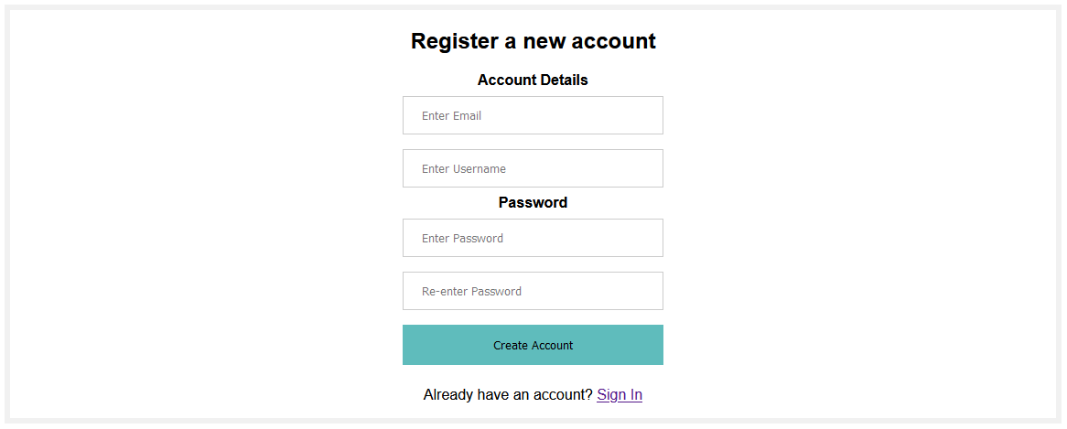
Our biggest coding achievements
Partially functioning login system
Functioning registration system which pushes new user information into a hosted database with a POST request
Diff retrieval from a remote directory with a POST request

Slide 8
Testing efforts (headaches)

