Slide 1

A user’s guide to user authentication
Presented by: Christina Nguyen, Michael Bloomquist, Sarah Ramazani, Travis Lamb

Slide 2

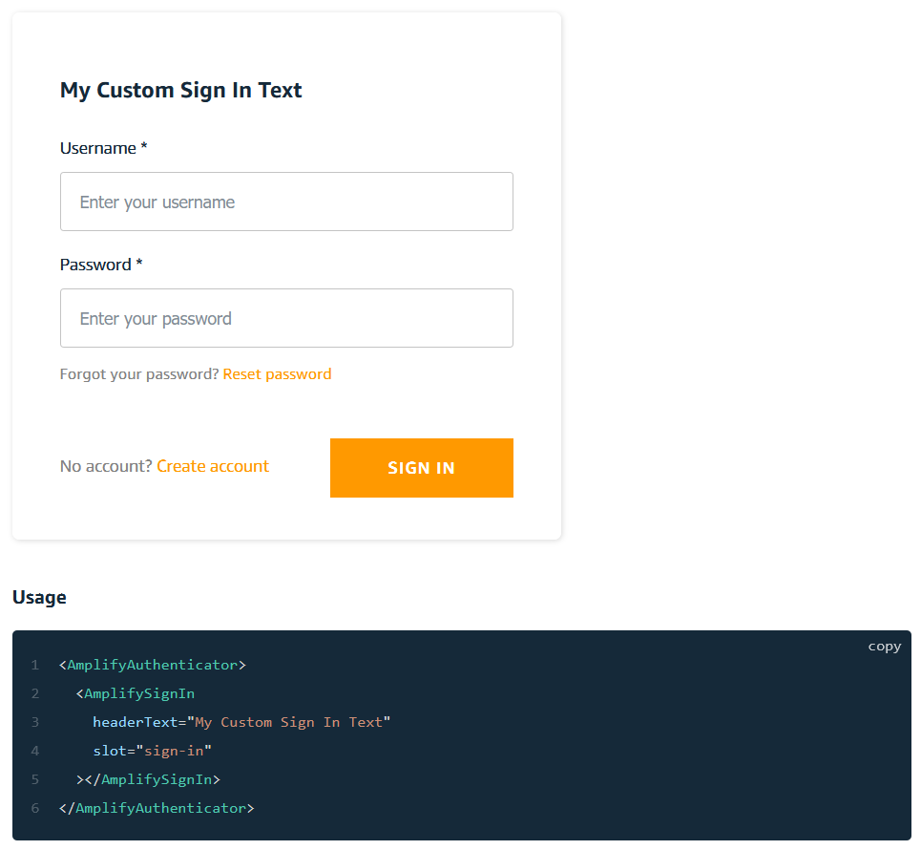
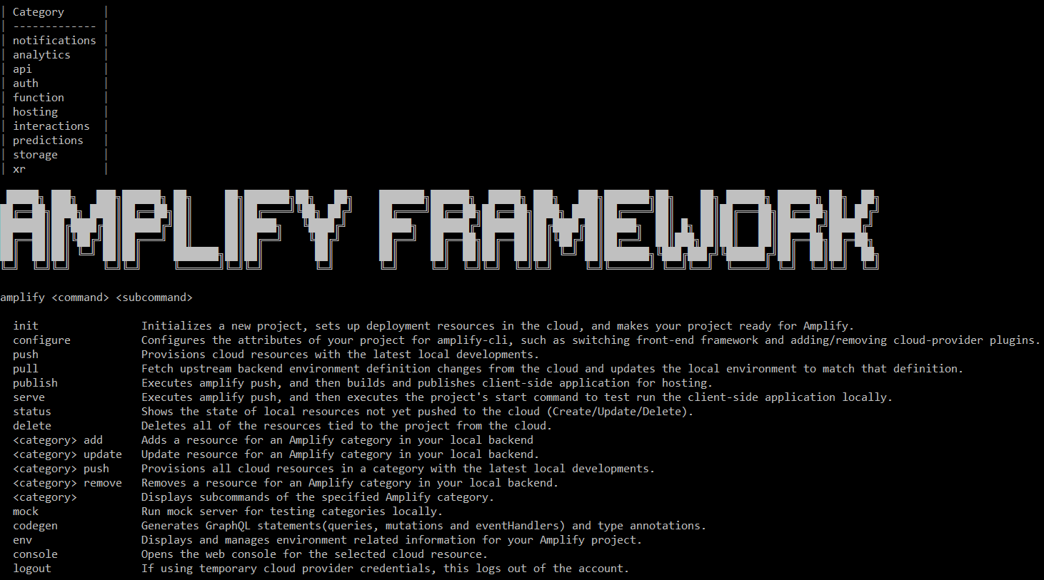
What is Amplify?
An open-source toolset designed to ease the process of setting up AWS backends
Provides the user with a CLI which is used for provisioning backend services
Pre-built UI components allow quick implementation of common systems

Slide 3
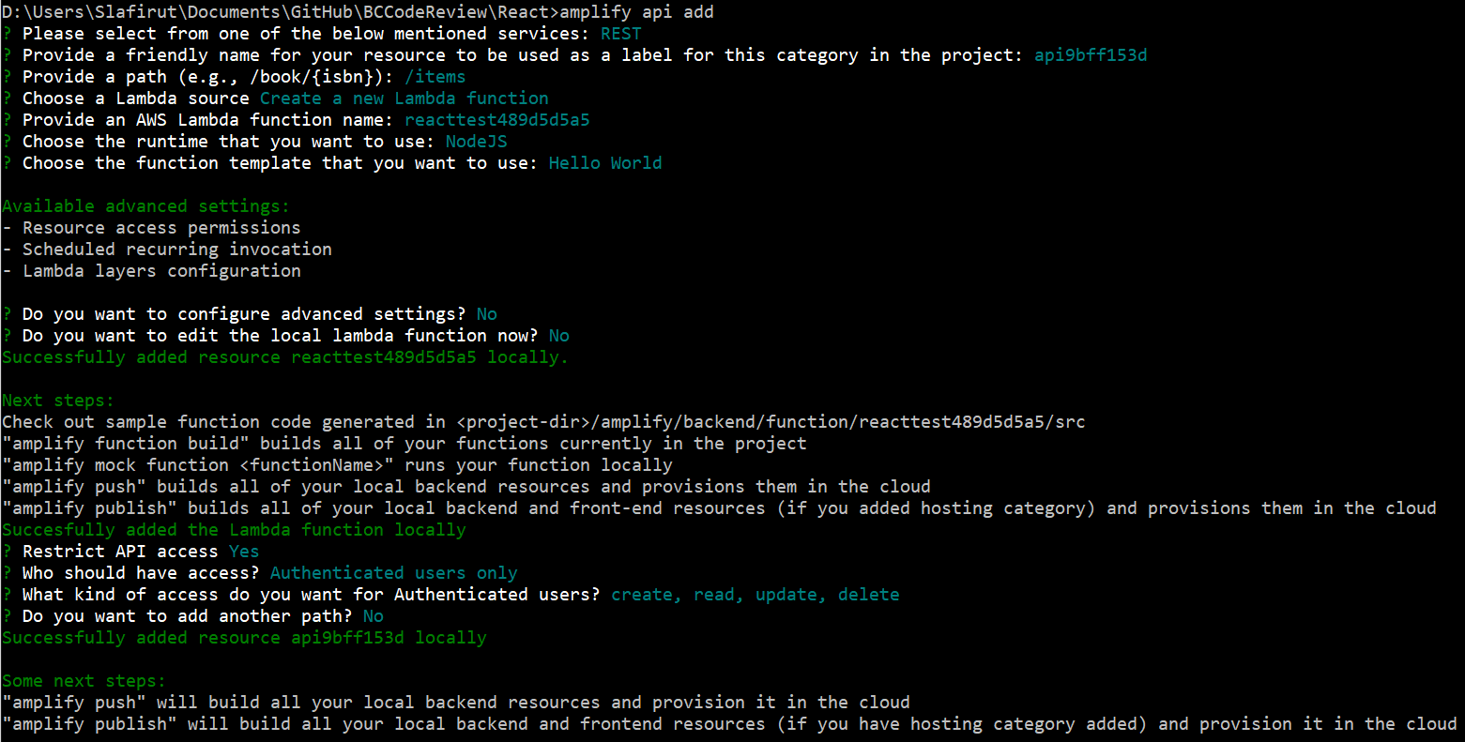
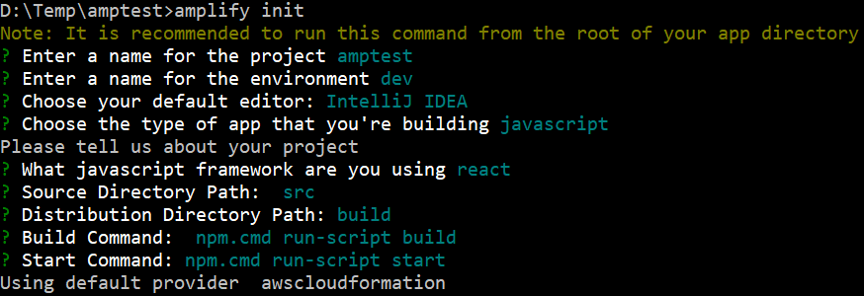
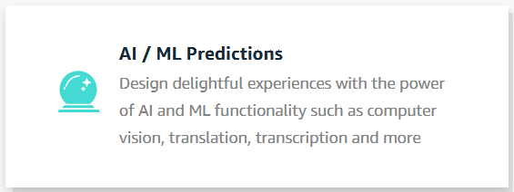
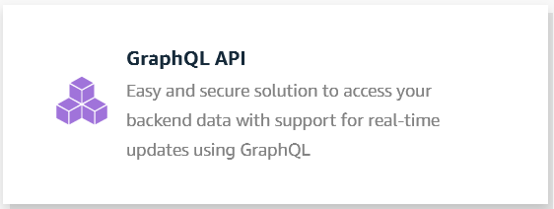
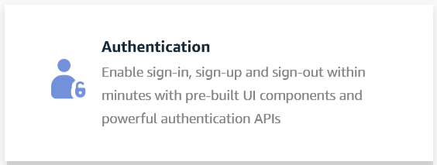
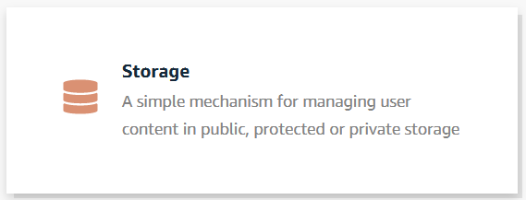
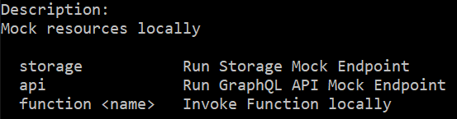
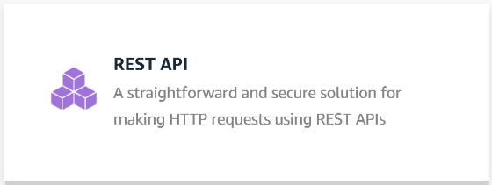
The Amplify CLI
Common commands
amplify init
amplify add
amplify pull
amplify mock
Categories
Auth
API
Storage
Predictions

Slide 4
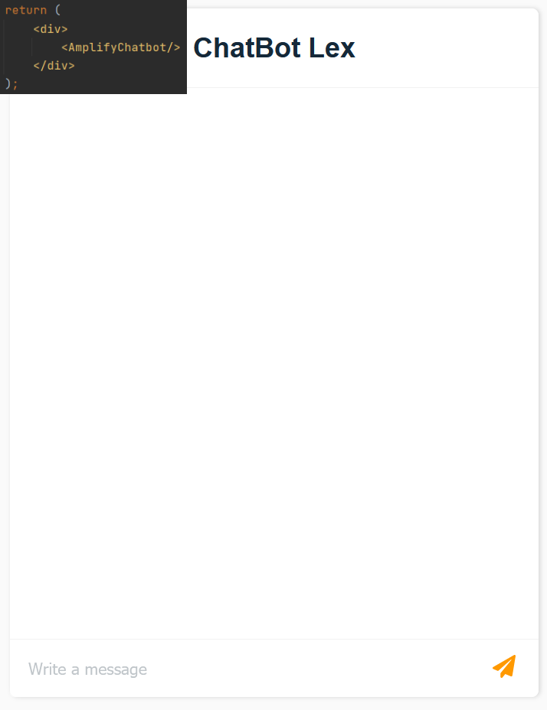
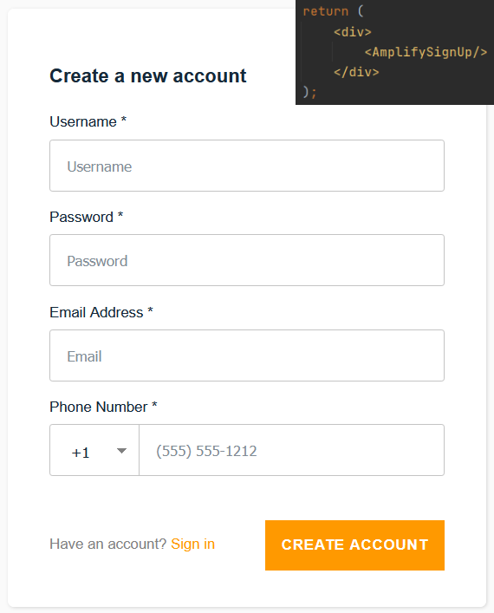
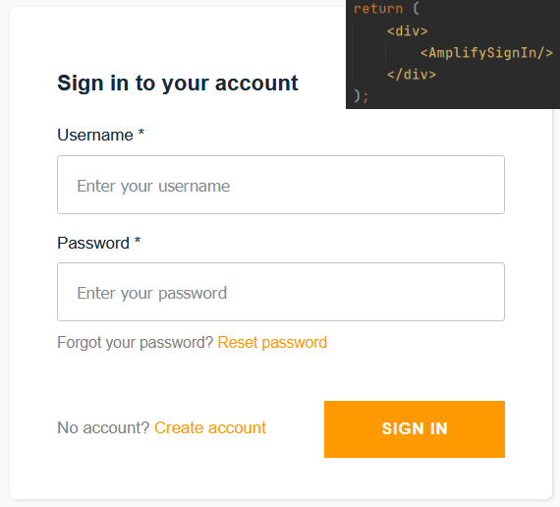
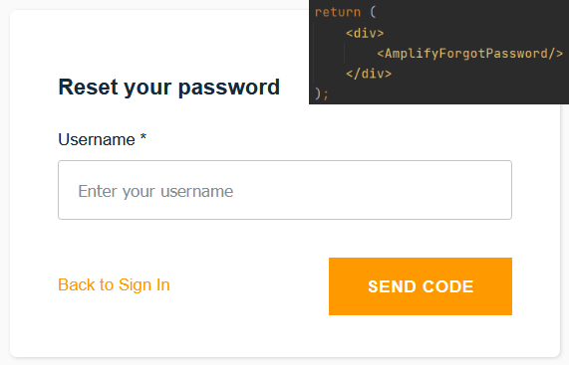



Pre-built UI components
Designed for quick implementation, not necessary
UI components for multiple frameworks (such as React, Angular, Vue)
Auth
AmplifySignUp
AmplifySignIn
AmplifyForgotPassword
Chatbot

