Slide 1

BC Code Reviewer – Final Presentation
Christina Nguyen
Michael Bloomquist
Sarah Ramazani
Travis Lamb

Slide 2

DESCRIPTION OF THE PROJECT

Slide 3
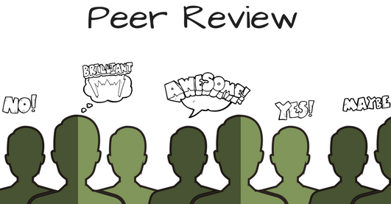

Slide 4
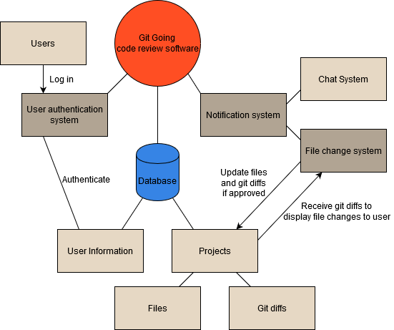
USER functional REQUIREMENTS
Registration
Login
Logout
Notification System
Chat System
File Change System

Slide 5
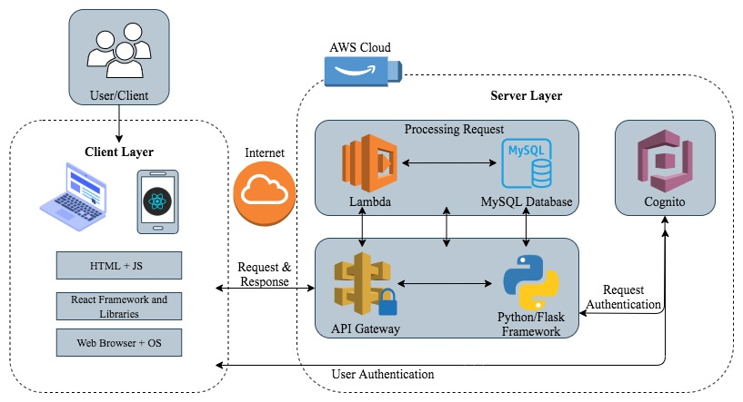
Architectural design
Client-Server pattern
Client layer: HTML, JS, React Frameworks etc.
Server layer: AWS cloud, API gateway.
Processing Request: Lambda and a MySQL database
Output: PC, smartphone, or laptop.

Slide 6

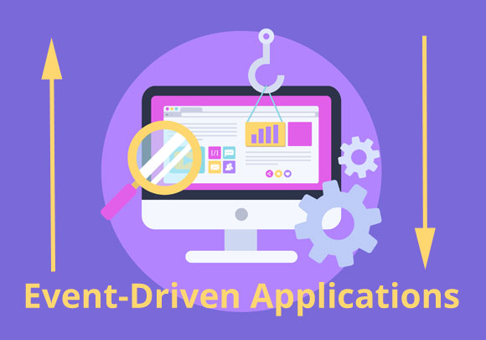
Techniques and technologies
Technologies:
Dependencies
React. MYSQL, AWS, Congnito
Flask, Node.js, Express.js
Techniques:
Event-Driven approach

Slide 7
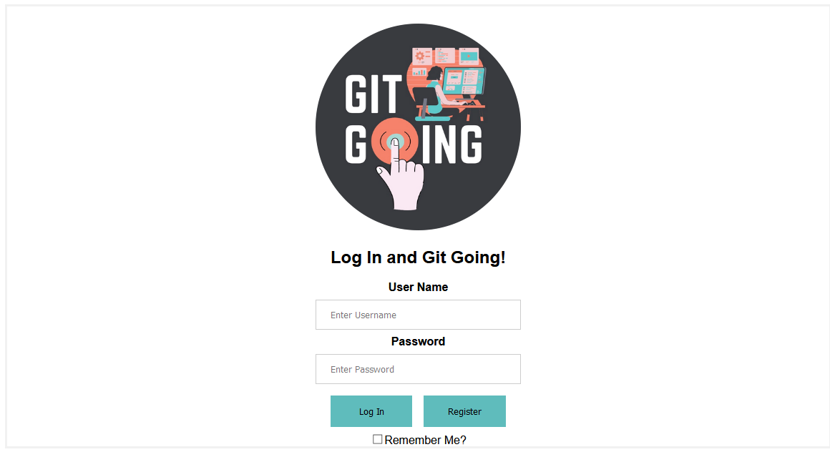
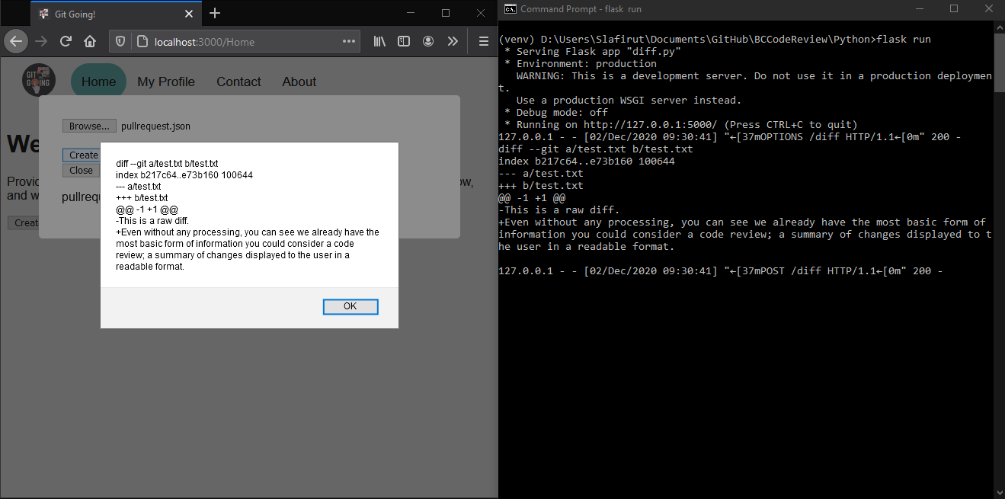
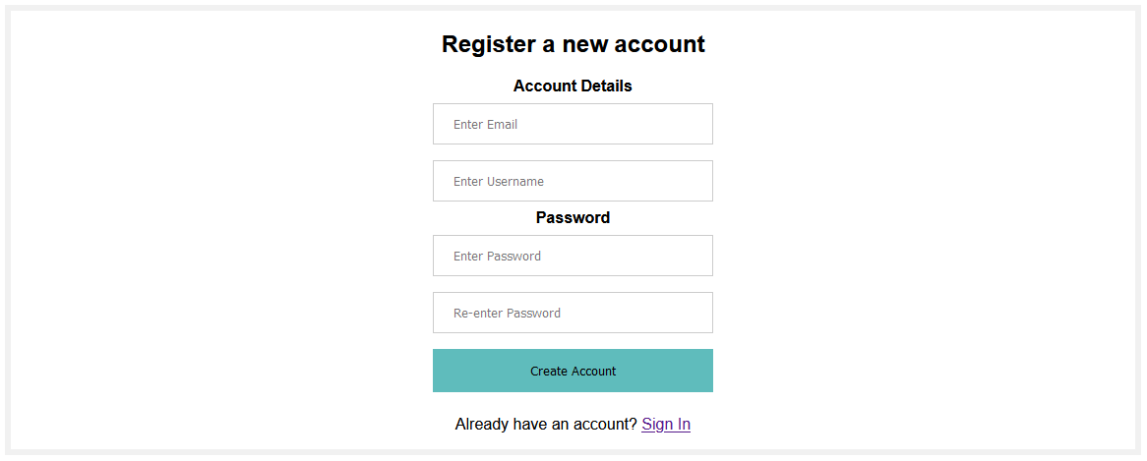
Our biggest coding achievements
Partially functioning login system
Functioning registration system which pushes new user information into a hosted database with a POST request
Diff retrieval from a remote directory with a POST request

Slide 8
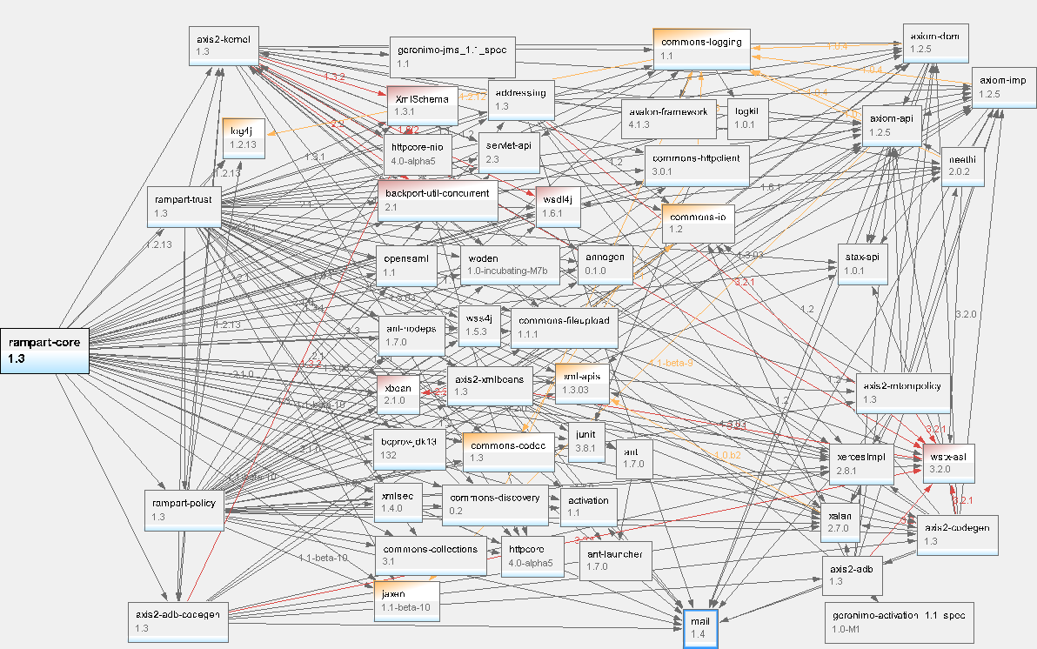
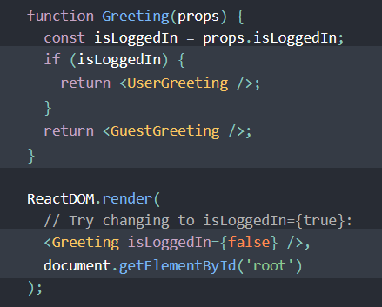
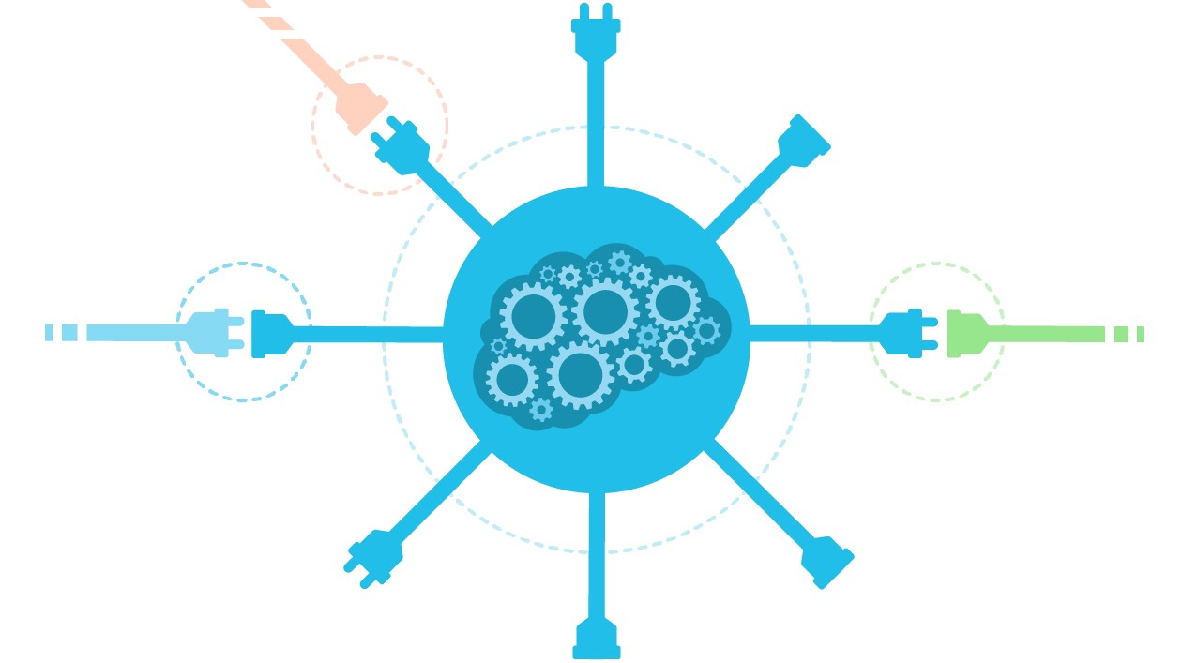

Testing efforts (headaches)
Conditional Rendering
Excessive, unsupported or unnecessary dependencies
Setting up APIs to transfer information between systems
Unexpected Obstacles

