Slide 1

Qiyas AI and Data Science Hackathon
Ethiopian Farm Intelligence
Team Alpha
Team Members
  Saron Hailemichael
  Abdi Mudesir
  Meftuha Kedir
  Wissam Jemal
  Yedidya Solomon
  Kidist Dagnachaew
Oct 2026

Slide 2
PROBLEM AND DATASET
Ethiopian Farm
Intelligence
From raw farm + weather + price data to reliable yield prediction and farm-revenue insight.
15,090
3,750
3
LightGBM
training plots
test plots
data sources
final model
5 regions • 5 crops
final competition predictions
plots • weather • prices
weather included
Problem
Our pipeline
Predict yield_tons_per_ha for Ethiopian smallholder farms while keeping the workflow leakage-safe and explainable.
Clean
→
Join weather
→
Analyze
→
Model
→
Predict
Price is excluded from model features and used only after prediction for revenue.

Slide 3
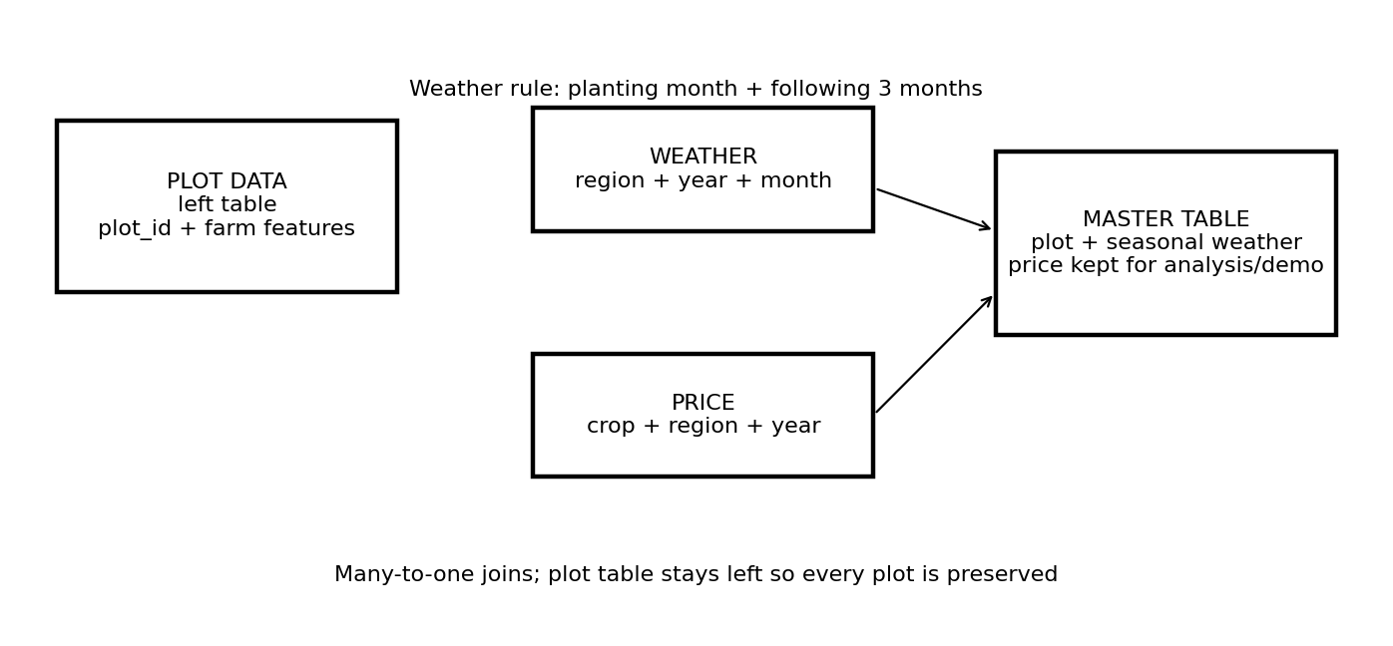
CLEANING & INTEGRATION
Turning messy sources into one modeling table
Standardize → aggregate growing-season weather → left join → audit
100%
100%
weather match rate
price match rate
train + test
analysis/revenue only
2,925
748
train incomplete
test incomplete
weather windows
weather windows
Growing-season rule
Planting month + following 3 months → seasonal rainfall, mean temperature and extreme-heat days.
Rows were preserved after joins; integrity checks protect IDs, target separation and leakage rules.

Slide 4
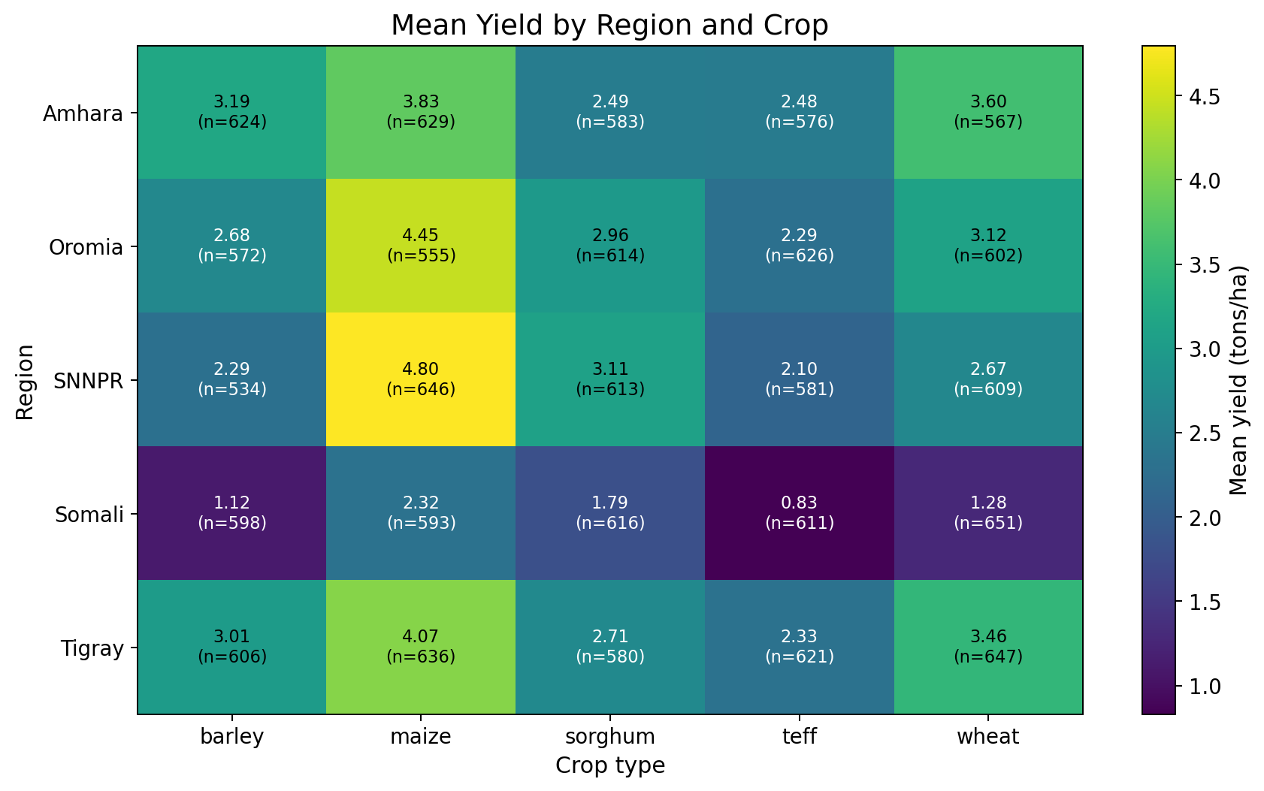
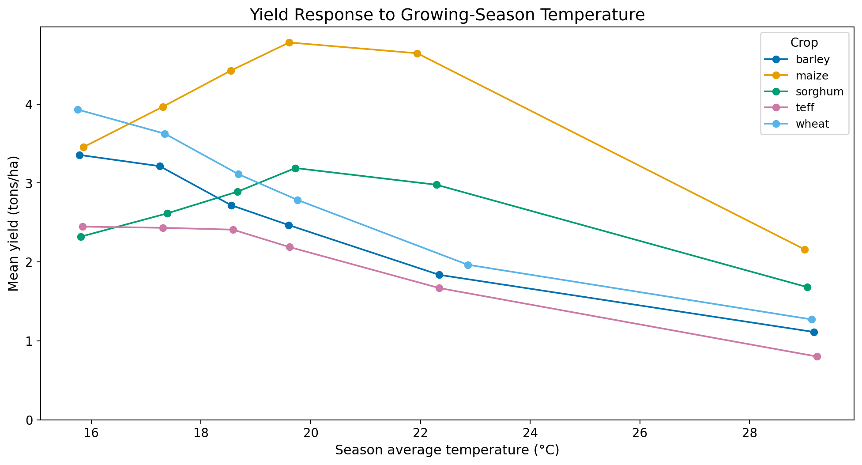
WHAT THE DATA SAYS
Two patterns that matter for yield
Region × crop differences are large, and growing-season temperature response varies by crop.
Finding 1
Yield differs strongly across region crop combinations.
Finding 2
Temperature yield patterns differ by crop; one climate response does not fit every crop.
Agronomic analysis also examined fertilizer, altitude, planting month and distance to market; distance had almost no linear relationship with yield (r ≈ 0.005).

Slide 5
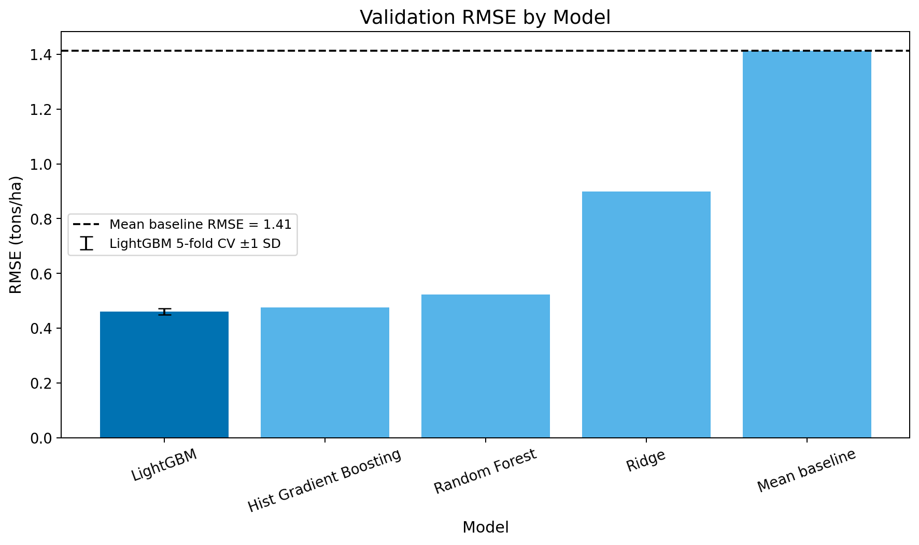
MODELING & EVALUATION
LightGBM gave the strongest validation performance
Same split and features for fair comparison; final model checked with CV, time split and weather ablation.
0.459
0.336
RMSE
MAE
tons/ha
tons/ha
0.894
0.469 ± 0.011
R²
5-fold CV
validation
RMSE
Weather was worth the join
RMSE improved from 0.4899 → 0.4593 t/ha, about a 6.2% reduction.
Out-of-time 2024 RMSE: 0.4845 t/ha

Slide 6
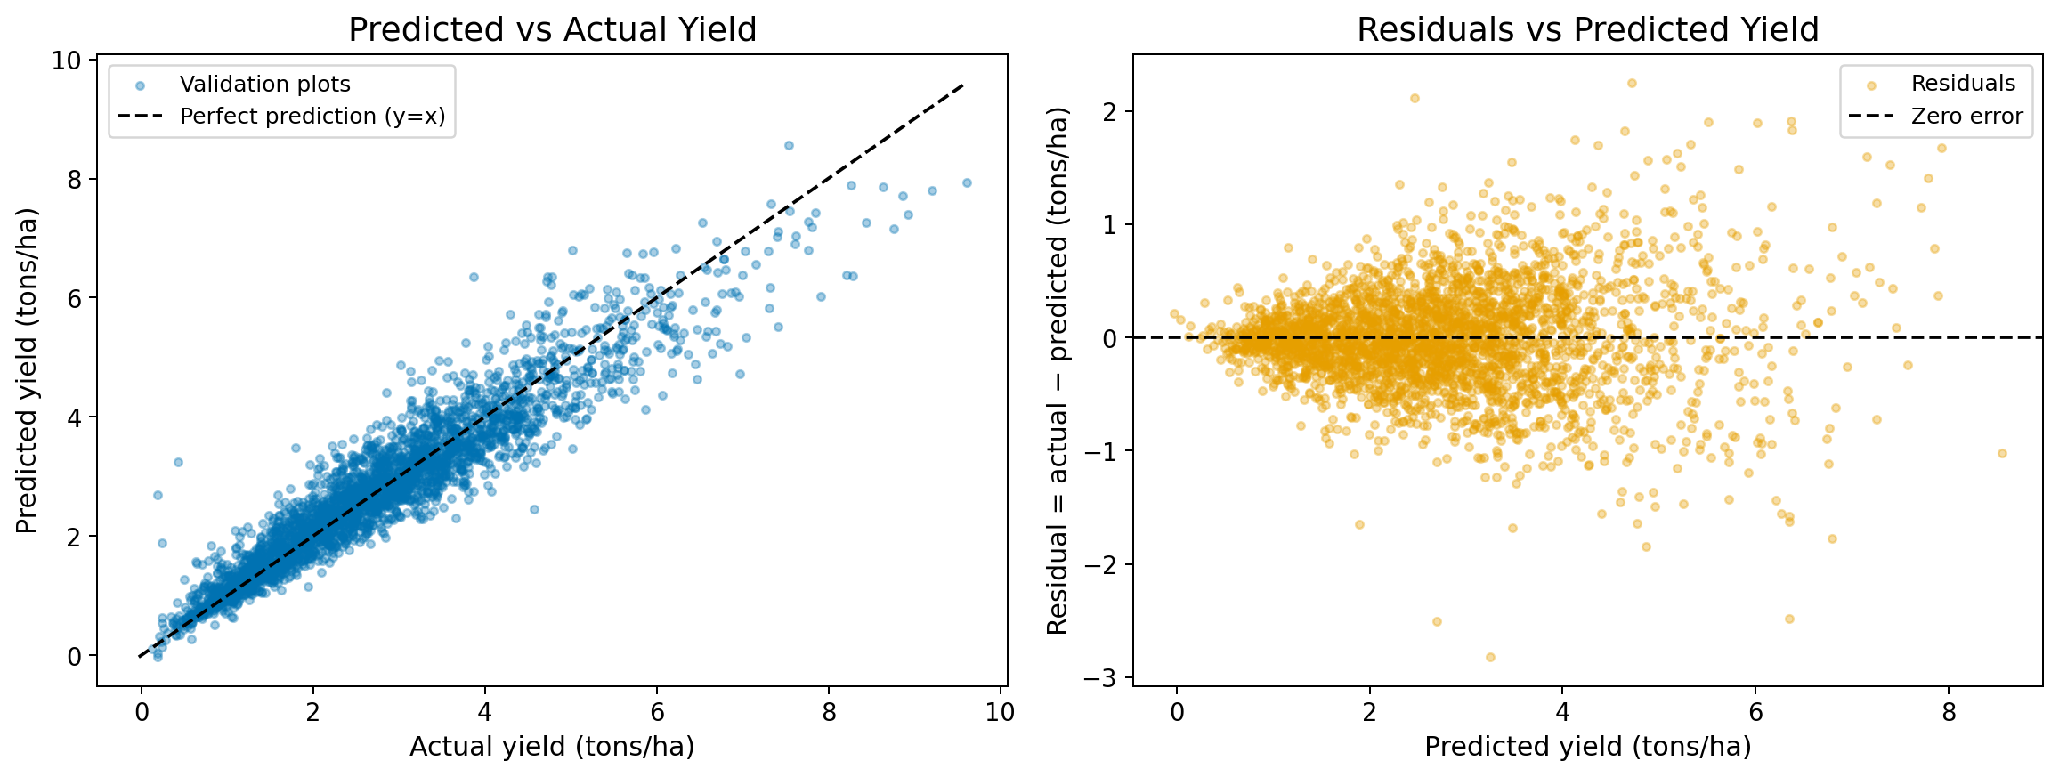
ERROR → DECISION → DEMO
What the model gets wrong and how we use it
We inspected residuals, tested a response to large errors, then packaged the model into a Streamlit decision demo.
D8 Response to errors
0.5–99.5% prediction clipping worsened RMSE (0.4593 → 0.4620), so we rejected it.
Plain language impact
RMSE ≈ 16.6% of mean yield • MAE ≈ 12.1% • approximate MAE value ≈ 15,537 birr/ha.
LIVE DEMO
Farm inputs → automatic weather + price lookup → predicted yield → estimated revenue
Next: deploy the Streamlit app and add its public URL to README + this slide.

Slide 7
Thank You

