Slide 1
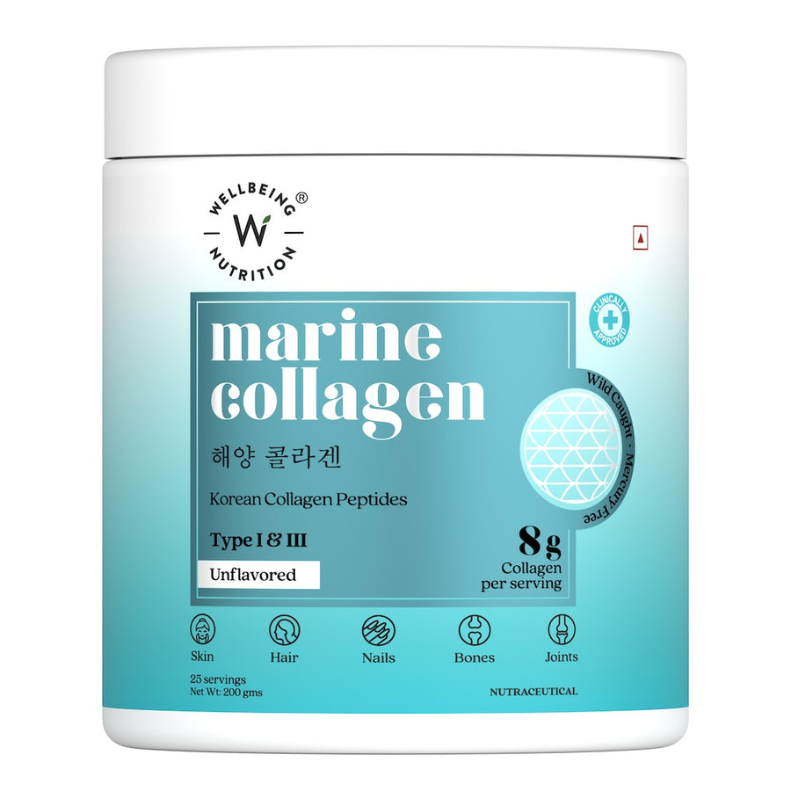
Wellbeing Nutrition
People do judge
a book by
its cover
A conversion rate optimisation proposal for Korean Marine Collagen
A product page that earns belief before it asks for a purchase
CRO proposal · September 2026
Notes:
Sources: Wellbeing Nutrition Korean Marine Collagen product page, accessed for this assignment; W3C WCAG 2.2 Target Size and Reflow guidance. All conversion outcomes are hypotheses to validate through experimentation.

Slide 2
What the current product page already does well
The CRO proposal keeps these existing assets and presents them closer to the buying decision.
01
02
Credible product story
Relevant proof assets
Korean marine collagen, ingredient cues and specific product facts give the page a strong foundation.
The page contains a 4.74 rating, clinical-study references, benefit claims and product standards.
03
04
Indian payment relevance
A broader wellness catalogue
UPI, COD, EMI and cashback cues address familiar ways to pay.
Related products create a genuine opportunity for relevant discovery after the core choice.
The recommendation improves hierarchy and interaction design. It does not discard the brand’s existing evidence base.
Wellbeing Nutrition · Korean Marine Collagen CRO proposal
Notes:
Sources: Wellbeing Nutrition Korean Marine Collagen product page, accessed for this assignment; W3C WCAG 2.2 Target Size and Reflow guidance. All conversion outcomes are hypotheses to validate through experimentation.

Slide 3
The conversion problem
The product has credible reasons to buy. The page makes shoppers work too hard to find, trust and act on them.
01
02
03
Belief
Effort
Confidence
Claims, proof and product cues sit too far apart.
Routine, payment and delivery decisions feel fragmented.
The page needs a calmer, premium signal at every buying moment.
The opportunity: translate product credibility into a quick, low-friction decision.
Wellbeing Nutrition · Korean Marine Collagen CRO proposal
Notes:
Sources: Wellbeing Nutrition Korean Marine Collagen product page, accessed for this assignment; W3C WCAG 2.2 Target Size and Reflow guidance. All conversion outcomes are hypotheses to validate through experimentation.

Slide 4
What needs to change
Observed on the current product page
01
The proof is scattered
Benefits, ratings, clinical claims and product standards appear across separate moments.
02
The purchase area asks too much
Price, pack choice, delivery and payment options compete for attention.
03
The mobile experience feels dense
Sticky actions and controls need clearer states and more dependable touch space.
04
Related products arrive without a decision frame
They can distract unless they appear after the core product choice.
Wellbeing Nutrition · Korean Marine Collagen CRO proposal
Notes:
Sources: Wellbeing Nutrition Korean Marine Collagen product page, accessed for this assignment; W3C WCAG 2.2 Target Size and Reflow guidance. All conversion outcomes are hypotheses to validate through experimentation.

Slide 5
The decision sequence for an Indian wellness shopper
The page should answer the questions in the order shoppers naturally ask them.
1
2
3
4
Is this credible?
Is it worth it?
Can I get it?
What else fits?
Rating, ingredient standard and plain-language benefits appear together.
Price per day, routine value and payment choice reduce the perceived jump.
Pincode, delivery estimate, UPI, cards and COD remove checkout uncertainty.
Relevant additions appear only after the core product decision.
This structure makes the buying choice feel earned, not forced.
Wellbeing Nutrition · Korean Marine Collagen CRO proposal
Notes:
Sources: Wellbeing Nutrition Korean Marine Collagen product page, accessed for this assignment; W3C WCAG 2.2 Target Size and Reflow guidance. All conversion outcomes are hypotheses to validate through experimentation.

Slide 6
The redesigned page puts proof at the point of choice
A premium, clinical layout leads with product confidence and protects focus.
1
2
3
4
Gallery
Belief layer
Decision layer
Support layer
Swipeable product and evidence imagery
4.74 rating, six benefit icons, standards
Price, routine choice, pincode and actions
Payment methods, evidence, objections and related products
Every block has one job: reduce uncertainty or make the next action obvious.
Wellbeing Nutrition · Korean Marine Collagen CRO proposal
Notes:
Sources: Wellbeing Nutrition Korean Marine Collagen product page, accessed for this assignment; W3C WCAG 2.2 Target Size and Reflow guidance. All conversion outcomes are hypotheses to validate through experimentation.

Slide 7
Evidence now appears before the price
The redesigned buy box groups rating, benefits and product standards together.
Pure Korean Marine Collagen
Why it helps
The customer can make a quick credibility judgement without scrolling through separate proof modules.
4.74
★★★★★
From 571 verified buyers
◌
Reduce signs of ageing
◌
Firmness & elasticity
◌
Improves hydration
This converts claims from background information into a reason to continue.
◌
Refines skin texture
◌
Collagen density
◌
Joint health
Claim provenance remains visible
Wellbeing Nutrition · Korean Marine Collagen CRO proposal
Notes:
Sources: Wellbeing Nutrition Korean Marine Collagen product page, accessed for this assignment; W3C WCAG 2.2 Target Size and Reflow guidance. All conversion outcomes are hypotheses to validate through experimentation.

Slide 8
A single routine state stays consistent across the page
The selected routine drives every price, CTA, sticky control and cart line.
1
2
3
4
5
Choose 25, 50, 75 or 100 days
→
See the price and daily cost update
→
Add once
→
Adjust quantity in the same control
→
Buy now opens the bag with the selected routine
CRO rationale
Shoppers should never see one routine selected and another routine reflected in the CTA or cart. State consistency prevents doubt at the moment of purchase.
Wellbeing Nutrition · Korean Marine Collagen CRO proposal
Notes:
Source: Prototype interaction design. Sources: Wellbeing Nutrition Korean Marine Collagen product page, accessed for this assignment; W3C WCAG 2.2 Target Size and Reflow guidance. All conversion outcomes are hypotheses to validate through experimentation.

Slide 9
Trust and payment friction move into the buying moment
+
Pincode before checkout
Show delivery availability and COD before payment.
The purchase promise
“You will know the delivery option and payment choice before you commit.”
+
Payment recognition
UPI, cards, net banking, wallets and COD use clear symbols.
+
Installment clarity
EMI and cashback appear with eligibility conditions.
This removes avoidable uncertainty without using deceptive pressure.
+
Live stock only
Urgency must connect to inventory rather than a fabricated number.
Wellbeing Nutrition · Korean Marine Collagen CRO proposal
Notes:
Source: Wellbeing Nutrition product page payment and stock widgets observed during assignment review. Sources: Wellbeing Nutrition Korean Marine Collagen product page, accessed for this assignment; W3C WCAG 2.2 Target Size and Reflow guidance. All conversion outcomes are hypotheses to validate through experimentation.

Slide 10
Related products increase basket value after core intent
The page first helps a shopper choose Marine Collagen. It then presents relevant, optional additions and similar collagen flavours.
Daily nutrition
Popular pairing
Similar product
Daily Greens
Healthy Hair
Beauty Collagen Mango Peach
₹1,043
₹599
₹1,939
Add to bag
Add to bag
Buy now
Guardrail: cross-sells must never overwrite the chosen routine or obscure the primary purchase action.
Wellbeing Nutrition · Korean Marine Collagen CRO proposal
Notes:
Source: Wellbeing Nutrition catalogue pricing as observed during assignment review. Prices require live validation. Sources: Wellbeing Nutrition Korean Marine Collagen product page, accessed for this assignment; W3C WCAG 2.2 Target Size and Reflow guidance. All conversion outcomes are hypotheses to validate through experimentation.

Slide 11
How we would measure whether the redesign works
Metric
Definition
Why it matters
Primary outcome
Product-page purchase conversion
Completed checkout sessions / eligible product-page sessions
Decision quality
Routine selection rate
Visitors choosing a 25, 50, 75 or 100-day routine
Friction
Pincode validation completion
Visitors who receive a delivery answer
Confidence
Evidence interaction rate
Clicks on evidence, standards or payment-plan detail
Basket growth
Relevant add-on attachment
Orders containing a chosen optional product
No conversion uplift is promised. The proposal defines hypotheses that need controlled A/B validation.
Wellbeing Nutrition · Korean Marine Collagen CRO proposal
Notes:
Sources: Wellbeing Nutrition Korean Marine Collagen product page, accessed for this assignment; W3C WCAG 2.2 Target Size and Reflow guidance. All conversion outcomes are hypotheses to validate through experimentation.

Slide 12
Experiment plan
A staged rollout limits risk and produces interpretable learning
1
2
3
4
Instrument
Test the decision zone
Test the buying mechanics
Expand only after proof
Capture routine choice, pincode checks, cart opens, proof interactions and checkout starts.
Compare the compact benefit grid and proof placement against the current hierarchy.
Compare routine selection, sticky CTA, payment reassurance and quantity control treatments.
Scale cross-sell and financing treatments once core conversion and cancellation signals remain healthy.
Decision rule: keep variants that improve the primary metric without creating a decline in checkout completion or post-purchase quality.
Wellbeing Nutrition · Korean Marine Collagen CRO proposal
Notes:
Sources: Wellbeing Nutrition Korean Marine Collagen product page, accessed for this assignment; W3C WCAG 2.2 Target Size and Reflow guidance. All conversion outcomes are hypotheses to validate through experimentation.

Slide 13
What to ship, what to validate, what to govern
Ship in the page foundation
Validate with real traffic
Govern with live data
Responsive product gallery
Routine state synchronisation
Accessible CTA and quantity controls
Visible payment methods
Relevant product discovery
Benefit-grid placement
Default routine and best-value emphasis
Sticky action composition
EMI treatment
Cross-sell placement
Inventory count
Price and promotional terms
Payment eligibility
Clinical substantiation
Batch and heavy-metal proof
The result is a product page that looks premium because it behaves with clarity, consistency and restraint.
Wellbeing Nutrition · Korean Marine Collagen CRO proposal
Notes:
Sources: Wellbeing Nutrition Korean Marine Collagen product page, accessed for this assignment; W3C WCAG 2.2 Target Size and Reflow guidance. All conversion outcomes are hypotheses to validate through experimentation.

Slide 14
People do judge a book by its cover.
For this product page, the “cover” must show that the collagen is credible, valuable and simple to buy.
The redesigned experience
A clearer product story gives shoppers a reason to believe before they decide.
Makes proof immediate
Makes the next action obvious
Keeps every purchase state consistent
Conversion gains remain a hypothesis until live traffic validates the experience.
Notes:
Sources: Wellbeing Nutrition Korean Marine Collagen product page, accessed for this assignment; W3C WCAG 2.2 Target Size and Reflow guidance. All conversion outcomes are hypotheses to validate through experimentation.

