Slide 1

Getting a datagram from source to dest.
routing table in A
IP datagram:
Dest. Net. next router Nhops
223.1.1 1
223.1.2 223.1.1.4 2
223.1.3 223.1.1.4 2
misc
fields
source
IP addr
dest
IP addr
data
A
223.1.1.1
datagram remains unchanged, as it travels source to destination
addr fields of interest here
223.1.2.1
223.1.1.2
223.1.1.4
223.1.2.9
B
223.1.2.2
E
223.1.1.3
223.1.3.27
223.1.3.1
223.1.3.2

Slide 2
Getting a datagram from source to dest.
misc
fields
Dest. Net. next router Nhops
223.1.1.1
223.1.1.3
data
223.1.1 1
Starting at A, given IP datagram addressed to B:
look up net. address of B
find B is on same net. as A
link layer will send datagram directly to B inside link-layer frame
  B and A are directly connected
223.1.2 223.1.1.4 2
223.1.3 223.1.1.4 2
A
223.1.1.1
223.1.2.1
223.1.1.2
223.1.1.4
223.1.2.9
B
223.1.2.2
E
223.1.1.3
223.1.3.27
223.1.3.1
223.1.3.2

Slide 3
Getting a datagram from source to dest.
misc
fields
Dest. Net. next router Nhops
223.1.1.1
223.1.2.2
data
223.1.1 1
Starting at A, dest. E:
look up network address of E
E on different network
  A, E not directly attached
routing table: next hop router to E is 223.1.1.4
link layer sends datagram to router 223.1.1.4 inside link-layer frame
datagram arrives at 223.1.1.4
continued…..
223.1.2 223.1.1.4 2
223.1.3 223.1.1.4 2
A
223.1.1.1
223.1.2.1
223.1.1.2
223.1.1.4
223.1.2.9
B
223.1.2.2
E
223.1.1.3
223.1.3.27
223.1.3.1
223.1.3.2

Slide 4
Getting a datagram from source to dest.
Dest. next
misc
fields
network router Nhops interface
223.1.1.1
223.1.2.2
data
223.1.1 - 1 223.1.1.4
Arriving at 223.1.4, destined for 223.1.2.2
look up network address of E
E on same network as router’s interface 223.1.2.9
  router, E directly attached
link layer sends datagram to 223.1.2.2 inside link-layer frame via interface 223.1.2.9
datagram arrives at 223.1.2.2!!! (hooray!)
223.1.2 - 1 223.1.2.9
223.1.3 - 1 223.1.3.27
A
223.1.1.1
223.1.2.1
223.1.1.2
223.1.1.4
223.1.2.9
B
223.1.2.2
E
223.1.1.3
223.1.3.27
223.1.3.1
223.1.3.2

Slide 5
IP datagram format
IP protocol version
number
total datagram
length (bytes)
32 bits
header length
(bytes)
head.
len
type of
service
ver
length
for
fragmentation/
reassembly
“type” of data
flgs
fragment
offset
16-bit identifier
max number
remaining hops
(decremented at
each router)
time to
live
upper
layer
header
checksum
32 bit source IP address
upper layer protocol
to deliver payload to
32 bit destination IP address
options (if any)
e.g. timestamp,
record route
taken, specify
list of routers
to visit.
data
(variable length,
typically a TCP
or UDP segment)
how much overhead?
20 bytes of TCP
20 bytes of IP
= 40 bytes + app layer overhead
Network Layer: Data Plane
4-<number>

Slide 6
IP Fragmentation & Reassembly
network links have MTU (max.transfer size) - largest possible link-level frame.
  different link types, different MTUs
large IP datagram divided (“fragmented”) within net
  one datagram becomes several datagrams
  “reassembled” only at final destination
  IP header bits used to identify, order related fragments
fragmentation:
in: one large datagram
out: 3 smaller datagrams
reassembly
Notes:
Min Internet MTU 576 bytes (536 bytes of data, 40 bytes header)
Ethernet 1500 (1460 bytes of data, 40 bytes header)

Slide 7
Routing
Routing protocol
Goal: determine “good” path
(sequence of routers) thru
network from source to dest.
5
B
3
C
2
5
A
2
1
F
Graph abstraction for routing algorithms:
graph nodes are routers
graph edges are physical links
  link cost: delay, $ cost, or congestion level
3
1
2
D
E
1
“good” path:
  typically means minimum cost path
    Cost for whom?
  other definitions possible

Slide 8
Routing Algorithm classification
Global or decentralized information?
Global:
all routers have complete topology, link cost info
“link state” algorithms
Decentralized:
router knows physically-connected neighbors, link costs to neighbors
iterative process of computation, exchange of info with neighbors
“distance vector” algorithms
Static or dynamic?
Static:
routes change slowly over time
Dynamic:
routes change more quickly
  periodic update
  in response to link cost changes
    People with backhoes!

Slide 9
A Link-State Routing Algorithm
Dijkstra’s algorithm
net topology, link costs known to all nodes
  accomplished via link state broadcast
  all nodes have same info
computes least cost paths from one node (“source”) to all other nodes
  gives routing table for that node
iterative: after k iterations, know least cost path to k dest.’s
Notation:
c(i,j): link cost from node i to j. cost infinite if not direct neighbors
D(v): current value of cost of path from source to dest. V
p(v): predecessor node along path from source to v, that is next v
N: set of nodes whose least cost path definitively known

Slide 10
Dijsktra’s Algorithm
1 Initialization:
2 N = {A}
3 for all nodes v
4 if v adjacent to A
5 then D(v) = c(A,v)
6 else D(v) = ∞
7
8 Loop
9 find w not in N such that D(w) is a minimum
10 add w to N
11 update D(v) for all v adjacent to w and not in N:
12 D(v) = min( D(v), D(w) + c(w,v) )
13 /* new cost to v is either old cost to v or known
14 shortest path cost to w plus cost from w to v */
15 until all nodes in N

Slide 11
Dijkstra’s algorithm: example
Step
0
1
2
3
4
5
start N
A
AD
ADE
ADEB
ADEBC
ADEBCF
D(B),p(B)
2,A
2,A
2,A
D(C),p(C)
5,A
4,D
3,E
3,E
D(D),p(D)
1,A
D(E),p(E)
∞
2,D
D(F),p(F)
∞
∞
4,E
4,E
4,E
5
B
3
C
2
5
A
2
1
F
3
1
2
D
E
1

Slide 12
Dijkstra’s algorithm, discussion
Algorithm complexity: n nodes
each iteration: need to check all nodes, w, not in N
n*(n+1)/2 comparisons: O(n²)
more efficient implementations possible: O(nlogn)
Oscillations possible:
e.g., link cost = amount of carried traffic
1
A
A
A
A
1+e
2+e
0
0
2+e
2+e
0
D
0
0
B
D
B
D
B
D
B
1+e
1
0
0
1+e
1
0
e
0
0
1
1+e
0
C
C
C
C
0
1
1
e
… recompute
routing
… recompute
… recompute
initially

Slide 13
Distance Vector Routing Algorithm
iterative:
continues until no nodes exchange info.
self-terminating: no “signal” to stop
asynchronous:
nodes need not exchange info/iterate in lock step!
distributed:
each node communicates only with directly-attached neighbors
Distance Table data structure
each node has its own
  row for each possible destination
  column for each directly-attached neighbor to node
example: in node X, for dest. Y via neighbor Z:
distance from X to
Y, via Z as next hop
X
=
D (Y,Z)
=
c(X,Z) + min_{w} {D^{Z}(Y,w)}

Slide 14
Distance Table: example
cost to destination via
E
1
D ()
A
B
C
D
A
1
7
6
4
B
14
8
9
11
D
5
5
4
2
B
C
7
A
8
2
1
E
D
2
E
D (C,D)
=
c(E,D) + min_{W}{D^{D}(C,w)}
destination
=
2+2 = 4
E
D (A,D)
=
c(E,D) + min_{W}{D^{D}(A,w)}
=
2+3 = 5
loop!
E
D (A,B)
=
c(E,B) + min_{W}{D^{B}(A,w)}
=
8+6 = 14
loop!

Slide 15
Distance table gives routing table
cost to destination via
E
Outgoing link
to use, cost
D ()
A
B
C
D
A
1
7
6
4
B
14
8
9
11
D
5
5
4
2
A
B
C
D
A,1
D,5
D,4
D,2
destination
destination
Distance table
Routing table

Slide 16
Distance Vector Routing: overview
Each node:
wait for (change in local link cost of msg from neighbor)
recompute distance table
if least cost path to any dest has changed, notify neighbors
Iterative, asynchronous: each local iteration caused by:
local link cost change
message from neighbor: its least cost path change from neighbor
Distributed:
each node notifies neighbors only when its least cost path to any destination changes
  neighbors then notify their neighbors if necessary

Slide 17
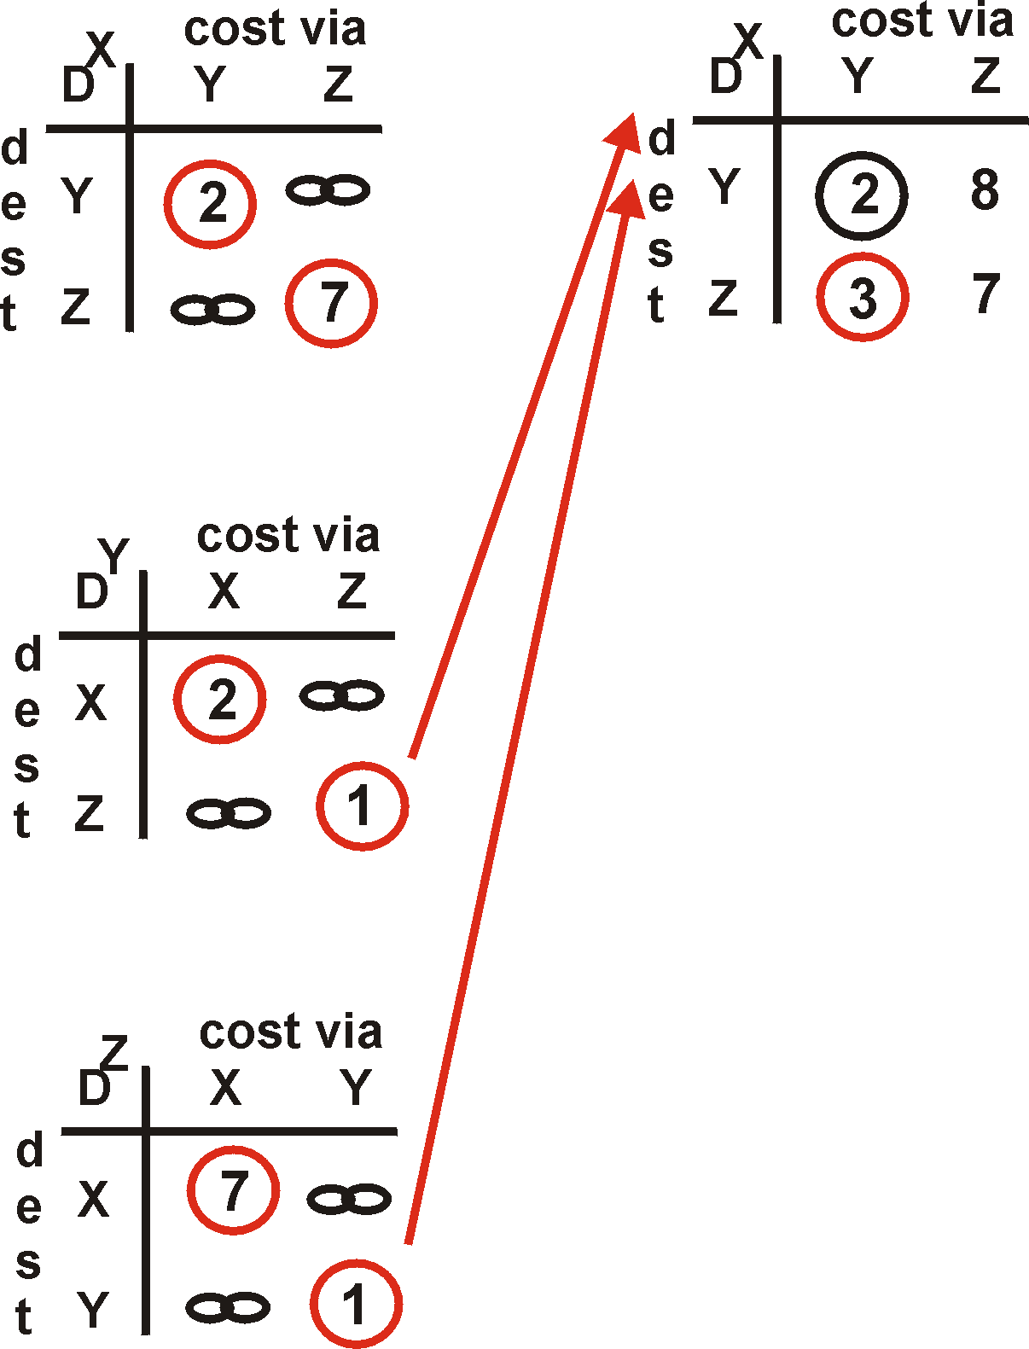
Distance Vector Algorithm: example
Y
2
1
X
Z
7
X
Z
D (Y,Z)
=
c(X,Z) + min {D (Y,w)}
w
=
7+1 = 8
X
Y
D (Z,Y)
=
c(X,Y) + min {D (Z,w)}
w
=
2+1 = 3

Slide 18
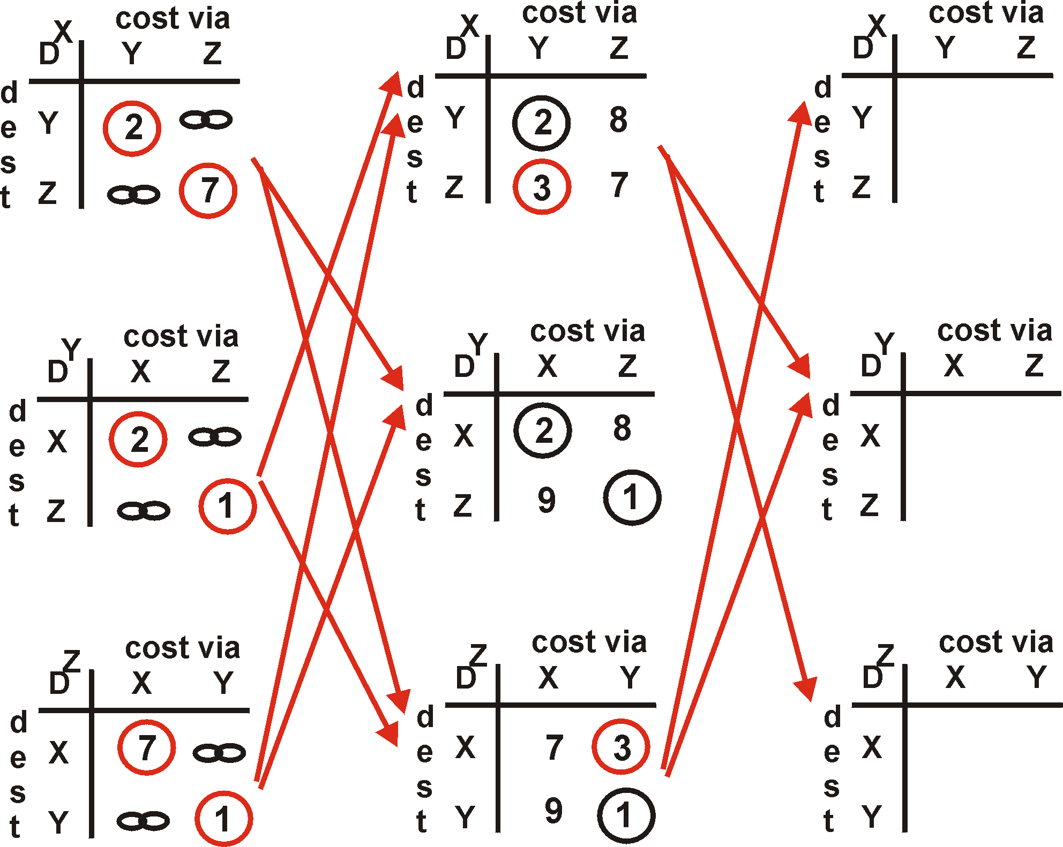
Distance Vector Algorithm: example
Y
2
1
X
Z
7

Slide 19
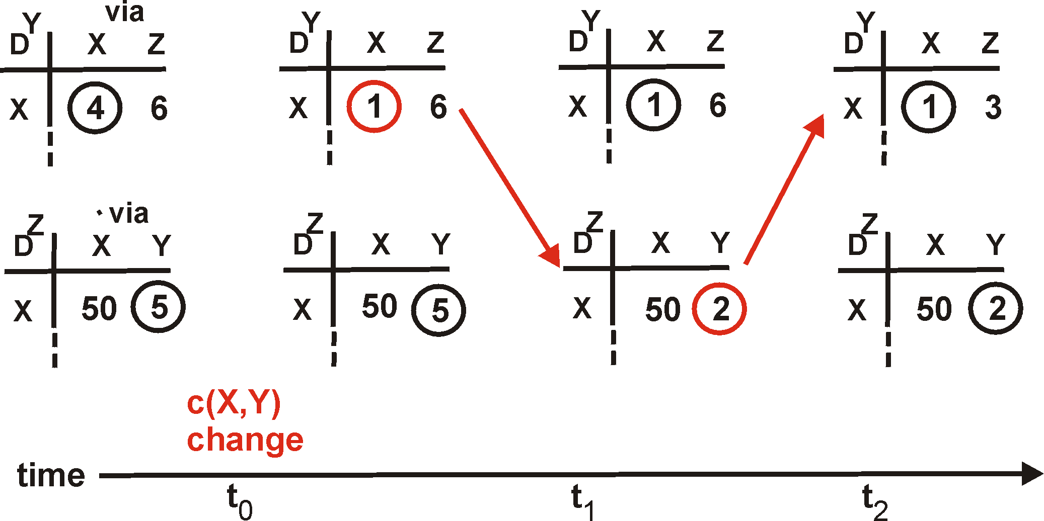
Link cost changes
Link cost changes:
node detects local link cost change
updates distance table
if cost change in least cost path, notify neighbors
1
Y
4
1
X
Z
50
“good
news
travels
fast”
algorithm
terminates

Slide 20
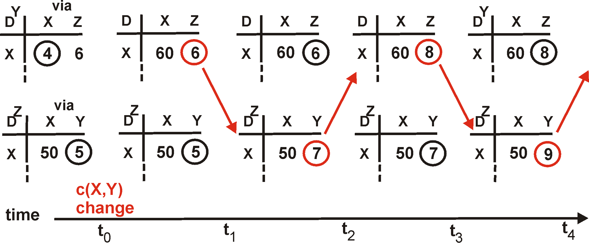
Link cost changes
Link cost changes:
good news travels fast
bad news travels slow - “count to infinity” problem!
60
Y
4
1
X
Z
50
algorithm
continues
on!

Slide 21
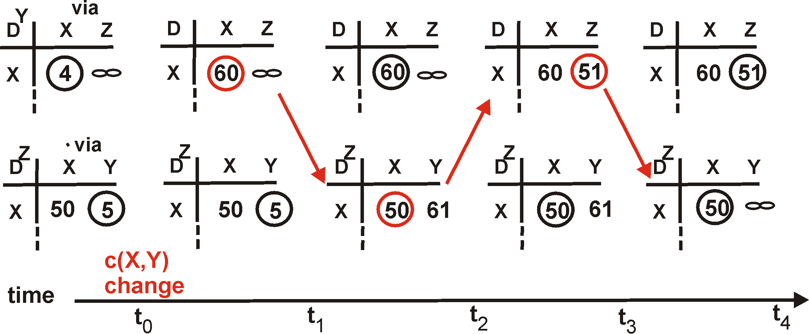
DV: poisoned reverse
If Z routes through Y to get to X :
Z tells Y its (Z’s) distance to X is infinite (so Y won’t route to X via Z)
will this completely solve count to infinity problem?
60
Y
4
1
X
Z
50
algorithm
terminates

Slide 22
Comparison of LS and DV algorithms
Message complexity
LS: with n nodes, E links, O(nE) msgs sent each
DV: exchange between neighbors only
Speed of Convergence
LS: O(n**2) algorithm requires O(nE) msgs
  may have oscillations
DV: convergence time varies
  may be routing loops
  count-to-infinity problem
Robustness: what happens if router malfunctions?
LS:
  node can advertise incorrect link cost
  each node computes only its own table
DV:
  DV node can advertise incorrect path cost
  each node’s table used by others
    error propagate thru network

Slide 23



Generalized Forwarding and SDN
Each router contains a flow table that is computed and distributed by a logically centralized routing controller
logically-centralized routing controller
control plane
data plane
local flow table
headers counters actions
1
0100 1101
3
2
values in arriving
packet’s header
Network Layer: Data Plane
4-<number>

Slide 24
OpenFlow: Flow Table Entries
Rule
Action
Stats
Packet + byte counters
Forward packet to port(s)
Encapsulate and forward to controller
Drop packet
Send to normal processing pipeline
Modify Fields
Switch
Port
VLAN
ID
MAC
src
MAC
dst
Eth
type
IP
Src
IP
Dst
IP
Prot
TCP
sport
TCP
dport
Link layer
Network layer
Transport layer
Notes:
Now I’ll describe the API that tries to meet these goals.

Slide 25
Examples
Destination-based forwarding:
Switch
Port
MAC
src
MAC
dst
Eth
type
VLAN
ID
IP
Src
IP
Dst
IP
Prot
TCP
sport
TCP
dport
Action
*
*
*
*
*
*
51.6.0.8
*
*
*
port6
IP datagrams destined to IP address 51.6.0.8 should be forwarded to router output port 6
Firewall:
Switch
Port
MAC
src
MAC
dst
Eth
type
VLAN
ID
IP
Src
IP
Dst
IP
Prot
TCP
sport
TCP
dport
Forward
*
*
*
*
*
*
*
*
*
22
drop
do not forward (block) all datagrams destined to TCP port 22
Switch
Port
MAC
src
MAC
dst
Eth
type
VLAN
ID
IP
Src
IP
Dst
IP
Prot
TCP
sport
TCP
dport
Forward
*
*
*
128.119.1.1
drop
*
*
*
*
*
*
do not forward (block) all datagrams sent by host 128.119.1.1

