Slide 1
Market-Graded Learning
The market's closing price grades every part of our NBA trading agent. Only the parts that defer to the market survive, so a consumer betting against it is at a structural disadvantage.
Market-Graded Learning for NBA Game-Impact Intelligence
DASC7606C (COMP7606) · Group 12 · Track 2: Agentic Framework Design
Presenter: Ngan Tsz Sui · Friday 9 October 2026
Notes:
Good morning, we are Group 12. Our title is Market-Graded Learning, and it is also our thesis. We built an AI agent that trades NBA prediction markets, and we let the market's closing price grade every part of it: the models, the learned rules and the LLM. The finding is that only the parts that defer to the market survive. If a disciplined agent cannot beat the close, a consumer cannot either, so our product educates and protects instead of giving tips.

Slide 2
The problem: three things consumers face
1 People want to learn
2 Markets are tilted
3 Betting causes harm
Mainstream: legal in 38 US states since 2018 ¹
46% of adults worldwide gambled last year ²
Few understand prices, fees and spreads
~5.0% cost on every trade
91% of the price move comes before the public news
The market beats our model; never trading wins
~80M adults with gambling disorder or problem gambling ²
Online betting: credit scores −2.75 pts, bankruptcies +~10% ¹
$1 of online betting cuts investment ~$0.99 ³
Our measurements
External research
Consumers need education and protection, not betting tips
¹ Hollenbeck, Larsen & Proserpio 2024 (SSRN) ² Lancet Public Health Commission on gambling 2024 ³ Baker et al. 2024 (NBER WP 33108)
DASC7606C Group 12 · Market-Graded Learning: the closing price grades every component
2
Notes:
Three parts. First, consumers want to learn: since 2018, 38 US states have legalised sports betting, and the Lancet Public Health Commission estimates 46% of adults worldwide gambled last year. Second, the markets are structurally tilted, which is what we measured: about 5.0% cost per trade, 91% of the price move before the public news, and the market beats our model. Third, published research shows harm: about 80M adults with gambling disorder; online betting lowers credit scores by 2.75 points and raises bankruptcies by about 10%; each dollar of online betting cuts investment by about $0.99. References: Wardle et al., Lancet Public Health 2024; Hollenbeck, Larsen and Proserpio, SSRN 4903302; Baker et al., NBER WP 33108.

Slide 3
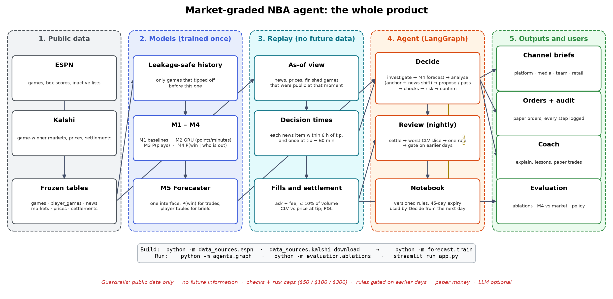
Research question, and what we built to test it
Can a consumer, even one armed with an AI agent and public news, beat the market?
We built the strongest consumer we could:
Public news: ESPN inactive lists and box scores, 3 seasons
Trained models, incl. a neural net trained on the market's own moves
LangGraph agent; code risk limits; gated rule learning; LLM tools
Graded on 1,316 Kalshi games (~3.9M price rows); every order pays the recorded ask + fee
Answer: no. Tested with confidence intervals, never trading wins, so the product educates and protects instead.
DASC7606C Group 12 · Market-Graded Learning: the closing price grades every component
3
Notes:
Our research question: can a consumer, even one armed with an AI agent and public news, beat the market? We built the strongest consumer we could: public news, trained models including a neural net trained on the market's own moves, a LangGraph agent with code risk limits and gated rule learning, and an LLM tool agent. A replay walks the season day by day, shows the agent only what was public, and fills every order at the recorded ask plus the Kalshi fee. The answer, tested with confidence intervals, is no: never trading wins.

Slide 4
Market-Graded Learning: the closing price is the grader
Component | Market's test | Verdict
Raw win model (M4) trading | Beat never trading | Failed: −$2,475, CI below 0
Recalibrated M4 | Beat the market's Brier score | Failed: 0.185 vs market 0.164
M6 neural impact model | Beat “the price won't move” | Failed: 9 of 9 configurations worse
Market anchor | Beat the raw model | Passed: +$2,450, p = 0.002
Gated rule learning | Beat no learning on CLV $ | Passed (trades less): +$39 CLV, p = 0.001
LLM agent, Coach, policy … | Same gates (slide 11) | See agentic upgrades
A consumer | Beat ~1.92¢ cost; news 91% priced | Structurally hard
Only the components that defer to the market survive, so the product teaches, lets people practise and enforces limits
DASC7606C Group 12 · Market-Graded Learning: the closing price grades every component
4
Notes:
This is what the title means. Every component is a hypothesis that must pass an evidence gate on recorded prices, and the grader is the market's closing price. The raw win model fails: −$2,475 over the season, and recalibrating it does not help. The neural impact model fails: all 9 configurations are worse than predicting no move. What passes defers to the market: the market anchor, +$2,450 with p 0.002, and gated learning, which passes only by trading less. The newer agentic parts face the same gate; slide 11. So the finding is the product: if a disciplined agent cannot beat the close, a consumer cannot either. We say “we pass” as often as “we trade”.

Slide 5
Data: five public sources, split in time, no look-ahead
Source | What it contains | Rows | Used for
Kalshi prices (KXNBAGAME) | 1-minute bid, ask, volume | 3,938,368 | Fills, costs, CLV, anchor, M6
Kalshi markets, settlements | Market → game; yes / no result | 2,632 / 2,634 | Settling P&L
ESPN games | Schedule, tip time, score, 3 seasons | 3,962 | Splits, M4 labels
ESPN box scores | Minutes, points, shots per player | 85,422 | M1–M4 features
ESPN inactive lists | Who is out and why (our news) | 3,371 | News trigger; M4 after news
Time splits
Models train before 1 Feb 2026; agent develops Nov–Jan
Test 1 Feb – 12 Apr (501 games); walk-forward retrains monthly
Play-offs (87 games): holdout scored once
No look-ahead, real costs
Agent sees only what was published by then
Inactive list = news at tip − 30 min (ends 7 May)
Fill at ask + fee; quote ≤ 5 min old; ≤ 10% of volume
DASC7606C Group 12 · Market-Graded Learning: the closing price grades every component
5
Notes:
The data is all public. From Kalshi: every NBA game-winner market for 2025-26, 2,632 markets on 1,316 games, 3,938,368 one-minute rows of bid, ask and volume, and settlements. From ESPN: three seasons of games, 85,422 box-score rows and 3,371 inactive-list entries, which are our news. Models train on games before 1 February; the agent develops on November to January; the test period is 1 February to 12 April, 501 games; the walk-forward retrains monthly; and the 87 play-off games are a holdout scored once. The replay shows the agent only what was public, counts each inactive list as news 30 minutes before tip, and fills at the recorded ask plus the Kalshi fee.

Slide 6
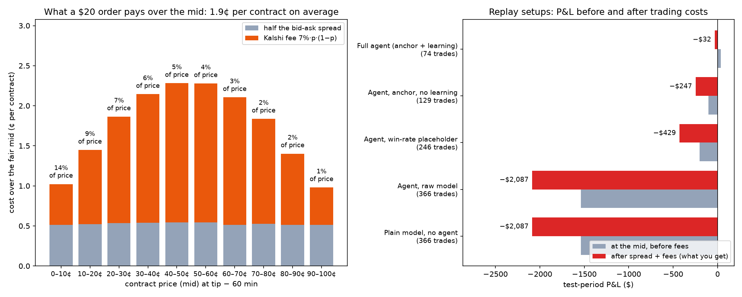
Evidence 1: costs set a hurdle before you start
1.92¢ per contract = 5.0% of price; 9–14% under 20¢
Best agent, Feb–Apr: +$36 at mid → −$32 after costs
771 decision points → 153 with gap > 4 pts → 74 trades
Only 27 (36%) beat or matched the close
DASC7606C Group 12 · Market-Graded Learning: the closing price grades every component
6
Notes:
First, costs. One hour before tip a $20 order pays half the bid-ask spread plus the Kalshi fee: 1.92 cents per contract on average, 5.0% of the price, and 9–14% on cheap contracts. Our best agent would have made +$36 at the mid but lost −$32 after costs. Even very selective, 74 trades out of 771 decision points, only 27 (36%) beat or matched the closing price.

Slide 7
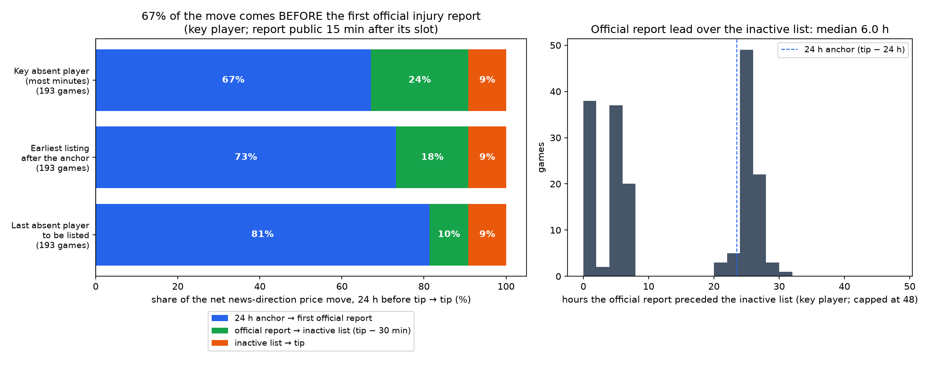
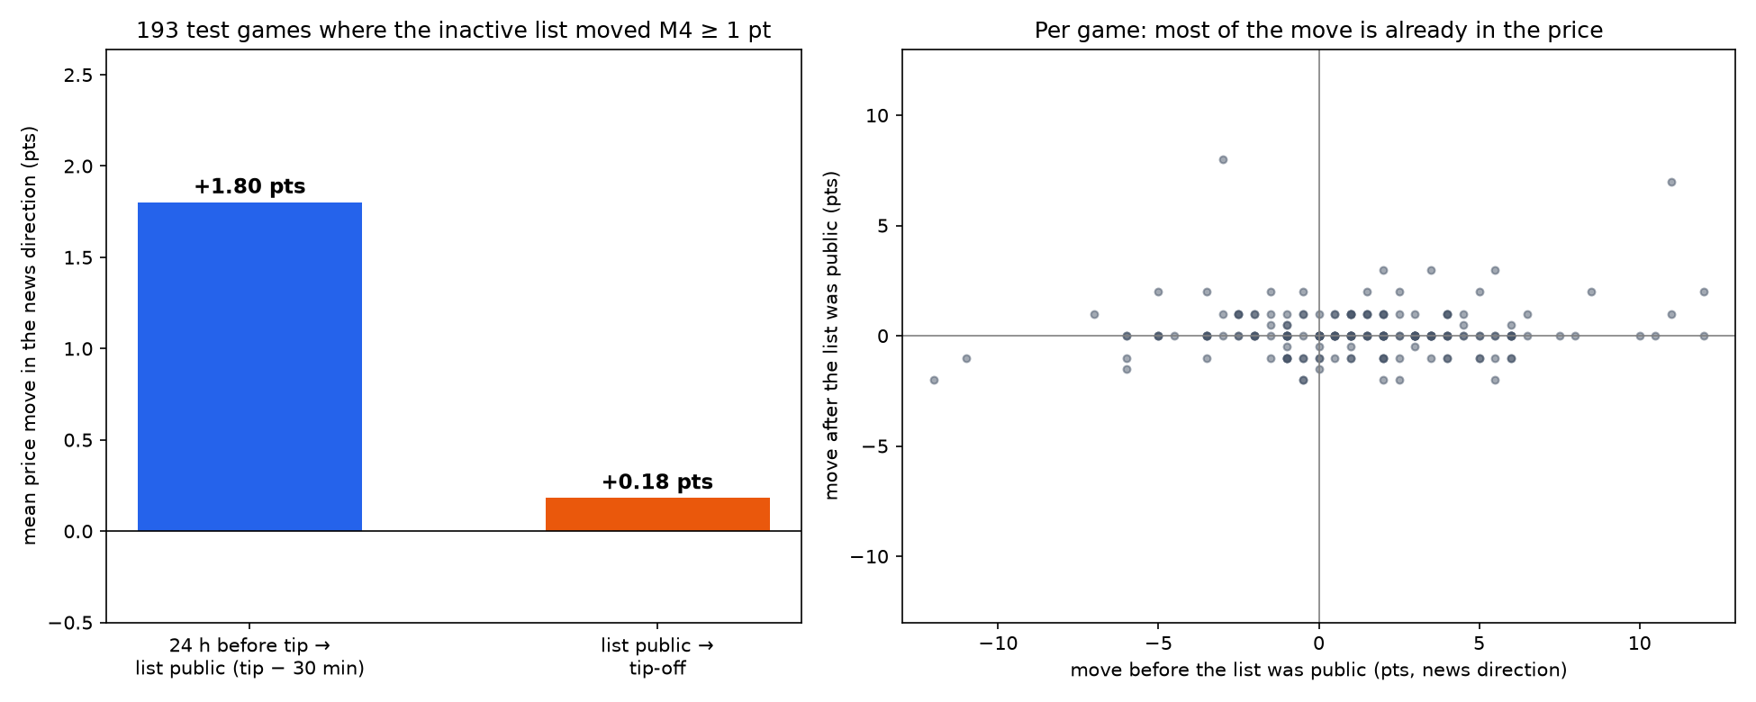
Evidence 2: the price moves before the news reaches you
91% of the move happens before the inactive list (+1.80 vs +0.18 pts, 193 test games)
About two-thirds (67%, CI 47–85%) comes before the first official injury report, ~6 h earlier
49% if reports are public at their slot; official reports only, so news can be earlier
DASC7606C Group 12 · Market-Graded Learning: the closing price grades every component
7
Notes:
Second, speed. On the 193 test games where the inactive list moved our win model by at least a point, 91% of the price move in the news direction happened before the inactive list, which is when a retail user reading it could act. We then matched the official NBA injury reports: about two-thirds of the move, 67% with a confidence interval of 47–85%, came before the first official report listing the player out, which itself comes a median of about 6 hours before the inactive list. Assuming no publication lag the share is 49%. Official reports only; beat reporters and social media can be earlier still.

Slide 8
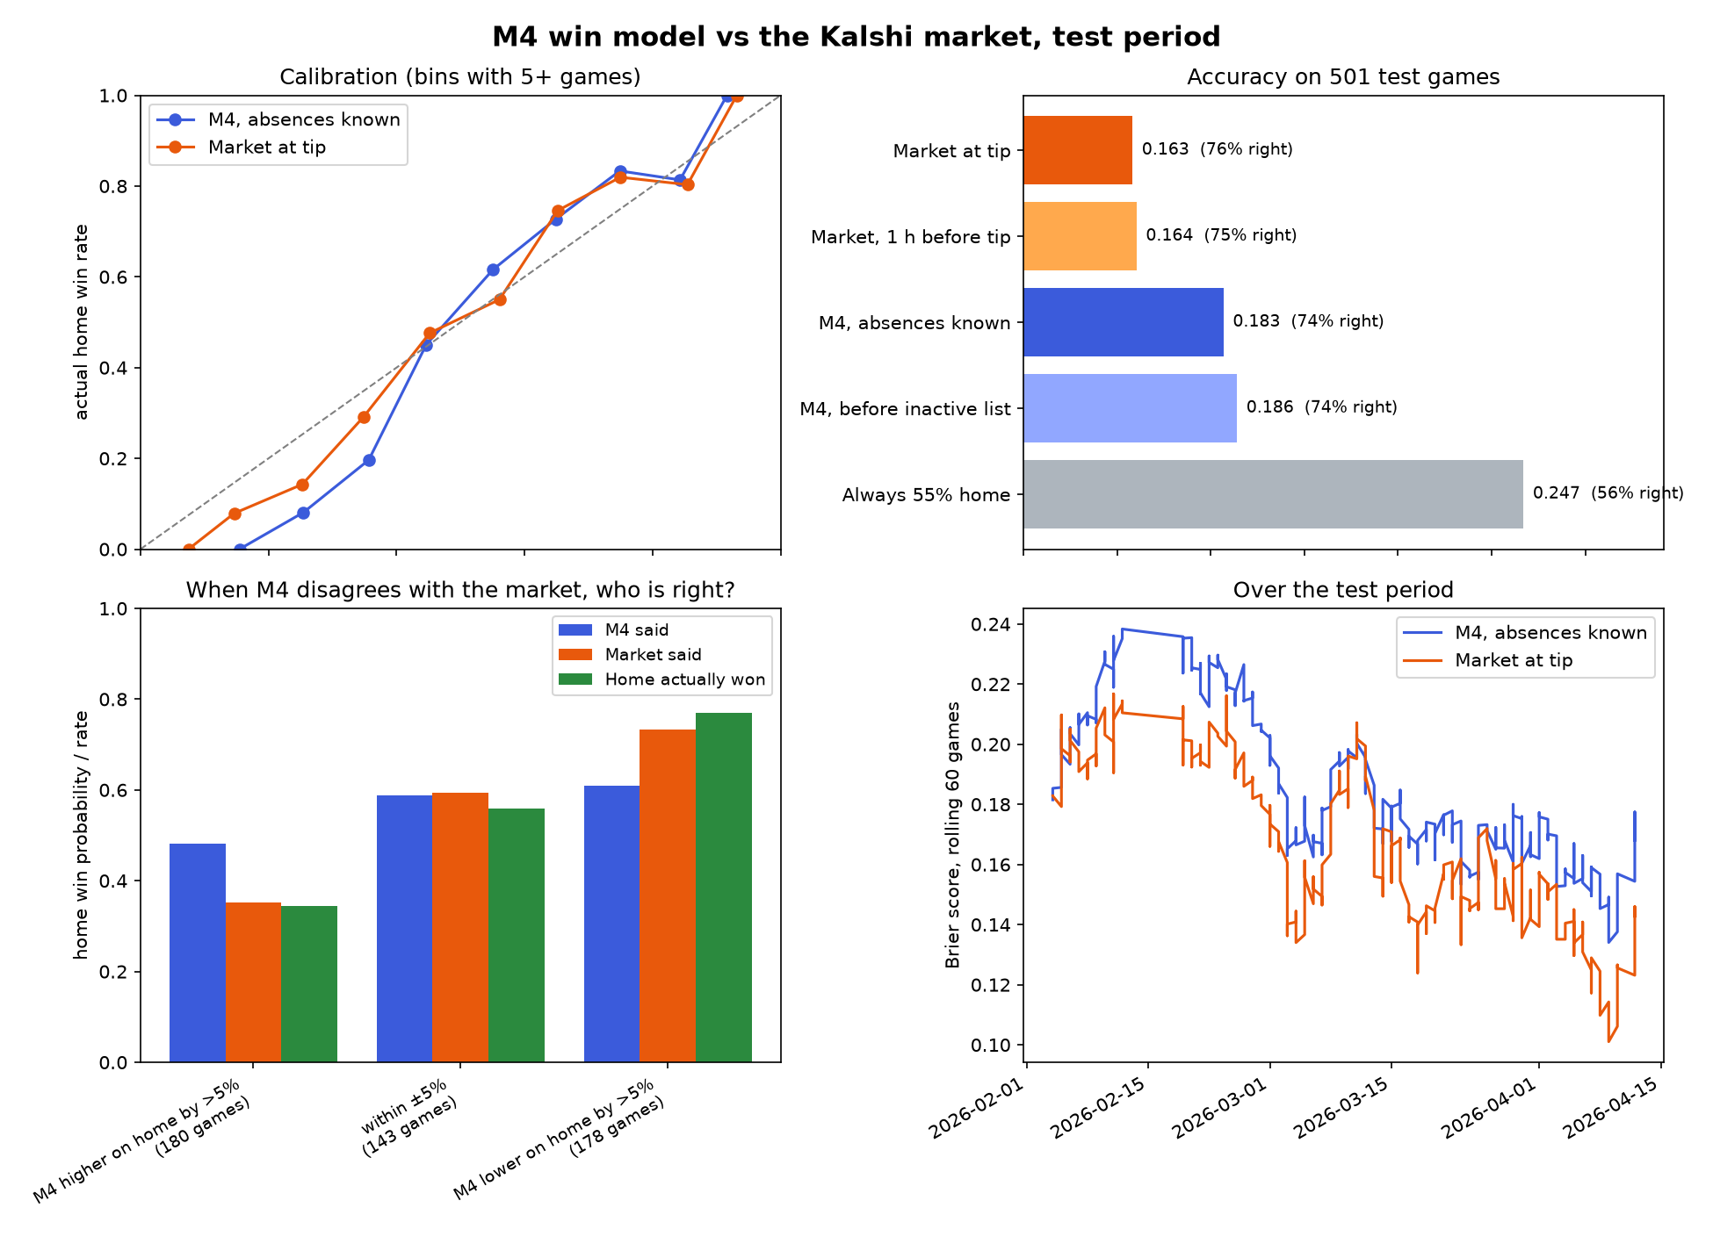
Evidence 3: the market beats our model
Brier, 501 test games, 1 h before tip: market 0.164, our model 0.186
Disagree by more than 5 pts, and the market is right:
model higher on home: model 48%, market 35%, actual 34%
model lower on home: model 61%, market 73%, actual 77%
With the inactive list: model 0.183 vs market at tip 0.163
DASC7606C Group 12 · Market-Graded Learning: the closing price grades every component
8
Notes:
Third, expertise. On 501 test games our win model's Brier score one hour before tip is 0.186, against 0.164 for the market at the same moment; lower is better. When they disagree by more than five points, the market is right in both directions.

Slide 9
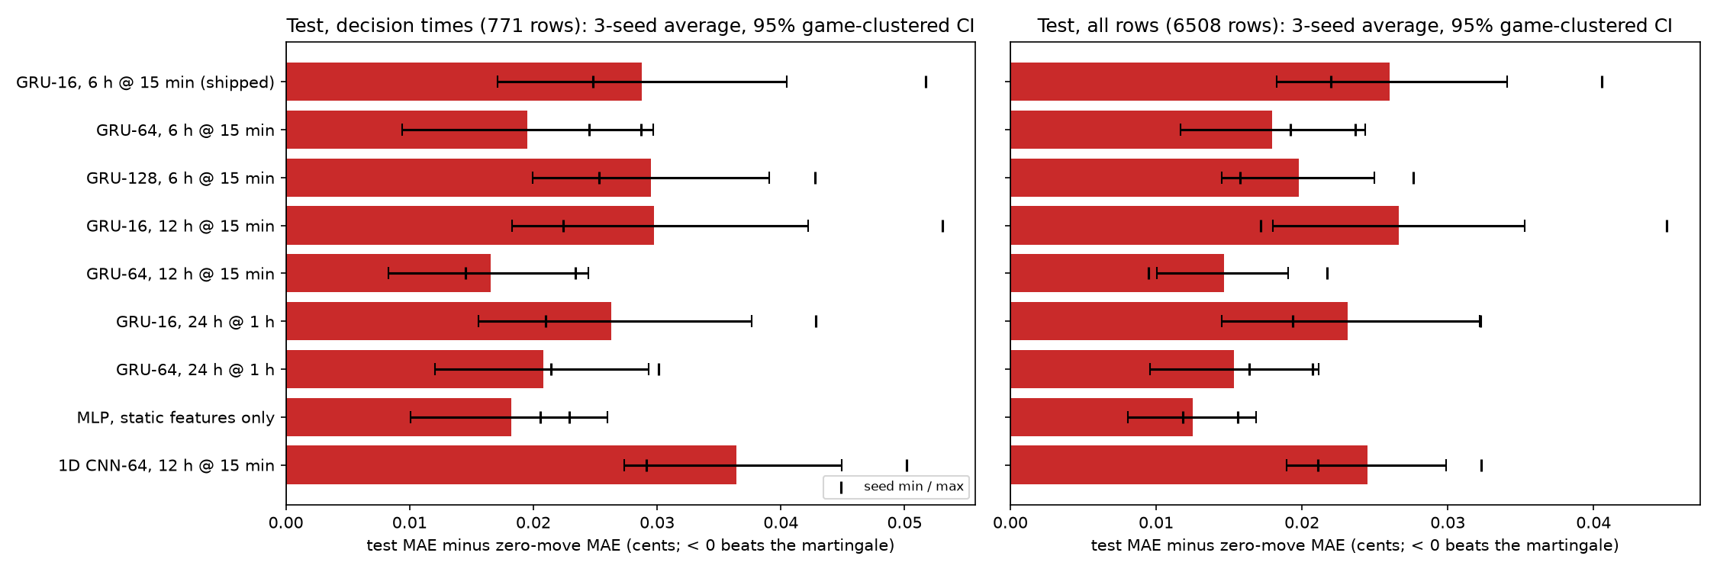
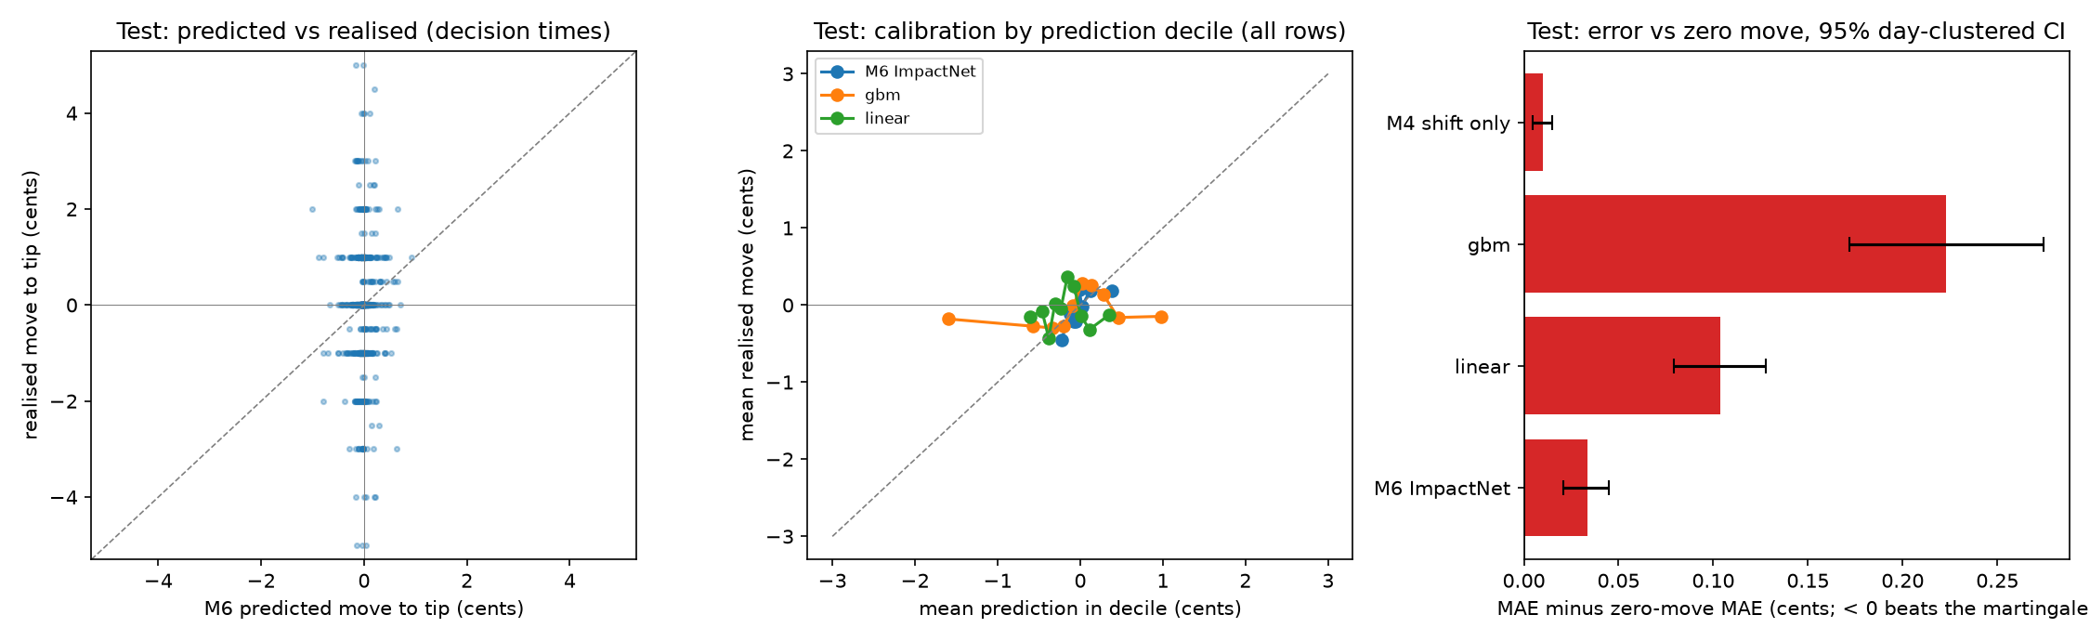
Deep learning: a GRU trained on the market's own moves
M6 design
Label = price move to tip (the market grades it)
GRU-16 over 6 h of prices, 15-min steps
+ 18 static features → MLP → 10 / 50 / 90th percentiles
Pinball loss, early stopping; leak-tested
Result
MAE 0.867¢ vs zero move 0.833¢; agent makes 0 trades
Robustness: 9 configurations × 3 seeds, all worse than zero move (best +0.017¢); none predicts the 5.5¢ needed to trade
M4 recalibration: Brier 0.183 raw, 0.185 Platt, 0.184 isotonic vs market 0.164; miscalibration changes with season phase
DASC7606C Group 12 · Market-Graded Learning: the closing price grades every component
9
Notes:
Our deep-learning component is M6. Its label is the market itself: the move of the home price from the decision time to tip-off, so every decision time is a training row. A 16-unit GRU reads the last six hours of the price in 15-minute steps; it is joined with 18 static features such as the anchor, the clock, M4's news shift and who is out, and an MLP outputs the 10th, 50th and 90th percentiles, trained with pinball loss. It cannot beat “the price won't move”: 0.867 against 0.833 cents. To check that this is not a tuning accident, we ran a pre-declared grid of 9 configurations, GRU sizes, history lengths, an MLP and a CNN, with 3 seeds each: every one is worse than zero move, all 18 of 18 confidence intervals above zero, and none ever predicts the 5.5¢ move needed to pay for a trade. Recalibrating the win model does not help either: Brier 0.183 raw, 0.185 Platt, 0.184 isotonic, against 0.164 for the market, because its miscalibration flips between early and late season.

Slide 10
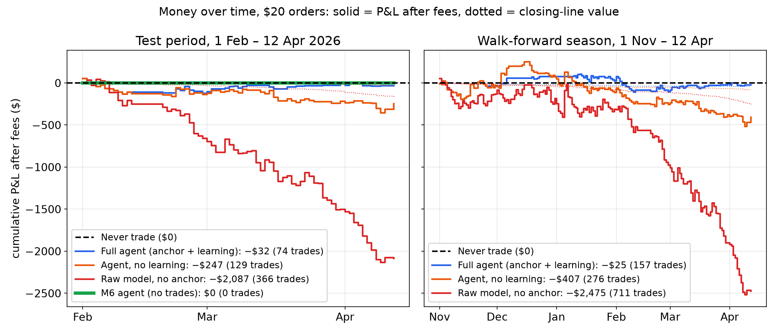
Evidence 4: every line drifts down; never trading wins
Walk-forward, Nov – 12 Apr | Trades | P&L after fees [95% CI]
Never trade | 0 | $0
Full agent: anchor + learning | 157 | −$25 [−$569 to +$564]
Anchor, no learning | 276 | −$407 [−$1,324 to +$553]
Raw model | 711 | −$2,475 [−$3,995 to −$845]
Mean CLV < 0 for every setup; every CI below zero
Anchor is real: +$2,450 (p = 0.002); learning = trading less (p = 0.13)
Play-off holdout: full agent 0 trades
DASC7606C Group 12 · Market-Graded Learning: the closing price grades every component
10
Notes:
Money over time, after fees; the dashed line at zero is never trading. The red raw model falls steadily, −$2,087 in the test period and −$2,475 over the season: that slope is costs. The agent without learning falls less; the full agent learned rules that mostly say do not trade, so it flattens near zero. Then the honest test: walk-forward over the whole season with the win model retrained monthly and day-clustered bootstrap intervals. Mean closing-line value is below zero for every setup. The full agent's −$25 is indistinguishable from never trading, p 0.53. The market anchor is real, +$2,450, p 0.002; learning only means trading less. On the play-off holdout the full agent made no trades.

Slide 11
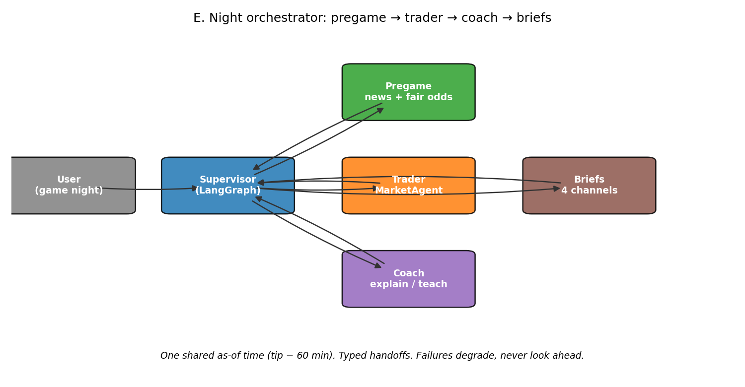
Agentic upgrades: the same market grade
Upgrade | What it is | Result
LLM tool agent + sceptic | LLM picks as-of tools; code checks every number; a sceptic asks “already priced in?” | Not scored (API quota); all 32 valid calls passed
Gate audit + placebo | Rule gate on held-out days; reviewer vs random rules | Random rules pass as often (57% vs 57%)
Kill switch | $100 daily realised-loss stop, enforced in the replay | Never triggered (worst day −$54)
Fractional Kelly | ¼-Kelly sizing, fee in the formula, vs flat $20 | pending
Coach, simulated users | Biased personas play League slates with and without Coach nudges | Users trade less, lose less CLV; per-trade CLV no better
Orchestrator | Supervisor graph: pregame → trader → coach → briefs for one night | pending
Learned policy | Trade / pass classifier on as-of features, chosen on Nov–Jan only | pending
Rule DSL | LLM writes free-form rules, compiled to a safe DSL, still gated | pending
Episodic memory | Retrieve similar past situations and their outcomes | pending
Pre-registered before scoring (docs/preregistration_*.md); same replay, costs and bootstrap as above
DASC7606C Group 12 · Market-Graded Learning: the closing price grades every component
11
Notes:
We then made the agent more agentic, and graded each upgrade the same way, pre-registered before scoring. An LLM tool agent chooses its own as-of tools, with code checking every number and a sceptic asking whether the edge is already priced in. We audited the rule gate against placebo rules, enforced a daily kill switch, tried fractional Kelly sizing, tested the Coach on simulated users, joined pregame, trader and coach under one orchestrator, and tried a learned trade-or-pass policy, a rule language for LLM-written rules, and episodic memory. Results so far: LLM tool agent + sceptic: Not scored (API quota); all 32 valid calls passed; Gate audit + placebo: Random rules pass as often (57% vs 57%); Kill switch: Never triggered (worst day −$54); Coach, simulated users: Users trade less, lose less CLV; per-trade CLV no better. 5 of 9 are still pending at build time.

Slide 12
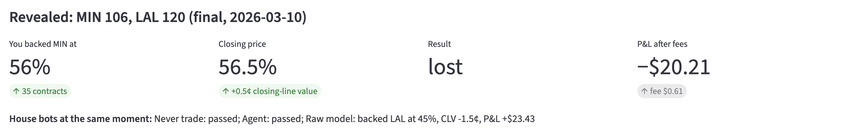
Our product: protect, teach, practise
Protect: the agent
Teach: the Coach
Practise: the League
Passes by default: 90% of decision points
Says why there is no order
Code limits: $50 / order, $100 / game, $300 / day
Bans “lock”, “guaranteed”; 9 / 9 planted violations blocked
Only what was public at that moment
Break-even after spread + fee
Lessons: priced in, long shots, closing line
Paper call, then the close and the agent's choice
Same 10 real decisions, $1,000 play money
Fills at ask + fee, like the agent
Ranked by CLV, not profit (≥ 5 trades)
Raw-model bot +$15 with CLV −0.63¢: “costs”
Educational, paper money only · only information public at that moment · no promise words
DASC7606C Group 12 · Market-Graded Learning: the closing price grades every component
12
Notes:
So the product educates and protects instead of encouraging bets. Protect: the agent passes by default, about 90% of decision points, and says why; risk limits and banned words are code the LLM cannot override, and all 9 / 9 planted violations were blocked. Teach: the Coach explains a game with only what was public and shows the break-even after spread and fee. Practise: the League gives everyone the same 10 real past decisions and $1,000 of play money, and ranks on closing-line value, not profit. In our example league the raw-model bot is up +$15 with negative CLV, and the badge says costs, not skill.

Slide 13
Team contributions
Work | PR | Who | What it adds
Pregame news and fair-odds loop | #7 | codingMiiichael | Multi-source news polling → fair odds
Player-feature experiment | #8 | Catharine Li | Isolated player features + probability calibration
In-play news and odds | #9 | codingMiiichael | Independent in-play updates (synthetic scenarios)
Live Polymarket markets | #11, #12 | shidafuyang-alt, hijojo | Read-only live prices and page
Replay, agent and evaluation | branch | Michael Ngan | As-of replay, M4 / M6, LangGraph agent, gate, walk-forward, Coach, League
Every part is graded the same way: by the market's closing price
DASC7606C Group 12 · Market-Graded Learning: the closing price grades every component
13
Notes:
The work is split across the team. The pregame news loop polls several news sources before a game and turns them into fair odds, pull request 7. The player-feature experiment tested isolated player features and probability calibration, pull request 8. In-play news and odds updates are pull request 9. Live, read-only Polymarket prices are pull requests 11 and 12. The replay, the agent, the models M4 and M6, the evaluation, the Coach and the League are on our main branch. Each part had to face the same market grade.

Slide 14
Live demo: streamlit run app.py
Tab | What to watch
Replayed night | News → estimate vs bid-ask → usually no order, with the reason
Coach | Break-even after spread + fee; paper call vs the close and the agent
League | One call on the shared slate → close revealed → ranked by CLV next to the house bots
Learning | Gate keeps protective rules (skip long shots, skip chasing)
Safety | Planted violations blocked (9 / 9)
Backup: recorded run of the same demo
DASC7606C Group 12 · Market-Graded Learning: the closing price grades every component
14
Notes:
Now the demo, focused on protection. On the replayed night, watch the agent see the news, compare its estimate with the bid and ask, and usually decline with a reason. In the Coach, I'll make a paper call and compare it with the close. In the League tab I'll make one call on the shared slate, watch the closing line and result being revealed, and show the leaderboard ranked by closing-line value next to the house bots. Then a quick look at the learned rules and planted violations being blocked. If anything fails, we have a backup recording.

Slide 15
Recommendations, honest scope and Q&A
For products and policy
Honest scope
Show the all-in cost and break-even before every order
Default warning: “this news is likely priced in”
Education and play-money practice before the first trade
Treat betting harm as a public-health issue (Lancet)
“Unfair” = costs, speed, expertise; not fraud; no accusation against Kalshi
Anchor and reviewer designed after seeing Feb–Apr; walk-forward and play-offs are the honest tests
One season, inactive lists as our news; paper money
Thank you. Questions?
DASC7606C Group 12 · Market-Graded Learning: the closing price grades every component
15
Notes:
Our recommendations follow from the evidence. Before any order, show the all-in cost and the break-even probability. Warn by default when news is likely already priced in. Put education and play-money practice in front of the first trade, and treat betting harm as a public-health issue, as the Lancet Commission argues. Honest scope: unfair here means structural disadvantages, costs, speed and expertise, not manipulation or fraud, and we make no accusation against Kalshi. We designed the market anchor and the reviewer after seeing the first February-to-April results, so the walk-forward season and the play-off holdout are our headline tests. Thank you, we are happy to take questions.

