Slide 1
Performance and Web

Slide 2
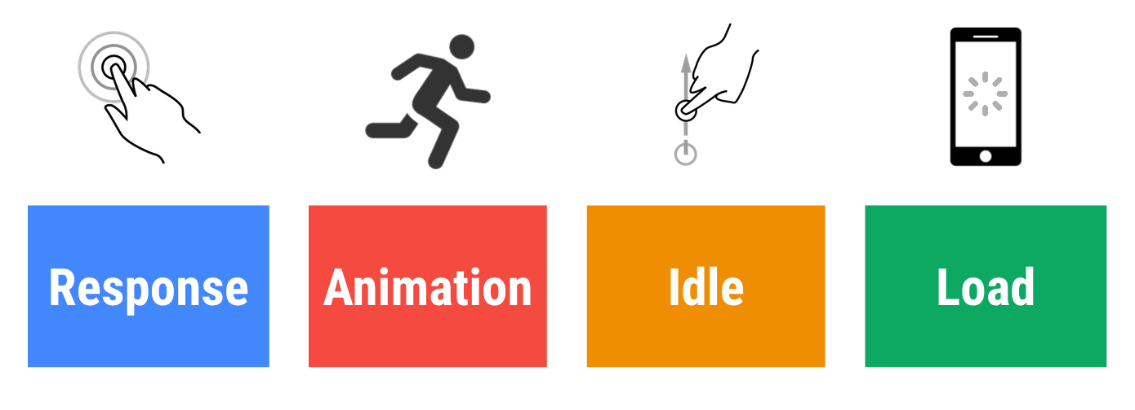
Measure Performance with the RAIL Model
Notes:
the model breaks down the user's experience into key actions and helps developers and designers ensure a good user experience for each of these actions

Slide 3

Как пользователи реагируют на задержки производительности
0мс
16мс
Notes:
Пользователи исключительно хорошо отслеживают движение, и им не нравится, когда анимация неплавная.
Анимация кажется им гладкой, если каждую секунду визуализируются 60 новых кадров.
Это 16 мс на кадр, включая время, необходимое браузеру для рисования нового кадра на экране, оставляя приложению около 10 мс для создания кадра.

Slide 4
Как пользователи реагируют на задержки производительности
0мс
100мс
Notes:
В течение этого временного окна необходимо ответить на действия пользователя, пользователям кажется, что результат мгновенный. Перейти эту черту, и связь между действием и реакцией (ответом) нарушится.

Slide 5

Как пользователи реагируют на задержки производительности
0мс
100мс
300мс
Notes:
Пользователи испытывают небольшую заметную задержку.

Slide 6



Как пользователи реагируют на задержки производительности
0мс
100мс
300мс
1000мс
Notes:
В рамках этого окна загрузка страницы и ее изменение кажется частью естественного и непрерывного процесса.

Slide 7


Как пользователи реагируют на задержки производительности
0мс
300мс
1000мс
Notes:
После 1000 миллисекунд (1 секунда) пользователи теряют сосредоточенность на задаче, которую они выполняют.

Slide 8


Как пользователи реагируют на задержки производительности
1000мс
10000мс
Notes:
Пользователи разочарованы и могут покинуть страницу. Они могут вернуться или не вернуться позже.

Slide 9
Как пользователи реагируют на задержки
User Perception Of Performance Delays
0 to 16ms | Users are exceptionally good at tracking motion, and they dislike it when animations aren't smooth. They perceive animations as smooth so long as 60 new frames are rendered every second. That's 16ms per frame, including the time it takes for the browser to paint the new frame to the screen, leaving an app about 10ms to produce a frame.
0 to 100ms | Respond to user actions within this time window and users feel like the result is immediate. Any longer, and the connection between action and reaction is broken.
100 to 300ms | Users experience a slight perceptible delay.
300 to 1000ms | Within this window, things feel part of a natural and continuous progression of tasks. For most users on the web, loading pages or changing views represents a task.
1000ms or more | Within this window, things feel part of a natural and continuous progression of tasks. For most users on the web, loading pages or changing views represents a task.
10000ms or more | Users are frustrated and are likely to abandon tasks. They may or may not come back later.

Slide 10
User Perception Of Performance Delays
0 to 16ms | Users are exceptionally good at tracking motion, and they dislike it when animations aren't smooth. They perceive animations as smooth so long as 60 new frames are rendered every second. That's 16ms per frame, including the time it takes for the browser to paint the new frame to the screen, leaving an app about 10ms to produce a frame.
0 to 100ms | Respond to user actions within this time window and users feel like the result is immediate. Any longer, and the connection between action and reaction is broken.
100 to 300ms | Users experience a slight perceptible delay.
300 to 1000ms | Within this window, things feel part of a natural and continuous progression of tasks. For most users on the web, loading pages or changing views represents a task.
1000ms or more | Beyond 1000 milliseconds (1 second), users lose focus on the task they are performing.
10000ms or more | Beyond 10000 milliseconds (10 seconds), users are frustrated and are likely to abandon tasks. They may or may not come back later.

Slide 11
Response: respond in under 50ms
Goal: Complete a transition initiated by user input within 100ms. Users spend the majority of their time waiting for sites to respond to their input, not waiting for the sites to load.
Guidelines:
Respond to user input within 50ms, or else the connection between action and reaction is broken. This applies to most inputs, such as clicking buttons, toggling form controls, or starting animations. This does not apply to touch drags or scrolls.
Though it may sound counterintuitive, it's not always the right call to respond to user input immediately. You can use this 100ms window to do other expensive work. But be careful not to block the user. If possible, do work in the background.
For actions that take longer than 50ms to complete, always provide feedback.

Slide 12
Animation: produce a frame in 10ms
Goals:
Produce each frame in an animation in 10ms or less. Technically, the maximum budget for each frame is 16ms (1000ms / 60 frames per second ≈ 16ms), but browsers need about 6ms to render each frame, hence the guideline of 10ms per frame.
Aim for visual smoothness. Users notice when frame rates vary.
Guidelines:
In high pressure points like animations, the key is to do nothing where you can, and the absolute minimum where you can't. Whenever possible, make use of the 100ms response to pre-calculate expensive work so that you maximize your chances of hitting 60fps.
See Rendering Performance for various animation optimization strategies.
Recognize all the types of animations. Animations aren't just fancy UI effects. Each of these interactions are considered animations:
Visual animations, such as entrances and exits, tweens, and loading indicators.
Scrolling. This includes flinging, which is when the user starts scrolling, then lets go, and the page continues scrolling.
Dragging. Animations often follow user interactions, such as panning a map or pinching to zoom.

Slide 13
Idle: maximize idle time
Goal: Maximize idle time to increase the odds that the page responds to user input within 50ms.
Guidelines:
Use idle time to complete deferred work. For example, for the initial page load, load as little data as possible, then use idle time to load the rest.
Perform work during idle time in 50ms or less. Any longer, and you risk interfering with the app's ability to respond to user input within 50ms.
If a user interacts with a page during idle time work, the user interaction should always take the highest priority and interrupt the idle time work.

Slide 14
Load: deliver content and become interactive in under 5 seconds
When pages load slowly, user attention wanders, and users perceive the task as broken. Sites that load quickly have longer average sessions, lower bounce rates, and higher ad viewability.
Guidelines:
Test your load performance on the mobile devices and network connections that are common among your users. If your business has information on what devices and network connections your users are on, then you can use that combination and set your own loading performance targets. Otherwise, The Mobile Economy 2017 suggests that a good global baseline is a mid-range Android phone, such as a Moto G4, and a slow 3G network, defined as 400ms RTT and 400kbps transfer speed. This combination is available on WebPageTest.
Keep in mind that although your typical mobile user's device might claim that it's on a 2G, 3G, or 4G connection, in reality the effective connection speed is often significantly slower, due to packet loss and network variance.
Focus on optimizing the Critical Rendering Path to unblock rendering.
You don't have to load everything in under 5 seconds to produce the perception of a complete load. Enable progressive rendering and do some work in the background. Defer non-essential loads to periods of idle time. See Website Performance Optimization.

Slide 15
Summary
RAIL is a lens for looking at a website's user experience as a journey composed of distinct interactions. Understand how users perceive your site in order to set performance goals with the greatest impact on user experience.
Focus on the user.
Respond to user input in under 100ms.
Produce a frame in under 10ms when animating or scrolling.
Maximize main thread idle time.
Load interactive content in under 5000ms.

Slide 16
Load
Render

Slide 17
Content optimization
Our web applications continue to grow in their scope, ambition, and functionality -- that's a good thing. However, the relentless march toward a richer web is driving another trend: the amount of data downloaded by each application continues to increase at a steady pace. To deliver great performance we need to optimize delivery of each and every byte!

Slide 18
The above data captures the trend in growth of number of downloaded bytes for popular destinations on the web between January 2013 and January 2014. Of course, not every site grows at the same rate or requires the same amount of data, hence the reason why we are highlighting the different quantiles within the distribution: 50th (median), 75th, and 90th.
A median site at the beginning of 2014 is composed of 75 requests that add up to 1054 KB of total transferred bytes, and the total number of bytes (and requests) has grown at a steady pace throughout the previous year. This by itself should not be all that surprising, but it does carry important performance implications: yes, internet speeds are getting faster, but they are getting faster at different rates in different countries, and many users are still subject to data caps and expensive metered plans - especially on mobile.
Unlike their desktop counterparts, web applications do not require a separate installation process: enter the URL and we are up and running -- that’s a key feature of the web. However, to make this happen we often have to fetch dozens, and sometime hundreds, of various resources, all of which can add up to megabytes of data and must come together in hundreds of milliseconds to facilitate the instant web experience we are aiming for.
Achieving an instant web experience in light of these requirements is no small feat, which is why optimizing content efficiency is critical: eliminating unnecessary downloads, optimizing transfer encoding of each resource through various compression techniques, and leveraging caching whenever possible to eliminate redundant downloads.
 | 50th percentile | 75th percentile | 90th percentile
HTML | 13 KB | 26 KB | 54 KB
Images | 528 KB | 1213 KB | 2384 KB
JavaScript | 207 KB | 385 KB | 587 KB
CSS | 24 KB | 53 KB | 108 KB
Other | 282 KB | 308 KB | 353 KB
Total | 1054 KB | 1985 KB | 3486 KB

Slide 19
Eliminating Unnecessary Downloads
Inventory your own assets and third-party assets on your pages.
Measure the performance of each asset: its value and its technical performance.
Determine if the resources are providing sufficient value.
The fastest and best-optimized resource is a resource not sent. You should eliminate unnecessary resources from your application. It’s a good practice to question, and periodically revisit, the implicit and explicit assumptions with your team. Here are a few examples:
You've always included resource X on your pages, but does the cost of downloading and displaying it offset the value it delivers to the user? Can you measure and prove its value?
Does the resource (especially if it's a third-party resource) deliver consistent performance? Is this resource in the critical path, or need to be? If the resource is in the critical path, could it be a single point of failure for the site? That is, if the resource is unavailable, does it affect performance and the user experience of your pages?
Does this resource need or have an SLA? Does this resource follow performance best practices: compression, caching, and so on?

Slide 20
Too often, pages contain resources that are unnecessary, or worse, that hinder page performance without delivering much value to the visitor or to the site they're hosted on. This applies equally to first-party and third-party resources and widgets:
Site A has decided to display a photo carousel on its homepage to allow the visitor to preview multiple photos with a quick click. All of the photos are loaded when the page is loaded, and the user advances through the photos.
Question: Have you measured how many users view multiple photos in the carousel? You might be incurring high overhead by downloading resources that most visitors never view.
Site B has decided to install a third-party widget to display related content, improve social engagement, or provide some other service.
Question: Have you tracked how many visitors use the widget or click-through on the content that the widget provides? Is the engagement that this widget generates enough to justify its overhead?
Determining whether to eliminate unnecessary downloads often requires a lot of careful thinking and measurement. For best results, periodically inventory and revisit these questions for every asset on your pages.

Slide 21
Minification: preprocessing & context-specific optimizations
Content-specific optimizations can significantly reduce the size of delivered resources.
Content-specific optimizations are best applied as part of your build/release cycle.
The best way to compress redundant or unnecessary data is to eliminate it altogether. We can’t just delete arbitrary data, but in some contexts where we have content-specific knowledge of the data format and its properties, it's often possible to significantly reduce the size of the payload without affecting its actual meaning.

Slide 22
<html> <head> <style> /* awesome-container is only used on the landing page */ .awesome-container { font-size: 120% } .awesome-container { width: 50% } </style> </head> <body> <!-- awesome container content: START --> <div>…</div> <!-- awesome container content: END --> <script> awesomeAnalytics(); // beacon conversion metrics </script> </body> </html>
<html><head><style>.awesome-container{font-size:120%;width: 50%} </style></head><body><div>…</div><script>awesomeAnalytics(); </script></body></html>

Slide 23
Text compression with GZIP
GZIP performs best on text-based assets: CSS, JavaScript, HTML.
All modern browsers support GZIP compression and will automatically request it.
Your server must be configured to enable GZIP compression.
Some CDNs require special care to ensure that GZIP is enabled.
GZIP is a generic compressor that can be applied to any stream of bytes. Under the hood, it remembers some of the previously seen content and attempts to find and replace duplicate data fragments in an efficient way. (If you're curious, here's a great low-level explanation of GZIP.) However, in practice, GZIP performs best on text-based content, often achieving compression rates of as high as 70-90% for larger files, whereas running GZIP on assets that are already compressed via alternative algorithms (for example, most image formats) yields little to no improvement.
All modern browsers support and automatically negotiate GZIP compression for all HTTP requests. You must ensure that the server is properly configured to serve the compressed resource when the client requests it.

Slide 24
Library | Size | Compressed size | Compression ratio
jquery-1.11.0.js | 276 KB | 82 KB | 70%
jquery-1.11.0.min.js | 94 KB | 33 KB | 65%
angular-1.2.15.js | 729 KB | 182 KB | 75%
angular-1.2.15.min.js | 101 KB | 37 KB | 63%
bootstrap-3.1.1.css | 118 KB | 18 KB | 85%
bootstrap-3.1.1.min.css | 98 KB | 17 KB | 83%
foundation-5.css | 186 KB | 22 KB | 88%
foundation-5.min.css | 146 KB | 18 KB | 88%

Slide 25
The above table shows the savings that GZIP compression produces for a few of the most popular JavaScript libraries and CSS frameworks. The savings range from 60 to 88%, and the combination of minified files (identified by “.min” in their filenames), plus GZIP, offers even more savings.
Apply content-specific optimizations first: CSS, JS, and HTML minifiers.
Apply GZIP to compress the minified output.
Enabling GZIP is one of the simplest and highest-payoff optimizations to implement, and yet, many people don't implement it. Most web servers compress content on your behalf, and you just need to verify that the server is correctly configured to compress all the content types that benefit from GZIP compression.

Slide 26
Image Optimization

Slide 27
Eliminating and replacing images
Eliminate unnecessary image resources
Leverage CSS3 effects where possible
Use web fonts instead of encoding text in images
CSS effects (gradients, shadows, etc.) and CSS animations can be used to produce resolution-independent assets that always look sharp at every resolution and zoom level, often at a fraction of the bytes required by an image file.
Web fonts enable use of beautiful typefaces while preserving the ability to select, search, and resize text - a significant improvement in usability.

Slide 28
Vector vs. Raster images
Vector images are ideal for images that consist of geometric shapes
Vector images are zoom and resolution-independent
Raster images should be used for complex scenes with lots of irregular shapes and details

Slide 29
Optimizing vector images
SVG is an XML-based image format
SVG files should be minified to reduce their size
SVG files should be compressed with GZIP

Slide 30
Optimizing raster images
A raster image is a grid of pixels
Each pixel encodes color and transparency information
Image compressors use a variety of techniques to reduce the number of required bits per pixel to reduce file size of the image

Slide 31
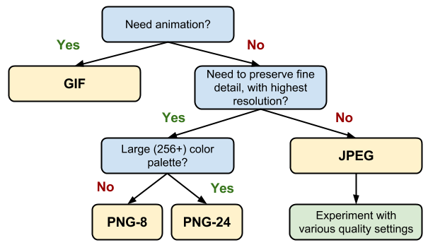
Selecting the right image format
Do you need animation? If so, GIF is the only universal choice.
GIF limits the color palette to at most 256 colors, which makes it a poor choice for most images. Further, PNG-8 delivers better compression for images with a small palette. As a result, GIF is the right answer only when animation is required.
Do you need to preserve fine detail with highest resolution? Use PNG.
PNG does not apply any lossy compression algorithms beyond the choice of the size of the color palette. As a result, it will produce the highest quality image, but at a cost of significantly higher filesize than other formats. Use judiciously.
If the image asset contains imagery composed of geometric shapes, consider converting it to a vector (SVG) format!
If the image asset contains text, stop and reconsider. Text in images is not selectable, searchable, or "zoomable". If you need to convey a custom look (for branding or other reasons), use a web font instead.
Are you optimizing a photo, screenshot, or a similar image asset? Use JPEG.
JPEG uses a combination of lossy and lossless optimization to reduce filesize of the image asset. Try several JPEG quality levels to find the best quality vs. filesize tradeoff for your asset.

Slide 32
Delivering scaled image assets
Delivering scaled assets is one of the simplest and most effective optimizations
Pay close attention to large assets as they result in high overhead
Reduce the number of unnecessary pixels by scaling your images to their display size
As a result, one of the simplest and most effective image optimization techniques is to ensure that we are not shipping any more pixels than needed to display the asset at its intended size in the browser. Sounds simple, right? Unfortunately, most pages fail this test for many of their image assets: typically, they ship larger assets and rely on the browser to rescale them - which also consumes extra CPU resources - and display them at a lower resolution.

Slide 33
Image optimization checklist
Prefer vector formats: vector images are resolution and scale independent, which makes them a perfect fit for the multi-device and high-resolution world.
Minify and compress SVG assets: XML markup produced by most drawing applications often contains unnecessary metadata which can be removed; ensure that your servers are configured to apply GZIP compression for SVG assets.
Pick best raster image format: determine your functional requirements and select the one that suits each particular asset.
Experiment with optimal quality settings for raster formats: don't be afraid to dial down the "quality" settings, the results are often very good and byte savings are significant.
Remove unnecessary image metadata: many raster images contain unnecessary metadata about the asset: geo information, camera information, and so on. Use appropriate tools to strip this data.
Serve scaled images: resize images on the server and ensure that the "display" size is as close as possible to the "natural" size of the image. Pay close to attention to large images in particular, as they account for largest overhead when resized!
Automate, automate, automate: invest into automated tools and infrastructure that will ensure that all of your image assets are always optimized.

Slide 34
Some more details
https://developers.google.com/web/fundamentals/performance/optimizing-content-efficiency/automating-image-optimization/

Slide 35
Js optimization
https://developers.google.com/web/fundamentals/performance/optimizing-content-efficiency/javascript-startup-optimization/

Slide 36
Web Font Optimization
Unicode fonts can contain thousands of glyphs.
There are four font formats: WOFF2, WOFF, EOT, and TTF.
Some font formats require the use of compression.

Slide 37
Webfont formats
Today there are four font container formats in use on the web: EOT, TTF, WOFF, and WOFF2. Unfortunately, despite the wide range of choices, there isn't a single universal format that works across all old and new browsers: EOT is IE only, TTF has partial IE support, WOFF enjoys the widest support but is not available in some older browsers, and WOFF 2.0 support is a work in progress for many browsers.
So, where does that leave us? There isn't a single format that works in all browsers, which means that we need to deliver multiple formats to provide a consistent experience:
Serve WOFF 2.0 variant to browsers that support it.
Serve WOFF variant to the majority of browsers.
Serve TTF variant to old Android (below 4.4) browsers.
Serve EOT variant to old IE (below IE9) browsers.

Slide 38
Reducing font size with compression
Reducing font size with compression
A font is a collection of glyphs, each of which is a set of paths describing the letter form. The individual glyphs are different, but they contain a lot of similar information that can be compressed with GZIP or a compatible compressor:
EOT and TTF formats are not compressed by default. Ensure that your servers are configured to apply GZIP compression when delivering these formats.
WOFF has built-in compression. Ensure that your WOFF compressor is using optimal compression settings.
WOFF2 uses custom preprocessing and compression algorithms to deliver ~30% file-size reduction over other formats. For more information, see the WOFF 2.0 evaluation report.

Slide 39
Format selection
Use the format() hint to specify multiple font formats.
Subset large Unicode fonts to improve performance. Use Unicode-range subsetting and provide a manual subsetting fallback for older browsers.
Reduce the number of stylistic font variants to improve the page- and text-rendering performance.

Slide 40
@font-face { font-family: 'Awesome Font'; font-style: normal; font-weight: 400; src: local('Awesome Font'), url('/fonts/awesome.woff2') format('woff2'), url('/fonts/awesome.woff') format('woff'), url('/fonts/awesome.ttf') format('truetype'), url('/fonts/awesome.eot') format('embedded-opentype'); } @font-face { font-family: 'Awesome Font'; font-style: italic; font-weight: 400; src: local('Awesome Font Italic'), url('/fonts/awesome-i.woff2') format('woff2'), url('/fonts/awesome-i.woff') format('woff'), url('/fonts/awesome-i.ttf') format('truetype'), url('/fonts/awesome-i.eot') format('embedded-opentype'); }

Slide 41
Some more text
Audit and monitor your font use: don't use too many fonts on your pages, and, for each font, minimize the number of used variants. This helps produce a more consistent and a faster experience for your users.
Subset your font resources: many fonts can be subset, or split into multiple unicode-ranges to deliver just the glyphs that a particular page requires. This reduces the file size and improves the download speed of the resource. However, when defining the subsets, be careful to optimize for font re-use. For example, don't download a different but overlapping set of characters on each page. A good practice is to subset based on script: for example, Latin, Cyrillic, and so on.
Deliver optimized font formats to each browser: provide each font in WOFF2, WOFF, EOT, and TTF formats. Make sure to apply GZIP compression to the EOT and TTF formats, because they are not compressed by default.
Give precedence to local() in your src list: listing local('Font Name') first in your src list ensures that HTTP requests aren't made for fonts that are already installed.
Customize font loading and rendering using <link rel="preload">, font-display, or the Font Loading API: default lazyloading behavior may result in delayed text rendering. These web platform features allow you to override this behavior for particular fonts, and to specify custom rendering and timeout strategies for different content on the page.
Specify revalidation and optimal caching policies: fonts are static resources that are infrequently updated. Make sure that your servers provide a long-lived max-age timestamp and a revalidation token to allow for efficient font reuse between different pages. If using a service worker, a cache-first strategy is appropriate.

Slide 42
Http cache
A lot of text, short speaking about attributes

Slide 43
Critical Rendering Path
Optimizing for performance is all about understanding what happens in these intermediate steps between receiving the HTML, CSS, and JavaScript bytes and the required processing to turn them into rendered pixels - that's the critical rendering path.

Slide 44
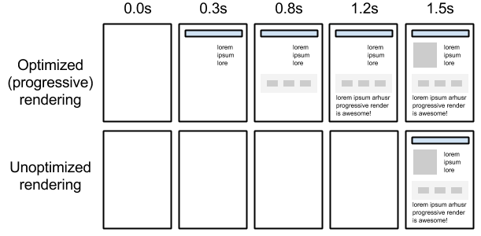

Slide 45
Steps to render a page
Process HTML markup and build the DOM tree.
Process CSS markup and build the CSSOM tree.
Combine the DOM and CSSOM into a render tree.
Run layout on the render tree to compute geometry of each node.
Paint the individual nodes to the screen.
Optimizing the critical rendering path is the process of minimizing the total amount of time spent performing steps 1 through 5 in the above sequence.
Возможно подробнее о каждом шаге

Slide 46
Render Blocking CSS
By default, CSS is treated as a render blocking resource.
Media types and media queries allow us to mark some CSS resources as non-render blocking.
The browser downloads all CSS resources, regardless of blocking or non-blocking behavior.
By using media queries, we can tailor our presentation to specific use cases, such as display versus print, and also to dynamic conditions such as changes in screen orientation, resize events, and more. When declaring your style sheet assets, pay close attention to the media type and queries; they greatly impact critical rendering path performance.

Slide 47
Adding Interactivity with JavaScript
JavaScript can query and modify the DOM and the CSSOM.
JavaScript execution blocks on the CSSOM.
JavaScript blocks DOM construction unless explicitly declared as async.
JavaScript introduces a lot of new dependencies between the DOM, the CSSOM, and JavaScript execution. This can cause the browser significant delays in processing and rendering the page on the screen:
The location of the script in the document is significant.
When the browser encounters a script tag, DOM construction pauses until the script finishes executing.
JavaScript can query and modify the DOM and the CSSOM.
JavaScript execution pauses until the CSSOM is ready.

Slide 48
Add <script> tags to the end of body to prevent blocking
By default, JavaScript execution is "parser blocking": when the browser encounters a script in the document it must pause DOM construction, hand over control to the JavaScript runtime, and let the script execute before proceeding with DOM construction. Use "async" if script don't rely on DOM and other scripts
Use "defer" to preserve script order and execute them after document loading

Slide 49
Measuring the Critical Rendering Path

Slide 50
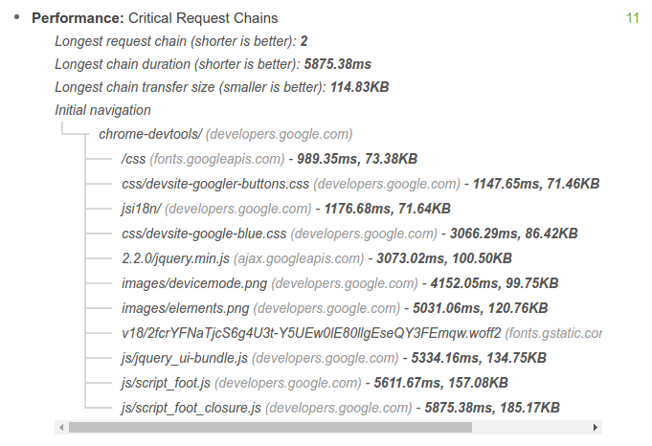
Auditing a page with Lighthouse можно пропустить
Lighthouse is a web app auditing tool that runs a series of tests against a given page, and then displays the page's results in a consolidated report. You can run Lighthouse as a Chrome Extension or NPM module, which is useful for integrating Lighthouse with continuous integration systems.

Slide 51
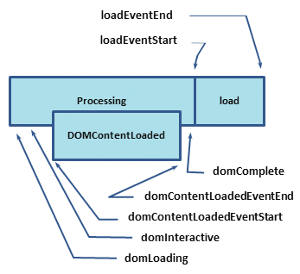
Instrumenting your code with the Navigation Timing API
The combination of the Navigation Timing API and other browser events emitted as the page loads allows you to capture and record the real-world CRP performance of any page.

Slide 52
domLoading: this is the starting timestamp of the entire process, the browser is about to start parsing the first received bytes of the HTML document.
domInteractive: marks the point when the browser has finished parsing all of the HTML and DOM construction is complete.
domContentLoaded: marks the point when both the DOM is ready and there are no stylesheets that are blocking JavaScript execution - meaning we can now (potentially) construct the render tree.
Many JavaScript frameworks wait for this event before they start executing their own logic. For this reason the browser captures the EventStart and EventEnd timestamps to allow us to track how long this execution took.
domComplete: as the name implies, all of the processing is complete and all of the resources on the page (images, etc.) have finished downloading - in other words, the loading spinner has stopped spinning.
loadEvent: as a final step in every page load the browser fires an onload event which can trigger additional application logic.
The HTML specification dictates specific conditions for each and every event: when it should be fired, which conditions should be met, and so on. For our purposes, we'll focus on a few key milestones related to the critical rendering path:
domInteractive marks when DOM is ready.
domContentLoaded typically marks when both the DOM and CSSOM are ready.
If there is no parser blocking JavaScript then DOMContentLoaded will fire immediately after domInteractive.
domComplete marks when the page and all of its subresources are ready.

Slide 53
Analyzing Critical Rendering Path Performance
Smth really important
https://developers.google.com/web/fundamentals/performance/critical-rendering-path/analyzing-crp

Slide 54
Optimizing the Critical Rendering Path

Slide 55
To deliver the fastest possible time to first render, we need to minimize three variables:
The number of critical resources.
The critical path length.
The number of critical bytes.
A critical resource is a resource that could block initial rendering of the page. The fewer of these resources, the less work for the browser, the CPU, and other resources.
Similarly, the critical path length is a function of the dependency graph between the critical resources and their bytesize: some resource downloads can only be initiated after a previous resource has been processed, and the larger the resource the more roundtrips it takes to download.
Finally, the fewer critical bytes the browser has to download, the faster it can process content and render it visible on the screen. To reduce the number of bytes, we can reduce the number of resources (eliminate them or make them non-critical) and ensure that we minimize the transfer size by compressing and optimizing each resource.
The general sequence of steps to optimize the critical rendering path is:
Analyze and characterize your critical path: number of resources, bytes, length.
Minimize number of critical resources: eliminate them, defer their download, mark them as async, and so on.
Optimize the number of critical bytes to reduce the download time (number of roundtrips).
Optimize the order in which the remaining critical resources are loaded: download all critical assets as early as possible to shorten the critical path length.

Slide 56
conclusion
https://developers.google.com/web/fundamentals/performance/critical-rendering-path/page-speed-rules-and-recommendations

Slide 57
Rendering performance

Slide 58
to-do list
Правильная шкала ожиданий пользователя
joke about long loading
Eliminating Unnecessary Downloads – переводчик и debounce + подсчет запросов + kb size
Made examples on rail
1. measuring critical rendering path – methods, examples
https://www.youtube.com/watch?v=GP7U6LW2zDY&feature=youtu.be&t=14m45s
Examples of content optimization (uglify, gzip)
Image handling + optimization (svg, raster examples)
Examples of image scaling
http cache text + examples
Rendering performance
Find and Fix Web App Performance Issues https://developers.google.com/web/fundamentals/codelabs/web-perf/#exercise_4_memory_waste

