Slide 1
Variational Deep Autoencoder
Michał Gromadzki

Slide 2

What was done?
VAE
VaDE
ELBO for VaDE
Pretraining for VaDE
Latent space visualization
Generation of new observations
Computation of clustering metrics

Slide 3
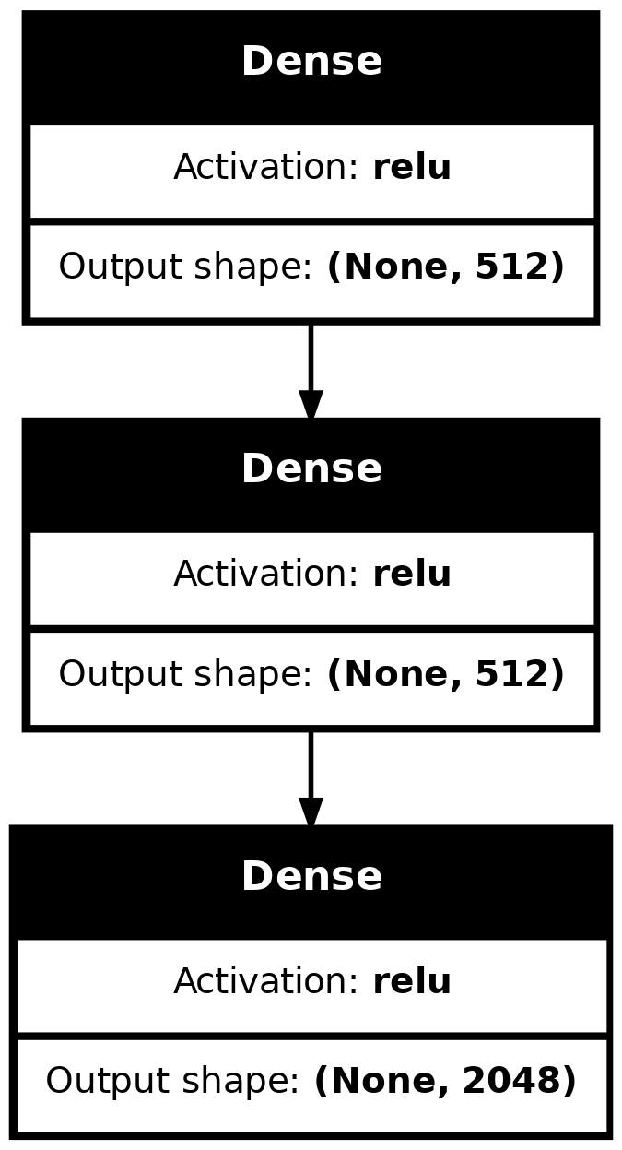
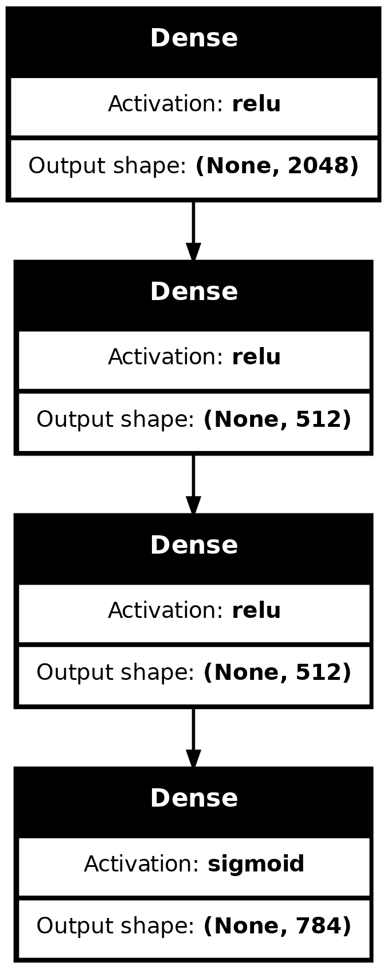
Encoder and Decoder

Slide 4
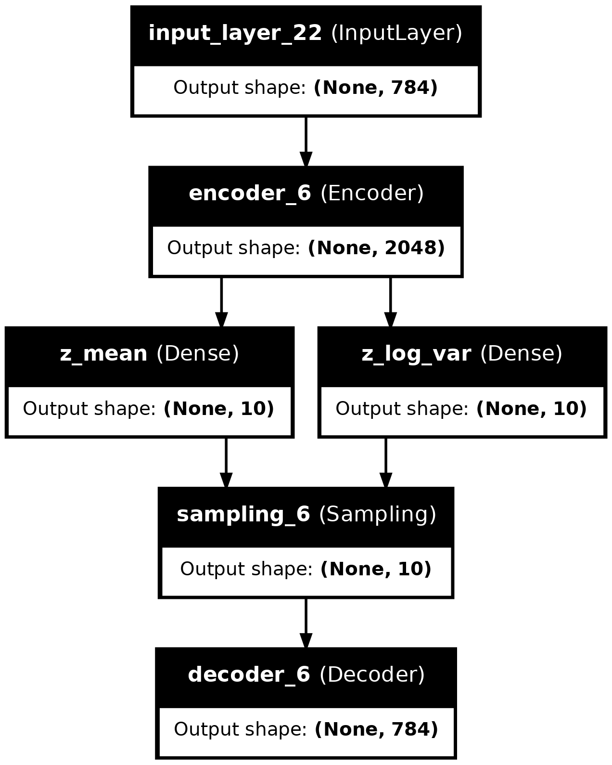

VaDE vs VAE
No. Of Params: 3 492 854
No. Of Params: 3 492 644

Slide 5
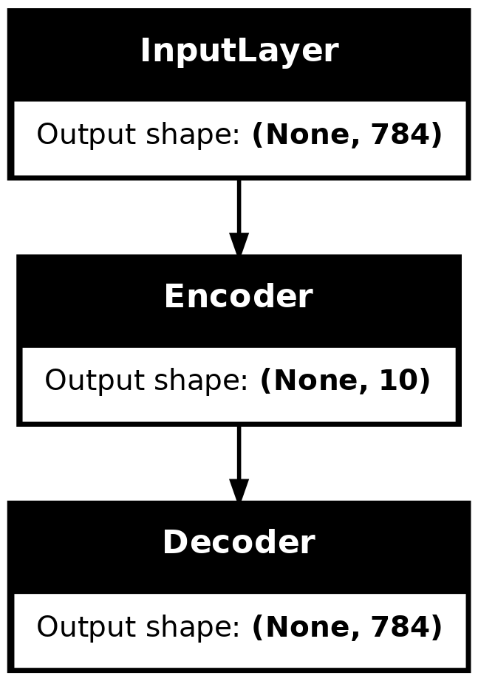
Pretraining of VaDE
Train autoencoder and use its weights as starting points
Run gaussian mixture model on latent space

Slide 6
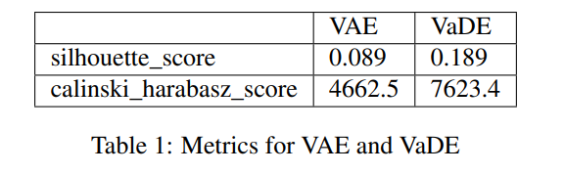
Metrics
Cluster_accuracy: 0.8167
V_measure_score: 0.7648

Slide 7
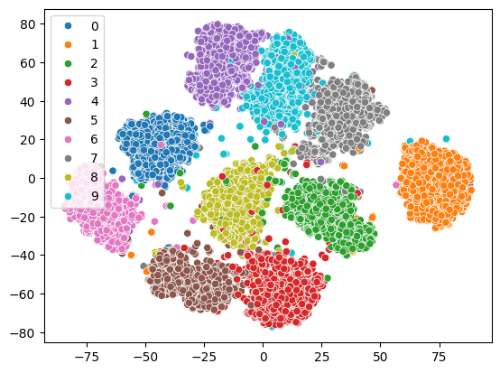
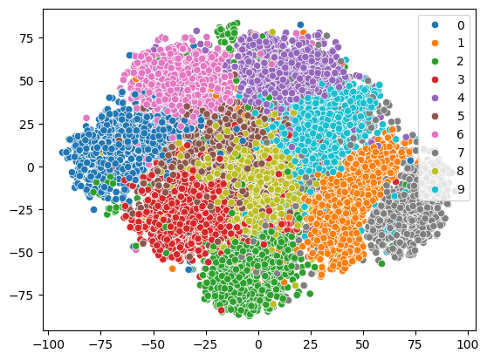
Latent space

Slide 8
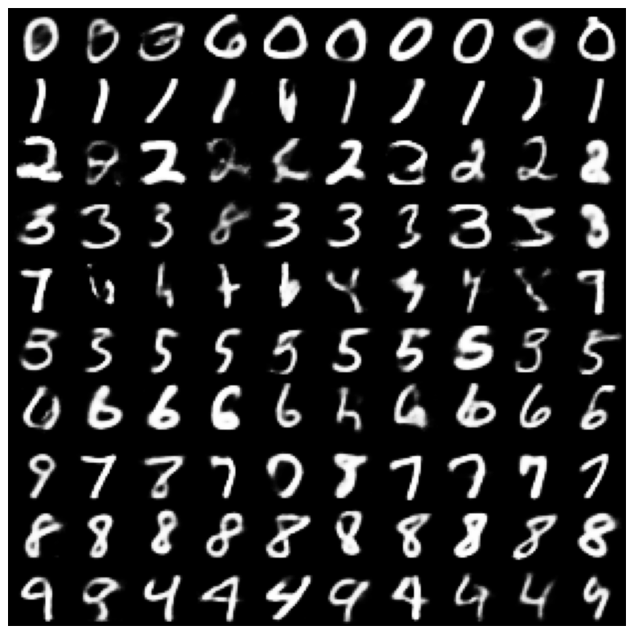
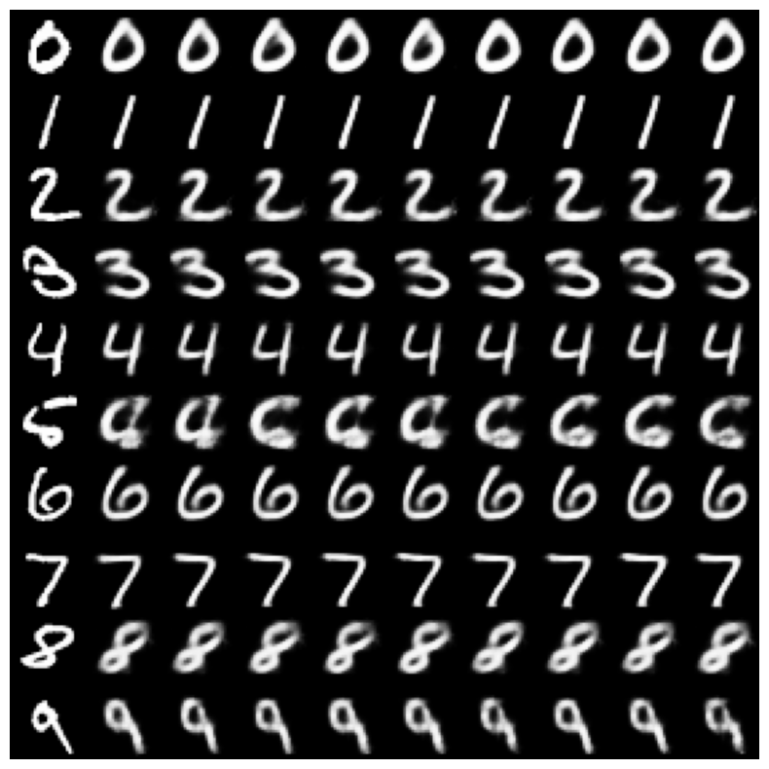
Generated observations

Slide 9
Bibliography
Variational Deep Embedding: An Unsupervised and Generative Approach to Clustering Zhuxi Jiang, Yin Zheng, Huachun Tan, Bangsheng Tang, Hanning Zhou
https://github.com/kozlovskia/Variational_Clustering

