Slide 1

System Documentation

Slide 2
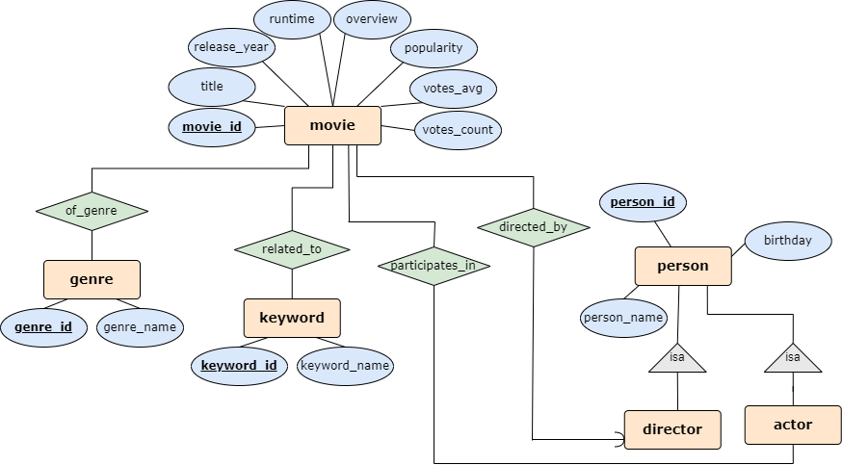
ER Diagram

Slide 3
Comedy Movies Schema
Tables:
Movie(Movie_id, Title, Director_id, Release_year, Runtime, Overview, Popularity, Vote_average, Vote_count)
Person(Person_id, Person_name, Birthday)
Actor(Actor_id)
Director(Director_id)
Movie-person(Movie_id, Person_id
Genre(Genre_id, Genre_name)
Movie-genre(Movie_id, Genre_id)
Keywords(Keyword_id, Keyword_name)
Movie-keyword(Movie_id, Keyword_id)

Slide 4
Comedy Movies Schema
Foreign keys:
Movie(Director_id) → Director(Director_id)
Actor(Actor_id) → Person(Person_id)
Director(Director_id) → Person(Person_id)
Movie-person(Movie_id) → Movie(Movie_id)
Movie-person(Person_id) → Person(Person_id)
Movie-genre(Movie_id) → Movie(Movie_id)
Movie-genre(Genre_id) → Genre(Genre_id)
Movie-keyword(Movie_id) → Movie(Movie_id)
Movie-keyword(Keyword_id) → Keywords(Keyword_id)

Slide 5
Schema – Description
The schema includes the movies table which stores the main characteristics of each movie and a column with the director ID, the genres table, a table for keywords and a table of relevant people characteristics.
In addition to this, a table of actors with the actor's ID, a table of directors with the directors' ID and tables linking a movie to a person, between a movie to a genre and between a movie to a keyword.

Slide 6
Database Design – Explanation
The database aggregates the key features of movies that may be of interest to the users of the application, while supporting a suitable search.
First we divided the information into a table of genres, a table of keywords, a table of people - all of these are many-to-many - each value can be shared by several movies, and each movie can contain several values.
In addition, a central table that gathers the other features (of which there cannot be several for the same movie) of the movies.
After that we noticed that an actor and a director are both a type of person, and to avoid duplication we built appropriate tables to refer to them as is-a person, as we saw in class.
Since director and movie have a one-to-many relationship, we added the director ID as a column to the movies table.

Slide 7
Database Optimizations
We chose to create four indexes. As we saw in the lectures, proper indexes allow the data to be retrieved more efficiently and faster.
Most of them on the movie table, which is the busiest and concentrates most of the information.
Fulltext index on title and overview
Index on release_year that supports filtering movies by year
Index on popularity that supports filtering movies by popularity
Index on vote_average that supports filtering movies by vote average.
Index on keyword_name – the unusual index that is defined on the keyword table. Supports inserting unique keywords.

Slide 8
Query 1
This is a full-text query – supports searching for words that appear in the title or overview of a movie, and returns as output movie name, its genres, overview and rating.
We used MATCH ... AGAINST as we saw in the recitation.
The full text index we created on title and overview supports efficient execution of this query.

Slide 9
Query 2
This is another full-text query that supports searching for movies by keyword - enter a word to search for all keywords that contain it, and outputs the name of the movie, its overview, rating, release year and director.
We used MATCH ... AGAINST as we saw in the recitation.
The index on keyword_name supports this query.

Slide 10
Query 3
Complex query – "Director's favourite actors" - which actors have appeared in the 10 most popular movies of a given director and how many times have they appeared?
We used a nested query and group by.
The indexes on release_year and popularity support this query.

Slide 11
Query 4
Complex query - "Hall of Fame" - for a given decade and sub-genre, outputs the first 10 actors who played in the most movies of that sub-genre in that decade.
Uses group by.
The index on release_year supports this query.

Slide 12
Query 5
Complex query: “Hidden Gems" - finds unpopular but highly rated movies for a given year (rating > 7.0 and popularity < average popularity). Outputs title, overview, vote_average, popularity of movies from the requested year, in descending order of average votes.
Uses a nested query and order by.
The indexes on release_year, popularity and vote_average support this query.

Slide 13
Extra Queries
We added 3 queries that we felt were needed to complete the application's functionality.
"Most popular movies of a director" - for a given director, output their 5 most popular movies
"Most popular movies of an actor" - for a given actor, output their 5 most popular movies
"Most popular genres of an actor" - for a given actor, output the genres they have appeared in the most

Slide 14
Code Structure and API Usage
We used an API from the TMDB site which contains information on over a million movies.
In the create_db_script.py file, create the tables with the appropriate columns, as we described above, and create the indexes for the movies table.
In the api_data_retrieve.py file, the API selects the films from the comedy genre, which are leading in the ranking and have won at least 500 votes (meaning that their ranking can be trusted). The different functions fill the tables we created with the features of these movies.
The queries_db_script.py file contains the functions that run the queries we wrote, and the main function in the queries_execution.py file calls them and prints the results.

