Slide 1
Mapping PE (paired-end ) “regular” DNA fragments from NovaSeqX Plus
fastq2tracks workflow

Slide 2
fastq2tracks.sh workflow
Reads FASTQ
multiQC
QC report
TrimmGalore
Trimmed FASTQ
multiQC
QC report
Bowtie2
Genomic Alignments BAM
multiQC
QC report
Picard
Deduplicated BAM
multiQC
QC report
FINAL REPORT
Bedtools/R
Genomic Coverage BedGraph
Bedtools/R
Read-depth normalised BedGraph
Kentutills/ bedgraphToBigwig
Indexed Binary Coverage BigWig

Slide 3
DNAfastqBigWig_human_main_v5_30aug2025.sh
usage
# 1
PATH_to_Script/DNAfastqBigWig_human_main_v5_31aug2025.sh [inputFolder] [outputFolder] [max jobs]
[inputFolder] - folder with fastq files; seperately human and mouse; distinct scripts for each
[outputFolder] - for all script outputs
[max jobs] - maximal number of jobs to be run in parallel
#2
script assumes that one sample is represented by 1 pair of fastq files stored in seperate files in "inputFolder" named:
path/to/folder/inputFolder/*_1.fq.gz
path/to/folder/inputFolder/*_2.fq.gz
It has been tested initially on 150 bp paire-end reads generated by Illumina NovaSeqX Plu

Slide 4
DNAfastqBigWig_human_main_v5_30aug2025.sh
Scripts used in workflow
# 3 scripts:
DNAfastqBigWig_human_main_v5_31aug2025.sh # master script
fastqc_batch_v1_30aug2025.sh
trimgalore_batch_final_v2_30aug2025.sh
bowtie2_human_batch_v1_31aug.sh
bowtie2_dovetail_pairedEnd_Hsapiens_31Aug25.sh
picard_deduplication_batch_31aug2025_v8.sh
picard_deduplication_28aug2025.sh
genomecoverage_batch_v1_31aug2025.sh
genomeCoverage_DNA_human_26aug2025.sh
create_ucsc_tracks_v1_31aug2025.sh
generate_pipeline_report_final_v4_01sep2025.sh
generate_multiqc_unified_report.sh
# 4 folders:
outputFolder/reports/
outputFolder/fastQC/
outputFolder/fastQC/fastQC_unTrimmed/
outputFolder/fastQC/fastQC_trimmed/
outputFolder/multiQC/
outputFolder/multiQC/multiQC_unTrimmed
outputFolder/multiQC/multiQC_trimmed
outputFolder/multiQC/multiQC_alignments
outputFolder/multiQC/multiQC_deduplication
outputFolder/trimmedFastq
outputFolder/bams
outputFolder/dedupBams
outputFolder/bedGraph
outputFolder/NormBedGraph
outputFolder/bigwig

Slide 5
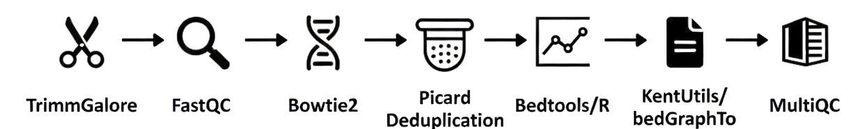
DNAfastqBigWig_human_main_v5_30aug2025.sh
Workflow steps
1. Creating folders:
2. Quality control of unprocessed fastq files :
3. trimming fastq files with TrmmGalore based on quality & sequence - adpater removal
4. Quality control of trimmed fastq files :
5. Alignment of trimmed fastq files with Bowtie2 to hg38 genome
6. Removal of read duplicates with picard
7. Generation of coverages, rpm normalization and generation of bedGraph & bigWig files
8. Creating generic UCSC bigwig track lines
9. Generating analysis report
10. Generating report with summary of multiqc analysis of fastq files, trimming, aligmnet and deduplication

Slide 6
DNAfastqBigWig: FastQC of untrimmed FASTQ files
# 1 Workflow parts:
1. Creating folders:
2. Quality control of unprocessed fastq files :
3. trimming fastq files with TrmmGalore based on quality & sequence - adpater removal
4. Quality control of trimmed fastq files :
5. Alignment of trimmed fastq files with Bowtie2 to hg38 genome
6. Removal of read duplicates with picard
7. Generation of coverages, rpm normalization and generation of bedGraph & bigWig files
8. Creating generic UCSC bigwig track lines
9. Generating analysis report
10. Generating report with summary of multiqc analysis of fastq files, trimming, aligmnet and deduplication

Slide 7
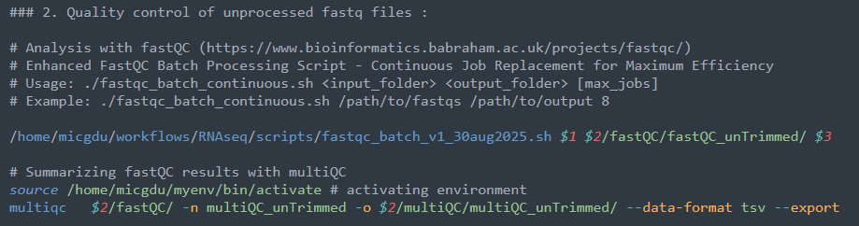

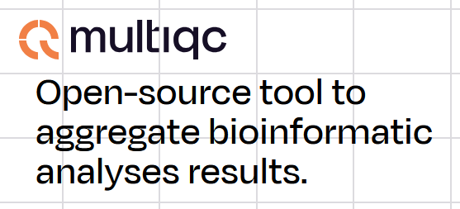
DNAfastqBigWig: FastQC of untrimmed FASTQ files & summary with multiQC

Slide 8
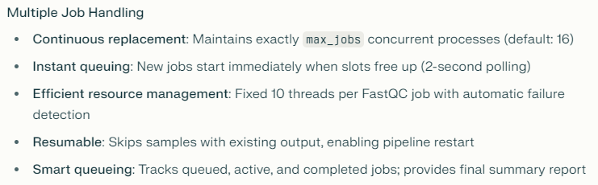
Lower-level script: fastqc_batch_v1_30aug2025.sh – multiple job handling

Slide 9
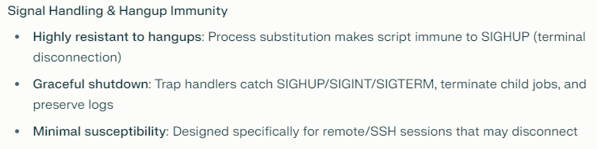
Lower-level script: fastqc_batch_v1_30aug2025.sh – hangup handling

Slide 10
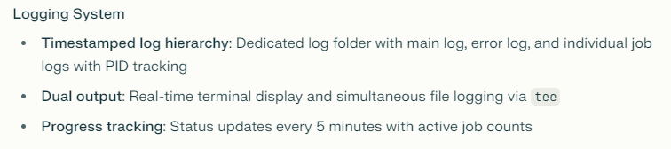
Lower-level script: fastqc_batch_v1_30aug2025.sh – logging

Slide 11
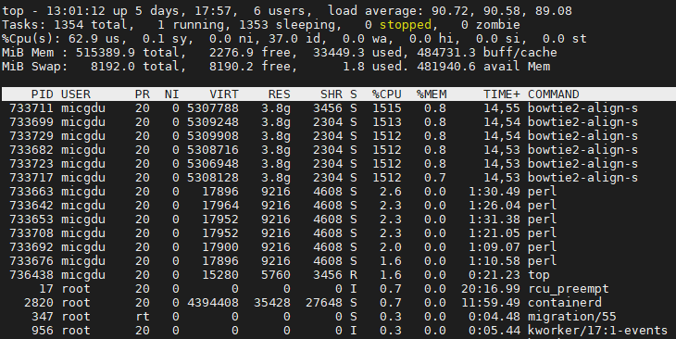
Monitoring usage of computing resources: adjust “max jobs”
8 is fine most of the time, you can go for 2-4 if server busy with other urgent jobs

Slide 12
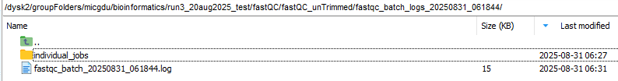
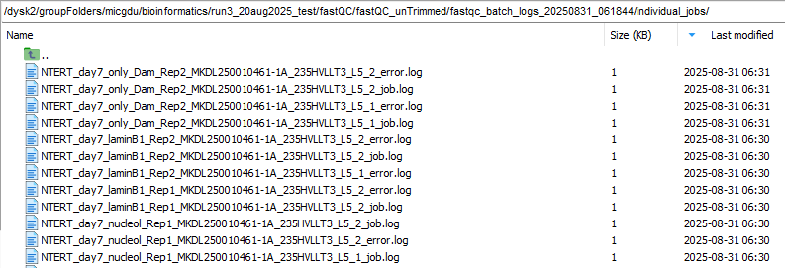
Lower-level script: fastqc_batch_v1_30aug2025.sh – batch & individual logs

Slide 13
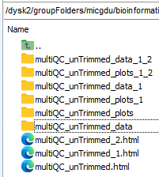
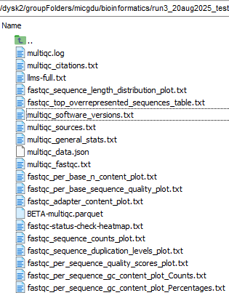
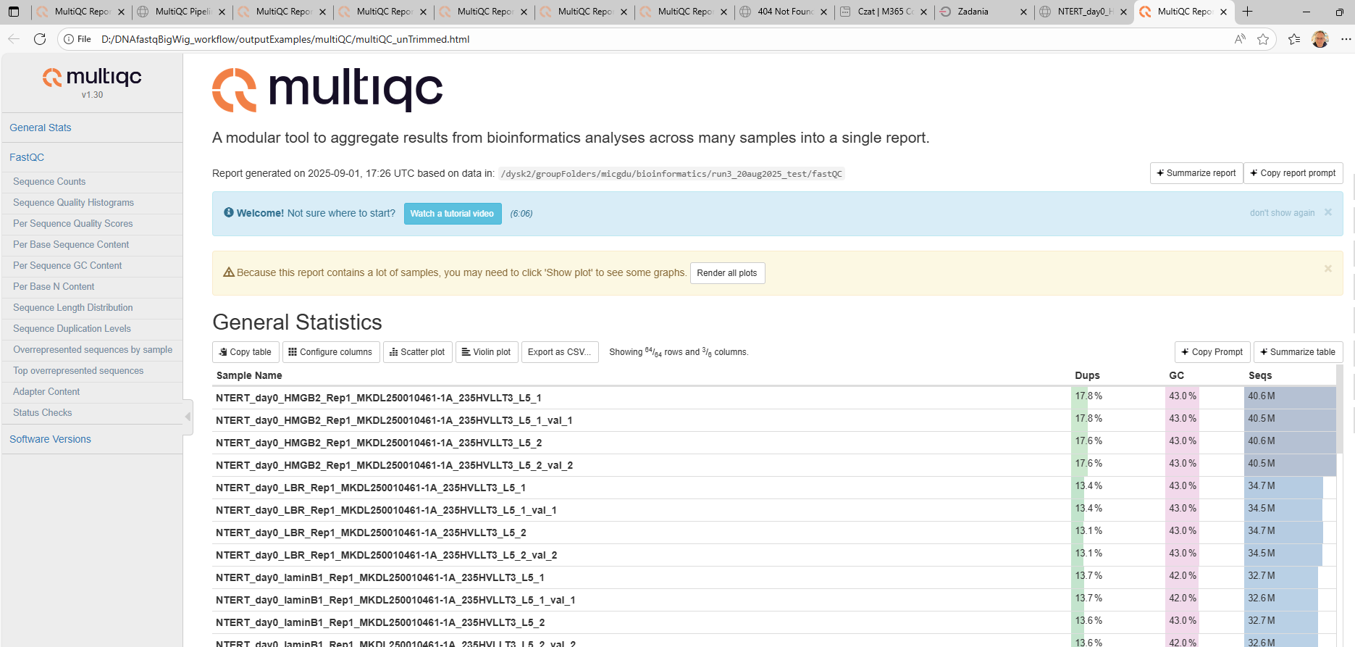
DNAfastqBigWig: summary with multiQC

Slide 14
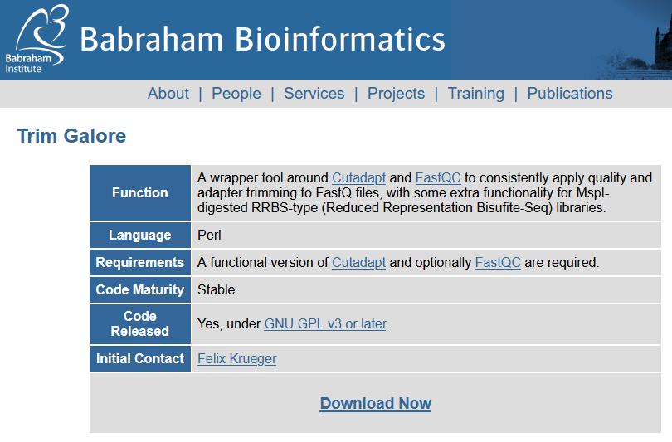
Lower-level script, TrimGalore: trimgalore_batch_final_v2_30aug2025.sh
# 1 Workflow parts:
1. Creating folders:
2. Quality control of unprocessed fastq files :
3. trimming fastq files with TrmmGalore based on quality & sequence - adpater removal
4. Quality control of trimmed fastq files :
5. Alignment of trimmed fastq files with Bowtie2 to hg38 genome
6. Removal of read duplicates with picard
7. Generation of coverages, rpm normalization and generation of bedGraph & bigWig files
8. Creating generic UCSC bigwig track lines
9. Generating analysis report
10. Generating report with summary of multiqc analysis of fastq files, trimming, aligmnet and deduplication

Slide 15
DNAfastqBigWig: FastQC of trimmed FASTQ files
# 1 Workflow parts:
1. Creating folders:
2. Quality control of unprocessed fastq files :
3. trimming fastq files with TrmmGalore based on quality & sequence - adpater removal
4. Quality control of trimmed fastq files :
5. Alignment of trimmed fastq files with Bowtie2 to hg38 genome
6. Removal of read duplicates with picard
7. Generation of coverages, rpm normalization and generation of bedGraph & bigWig files
8. Creating generic UCSC bigwig track lines
9. Generating analysis report
10. Generating report with summary of multiqc analysis of fastq files, trimming, aligmnet and deduplication

Slide 16

DNAfastqBigWig: Alignment with Bowtie2 with bowtie2_human_batch_v1_31aug.sh
# 1 Workflow parts:
1. Creating folders:
2. Quality control of unprocessed fastq files :
3. trimming fastq files with TrmmGalore based on quality & sequence - adpater removal
4. Quality control of trimmed fastq files :
5. Alignment of trimmed fastq files with Bowtie2 to hg38 genome
6. Removal of read duplicates with picard
7. Generation of coverages, rpm normalization and generation of bedGraph & bigWig files
8. Creating generic UCSC bigwig track lines
9. Generating analysis report
10. Generating report with summary of multiqc analysis of fastq files, trimming, aligmnet and deduplication

Slide 17
FastQC/MultiQC – reports
reports

Slide 18
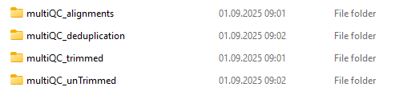
Full MultiQC reports
file:///D:/bioinformatics/github/thirdRunAug2025/multiQC_current/multiQC/multiQC_unTrimmed/multiQC_unTrimmed.html
file:///D:/bioinformatics/github/thirdRunAug2025/multiQC_current/multiQC/multiQC_trimmed/multiQC_trimmed.html
file:///D:/bioinformatics/github/thirdRunAug2025/multiQC_current/multiQC/multiQC_alignments/multiQC_aligments.html
file:///D:/bioinformatics/github/thirdRunAug2025/multiQC_current/multiQC/multiQC_deduplication/multiQC_deduplication.html

Slide 19
DNAfastqBigWig_human_main_v5_30aug2025.sh workflow
Reads FASTQ
multiQC
QC report
TrimmGalore
Trimmed FASTQ
multiQC
QC report
Bowtie2
Genomic Alignments BAM
multiQC
QC report
Picard
Deduplicated BAM
multiQC
QC report
FINAL REPORT
Bedtools/R
Genomic Coverage BedGraph
Bedtools/R
Read-depth normalised BedGraph
Kentutills/ bedgraphToBigwig
Indexed Binary Coverage BigWig

Slide 20
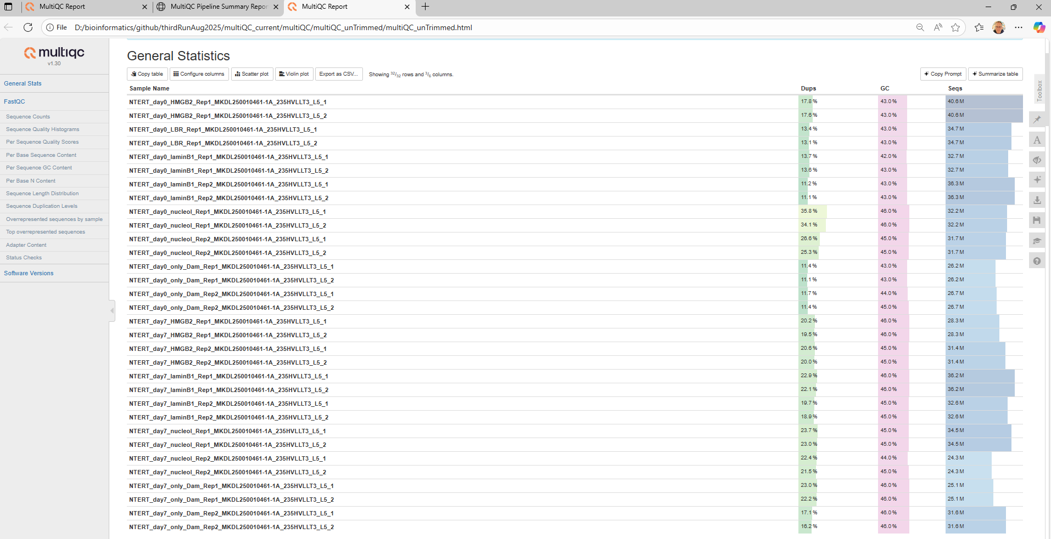
FastQC/MultiQC - summary

Slide 21
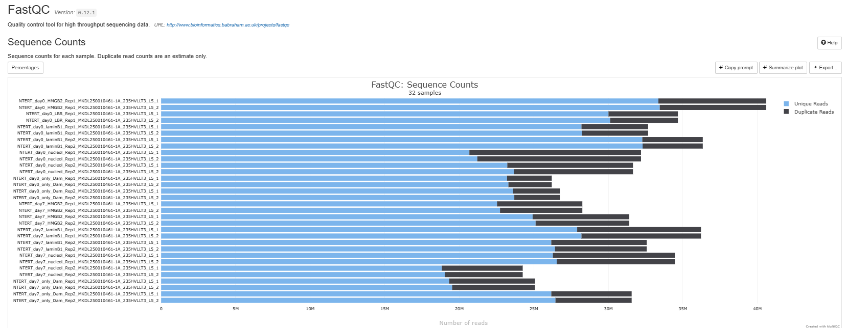
FastQC/MultiQC – unique/dup sequence counts

Slide 22
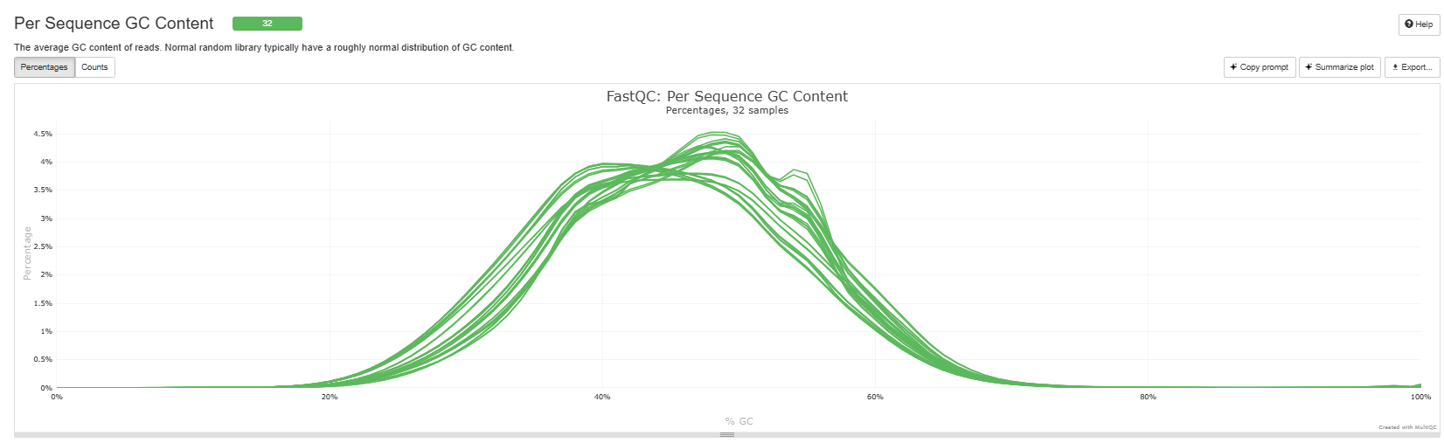
FastQC/MultiQC – per sequence GC content

Slide 23
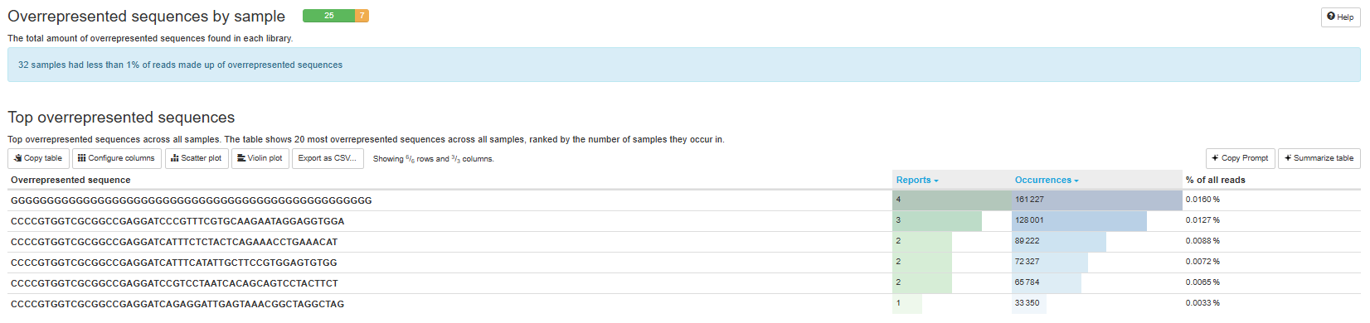
FastQC/MultiQC – overrepresented sequences

Slide 24
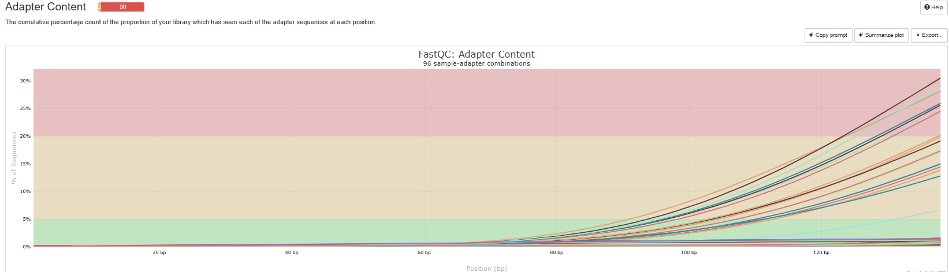
FastQC/MultiQC – Adapter content

Slide 25
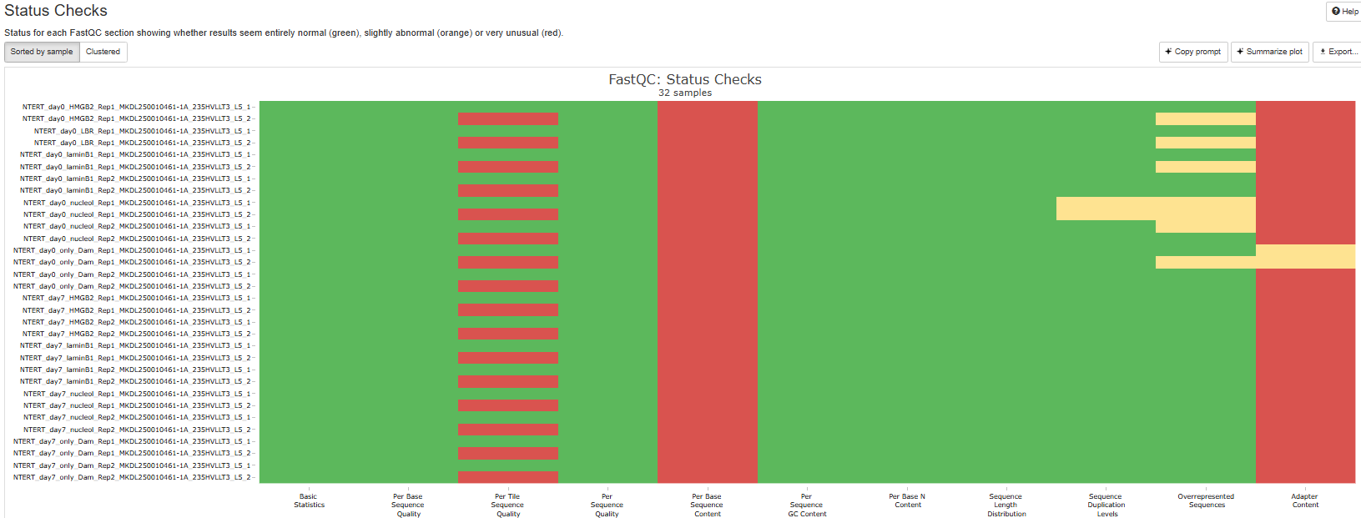
FastQC/MultiQC – status checks

Slide 26
DNAfastqBigWig_human_main_v5_30aug2025.sh workflow
Reads FASTQ
multiQC
QC report
TrimmGalore
Trimmed FASTQ
multiQC
QC report
Bowtie2
Genomic Alignments BAM
multiQC
QC report
Picard
Deduplicated BAM
multiQC
QC report
FINAL REPORT
Bedtools/R
Genomic Coverage BedGraph
Bedtools/R
Read-depth normalised BedGraph
Kentutills/ bedgraphToBigwig
Indexed Binary Coverage BigWig

Slide 27
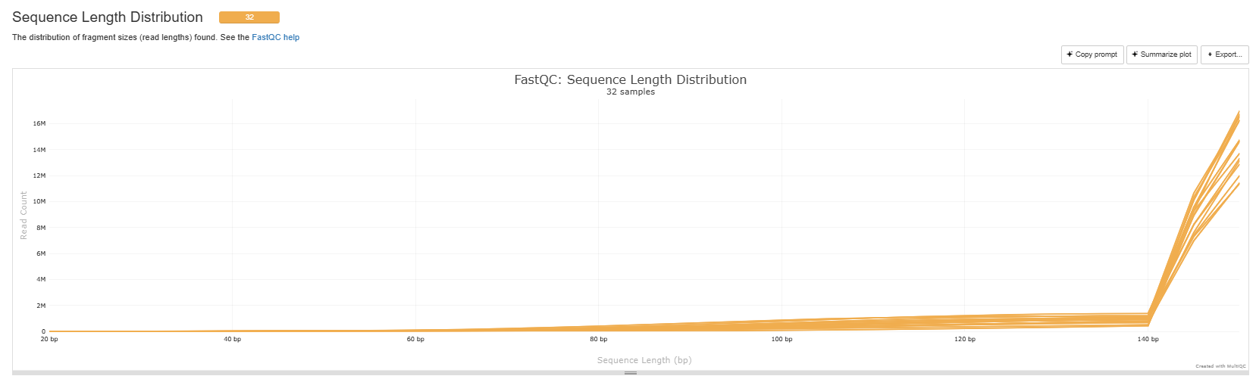
FastQC/MultiQC – length distribution

Slide 28
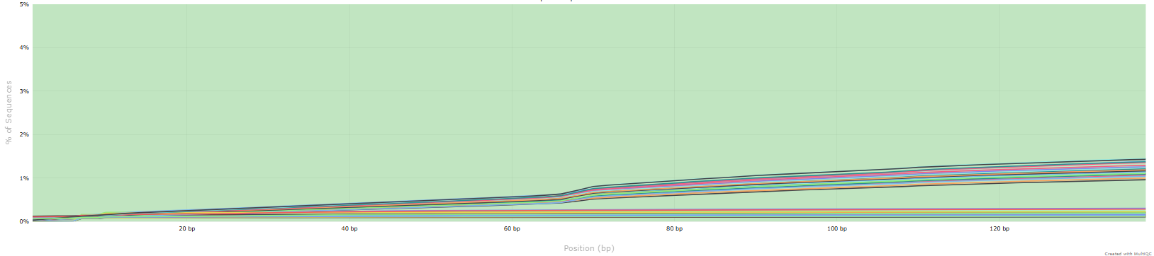
FastQC/MultiQC – Adapter content

Slide 29
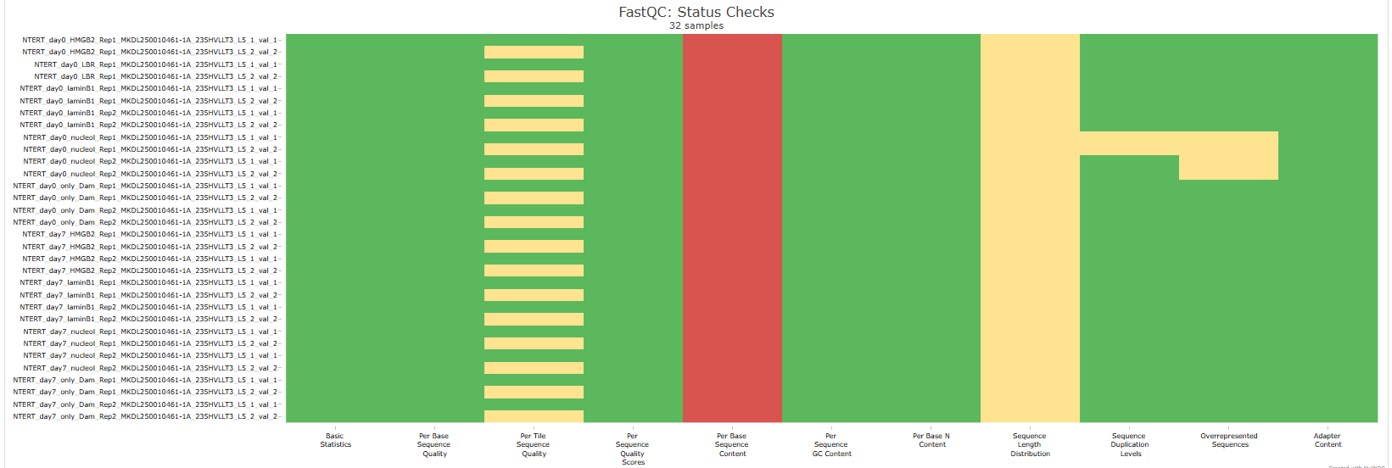
FastQC/MultiQC – status checks

Slide 30
DNAfastqBigWig_human_main_v5_30aug2025.sh workflow
Reads FASTQ
multiQC
QC report
TrimmGalore
Trimmed FASTQ
multiQC
QC report
Bowtie2
Genomic Alignments BAM
multiQC
QC report
Picard
Deduplicated BAM
multiQC
QC report
FINAL REPORT
Bedtools/R
Genomic Coverage BedGraph
Bedtools/R
Read-depth normalised BedGraph
Kentutills/ bedgraphToBigwig
Indexed Binary Coverage BigWig

Slide 31
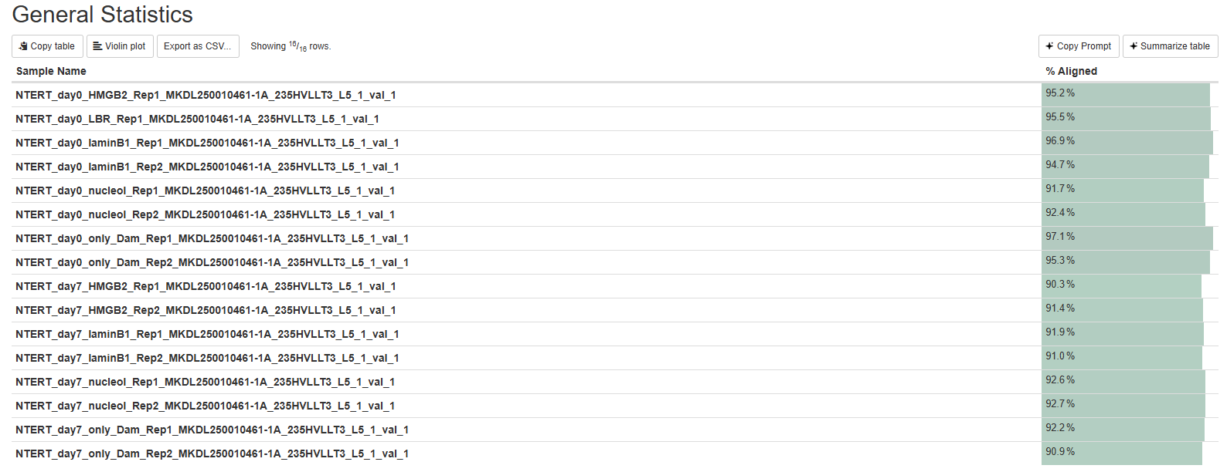
FastQC/MultiQC – % Aligned

Slide 32
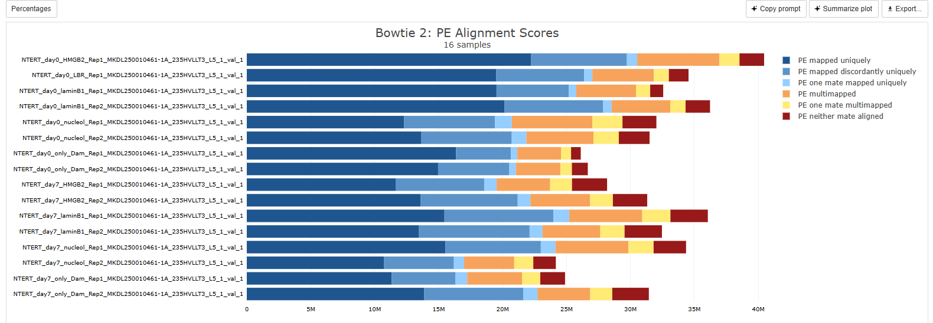
FastQC/MultiQC – PE alignment scores

Slide 33
DNAfastqBigWig_human_main_v5_30aug2025.sh workflow
Reads FASTQ
multiQC
QC report
TrimmGalore
Trimmed FASTQ
multiQC
QC report
Bowtie2
Genomic Alignments BAM
multiQC
QC report
Picard
Deduplicated BAM
multiQC
QC report
FINAL REPORT
Bedtools/R
Genomic Coverage BedGraph
Bedtools/R
Read-depth normalised BedGraph
Kentutills/ bedgraphToBigwig
Indexed Binary Coverage BigWig

Slide 34
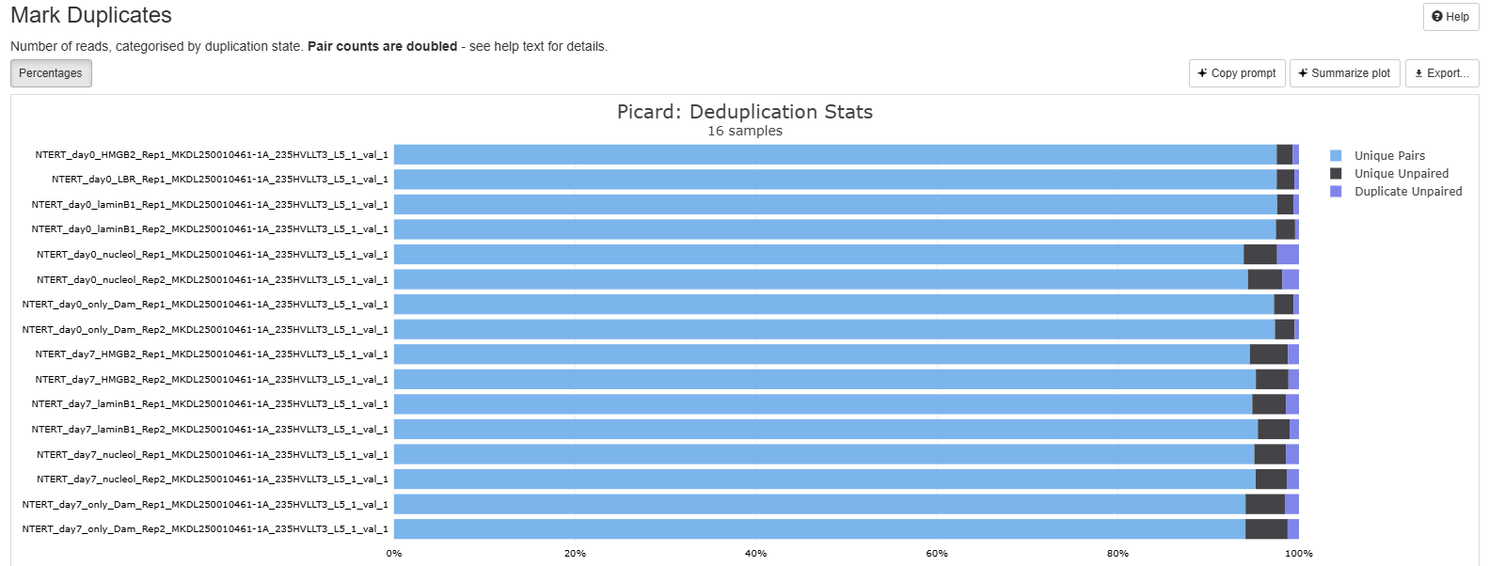
FastQC/MultiQC – deduplication stats

Slide 35
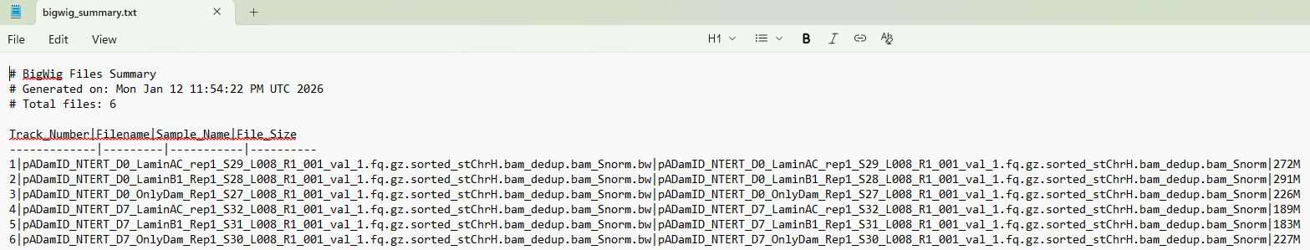
Reports/summaries: bigwig_summary.txt

Slide 36
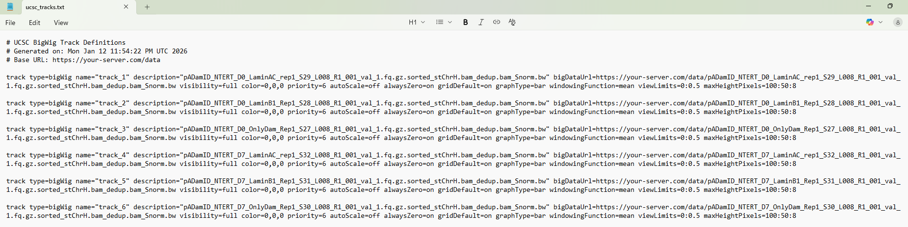
Reports/summaries: ucsc_tracks.txt

Slide 37
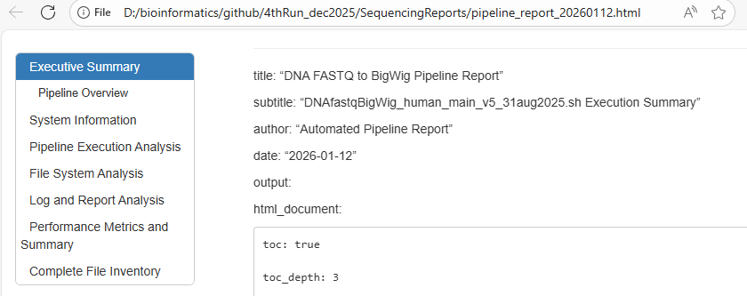
Reports/summaries: html pipeline report

Slide 38
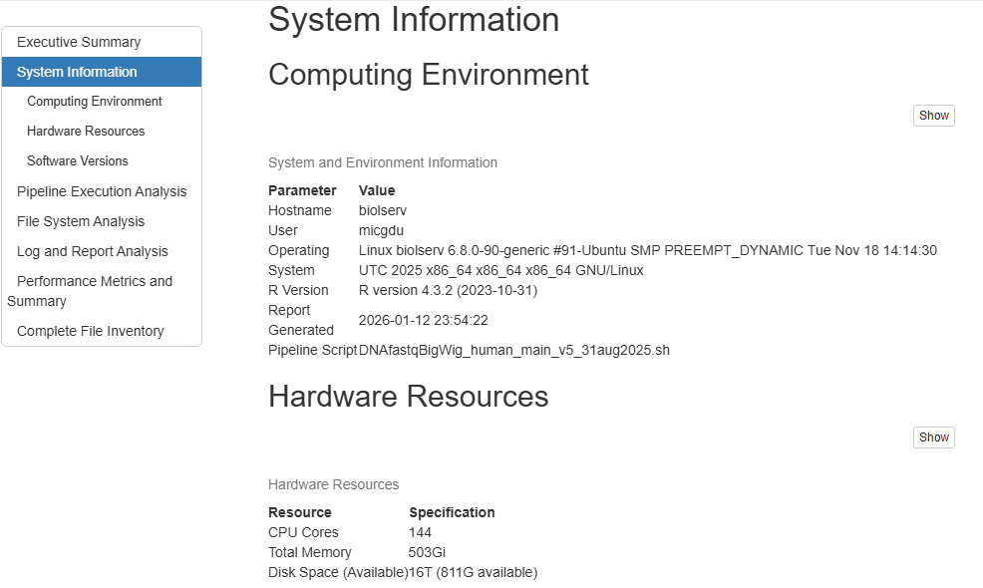
Reports/summaries: html pipeline report

Slide 39
Reports/summaries: html pipeline report

Slide 40
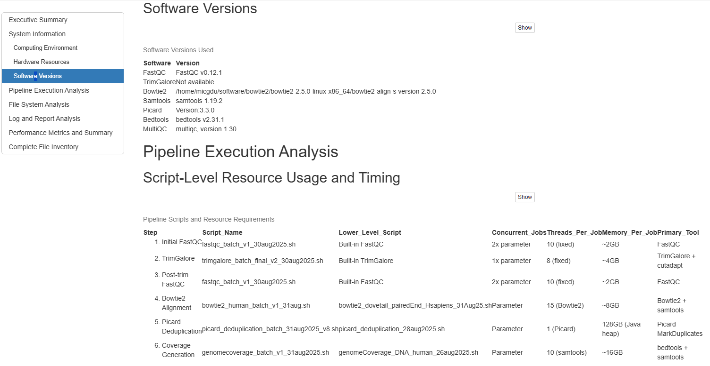
Reports/summaries: html pipeline report

Slide 41
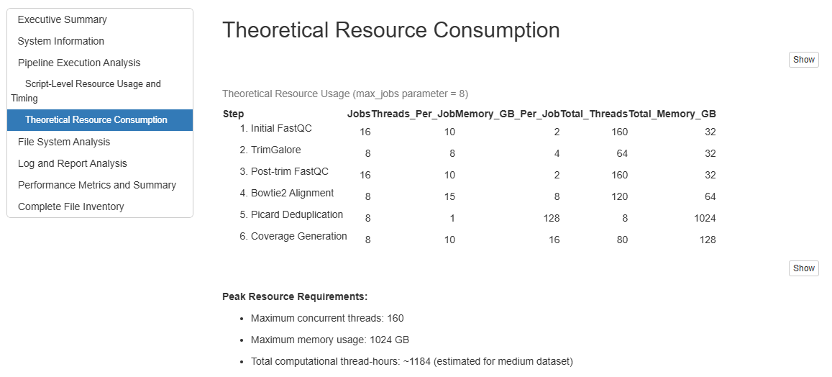
Reports/summaries: html pipeline report

Slide 42
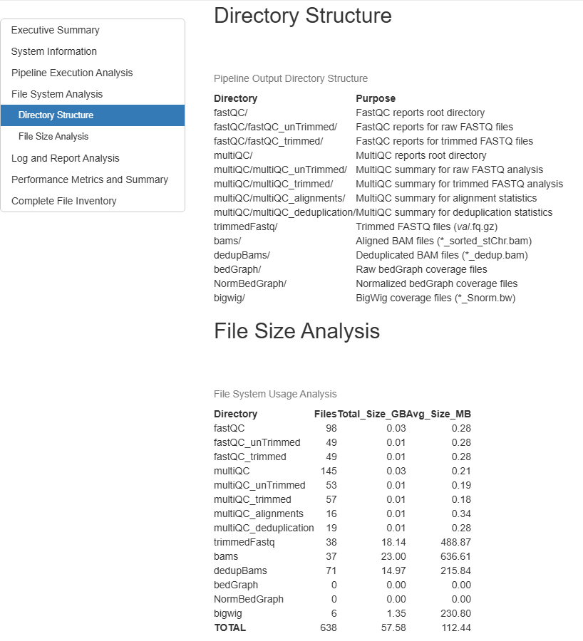
Reports/summaries: html pipeline report

Slide 43
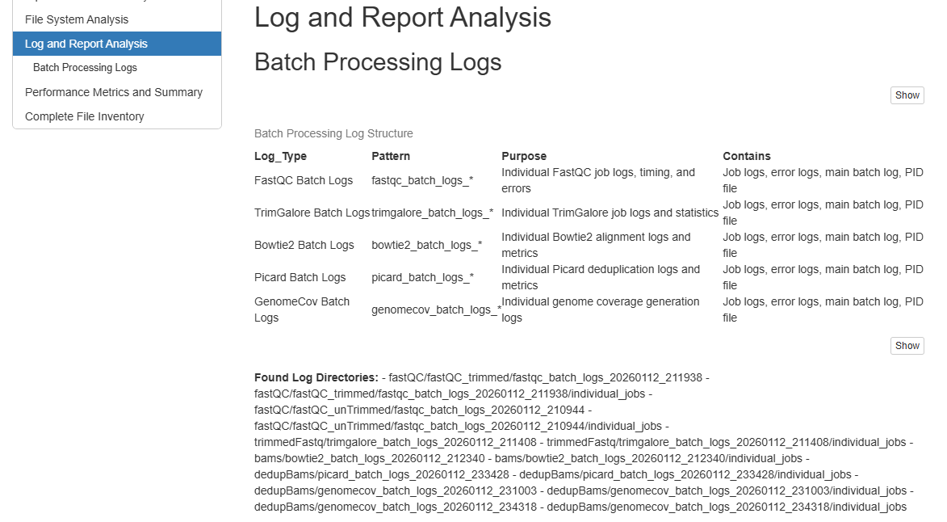
Reports/summaries: html pipeline report

Slide 44
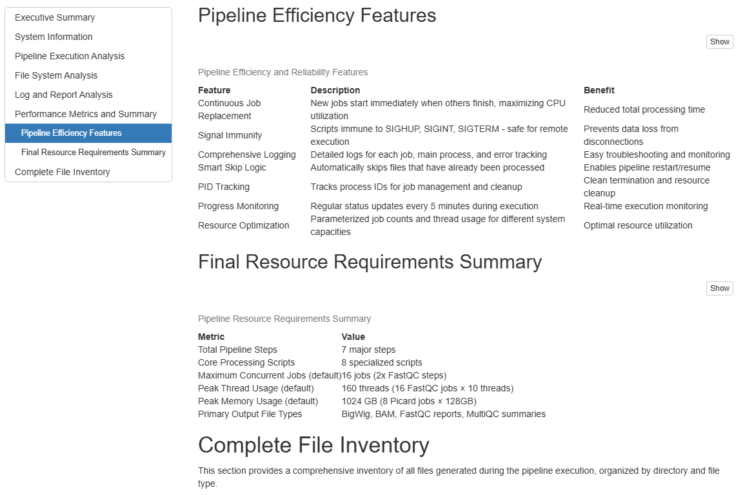
Reports/summaries: html pipeline report

Slide 45
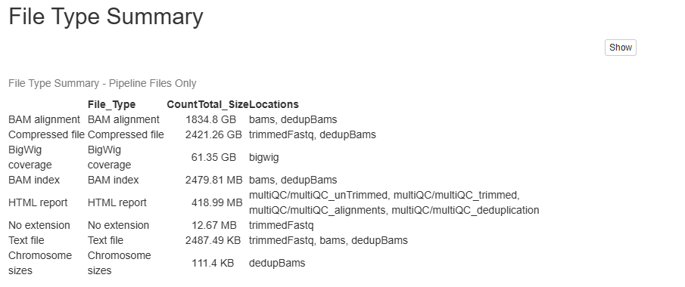
Reports/summaries: html pipeline report

Slide 46
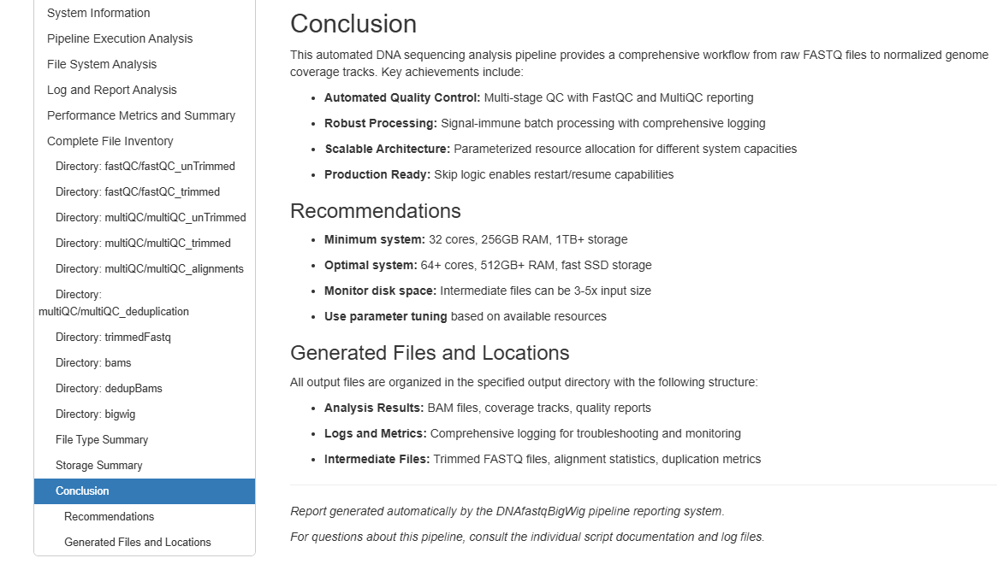
Reports/summaries: html pipeline report

Slide 47
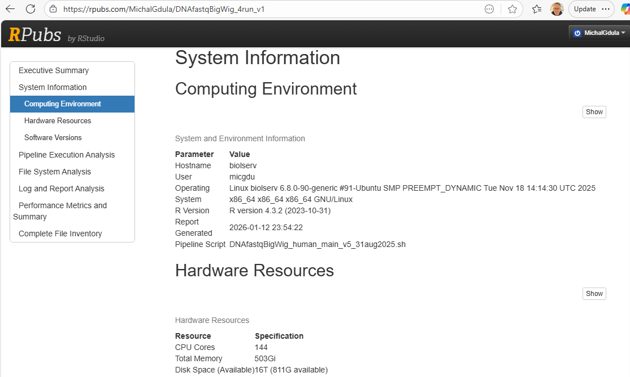
Reports/summaries: RPubs
RPubs - DNAseq_report_4thrun_13jan2026

