Slide 1
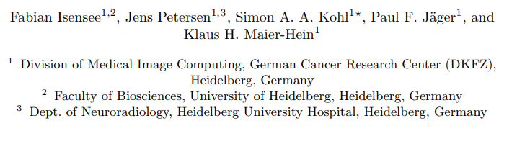
nnU-Net: Breaking the Spell on Successful Medical Image Segmentation

Slide 2
Introduction
Semantic segmentation is a popular subfield in medical image analysis with a vast number of new methods being proposed each year.
Datasets vary tremendously when considering: - cohort size - image dimensionality - image size - voxel intensity ranges - intensity interpretation
Class labels can be highly imbalanced and labels can be ambiguous, while expert annotation quality varies strongly from dataset to dataset.

Slide 3
Introduction
These circumstances make it more difficult to generalize findings from one task to others.
This naturally led to a large number of segmentation methods being proposed, especially variations of encoder-decoder with: - skip connections (U-Net) - residual connections - dense connections - attention mechanisms - additional loss layers - feature recalibration
The specific modifications differ substantially from each other, but they all share a particular focus on architectural modifications.
This process was completely human-driven so far.

Slide 4
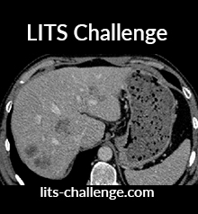
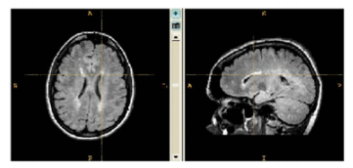
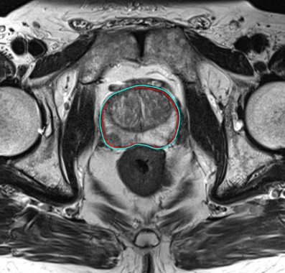
nnU-Net (“no new” U-NET)
Automatically adapts itself to any given new dataset (preprocessing, patch size, batch size…).
Based on an automated analysis of the dataset.
Automatically designs and executes a network training pipeline.
Wrapped around the standard U-Net architecture under the hypothesis that a systematic and careful choice of all hyperparameters will still yield competitive performance.

Slide 5

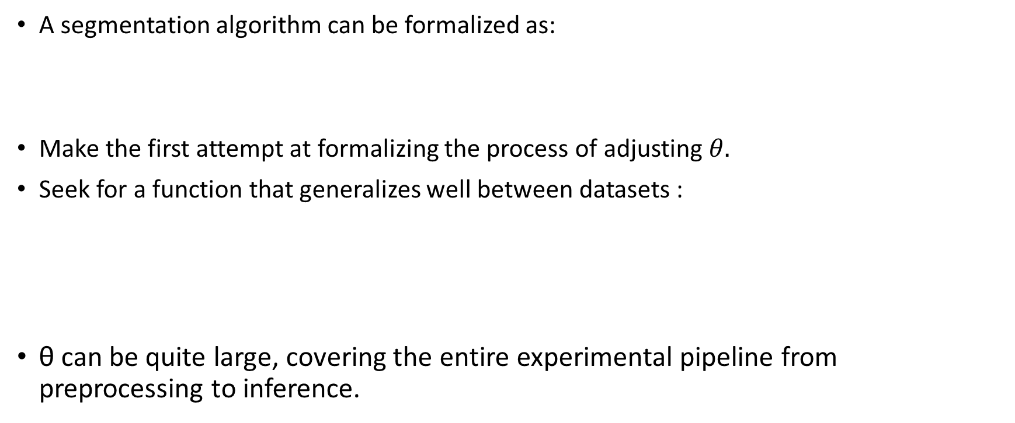
Method
$$f_{θ}\left(x\right)=\hat{y}$$
A segmentation algorithm can be formalized as:
Make the first attempt at formalizing the process of adjusting $θ.$
Seek for a function that generalizes well between datasets :
θ can be quite large, covering the entire experimental pipeline from preprocessing to inference.

Slide 6
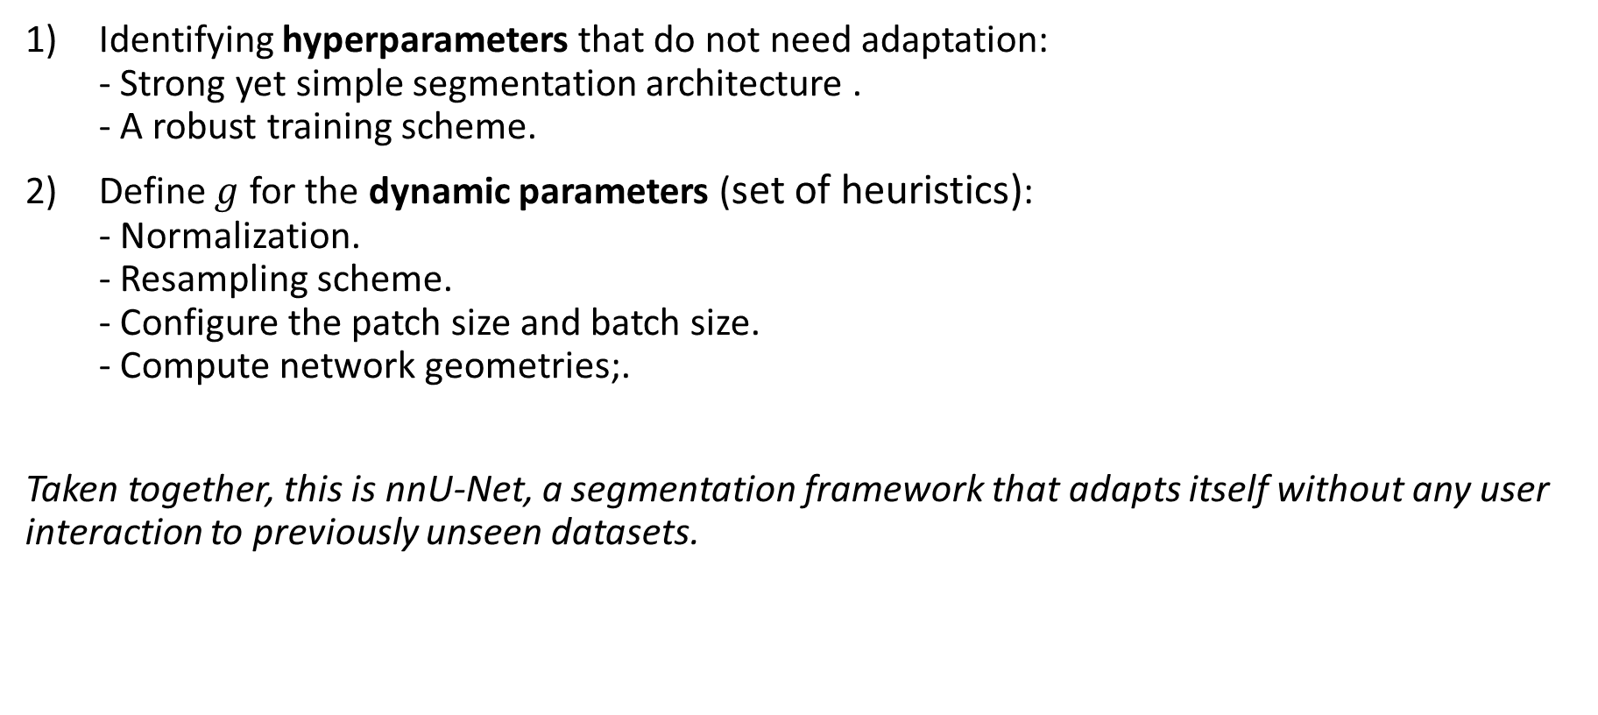
Method
Identifying hyperparameters that do not need adaptation: - Strong yet simple segmentation architecture . - A robust training scheme.
Define $g$ for the dynamic parameters (set of heuristics): - Normalization. - Resampling scheme. - Configure the patch size and batch size. - Compute network geometries;.
Taken together, this is nnU-Net, a segmentation framework that adapts itself without any user interaction to previously unseen datasets.

Slide 7



Preprocessing
Image Normalization:
The described scheme is independently applied to each case and each modality .
Voxel Spacing:
$$\frac{x−μ_{F}}{σ_{F}}$$
CT
$$clip[0.5∙I_{F} , 99.5∙I_{F}]$$
Input channels
Which modality?
not CT
$$\frac{x−μ}{σ}$$
Training data
Calculate median for each axis
3rd order spline interpolation
Collect all spacings

Slide 8
Training Procedure
Network Architecture:
Three U-net models are configured, designed and trained indepentently :
Network Hyperparameters:
Instantiation is adapted depending on the shape of the preprocessed training data: - batch size (minimum of 2) - patch size - number of pooling operations (minimum of 4 voxels) - start with 30 conv filters in first layer → double with each pooling op
If the selected patch size covers less than 25% of the voxels, the 3D U-Net cascade is additionally configured and trained on a downsampled version of the training data. (enable nnU-Net to still acquire sufficient context if the patch size is too small)
2D U-Net
3D U-Net
cascade of two 3D U-Net models
maximize spatial context

Slide 9
Training Procedure
Network Training:
Training scheme: All UNet architectures are trained in a 5-fold cross-validation.
Epochs: One epoch = 250 batches (max 1000 epochs )
Loss Function: The sum of the cross-entropy loss and the dice loss.
Optimizer: Adam (lr = 3e-04)
Weigth decay: l2 weight decay of 3 ×10−5
Reduce on plateau: patience= 30 epochs, factor= 0.2, min_lr= 10−6
Data augmentation (online): elastic deformations, random scaling and random rotations, gamma augmentation.
nnU-Net ensembles combinations of two U-Net configurations (2D, 3D and cascade) and based on the cross-validation results automatically chooses the best option for test.

Slide 10
Results
Medical Segmentation Decathlon dataset: - Covers a substantial amount of variability and challenges that are typically encountered in medical segmentation problems. - consisted of the seven aforementioned datasets which were used by participants to develop generalizable segmentation algorithms
Dataset:
Medical Segmentation Decathlon (Decathlon)- Phase I and II.
Automatic Cardiac Segmentation Challenge (ACDC)- heart segmentation (3 parts) in cine-MRI images.
Longitudinal multiple sclerosis lesion segmentation challenge- MS lesions segmentation in MRI images.
PROMISE12- prostate segmentation.
LiTS – liver tumor segmentation challenge.
Multi-Atlas Labeling Beyond the Cranial Vault Challenge (Abdomen)- segmentation of 13 organs in abdominal CT images.

Slide 11
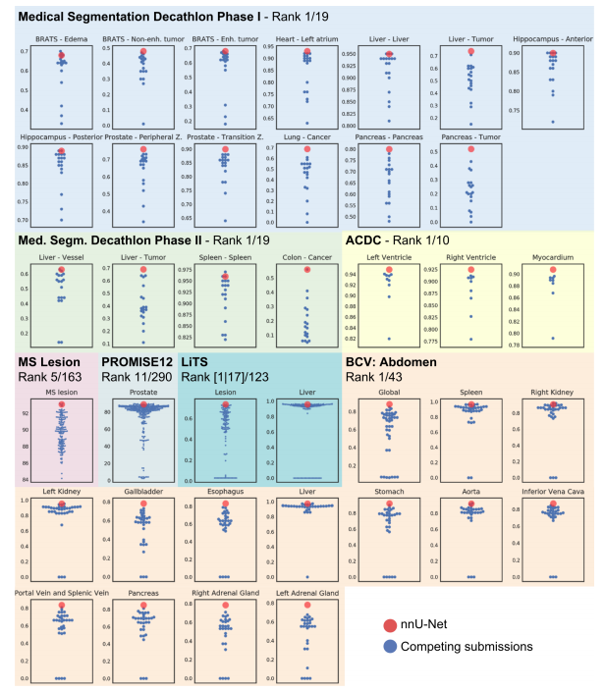
Fig. 1. Summary of nnU-Net performance on the test sets of medical segmentation challenges.
* Numbers for Decathlon, LiTS, ACDC and BCV are Dice scores, MS lesion and PROMISE12 use different metrics.
nnU-Net was the clear winner of the Decathlon challenge in both phase I and phase II
new state of the art for BCV!
ranked 5th out of 163 in MS lesion
ranked 11th out of 290 in PROMISE12
new state of the art in lesion dice score in the LITS challenge!

Slide 12
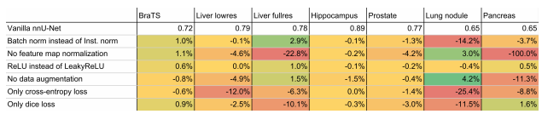
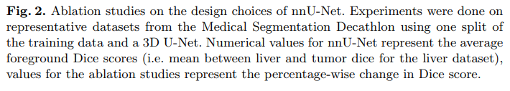

Slide 13
Discussion
nnU-Net is a framework that automatically adapts itself to any given medical segmentation dataset without user intervention.
Achieved state of the art performance on six publicly available segmentation challenges.
nnU-Net took away most of the more complicated developments of the recent years and relied on nothing but simple U-Net architectures.
nnU-Net revolves around both the selection of well-generalizing static design choices (U-Net , dice loss, data augmentation, ensembling) as well as a number of the dynamic design choices that are determined by a set of rules that ultimately reflect our segmentation expertise.
Do not claim to have found the globally optimal configuration (see ablation studies results).
Results on LiTS suggest that a properly chosen postprocessing can be beneficial.
Established what could be considered the strongest U-Net baseline to date. This enables to systematically evaluate more advanced network designs with respect to their generalizability as well as their performance gain relative to the plain architecture employed here

