Slide 1
CS 484
Introduction to Machine Learning
Week 6, October 3, 2022
Fall Semester 2022

Slide 2
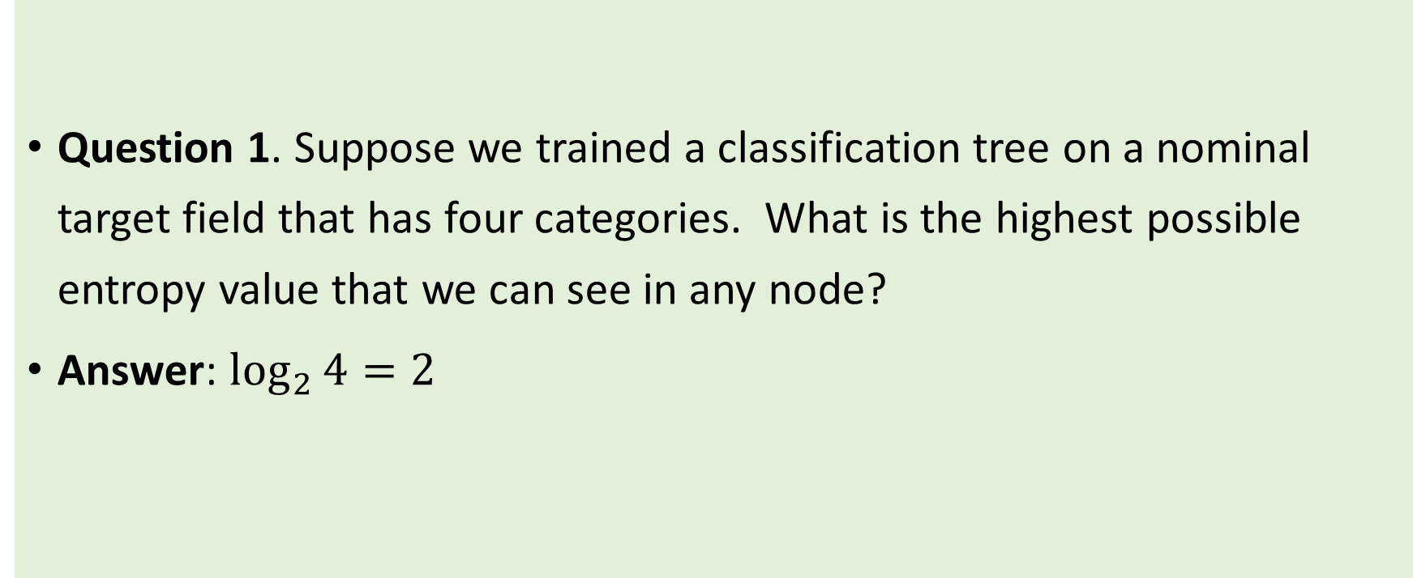
Week 5 Quiz Review
Question 1. Suppose we trained a classification tree on a nominal target field that has four categories. What is the highest possible entropy value that we can see in any node?
Answer: $\log_{2}{4}=2$

Slide 3
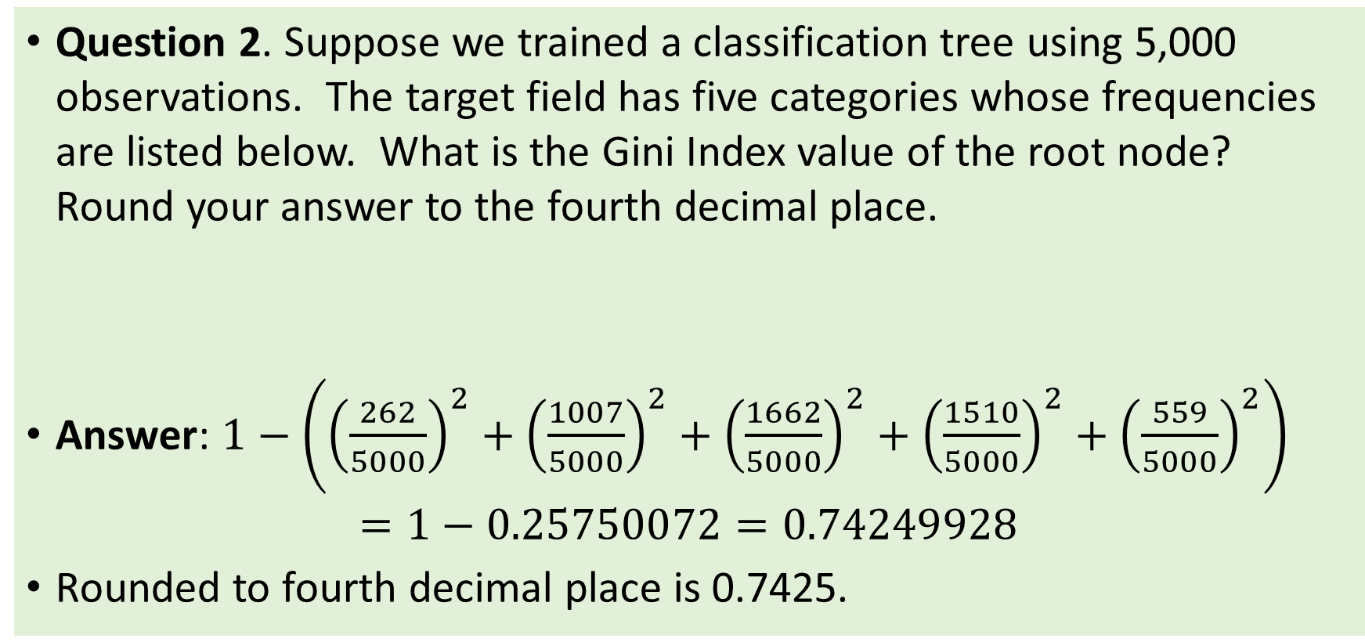
Week 5 Quiz Review
Question 2. Suppose we trained a classification tree using 5,000 observations. The target field has five categories whose frequencies are listed below. What is the Gini Index value of the root node? Round your answer to the fourth decimal place.
Answer: $1−\left({\left(\frac{262}{5000}\right)}^{2}+{\left(\frac{1007}{5000}\right)}^{2}+{\left(\frac{1662}{5000}\right)}^{2}+{\left(\frac{1510}{5000}\right)}^{2}+{\left(\frac{559}{5000}\right)}^{2}\right)$ $=1−0.25750072=0.74249928$
Rounded to fourth decimal place is 0.7425.
Target Category | I | II | III | IV | V
Frequency | 262 | 1,007 | 1,662 | 1,510 | 559

Slide 4
Week 5 Quiz Review
Question 3. We are going to train a classification tree on 5,000 observations. We will use the Entropy criterion for growing the tree. The target field has five categories, namely, A, B, C, D, and E. The ordinal feature has four categories where I < II < III < IV. Instead of a casewise dataset, the data have been aggregated and shown in the following table.
Target Field
Feature | A | B | C | D | E
I | 65 | 304 | 530 | 487 | 140
II | 74 | 185 | 160 | 55 | 16
III | 33 | 228 | 623 | 755 | 363
IV | 90 | 290 | 349 | 213 | 40

Slide 5
Week 5 Quiz Review
Answer: Since Feature is an ordinal variable with four categories, there are only three ways to split the categories into two groups. Here are the possible splits and their entropy values.
Split: {I} + {II, III, IV} Entropy = 2.089478999488883
Split: {I, II} + {III, IV} Entropy = 2.0779208573939933
Split: {I, II, III} + {IV} Entropy = 2.0654819381740097
The split {I, II, III} + {IV} has the lowest Entropy value and thus it is the optimal split in the first layer.

Slide 6
Week 6: Logistic Regression
Multinomial Logistic Regression
Forward and Backward Selection
All Possible Selection
Chapter 6 of the Machine Learning book

Slide 7
Rule-Based vs. Parametric Classification Model
Decision Tree is a Rule-Based Model
Use rules to divide observations into disjoint segments
Use empirical proportions of the target categories as predicted probabilities
Logistic Regression is a Parametric Model
Use a formula to calculate the predicted probabilities
Can do sensitive study to understand impacts to model outcomes when a predictor change values

Slide 8
Logistic Regression Model
In a nutshell, a logistic model relates the probability that a target category will occur as a linear function of the predictors
Domain: $u∈ℝ$ (the real number line)
Domain: 𝑢∈ℝ (the real number line)
Range: $0≤f\left(u\right)≤1$
Range: 0≤𝑓(𝑢)≤1
Trend: when $u$ increases, so does $f\left(u\right)$
Trend: when 𝑢 increases, so does 𝑓(𝑢)
$$u=b_{0}+\sum_{i=1}^{k}{b_{i}x_{i}}$$
𝑢=𝑏_0+∑2_(𝑖=1)^𝑘▒〖𝑏_𝑖 𝑥_𝑖 〗
$Pr\left(Y=y\right)=f\left(u\right)$
Pr(𝑌=𝑦)=𝑓(𝑢)

Slide 9
Three Types of Logistic Model
Type of Logistic Model | Type of Target Variable | Example of Target Variable
Binary Logistic Model | Binary Categorical Two unique values | Loan Default: No Yes
Multinomial Logistic Model | Nominal Categorical Any number of unique values | US credit card network: American Express Discover MasterCard Visa
Ordinal Logistic Model | Ordinal Categorical Any number of unique values Explicit numerical, lexical, or contextual order among values | FICO score range (300 to 850): Deep Subprime (< 580) Subprime (580 – 619) Near Prime (620 – 659) Prime (660 – 719) Superprime (≥ 720)
FICO: Fair Isaac Corporation

Slide 10
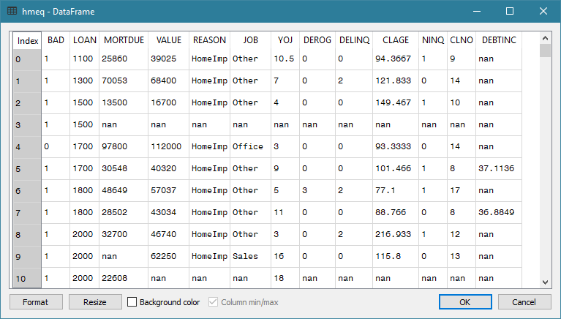
Multinomial Logistic (MNL): Data
Since BAD is 0 or 1, how can I see the proportion of a BAD loan?
Let us look at segments of observations by predictor values!

Slide 11
Multinomial Logistic (MNL): Strategy
Create observation segments defined by unique values of the predictors
Count the occurrences (i.e., the frequencies) of the target categories in each group
Analyze how the predictor values influence the relative frequencies of the target categories

Slide 12
Odds (Plural Only)
Odds are the likelihood of something happening or being the case.
Odds are the ratios of two probabilities.
For tossing a fair coin, Prob(Head on Top) = Prob(Tail on Top) = 0.5, the odds of Head versus Tail is 0.5 / 0.5 = 1.
According to https://www.weather.gov/safety/lightning-odds, the odds of being struck by lightning in any given year is 1/1,222,000.
Technically, Prob(A Person Struck by Lightning) / (1 - Prob(A Person Struck by Lightning)) = 1/1,222,000.

Slide 13
Feature Segments
Example
Home equity loan data: hmeq.csv
BAD: Loan in default (0=No, 1=Yes), binary
REASON: Reason for getting the loan, (DebtCon=debt consolidation, HomeImp=home improvement), categorical
JOB: Job type (Mgr=manager, Office=office worker, Other=others, ProfExe=professional or executive, Sales=sales profession, Self=self employed), categorical
DEROG: The number of derogatory inquiries (0+), interval
Target
Predictor
Week 6 HMEQ Logistic.py

Slide 14
HMEQ Feature Segments
Week 6 HMEQ Feature Segment.py

Slide 15
Feature Segments by REASON
Odds of BAD = 1 versus BAD = 0
The overall odds is 0.249836
REASON = DebtCon, the odds is 0.234056 (0.94 X Overall)
REASON = HomeImp, the odds is 0.286127 (1.15 X Overall)
Percent Table:
BAD 0 1 All
REASON
DebtCon 81.03360489 18.96639511 100.0
HomeImp 77.75280899 22.24719101 100.0
All 80.01051156 19.98948844 100.0
Odds Table:
REASON Odds Ratio
DebtCon 0.2340559221 0.936839085
HomeImp 0.2861271676 1.145260977
All 0.2498357784 1.0

Slide 16
Feature Segments by JOB
Percent Table:
BAD 0 1 All
JOB
Mgr 76.66232073 23.33767927 100.0
Office 86.81434599 13.18565401 100.0
Other 76.80067002 23.19932998 100.0
ProfExe 83.38557994 16.61442006 100.0
Sales 65.13761468 34.86238532 100.0
Self 69.94818653 30.05181347 100.0
All 79.47544446 20.52455554 100.0
Odds Table:
JOB Odds Ratio
Mgr 0.3044217687 1.178785837
Office 0.1518833536 0.588124650
Other 0.3020719738 1.169686931
ProfExe 0.1992481203 0.771531100
Sales 0.5352112676 2.072451864
Self 0.4296296296 1.663617305
All 0.2582502769 1.0

Slide 17
Feature Segments Jointly by REASON and JOB
Percent Table:
BAD 0 1 All
REASON JOB
DebtCon Mgr 79.72027972 20.27972028 100.0
Office 85.16129032 14.83870968 100.0
Other 79.23940150 20.76059850 100.0
ProfExe 84.76977568 15.23022432 100.0
Sales 64.94845361 35.05154639 100.0
Self 56.16438356 43.83561644 100.0
HomeImp Mgr 67.81609195 32.18390805 100.0
Office 89.03654485 10.96345515 100.0
Other 71.36871508 28.63128492 100.0
ProfExe 81.97530864 18.02469136 100.0
Sales 66.66666667 33.33333333 100.0
Self 81.73913043 18.26086957 100.0
All 79.62427746 20.37572254 100.0
Odds Table:
REASON JOB Odds Ratio
DebtCon Mgr 0.2543859649 0.994089835
Office 0.1742424242 0.680904793
Other 0.2619984264 1.023837822
ProfExe 0.1796657382 0.702098026
Sales 0.5396825397 2.108972194
Self 0.7804878049 3.049991351
HomeImp Mgr 0.4745762712 1.854549826
Office 0.1231343284 0.481184503
Other 0.4011741683 1.567708984
ProfExe 0.2198795181 0.859245493
Sales 0.5 1.953900709
Self 0.2234042553 0.873019466
All 0.2558983666 1.0

Slide 18
Feature Segments
Percent Table:
BAD 0 1 All
REASON JOB DEROG
DebtCon Mgr 0.0 82.425743 17.574257 100.0
1.0 68.965517 31.034483 100.0
2.0 40.909091 59.090909 100.0
3.0 0.000000 100.000000 100.0
4.0 0.000000 100.000000 100.0
7.0 0.000000 100.000000 100.0
8.0 0.000000 100.000000 100.0
Office 0.0 88.376754 11.623246 100.0
1.0 50.000000 50.000000 100.0
2.0 46.666667 53.333333 100.0
3.0 0.000000 100.000000 100.0
Other 0.0 81.712386 18.287614 100.0
1.0 57.692308 42.307692 100.0
2.0 65.957447 34.042553 100.0
3.0 50.000000 50.000000 100.0
4.0 71.428571 28.571429 100.0
5.0 100.000000 0.000000 100.0
6.0 62.500000 37.500000 100.0
7.0 0.000000 100.000000 100.0
8.0 0.000000 100.000000 100.0
9.0 0.000000 100.000000 100.0
10.0 0.000000 100.000000 100.0
ProfExe 0.0 87.352941 12.647059 100.0
1.0 76.923077 23.076923 100.0
2.0 37.500000 62.500000 100.0
3.0 22.222222 77.777778 100.0
4.0 0.000000 100.000000 100.0
6.0 0.000000 100.000000 100.0
7.0 0.000000 100.000000 100.0
Sales 0.0 72.000000 28.000000 100.0
... ... ...
All 78.939972 21.060028 100.0
How should we handle the interval predictors?
Although DEROG is an interval variable, it is treated as a categorical variable only for the purpose of aggregation

Slide 19
Feature Segments by REASON, JOB, & DEROG
REASON | JOB | DEROG | Odds | Ratio |  | REASON | JOB | DEROG | Odds | Ratio |  | REASON | JOB | DEROG | Odds | Ratio |  | REASON | JOB | DEROG | Odds | Ratio
DebtCon | Mgr | 0 | 0.2132 | 0.7992 |  | DebtCon | ProfExe | 0 | 0.1448 | 0.5427 |  | HomeImp | Mgr | 0 | 0.3978 | 1.4913 |  | HomeImp | ProfExe | 0 | 0.1526 | 0.5722
DebtCon | Mgr | 1 | 0.4500 | 1.6867 |  | DebtCon | ProfExe | 1 | 0.3 | 1.1245 |  | HomeImp | Mgr | 1 | 1 | 3.7483 |  | HomeImp | ProfExe | 1 | 2.6667 | 9.9956
DebtCon | Mgr | 2 | 1.4444 | 5.4143 |  | DebtCon | ProfExe | 2 | 1.6667 | 6.2472 |  | HomeImp | Mgr | 2 | inf | inf |  | HomeImp | ProfExe | 2 | inf | inf
DebtCon | Mgr | 3 | inf | inf |  | DebtCon | ProfExe | 3 | 3.5 | 13.1192 |  | HomeImp | Mgr | 3 | inf | inf |  | HomeImp | ProfExe | 3 | inf | inf
DebtCon | Mgr | 4 | inf | inf |  | DebtCon | ProfExe | 4 | inf | inf |  | HomeImp | Mgr | 4 | inf | inf |  | HomeImp | ProfExe | 4 | inf | inf
DebtCon | Mgr | 7 | inf | inf |  | DebtCon | ProfExe | 6 | inf | inf |  | HomeImp | Mgr | 5 | inf | inf |  | HomeImp | ProfExe | 5 | inf | inf
DebtCon | Mgr | 8 | inf | inf |  | DebtCon | ProfExe | 7 | inf | inf |  | HomeImp | Office | 0 | 0.0526 | 0.1973 |  | HomeImp | ProfExe | 6 | inf | inf
DebtCon | Office | 0 | 0.1315 | 0.4930 |  | DebtCon | Sales | 0 | 0.3889 | 1.4577 |  | HomeImp | Office | 1 | 1.75 | 6.5596 |  | HomeImp | ProfExe | 7 | inf | inf
DebtCon | Office | 1 | 1.0000 | 3.7483 |  | DebtCon | Sales | 1 | 3 | 11.2450 |  | HomeImp | Office | 2 | 2 | 7.4967 |  | HomeImp | Sales | 0 | inf | inf
DebtCon | Office | 2 | 1.1429 | 4.2838 |  | DebtCon | Sales | 2 | inf | inf |  | HomeImp | Office | 3 | 1 | 3.7483 |  | HomeImp | Sales | 1 | 0.6667 | 2.4989
DebtCon | Office | 3 | inf | inf |  | DebtCon | Sales | 3 | inf | inf |  | HomeImp | Office | 5 | inf | inf |  | HomeImp | Sales | 2 | 0 | 0
DebtCon | Other | 0 | 0.2238 | 0.8389 |  | DebtCon | Sales | 4 | inf | inf |  | HomeImp | Other | 0 | 0.3382 | 1.2677 |  | HomeImp | Self | 0 | 0.1646 | 0.6168
DebtCon | Other | 1 | 0.7333 | 2.7488 |  | DebtCon | Self | 0 | 0.4750 | 1.7805 |  | HomeImp | Other | 1 | 0.7097 | 2.6601 |  | HomeImp | Self | 1 | 0.2667 | 0.9996
DebtCon | Other | 2 | 0.5161 | 1.9346 |  | DebtCon | Self | 1 | 5 | 18.7417 |  | HomeImp | Other | 2 | 0.7222 | 2.7071 |  | HomeImp | Self | 2 | inf | inf
DebtCon | Other | 3 | 1 | 3.7483 |  | DebtCon | Self | 2 | inf | inf |  | HomeImp | Other | 3 | inf | inf |  | All |  |  | 0.2668 | 1
DebtCon | Other | 4 | 0.4 | 1.4993 |  | DebtCon | Self | 3 | inf | inf |  | HomeImp | Other | 4 | inf | inf
DebtCon | Other | 5 | 0 | 0 |  |  |  |  |  |  |  | HomeImp | Other | 6 | inf | inf
DebtCon | Other | 6 | 0.6 | 2.2490 |  |  |  |  |  |  |  | HomeImp | Other | 8 | inf | inf
DebtCon | Other | 7 | inf | inf |  |  |  |  |  |  |  | HomeImp | Other | 9 | inf | inf
DebtCon | Other | 8 | inf | inf |  |  |  |  |  |  |  | HomeImp | Other | 10 | inf | inf
DebtCon | Other | 9 | inf | inf
DebtCon | Other | 10 | inf | inf

Slide 20
Feature Segments
Feature Segments are defined jointly by the observed unique values of input features (a.k.a., predictors).
For example, if REASON (categorical), JOB (categorical), DEROG (interval) are predictors, then examples of segments are:
Reason = DebtCon, JOB = Mgr, and DEROG=0
REASON = DebtCon, JOB = ProfExe, and DEROG=6
REASON = HomeImp, JOB = Office, DEROG=2
Each observation can belong to one and only one feature segment.

Slide 21
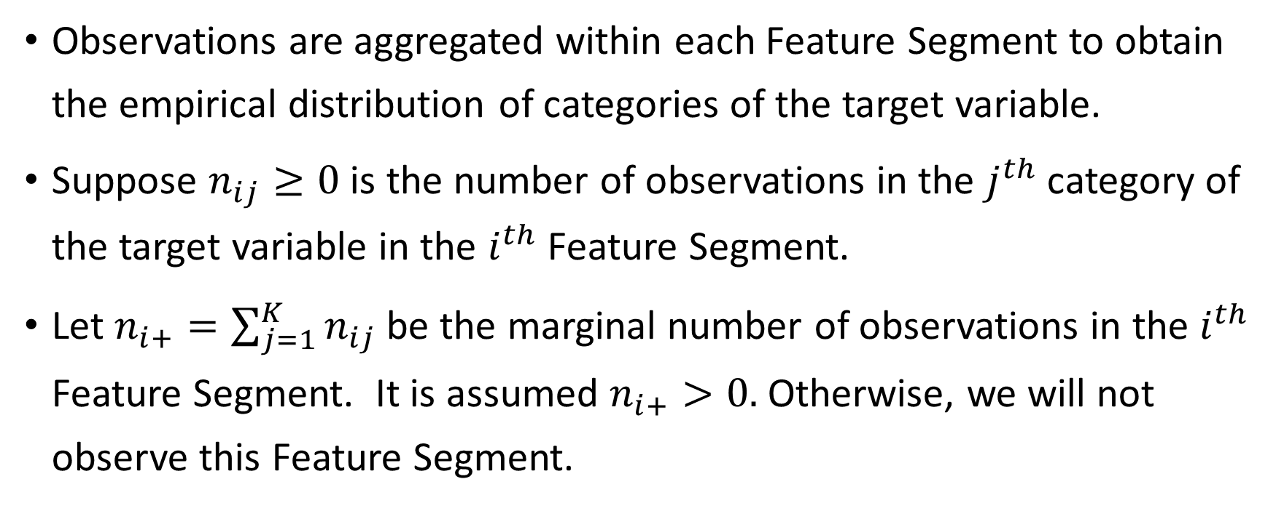
Feature Segments
Observations are aggregated within each Feature Segment to obtain the empirical distribution of categories of the target variable.
Suppose $n_{ij}≥0$ is the number of observations in the $j^{th}$ category of the target variable in the $i^{th}$ Feature Segment.
Let $n_{i+}=\sum_{j=1}^{K}{n_{ij}}$ be the marginal number of observations in the $i^{th}$ Feature Segment. It is assumed $n_{i+}>0.$ Otherwise, we will not observe this Feature Segment.

Slide 22
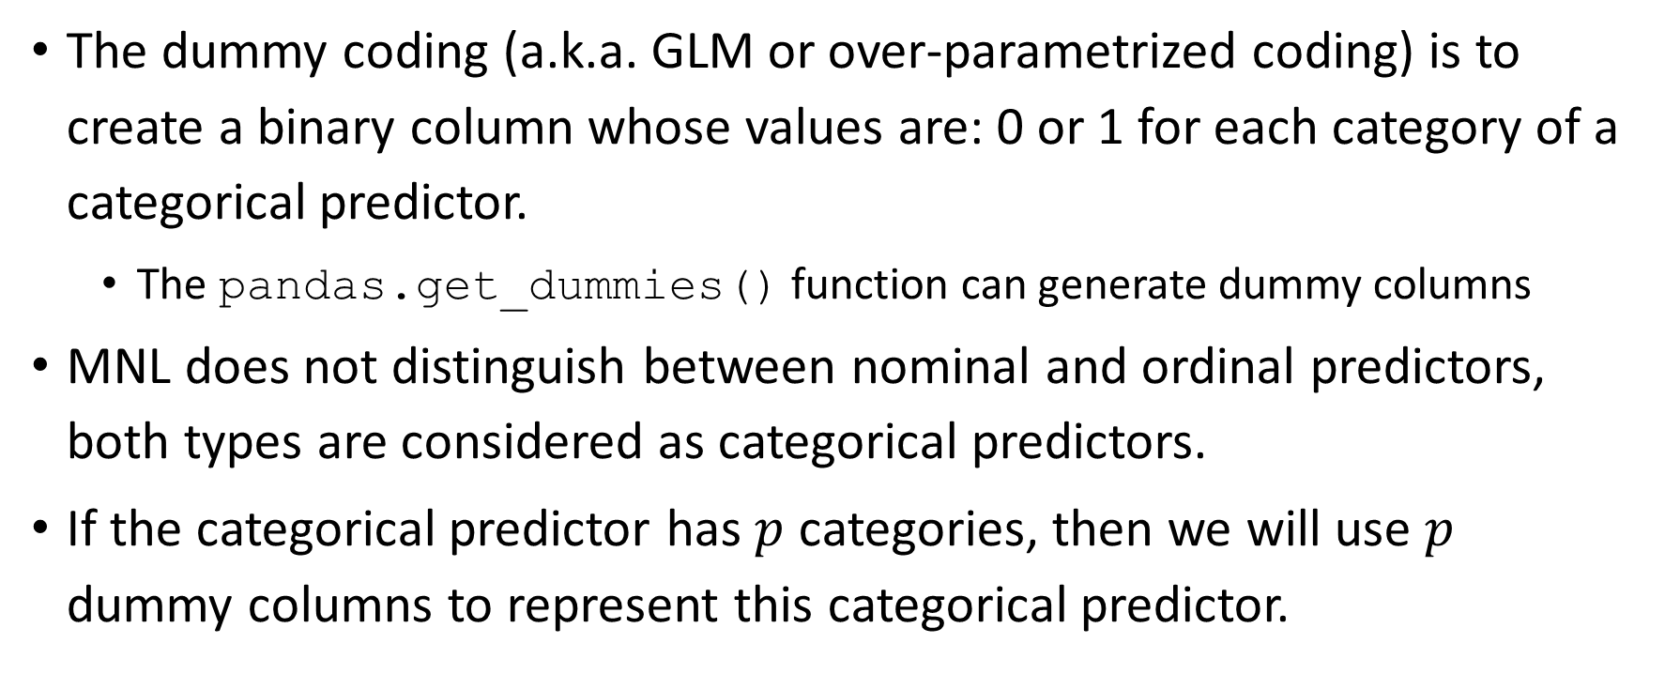
Parameter Coding for Categorical Predictor
The dummy coding (a.k.a. GLM or over-parametrized coding) is to create a binary column whose values are: 0 or 1 for each category of a categorical predictor.
The pandas.get_dummies() function can generate dummy columns
MNL does not distinguish between nominal and ordinal predictors, both types are considered as categorical predictors.
If the categorical predictor has $p$ categories, then we will use $p$ dummy columns to represent this categorical predictor.

Slide 23
Parameter Coding for Categorical Predictor
REASON has two categories. The two dummy columns are:
REASON_Debtcon = 1 if REASON = ‘DebtCon’, 0 otherwise
REASON_HomeImp = 1 if REASON = ‘HomeImp’, 0 otherwise.
JOB has six categories. The six dummy columns are:
JOB_Mgr = 1 if JOB = ‘Mgr’, 0 otherwise
JOB_Office = 1 if JOB = ‘Office’, 0 otherwise
JOB_Other = 1 if JOB = ‘Other’, 0 otherwise
JOB_ProfExe = 1 if JOB = ‘ProfExe’, 0 otherwise
JOB_Sales = 1 if JOB = ‘Sales’, 0 otherwise
JOB_Self = 1 if JOB = ‘Self’, 0 otherwise

Slide 24
Continuous Predictor
Feature Segment
Parameter Encoding
REASON | JOB | DEROG
DebtCon | Mgr | 0
REASON | JOB | DEROG
HomeImp | ProfExe | 6
REASON_DebtCon | REASON_HomeImp | JOB_Mgr | JOB_Office | JOB_Other | JOB_ProfExe | JOB_Sales | JOB_Self | DEROG
1 | 0 | 1 | 0 | 0 | 0 | 0 | 0 | 0
REASON_DebtCon | REASON_HomeImp | JOB_Mgr | JOB_Office | JOB_Other | JOB_ProfExe | JOB_Sales | JOB_Self | DEROG
0 | 1 | 0 | 0 | 0 | 1 | 0 | 0 | 6

Slide 25
Target Variable (a.k.a. Label)
When we observed the $i^{th}$ Feature Segment, then we must observe some categories of the target variable. Thus, we can assume that $π_{ij}>0$ for some $1≤j≤K$.
When we observed the 𝑖^𝑡ℎ Feature Segment, then we must observe some categories of the target variable. Thus, we can assume that 𝜋_𝑖𝑗>0 for some 1≤𝑗≤𝐾.
Let ${0≤π}_{ij}≤1$ be the probability that the $j^{th}$ category of the target variable will be observed in the $i^{th}$ Feature Segment
Let 〖0≤𝜋〗_𝑖𝑗≤1 be the probability that the 𝑗^𝑡ℎ category of the target variable will be observed in the 𝑖^𝑡ℎ Feature Segment
Let $K$ denotes number of target categories ($K≥2$)
Let 𝐾 denotes number of target categories (𝐾≥2)
Occurrences of the categories in each subpopulation follow a multinomial distribution
Restriction $\sum_{j=1}^{K}{π_{ij}}=1$
Restriction ∑_(𝑗=1)^𝐾▒𝜋_𝑖𝑗 =1
Distributions across Feature Segments are independent

Slide 26
Model Parameters
Let $β_{j}$ be the $p×1$ column vector of parameters. Parameters are defined by [categories of] the predictors. One $β_{j}$ for each category of the target variable
Let 𝛃_𝑗 be the 𝑝×1 column vector of parameters. Parameters are defined by [categories of] the predictors. One 𝛃_𝑗 for each category of the target variable
Therefore, we arbitrarily set $β_{J}=0$ for the $J^{th}$ category (a.k.a. the reference category) of the target variable
Therefore, we arbitrarily set 𝛃_𝐽=0 for the 𝐽^th category (a.k.a. the reference category) of the target variable
The preferred choice is the MODE category (greatest number of observations)
A common choice is the LAST category (highest lexical order)
Since $\sum_{j=1}^{K}{π_{ij}}=1$, we only need $K−1$ parameter vectors
Since ∑_(𝑗=1)^𝐾▒𝜋_𝑖𝑗 =1, we only need 𝐾−1 parameter vectors
Choice of reference target category does not affect model goodness-of-fit

Slide 27
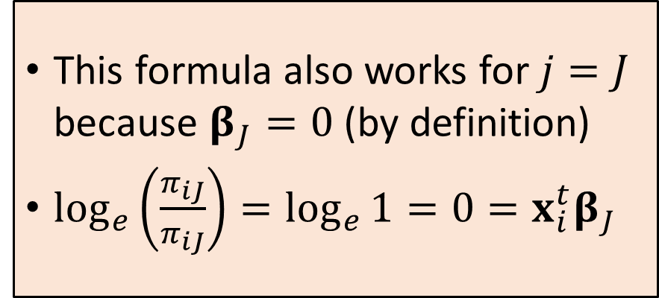
Statistical Theory
Logit: $\log_{e}\left(\frac{π_{ij}}{π_{iJ}}\right)$
Formula: $\log_{e}\left(\frac{π_{ij}}{π_{iJ}}\right)={x_{i}^{t}β}_{j}$ for $j=1,…,K$.
This formula also works for $j=J$ because $β_{J}=0$ (by definition)
$\log_{e}\left(\frac{π_{iJ}}{π_{iJ}}\right)=\log_{e}{1}=0={x_{i}^{t}β}_{J}$
The natural logarithm of the odds (or logit) of the $j^{th}$ category over the reference category is a linear combination of the parameters.

Slide 28
Statistical Theory
Equation: $\log_{e}\left(\frac{π_{ij}}{π_{iJ}}\right)={x_{i}^{T}β}_{j}$ is equivalent to $π_{ij}=π_{iJ}exp⁡\left({x_{i}^{T}β}_{j}\right)$
The sum of $π_{ij}$ over all $j=1,…,K$ gives $1=\sum_{j=1}^{K}{π_{ij}}=π_{iJ}\sum_{j=1}^{K}{exp⁡\left({x_{i}^{T}β}_{j}\right)}$
Therefore, $π_{iJ}=1/{\sum_{j=1}^{K}{exp⁡\left({x_{i}^{T}β}_{j}\right)}}$
Finally, $π_{ij}={exp⁡\left({x_{i}^{T}β}_{j}\right)}/{\sum_{l=1}^{K}{exp⁡\left({x_{i}^{T}β}_{l}\right)}}$ for $j=1,…,K$
The above formula also works for $j=J$ because of $\exp\left({x_{i}^{T}β}_{J}\right)=exp⁡\left(0\right)=1$.

Slide 29
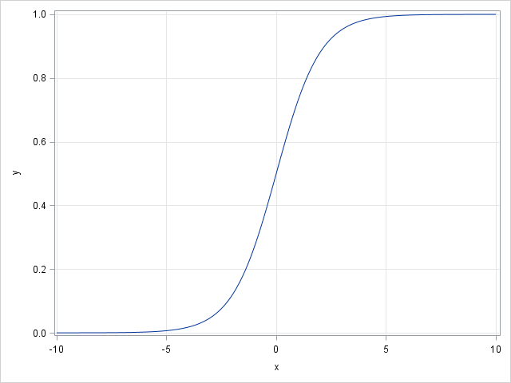
Why Logistic?
The logistic curve has the formula: $y=\frac{1}{1+e^{−x}}=\frac{e^{x}}{1+e^{x}}$ for any real x.
The range: $0≤y≤1$ for all values of $x$
It has two horizontal asymptotes:
$y=0$ as $x→−∞$ and
$y=1$ as $x→+∞$
In the middle portion of the domain, the curve appears approximately linear in $x$
Therefore, the curve is suitable for representing probability.

Slide 30
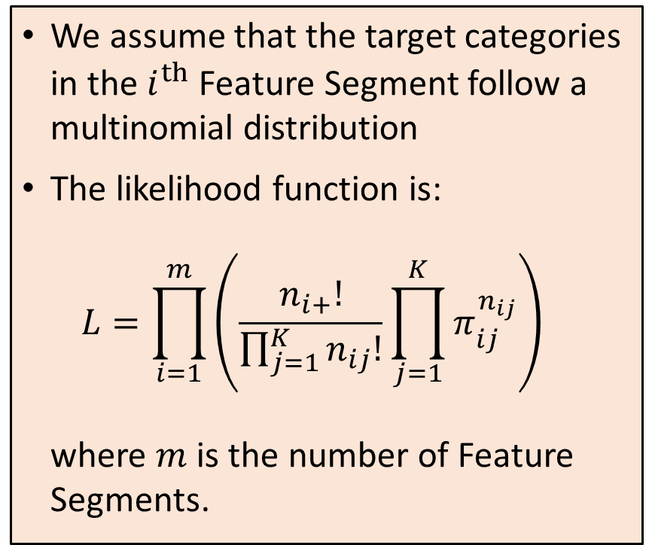
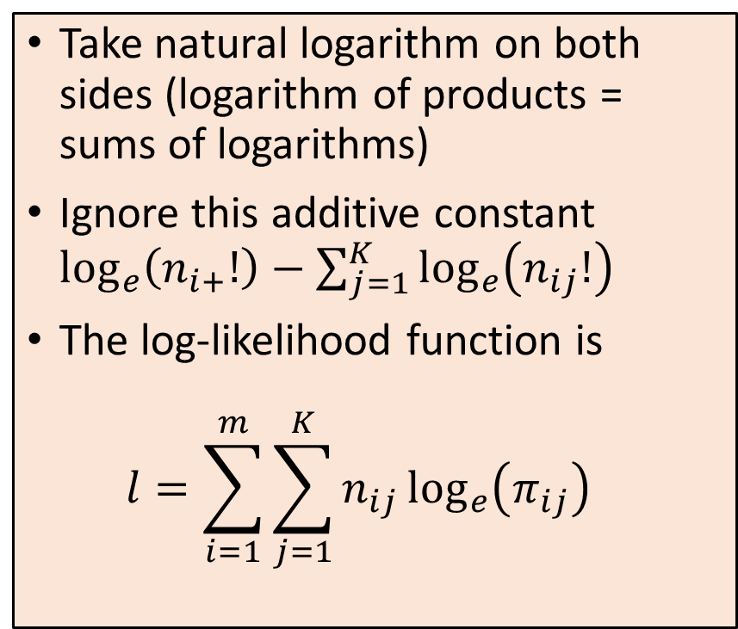
Maximum Likelihood Estimation (MLE)
We assume that the target categories in the $i^{th}$ Feature Segment follow a multinomial distribution
The likelihood function is: $L=\prod_{i=1}^{m}{\left(\frac{n_{i+}!}{\prod_{j=1}^{K}{n_{ij}!}}\prod_{j=1}^{K}{π_{ij}^{n_{ij}}}\right)}$ where $m$ is the number of Feature Segments.
Take natural logarithm on both sides (logarithm of products = sums of logarithms)
Ignore this additive constant $\log_{e}\left(n_{i+}!\right)−\sum_{j=1}^{K}{\log_{e}\left(n_{ij}!\right)}$
The log-likelihood function is $l=\sum_{i=1}^{m}{\sum_{j=1}^{K}{n_{ij}\log_{e}\left(π_{ij}\right)}}$

Slide 31
The Log-Likelihood Function
The log-likelihood function is a function of the betas:
$$l=\sum_{i=1}^{m}{\sum_{j=1}^{K}{n_{ij}\log_{e}\left(π_{ij}\right)}}=\sum_{i=1}^{m}{\sum_{j=1}^{K}{n_{ij}\log_{e}\left({exp⁡\left({x_{i}^{T}β}_{j}\right)}/{\sum_{l=1}^{K}{exp⁡\left({x_{i}^{T}β}_{l}\right)}}\right)}}$$
For the sake of discussion, let us set the last target category as reference, i.e., $J=K$.

Slide 32
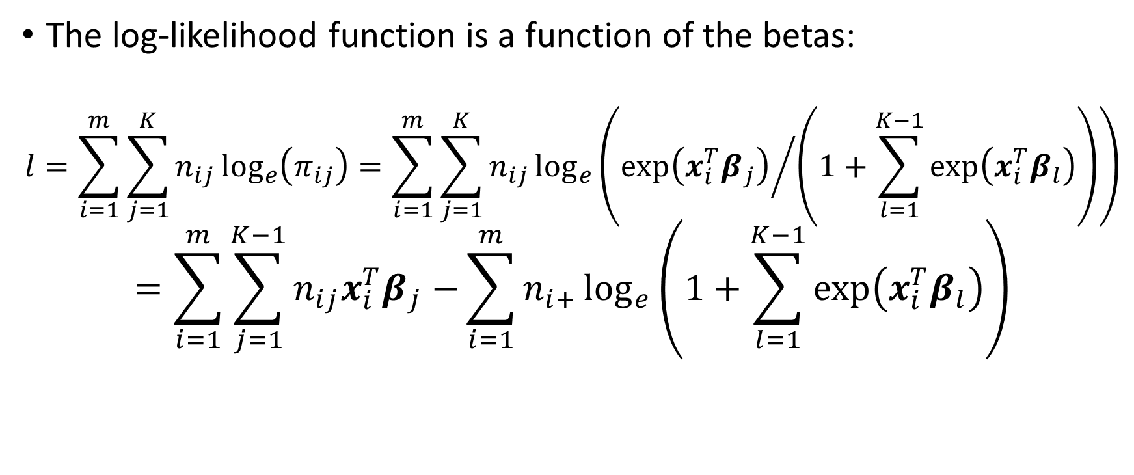
The Log-Likelihood Function
The log-likelihood function is a function of the betas:
$$l=\sum_{i=1}^{m}{\sum_{j=1}^{K}{n_{ij}\log_{e}\left(π_{ij}\right)}}=\sum_{i=1}^{m}{\sum_{j=1}^{K}{n_{ij}\log_{e}\left({exp⁡\left({x_{i}^{T}β}_{j}\right)}/{\left(1+\sum_{l=1}^{K−1}{exp⁡\left({x_{i}^{T}β}_{l}\right)}\right)}\right)}}$$
$$=\sum_{i=1}^{m}{\sum_{j=1}^{K−1}{n_{ij}{x_{i}^{T}β}_{j}−}\sum_{i=1}^{m}{n_{i+}\log_{e}\left(1+\sum_{l=1}^{K−1}{exp⁡\left({x_{i}^{T}β}_{l}\right)}\right)}}$$

Slide 33
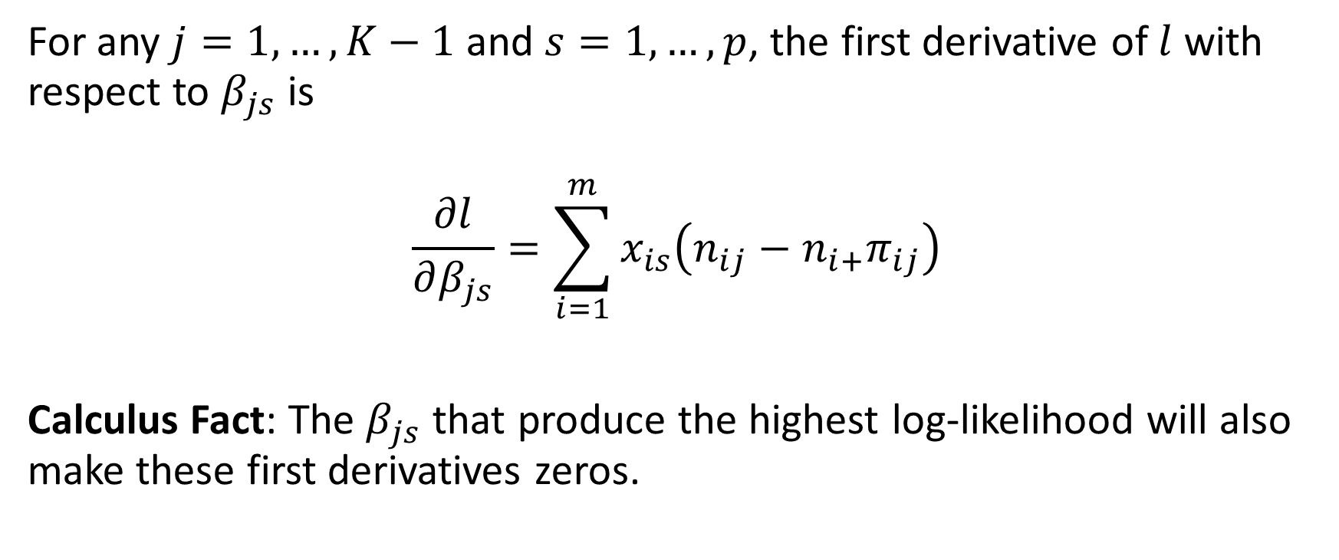
First Derivative of the Log-Likelihood
For any $j=1,…,K−1$ and $s=1,…,p$, the first derivative of $l$ with respect to $β_{js}$ is
$$\frac{∂l}{∂β_{js}}=\sum_{i=1}^{m}{x_{is}\left(n_{ij}−{n_{i+}π}_{ij}\right)}$$
Calculus Fact: The $β_{js}$ that produce the highest log-likelihood will also make these first derivatives zeros.

Slide 34
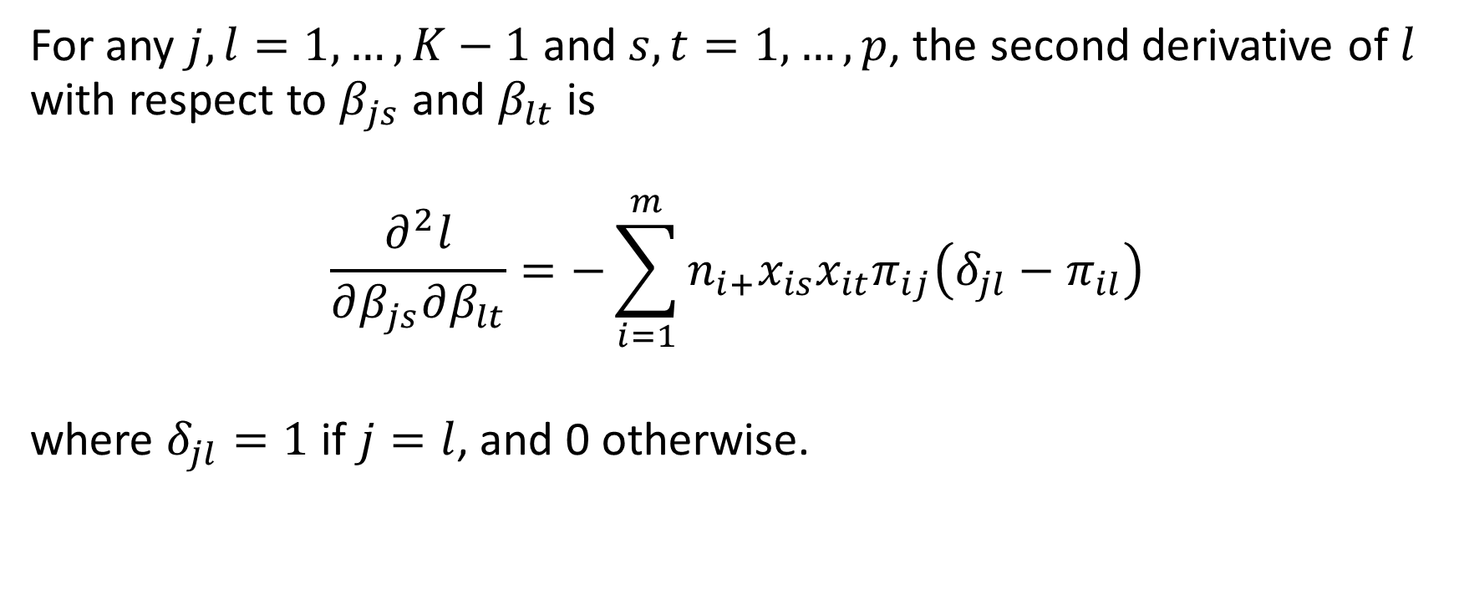
Second Derivative of the Log-Likelihood
For any $j,l=1,…,K−1$ and $s,t=1,…,p$, the second derivative of $l$ with respect to $β_{js}$ and $β_{lt}$ is
$$\frac{∂^{2}l}{∂β_{js}∂β_{lt}}=−\sum_{i=1}^{m}{{n_{i+}x}_{is}x_{it}π_{ij}\left(δ_{jl}−π_{il}\right)}$$
where $δ_{jl}=1$ if $j=l$, and 0 otherwise.
See the Machine Learning book for details

Slide 35
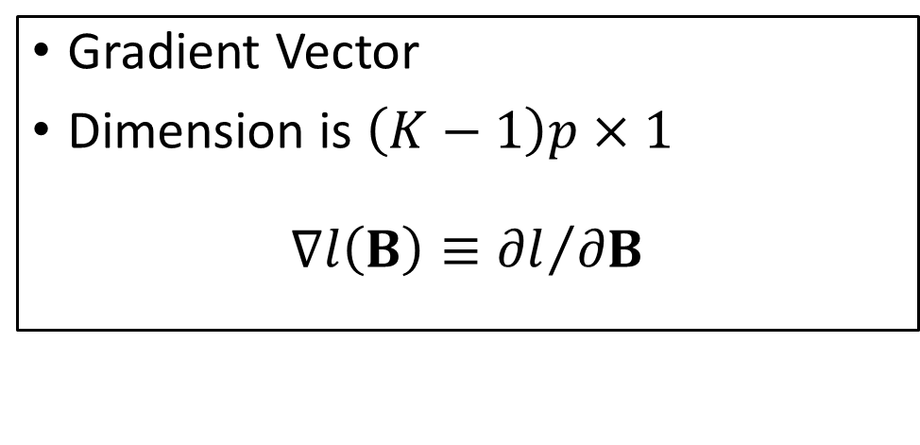
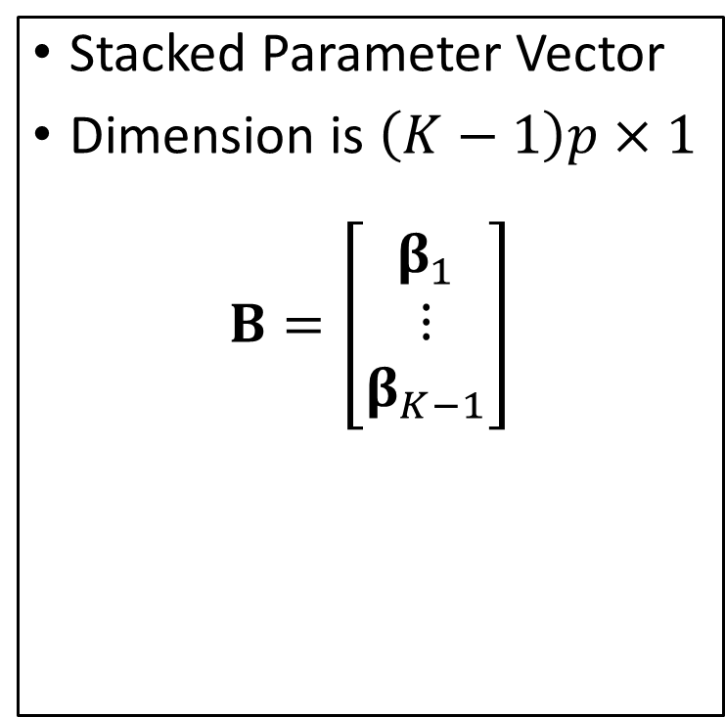
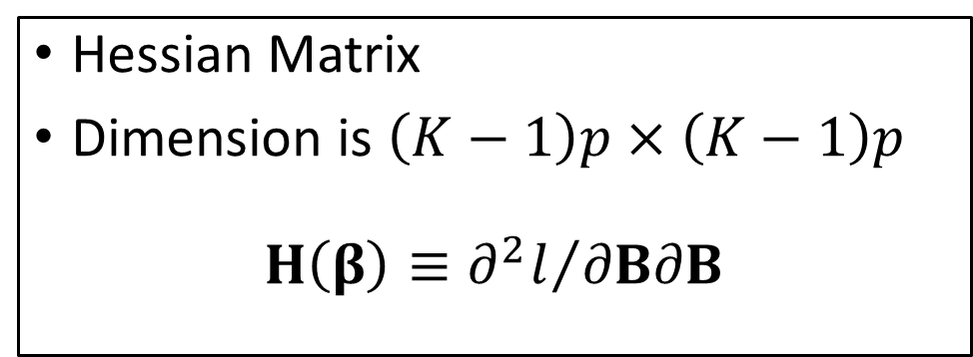
Matrix Representation of Gradient and Hessian
Stacked Parameter Vector
Dimension is $\left(K−1\right)p×1$
$$B=\left[\begin{matrix}β_{1} \\ ⋮ \\ β_{K−1}\end{matrix}\right]$$
Gradient Vector
Dimension is $\left(K−1\right)p×1$
$$∇l\left(B\right)≡{∂l}/{∂B}$$
Hessian Matrix
Dimension is $\left(K−1\right)p×\left(K−1\right)p$
$$H\left(β\right)≡{∂^{2}l}/{∂B∂B}$$

Slide 36
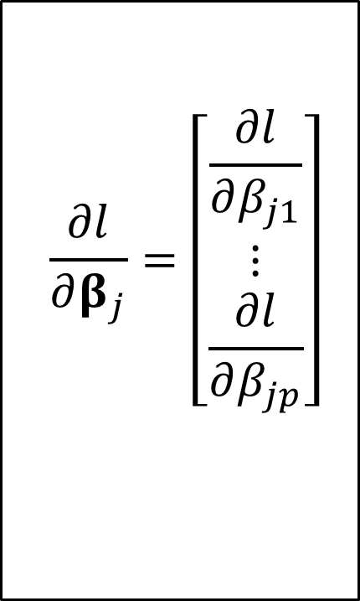
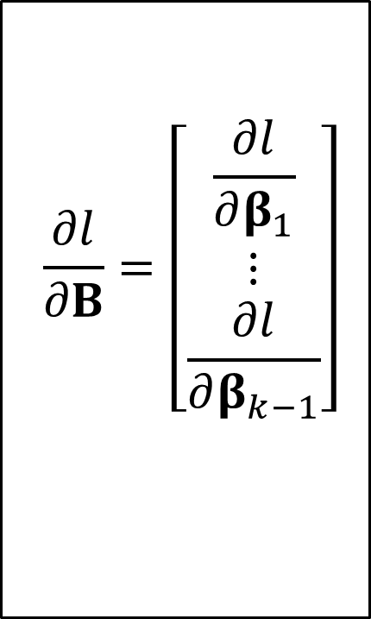
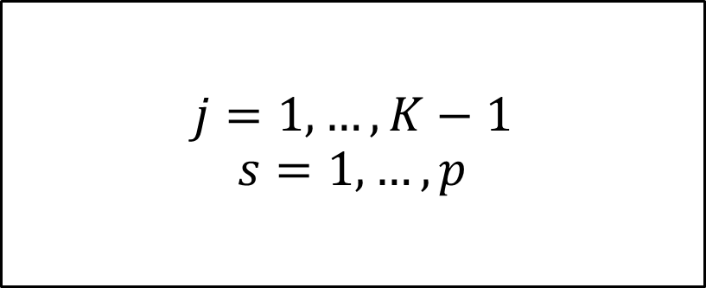
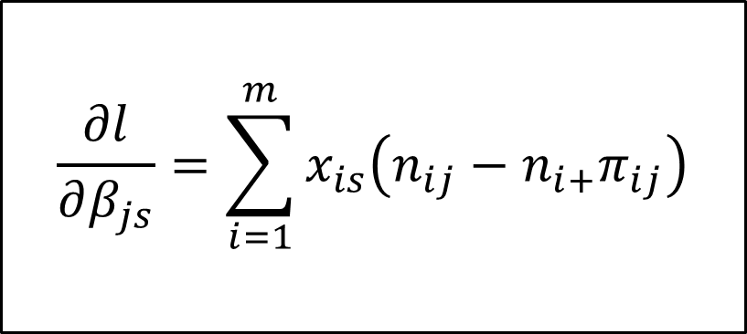
Matrix Representation of Gradient
$$\frac{∂l}{∂B}=\left[\begin{matrix}\frac{∂l}{∂β_{1}} \\ ⋮ \\ \frac{∂l}{∂β_{k−1}}\end{matrix}\right]$$
$$\frac{∂l}{∂β_{j}}=\left[\begin{matrix}\frac{∂l}{∂β_{j1}} \\ ⋮ \\ \frac{∂l}{∂β_{jp}}\end{matrix}\right]$$
$$\frac{∂l}{∂β_{js}}=\sum_{i=1}^{m}{x_{is}\left(n_{ij}−{n_{i+}π}_{ij}\right)}$$
$$j=1,…,K−1$$
$$s=1,…,p$$

Slide 37
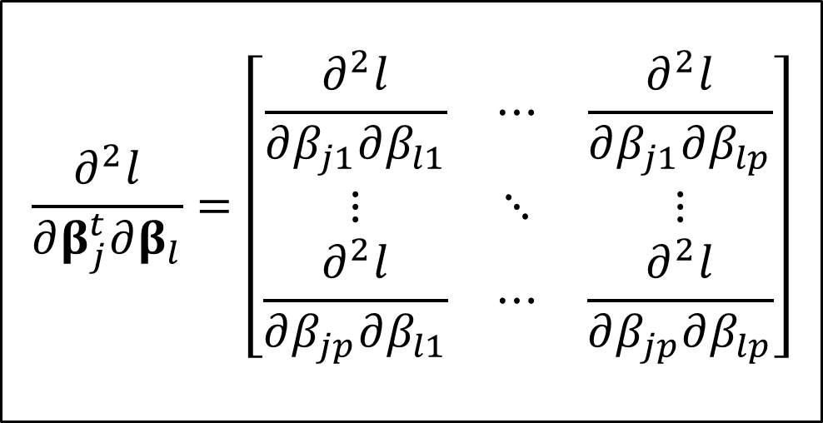
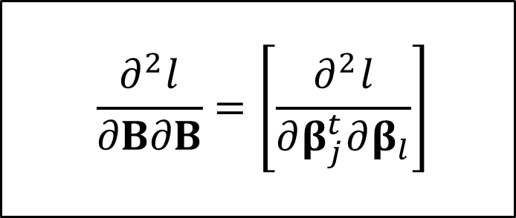

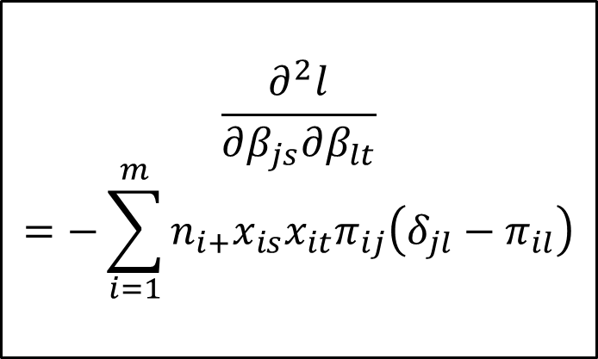
Matrix Representation of Hessian
$$\frac{∂^{2}l}{∂B∂B}=\left[\frac{∂^{2}l}{∂β_{j}^{t}∂β_{l}}\right]$$
$$\frac{∂^{2}l}{∂β_{j}^{t}∂β_{l}}=\left[\begin{matrix}\frac{∂^{2}l}{∂β_{j1}∂β_{l1}} & ⋯ & \frac{∂^{2}l}{∂β_{j1}∂β_{lp}} \\ ⋮ & ⋱ & ⋮ \\ \frac{∂^{2}l}{∂β_{jp}∂β_{l1}} & ⋯ & \frac{∂^{2}l}{∂β_{jp}∂β_{lp}}\end{matrix}\right]$$
Blocks
$$\frac{∂^{2}l}{∂β_{js}∂β_{lt}}$$
$$=−\sum_{i=1}^{m}{{n_{i+}x}_{is}x_{it}π_{ij}\left(δ_{jl}−π_{il}\right)}$$
$$j,l=1,…,K−1$$
$$s,t=1,…,p$$

Slide 38
Newton-Raphson Algorithm
Calculate initial predicted probability $π^{\left(0\right)}$ and set $v=0$
Do iteration until converge
Calculate $∇l\left(B^{\left(ν\right)}\right)$ and $H\left(B^{\left(ν\right)}\right)$
Update parameter estimates $B^{\left(ν+1\right)}=B^{\left(ν\right)}−ξ{\left(H\left(B^{\left(ν\right)}\right)\right)}^{−1}\left(∇l\left(B^{\left(ν\right)}\right)\right)$
If necessary, adjust the stepping scalar $ξ>0$ to ensure that $l\left(B^{\left(ν+1\right)}\right)≥l\left(B^{\left(ν\right)}\right)$
Calculate the predicted probability $π^{\left(v+1\right)}$
Check if the iteration has converged or cannot continue due to errors

Slide 39
Step-Halving Adjustment
If the log-likelihood function decreases, i.e., $l\left(B^{\left(ν+1\right)}\right)<l\left(B^{\left(ν\right)}\right)$.
Adjust $ξ={\left(1/2\right)}^{u}$ for $u=0,…,U$ for a prespecified $U$. A common choice $U=7$ because ${\left(1/2\right)}^{7}=0.0078125<0.01$.
If the log-likelihood value still goes down after $U$ number of adjustments, then stop the iteration with a return code.
The main iteration will then decide the next step.

Slide 40
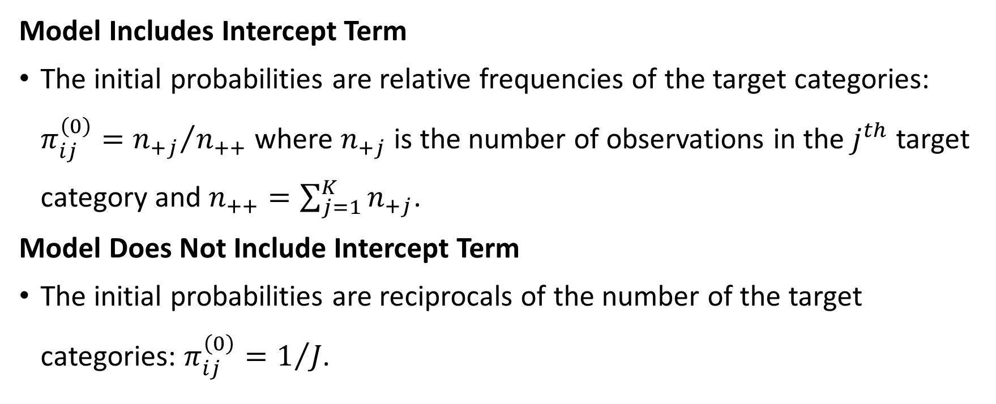
Initial Probabilities
Model Includes Intercept Term
The initial probabilities are relative frequencies of the target categories: $π_{ij}^{\left(0\right)}={n_{+j}}/{n_{++}}$ where $n_{+j}$ is the number of observations in the $j^{th}$ target category and $n_{++}=\sum_{j=1}^{K}{n_{+j}}$.
Model Does Not Include Intercept Term
The initial probabilities are reciprocals of the number of the target categories: $π_{ij}^{\left(0\right)}=1/J$.

Slide 41
StatsModels 0.13.2 Python Library

Slide 42
Cars Multinomial Logistic Regression
Week 6 Cars Logistic.py

Slide 43
Specify the Target (a.k.a. Label) Variable
import statsmodels.api as smodel
cars = pandas.read_csv('C:\\IIT\\Machine Learning\\Data\\cars.csv')
n_sample = cars.shape[0]
# Specify Origin as a categorical variable
y = cars['Origin'].astype('category')
y_category = y.cat.categories
print('Categories of Origin:', y_category)
print(y.value_counts()) # value_counts() sorts categories in ascending frequencies
Categories of Origin: Index(['Asia', 'Europe', 'USA'], dtype='object')
Asia 158
USA 147
Europe 123
Name: Origin, dtype: int64

Slide 44
Train the Model Without Predictors
# Train a model with only the Intercept term
X0 = cars[['Origin']].copy()
X0.insert(0, 'Intercept', 1.0)
X0.drop(columns = ['Origin'], inplace = True)
# Train a multinominal logistic model
modelObj = smodel.MNLogit(y, X0)
print("Name of Target Variable:", modelObj.endog_names)
print("Name(s) of Predictors:", modelObj.exog_names)
thisFit = modelObj.fit(full_output = True)
print('Model Summary:\n', thisFit.summary())
Name of Target Variable: Origin
Name(s) of Predictors: ['Intercept']

Slide 45
Train the Model Without Predictors
Optimization terminated successfully.
Current function value: 1.093277
Iterations 4
Model Summary:
MNLogit Regression Results
==============================================================================
Dep. Variable: Origin No. Observations: 428
Model: MNLogit Df Residuals: 426
Method: MLE Df Model: 0
Date: Mon, 14 Feb 2022 Pseudo R-squ.: 6.712e-11
Time: 11:12:55 Log-Likelihood: -467.92
converged: True LL-Null: -467.92
Covariance Type: nonrobust LLR p-value: nan
==============================================================================
Origin=Europe coef std err z P>|z| [0.025 0.975]
---------------------------------------------------------------------------------
Intercept -0.2504 0.120 -2.082 0.037 -0.486 -0.015
---------------------------------------------------------------------------------
Origin=USA coef std err z P>|z| [0.025 0.975]
------------------------------------------------------------------------------
Intercept -0.0722 0.115 -0.630 0.529 -0.297 0.152
==============================================================================

Slide 46
Terminology for a Statistical Model
Degrees of Freedom of a Model: The number of non-aliased parameters excluding the Intercept term, if specified
Degrees of Freedom of Residuals: The number of observations minus the number of non-aliased parameters (including the Intercept term)
Log-Likelihood of a Model: The log-likelihood of the current model
Log-Likelihood of a Null Model: The log-likelihood of a model that only has the Intercept term
Log-Likelihood p-Value: The p-value from performing a Chi-Square statistical test that compares the current model from the Null model

Slide 47
Assess the Intercept-Only Model
Since the current model only has the Intercept term, the current model is the Null model, and the Model Degrees of Freedom is zero.
There are 428 observations and there are two non-aliased parameters, thus the Residual Degrees of Freedom is 426.
The Null model’s log-likelihood value is -467.92.
Since the current model is the Null model, we do not perform the Chi-Squares statistical test.
print('Intercept Model Log-Likelihood Value = ', thisFit.llnull)
print(' Current Model Log-Likelihood Value = ', thisFit.llf)
Intercept Model Log-Likelihood Value = -467.922446554874
Current Model Log-Likelihood Value = -467.92244652346665

Slide 48
Predict the Intercept-Only Model
Since there are three target categories: Asia, Europe, and USA, we will calculate three predicted probabilities, one for each target category.
A common convention is to choose the target category whose predicted probability is highest among the three values.
In case of ties, we may choose the first category found, the last category found, or a random category found.
Our convention is to choose the first category found.
y_predProb = thisFit.predict(X0)
y_predProb.columns = y_category
y_predClass = y_predProb.idxmax(axis = 1)

Slide 49
Assess the Intercept-Only Model
y_confusion = pandas.DataFrame(metrics.confusion_matrix(y, y_predClass))
y_confusion.columns = y_category
y_confusion.index = y_category
print("Confusion Matrix (Row is Observed, Column is Predicted) = \n")
print(y_confusion)
y_accuracy = metrics.accuracy_score(y, y_predClass)
print("Accuracy Score = ", y_accuracy)
Confusion Matrix (Row is Obsered, Column is Predicted) =
Asia Europe USA
Asia 158 0 0
Europe 123 0 0
USA 147 0 0
Accuracy Score = 0.3691588785046729
All observations are classified into the “Asia” category
Only 158/428 = 36.9% observations are correctly classified

Slide 50
Assess the Intercept-Only Model
# Review the predicted probabilities
plotData = y_predProb.join(y)
fig, axs = plt.subplots(nrows = 1, ncols = 3, sharex = True, sharey = True, dpi = 200, figsize=(12,6))
for j in range(3):
ax = axs[j]
plotData.boxplot(column = y_category[j], by = 'Origin', ax = ax, vert = True)
# ax.set_ylabel('Predicted Probability for ' + str(y_category[j]))
ax.set_xlabel('Origin')
ax.yaxis.grid(True)
ax.set_title(y_category[j])
plt.suptitle('Predicted Probability for\n')
plt.show()

Slide 51
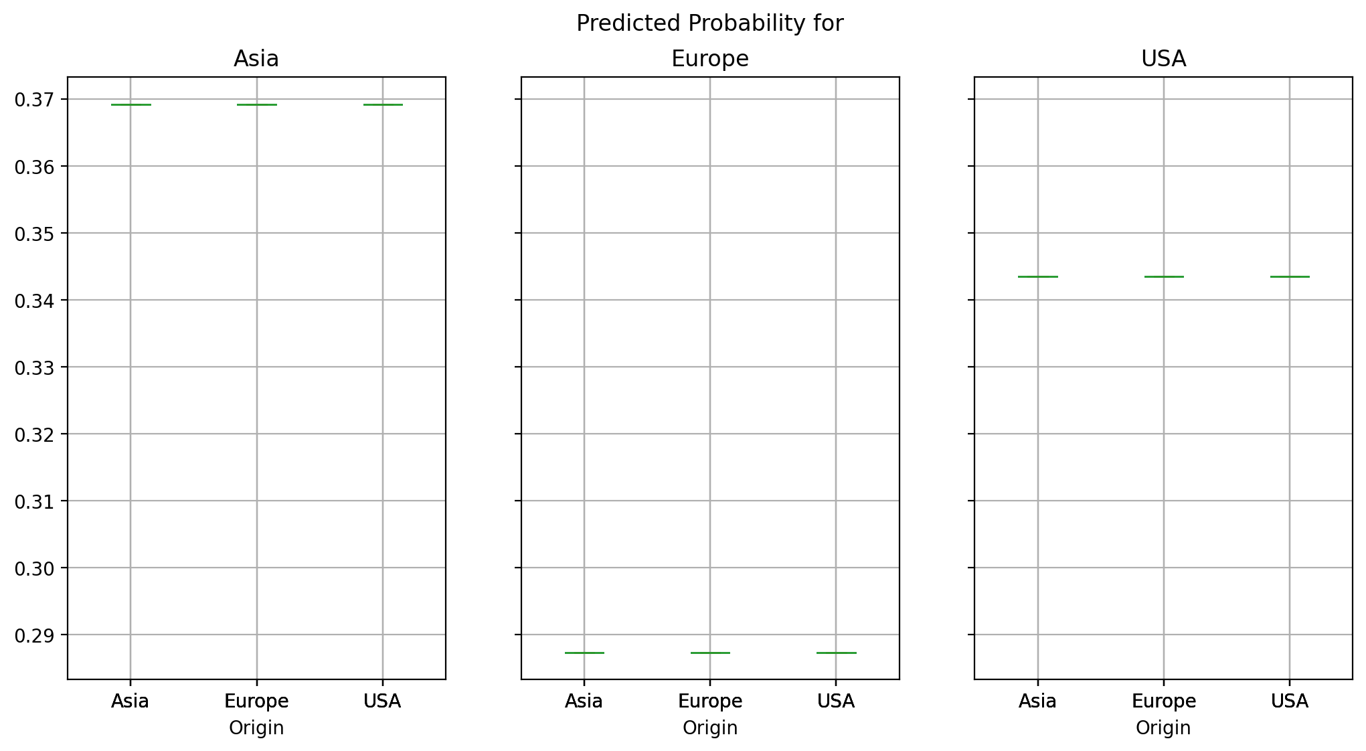
Assess the Intercept-Only Model
Category | Count | Percent
Asia | 158 | 36.92%
Europe | 123 | 28.74%
U.S.A. | 147 | 34.34%
Total | 428 | 100%
Comments?

Slide 52
Specify a Model With Continuous Predictors
# Add the predictors EngineSize, Horsepower, Length, and Weight
X = X0.join(cars[['EngineSize','Horsepower','Length','Weight']])
# Train a multinominal logistic model
modelObj = smodel.MNLogit(y, X)
print("Name of Target Variable:", modelObj.endog_names)
print("Name(s) of Predictors:", modelObj.exog_names)
thisFit = modelObj.fit(full_output = True)
print('Model Summary:\n', thisFit.summary())
print('Intercept Model Log-Likelihood Value = ', thisFit.llnull)
print(' Current Model Log-Likelihood Value = ', thisFit.llf)
print("Model Parameter Estimates:\n", thisFit.params)

Slide 53
Specify a Model With Continuous Predictors
Optimization terminated successfully.
Current function value: 0.785477
Iterations 7
Model Summary:
MNLogit Regression Results
==============================================================================
Dep. Variable: Origin No. Observations: 428
Model: MNLogit Df Residuals: 418
Method: MLE Df Model: 8
Date: Mon, 14 Feb 2022 Pseudo R-squ.: 0.2815
Time: 12:01:33 Log-Likelihood: -336.18
converged: True LL-Null: -467.92
Covariance Type: nonrobust LLR p-value: 2.386e-52
==============================================================================
Origin=Europe coef std err z P>|z| [0.025 0.975]
---------------------------------------------------------------------------------
Intercept 5.2977 2.331 2.273 0.023 0.729 9.867
EngineSize -1.2357 0.334 -3.699 0.000 -1.890 -0.581
Horsepower 0.0238 0.004 5.680 0.000 0.016 0.032
Length -0.0674 0.016 -4.215 0.000 -0.099 -0.036
Weight 0.0015 0.000 3.858 0.000 0.001 0.002
---------------------------------------------------------------------------------
Origin=USA coef std err z P>|z| [0.025 0.975]
------------------------------------------------------------------------------
Intercept -7.3857 2.291 -3.224 0.001 -11.875 -2.896
EngineSize 2.4380 0.383 6.364 0.000 1.687 3.189
Horsepower -0.0297 0.005 -5.583 0.000 -0.040 -0.019
Length 0.0451 0.015 3.035 0.002 0.016 0.074
Weight -0.0008 0.000 -2.239 0.025 -0.002 -0.000
==============================================================================
Intercept Model Log-Likelihood Value =
-467.922446554874
Current Model Log-Likelihood Value =
-336.18406479506086
Model Parameter Estimates:
0 1
Intercept 5.297676023 -7.385659155
EngineSize -1.235670641 2.438025558
Horsepower 0.02381170936 -0.02970130516
Length -0.06743299686 0.04505408369
Weight 0.001501179149 -0.0008271157659

Slide 54
Assess a Model With Continuous Predictors
Asia: 106 out of 158 observations are correctly classified. The accuracy rate is 106/158 = 67.09%.
Europe: 74 out of the 123 observations are correctly classified. The accuracy rate is 74/123 = 60.16%.
USA: 88 out of 147 observations are correctly classified. The accuracy rate is 88/147 = 59.86%.
The overall accuracy is (106 + 74 + 88) / (158 + 123 + 147) = 268 / 428 = 62.62%
Confusion Matrix (Row is Observed, Column is Predicted) =
Asia Europe USA
Asia 106 26 26
Europe 41 74 8
USA 48 11 88
Accuracy Score = 0.6261682242990654

Slide 55
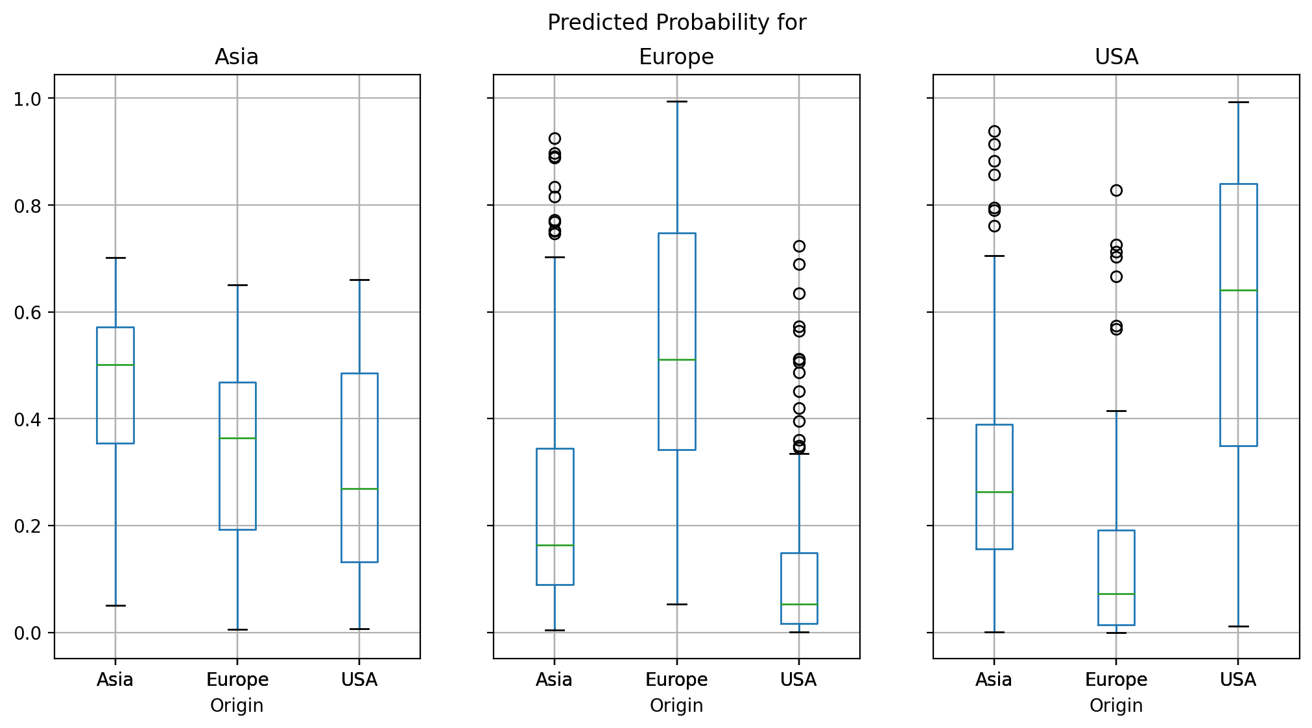
Assess a Model With Continuous Predictors

Slide 56
Train a Model With Categorical Predictors
Since values of a categorical predictor are not necessarily numeric, we will create dummy variables to represent the categories.
The pandas.get_dummies() function can create the dummy columns.
For instance, we can create the model matrix for a model that includes the Intercept and the categorical variable DriveTrain.
DriveTrain | Frequency | Percent
AWD | 92 | 21.50%
FWD | 226 | 52.80%
RWD | 110 | 25.70%
Total | 428 | 100%
# Add the categorical predictors DriveTrain
X = X0.join(pandas.get_dummies(cars[['DriveTrain']].astype('category')))

Slide 57
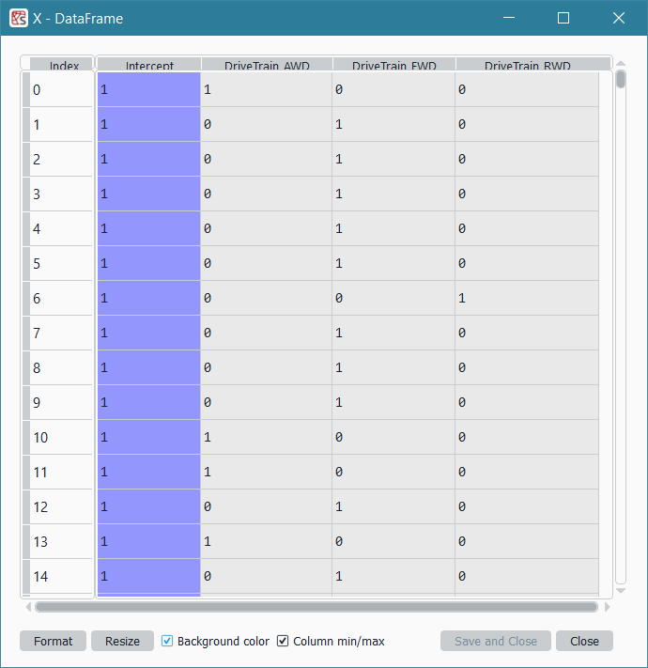
Intrinsic Aliasing Among Columns
Do you notice that the sum of the last three columns always equal to the Intercept column?
It is because the DriveTrain of each observation is either AWD, FWD, or RWD.
Intrinsic Aliasing!

Slide 58
Multicollinearity Due to Aliased Parameters
Aliasing (Multicollinearity or Redundancy) occurs when a column in the model matrix is linearly dependent on other columns.
Mathematically, a column can be expressed as a linear combination of the other columns.
Intrinsic Aliasing is often the result of how we construct the model matrix.
Extrinsic Aliasing is a technical artifact of the data. For example, we collected two closely related information.
How can train the model in the presence of aliasing?
We need a strategy to detect the aliased column and then deal with it.

Slide 59
The SWEEP Operator
James H. Goodnight (1979), “A Tutorial on the SWEEP Operator”, The American Statistician , Volume 33, Number 2, pages 149 – 158.
Clarke, Michael R. B. (1982), “Algorithm AS 178: The Gauss-Jordan Sweep Operator with Detection of Collinearity”, Journal of the Royal Statistical Society. Series C (Applied Statistics), Volume 31, Number 2, Pages 166 – 168.

Slide 60
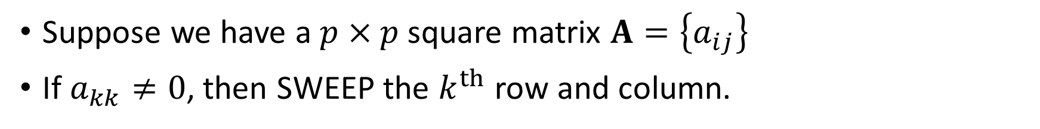
The SWEEP Operator
Suppose we have a $p×p$ square matrix $A=\left\{a_{ij}\right\}$
If $a_{kk}≠0$, then SWEEP the $k^{th}$ row and column.
Step 1: $a_{ij}←a_{ij}−{a_{ik}a_{kj}}/{a_{kk}}$ for $i≠k$ and $j≠k$
Step 1: 𝑎_𝑖𝑗←𝑎_𝑖𝑗−〖𝑎_𝑖𝑘 𝑎_𝑘𝑗〗∕𝑎_𝑘𝑘 for 𝑖≠𝑘 and 𝑗≠𝑘
Step 2: $a_{ik}←{a_{ik}}/{\left|a_{kk}\right|}$ for $i≠k$
Step 2: 𝑎_𝑖𝑘←𝑎_𝑖𝑘∕|𝑎_𝑘𝑘 | for 𝑖≠𝑘
Step 3: $a_{kj}←{a_{kj}}/{\left|a_{kk}\right|}$ for $j≠k$
Step 3: 𝑎_𝑘𝑗←𝑎_𝑘𝑗∕|𝑎_𝑘𝑘 | for 𝑗≠𝑘
Step 4: $a_{kk}←−1/{a_{kk}}$
Step 4: 𝑎_𝑘𝑘←−1∕𝑎_𝑘𝑘

Slide 61
The SWEEP Operator
Utility.py

Slide 62
The SWEEP Operator
def SWEEPOperator (pDim, inputM, origDiag, sweepCol = None, tol = 1e-7):
''' Implement the SWEEP operator
Parameter
---------
pDim: dimension of matrix inputM, integer greater than one
inputM: a square and symmetric matrix, numpy array
origDiag: the original diagonal elements before any SWEEPing
sweepCol: a list of columns numbers to SWEEP
tol: singularity tolerance, positive real
Return
------
A: negative of a generalized inverse of input matrix
aliasParam: a list of aliased rows/columns in input matrix
nonAliasParam: a list of non-aliased rows/columns in input matrix
'''
if (sweepCol is None):
sweepCol = range(pDim)
aliasParam = []
nonAliasParam = []
A = numpy.copy(inputM)
ANext = numpy.zeros((pDim,pDim))
for k in sweepCol:
Akk = A[k,k]
pivot = tol * abs(origDiag[k])
if (not numpy.isinf(Akk) and abs(Akk) >= pivot):
nonAliasParam.append(k)
ANext = A - numpy.outer(A[:, k], A[k, :]) / Akk
ANext[:, k] = A[:, k] / abs(Akk)
ANext[k, :] = ANext[:, k]
ANext[k, k] = -1.0 / Akk
else:
aliasParam.append(k)
ANext[:,k] = numpy.zeros(pDim)
ANext[k, :] = numpy.zeros(pDim)
A = ANext
return (A, aliasParam, nonAliasParam)

Slide 63
Train a Model With Categorical Predictors
# Identify the aliased parameters
XtX = X.transpose().dot(X)
n_param = X.shape[1]
origDiag = numpy.diag(XtX)
XtXGinv, aliasParam, nonAliasParam = Utility.SWEEPOperator (n_param, XtX, origDiag)
print('Aliased Parameters: ', list(aliasParam))
print('Non-aliased Parameters: ', list(nonAliasParam))
Aliased Parameters: [3]
Non-aliased Parameters: [0, 1, 2]
XtX | Intercept | DriveTrain_AWD | DriveTrain_FWD | DriveTrain_RWD
Intercept | 428 | 92 | 226 | 110
DriveTrain_AWD | 92 | 92 | 0 | 0
DriveTrain_FWD | 226 | 0 | 226 | 0
DriveTrain_RWD | 110 | 0 | 0 | 110

Slide 64
Train a Model With Categorical Predictors
# Train a multinominal logistic model
X_reduce = X.iloc[:, list(nonAliasParam)]
modelObj = smodel.MNLogit(y, X_reduce)
print("Name of Target Variable:", modelObj.endog_names)
print("Name(s) of Predictors:", modelObj.exog_names)
thisFit = modelObj.fit(full_output = True)
print('Model Summary:\n', thisFit.summary())
print('Intercept Model Log-Likelihood Value = ', thisFit.llnull)
print(' Current Model Log-Likelihood Value = ', thisFit.llf)
print("Model Parameter Estimates:\n", thisFit.params)
Name of Target Variable: Origin
Name(s) of Predictors: ['Intercept', 'DriveTrain_AWD', 'DriveTrain_FWD']

Slide 65
Train a Model With Categorical Predictors
Optimization terminated successfully.
Current function value: 1.044810
Iterations 5
Model Summary:
MNLogit Regression Results
==============================================================================
Dep. Variable: Origin No. Observations: 428
Model: MNLogit Df Residuals: 422
Method: MLE Df Model: 4
Date: Mon, 14 Feb 2022 Pseudo R-squ.: 0.04433
Time: 13:15:07 Log-Likelihood: -447.18
converged: True LL-Null: -467.92
Covariance Type: nonrobust LLR p-value: 2.130e-08
==================================================================================
Origin=Europe coef std err z P>|z| [0.025 0.975]
----------------------------------------------------------------------------------
Intercept 0.6931 0.245 2.830 0.005 0.213 1.173
DriveTrain_AWD -0.6360 0.342 -1.858 0.063 -1.307 0.035
DriveTrain_FWD -1.6773 0.312 -5.382 0.000 -2.288 -1.067
----------------------------------------------------------------------------------
Origin=USA coef std err z P>|z| [0.025 0.975]
----------------------------------------------------------------------------------
Intercept 0.3365 0.262 1.285 0.199 -0.177 0.850
DriveTrain_AWD -0.7718 0.379 -2.038 0.042 -1.514 -0.029
DriveTrain_FWD -0.4318 0.300 -1.441 0.150 -1.019 0.155
==================================================================================
Intercept Model Log-Likelihood Value = -467.922446554874
Current Model Log-Likelihood Value = -447.17849925983535
Model Parameter Estimates:
0 1
Intercept 0.6931471806 0.3364722366
DriveTrain_AWD -0.6359887667 -0.7717903079
DriveTrain_FWD -1.677349118 -0.4317824164
Confusion Matrix (Row is Observed, Column is Predicted) =
Asia Europe USA
Asia 99 59 0
Europe 37 86 0
USA 90 57 0
Accuracy Score = 0.4322429906542056
Origin | Accuracy
Asia | 99/158 = 62.66%
Europe | 86/123 = 69.92%
USA | 0 / 147 = 0%
Total | (99+86+0)/428 = 43.22%

Slide 66
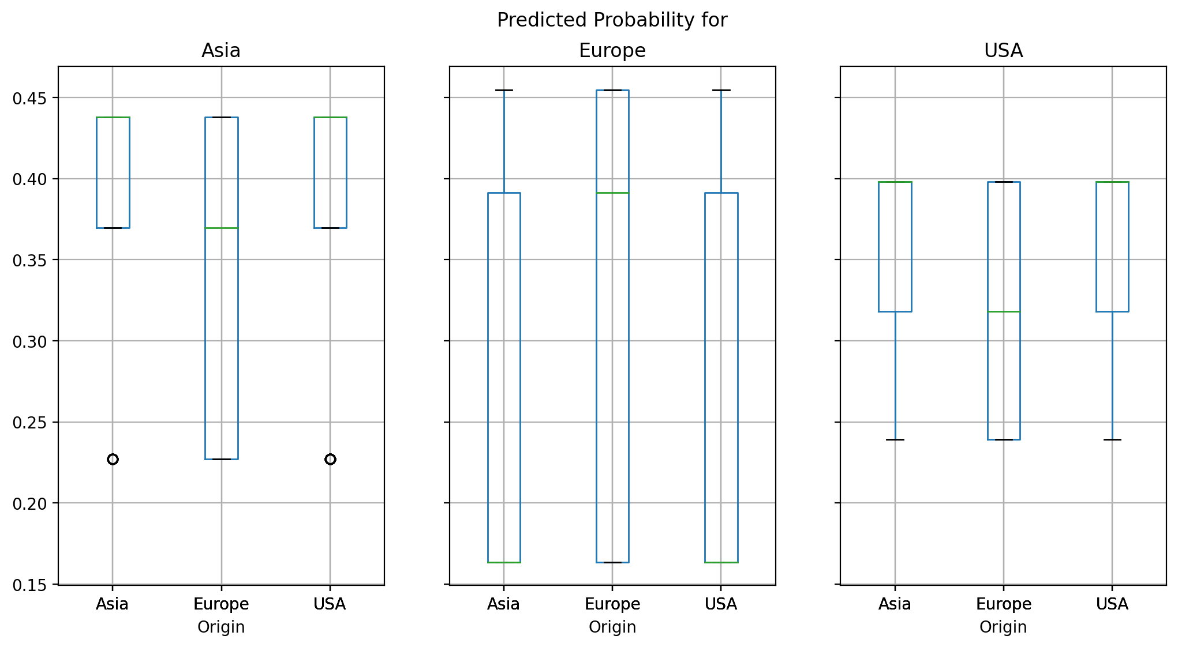
Train a Model With Categorical Predictors

Slide 67
Select Predictors Into Model
Forward Selection
Enter predictor into the model one at a time
Test if adding the predictor will improve the model goodness-of-fit
Backward Selection
Remove predictor from the model one at a time
Test if removing the predictor will not reduce the model goodness-of-fit
Start with a model without any predictor
Start with a model with ALL the predictors

Slide 68
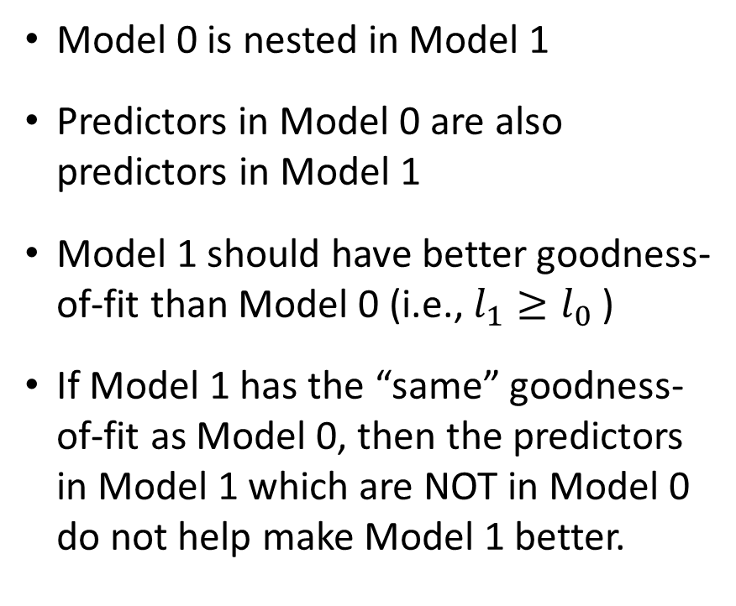
Concept of Nested Models
Model 1
Model 0
Model 0 is nested in Model 1
Predictors in Model 0 are also predictors in Model 1
Model 1 should have better goodness-of-fit than Model 0 (i.e., $l_{1}≥l_{0}$ )
If Model 1 has the “same” goodness-of-fit as Model 0, then the predictors in Model 1 which are NOT in Model 0 do not help make Model 1 better.

Slide 69
Nested Models
Model 1
Model 0
1. Model 1
2. Model 0
1. Model 0
2. Model 1

Slide 70
Deviance Test for Comparing Nested Models
Model 0
Let $l_{0}$ be the log-likelihood value
Let $m_{0}$ be the number of free parameters (excluding the linear dependent)
Model 1
Let $l_{1}$ be the log-likelihood value
Let $m_{1}$ be the number of free parameters (excluding the linear dependent)
The Deviance Test
Test statistic as $G^{2}=2\left(l_{1}−l_{0}\right)≥0$
The degree of freedom $df=m_{1}−m_{0}>0$
$G^{2}$ has a Chi-square distribution with $m_{1}−m_{0}$ degrees of freedom

Slide 71
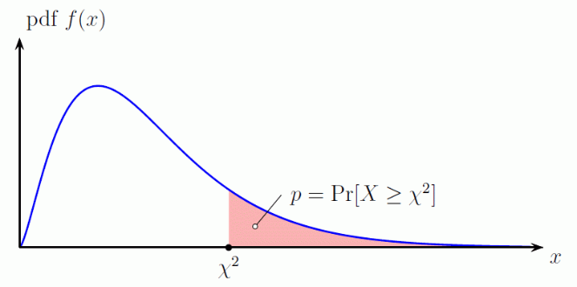
Deviance Test Procedure
Calculate the significance value of the $G^{2}$ statistic using the Chi-square distribution with $m_{1}−m_{0}$ degrees of freedom
Forward: If the significance value is less than a preset level, say 5%, then we will conclude that adding that predictor will improve the overall model goodness-of-fit.
Backward: If the significance value is greater than a preset level, say 5%, then we will conclude that removing that predictor will not reduce the overall model goodness-of-fit.

Slide 72
Deviance Test Decision
Forward Selection
Consider only predictors whose significances are less than 5%
Enter the predictor which has the lowest significance value into the current model
Backward Selection
Consider only predictors whose significances are greater than 5%
Remove the predictor which has the highest significance value from the current model

Slide 73
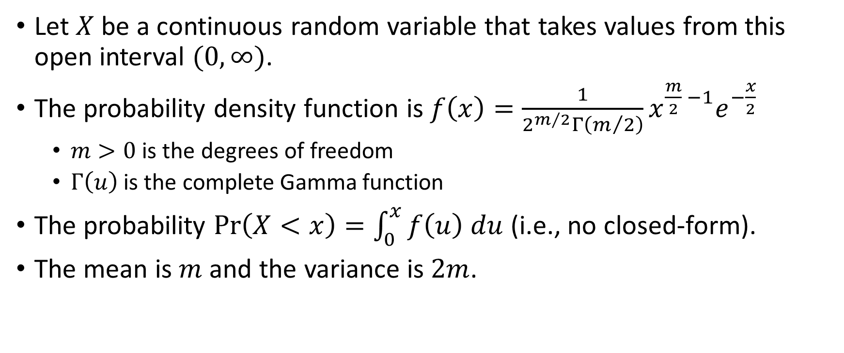
Chi-Square Distribution
Let $X$ be a continuous random variable that takes values from this open interval $(0,∞)$.
The probability density function is $f\left(x\right)=\frac{1}{2^{m/2}Γ\left(m/2\right)}x^{\frac{m}{2} −1}e^{−\frac{x}{2}}$
$m>0$ is the degrees of freedom
$Γ\left(u\right)$ is the complete Gamma function
The probability $Pr\left(X<x\right)=\int_{0}^{x}{f\left(u\right) du}$ (i.e., no closed-form).
The mean is $m$ and the variance is $2m$.

Slide 74
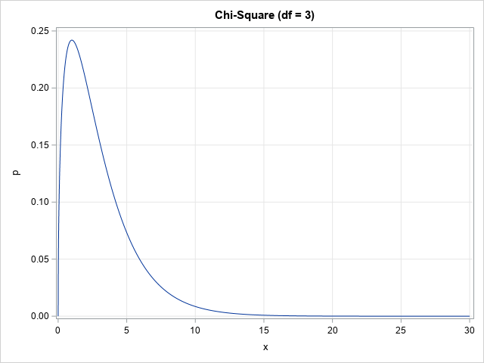
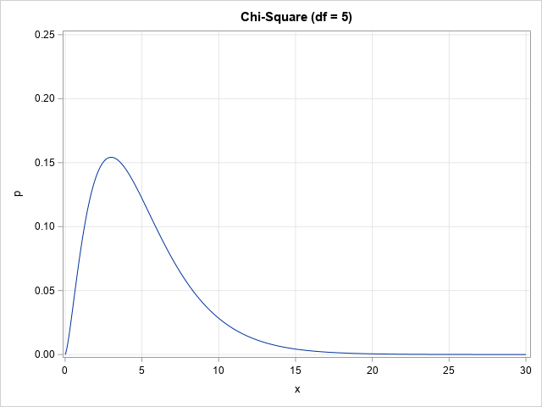
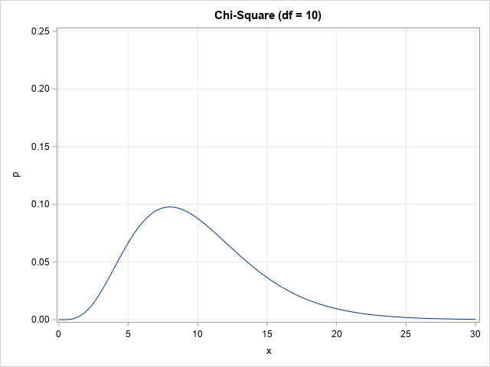
Chi-Square Distribution
Python Function | Density | Distribution | Significance | Quantile | Random Number
scipy.stats.chi2 | .pdf() | .cdf() | .sf() | .ppf() | .rvs()

Slide 75
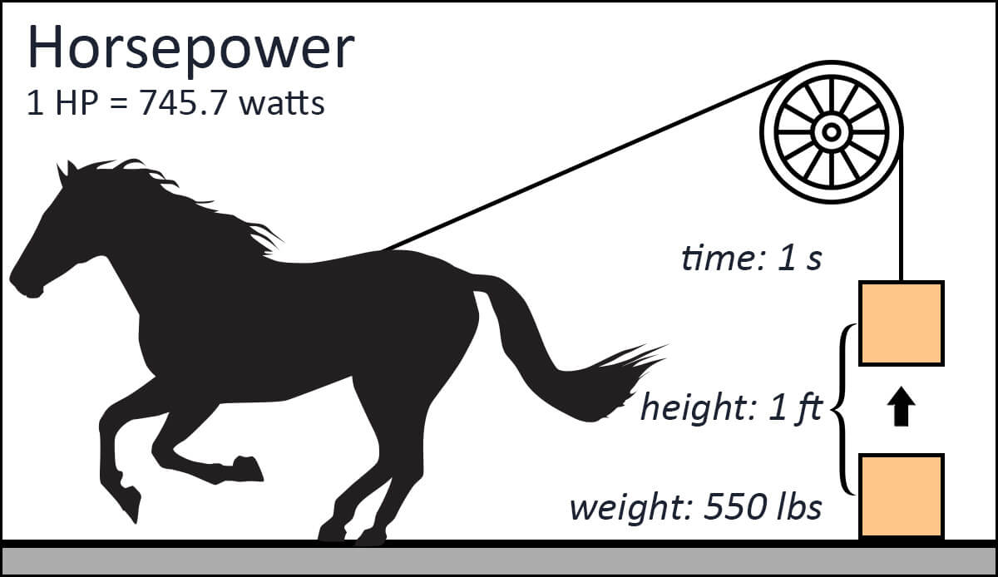
2004 Cars Data
Nominal Target Variable
Origin: Manufacturer Origin. Categories are Asia, Europe, and USA
Categorical Predictor
DriveTrain: Type of Drive Train.
Continuous Predictor
EngineSize: Volume of Engine Cylinders in unit of liter.
Horsepower: Power of Engine output in unit of horsepower.
Length: Vehicle Length in unit of inches.
Weight: Vehicle Weight in unit of pounds.

Slide 76
Select Predictors for Cars Logistic Regression
Week 6 Cars Logistic Forward Selection.py

Slide 77
Descriptive Statistics
Origin | Frequency | Percent
Asia | 158 | 36.92%
Europe | 123 | 28.74%
USA | 147 | 34.35%
Total | 428 | 100%
 | EngineSize | Horsepower | Length | Weight
count | 428 | 428 | 428 | 428
mean | 3.20 | 215.89 | 186.36 | 3577.95
std | 1.11 | 71.84 | 14.36 | 758.98
min | 1.3 | 73 | 143 | 1,850.00
25% | 2.375 | 165 | 178 | 3,104.00
50% | 3 | 210 | 187 | 3,474.50
75% | 3.9 | 255 | 194 | 3,977.75
max | 8.3 | 500 | 238 | 7,190.00
DriveTrain | Frequency | Percent
AWD | 92 | 21.50%
FWD | 226 | 52.80%
RWD | 110 | 25.70%
Total | 428 | 100%

Slide 78
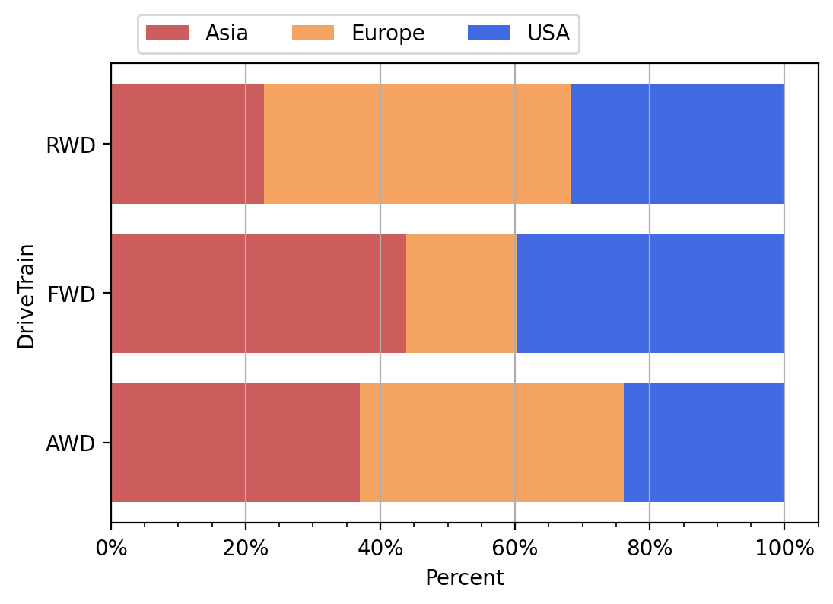
Categorical Predictors
European manufacturers make more RWD vehicles than Asian and USA manufacturers
FWD vehicles are made more often by Asian and USA manufacturers than European manufacturer
It seems that Asian and European manufacturers make equally number of AWD vehicles

Slide 79
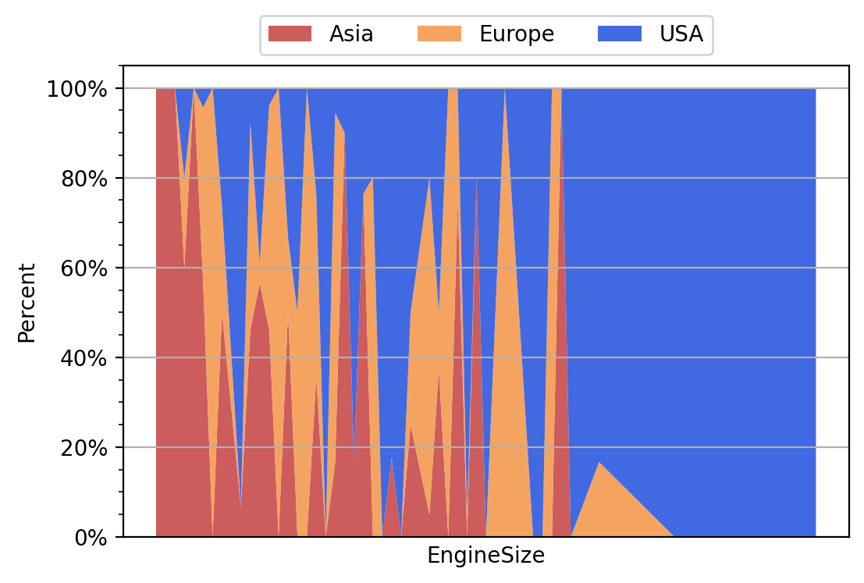
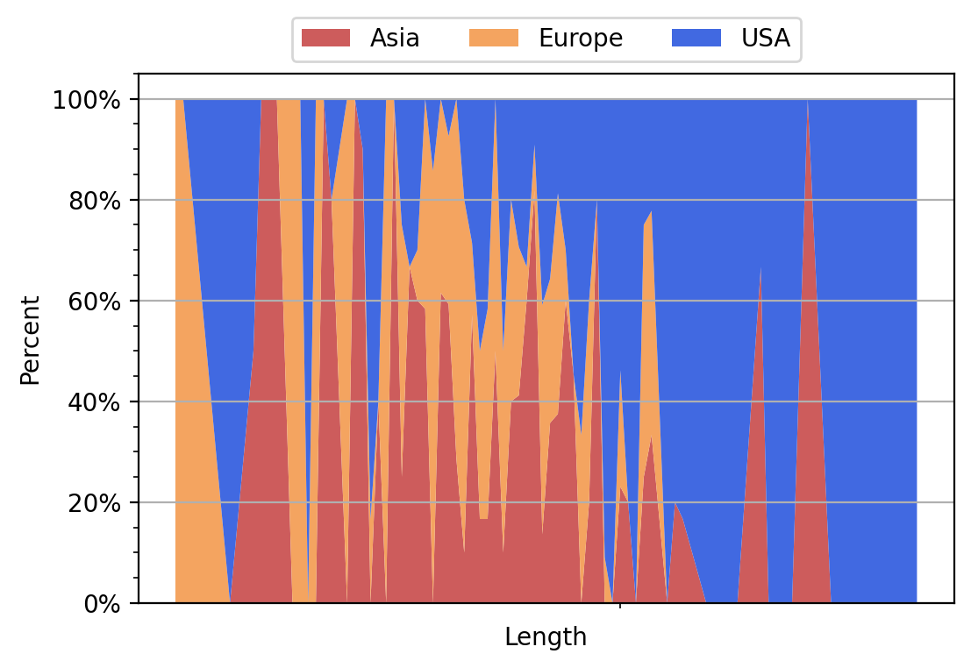
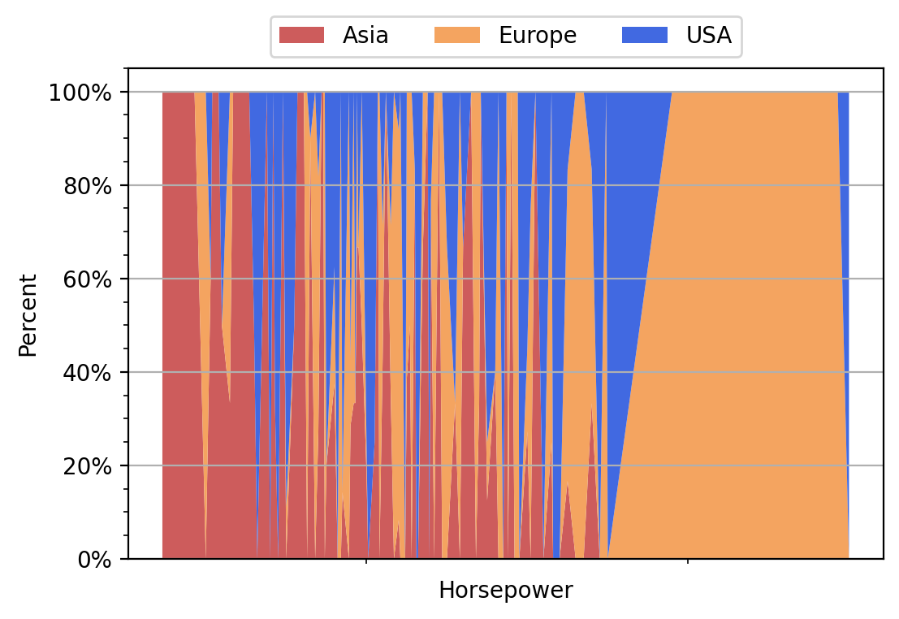
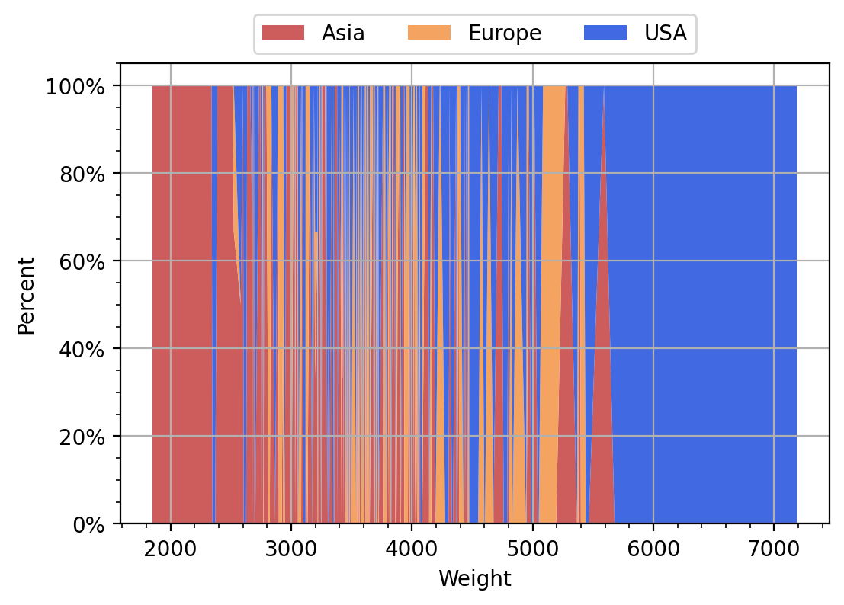
Continuous Predictors

Slide 80
2004 Cars Data: Forward Selection
Model 0: Origin = Intercept
In other words, it is the Intercept Only model
Consider Model 1: Origin = Intercept + <predictor> <predictor> = DriveTrain, Weight
Calculate the Deviance test statistic and then use the Chi-square significance value to determine if the <predictor> will improve model goodness-of-fit

Slide 81
The MNLogisticModel Function
Utility.py

Slide 82
Train Model Function
def MNLogisticModel (X, y, maxIter = 20, tolSweep = 1e-7):
''' Train a Multinomial Logistic Model
Parameter
---------
X: A Pandas DataFrame, rows are observations, columns are regressors
y: A Pandas Series, rows are observations of the response variable
maxIter: Maximum number of iterations
tolSweep: Tolerance for SWEEP Operator
Return
------
A list of model output:
(0) mFit: the Fit object of MNLogit
(1) mLLK: model log-likelihood value
(2) mDF: model degrees of freedom
(3) mParameter: model parameter estimates
'''

Slide 83
Train Model Function
n_sample = X.shape[0]
n_param = X.shape[1]
# Identify the aliased parameters
XtX = X.transpose().dot(X)
origDiag = numpy.diag(XtX)
XtXGinv, aliasParam, nonAliasParam = SWEEPOperator (n_param, XtX, origDiag,
sweepCol = range(n_param), tol = tolSweep)
# Train a multinominal logistic model
X_reduce = X.iloc[:, list(nonAliasParam)]
mObj = smodel.MNLogit(y, X_reduce)
mFit = mObj.fit(method = 'newton', maxiter = maxIter, gtol = 1e-6,
full_output = True, disp = True)
mLLK = mFit.llf
mDF = len(nonAliasParam) * (mFit.J - 1)
mParameter = mFit.params
# Return model statistics
return ([mFit, mLLK, mDF, mParameter])

Slide 84
Select Mode as Reference Category
Choice of Reference Category will not affect the model fit. But make estimation more numerically stable!
# Reorder the categories of the target variables in descending frequency
# MNLOGIT function takes first category as reference
u = trainData[yName].astype('category').copy()
u_freq = u.value_counts(ascending = False)
trainData[yName] = u.cat.reorder_categories(list(u_freq.index)).copy()
# Reorder the categories of the categorical variables in ascending frequency
# SWEEP Operator takes last category as reference
for pred in catName:
u = trainData[pred].astype('category').copy()
u_freq = u.value_counts(ascending = True)
trainData[pred] = u.cat.reorder_categories(list(u_freq.index)).copy()

Slide 85
Forward Selection: Step 0
Train a model (M0) that only has the Intercept term
Next, add one predictor (at a time) to this M0 and perform a Deviance test to determine if the predictor is significant.
Here, Significant means adding the predictor will significantly increase the model log-likelihood.
Specification | Degree of Freedom | Log-Likelihood
Intercept | 2 | -467.9224465

Slide 86
Forward Selection: Step 1
Predictor | Model |  | Deviance
Predictor | Degree of Freedom | Log-Likelihood | Chi-Square | Degree of Freedom | Significance
Intercept | 2 | -467.922
+ Length | 4 | -433.788 | 68.270 | 2 | 1.50E-15
+ Horsepower | 4 | -441.433 | 52.979 | 2 | 3.13E-12
+ EngineSize | 4 | -442.945 | 49.954 | 2 | 1.42E-11
+ DriveTrain | 6 | -447.178 | 41.488 | 4 | 2.13E-08
+ Weight | 4 | -451.470 | 32.904 | 2 | 7.16E-08
Selection Criterion: Add the predictor whose Significance is smallest and less than 0.05.

Slide 87
Forward Selection: Step 2
Predictor | Model |  | Deviance
Predictor | Degree of Freedom | Log-Likelihood | Chi-Square | Degree of Freedom | Significance
Intercept + Length | 4 | -433.788
+ Horsepower | 6 | -392.817 | 81.941 | 2 | 1.61E-18
+ Weight | 6 | -410.890 | 45.796 | 2 | 1.14E-10
+ DriveTrain | 8 | -409.063 | 49.449 | 4 | 4.71E-10
+ EngineSize | 6 | -421.690 | 24.196 | 2 | 5.57E-06
Selection Criterion: Add the predictor whose Significance is smallest and less than 0.05.

Slide 88
Forward Selection: Step 3
Predictor | Model |  | Deviance
Predictor | Degree of Freedom | Log-Likelihood | Chi-Square | Degree of Freedom | Significance
Intercept + Length + Horsepower | 6 | -392.817
+ EngineSize | 8 | -354.681 | 76.272 | 2 | 2.74E-17
+ DriveTrain | 10 | -386.512 | 12.610 | 4 | 0.013349
+ Weight | 8 | -389.533 | 6.569 | 2 | 0.037461
Selection Criterion: Add the predictor whose Significance is smallest and less than 0.05.

Slide 89
Forward Selection: Step 4
Predictor | Model |  | Deviance
Predictor | Degree of Freedom | Log-Likelihood | Chi-Square | Degree of Freedom | Significance
Intercept + Length + Horsepower + EngineSize | 8 | -354.681
+ Weight | 10 | -336.184 | 36.995 | 2 | 9.26E-09
+ DriveTrain | 12 | -339.329 | 30.704 | 4 | 3.52E-06
Selection Criterion: Add the predictor whose Significance is smallest and less than 0.05.

Slide 90
Forward Selection: Step 5
Predictor | Model |  | Deviance
Predictor | Degree of Freedom | Log-Likelihood | Chi-Square | Degree of Freedom | Significance
Intercept + Length + Horsepower + EngineSize + Weight | 10 | -336.184
+ DriveTrain | 14 | -327.675 | 17.017 | 4 | 0.0019
Selection Criterion: Add the predictor whose Significance is smallest and less than 0.05.

Slide 91
Forward Selection: Step Summary
Step | Predictor | Model |  | Deviance
 | Predictor | Degree of Freedom | Log-Likelihood | Chi-Square | Degree of Freedom | Significance
0 | Intercept | 2 | -467.922 | N/A | N/A | N/A
1 | Length | 4 | -433.788 | 68.270 | 2 | 1.498E-15
2 | Horsepower | 6 | -392.817 | 81.941 | 2 | 1.610E-18
3 | EngineSize | 8 | -354.681 | 76.272 | 2 | 2.740E-17
4 | Weight | 10 | -336.184 | 36.995 | 2 | 9.262E-09
5 | DriveTrain | 14 | -327.675 | 17.017 | 4 | 1.918E-03

Slide 92
Backward Selection
Model 0: Origin = Intercept + DriveTrain + EngineSize + Horsepower + Length + Weight (Full Main Effect Model)
Consider Model 1: Remove <predictor> from Model 0 <predictor> = DriveTrain, EngineSize, Horsepower, Length, and Weight
Calculate the Deviance test statistic and then use the Chi-square significance value to determine if the <predictor> will decrease model goodness-of-fit

Slide 93
Backward Selection
Predictor | Model |  | Deviance
Predictor | Degree of Freedom | Log-Likelihood | Chi-Square | Degree of Freedom | Significance
Intercept + DriveTrain + EngineSize + Horsepower + Length + Weight | 14 | -327.6754989
- DriveTrain | 10 | -336.1840648 | 17.0171 | 4 | 1.9182E-03
- EngineSize | 12 | -382.1251915 | 108.8994 | 2 | 2.2532E-24
- Horsepower | 12 | -384.8286050 | 114.3062 | 2 | 1.5091E-25
- Length | 12 | -341.9739781 | 28.5970 | 2 | 6.1695E-07
- Weight | 12 | -339.3294649 | 23.3079 | 2 | 8.6845E-06
Selection Criterion: Remove the predictor whose Significance is highest and greater than 0.05.

Slide 94
Backward Selection: Step Summary
Since all Significances are less than 0.05, NO PREDICTORS can be removed.
The model at Step 0 stays!
We conclude that the Forward Selection and the Backward Selection agree on the same model: Intercept + DriveTrain + EngineSize + Horsepower + Length + Weight
Discussion: In Forward Selection and Backward Selection, we practically search for the optimal model along a path. Is it possible that we miss something that is not on the path?

Slide 95
All Possible Subsets Selection
Suppose we have plenty of computing resources and time is not an issue
Suppose we want a model with the best goodness-of-fit
Then we can consider the All-Possible Selection

Slide 96
All Possible Subsets Selection
Suppose we are satisfied with models with only main effects (i.e., exclude interactions of predictors)
Suppose we have $r≥1$ predictors
Consider the model with no predictor (i.e., Intercept Only)
Consider models with only one predictors
Consider models with only $s<r$ predictors
…
Consider the model with all $r$ predictors

Slide 97
How Many Possible Subsets?
The Number of models considered
$$\left({r \atop 0}\right)+\left({r \atop 1}\right)+\left({r \atop 2}\right)+…+\left({r \atop s}\right)+…+\left({r \atop r}\right)=2^{r}$$
$$r$$ | 2 | 3 | 4 | 5 | 6 | 7 | 8 | 9 | 10 | 11 | 12
$$2^{r}$$ | 4 | 8 | 16 | 32 | 64 | 128 | 256 | 512 | 1024 | 2048 | 4096

Slide 98
Select Predictors for Cars Logistic Regression
Week 6 Cars Logistic All Possible.py

Slide 99
All Possible Subsets Selection
from itertools import combinations
catName = ['DriveTrain']
intName = ['EngineSize', 'Horsepower', 'Length', 'Weight']
yName = 'Origin'
nPredictor = len(catName) + len(intName)
cars = pandas.read_csv('C:\\IIT\\Machine Learning\\Data\\cars.csv')
trainData = cars[[yName] + catName + intName].dropna()
allCombResult = pandas.DataFrame()
allFeature = catName + intName
allComb = []
for r in range(nPredictor+1):
allComb = allComb + list(combinations(allFeature, r))

Slide 100
Choose Between Non-Nested Models
Suppose we need to choose between two models that are not nested, can we choose the model that has a higher log-likelihood value?
It is known that the more parameters (or higher degree of freedom) in a model, the higher the model’s log-likelihood value.
If we choose the model that has a higher log-likelihood, then we will always choose the model that also has more parameters.
Do we have other alternatives?

Slide 101
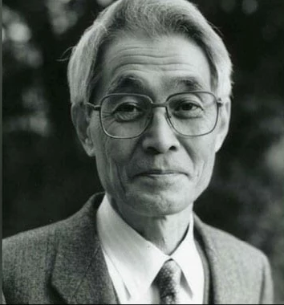
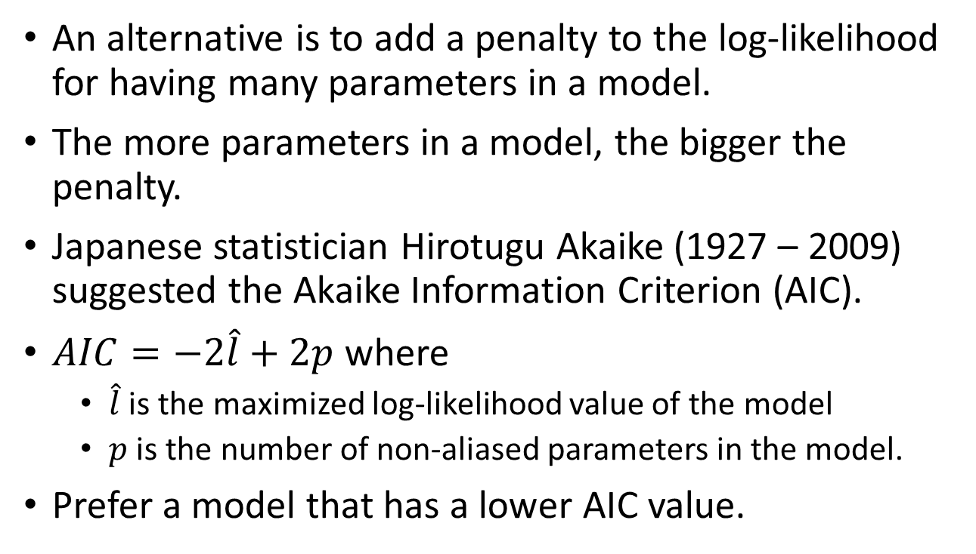
Akaike Information Criterion
An alternative is to add a penalty to the log-likelihood for having many parameters in a model.
The more parameters in a model, the bigger the penalty.
Japanese statistician Hirotugu Akaike (1927 – 2009) suggested the Akaike Information Criterion (AIC).
$AIC=−2\hat{l}+2p$ where
$\hat{l}$ is the maximized log-likelihood value of the model
$p$ is the number of non-aliased parameters in the model.
Prefer a model that has a lower AIC value.

Slide 102
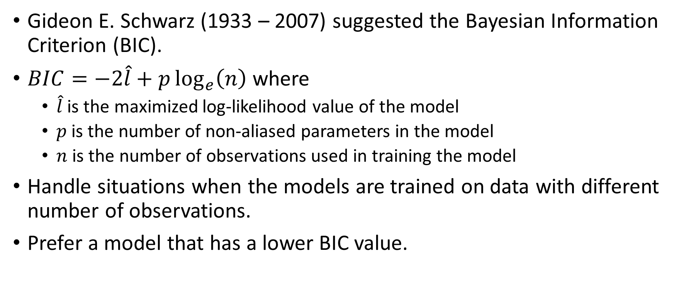
Bayesian Information Criterion
Gideon E. Schwarz (1933 – 2007) suggested the Bayesian Information Criterion (BIC).
$BIC=−2\hat{l}+p\log_{e}\left(n\right)$ where
$\hat{l}$ is the maximized log-likelihood value of the model
$p$ is the number of non-aliased parameters in the model
$n$ is the number of observations used in training the model
Handle situations when the models are trained on data with different number of observations.
Prefer a model that has a lower BIC value.

Slide 103
All Possible Subsets Selection
startTime = time.time()
maxIter = 20
tolS = 1e-7
nComb = len(allComb)
for r in range(nComb):
modelTerm = list(allComb[r])
trainData = cars[[yName] + modelTerm].dropna()
n_sample = trainData.shape[0]
X_train = trainData[[yName]].copy()
X_train.insert(0, 'Intercept', 1.0)
X_train.drop(columns = [yName], inplace = True)
y_train = trainData[yName].copy()
for pred in modelTerm:
if (pred in catName):
X_train = X_train.join(pandas.get_dummies(trainData[pred].
astype('category')))
elif (pred in intName):
X_train = X_train.join(trainData[pred])
resultList = Utility.MNLogisticModel (X_train, y_train, maxIter = maxIter, tolSweep = tolS)
modelLLK = resultList[1]
modelDF = resultList[2]
del resultList
AIC = 2.0 * modelDF - 2.0 * modelLLK
BIC = modelDF * numpy.log(n_sample) - 2.0 * modelLLK
allCombResult = allCombResult.append([[r, modelTerm, len(modelTerm), modelLLK, modelDF, AIC, BIC, n_sample]],
ignore_index = True)
endTime = time.time()
allCombResult = allCombResult.rename(
columns = {0: 'Step', 1: 'Model Term', 2: 'Number of Terms',
3: 'Log-Likelihood', 4: 'Model Degree of Freedom',
5: 'Akaike Information Criterion', 6: 'Bayesian Information Criterion',
7: 'Sample Size'})
elapsedTime = endTime - startTime

Slide 104
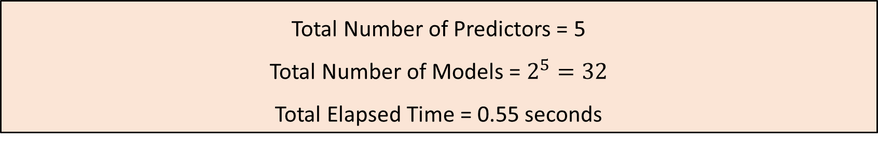
2004 Cars Data: All Possible Subsets
Target Variable: Origin
Nominal Predictors: DriveTrain
Interval Predictors: EngineSize, Horsepower, Length, and Weight
Total Number of Predictors = 5
Total Number of Models = $2^{5}=32$
Total Elapsed Time = 0.55 seconds

Slide 105
The Thirty-Two Possible Subsets
Step | Model Term | Number of Terms | Log-Likelihood | Model Degree of Freedom | Akaike Information Criterion | Bayesian Information Criterion | Sample Size
0 | [] | 0 | -467.9224 | 2 | 939.8449 | 947.9631 | 428
1 | ['DriveTrain'] | 1 | -447.1785 | 6 | 906.3570 | 930.7117 | 428
2 | ['EngineSize'] | 1 | -442.9454 | 4 | 893.8908 | 910.1273 | 428
3 | ['Horsepower'] | 1 | -441.4329 | 4 | 890.8657 | 907.1022 | 428
4 | ['Length'] | 1 | -433.7876 | 4 | 875.5753 | 891.8118 | 428
5 | ['Weight'] | 1 | -451.4704 | 4 | 910.9408 | 927.1773 | 428
6 | ['DriveTrain', 'EngineSize'] | 2 | -414.6593 | 8 | 845.3186 | 877.7915 | 428
7 | ['DriveTrain', 'Horsepower'] | 2 | -432.9187 | 8 | 881.8374 | 914.3104 | 428
8 | ['DriveTrain', 'Length'] | 2 | -409.0631 | 8 | 834.1262 | 866.5992 | 428
9 | ['DriveTrain', 'Weight'] | 2 | -426.7579 | 8 | 869.5158 | 901.9888 | 428
10 | ['EngineSize', 'Horsepower'] | 2 | -364.1252 | 6 | 740.2504 | 764.6051 | 428
11 | ['EngineSize', 'Length'] | 2 | -421.6898 | 6 | 855.3796 | 879.7344 | 428
12 | ['EngineSize', 'Weight'] | 2 | -438.7476 | 6 | 889.4952 | 913.8499 | 428
13 | ['Horsepower', 'Length'] | 2 | -392.8172 | 6 | 797.6345 | 821.9892 | 428
14 | ['Horsepower', 'Weight'] | 2 | -428.3282 | 6 | 868.6564 | 893.0111 | 428
15 | ['Length', 'Weight'] | 2 | -410.8899 | 6 | 833.7797 | 858.1345 | 428

Slide 106
The Thirty-Two Possible Subsets
Step | Model Term | Number of Terms | Log-Likelihood | Model Degree of Freedom | Akaike Information Criterion | Bayesian Information Criterion | Sample Size
16 | ['DriveTrain', 'EngineSize', 'Horsepower'] | 3 | -345.7487 | 10 | 711.4973 | 752.0886 | 428
17 | ['DriveTrain', 'EngineSize', 'Length'] | 3 | -401.3614 | 10 | 822.7227 | 863.3139 | 428
18 | ['DriveTrain', 'EngineSize', 'Weight'] | 3 | -410.2127 | 10 | 840.4254 | 881.0167 | 428
19 | ['DriveTrain', 'Horsepower', 'Length'] | 3 | -386.5124 | 10 | 793.0248 | 833.6161 | 428
20 | ['DriveTrain', 'Horsepower', 'Weight'] | 3 | -409.6143 | 10 | 839.2287 | 879.8199 | 428
21 | ['DriveTrain', 'Length', 'Weight'] | 3 | -396.1302 | 10 | 812.2604 | 852.8516 | 428
22 | ['EngineSize', 'Horsepower', 'Length'] | 3 | -354.6814 | 8 | 725.3628 | 757.8358 | 428
23 | ['EngineSize', 'Horsepower', 'Weight'] | 3 | -357.6633 | 8 | 731.3266 | 763.7996 | 428
24 | ['EngineSize', 'Length', 'Weight'] | 3 | -403.4723 | 8 | 822.9446 | 855.4176 | 428
25 | ['Horsepower', 'Length', 'Weight'] | 3 | -389.5328 | 8 | 795.0656 | 827.5385 | 428
26 | ['DriveTrain', 'EngineSize', 'Horsepower', 'Length'] | 4 | -339.3295 | 12 | 702.6589 | 751.3684 | 428
27 | ['DriveTrain', 'EngineSize', 'Horsepower', 'Weight'] | 4 | -341.9740 | 12 | 707.9480 | 756.6574 | 428
28 | ['DriveTrain', 'EngineSize', 'Length', 'Weight'] | 4 | -384.8286 | 12 | 793.6572 | 842.3667 | 428
29 | ['DriveTrain', 'Horsepower', 'Length', 'Weight'] | 4 | -382.1252 | 12 | 788.2504 | 836.9599 | 428
30 | ['EngineSize', 'Horsepower', 'Length', 'Weight'] | 4 | -336.1841 | 10 | 692.3681 | 732.9594 | 428
31 | ['DriveTrain', 'EngineSize', 'Horsepower', 'Length', 'Weight'] | 5 | -327.6755 | 14 | 683.3510 | 740.1787 | 428

Slide 107
Model Training Summary
Criterion | Highest Log-Likelihood | Lowest AIC | Lowest BIC
Model Term | ['DriveTrain', 'EngineSize', 'Horsepower', 'Length', 'Weight'] | ['DriveTrain', 'EngineSize', 'Horsepower', 'Length', 'Weight'] | ['EngineSize', 'Horsepower', 'Length', 'Weight']
Number of Terms | 5 | 5 | 4
Log-Likelihood | -327.6755 | -327.6755 | -336.1841
Model Degree of Freedom | 14 | 14 | 10
Akaike Information Criterion | 683.3510 | 683.3510 | 692.3681
Bayesian Information Criterion | 740.1787 | 740.1787 | 732.9594
Sample Size | 428 | 428 | 428

Slide 108
Lecture Recap
Introduced multinomial logistic regression algorithm ✓
Estimated using maximum likelihood method ✓
Trained a model using Python statsmodels ✓
Forward, Backward, All-Possible Model Selection ✓

Slide 109
Week 6 Quiz Questions
A school cafeteria conducted a survey about 137 student’s preferences on having cheese on their lunch. The cafeteria served two types of lunch, namely, ham sandwich and beef burger. The preferences are Less, Same, and More. The data is available in GotCheese.csv.
You will train a logistic regression using the first 100 observations (i.e., indices from 0 to 99). Then, you will score your model on the remaining 37 observations (i.e., indices from 100 to 136).
The Label variable is Preference. The categorical predictors are Lunch and HasCheese. The model specification is Intercept + Lunch + HasCheese.
Q1. What is the log-likelihood value of the model? Please round your answer up to the fifth decimal place.
Q2. What is misclassification rate (in percent) when you applied the model to the remaining 37 observations? Please round your answer up to the second decimal place.

Slide 110
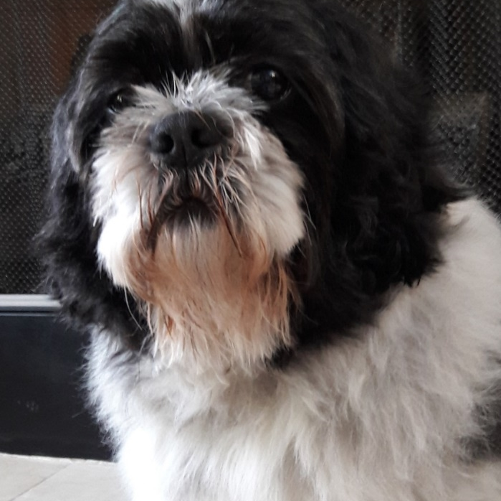
Assignment 3 Reminder
Due at 11:59 PM on October 11, 2022
Submit your answers as a PDF file
Submit your Python codes, otherwise liable for 50% deduction
Maximum two attempts before due
Only grade the most recently submitted answers

