Slide 1
CS 484
Introduction to Machine Learning
Week 2, August 29, 2022
Autumn Semester 2022

Slide 2
Week 2: Nearest Neighbors
Overview Memory-Based Learner
Choose Applicable Distance Metric
Determine Optimal Number of Neighbors
Chapter 2 of the Machine Learning book

Slide 3
Memory-Based Learning (MBL) in Law
Legal Precedents:
Precedent refers to a court decision that is considered as authority for deciding subsequent cases involving identical or similar facts, or similar legal issues.
Precedent ensures that individuals in similar situations are treated by judges alike instead of based on a particular judge’s personal views.
Precedent is generally established by a series of decisions. Sometimes, a single decision can create precedent.

Slide 4
Memory-Based Learning (MBL) in Law
Stare decisis (pronunciation: stehr duh·sai·suhs)
Stare means stand by and decisis means decision. So, stare decisis means to stand by decision or let the decision stand.
Stare decisis is a legal doctrine that obligates courts to follow historical cases when making a ruling on a similar case.
Stare decisis ensures that cases with similar scenarios and facts are approached in the same way. Simply put, it binds courts to follow legal precedents set by previous decisions.

Slide 5
Memory-Based Learning (MBL)
You encounter a problem
You remembered a few times you solved similar problems before
You decide to apply the previous solutions to the current problem
If the solution does solve the current problem, you remember it
A memorization technique based on similarity
Use a definition of similarity
Find a fixed number of similar situations
Sum up the outcomes of these similar situation
The summary of the outcomes is the decision

Slide 6
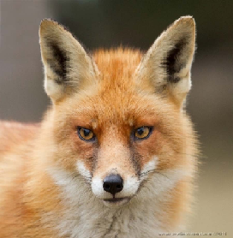

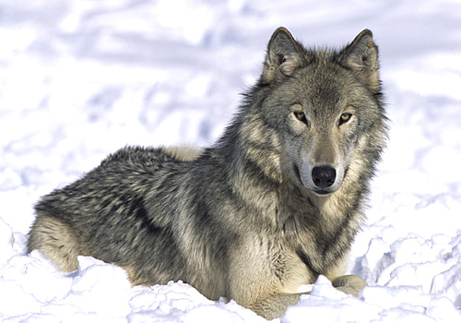
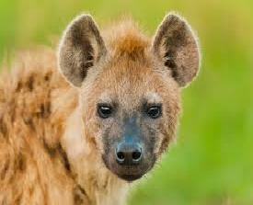
Basic Idea of the Nearest Neighbors Algorithm
If a creature walks like a dog, looks like a dog, sits like a dog, and eats like a dog then it is probably a dog.
Well, it may not bark and be obedient as a dog.
Fox
Dog
Wolf
Hyena

Slide 7
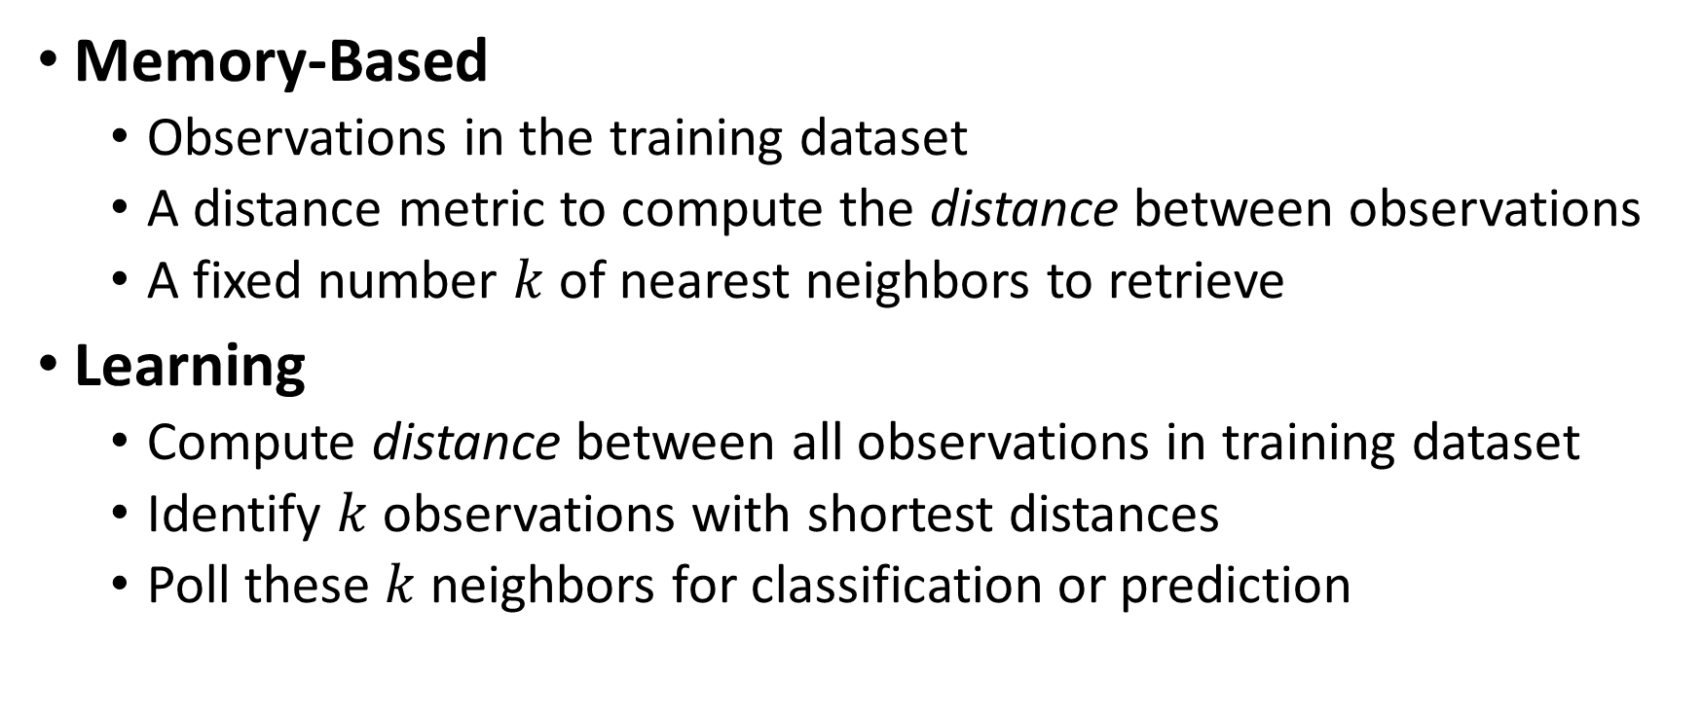
k-Nearest Neighbors (kNN) Algorithm
Memory-Based
Observations in the training dataset
A distance metric to compute the distance between observations
A fixed number $k$ of nearest neighbors to retrieve
Learning
Compute distance between all observations in training dataset
Identify $k$ observations with shortest distances
Poll these $k$ neighbors for classification or prediction

Slide 8
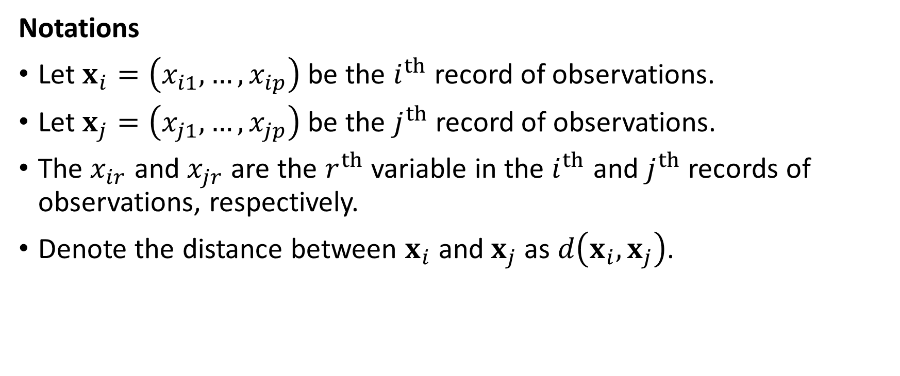
Distance Metric
Notations
Let $x_{i}=\left(x_{i1},…,x_{ip}\right)$ be the $i^{th}$ record of observations.
Let $x_{j}=\left(x_{j1},…,x_{jp}\right)$ be the $j^{th}$record of observations.
The $x_{ir}$ and $x_{jr}$ are the $r^{th}$ variable in the $i^{th}$ and $j^{th}$records of observations, respectively.
Denote the distance between $x_{i}$ and $x_{j}$ as $d\left(x_{i},x_{j}\right)$.

Slide 9
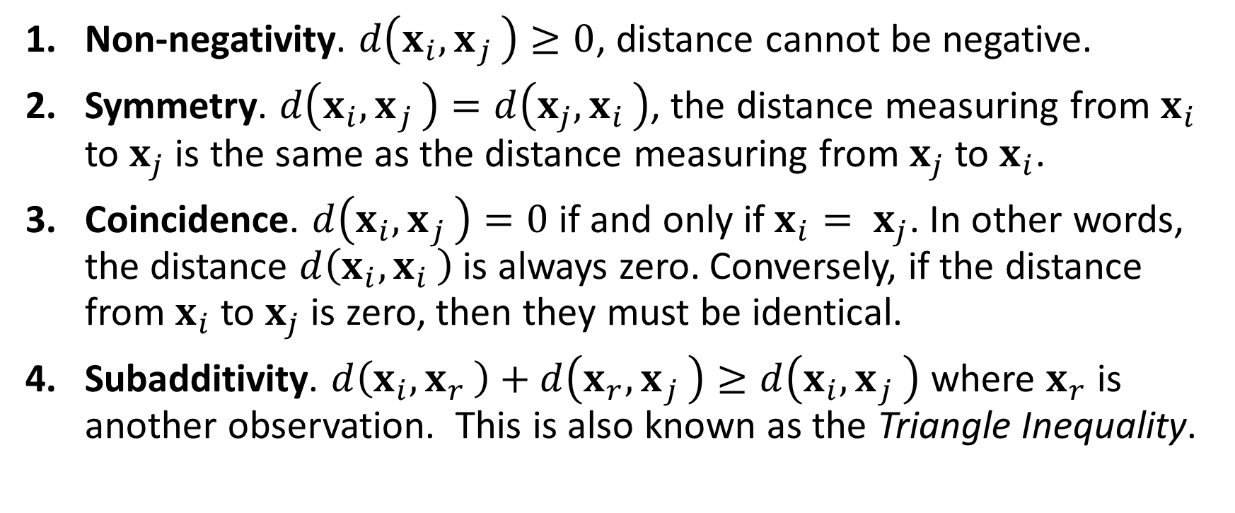
Four Requirements for Distance Metric
Non-negativity. $d\left(x_{i}{, x}_{j}\right)≥0$, distance cannot be negative.
Symmetry. $d\left(x_{i}{, x}_{j}\right)=d\left(x_{j}{, x}_{i}\right)$, the distance measuring from $x_{i}$ to $x_{j}$ is the same as the distance measuring from $x_{j}$ to $x_{i}$.
Coincidence. $d\left(x_{i}{, x}_{j}\right)=0$ if and only if $x_{i}{= x}_{j}$. In other words, the distance $d\left(x_{i}{, x}_{i}\right)$ is always zero. Conversely, if the distance from $x_{i}$ to $x_{j}$ is zero, then they must be identical.
Subadditivity. $d\left(x_{i}{, x}_{r}\right)+d\left(x_{r}{, x}_{j}\right)≥d\left(x_{i}{, x}_{j}\right)$ where $x_{r}$ is another observation. This is also known as the Triangle Inequality.

Slide 10
Common Distance Metrics
Euclidean
Manhattan
Chebyshev
Cosine

Slide 11

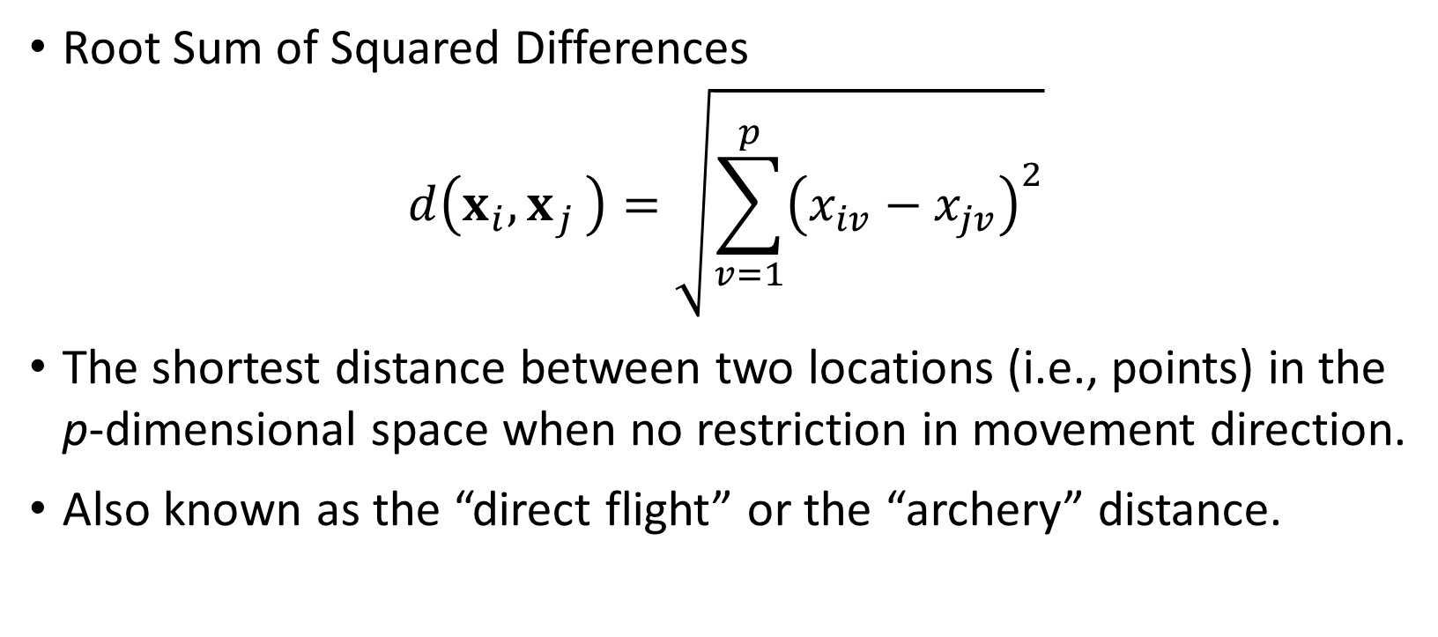
Euclidean Distance
Root Sum of Squared Differences
$$d\left(x_{i}{, x}_{j}\right)=\sqrt{\sum_{v=1}^{p}{{\left(x_{iv}−x_{jv}\right)}^{2}}}$$
The shortest distance between two locations (i.e., points) in the p-dimensional space when no restriction in movement direction.
Also known as the “direct flight” or the “archery” distance.

Slide 12
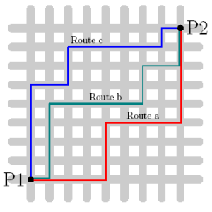
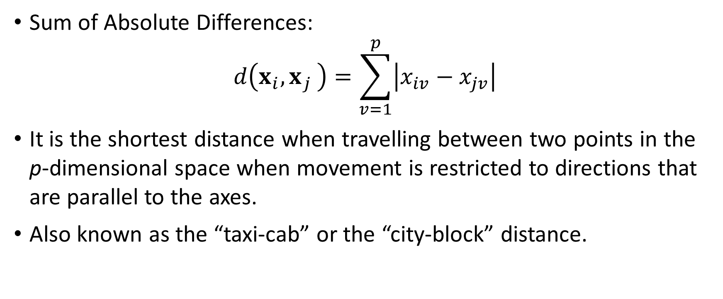
Manhattan Distance
Sum of Absolute Differences:
$$d\left(x_{i}{, x}_{j}\right)=\sum_{v=1}^{p}{\left|x_{iv}−x_{jv}\right|}$$
It is the shortest distance when travelling between two points in the p-dimensional space when movement is restricted to directions that are parallel to the axes.
Also known as the “taxi-cab” or the “city-block” distance.

Slide 13
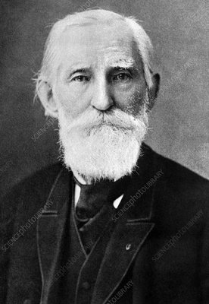
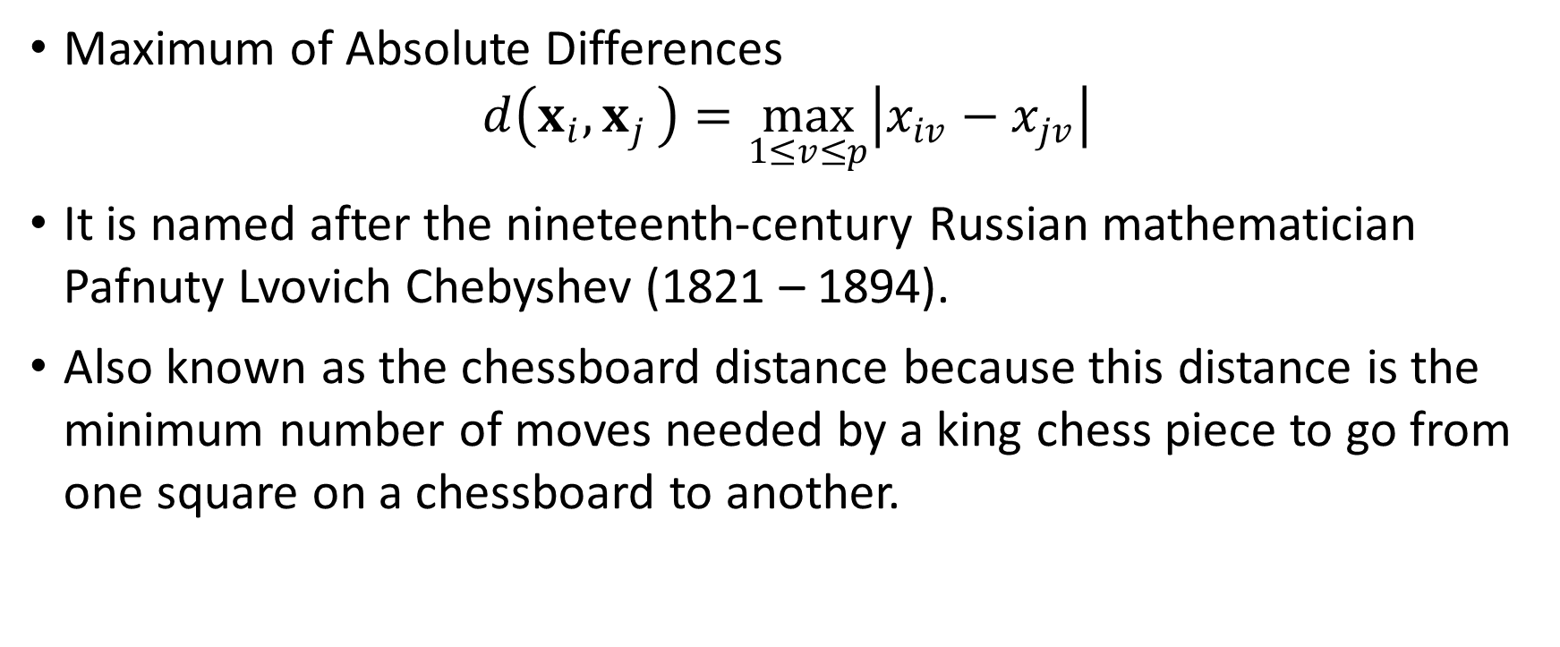
Chebyshev Distance
Maximum of Absolute Differences
$$d\left(x_{i}{, x}_{j}\right)=\max_{1≤v≤p}\left|x_{iv}−x_{jv}\right|$$
It is named after the nineteenth-century Russian mathematician Pafnuty Lvovich Chebyshev (1821 – 1894).
Also known as the chessboard distance because this distance is the minimum number of moves needed by a king chess piece to go from one square on a chessboard to another.

Slide 14
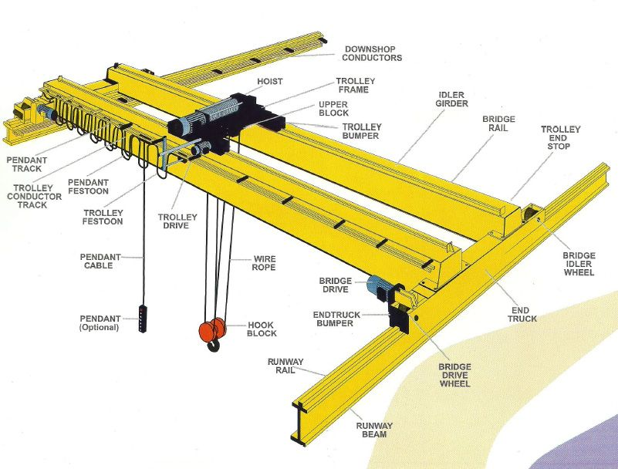
Usage of Chebyshev Distance
Suppose the crane moves at the same speed on both rails.
What is the time to move an item from one location to another location?
The time is determined only by the longest distance moved on either rails.

Slide 15
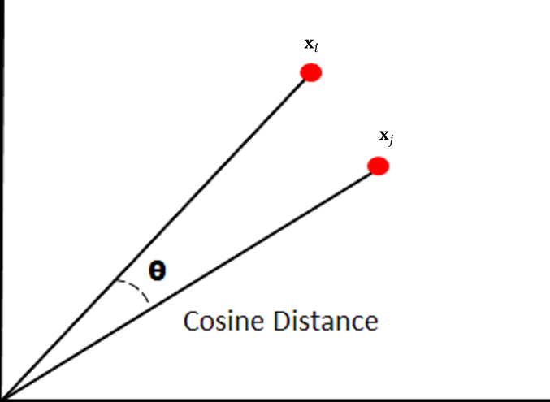
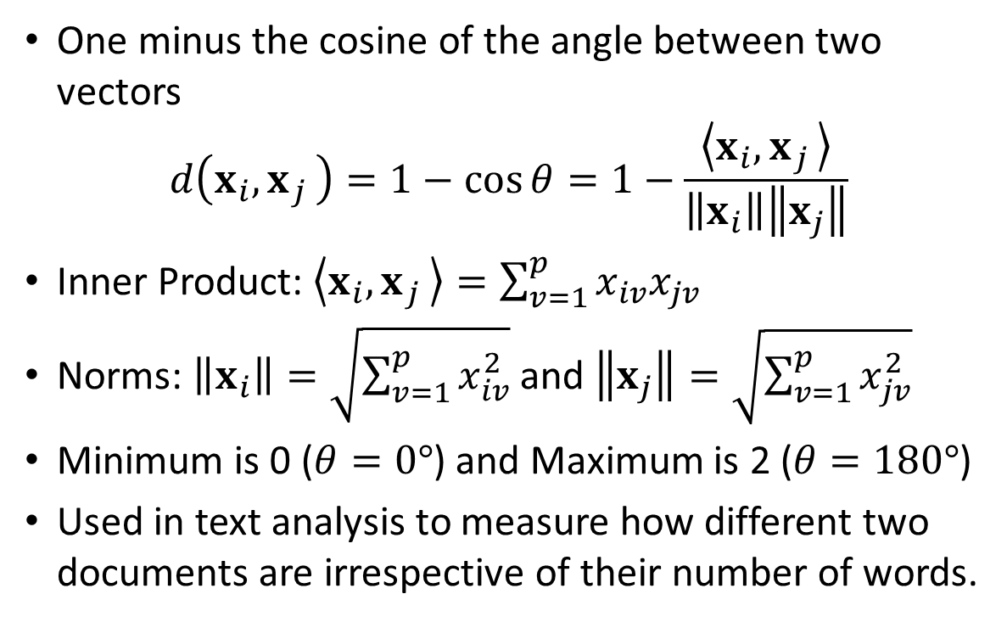
Cosine Distance
One minus the cosine of the angle between two vectors
$$d\left(x_{i}{, x}_{j}\right)=1−cos{θ}=1−\frac{\left\langle x_{i}{, x}_{j}\right\rangle }{\left\|x_{i}\right\|\left\|x_{j}\right\|}$$
Inner Product: $\left\langle x_{i}{, x}_{j}\right\rangle =\sum_{v=1}^{p}{x_{iv}x_{jv}}$
Norms: $\left\|x_{i}\right\|=\sqrt{\sum_{v=1}^{p}{x_{iv}^{2}}}$ and $\left\|x_{j}\right\|=\sqrt{\sum_{v=1}^{p}{x_{jv}^{2}}}$
Minimum is 0 ($θ=0°$) and Maximum is 2 ($θ=180°$)
Used in text analysis to measure how different two documents are irrespective of their number of words.

Slide 16
Usage Scenario of Cosine Distance
Determine if the document contains the name of a Chinese city
 | ID | Words in Document | City in China?
Data | 1 | Chinese Beijing Chinese | Yes
 | 2 | Chinese Chinese Shanghai | Yes
 | 3 | Chinese Macao | Yes
 | 4 | Tokyo Japan Chinese | No
Probe | 5 | Chinese Chinese Chinese Tokyo Japan | ?
 | 6 | Beijing Shanghai Macao | ?

Slide 17
Cosine Distance
Create Word Count Array. There are six unique words: (1) Chinese, (2) Beijing, (3) Shanghai, (4) Macao, (5) Tokyo, and (6) Japan.
Data:
Probe:
ID | Chinese | Beijing | Shanghai | Macao | Tokyo | Japan
1 | 2 | 1 | 0 | 0 | 0 | 0
2 | 2 | 0 | 1 | 0 | 0 | 0
3 | 1 | 0 | 0 | 1 | 0 | 0
4 | 1 | 0 | 0 | 0 | 1 | 1
ID | Chinese | Beijing | Shanghai | Macao | Tokyo | Japan
5 | 3 | 0 | 0 | 0 | 1 | 1
6 | 0 | 1 | 1 | 1 | 0 | 0

Slide 18
Calculate Distances
import numpy
def CosineD (x, y):
normX = numpy.sqrt(numpy.dot(x, x))
normY = numpy.sqrt(numpy.dot(y, y))
if (normX > 0.0 and normY > 0.0):
outDistance = 1.0 - numpy.dot(x, y) / normX / normY
else:
outDistance = numpy.NaN
return (outDistance)
X = numpy.array([[2,1,0,0,0,0],
[2,0,1,0,0,0],
[1,0,0,1,0,0],
[1,0,0,0,1,1]])
P = numpy.array([[3,0,0,0,1,1],
[0,1,1,1,0,0]])
cosine_D = numpy.zeros((4,2))
for i in range(4):
for j in range(2):
cosine_D[i,j] = CosineD(X[i,:], P[j,:])
cosine_D
 | Probe
Data | 5 | 6
1 | 0.19 | 0.74
2 | 0.19 | 0.74
3 | 0.36 | 0.59
4 | 0.13 | 1.00
Probe ID #5 is closest to Data ID #4.
Probe ID #6 is closest to Data ID #3.

Slide 19
Closest Neighbor According to Cosine Distance
Probe ID #5 is closest to Data ID #4.
Probe ID #6 is closest to Data ID #3
 | ID | Words in Document | City in China?
Data | 1 | Chinese Beijing Chinese | Yes
 | 2 | Chinese Chinese Shanghai | Yes
 | 3 | Chinese Macao | Yes
 | 4 | Tokyo Japan Chinese | No
Probe | 5 | Chinese Chinese Chinese Tokyo Japan | ?
 | 6 | Beijing Shanghai Macao | ?

Slide 20
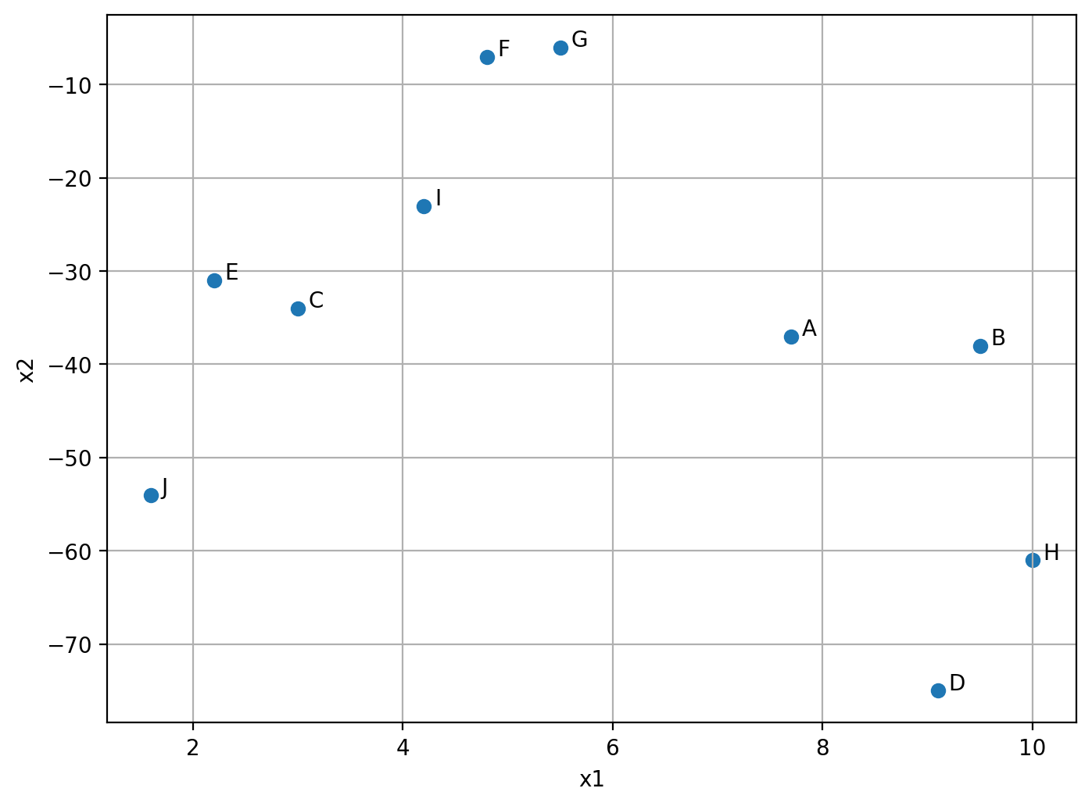
Toy Example
CaseID | x1 | x2 | y
A | 7.7 | -37 | 4
B | 9.5 | -38 | 1
C | 3 | -34 | 2
D | 9.1 | -75 | 1
E | 2.2 | -31 | 2
F | 4.8 | -7 | 4
G | 5.5 | -6 | 3
H | 10 | -61 | 1
I | 4.2 | -23 | 2
J | 1.6 | -54 | 1

Slide 21
Toy Example
Week 2 Sample Nearest Neighbor.py
import matplotlib.pyplot as plt
import numpy
import pandas
toyData = pandas.DataFrame([[7.7, -37, 4], [9.5, -38, 1], [3, -34, 2], [9.1, -75, 1],
[2.2, -31, 2], [4.8, -7, 4], [5.5, -6, 3], [10, -61, 1],
[4.2, -23, 2], [1.6, -54, 1]],
index = ['A','B','C','D','E','F','G','H','I','J'],
columns = ['x1','x2','y'])
# Visualize the relative positions of the points (x1,x2)
plt.figure(figsize = (8,6), dpi = 200)
plt.scatter(toyData['x1'], toyData['x2'], marker = 'o')
for index, row in toyData.iterrows():
plt.annotate(index, (row['x1']+0.1, row['x2']+0.1))
plt.xlabel('x1')
plt.ylabel('x2')
plt.grid(axis = 'both')
plt.show()

Slide 22

Toy Example
CaseID | x1 | x2 | y
A | 7.7 | -37 | 4
B | 9.5 | -38 | 1
C | 3 | -34 | 2
D | 9.1 | -75 | 1
E | 2.2 | -31 | 2
F | 4.8 | -7 | 4
G | 5.5 | -6 | 3
H | 10 | -61 | 1
I | 4.2 | -23 | 2
J | 1.6 | -54 | 1
Two input variables: x1 and x2
One target: y
Ten observations
Euclidean distance between first two cases:
SQRT((7.7 – 9.5)² + ((-37) – (-38))²) = SQRT(4.24) = 2.0591 (up to 4 decimal places)
SQRT(x) = $\sqrt{x}$

Slide 23
Toy Example
Week 2 Sample Nearest Neighborhood.py
rank_vector = lambda vec: list(map(lambda i: sorted(vec).index(i)+1, vec))
def dist_2_data (probe, df):
out_list = []
for index, row in df.iterrows():
euclidean = numpy.sqrt(numpy.sum(numpy.power((row - probe), 2)))
out_list.append(euclidean)
out_distance = pandas.DataFrame([out_list], columns = df.index)
out_rank = pandas.DataFrame([rank_vector(out_list)], columns = df.index)
return(out_distance, out_rank)

Slide 24
Toy Example
Week 2 Sample Nearest Neighbor.py
def pair_euclidean (df):
out_distance = pandas.DataFrame()
out_rank = pandas.DataFrame()
for index, row in df.iterrows():
row_distance, row_rank = dist_2_data(row, df)
out_distance = pandas.concat([out_distance, row_distance], axis = 0, ignore_index = True)
out_rank = pandas.concat([out_rank, row_rank], axis = 0, ignore_index = True)
out_distance = out_distance.set_index(df.index)
out_rank = out_rank.set_index(df.index)
return(out_distance, out_rank)
# Train the Nearest Neighbor using Euclidean distance
pairwise_euclidean, row_rank = pair_euclidean(toyData[['x1','x2']])

Slide 25
Toy Example
Do You See the Matrix Symmetry?
Euclidean Distance Matrix:
 | CaseID
CaseID | A | B | C | D | E | F | G | H | I | J
A | 0 | 2.0591 | 5.5758 | 38.0258 | 8.1394 | 30.1398 | 31.0780 | 24.1100 | 14.4309 | 18.0613
B | 2.0591 | 0 | 7.6322 | 37.0022 | 10.1139 | 31.3543 | 32.2490 | 23.0054 | 15.9088 | 17.8440
C | 5.5758 | 7.6322 | 0 | 41.4513 | 3.1048 | 27.0599 | 28.1114 | 27.8927 | 11.0653 | 20.0489
D | 38.0258 | 37.0022 | 41.4513 | 0 | 44.5377 | 68.1358 | 69.0938 | 14.0289 | 52.2304 | 22.2991
E | 8.1394 | 10.1139 | 3.1048 | 44.5377 | 0 | 24.1404 | 25.2169 | 30.9974 | 8.2462 | 23.0078
F | 30.1398 | 31.3543 | 27.0599 | 68.1358 | 24.1404 | 0 | 1.2207 | 54.2498 | 16.0112 | 47.1088
G | 31.0780 | 32.2490 | 28.1114 | 69.0938 | 25.2169 | 1.2207 | 0 | 55.1838 | 17.0496 | 48.1582
H | 24.1100 | 23.0054 | 27.8927 | 14.0289 | 30.9974 | 54.2498 | 55.1838 | 0 | 38.4401 | 10.9343
I | 14.4309 | 15.9088 | 11.0653 | 52.2304 | 8.2462 | 16.0112 | 17.0496 | 38.4401 | 0 | 31.1088
J | 18.0613 | 17.8440 | 20.0489 | 22.2991 | 23.0078 | 47.1088 | 48.1582 | 10.9343 | 31.1088 | 0

Slide 26
Toy Example
Rank the Euclidean distances:
1 = the most-nearest neighbor which is usually yourself
10 = the least-nearest (i.e., most distant) neighbor
 | CaseID
CaseID | A | B | C | D | E | F | G | H | I | J
A | 0 | 2.0591 | 5.5758 | 38.0258 | 8.1394 | 30.1398 | 31.0780 | 24.1100 | 14.4309 | 18.0613
Rank | 1 | 2 | 3 | 10 | 4 | 8 | 9 | 7 | 5 | 6

Slide 27
Toy Example
Do You Notice this Matrix Is Not Symmetric?
Rank of Euclidean Distance Matrix:
Always Read Across Columns
 | CaseID
CaseID | A | B | C | D | E | F | G | H | I | J
A | 1 | 2 | 3 | 10 | 4 | 8 | 9 | 7 | 5 | 6
B | 2 | 1 | 3 | 10 | 4 | 8 | 9 | 7 | 5 | 6
C | 3 | 4 | 1 | 10 | 2 | 7 | 9 | 8 | 5 | 6
D | 5 | 4 | 6 | 1 | 7 | 9 | 10 | 2 | 8 | 3
E | 3 | 5 | 2 | 10 | 1 | 7 | 8 | 9 | 4 | 6
F | 6 | 7 | 5 | 10 | 4 | 1 | 2 | 9 | 3 | 8
G | 6 | 7 | 5 | 10 | 4 | 2 | 1 | 9 | 3 | 8
H | 5 | 4 | 6 | 3 | 7 | 9 | 10 | 1 | 8 | 2
I | 4 | 5 | 3 | 10 | 2 | 6 | 7 | 9 | 1 | 8
J | 4 | 3 | 5 | 6 | 7 | 9 | 10 | 2 | 8 | 1

Slide 28
Toy Example
Week 2 Sample Nearest Neighbor.py
def find_neighbor (row_rank, n_neighbor):
row_columns = row_rank.columns
row_neighbor = []
for index, row in row_rank.iterrows():
row_neighbor.append([row_columns[row == (i+1)][0] for i in range(n_neighbor)])
out_neighbor = pandas.DataFrame(row_neighbor).set_index(row_rank.index)
return(out_neighbor)
def find_neighbor_response (row_neighbor, response):
row_response = []
for index, row in row_neighbor.iterrows():
row_response.append(response.loc[row].values)
out_neighbor_response = pandas.DataFrame(row_response).set_index(row_neighbor.index)
return(out_neighbor_response)

Slide 29
Toy Example
Week 2 Sample Nearest Neighbor.py
def find_neighbor_distance (pairwise_distance, row_neighbor):
row_neighbor_distance = []
for index, row in pairwise_distance.iterrows():
row_neighbor_distance.append(list(row[row_neighbor.loc[index]]))
out_neighbor_distance = pandas.DataFrame(row_neighbor_distance).set_index(pairwise_distance.index)
return(out_neighbor_distance)

Slide 30
Toy Example
Week 2 Sample Nearest Neighbor.py
# Specifiy the number of neighbors
n_neighbor = 5
# Find the neighbors for each row
row_neighbor = find_neighbor(row_rank, n_neighbor)
# Find distances from each row to its neighbors
row_neighbor_distance = find_neighbor_distance(pairwise_euclidean, row_neighbor)
# Find the neighbors' responses for each row
row_neighbor_response = find_neighbor_response(row_neighbor, toyData['y'])
# Calculate the mean of the neighbors' response
mean_response = row_neighbor_response.mean(axis = 1)

Slide 31
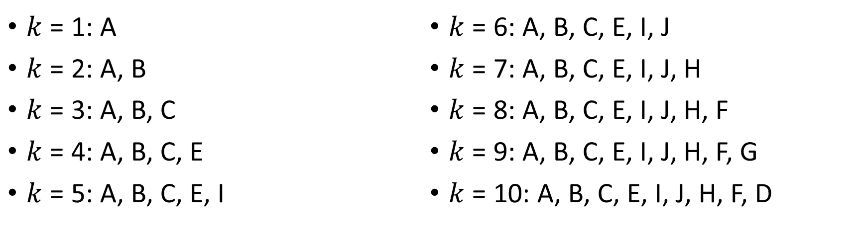
Toy Example: Find neighbors of CaseID = A
$k$ = 1: A
$k$ = 2: A, B
$k$ = 3: A, B, C
$k$ = 4: A, B, C, E
$k$ = 5: A, B, C, E, I
$k$ = 6: A, B, C, E, I, J
$k$ = 7: A, B, C, E, I, J, H
$k$ = 8: A, B, C, E, I, J, H, F
$k$ = 9: A, B, C, E, I, J, H, F, G
$k$ = 10: A, B, C, E, I, J, H, F, D
 | CaseID
CaseID | A | B | C | D | E | F | G | H | I | J
A | 0 | 2.0591 | 5.5758 | 38.0258 | 8.1394 | 30.1398 | 31.0780 | 24.1100 | 14.4309 | 18.0613
Rank | 1 | 2 | 3 | 10 | 4 | 8 | 9 | 7 | 5 | 6

Slide 32
Classification or Prediction
Classification:
Target is categorical
Probabilities of the categories from the neighbors are calculated
The category with the highest probability is the predicted target value
Prediction:
Target is of interval type
Mean or median of the neighbors is the predicted target value

Slide 33
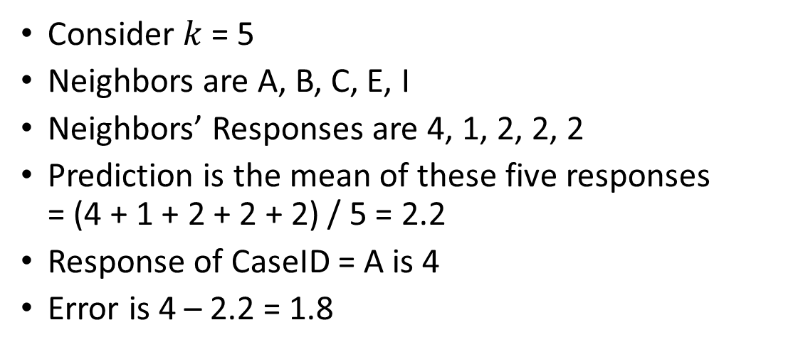
Toy Example: Prediction for CaseID = A
CaseID | x1 | x2 | y
A | 7.7 | -37 | 4
B | 9.5 | -38 | 1
C | 3 | -34 | 2
D | 9.1 | -75 | 1
E | 2.2 | -31 | 2
F | 4.8 | -7 | 4
G | 5.5 | -6 | 3
H | 10 | -61 | 1
I | 4.2 | -23 | 2
J | 1.6 | -54 | 1
Consider $k$ = 5
Neighbors are A, B, C, E, I
Neighbors’ Responses are 4, 1, 2, 2, 2
Prediction is the mean of these five responses = (4 + 1 + 2 + 2 + 2) / 5 = 2.2
Response of CaseID = A is 4
Error is 4 – 2.2 = 1.8
 | CaseID
CaseID | A | B | C | D | E | F | G | H | I | J
A | 0 | 2.0591 | 5.5758 | 38.0258 | 8.1394 | 30.1398 | 31.0780 | 24.1100 | 14.4309 | 18.0613
Rank | 1 | 2 | 3 | 10 | 4 | 8 | 9 | 7 | 5 | 6

Slide 34
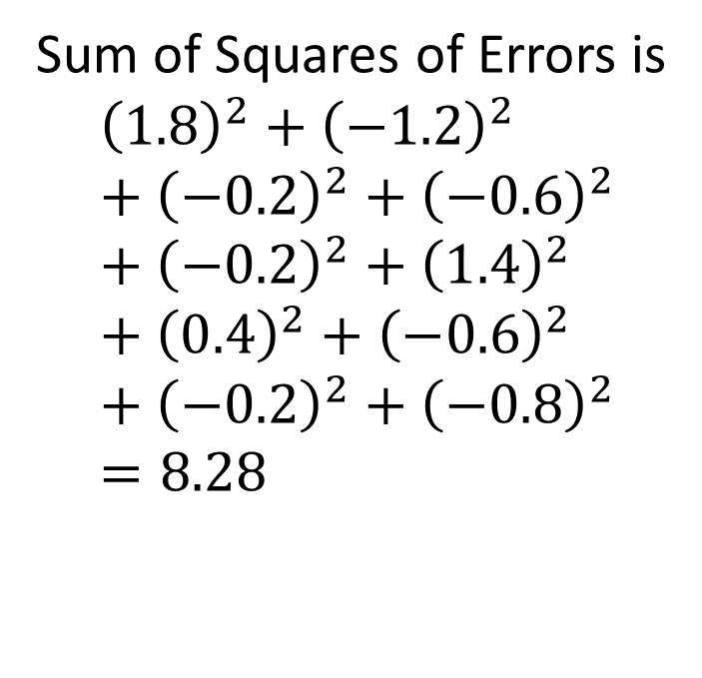
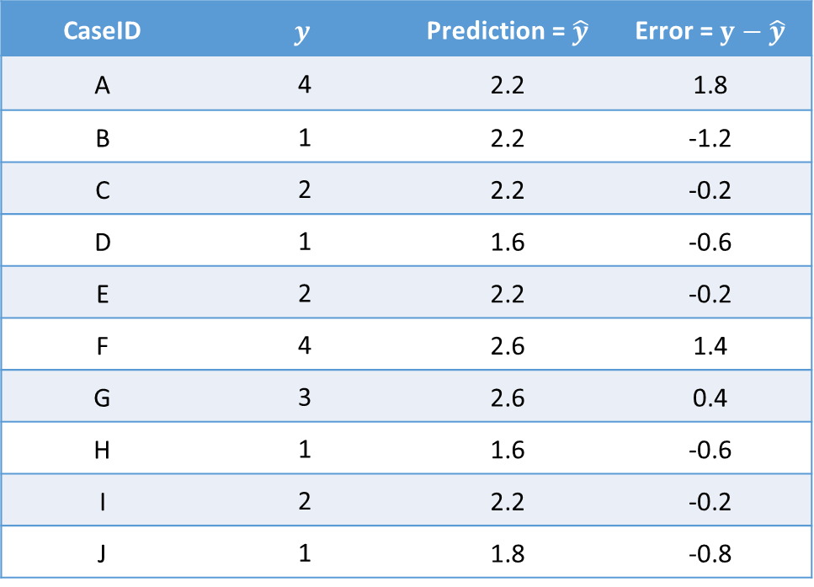

Toy Example: Prediction When $k$ = 5
CaseID | $$y$$ | Prediction = $\hat{y}$ | Error = $y−\hat{y}$
A | 4 | 2.2 | 1.8
B | 1 | 2.2 | -1.2
C | 2 | 2.2 | -0.2
D | 1 | 1.6 | -0.6
E | 2 | 2.2 | -0.2
F | 4 | 2.6 | 1.4
G | 3 | 2.6 | 0.4
H | 1 | 1.6 | -0.6
I | 2 | 2.2 | -0.2
J | 1 | 1.8 | -0.8
Sum of Squares of Errors is
$${\left(1.8\right)}^{2}+{\left(−1.2\right)}^{2}+{\left(−0.2\right)}^{2}+{\left(−0.6\right)}^{2}+{\left(−0.2\right)}^{2}+{\left(1.4\right)}^{2}+{\left(0.4\right)}^{2}+{\left(−0.6\right)}^{2}+{\left(−0.2\right)}^{2}+{\left(−0.8\right)}^{2}=8.28$$

Slide 35
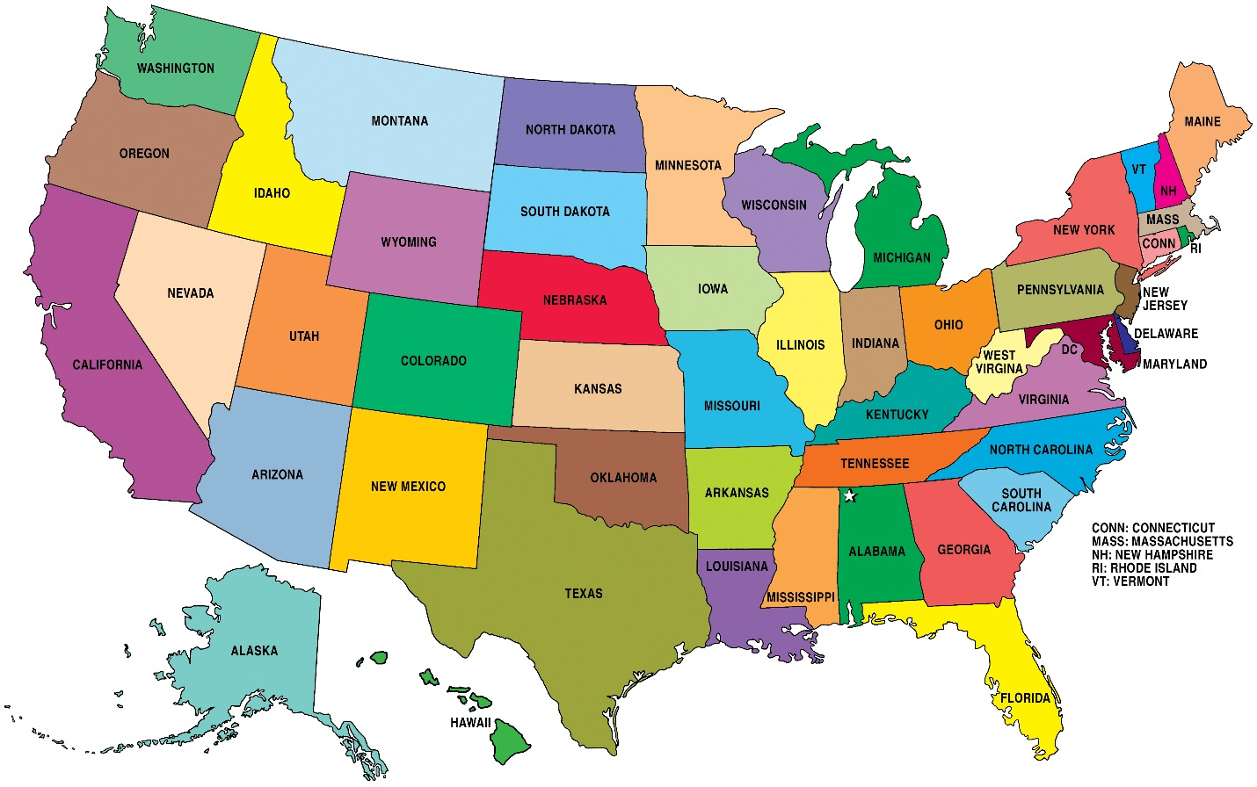
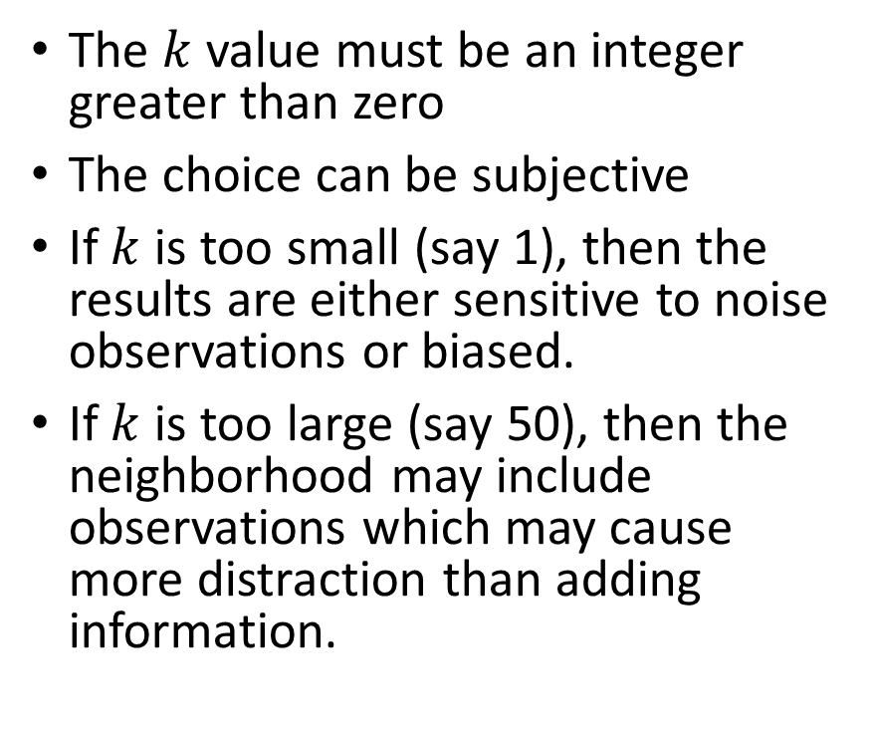
Number of Neighbors
The $k$ value must be an integer greater than zero
The choice can be subjective
If $k$ is too small (say 1), then the results are either sensitive to noise observations or biased.
If $k$ is too large (say 50), then the neighborhood may include observations which may cause more distraction than adding information.

Slide 36
Determine the Number of Neighbors
Supervised: Has Target Variable
Try a different number of neighbors until the classifications (or predictions) are more “consistent” with the observed target value(s)
Unsupervised: No Target Variable
I am not aware of the answer when there is no target variable
Use your best analytical judgment!
Consistency is defined in terms of lower misclassification or prediction error

Slide 37
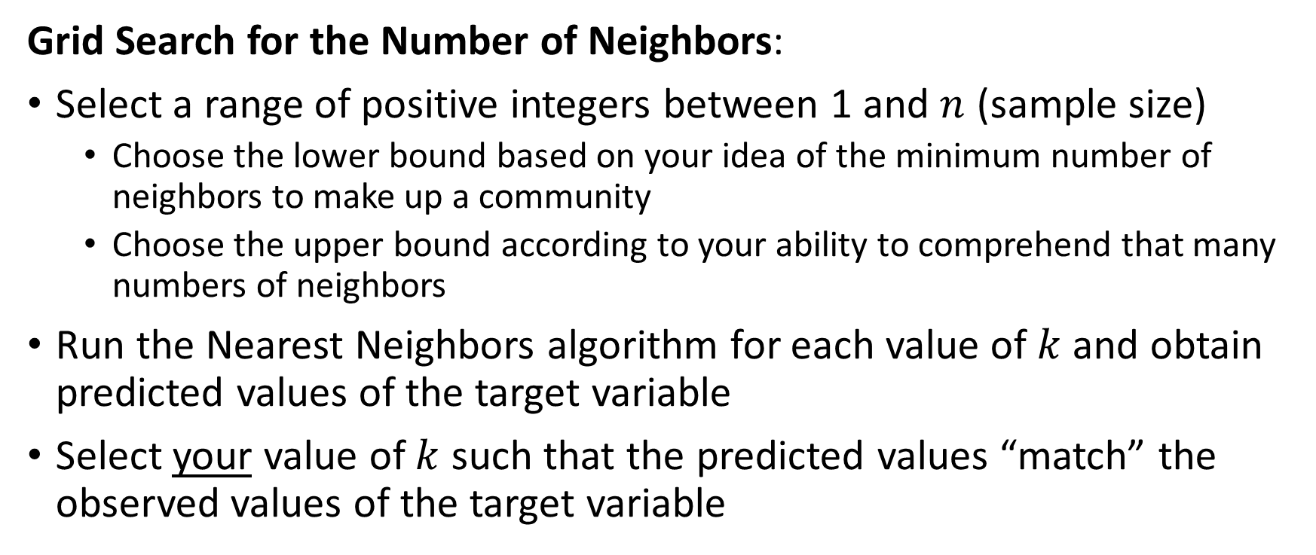
Number of Neighbors
Grid Search for the Number of Neighbors:
Select a range of positive integers between 1 and $n$ (sample size)
Choose the lower bound based on your idea of the minimum number of neighbors to make up a community
Choose the upper bound according to your ability to comprehend that many numbers of neighbors
Run the Nearest Neighbors algorithm for each value of $k$ and obtain predicted values of the target variable
Select your value of $k$ such that the predicted values “match” the observed values of the target variable

Slide 38
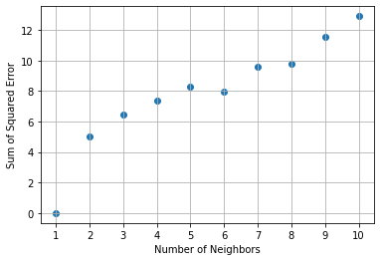

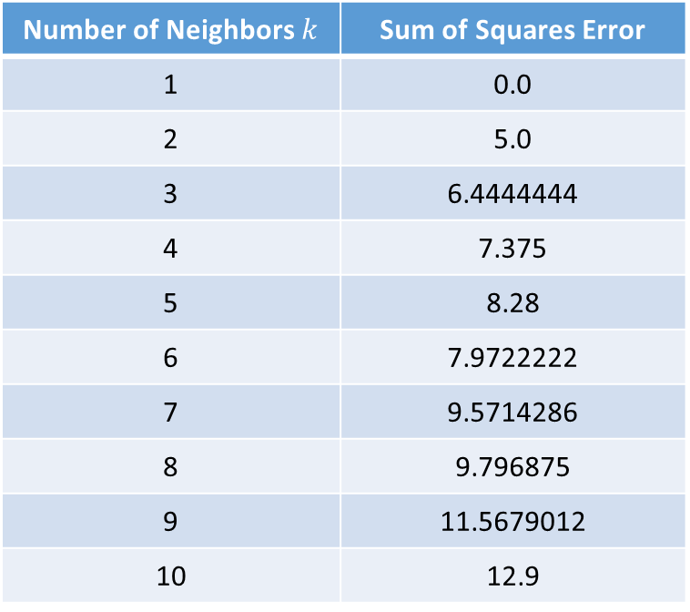

Toy Example: Number of Neighbors ($k$)
Since there are only ten observations, we consider $k =1, 2, …, 10$
Number of Neighbors $k$ | Sum of Squares Error
1 | 0.0
2 | 5.0
3 | 6.4444444
4 | 7.375
5 | 8.28
6 | 7.9722222
7 | 9.5714286
8 | 9.796875
9 | 11.5679012
10 | 12.9

Slide 39

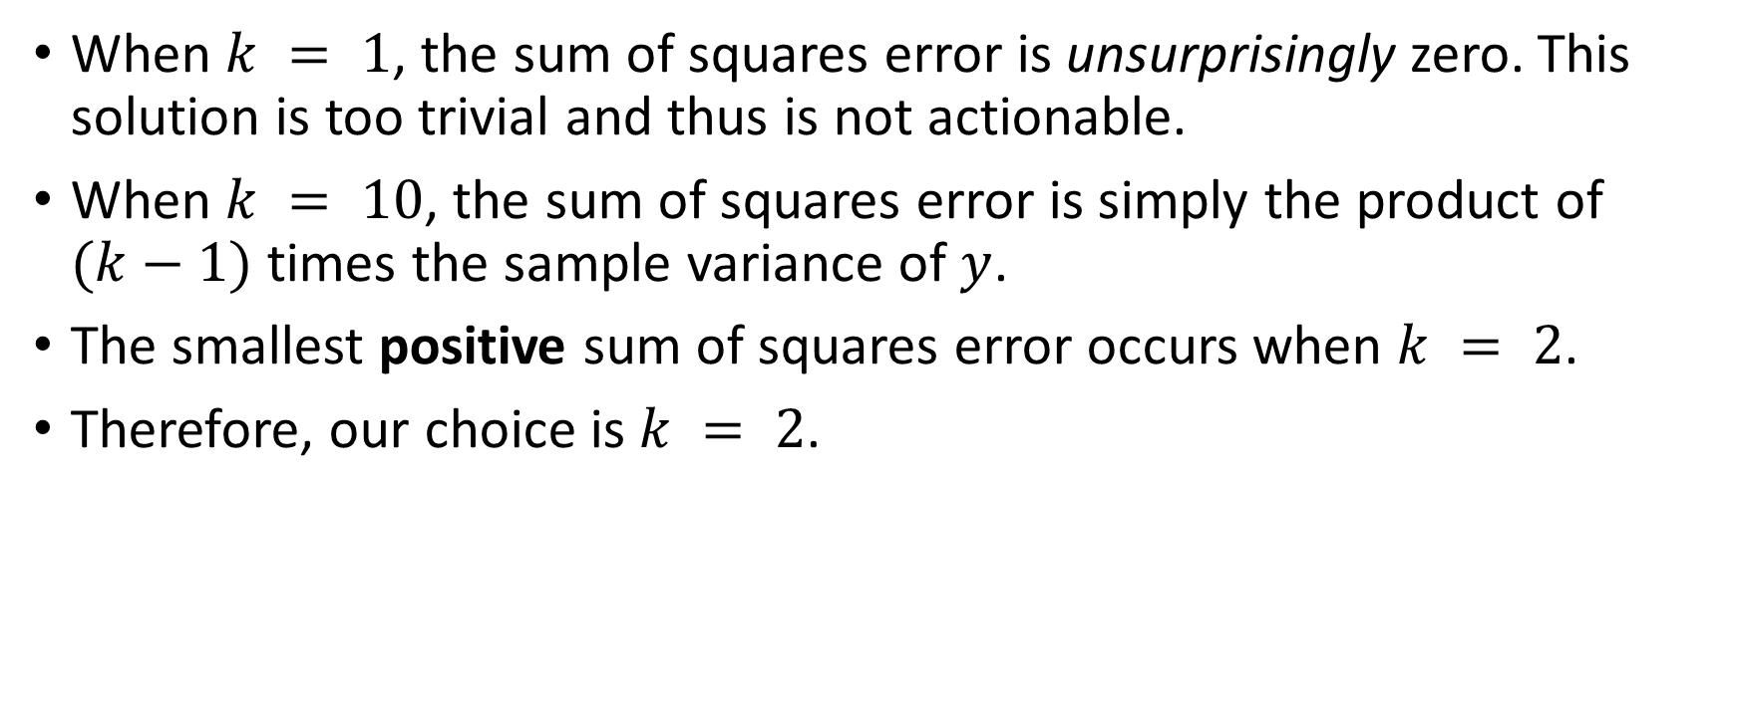
Toy Example: Our Choice for $k$
When $k = 1$, the sum of squares error is unsurprisingly zero. This solution is too trivial and thus is not actionable.
When $k = 10$, the sum of squares error is simply the product of $(k−1)$ times the sample variance of $y$.
The smallest positive sum of squares error occurs when $k = 2$.
Therefore, our choice is $k = 2$.

Slide 40
Toy Example: Sklearn Codes
Week 2 Toy Example Prediction.py
import numpy
import pandas
from sklearn.neighbors import KNeighborsRegressor
toy_example = pandas.read_csv("C:\\IIT\\Machine Learning\\Data\\Week 2 Toy Example.csv", header = 0)
# Specify the data
X = toy_example[['x1', 'x2']]
y = toy_example['y']
# Build nearest neighbors
kNNSpec = KNeighborsRegressor(n_neighbors = 2, metric = 'euclidean')
nbrs = kNNSpec.fit(X, y)
distances, indices = nbrs.kneighbors(X)
# Calculate prediction, errors, and sum of squared error
pred_y = nbrs.predict(X)
error_y = y - pred_y
sse_y = numpy.sum(error_y ** 2)

Slide 41
Categorical Features
Since distance metric works only on interval predictors, we will dummy (or indicator) variables for nominal or ordinal predictors.
Suppose CAT is a nominal predictor with levels: “A”, “B”, and “C”
Dummy (or indicator) variables for CAT are
CAT_A = 1 if CAT = “A”, and 0 otherwise
CAT_B = 1 if CAT = “B”, and 0 otherwise
CAT_C = 1 if CAT = “C”, and 0 otherwise
Warning. Do not create dummy variables for categorical response!

Slide 42
Measurement Units of Features
Example (attributes of a person):
BMI Table: Height may vary from 4 feet 10 inches to 6 feet 4 inches
BMI Table: Weight may vary from 91 pounds to 443 pounds
Annual Income may vary from $20,000 to $500,000
Difference:
10 inches difference in height is very visible
10 pounds difference in weight may worry some but not all the people
10 dollars difference in income won’t make one person richer than the others

Slide 43
Optionally Transform Features
Two reasons to transform the input variables
Avoid highly correlated input variables to contribute unnecessary addition to the distance metric
Avoid input variables that have relatively large absolute values to exert unwanted leverages on the results
Perform principal component analysis to scale or transform input (excluding target) variables into orthonormal components.
Any two orthonormal components have zero correlation
All orthonormal components have the same variance

Slide 44
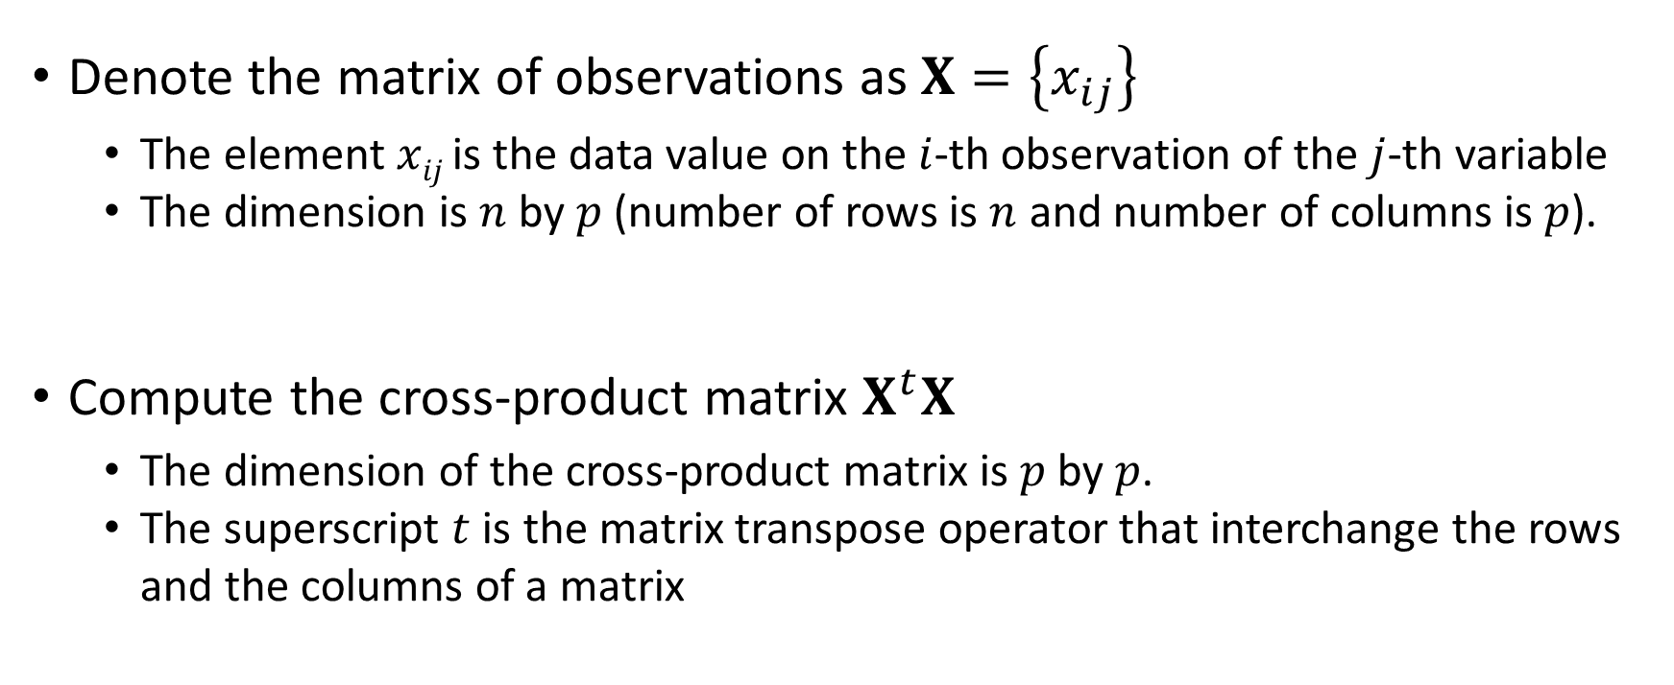
Orthonormal Transformation
Denote the matrix of observations as $X=\left\{x_{ij}\right\}$
The element $xij$ is the data value on the $i$-th observation of the $j$-th variable
The dimension is $n$ by $p$ (number of rows is $n$ and number of columns is $p$).
Compute the cross-product matrix $X^{t}X$
The dimension of the cross-product matrix is $p$ by $p$.
The superscript $t$ is the matrix transpose operator that interchange the rows and the columns of a matrix

Slide 45

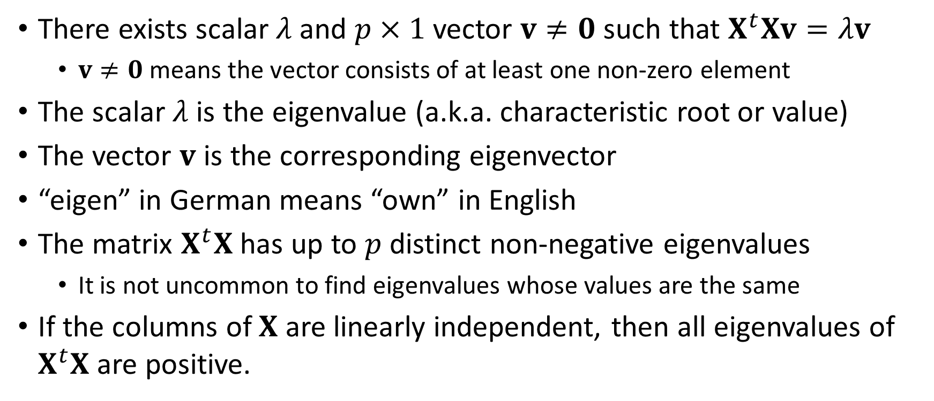
Eigenvalues and Eigenvectors of $X^{t}X$
In Case You Are New To …
There exists scalar $λ$ and $p×1$ vector $v≠0$ such that $X^{t}Xv=λv$
$v≠0$ means the vector consists of at least one non-zero element
The scalar $λ$is the eigenvalue (a.k.a. characteristic root or value)
The vector $v$ is the corresponding eigenvector
“eigen” in German means “own” in English
The matrix $X^{t}X$ has up to $p$ distinct non-negative eigenvalues
It is not uncommon to find eigenvalues whose values are the same
If the columns of $X$ are linearly independent, then all eigenvalues of $X^{t}X$ are positive.

Slide 46
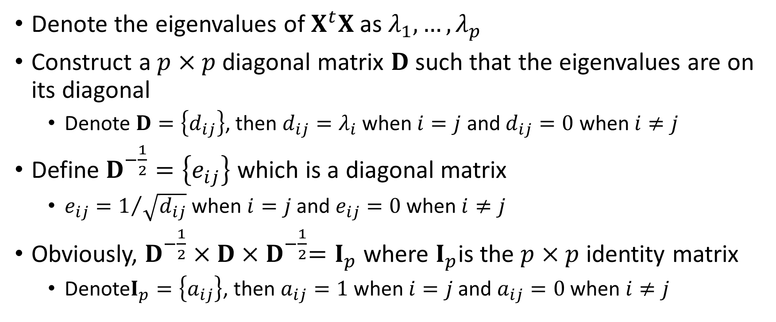
Orthonormal Transformation
Denote the eigenvalues of $X^{t}X$ as $λ_{1},…,λ_{p}$
Construct a $p×p$ diagonal matrix $D$ such that the eigenvalues are on its diagonal
Denote $D=\left\{d_{ij}\right\}$, then $d_{ij}=λ_{i}$ when $i=j$ and $d_{ij}=0$ when $i≠j$
Define $D^{−\frac{1}{2}}=\left\{e_{ij}\right\}$ which is a diagonal matrix
$e_{ij}=1/{\sqrt{d_{ij}}}$ when $i=j$ and $e_{ij}=0$ when $i≠j$
Obviously, $D^{−\frac{1}{2}}×D{×D}^{−\frac{1}{2}}=I_{p}$ where $I_{p}$is the $p×p$ identity matrix
Denote$I_{p}=\left\{a_{ij}\right\}$, then $a_{ij}=1$ when $i=j$ and $a_{ij}=0$ when $i≠j$

Slide 47
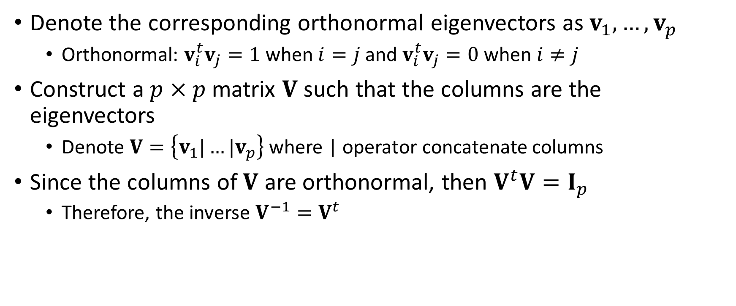
Orthonormal Transformation
Denote the corresponding orthonormal eigenvectors as $v_{1},…,v_{p}$
Orthonormal: $v_{i}^{t}v_{j}=1$ when $i=j$ and $v_{i}^{t}v_{j}=0$ when $i≠j$
Construct a $p×p$ matrix $V$ such that the columns are the eigenvectors
Denote $V=\left\{v_{1}|…|v_{p}\right\}$ where | operator concatenate columns
Since the columns of $V$ are orthonormal, then $V^{t}V=I_{p}$
Therefore, the inverse $V^{−1}=V^{t}$

Slide 48
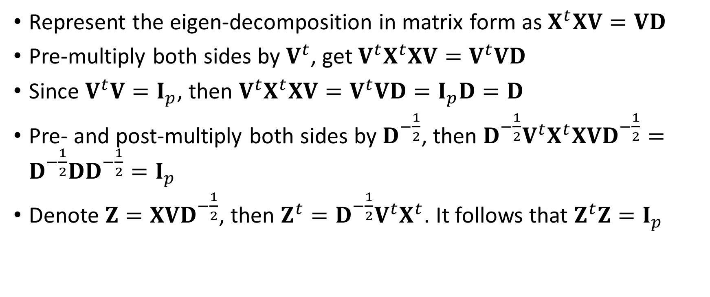
Orthonormal Transformation
Represent the eigen-decomposition in matrix form as $X^{t}XV=VD$
Pre-multiply both sides by $V^{t}$, get $V^{t}X^{t}XV=V^{t}VD$
Since $V^{t}V=I_{p}$, then $V^{t}X^{t}XV=V^{t}VD=I_{p}D=D$
Pre- and post-multiply both sides by $D^{−\frac{1}{2}}$, then ${D^{−\frac{1}{2}}V}^{t}X^{t}XVD^{−\frac{1}{2}}=D^{−\frac{1}{2}}DD^{−\frac{1}{2}}=I_{p}$
Denote $Z=XVD^{−\frac{1}{2}}$, then $Z^{t}={D^{−\frac{1}{2}}V}^{t}X^{t}$. It follows that $Z^{t}Z=I_{p}$

Slide 49
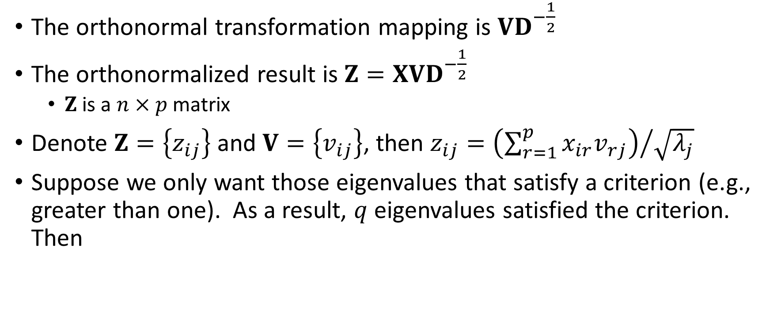
Orthonormal Transformation
The orthonormal transformation mapping is $VD^{−\frac{1}{2}}$
The orthonormalized result is $Z=XVD^{−\frac{1}{2}}$
$Z$ is a $n×p$ matrix
Denote $Z=\left\{z_{ij}\right\}$ and $V=\left\{v_{ij}\right\}$, then $z_{ij}={\left(\sum_{r=1}^{p}{x_{ir}v_{rj}}\right)}/{\sqrt{λ_{j}}}$
Suppose we only want those eigenvalues that satisfy a criterion (e.g., greater than one). As a result, $q$ eigenvalues satisfied the criterion. Then

Slide 50
Orthonormalization in Python: First Principle
Week 2 Eigenvalue.py
import numpy as np
from numpy import linalg as LA
import pandas as pd
# Input the matrix X
x = np.matrix([[5.1, 160, 82000],
[5.2, 170, 84000],
[5.3, 180, 86000],
[5.4, 190, 88000],
[5.5, 200, 90000],
[5.6, 110, 81000],
[5.7, 120, 83000],
[5.8, 130, 85000],
[5.9, 140, 87000],
[6.0, 150, 89000]])
print("Input Matrix = \n", x)
print("Number of Dimensions = ", x.ndim)
print("Number of Rows = ", np.size(x,0))
print("Number of Columns = ", np.size(x,1))
xtx = x.transpose() * x
print("t(x) * x = \n", xtx)
# Eigenvalue decomposition
evals, evecs = LA.eigh(xtx)
print("Eigenvalues of x = \n", evals)
print("Eigenvectors of x = \n",evecs)
# Here is the transformation matrix
dvals = 1.0 / numpy.sqrt(evals)
transf = evecs * numpy.diagflat(dvals)
print("Transformation Matrix = \n", transf)
# Here is the transformed X
transf_x = x * transf
print("The Transformed x = \n", transf_x)
# Check columns of transformed X
xtx = transf_x.transpose() * transf_x
print("Expect an Identity Matrix = \n", xtx)

Slide 51
Orthonormalization in Python: First Principle
Week 2 Eigenvalue.py
Input Matrix =
[[5.1e+00 1.6e+02 8.2e+04]
[5.2e+00 1.7e+02 8.4e+04]
[5.3e+00 1.8e+02 8.6e+04]
[5.4e+00 1.9e+02 8.8e+04]
[5.5e+00 2.0e+02 9.0e+04]
[5.6e+00 1.1e+02 8.1e+04]
[5.7e+00 1.2e+02 8.3e+04]
[5.8e+00 1.3e+02 8.5e+04]
[5.9e+00 1.4e+02 8.7e+04]
[6.0e+00 1.5e+02 8.9e+04]]
Number of Dimensions = 2
Number of Rows = 10
Number of Columns = 3
t(x) * x =
[[3.0885e+02 8.5600e+03 4.7480e+06]
[8.5600e+03 2.4850e+05 1.3305e+08]
[4.7480e+06 1.3305e+08 7.3185e+10]]
Eigenvalues of x =
[3.53398246e-02 6.61645828e+03 7.31852422e+10]
Eigenvectors of x =
[[ 9.99941038e-01 1.08589624e-02 -6.48765732e-05]
[ 1.08588266e-02 -9.99939389e-01 -1.81799265e-03]
[-8.46141548e-05 1.81718097e-03 -9.99998345e-01]]
Transformation Matrix =
[[ 5.31914960e+00 1.33498241e-04 -2.39814890e-10]
[ 5.77631289e-02 -1.22930851e-02 -6.72017163e-09]
[-4.50101887e-04 2.23401143e-05 -3.69647288e-06]]
The Transformed x =
[[-0.53859115 -0.1343234 -0.30311185]
[-0.32924867 -0.21256067 -0.31050487]
[-0.1199062 -0.29079794 -0.31789788]
[ 0.08943628 -0.36903521 -0.32529089]
[ 0.29877875 -0.44727248 -0.3326839 ]
[-0.31707091 0.45805749 -0.29941504]
[-0.10772844 0.37982022 -0.30680806]
[ 0.10161404 0.30158295 -0.31420107]
[ 0.31095651 0.22334568 -0.32159408]
[ 0.52029899 0.1451084 -0.3289871 ]]
Expect an Identity Matrix =
[[ 9.99999987e-01 2.77018366e-09 -5.73498741e-13]
[ 2.77018366e-09 9.99999999e-01 2.81749885e-13]
[-5.73498741e-13 2.81749885e-13 1.00000000e+00]]
(XVD^{-1/2})^{t}(XVD^{-1/2}) = I

Slide 52
Orthonormalization in Python: SciPy Function
Week 2 Eigenvalue.py
import numpy as np
from numpy import linalg as LA
import pandas as pd
# Input the matrix X
x = np.matrix([[5.1, 160, 82000],
[5.2, 170, 84000],
[5.3, 180, 86000],
[5.4, 190, 88000],
[5.5, 200, 90000],
[5.6, 110, 81000],
[5.7, 120, 83000],
[5.8, 130, 85000],
[5.9, 140, 87000],
[6.0, 150, 89000]])
# Orthonormalize using the orth function
import scipy
from scipy import linalg as LA2
orthx = LA2.orth(x)
print("The orthonormalize x = \n", orthx)
# Check columns of the ORTH function
check = orthx.transpose().dot(orthx)
print("Also Expect an Identity Matrix = \n", check)

Slide 53
Comparison
First Principles
The Transformed x =
[[-0.53859114 -0.1343234 -0.30311185]
[-0.32924867 -0.21256067 -0.31050487]
[-0.1199062 -0.29079794 -0.31789788]
[ 0.08943627 -0.36903521 -0.32529089]
[ 0.29877874 -0.44727248 -0.3326839 ]
[-0.3170709 0.45805749 -0.29941504]
[-0.10772843 0.37982022 -0.30680806]
[ 0.10161404 0.30158295 -0.31420107]
[ 0.31095651 0.22334568 -0.32159408]
[ 0.52029898 0.1451084 -0.3289871 ]]
Expect an Identity Matrix =
[[ 9.99999953e-01 1.00405564e-08 -2.52808885e-12]
[ 1.00405564e-08 9.99999998e-01 1.23873134e-13]
[-2.52808885e-12 1.23873134e-13 1.00000000e+00]]
SciPy orth() Function
The orthonormalize x =
[[-0.30311185 0.1343234 0.53859115]
[-0.31050487 0.21256067 0.32924868]
[-0.31789788 0.29079794 0.1199062 ]
[-0.32529089 0.36903521 -0.08943628]
[-0.3326839 0.44727248 -0.29877875]
[-0.29941504 -0.45805749 0.31707091]
[-0.30680806 -0.37982022 0.10772844]
[-0.31420107 -0.30158295 -0.10161404]
[-0.32159408 -0.22334568 -0.31095652]
[-0.3289871 -0.1451084 -0.52029899]]
Also Expect an Identity Matrix =
[[ 1.00000000e+00 2.77555756e-17 1.11022302e-16]
[ 2.77555756e-17 1.00000000e+00 -1.11022302e-16]
[ 1.11022302e-16 -1.11022302e-16 1.00000000e+00]]
Switched Sign
Week 2 Eigenvalue.py

Slide 54
Orthonormal Transformation
Suppose we only want those eigenvalues that satisfy a criterion (e.g., greater than one).
As a result, $q$ eigenvalues satisfied the criterion.
As a result, 𝑞 eigenvalues satisfied the criterion.
The matrix $V$ consists of the corresponding $q$ eigenvectors
The matrix 𝐕 consists of the corresponding 𝑞 eigenvectors
Finally, $Z$ would be a $n×q$ matrix instead
Finally, 𝑍 would be a 𝑛×𝑞 matrix instead

Slide 55
Want Eigenvalues that are Greater than One
Week 2 Eigenvalue Special.py
import numpy as np
from numpy import linalg as LA
import pandas as pd
# Input the matrix X
x = np.matrix([[5.1, 160, 82000],
[5.2, 170, 84000],
[5.3, 180, 86000],
[5.4, 190, 88000],
[5.5, 200, 90000],
[5.6, 110, 81000],
[5.7, 120, 83000],
[5.8, 130, 85000],
[5.9, 140, 87000],
[6.0, 150, 89000]])
print("Input Matrix = \n", x)
print("Number of Dimensions = ", x.ndim)
print("Number of Rows = ", np.size(x,0))
print("Number of Columns = ", np.size(x,1))
xtx = x.transpose() * x
print("t(x) * x = \n", xtx)
# Eigenvalue decomposition
evals, evecs = LA.eigh(xtx)
print("Eigenvalues of x = \n", evals)
print("Eigenvectors of x = \n",evecs)
# Want eigenvalues greater than one
evals_1 = evals[evals > 1.0]
evecs_1 = evecs[:,evals > 1.0]
# Here is the transformation matrix
dvals = 1.0 / numpy.sqrt(evals_1)
transf = evecs_1 * numpy.diagflat(dvals)
print("Transformation Matrix = \n", transf)
# Here is the transformed X
transf_x = x * transf;
print("The Transformed x = \n", transf_x)
# Check columns of transformed X
xtx = transf_x.transpose() * transf_x;
print("Expect an Identity Matrix = \n", xtx)

Slide 56
Orthonormalization in Python: First Principle
Week 2 Eigenvalue Special.py
Input Matrix =
[[5.1e+00 1.6e+02 8.2e+04]
[5.2e+00 1.7e+02 8.4e+04]
[5.3e+00 1.8e+02 8.6e+04]
[5.4e+00 1.9e+02 8.8e+04]
[5.5e+00 2.0e+02 9.0e+04]
[5.6e+00 1.1e+02 8.1e+04]
[5.7e+00 1.2e+02 8.3e+04]
[5.8e+00 1.3e+02 8.5e+04]
[5.9e+00 1.4e+02 8.7e+04]
[6.0e+00 1.5e+02 8.9e+04]]
Number of Dimensions = 2
Number of Rows = 10
Number of Columns = 3
t(x) * x =
[[3.0885e+02 8.5600e+03 4.7480e+06]
[8.5600e+03 2.4850e+05 1.3305e+08]
[4.7480e+06 1.3305e+08 7.3185e+10]]
Eigenvalues of x =
[3.53398234e-02 6.61645827e+03 7.31852422e+10]
Eigenvectors of x =
[[ 9.99941038e-01 1.08589624e-02 -6.48765732e-05]
[ 1.08588266e-02 -9.99939389e-01 -1.81799265e-03]
[-8.46141549e-05 1.81718097e-03 -9.99998345e-01]]
Transformation Matrix =
[[ 1.33498241e-04 -2.39814890e-10]
[-1.22930851e-02 -6.72017163e-09]
[ 2.23401143e-05 -3.69647288e-06]]
The Transformed x =
[[-0.1343234 -0.30311185]
[-0.21256067 -0.31050487]
[-0.29079794 -0.31789788]
[-0.36903521 -0.32529089]
[-0.44727248 -0.3326839 ]
[ 0.45805749 -0.29941504]
[ 0.37982022 -0.30680806]
[ 0.30158295 -0.31420107]
[ 0.22334568 -0.32159408]
[ 0.1451084 -0.3289871 ]]
Expect an Identity Matrix =
[[9.99999999e-01 2.81722129e-13]
[2.81722129e-13 1.00000000e+00]]
Did you spot any differences when compared with previous results?
(XVD^{-1/2})^{t}(XVD^{-1/2}) = I

Slide 57
Example: 2004 Automobile Data
Input data is Cars.csv.
Feature Variables:
Invoice: Invoice price in 2004 ($9,875 – $173,560)
Horsepower: Number of horsepower units (73 – 500 hp)
Weight: Curb Weight (1,850 – 7,190 pounds)
Identification Variable:
CaseID: Make and Row Index (e.g., Porsche_335)
Number of Neighbors:
K = 4

Slide 58
Unsupervised, Original Scale
Week 2 Nearest Neighbors Unsupervised.py
cars = pandas.read_csv('C:\\IIT\\Machine Learning\\Data\\cars.csv',delimiter=',')
cars["CaseID"] = cars["Make"] + "_" + cars.index.values.astype(str)
cars_wIndex = cars.set_index("CaseID")
# Specify the kNN
kNNSpec = kNN(n_neighbors = 4, algorithm = 'brute', metric = 'euclidean')
# Specify the training data
trainData = cars_wIndex[['Invoice', 'Horsepower', 'Weight']]
# Build nearest neighbors
nbrs = kNNSpec.fit(trainData)
distances, indices = nbrs.kneighbors(trainData)

Slide 59
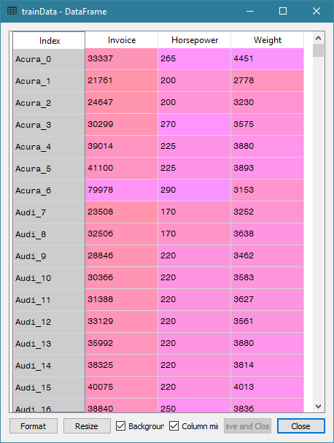
Training Data
Week 2 Nearest Neighbors Unsupervised.py

Slide 60
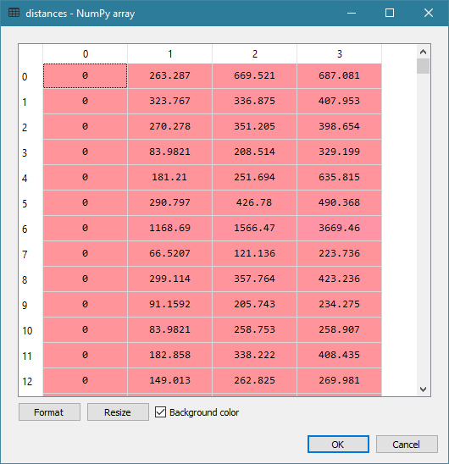
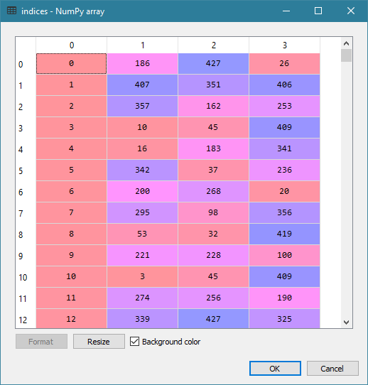
Distances and Indices

Slide 61
Neighbors Identified
Week 2 Nearest Neighbors Unsupervised.py
# Find the nearest neighbors of these focal observations
focal = [[173560, 477, 3131], # 334: Porsche 911 GT2 2dr
[119600, 493, 4473], # 262: Mercedes-Benz CL600 2dr
[117854, 493, 4429], # 271: Mercedes-Benz SL600 convertible 2dr
[113388, 493, 4235]] # 270: Mercedes-Benz SL55 AMG 2dr
myNeighbors = nbrs.kneighbors(focal, return_distance = False)
print("My Neighbors = \n", myNeighbors)
My Neighbors =
[[334 262 271 270] 261: Mercedes-Benz CL500 2dr [88324, 302, 4085]
[262 271 270 261]
[271 262 270 261]
[270 271 262 261]]

Slide 62
Unsupervised, Orthonormalized
Week 2 Nearest Neighbors Unsupervised.py
# Orthonormalized the training data
x = numpy.matrix(trainData.values)
xtx = x.transpose() * x
print("t(x) * x = \n", xtx)
# Eigenvalue decomposition
evals, evecs = numpy.linalg.eigh(xtx)
print("Eigenvalues of x = \n", evals)
print("Eigenvectors of x = \n",evecs)
# Here is the transformation matrix
dvals = 1.0 / numpy.sqrt(evals)
transf = evecs * numpy.diagflat(dvals)
print("Transformation Matrix = \n", transf)
# Here is the transformed X
transf_x = x * transf;
print("The Transformed x = \n", transf_x)
# Check columns of transformed X
xtx = transf_x.transpose() * transf_x;
print("Expect an Identity Matrix = \n", xtx)
nbrs = kNNSpec.fit(transf_x)
distances, indices = nbrs.kneighbors(transf_x)

Slide 63
Orthonormalization
Week 2 Nearest Neighbors Unsupervised.py
t(x) * x =
[[518478936590 3219102117 48492493679]
[ 3219102117 22151103 345284887]
[ 48492493679 345284887 5725124540]]
Eigenvalues of x =
[5.21119307e+05 1.18095293e+09 5.23044738e+11]
Eigenvectors of x =
[[ 0.00272996 -0.09349631 -0.99561588]
[-0.99930601 0.03673123 -0.00618944]
[ 0.03714888 0.99494184 -0.09333115]]
Transformation Matrix =
[[ 3.78170771e-06 -2.72068445e-06 -1.37664638e-06]
[-1.38429904e-03 1.06885585e-06 -8.55818530e-09]
[ 5.14608751e-05 2.89521886e-05 -1.29049758e-07]]
The Transformed x =
[[-0.0117161 0.03844998 -0.04646993]
[-0.05160776 0.02143814 -0.03031741]
[-0.01743343 0.02667263 -0.03434875]
...
[-0.02200692 -0.0097789 -0.05908168]
[ 0.00307681 0.0148444 -0.03428758]
[ 0.03402063 0.02081924 -0.04607865]]
Expect an Identity Matrix =
[[ 1.00000000e+00 -1.10824544e-13 -3.82333054e-14]
[-1.10824544e-13 1.00000000e+00 -4.37150316e-16]
[-3.82333054e-14 -4.37150316e-16 1.00000000e+00]]

Slide 64
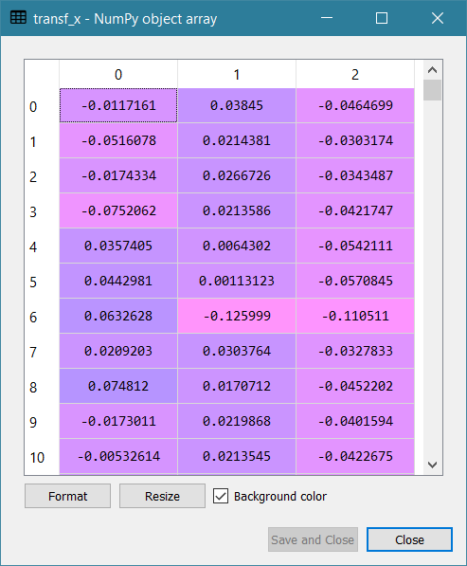
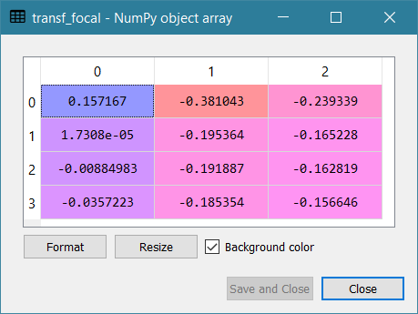
Orthonormalized Training / Focal Data

Slide 65
Neighbors Identified After Orthonormalization
Week 2 Nearest Neighbors Unsupervised.py
focal = [[173560, 477, 3131], # 334: Porsche 911 GT2 2dr
[119600, 493, 4473], # 262: Mercedes-Benz CL600 2dr
[117854, 493, 4429], # 271: Mercedes-Benz SL600 convertible 2dr
[113388, 493, 4235]] # 270: Mercedes-Benz SL55 AMG 2dr
transf_focal = focal * transf;
myNeighbors_t = nbrs.kneighbors(transf_focal, return_distance = False)
print("My Neighbors = \n", myNeighbors_t)
My Neighbors =
[[334 262 271 261]
[262 271 270 6] # 6 - Acura NSX coupe 2dr manual S [ 79978, 290, 3153]
[271 262 270 332] # 332 - Porsche 911 Carrera 4S coupe 2dr (convert) [72206, 315, 3240]
[270 271 262 200]] # 200 - Jaguar XKR convertible 2dr [79226, 390, 4042]

Slide 66
Supervised Classification
Week 2 Nearest Neighbors Supervised.py
trainData = cars_wIndex[['Invoice', 'Horsepower', 'Weight', 'Origin']].dropna().reset_index()
X = trainData[['Invoice', 'Horsepower', 'Weight']]
y = trainData['Origin']
target_class = list(y.unique())
neigh_choice = range(2,21,1)
result = []
for k in neigh_choice:
neigh = KNeighborsClassifier(n_neighbors = k, metric = 'euclidean')
nbrs = neigh.fit(X, y)
class_prob = nbrs.predict_proba(X)
nbrs_list = numpy.argmax(class_prob, axis = 1)
predicted_class = [target_class[k] for k in nbrs_list]
rate_miss_class = numpy.mean(numpy.where(predicted_class == y, 0, 1))
result.append([k, rate_miss_class])
miss_classification_k = pandas.DataFrame(result, columns = ['Number of Neighbors', 'Misclassification Rate'])

Slide 67

Supervised Classification: $k$ = 4
trainData = cars_wIndex[['Invoice', 'Horsepower', 'Weight', 'Origin']].dropna().reset_index()
X = trainData[['Invoice', 'Horsepower', 'Weight']]
y = trainData['Origin']
target_class = list(y.unique())
k = 4
neigh = KNeighborsClassifier(n_neighbors = k, metric = 'euclidean')
nbrs = neigh.fit(X, y)
class_prob = nbrs.predict_proba(X)
nbrs_list = numpy.argmax(class_prob, axis = 1)
predicted_class = [target_class[i] for i in nbrs_list]
rate_miss_class = numpy.mean(numpy.where(predicted_class == y, 0, 1))

Slide 68
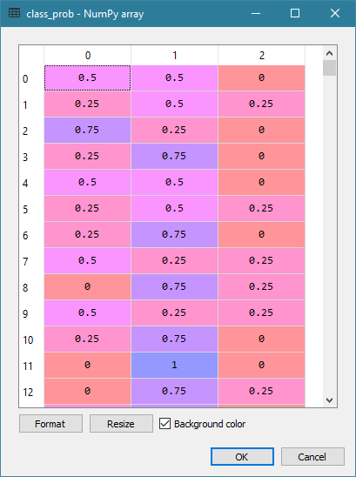
Supervised Classification
Target categories are Asia, Europe, and USA in lexical order
There are as many columns in Classification Probability as the number of target categories
Column 0 is for the first target category Asia
Column 1 is for the second target category Europe
Column 2 column is for the third target category USA

Slide 69
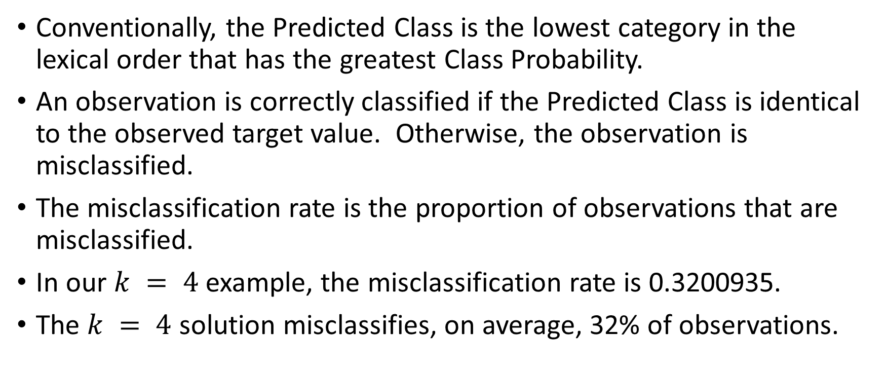
Supervised Classification: Predicted Class
Conventionally, the Predicted Class is the lowest category in the lexical order that has the greatest Class Probability.
An observation is correctly classified if the Predicted Class is identical to the observed target value. Otherwise, the observation is misclassified.
The misclassification rate is the proportion of observations that are misclassified.
In our $k = 4$ example, the misclassification rate is 0.3200935.
The $k = 4$ solution misclassifies, on average, 32% of observations.

Slide 70
Python SKLEARN Nearest Neighbors
http://scikit-learn.org/stable/modules/neighbors.html#unsupervised-neighbors
Pros
Produces results that are readily understandable.
Works efficiently on almost any number of variables.
Offers three algorithms for storing the training data.
Cons
Cannot handle training data with nominal and interval features.
Returns NaN distance for some feature (e.g., try adding the Cylinders)
Does not suggest an optimal number of neighbors

Slide 71

Quiz 1
Two questions, 100 points
Maximum two attempts
Only grade last attempt
Available on Blackboard after 12:01 AM on August 30, 2022
Answer before 11:59 PM on September 2, 2022

