Slide 1
CS 484
Introduction to Machine Learning
Week 1, August 22, 2022
Autumn Semester 2022

Slide 2
The Instruction Team
Instructor
Dr. Ming-Long Lam
mlam5@iit.edu
Teaching Assistant / Grader
To Be Announced
@hawk.iit.edu

Slide 3
About the Instructor: Ming-Long Lam
Thirty years of experience in practicing data science for:
Predictive analytics software development
Property and casualty insurance ratemaking
Human resources analytics for retail banking service
Passion and expertise
Develop analytics algorithms that enable machines to learn
Educate humans to mine data for insights
Develop commercial analytics software
Ph.D. in Statistics from The University of Chicago
Currently a Principal Research Statistician Developer of the SAS Institute, Cary, North Carolina
Previously held senior R&D technical positions in Chase, Allstate, and SPSS
ResearchGate profile: https://www.researchgate.net/profile/Ming_Long_Lam
LinkedIn profile: https://www.linkedin.com/pub/ming-long-lam/10/a73/657

Slide 4
This is a Survey Course
We Will
Learn the primary topics of a broad field of knowledge
Understand the main machine learning algorithms in each topic
Develop computer codes to implement or exercise these algorithms
We Will Not
Visit every machine learning topic (new ideas are constantly introduced)
Go through every algorithm in each topic
Teach basic Calculus and Probability (you need to refresh these topics)

Slide 5
Course Schedule
Introduction
Unsupervised Learning
Memory Based Learner*
Association Rules
Clustering*
Supervised Learning
Decision Trees
Binary Logistic Regression*
Feature Selection
Advanced Topics
Learner Evaluation and Comparison
Naïve Bayes
Perceptron Neural Networks*
Support Vector Machines
Bagging, Adaptive Boosting*
Gradient Boosting
* Assignment Week

Slide 6
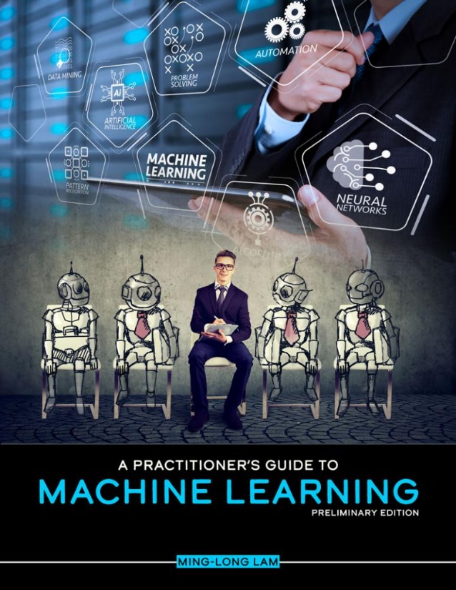


Software and Textbook for This Section
Mandatory: Python 3.9, numpy, pandas, scipy, sklearn 1.1.1, and statsmodel 0.13.2
Available from Anaconda https://www.anaconda.com/distribution
Recommended: Ming-Long Lam (2020). A Practitioner’s Guide to Machine Learning, Kendall Hunt Publishing
https://he.kendallhunt.com/product /practitioners-guide-machine-learning

Slide 7
Evaluation
Homework Assignments
Five Assignments
Each Assignment Weight 10% Toward Final Grade
Mid-Term
Weight 15%
Conduct Only Online After the Week 8 Lecture
Quizzes
Ten in Semester
Each Quiz Weight 2% Toward Final Grade
Final Examination
Weight 15%
Conduct Only Online After the Last Lecture

Slide 8
Weighted Score (S) to Letter Grade
$$90\%≤S$$
90%≤𝑆
75$\%≤S<90\%$
75%≤𝑆<90%
$$S<60\%$$
𝑆<60%
6$0\%≤S<75\%$
60%≤𝑆<75%

Slide 9
Assignments
Five assignments will be given on
Week 1, Week 3, Week 5, Week 9, and Week 11
Each assignment’s grade count towards 10% of your course grade
Submit your assignment as PDF documents
Each assignment carries a maximum of 100 points
Submit your assignments to the Blackboard site before the due date
Assignment is due after 14 calendar days (including weekends and holidays)
For example, the August 22 assignment is due at 11:59 pm on September 5.
Whenever applicable, properly documented and error-free Python program codes and output should be included your submission

Slide 10
Late Submission Policy
If you turn in an assignment late, then we reserve our rights to deduct 5 points from the total score for each 24-hour period after the deadline.
Assignments turned in more than 7 days late will not receive credit.
In the case of unexpected events (e.g., sickness, emergency, computer crash, loss of internet, etc.), you must contact the instructor and explain your situation before the assignment due date in order to receive a grace period.

Slide 11
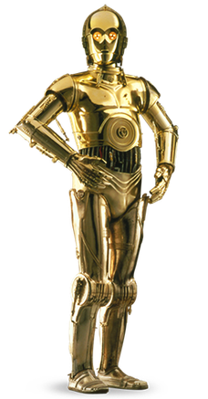
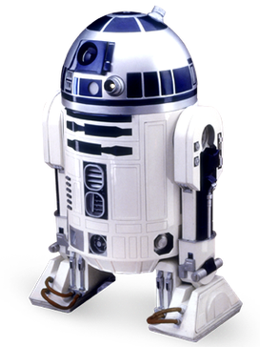
The Star Wars Film (1977)
C-3PO is a master of natural language processing and he knows over six million forms of communication, including English, in the galaxy
R2-D2 analyzes a problem logically, learns from past experiences, selects the right tool for the problem, and courageously reach the solution.
Which Machine Can Learn?

Slide 12
What is Data Mining?
Originally called Knowledge Discovery Process (KDD), Data Mining is a field of science that discover or find out the properties of datasets.
Large amounts of observations (or records) from relational database management system (RDMS) in data warehouses are analyzed (a.k.a. mined) to identify interesting correlations and formulate patterns among the data items.
The term “Knowledge Discovery in Databases” was coined by Gregory Piatetsky-Shapiro in 1989. The term “data mining” appeared in the database community in 1990. https://www.kdnuggets.com/gps.html

Slide 13
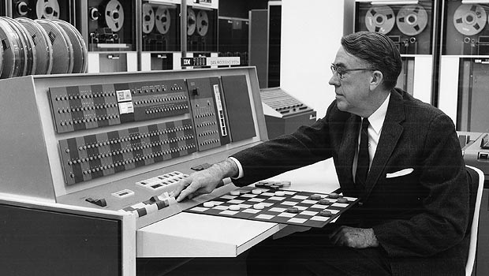
What is Machine Learning?
The term Machine Learning was coined by Arthur L. Samuel (1901 – 1990) in his 1959 paper.
Received a master's degree in Electrical Engineering from MIT in 1926
Developed the first Checkers program on IBM's first commercial computer in 1952
Retired from IBM in 1966 and joined Stanford University as a professor
Worked on the TeX project around 1978
Arthur Samuel playing Checkers on the IBM 701 in 1956. Source: http://www-03.ibm.com/ibm/history/ibm100/us/en/icons/ibm700series/impacts/

Slide 14
Historical Definitions
A field of study that gives computers the ability to learn without being explicitly programmed. – Arthur L. Samuel (1959). "Some Studies in Machine Learning Using the Game of Checkers". IBM Journal of Research and Development.
A computer program is said to learn from experience E with respect to some task T and some performance measure P, if its performance on T, as measured by P, improves with experience E. – Tom Mitchell (1997). Machine Learning, New York: McGraw-Hill
Tom Mitchell (1951 – ), currently Professor, Computer Science Department, Carnegie Mellon University

Slide 15
Definitions in the Dictionary
Machine Learning is the process by which a computer is able to improve its own performance (as in analyzing image files) by continuously incorporating new data into an existing statistical model. — Merriam-Webster, https://www.merriam-webster.com/dictionary/machine%20learning
Machine learning, in artificial intelligence (a subject within computer science), is a discipline concerned with the implementation of computer software that can learn autonomously. – Britannica, https://www.britannica.com/technology/machine-learning

Slide 16
Definitions on the Internet
Machine learning is a subset of artificial intelligence in the field of computer science that often uses statistical techniques to give computers the ability to "learn" (i.e., progressively improve performance on a specific task) with data, without being explicitly programmed. – Wikipedia, https://en.wikipedia.org/wiki/Machine_learning

Slide 17
Definitions from Tech Company
A program or system that builds (trains) a predictive model from input data. The system uses the learned model to make useful predictions from new (never-before-seen) data drawn from the same distribution as the one used to train the model. Machine learning also refers to the field of study concerned with these programs or systems. – Google, https://developers.google.com/machine-learning/glossary/#m
Machine learning is a form of AI that enables a system to learn from data rather than through explicit programming. However, machine learning is not a simple process. As the algorithms ingest training data, it is then possible to produce more precise models based on that data. A machine-learning model is the output generated when you train your machine-learning algorithm with data. — IBM, https://www.ibm.com/analytics/machine-learning

Slide 18
Definitions from Tech Company
Machine learning (ML) is the process of using mathematical models of data to help a computer learn without direct instruction. It’s considered a subset of artificial intelligence (AI). Machine learning uses algorithms to identify patterns within data, and those patterns are then used to create a data model that can make predictions. With increased data and experience, the results of machine learning are more accurate — much like how humans improve with more practice. — Microsoft, https://azure.microsoft.com/en-us/overview/what-is-machine-learning-platform/
Machine learning is a method of data analysis that automates analytical model building. It is a branch of artificial intelligence based on the idea that systems can learn from data, identify patterns and make decisions with minimal human intervention. – SAS Institute, https://www.sas.com/en_us/insights/analytics/machine-learning.html#machine-learning-importance

Slide 19
Machine Learning (Tom Mitchell,1997)
A computer program is said to learn from experience E with respect to some task T and some performance measure P, if its performance on T, as measured by P, improves with experience E.
When a machine learns, it involves three components.
Experience – What does a machine learn from?
Task – What does a machine learn for?
Performance Measure – How well did a machine learn?

Slide 20
Data Mining versus Machine Learning
Machine learning and data mining often use the same algorithms to discover patterns in the data.
Machine learning uses algorithms to improve its performance at a task with experience over time.
Emphasis is on the accuracy and the ability to reuse the algorithm outcomes in the future.
Data mining uses algorithms to generate insights for humans to identify and interpret the data patterns.
Emphasis is on the ability to maximize the utility of an algorithm for the current data.

Slide 21
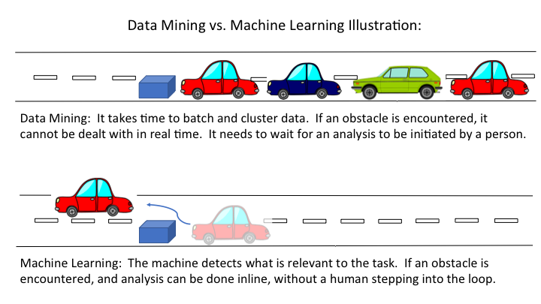
Data Mining versus Machine Learning
More look like Artificial Intelligence ???
Source: https://www.guavus.com/artificial-intelligence-vs-machine-learning-vs-data-mining-101-whats-big-difference

Slide 22
A Human Learning Activity
A human learning activity also contains these three components.
A person is said to learn from experience E with respect to some task T and some performance measure P, if its performance on T, as measured by P, improves with experience E.
A person learns to
EITHER do something better (i.e., improve benefits, accuracy, or profit)
OR avoid a mistake (i.e., reduce cost, error, or loss)

Slide 23
Three Components of a Learning Activity
For a student in this CS 484 course
Experience – lecture, textbook, assignments, tests, and exam
Task – learn various topics in machine learning
Performance Measure – Letter grade (A > B > C > E)
For a loan officer
Experience – historical data where 20% of loans have defaulted
Task – learn to identify loans whose default rates are substantially higher or lower than 20%
Performance Measure – misclassification rate which is the fraction of observations that are misclassified by your model, and lower is better

Slide 24

Before a Learning Activity
Before we dive into any learning activity,
Take a minute or two to ask yourself this question.
What is the primary motivation for this learning activity?
In other words, Why am I Learning This?
Some possible answers are:
Identify loans that have high likelihoods of default
Establish a profile of the most valuable customers
Estimate the current value of a real estate property
Study browsing history of users who eventually land on Amazon

Slide 25
The Loan Officer Learning Example
Experience tells us that 20% of loans have defaulted.
If we do not have access to the data (i.e., the experience), then we will say that the Loan Default probability is 0.2.
This is a One-Size-Fits-All solution.
Suppose we will declare (i.e., classify) a loan is going to default if its Loan Default probability is greater than or equal to p_{0.}
If p₀ ≤ 0.2, then all the loans will be classified as defaulted. As a result, 80% = (1 – 0.2 = 0.8) of the loans will be misclassified.
If p₀ > 0.2, then none of the loans will be classified as defaulted. As a result, 20% of loans will be misclassified.

Slide 26
The Loan Officer Learning Example
Experience tells us that 20% of loans have defaulted.
If we have access to the data (i.e., the experience), then we will divide the data into segments. The average Loan Default probabilities in some segments are higher than 0.2 and some are lower than 0.2. The data is in hmeq.csv.
We will use the Classification Tree algorithm to learn from the data. We will cover this popular algorithm in a few weeks.
Run the Python code Week 1 MyFirstDecisionTree.py to check if you have the right environment

Slide 27
The Loan Officer Learning Example
Week 1 MyFirstDecisionTree.py

Slide 28
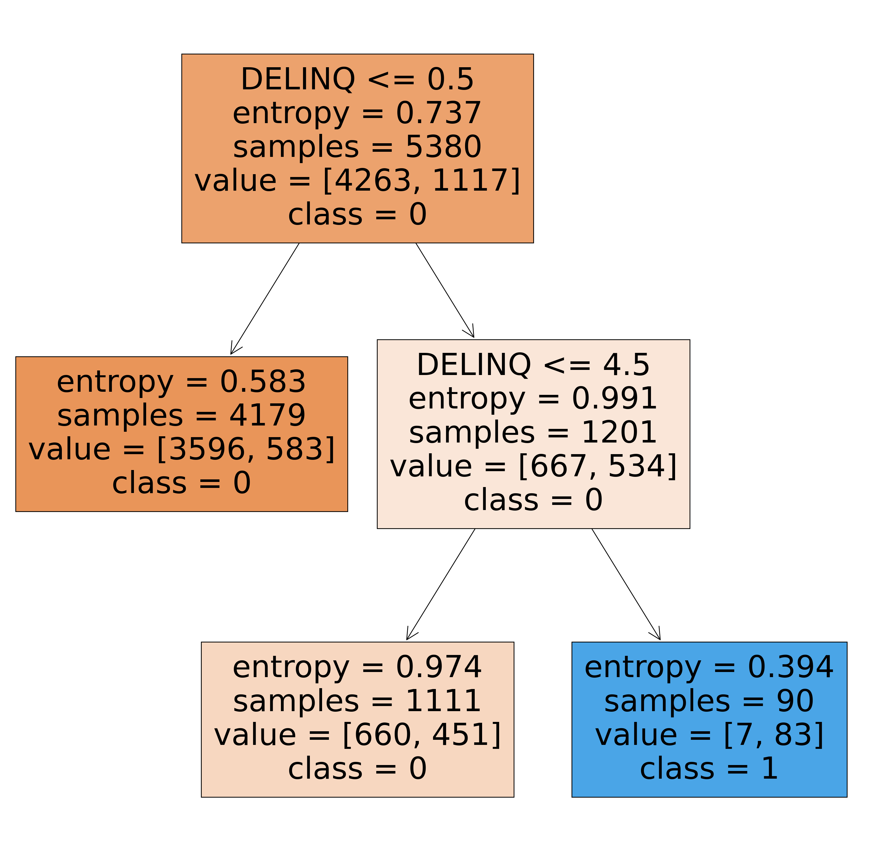
The Loan Officer Learning Example
The DELINQ variable is the number of credit inquiries (0, 1, …,15)
Value is the pair of [number of active loans, number of defaulted loans]
The training data contains 5,380 non-missing observations which have 1,117 defaulted loans.
The empirical default rate is 1117/5380 = 0.2076.

Slide 29
The Loan Officer Learning Example
There are 4,179 observations without any inquiries (i.e., DELINQ <= 0.5). The default rate is 583/4179 = 13.95%.
There are 1,201 observations which have at least one inquiry (i.e., DELINQ > 0.5). The default rate is 534/1201 = 44.46%.

Slide 30
The Loan Officer Learning Example
There are 1,111 observations which have 1, 2, 3 or 4 inquiries (i.e., 0.5 < DELINQ <= 4.5). The default rate is 451/1111 = 40.59%.
There are 90 observations which have at least five inquiries (i.e., DELINQ > 4.5). The default rate is 83/90 = 92.22%.

Slide 31
The Loan Officer Learning Example
After learning from the data, we produced these rules.
If DELINQ = 0, then the predicted Default Likelihood = 583/4179 = 13.95%.
If DELINQ = 1, 2, 3 or 4, then the predicted Default Likelihood = 451/1111 = 40.59%.
If DELINQ > 4, then the predicted Default Likelihood = 83/90 = 92.22%.

Slide 32

The Loan Officer Learning Example
Suppose we will declare (i.e., classify) a loan is going to default if its Loan Default probability is greater than or equal to p_{0.}
If p₀ ≤ 0.1395, then all the loans → defaulted. The Misclassification Rate is 4263/5380 = 79.24%.
If 0.1395 < p₀ ≤ 0.4059, then the loans under Rule 2 and Rule 3 → defaulted. In other words, if DELINQ > 0 → defaulted. The Misclassification Rate is 23.23%.
If DELINQ = 0, then the predicted Default Likelihood = 13.95%.
If DELINQ = 1, 2, 3 or 4, then the predicted Default Likelihood = 40.59%.
If DELINQ > 4, then the predicted Default Likelihood = 92.22%.

Slide 33
The Loan Officer Learning Example
If 0.4059 < p₀ ≤ 0. 9222, then the loans under Rule 3 → defaulted. In other words, if DELINQ > 4 → defaulted. The Misclassification Rate is 19.35%.
If 0. 9222 < p₀, then all loans will be classified as non-default. The Misclassification Rate is 20.76%.
If DELINQ = 0, then the predicted Default Likelihood = 13.95%.
If DELINQ = 1, 2, 3 or 4, then the predicted Default Likelihood = 40.59%.
If DELINQ > 4, then the predicted Default Likelihood = 92.22%.

Slide 34
The Loan Officer Learning Example
Without learning from the experience (i.e., the data), the misclassification rate is either 80% or 20%.
After learning from the experience by using the classification tree algorithm, the misclassification rate is 79.24%, 23.23%, 19.35%, and 20.76%.
The benefits of performing this learning activity are:
We get away from the One-Size-Fits-All solution, have more risk levels for consideration even although we still cannot attain 0% misclassification rate.
We can identify a small segment of loans (DELINQ > 4 in 1.5% of the loans) which exhibit a very high default likelihood (92.22%). In other words, we have found a credible indicator of default for a loan.

Slide 35

After a Learning Activity
After we wrap up any learning activity,
Take a few minutes to answer this question.
What is the main outcome of this learning activity?
In other word, What Did I Learn?
Some possible answers are:
The most valuable customers bought something recently, very often, and expensive items.
I conclude that I cannot learn anything using the data that I have (e.g., all customers eventually bought something from Amazon)
If you cannot figure out what you’ve learned or cannot learn, then the learning activity is simply an activity for you to spend some time.

Slide 36
Follow-Up a Learning Activity
Reproducibility
If we start from the original data, use the same algorithms, execute the same tasks on the same or compatible machine, the machine learning activity will reproduce the same results (within the machine precisions) and arrive at the same conclusions.
If the expected results cannot be reproduced, this indicates there are some unexplained (intentional or random) interactions among the data, the algorithm, and the machine.
Common causes are uninitialized variables in the codes or incomplete or inaccurate documentation of the activity.

Slide 37
Follow-Up a Learning Activity
Replicability
If a researcher runs the machine learning activity (i.e., use the same algorithms, execute the same tasks) using a different data on some compatible machine, the researcher can obtain results that lead to the same conclusions (e.g., the list of selected features, the distribution of the predicted outcomes).
If the expected conclusions cannot be replicated, this indicates there are some design flaws in the tasks. For example, some correlations among the features are not accounted for, the algorithms need further tunings, additional tasks are required, or different algorithms should be considered.
We will come back to this topic when we talk about Learner Evaluation and Comparison

Slide 38
A Simple Machine Learning Activity
Goal: Estimate Empirical Density Function
Khan Academy: A histogram is a graphical display of data using bars of different heights. In a histogram, each bar groups numbers into ranges. Taller bars show that more data falls in that range. A histogram displays the shape and spread of continuous sample data.
Idea: Use a histogram
Activity: Generate a histogram

Slide 39
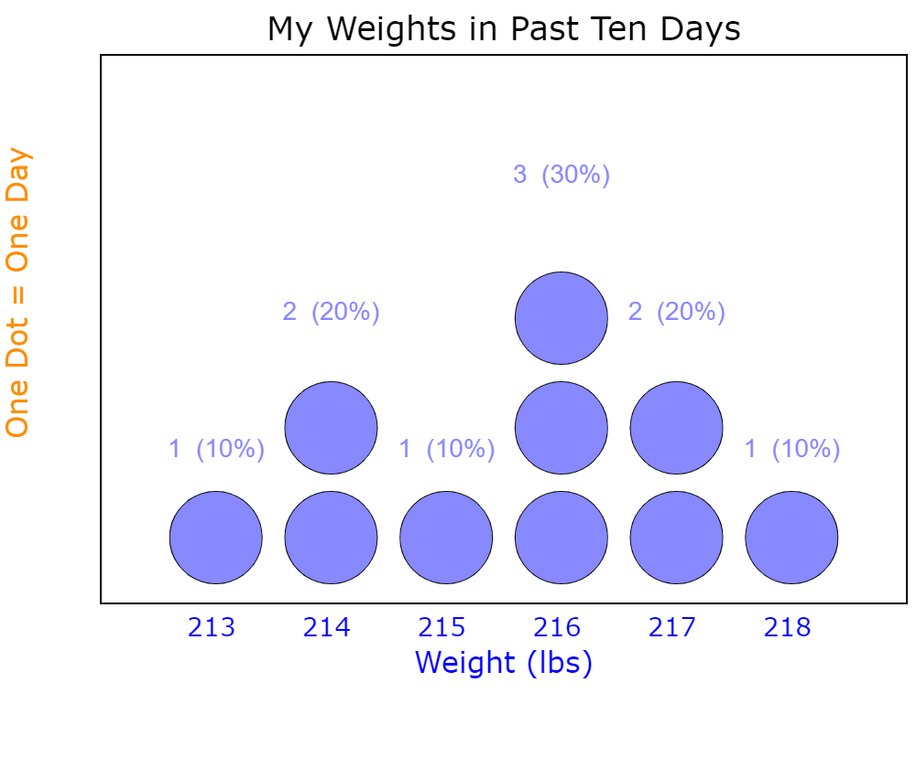
Represent Empirical Density Function
Suppose my weights (pounds) of the past ten days are: 213, 214, 214, 215, 216, 216, 216, 217, 217, 218
How my weights vary?
Use a Dot Plot
https://www.mathsisfun.com/data/data-graph.php

Slide 40
Represent Empirical Density Function
Frequency Table
List the unique values and their counts (i.e., number of observations that have the unique values)
Useful for knowing what values we have in the data and their counts
However, the table does not easily show the distances among values
Histogram
Display a macro-level view of how the values distribute
Useful for getting a glimpse of the data distribution
Easy to draw a histogram, but need skills to make an informative histogram

Slide 41
Represent Empirical Density Function
Week 1 Simple Histogram.py
import matplotlib.pyplot as plt
import numpy
x = numpy.array([213,214,214,215,216,216,216,217,217,218])
# Generate a frequence table
uvalue, ucount = numpy.unique(x, return_counts = True)
print('Unique Values:\n', uvalue)
print('Unique Counts:\n', ucount)
# Draw a properly labeled histogram with default specification
plt.hist(x)
plt.title('My Weights in Past Ten Days')
plt.xlabel('Weight (lbs)')
plt.ylabel('Number of Days')
plt.show()

Slide 42
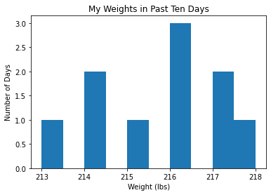
Represent Empirical Density Function
Unique Values:
[213 214 215 216 217 218]
Unique Counts:
[1 2 1 3 2 1]
What can we improve to this histogram?

Slide 43
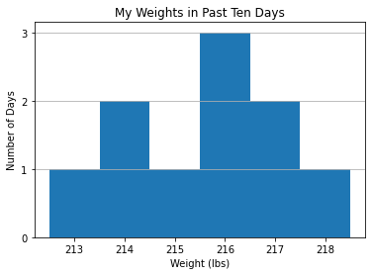
Represent Empirical Density Function
# Draw a better labeled histogram with specified bin boundaries (bin width = 1)
plt.hist(x, bins = [212.5,213.5,214.5,215.5,216.5,217.5,218.5], align='mid’)
# Specify title, labels
plt.title('My Weights in Past Ten Days')
plt.xlabel('Weight (lbs)')
plt.ylabel('Number of Days’)
# Specify y-axis tick values
plt.yticks(range(4))
# Show grid line on y-axis
plt.grid(axis = 'y’)
# Show the histogram
plt.show()

Slide 44
Represent Empirical Density Function
General Data
Number of Bins
Bin Width
Bin Boundary
Three Related Specifications
Number of Bins
Avoid empty bins
Bin Width
Fixed or Variable
Total span of bins should represent the data range
Bin Boundary
Nice looking and intelligent
Resemble data values

Slide 45
A Procedure for Constructing a Histogram
Select a positive bin width.
Select the mid-points of the bins
Construct the bins
Left-open and right-closed, i.e., (a,b], except for first bin [a, b]
Left-closed and right-open, i.e., [a,b), except for last bin [a, b]
Count the number of observations in each individual bin
Plot the numbers of observations against the bin definitions, either horizontally or vertically.

Slide 46
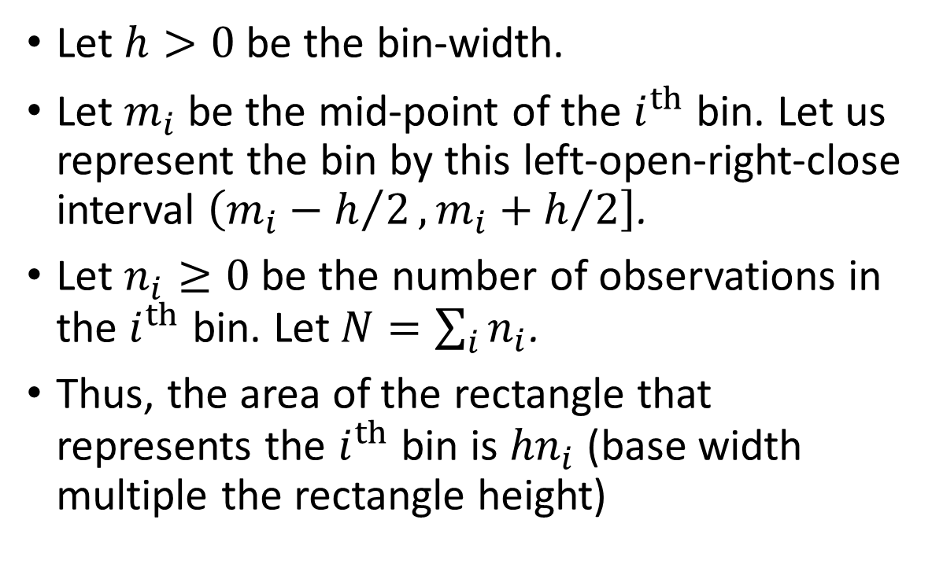



Use a Histogram to Estimate the Density
Let $h>0$ be the bin-width.
Let $m_{i}$ be the mid-point of the $i^{th}$ bin. Let us represent the bin by this left-open-right-close interval $\left(m_{i}−h/2,\left.m_{i}+h/2\right]\right.$.
Let $n_{i}≥0$ be the number of observations in the $i^{th}$ bin. Let $N=\sum_{i}{n_{i}}$.
Thus, the area of the rectangle that represents the $i^{th}$ bin is ${hn}_{i}$ (base width multiple the rectangle height)
$$n_{i}$$
$$m_{i}$$
$$h$$

Slide 47
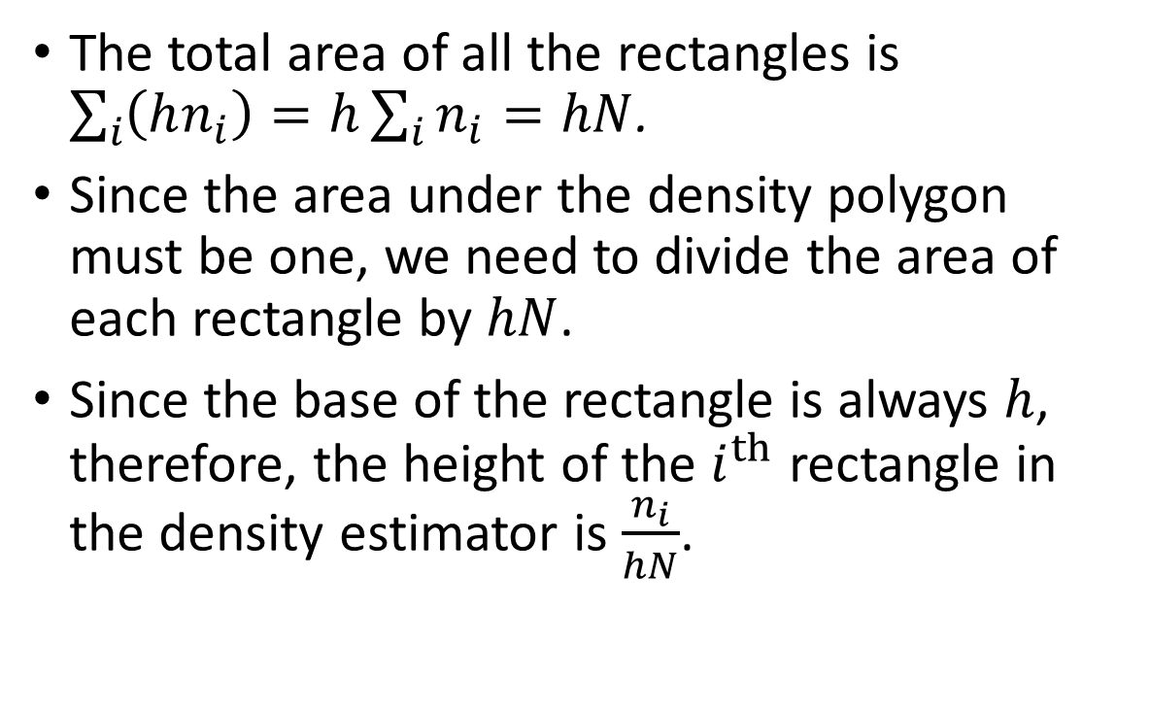
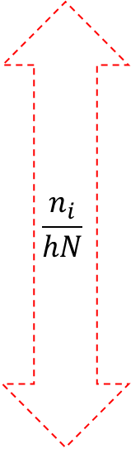
Use a Histogram to Estimate the Density
The total area of all the rectangles is $\sum_{i}{\left(hn_{i}\right)=h\sum_{i}{n_{i}}=hN}$.
Since the area under the density polygon must be one, we need to divide the area of each rectangle by $hN$.
Since the base of the rectangle is always $h$, therefore, the height of the $i^{th}$ rectangle in the density estimator is $\frac{n_{i}}{hN}$.
$$\frac{n_{i}}{hN}$$
$$m_{i}$$
$$h$$

Slide 48
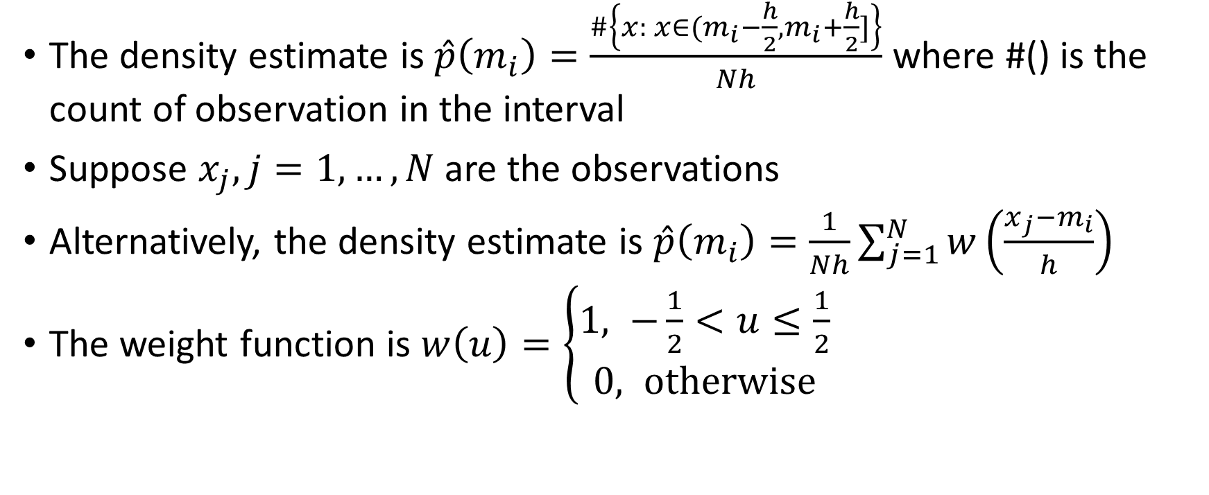
Use a Histogram to Estimate the Density
The density estimate is $\hat{p}\left(m_{i}\right)=\frac{\#\left\{x: x∈(m_{i}−\frac{h}{2},m_{i}+\frac{h}{2}]\right\}}{Nh}$ where #() is the count of observation in the interval
Suppose $x_{j}, j=1,…, N$ are the observations
Alternatively, the density estimate is $\hat{p}\left(m_{i}\right)=\frac{1}{Nh}\sum_{j=1}^{N}{w\left(\frac{x_{j}−m_{i}}{h}\right)}$
The weight function is $w\left(u\right)=\left\{\begin{aligned}1, −\frac{1}{2}<u≤\frac{1}{2} \\ &0, otherwise\end{aligned}\right.$

Slide 49
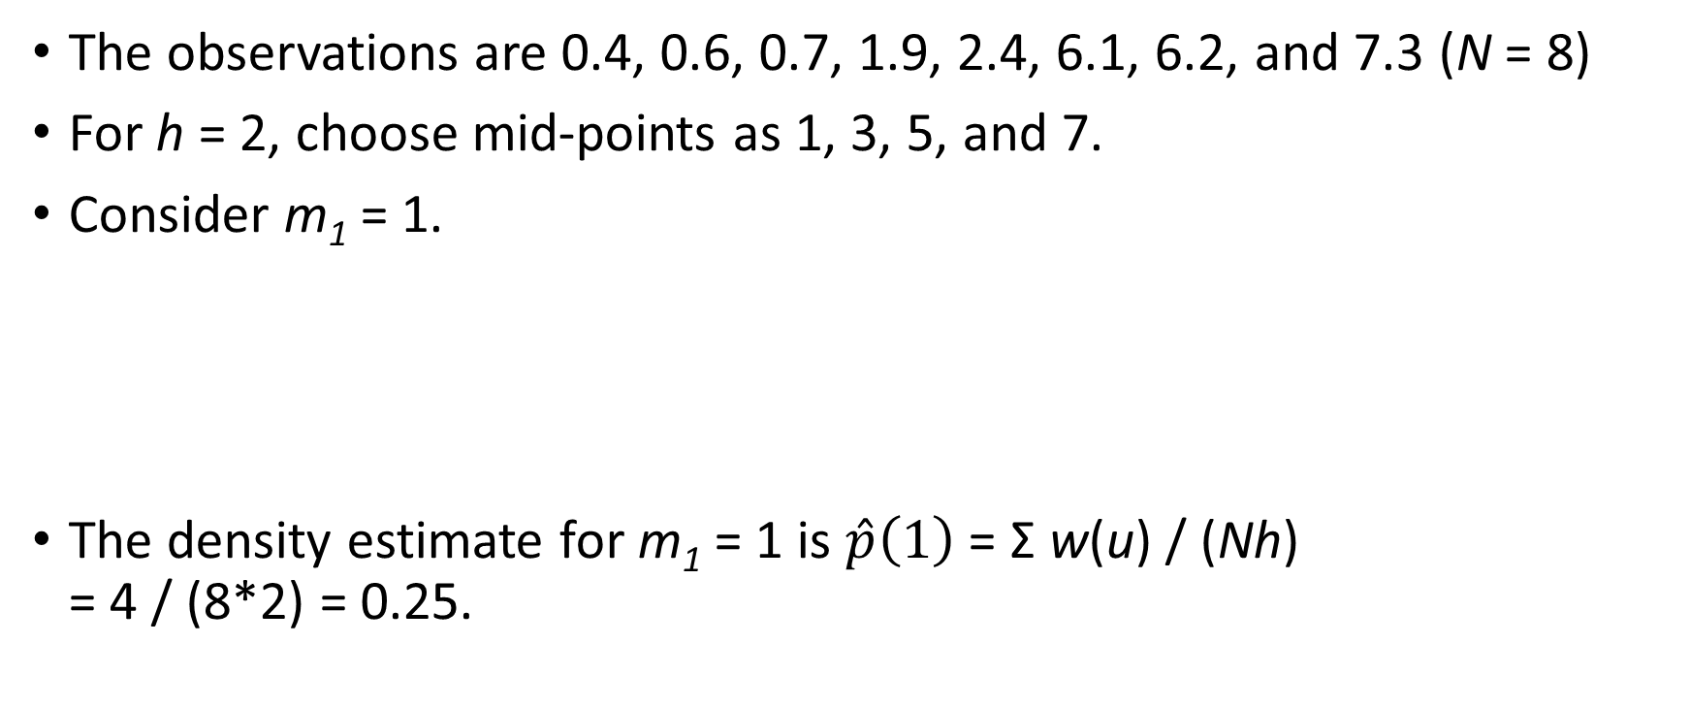
Density Estimation Example
The observations are 0.4, 0.6, 0.7, 1.9, 2.4, 6.1, 6.2, and 7.3 (N = 8)
For h = 2, choose mid-points as 1, 3, 5, and 7.
Consider m₁ = 1.
The density estimate for m₁ = 1 is $\hat{p}\left(1\right)$ = Σ w(u) / (Nh) = 4 / (8*2) = 0.25.
x_{i} | 0.4 | 0.6 | 0.7 | 1.9 | 2.4 | 6.1 | 6.2 | 7.3
u = (x_{i} - m₁)/2 | -0.3 | -0.2 | -0.15 | 0.45 | 0.7 | 2.55 | 2.6 | 3.15
w(u) | 1 | 1 | 1 | 1 | 0 | 0 | 0 | 0

Slide 50
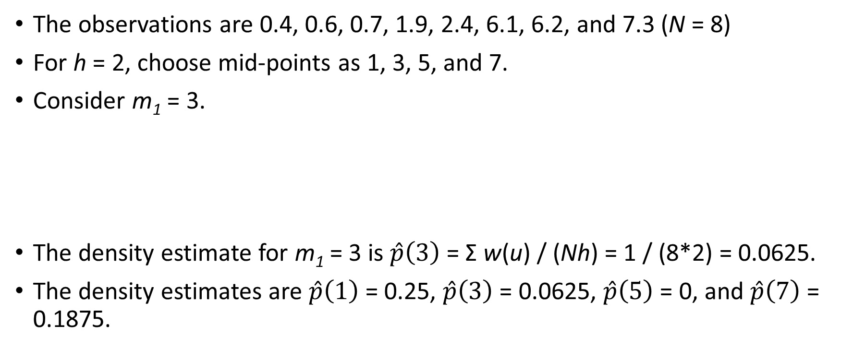
Density Estimation Example
The observations are 0.4, 0.6, 0.7, 1.9, 2.4, 6.1, 6.2, and 7.3 (N = 8)
For h = 2, choose mid-points as 1, 3, 5, and 7.
Consider m₁ = 3.
The density estimate for m₁ = 3 is $\hat{p}\left(3\right)$ = Σ w(u) / (Nh) = 1 / (8*2) = 0.0625.
The density estimates are $\hat{p}\left(1\right)$ = 0.25, $\hat{p}\left(3\right)$ = 0.0625, $\hat{p}\left(5\right)$ = 0, and $\hat{p}\left(7\right)$ = 0.1875.
x_{i} | 0.4 | 0.6 | 0.7 | 1.9 | 2.4 | 6.1 | 6.2 | 7.3
u = (x_{i} - m₁)/2 | -1.3 | -1.2 | -1.15 | -0.55 | -0.3 | 1.55 | 1.6 | 2.15
w(u) | 0 | 0 | 0 | 0 | 1 | 0 | 0 | 0

Slide 51
Density Estimation Example
h= 2
m_{i} | p(m_{i})
1 | 0.25
3 | 0.0625
5 | 0
7 | 0.1875
h = 0.5
m_{i} | p(m_{i})
0.25 | 0.25
0.75 | 0.5
1.25 | 0
1.75 | 0.25
2.25 | 0.25
2.75 | 0
3.25 | 0
3.75 | 0
4.25 | 0
4.75 | 0
5.25 | 0
5.75 | 0
6.25 | 0.5
6.75 | 0
7.25 | 0.25
7.75 | 0
h = 1
m_{i} | p(m_{i})
0.5 | 0.375
1.5 | 0.125
2.5 | 0.125
3.5 | 0
4.5 | 0
5.5 | 0
6.5 | 0.25
7.5 | 0.125

Slide 52
Break-Time Exercise
Download the Column_Y.csv file from Blackboard
The CSV file contains one column, namely, Y
Read the data into a Pandas dataframe
import matplotlib.pyplot as plt
import numpy
import pandas
inData = pandas.read_csv('C:\\IIT\\Machine Learning\\Data\\Column_Y.csv')
Y = inData['Y']

Slide 53
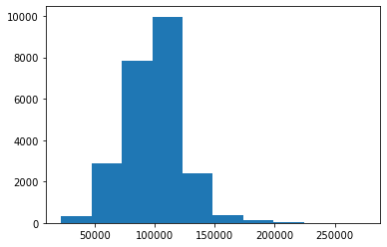

Break-Time Exercise
print(Y.describe())
plt.hist(Y)
plt.show()
count 23881.000000
mean 98913.972693
std 23255.541984
min 22248.000000
25% 86730.000000
50% 98940.000000
75% 110196.000000
max 275004.000000 Name: Y, dtype: float64
You will spend 15 minutes in recommending a bin width such that the histogram can best represent the empirical density function.

Slide 54
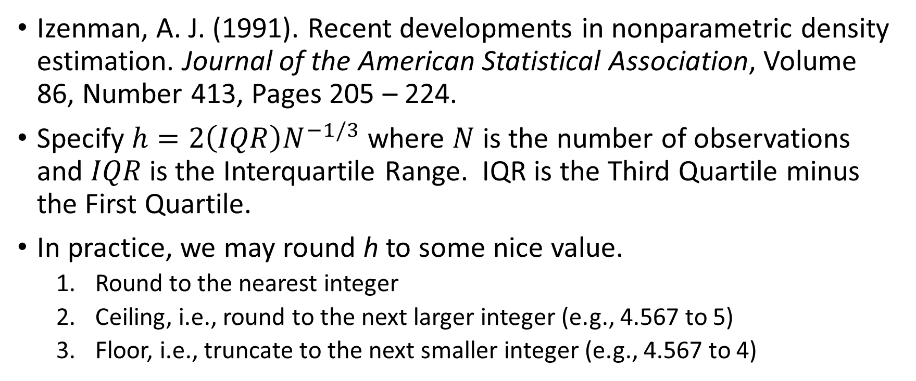
How to Specify the Bin-Width?
Izenman, A. J. (1991). Recent developments in nonparametric density estimation. Journal of the American Statistical Association, Volume 86, Number 413, Pages 205 – 224.
Specify $h=2\left(IQR\right)N^{−1/3}$ where $N$ is the number of observations and $IQR$ is the Interquartile Range. IQR is the Third Quartile minus the First Quartile.
In practice, we may round h to some nice value.
Round to the nearest integer
Ceiling, i.e., round to the next larger integer (e.g., 4.567 to 5)
Floor, i.e., truncate to the next smaller integer (e.g., 4.567 to 4)

Slide 55
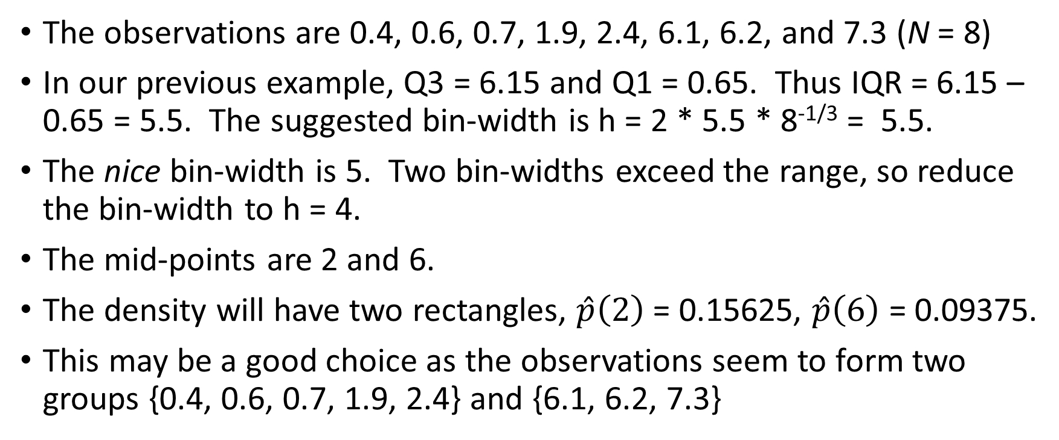
How to Specify the Bin-Width?
The observations are 0.4, 0.6, 0.7, 1.9, 2.4, 6.1, 6.2, and 7.3 (N = 8)
In our previous example, Q3 = 6.15 and Q1 = 0.65. Thus IQR = 6.15 – 0.65 = 5.5. The suggested bin-width is h = 2 * 5.5 * 8^{-1/3} = 5.5.
The nice bin-width is 5. Two bin-widths exceed the range, so reduce the bin-width to h = 4.
The mid-points are 2 and 6.
The density will have two rectangles, $\hat{p}\left(2\right)$ = 0.15625, $\hat{p}\left(6\right)$ = 0.09375.
This may be a good choice as the observations seem to form two groups {0.4, 0.6, 0.7, 1.9, 2.4} and {6.1, 6.2, 7.3}

Slide 56
How to Specify the Bin-Width?
Shimazaki H. and Shinomoto S. (2007). A method for selecting the bin size of a time histogram. Neural Computation, Volume 19, Issue 6, Pages 1503 – 1527
“From the observed data only, the method estimates a binwidth that minimizes expected L2 loss between the histogram and an unknown underlying density function. An assumption made here is merely that samples are drawn from the density independently each other.” – https://www.neuralengine.org/res/histogram.html

Slide 57
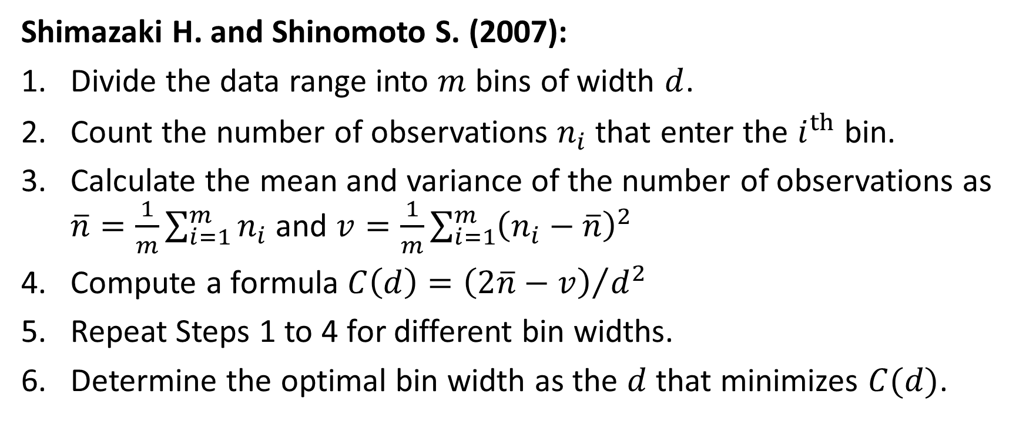
How to Specify the Bin-Width?
Shimazaki H. and Shinomoto S. (2007):
Divide the data range into $m$ bins of width $d$.
Count the number of observations $n_{i}$ that enter the $i^{th}$ bin.
Calculate the mean and variance of the number of observations as $\overline{n}=\frac{1}{m}\sum_{i=1}^{m}{n_{i}}$ and $v=\frac{1}{m}\sum_{i=1}^{m}{{\left(n_{i}−\overline{n}\right)}^{2}}$
Compute a formula $C\left(d\right)={\left(2\overline{n}−v\right)}/{d^{2}}$
Repeat Steps 1 to 4 for different bin widths.
Determine the optimal bin width as the $d$ that minimizes $C(d)$.

Slide 58
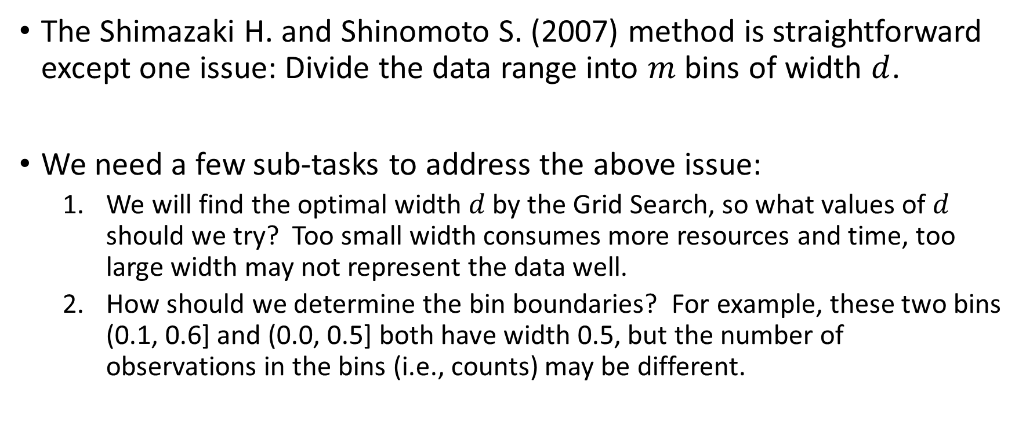
How to Specify the Bin-Width?
The Shimazaki H. and Shinomoto S. (2007) method is straightforward except one issue: Divide the data range into $m$ bins of width $d$.
We need a few sub-tasks to address the above issue:
We will find the optimal width $d$ by the Grid Search, so what values of $d$ should we try? Too small width consumes more resources and time, too large width may not represent the data well.
How should we determine the bin boundaries? For example, these two bins (0.1, 0.6] and (0.0, 0.5] both have width 0.5, but the number of observations in the bins (i.e., counts) may be different.

Slide 59
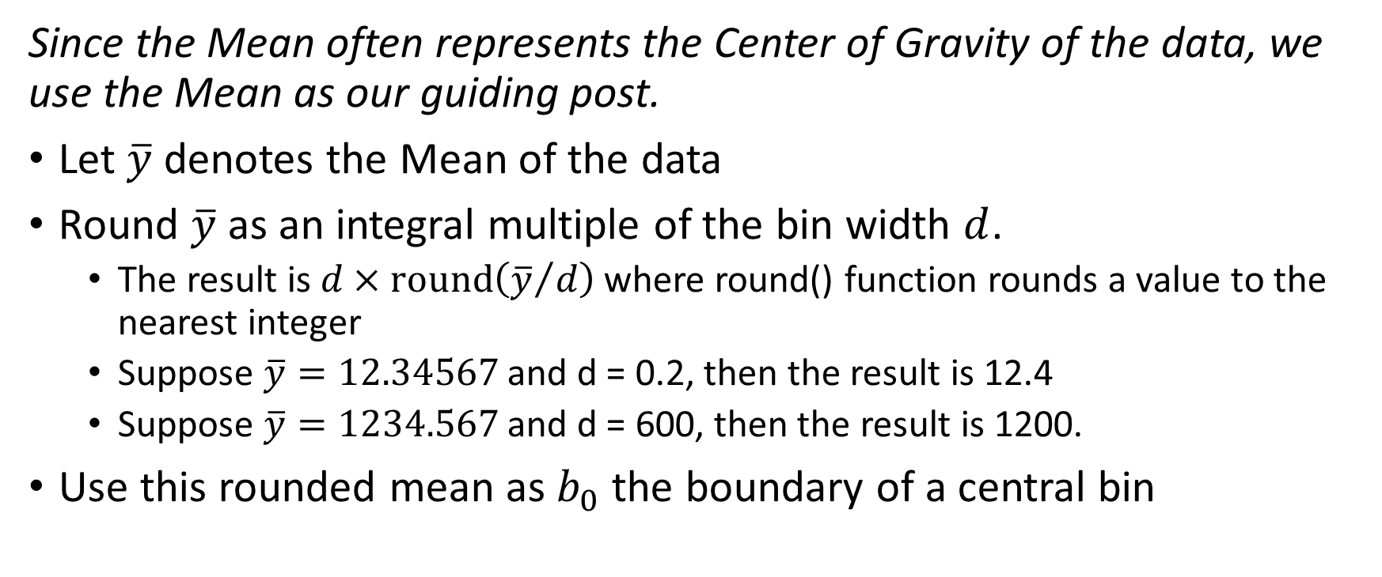
How to Specify the Bins’ Boundaries?
Since the Mean often represents the Center of Gravity of the data, we use the Mean as our guiding post.
Let $\overline{y}$ denotes the Mean of the data
Round $\overline{y}$ as an integral multiple of the bin width $d$.
The result is $d×round\left({\overline{y}}/d\right)$ where round() function rounds a value to the nearest integer
Suppose $\overline{y}=12.34567$ and d = 0.2, then the result is 12.4
Suppose $\overline{y}=1234.567$ and d = 600, then the result is 1200.
Use this rounded mean as $b_{0}$ the boundary of a central bin

Slide 60
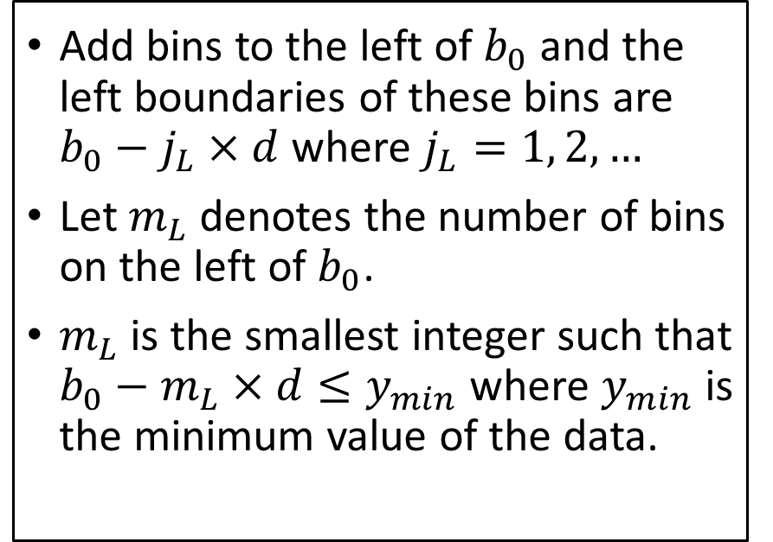
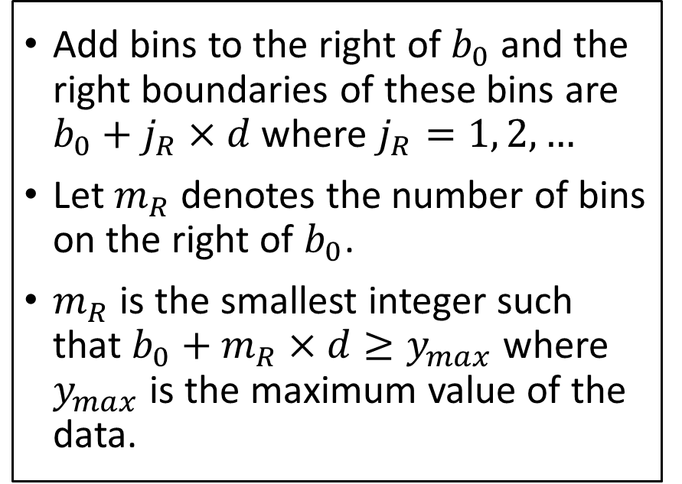
How to Specify the Bins’ Boundaries?
Use this rounded mean as $b_{0}$ the boundary of a central bin
Add bins to the left of $b_{0}$ and the left boundaries of these bins are $b_{0}−j_{L}×d$ where $j_{L}=1, 2, …$
Let $m_{L}$denotes the number of bins on the left of $b_{0}$.
$m_{L}$is the smallest integer such that $b_{0}−m_{L}×d≤y_{min}$ where $y_{min}$ is the minimum value of the data.
Add bins to the right of $b_{0}$ and the right boundaries of these bins are $b_{0}+j_{R}×d$ where $j_{R}=1, 2, …$
Let $m_{R}$denotes the number of bins on the right of $b_{0}$.
$m_{R}$is the smallest integer such that $b_{0}+m_{R}×d≥y_{max}$ where $y_{max}$ is the maximum value of the data.

Slide 61
Python Codes for Shimazaki and Shinomoto (2007) Method
Week 1 Shimazaki Bin Width.py
def calcCD (Y, delta):
maxY = numpy.max(Y)
minY = numpy.min(Y)
meanY = numpy.mean(Y)
# Round the mean to integral multiples of delta
middleY = delta * numpy.round(meanY / delta)
# Determine the number of bins on both sides of the rounded mean
nBinRight = numpy.ceil((maxY - middleY) / delta)
nBinLeft = numpy.ceil((middleY - minY) / delta)
lowY = middleY - nBinLeft * delta
# Assign observations to bins starting from 0
m = nBinLeft + nBinRight
BIN_INDEX = 0;
boundaryY = lowY
for iBin in numpy.arange(m):
boundaryY = boundaryY + delta
BIN_INDEX = numpy.where(Y > boundaryY, iBin+1, BIN_INDEX)
# Count the number of observations in each bins
uBin, binFreq = numpy.unique(BIN_INDEX, return_counts = True)
# Calculate the average frequency
meanBinFreq = numpy.sum(binFreq) / m
ssDevBinFreq = numpy.sum((binFreq - meanBinFreq)**2) / m
CDelta = (2.0 * meanBinFreq - ssDevBinFreq) / (delta * delta)
return(m, middleY, lowY, CDelta)

Slide 62
Python Codes for Shimazaki and Shinomoto (2007) Method
result = pandas.DataFrame()
deltaList = [1000, 2000, 5000, 10000, 20000, 50000]
for d in deltaList:
nBin, middleY, lowY, CDelta = calcCD(Y,d)
highY = lowY + nBin * d
result = result.append([[d, CDelta, lowY, middleY, highY, nBin]], ignore_index = True)
binMid = lowY + 0.5 * d + numpy.arange(nBin) * d
plt.hist(Y, bins = binMid, align='mid')
plt.title('Delta = ' + str(d))
plt.ylabel('Number of Observations')
plt.grid(axis = 'y')
plt.show()
result = result.rename(columns = {0:'Delta', 1:'CDelta', 2:'Low Y', 3:'Middle Y', 4:'High Y', 5:'N Bin'})

Slide 63
Optimal Bin Width for Column Y
Delta | C(Delta) | Low Y | Middle Y | High Y | N Bin
1000 | -0.0653048 | 22000 | 99000 | 276000 | 254
2000 | -0.0391265 | 22000 | 98000 | 276000 | 127
5000 | -0.0248580 | 20000 | 100000 | 280000 | 52
10000 | -0.0232307 | 20000 | 100000 | 280000 | 26
20000 | -0.0188715 | 20000 | 100000 | 280000 | 13
50000 | -0.0112881 | 0 | 100000 | 300000 | 6
Finding
C(Delta) is lowest when Delta = 1000.
Concern
Is 254 bins too many when Delta = 1000?
Consideration
Should we set maximum and minimum of bins?

Slide 64
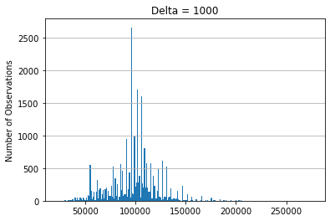
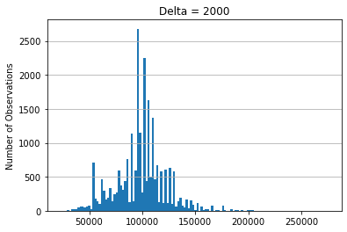
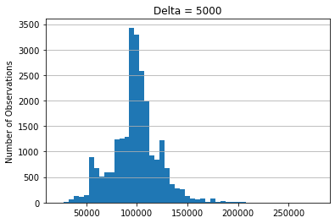
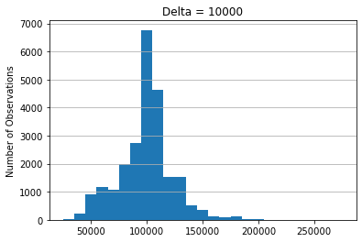
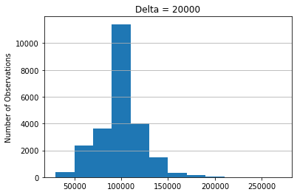
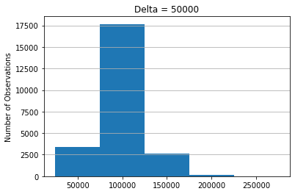
Optimal Bin Width for Column Y

Slide 65
An Afterthought …
We like the idea of making the $d$ values the multiples of 1, 2, and 5
We like the idea of making the 𝑑 values the multiples of 1, 2, and 5
Can we examine the data to determine the candidate list of $d$ values instead?
Can we examine the data to determine the candidate list of 𝑑 values instead?
Would you like to suggest a strategy for us?

Slide 66
Detect Statistical Outliers
Statistical outliers are not necessarily wrong or bad values.
Statistical outliers mean the values are significantly separated from the main body of data values.
So, what is the main body of data values?
What should the main body of data values include?
What about a box that represents the central 50% of data values?

Slide 67
A Procedure for Constructing a Box-Plot
Calculate the five-number summary which is the minimum, the first quartile, the median, the third quartile, and the maximum.
The first quartile (Q1) is the 25th percentile
The median (Q2) is the 50th percentile
The third quartile (Q3) is the 75th percentile
Draw a box, either horizontally or vertically
The centerline represents the median
The left or the lower box boundary represents the first quartile.
The right or the upper box boundary represents the third quartile
25%
25%
Q1
Q2
Q3

Slide 68
A Procedure for Constructing a Box-Plot
Calculate the Interquartile Range IQR = Q3 – Q1.
Draw two whiskers which extend from the ends of the box
The left or the lower whisker extends to the larger of Q1 – 1.5 * IQR and the minimum.
The right or the upper whisker extends to the smaller of Q3 + 1.5 * IQR and the maximum.
Q1 -1.5*IQR
Q3 +1.5*IQR
25%
25%
Q1
Q2
Q3

Slide 69
Why 1.5 Times of the IQR?
For a standard normal distribution (i.e., mean = 0 and standard deviation = 1)
Q1 = -0.67449, Q2 = 0, and Q3 = 0.67449.
Therefore IQR = Q3 – Q1 = 1.34898 and 1.5*IQR = 2.02347.
The lower whisker is Q1 – 1.5*IQR = -2.69796 and the upper whisker is Q3 + 1.5*IQR = 2.69796.
Common wisdom says any values more than three standard deviations from the mean are outliers.
If the multiplier is 2, then the upper whisker is 3.37245 > 3.
If the multiplier is 1, then the upper whisker is 2.02347 << 3.
The 1.5 multiplier is sort of the compromise.

Slide 70
Detect Outliers Using a Box-Plot
Observations whose values lie outside the whiskers Q1 – 1.5*IQR and Q3 + 1.5*IQR are considered outliers.
Actually, there are another set of whiskers which are Q1 – 3*IQR and Q3 + 3*IQR. Observations whose values lie outside these whiskers are considered extreme values.
Q1 -1.5*IQR
Q3 +1.5*IQR
25%
25%
Q1 -3*IQR
Q1
Q2
Q3
Q3 +3*IQR

Slide 71
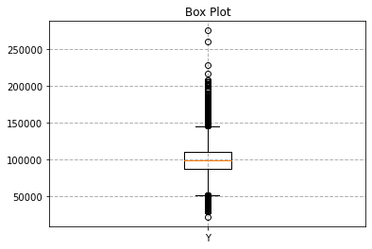
Statistical Outliers in Column Y
Q1 = 86730, Q2 = 98940, Q3 = 110196
IQR = Q3 – Q1 = 23466, 1.5 × IQR = 35199
Q1 – 1.5 × IQR = 51531, Q1 – 3 × IQR = 16,332
Q3 + 1.5 × IQR = 145395, Q3 + 3 × IQR = 180594
fig1, ax1 = plt.subplots()
ax1.set_title('Box Plot')
ax1.boxplot(Y, labels = ['Y'])
ax1.grid(linestyle = '--', linewidth = 1)
plt.show()

Slide 72

What is Column Y?
Source: https://data.cityofchicago.org/Administration-Finance/Current-Employee-Names-Salaries-and-Position-Title/xzkq-xp2w retrieved August 21, 2022
Data: Current Employee Names, Salaries, and Position Titles
Column Y: Annual Salary of the salaried employees
Four Statistical Outliers: Annual Salary > Q3 + 4.5 × IQR = $215,793
Name | Job Titles | Department | Full or Part-Time | Salary or Hourly | Annual Salary
RHEE, JAMIE L | COMMISSIONER OF AVIATION | AVIATION | F | Salary | 275004
BROWN, DAVID O | SUPERINTENDENT OF POLICE | POLICE | F | Salary | 260004
NANCE HOLT, ANNETTE M | FIRE COMMISSIONER | FIRE | F | Salary | 228612
LIGHTFOOT, LORI E | MAYOR | MAYOR'S OFFICE | F | Salary | 216210

Slide 73
Assignment 1
Four questions in CS484_IML_Assignment_1.docx
Due at 11:59 PM on Monday September 5, 2022.
You must submit your answers as a PDF file.
You must also submit your Python codes as .py files
You can attempt to submit your answers no more than two times.
Only the most recently submitted answers will be graded.

