Slide 1

AutoFixture
Michał Jankowski

Slide 2
AutoFixture
AutoFixture is an open source framework for .NET designed to minimize the ‘Arrange’ phase of your unit tests. Its primary goal is to allow developers to focus on what is being tested rather than how to setup the test scenario, by making it easier to create object graphs containing test data.
Mark Seemann

Slide 3
ExAMPLE
[Fact]
public void Add_CorrectPerson_PersonAddedToCompany_Classic()
{
// Arrange
var personMock = new Mock<IPerson>();
var employeesManagerMock = new Mock<IEmployeesManager>();
var tribeManagerMock = new Mock<ITribeManager>();
var company = new Company(employeesManagerMock.Object, tribeManagerMock.Object);
// Act
company.Add(personMock.Object);
// Assert
employeesManagerMock.Verify(x => x.Add(personMock.Object), Times.Once);
}
[AutoMoqData, Theory]
public void Add_CorrectPerson_PersonAddedToCompany_AutoFixture(
IPerson person,
[Frozen] Mock<IEmployeesManager> employeesManagerMock,
Company company)
{
// Arrange
// Act
company.Add(person);
// Assert
employeesManagerMock.Verify(x => x.Add(person), Times.Once);
}

Slide 4
In other way
AutoFixture:
Make Test-Driven Development more productive
Make unit test refactoring safer
Generate primitive and complex types
Automock dependencies
Links: GitHub | Mark Seemann's blog

Slide 5
Object creation
var fixture = new Fixture();
string test1 = fixture.Create<string>();
// Result: 473293a8-9d66-4553-8923-22399b3aa88d
string test2 = fixture.Create<string>("Name");
// Result: Nameca6facf4-5c84-4270-9023-c6e3bd5842cc
int test3 = fixture.Create<int>();
// Result: 251
string[] test4 = fixture.Create<string[]>();
// Result: { df33ba00-dd95-4b3d-9d26-d442b23d1149, 9f24a880-dfc2-4aeb-abeb-853f19a938d9,
// 94050f0d-87e0-42f3-8d8d-2779c2c6cd9a }
IEnumerable<string> test5 = fixture.CreateMany<string>();
// Result: { c05df390-4c55-4248-829b-00ca185608b0, 0ba9f7c8-948b-4956-91c0-ebb53237da2f,
// eb44adba-059f-4d26-a7a0-a243c2a83aa1 }
fixture.Register<string>(() => "GeneratedValue");
string test6 = fixture.Create<string>();
// Result: GeneratedValue
var user1 = fixture.Create<SimpleUser>();
fixture.Register<ISimpleUser>(() => new SimpleUser { Name = "Jan", Surname = "Kowalski" });
var user2 = fixture.Create<ISimpleUser>();

Slide 6
Customisation Creation
var fixture = new Fixture();
var user1 = fixture.Build<User>().With(x => x.Name, "Jan").Create();
// Result: user1.Name = "Jan"
var user2 = fixture.Build<User>().Without(x => x.Substitutes).Create();
// Result: user2.Substitute = null;
var user3 = fixture.Build<User>().OmitAutoProperties().Create();
// Result: Properties will have default values
var user4 = fixture.Build<User>().Do(x => x.Substitutes.Add(user1)).Create();
// Result: user4.Substitutes: { user1 }
var user5 = fixture.Build<User>().With(x => x.Name, "Jan")
.With(x => x.Surname, "Kowalski")
.Without(x => x.Substitutes)
.Create();
// Result: user5.Name = "Jan", user5.Surname = "Kowalski, user5.Substitutes = null
fixture.Customize<User>(u => u.With(x => x.Name, "Jan").With(x => x.Surname, "Kowalski"));
var user6 = fixture.Create<User>();
Notes:
Setter musi być publiczny
Jak nie to mozna przez konstruktor budować obiekt.

Slide 7
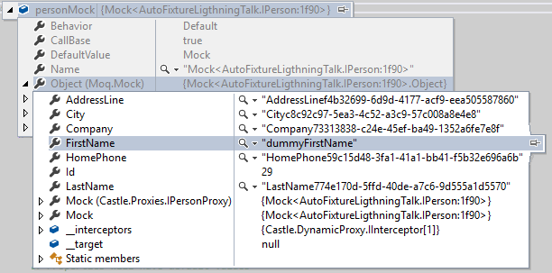
MOCKS Creation
// Option 1
var fixture = new Fixture().Customize(new AutoConfiguredMoqCustomization());
var userMock = fixture.Create<Mock<IPerson>>();
userMock.SetupProperty(u => u.FirstName, "dummyFirstName");
// Option 2
var fixture = new Fixture().Customize(new AutoConfiguredMoqCustomization());
var person = fixture.Create<IPerson>();
Mock.Get(person).SetupProperty(u => u.FirstName, "dummyFirstName");

Slide 8
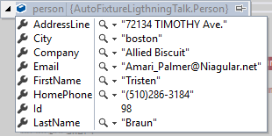
REAL DATA
public class HydratorAdapter : ISpecimenBuilder
{
private readonly IMap map;
public HydratorAdapter(IMap map)
{
if (map == null) { throw new ArgumentNullException("map"); }
this.map = map;
}
public object Create(object request, ISpecimenContext context)
{
var pi = request as PropertyInfo;
if (pi == null) { return new NoSpecimen(); }
if (!map.Match(pi) || (map.Type != pi.PropertyType))
{ return new NoSpecimen(); }
return map.Mapping(pi).Generate();
}
}
public class ObjectHydratorCustomization : Icustomization
{
public void Customize(IFixture fixture)
{
var builders = from m in new DefaultTypeMap() select new HydratorAdapter(m);
fixture.Customizations.Add(new CompositeSpecimenBuilder(builders));
}
}
var fixture = new Fixture().Customize(new ObjectHydratorCustomization());
var person = fixture.Create<Person>();
Notes:
https://github.com/bchavez/Bogus
https://github.com/PrintsCharming/ObjectHydrator

Slide 9
Freeze
// Option 1
var fixture = new Fixture().Customize(new AutoConfiguredMoqCustomization());
var employeesManagerMock = fixture.Freeze<Mock<IEmployeesManager>>();
var company = fixture.Create<Company>();
// Option 2
public static Mock<T> FreezeMoq<T>(this IFixture fixture) where T : class
{
var mock = new Mock<T>();
fixture.Register(() => mock.Object);
return mock;
}
var employeesManagerMock = fixture.FreezeMoq<IEmployeesManager>();
// Option 3
[AutoMoqData, Theory]
public void Add_CorrectPerson_PersonAddedToCompany_AutoFixture(
IPerson person,
[Frozen] Mock<IEmployeesManager> employeesManagerMock,
Company company)
{
// Arrange
// Act
company.Add(person);
// Assert
employeesManagerMock.Verify(x => x.Add(person), Times.Once);
}

Slide 10
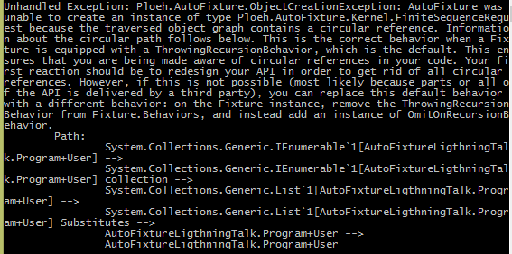
Circular Path
class User : IUser
{
public string Name { get; set; }
public List<User> Substitutes { get; set; }
public string Surname { get; set; }
}
var fixture = new Fixture();
var user1 = fixture.Build<User>()
.With(x => x.Name, "Jan")
.Create();

Slide 11
Circular Path - Solution
// Solution 1
var fixture = new Fixture();
fixture.Behaviors
.OfType<ThrowingRecursionBehavior>()
.ToList()
.ForEach(b => fixture.Behaviors.Remove(b));
fixture.Behaviors.Add(new OmitOnRecursionBehavior());
var user1 = fixture.Build<User>()
.With(x => x.Name, "Jan")
.Create();
// Solution 2
var fixture = new Fixture();
var user1 = fixture.Build<User>()
.With(x => x.Name, "Jan")
.Without(x => x.Substitutes)
.Create();
// Solution 3
var fixture = new Fixture();
var user1 = fixture.Build<User>()
.With(x => x.Name, "Jan")
.With(x => x.Substitutes, new List<User> { new User() })
.Create();

Slide 12
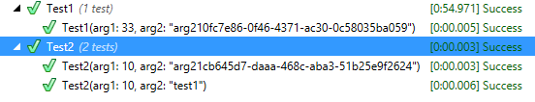
AutoData
[Theory, AutoData]
public void Test1(int arg1, string arg2)
{
}
[Theory]
[InlineAutoData(10)]
[InlineAutoData(10, "test1")]
public void Test2(int arg1, string arg2)
{
}

Slide 13
MOQ + AUTOFIXTURE
AutoMoqData
[Theory]
[AutoMoqData]
public void Sevice_ToggleLabel_ShouldToggleLabel(
Mock<IGenericRepository<Label>> repository,
AdminLabelService service)
InlineAutoMoqData
[Theory]
[InlineAutoMoqData(UserType.Creator, Status.Unknown, true)]
[InlineAutoMoqData(UserType.Employee, Status.Unknown, false)]
[InlineAutoMoqData(UserType.FinanceEmployee, Status.Accepted, true)]
public void SecurityAccessService_HasAccessByOrder_ShouldReturnExpectedValue(
UserType userType,
Status status,
bool expectedHasAccess,
int orderId,
OrderCase orderCase,
SecurityAccessService service)
MemberAutoMoqData
[Theory]
[MemberAutoMoqData("BuildFixtureDataForIsEmployeeShouldReturnTrue", MemberType = typeof(UserServiceFixture))]
[MemberAutoMoqData("BuildFixtureDataForIsEmployeeShouldReturnFalse", MemberType = typeof(UserServiceFixture))]
public void IsEmployee_WhenInvoke_ShouldReturnValue(User user, bool expectedResult, UserService userService)

Slide 14
NOT ONLY FOR TESTING
public class EditPersonSampleData : EditPersonViewModel
{
public EditPersonSampleData()
{
var fixture = new Fixture();
Person = fixture.Create<Person>();
}
}
<Grid x:Name="LayoutRoot"
d:DataContext="{d:DesignInstance Type=vm:EditPersonSampleData, IsDesignTimeCreatable=True}" >
</Grid>

Slide 15
Pros aND CONS OF AUTOFIXTURE
Great possibility of customisation:
Connection with mocking frameworks
Adding data generators
Project is still alive
Focus of test cases and not on implementation
List generation / hierarchical objects could be better
No build in data generators
Creates a lot of different strings
Issues with FxCop rules

Slide 16
OTHER Libraries - Bogus
Project is still being developed – C# port of faker.js
Fake data generator
Biggest number of types that can generate in different languages (support 34 languages – also Polish)
Generate repeatable data sets
var testUsers = new Faker<User>()
.CustomInstantiator(f => new User(userIds)))
.RuleFor(u => u.FirstName, f => f.Name.FirstName())
.RuleFor(u => u.Avatar, f => f.Internet.Avatar)
.RuleFor(u => u.Gender, f => f.PickRandom<Gender>())
.RuleFor(u => u.CartId, f => Guid.NewGuid)
.RuleFor(u => u.Orders, f => testOrders.Generate(3).ToList());

Slide 17
OTHER Libraries - Nbulider
Project not updated since 4 June 2012 (only small fixes)
Object creation similar to AutoFixture (instead of GUID property name is being used)
Better collection creation:
Builder<Product>.CreateListOfSize(30)
.WhereTheFirst(2).AreConstructedWith(arg4, arg5, arg6)
.WhereTheLast(10).Have(x => x.Title = "Special Title 1")
.And(x => x.PriceBeforeTax = specialPrice)
.AndThePrevious(10).Have(x => x.Title = "Special Title 2")
.Build();
Passing args to constructor:
var basketItem = Builder<BasketItem>.CreateNew().WithConstructorArgs(
basket, product, quantity).Build();

Slide 18
OTHER Libraries - AutoPoco
Project not updated since 28 April 2014
Highly configurable framework for the purpose of fluently building readable test data from Plain Old CLR Objects
Nice collection creation: session.List<SimpleUser>(100).Get();
Builded in data generators:
x.Include<SimpleUser>()
.Setup(c => c.EmailAddress).Use<EmailAddressSource>()
.Setup(c => c.FirstName).Use<FirstNameSource>()
.Setup(c => c.LastName).Use<LastNameSource>()
.Invoke(c => c.SetPassword(Use.Source<string, PasswordSource>()));
every session will generate repeatable test data (no flickering tests)

Slide 19
OTHER Libraries - Hydrator
Project not updated since 13 November 2013
Test data generator:
hydrator.Configure(x => { x.For<Person>().Property(y => y.FirstName).Is(CommonType.AmericanName); x.For<Person>().Property(y => y.LastName).Is(CommonType.AmericanLastName); x.For<Person>().Property(y => y.Weight).Use(new IntTypeConvention(99, 150)); x.For<Person>().Property(y => y.Height).Use(new IntTypeConvention(100, 999)); });
Include sets of generators

Slide 20
OTHER Libraries – NOT RECOMMENDED
Fabricator – too simple library
TestData (aka TestData.Profiles) – Author recommends using AutoFixture
TestDataGenerator – too simple library
TestDataFactory – too simple library

Slide 21
Thank You
Michał Jankowski
mjankowski@objectivity.co.uk
https://github.com/MichalJankowskii/AutoFixture.LightningTalk

