Slide 1
Travel Insurance analysis
Travel Assured
Michal Lauer | laumi.me

Slide 2
What you can look forward to
01
03
02
04
Business case
Travel habits
What is the goal?
How do people travel?
Data introduction
Customer profiles
What are we working with?
Who are your customers?
Summary
05
What have we learned?

Slide 3

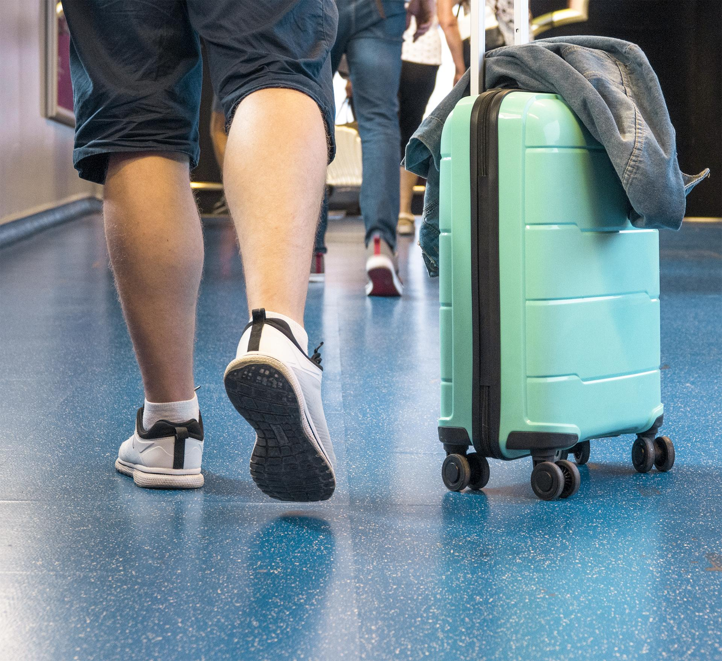
The goal
Differences in travel habits
2 characteristics
Typical customer profiles
Typical non-customer profiles
6 characteristics

Slide 4

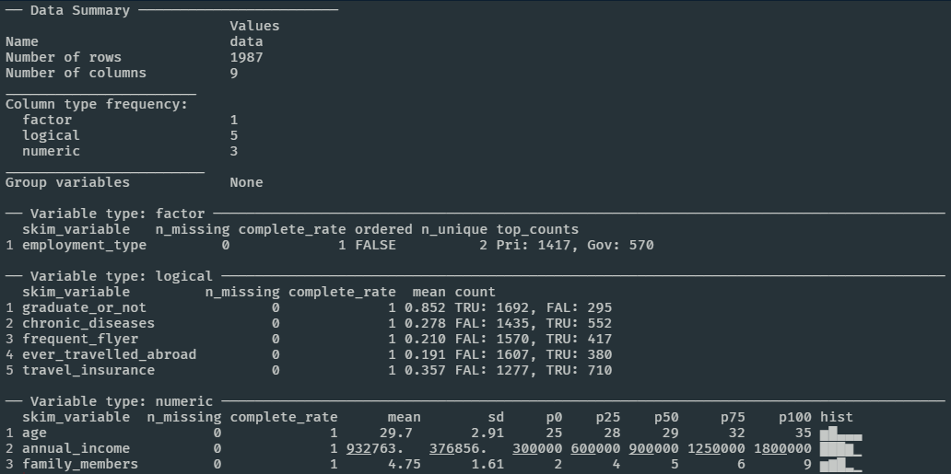
Data preparation

Slide 5

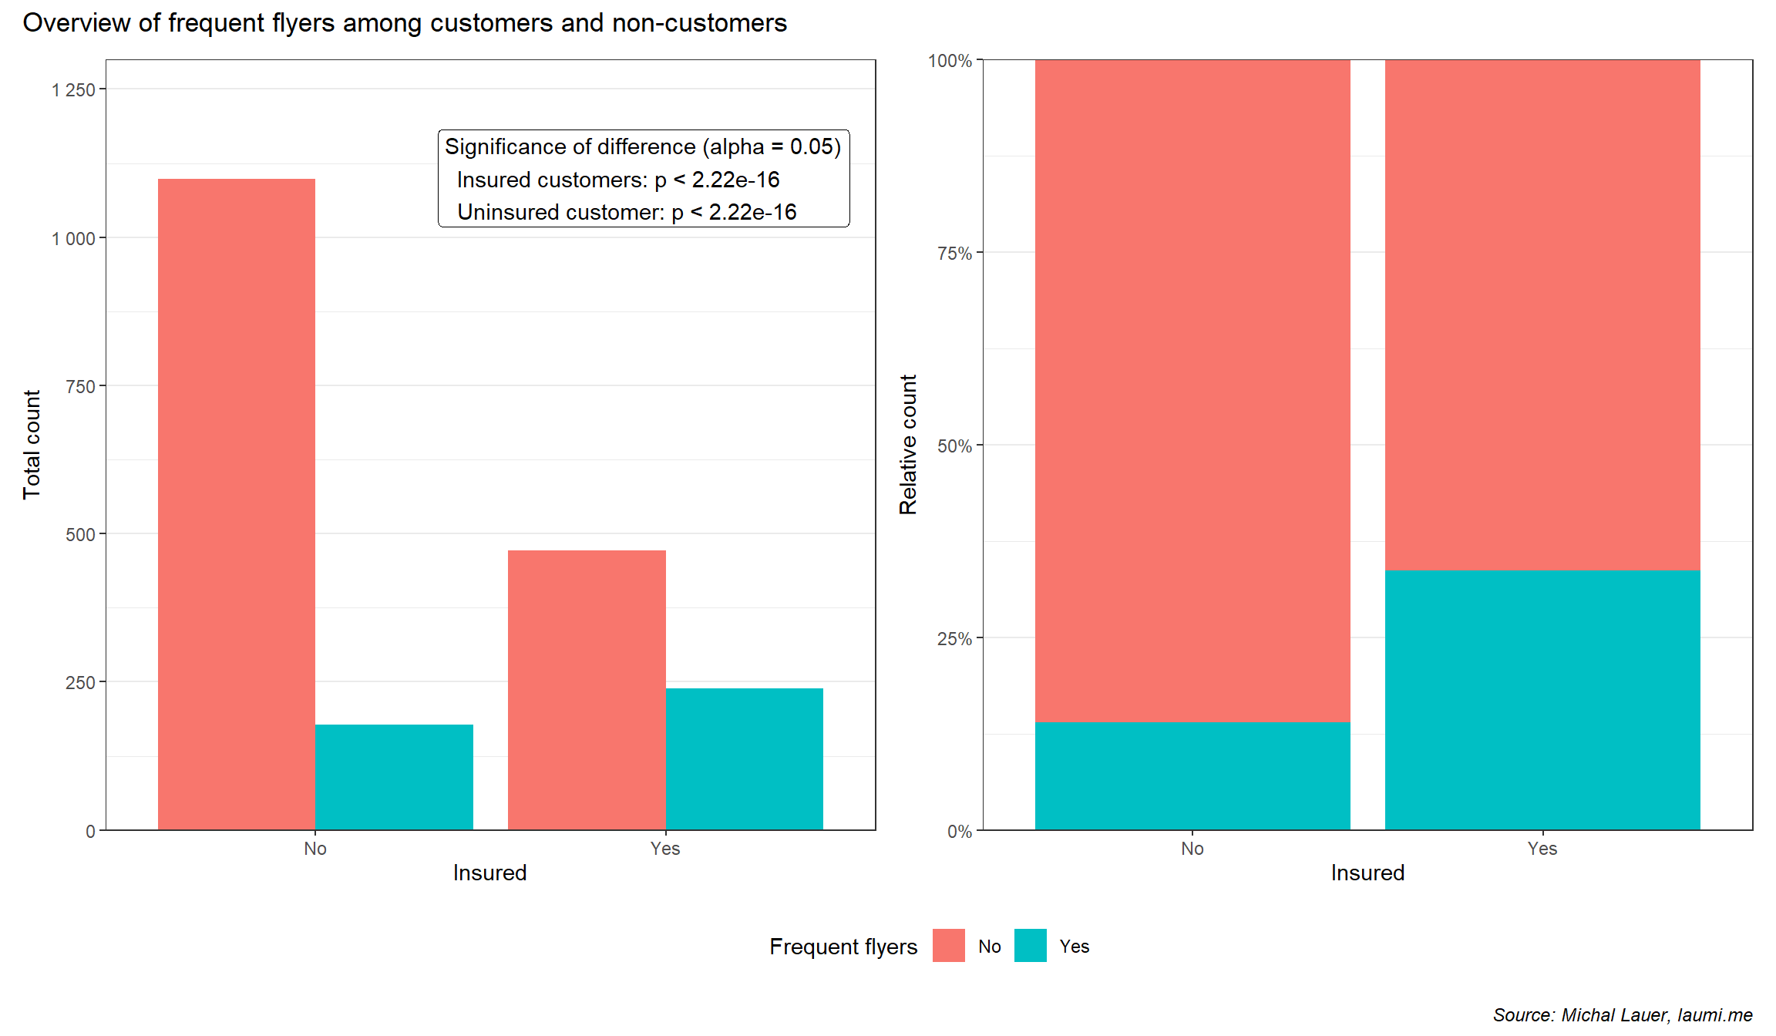
Frequent flyers

Slide 6
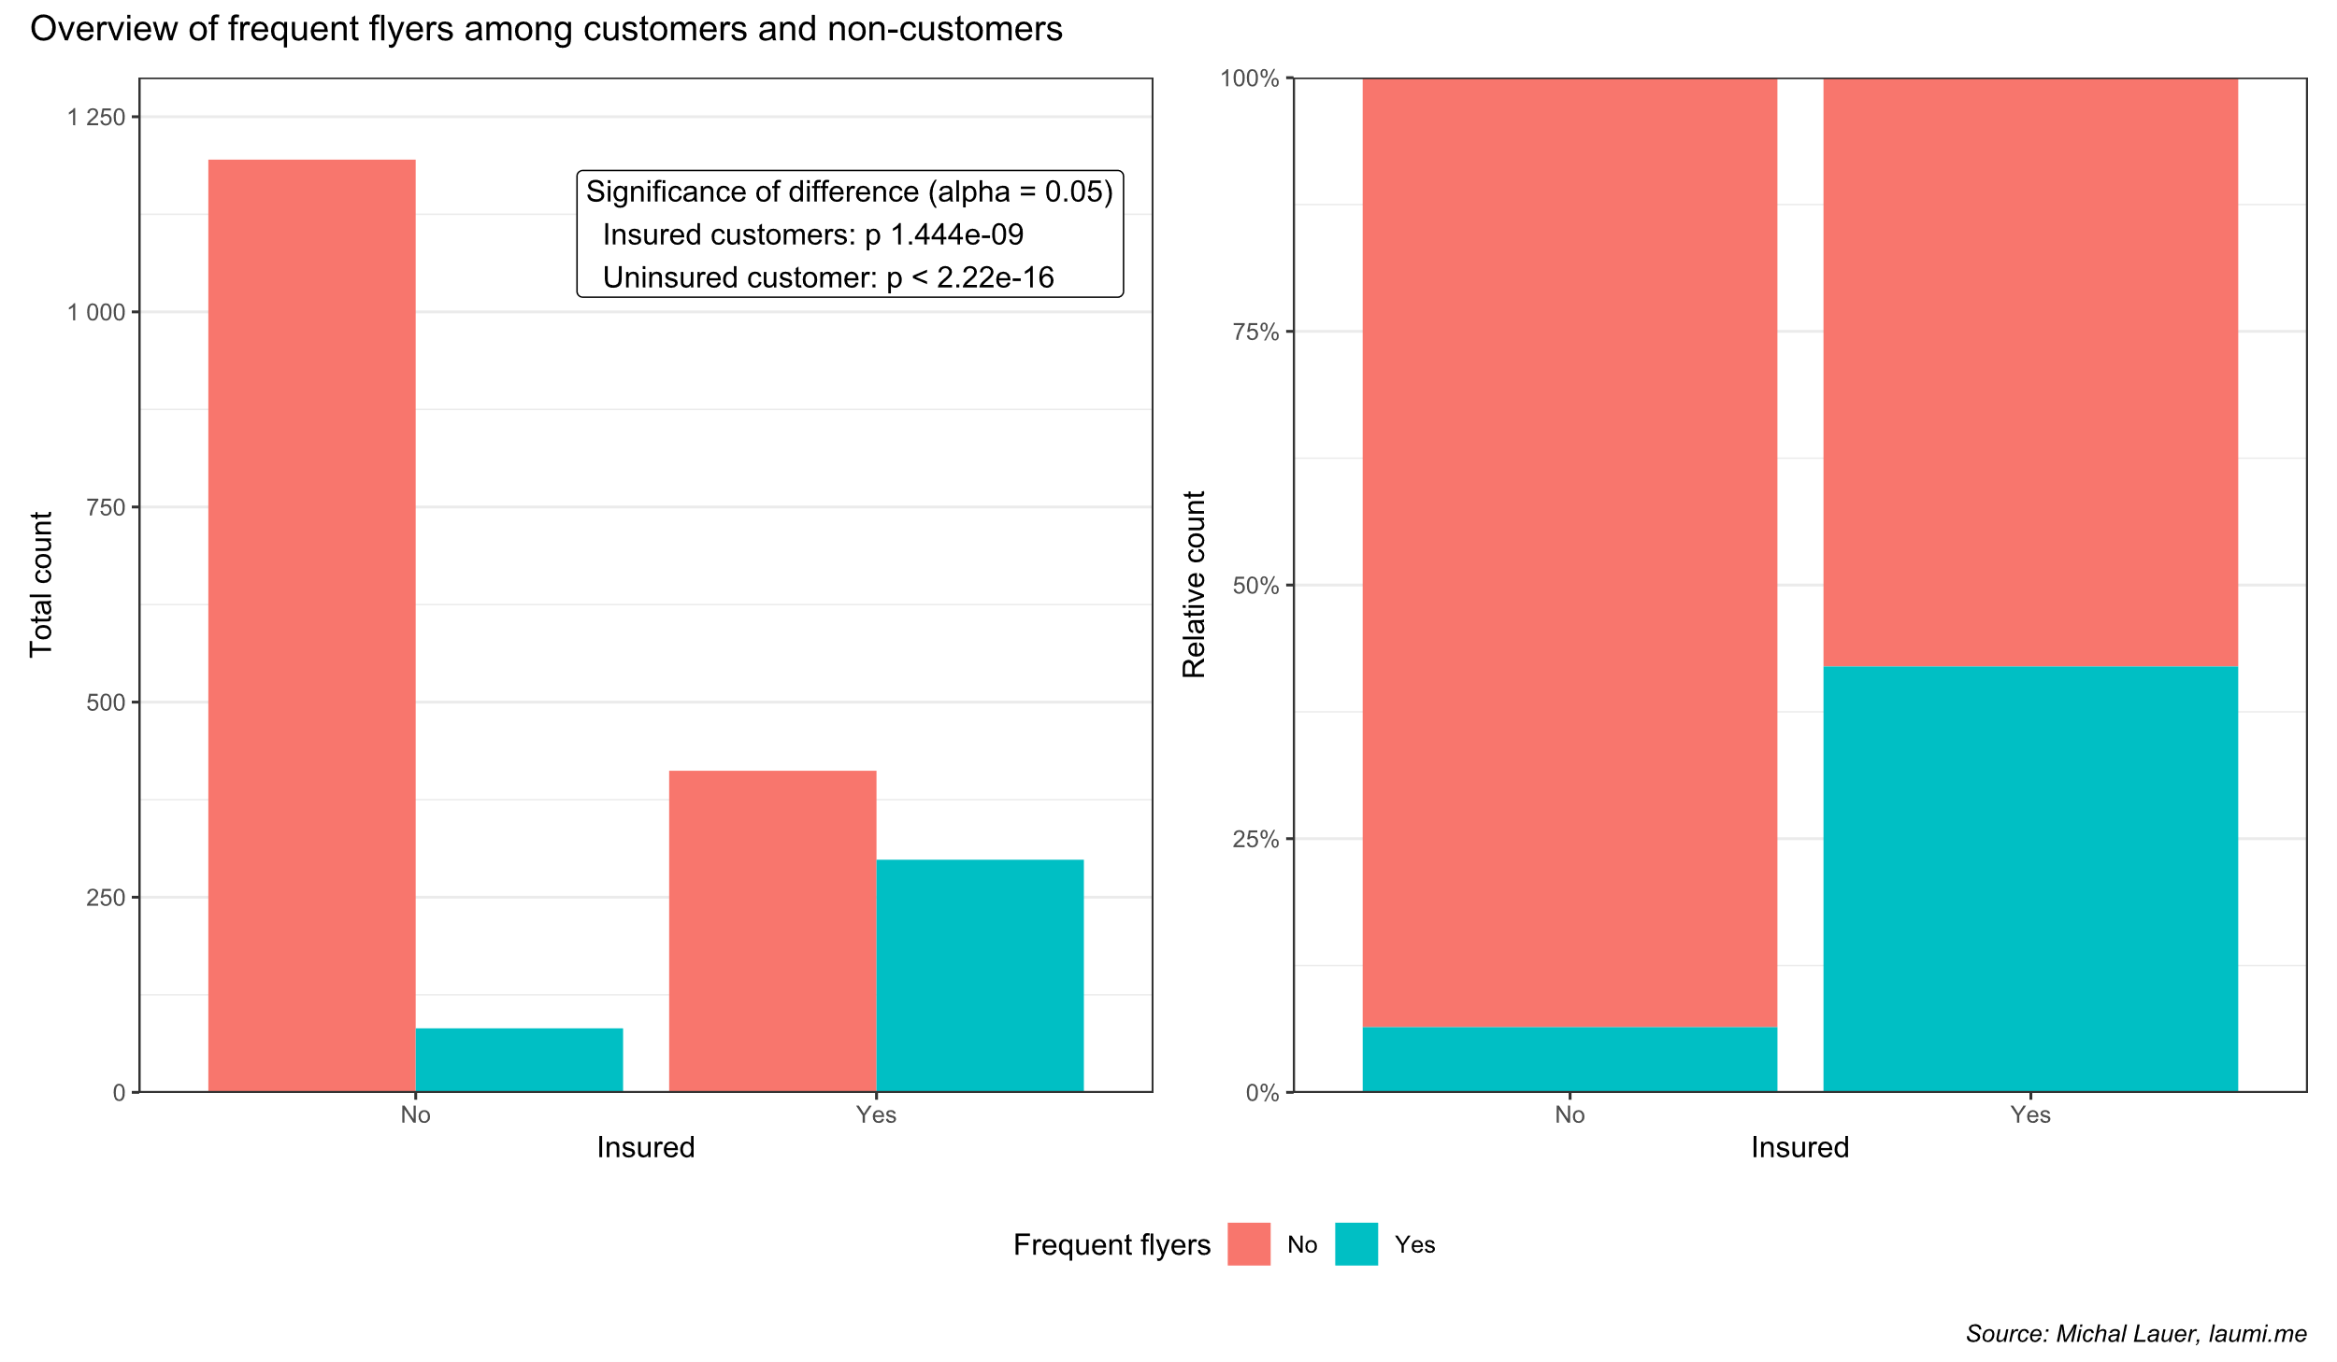
Ever travelled abroad

Slide 7

Customer profiles
 | Customers | Non-customers | P-value
Age | Mean: 29,9; SD: 3,33 | Mean: 29,50; SD: 2,64 | 0,031
Annual income (mil $) | Mean: 1,13; SD: 0,37 | Mean: 0,82; SD: 0,33 | < 0,001
Family members | Mean: 4,93; SD: 1,68 | Mean: 4,66; SD: 1,56 | < 0,001
Graduated | 611 / 710 (86,1 %) | 1 081 / 1 277 (84,7 %) | 0,40
Have chronic disease | 205 / 710 (28,9 %) | 347 / 1 277 (27, 2 %) | 0,42
Government sector | 140 / 710 (19,7 %) | 430 / 1 277 (33,7 %) | < 0,001

Slide 8

Final summary
Focus on irregular flyers
Discount for first flights in n months
Email newsletter
Customers who have never been abroad
Advertise interesting sights
Cooperate marketing with airlines
Non-customers who are young
New PR methods (TikTok, Instagram…)
Discounts for non-customers with smaller annual income
„First insurance is n % off“
Group discounts
„Pay for 3, get 1 for free/with a discount“

Slide 9
Thanks!
Pleasure having you!
laumi.me
michal.lauer.25@gmail.com
Please keep this slide for attribution

