Slide 1

Polarizing Social Media Debates
Team Social Media
Driving Democracy with Data in CEE Datathon
Vienna, 21st of April, 2018
Notes:
Several alternative title slide layouts are available toward the end of this template deck.

Slide 2

Agenda
Elements of Polarization
Data overview
Topics
Sentiments
Polarizations & Networks

Slide 3
Elements of Polarization
Sentiments
Networks
Polarization
Topics

Slide 4
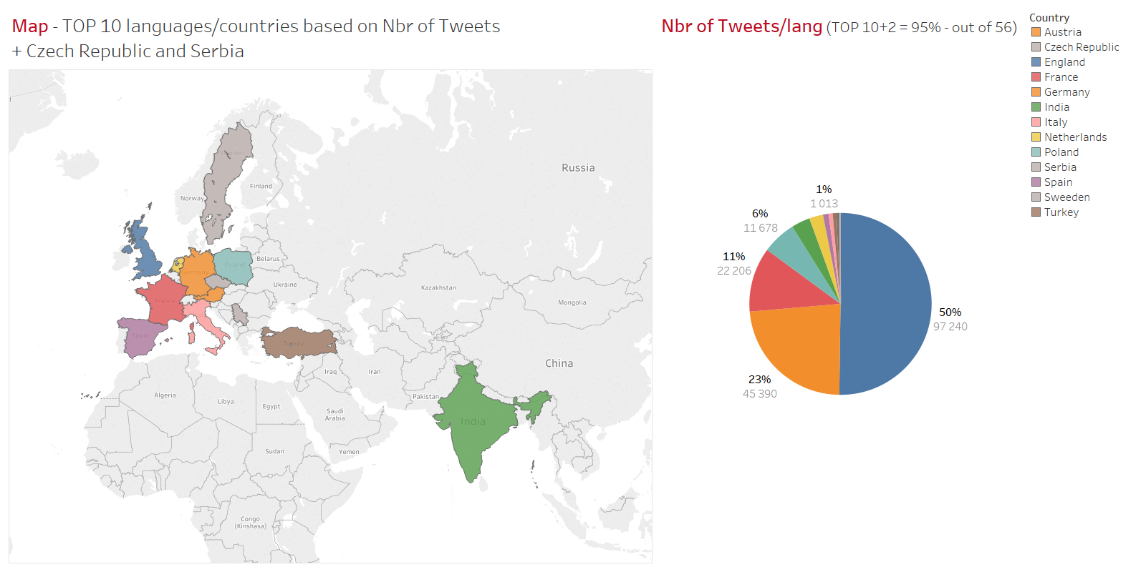
Data

Slide 5
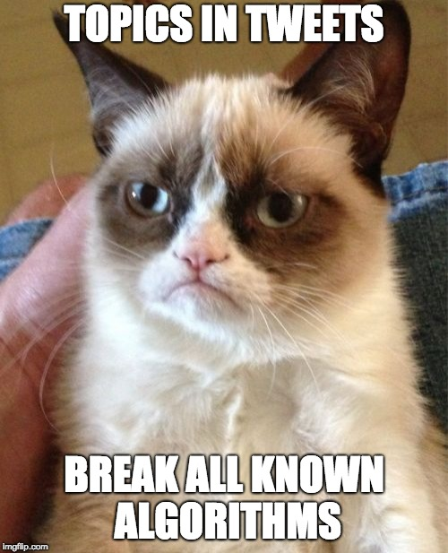

Slide 6
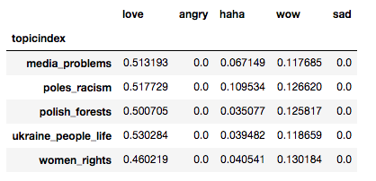
Topic Mining Tweets

Slide 7
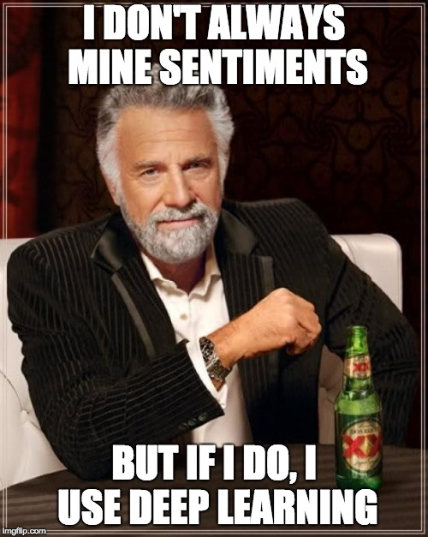

Slide 8
Deep Learning based Sentiment Analysis
Recurrent neural network trained on hundreds of thousands of Facebook posts and their reactions
Scraped from the 100 most popular pages – to avoid contextualization
Predicts the sentiment distribution of any given text in
Love
Wow
Haha
Sad
Angry

Slide 9
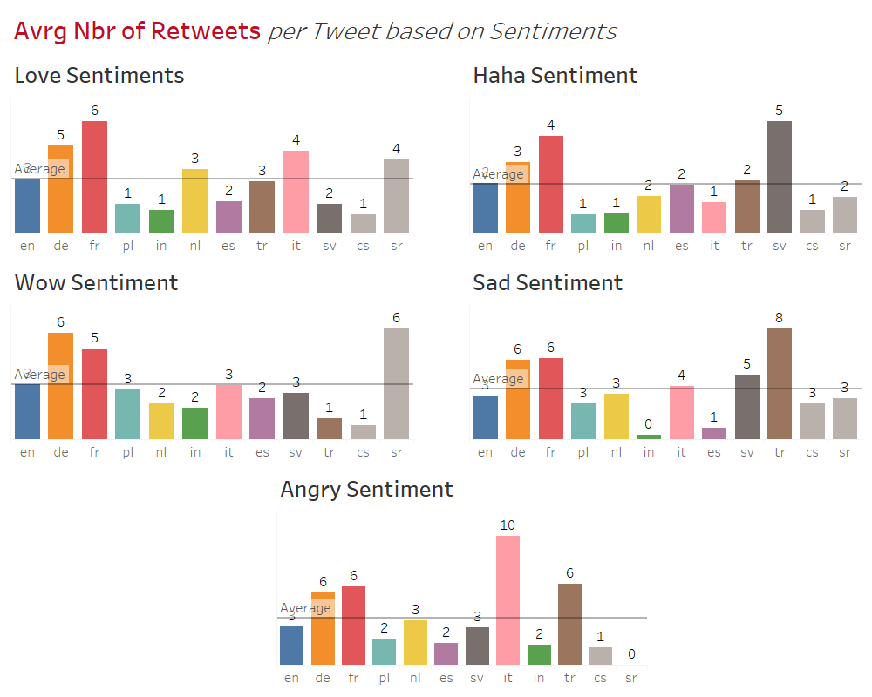
Influence of Sentiment on Popularity

Slide 10
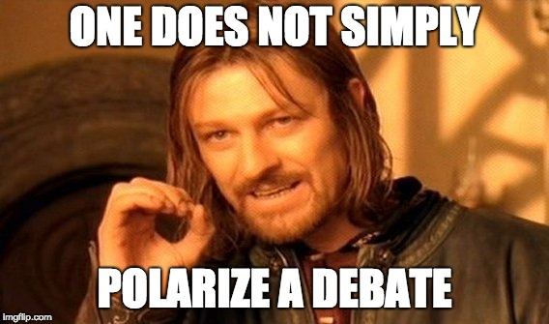

Slide 11
Polarization & Network Results

Slide 12
Notes:
Closing slide for all presentations

