Slide 1
Civil Society Participation
General insights from open data sources
Teradata - Datathon
21/04/2018 Vienna

Slide 2
First notes
Aim:
Scale: CEE countries
Dependent variable: civil society participation
Independent variables: from the world bank and civil society data sources (around 400)
Use of Python and R

Slide 3
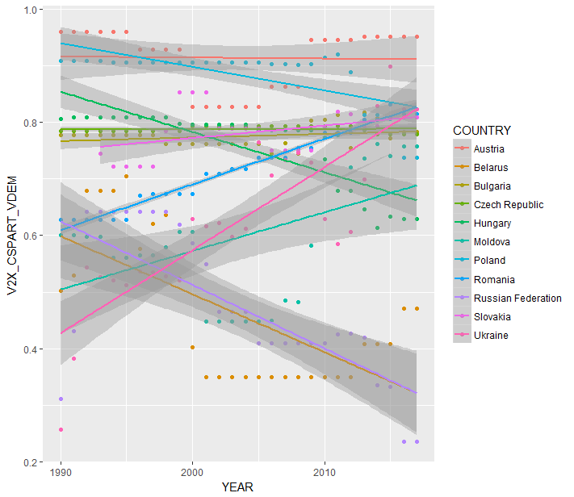
Overview of civil society participation in CEE

Slide 4
Top 10 positive correlated variables
CSO participatory environment *
Forest area (% land area)
CSO Consultation *
Women political participation index *
Religious organization consultation
Sustainable energy for all
State ownership of economy
Jobs (mobile cellular subscriptions (per 100 people))
Renewable electricity output (% of total electricity output)
Secondary tertiary enrollment

Slide 5
Top 10 negative correlated variables
Government attacks on judiciary
CO2 emissions (kg per 2010 US$ of GDP)
Ratio of female to male labor force participation rate (%)
Mortality rate, neonatal (per 1000 live births)
Mortality rate, under 5 months (per 1000 live births)
Freedom from forced labor
Health equality
Prevalence of anemia among children (%childrenUnder5)
Permanent cropland (% of land area)
CO2 emissions (metric tons per capita)

Slide 6
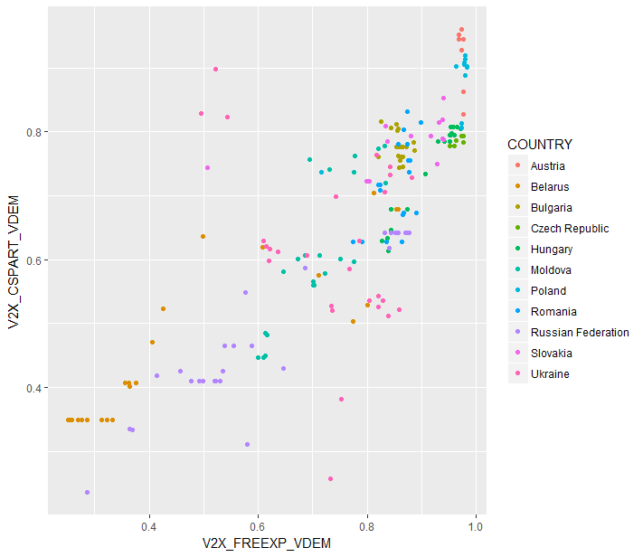
Example: freedom of expression (1)

Slide 7
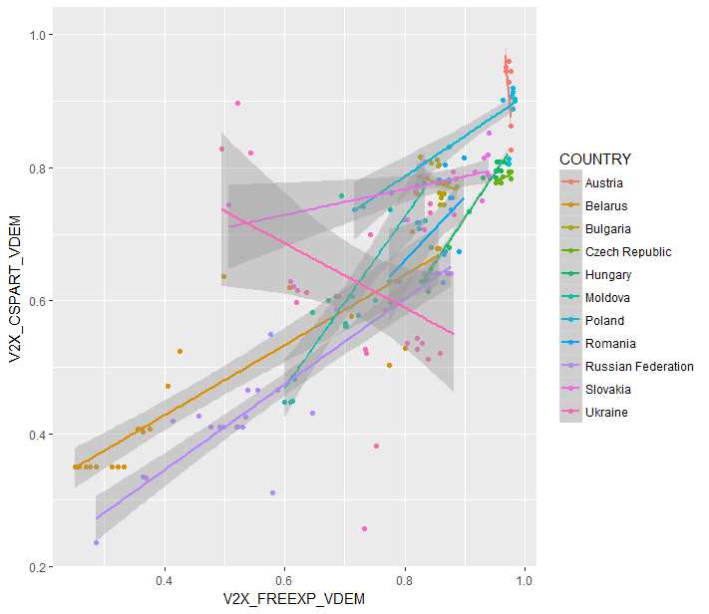
Example: freedom of expression (2)

Slide 8
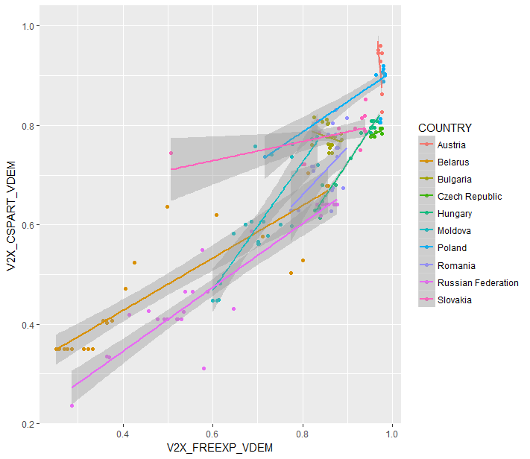
Example: freedom of expression (3)

Slide 9
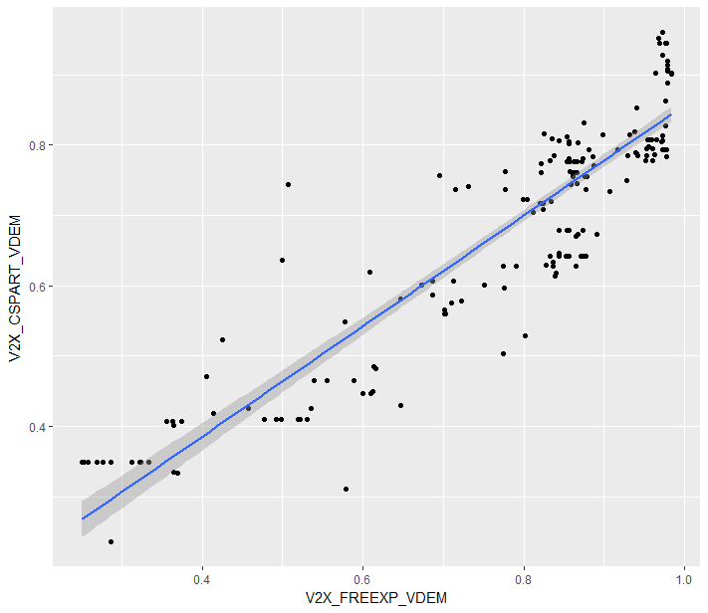
Example: freedom of expression (3)

Slide 10
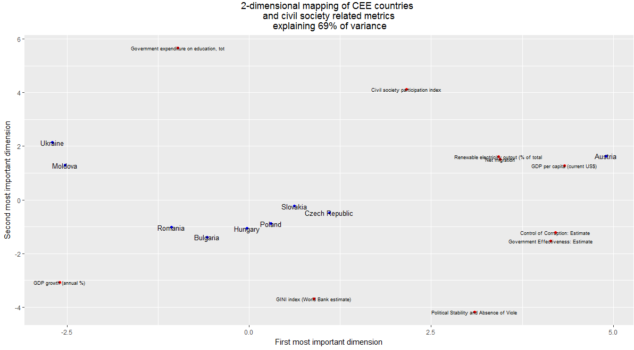
Unsupervised learning approach

Slide 11
Final result

Slide 12
Suggestions for future research
More accurate exploratory and cleaning process of the data => “More data dominates better techniques”
Normalization of variables for better interpretation of coefficients
Possible models (an overview for future discussion)
- Random forest
Gain a better understanding of the complex matter of civil society by:
conducting case studies for countries that disclose exceptional behaviour in multiple dimensions (e.g. Ukraine)
using regional data and spatial analysis
implementing microeconomic data and/or behavioural approaches (e.g. from household surveys) to explain what drives/motivates people to engage in civil society

