Slide 1
IP - The Internet Protocol
Relates to Lab 2.
A module on the Internet Protocol.

Slide 2
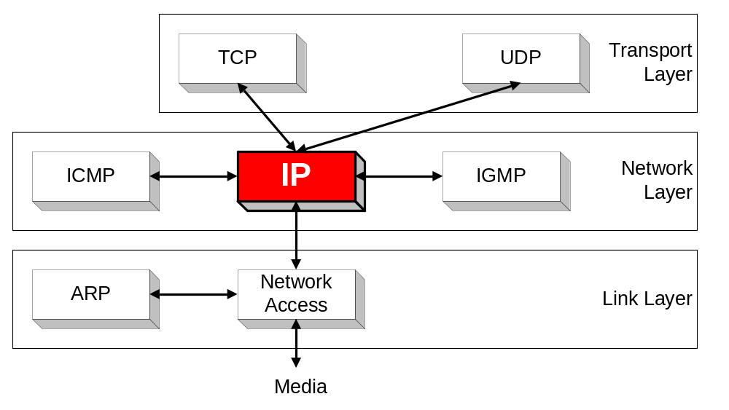
Orientation
IP (Internet Protocol) is a Network Layer Protocol.
IP’s current version is Version 4 (IPv4). It is specified in RFC 891.

Slide 3
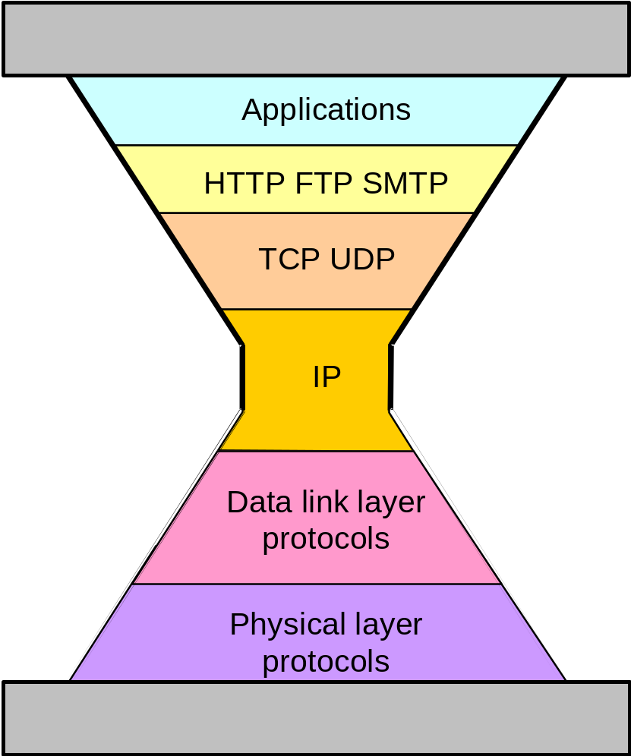
IP: The waist of the hourglass
IP is the waist of the hourglass of the Internet protocol architecture
Multiple higher-layer protocols
Multiple lower-layer protocols
Only one protocol at the network layer.

Slide 4
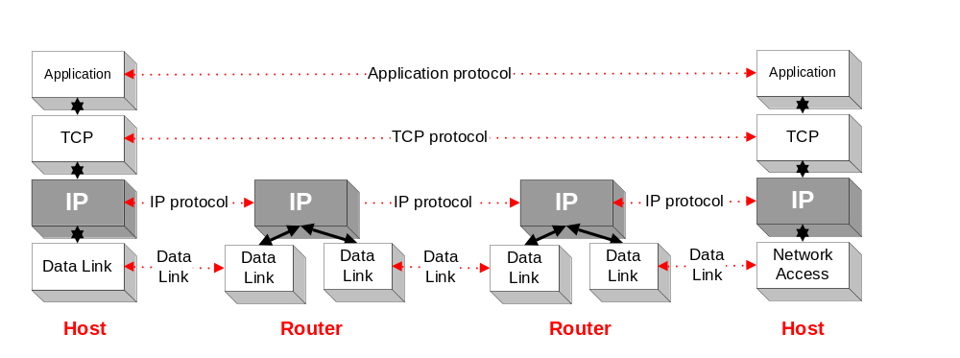
Application protocol
IP is the highest layer protocol which is implemented at both routers and hosts

Slide 5
IP Service
Delivery service of IP is minimal
IP provide provides an unreliable connectionless best effort service (also called: “datagram service”).
  Unreliable: IP does not make an attempt to recover lost packets
  Connectionless: Each packet (“datagram”) is handled independently. IP is not aware that packets between hosts may be sent in a logical sequence
  Best effort: IP does not make guarantees on the service (no throughput guarantee, no delay guarantee,…)
Consequences:
Higher layer protocols have to deal with losses or with duplicate packets
Packets may be delivered out-of-sequence

Slide 6

IP Service
IP supports the following services:
    one-to-one (unicast)
    one-to-all (broadcast)
    one-to-several (multicast)
IP multicast also supports a many-to-many service.
IP multicast requires support of other protocols (IGMP, multicast routing)
unicast
broadcast
multicast

Slide 7
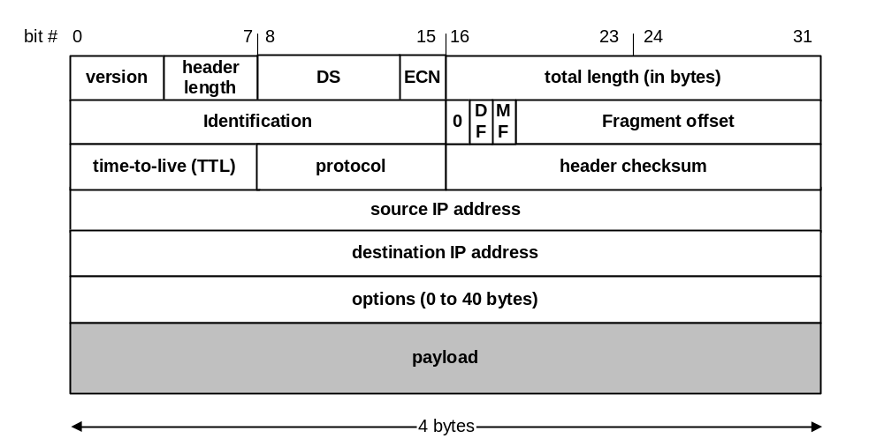
IP Datagram Format
20 bytes ≤ Header Size < 2⁴ x 4 bytes = 60 bytes
20 bytes ≤ Total Length < 2¹⁶ bytes = 65536 bytes

Slide 8
IP Datagram Format
Question: In which order are the bytes of an IP datagram transmitted?
Answer:
    Transmission is row by row
    For each row:
        1. First transmit bits 0-7
        2. Then transmit bits 8-15
        3. Then transmit bits 16-23
        4. Then transmit bits 24-31
This is called network byte order or big endian byte ordering.
Note: some computers store 32-bit words in little endian format.

Slide 9
Fields of the IP Header
Version (4 bits): current version is 4, next version will be 6.
Header length (4 bits): length of IP header, in multiples of 4 bytes
DS/ECN field (1 byte)
  This field was previously called as Type-of-Service (TOS) field. The role of this field has been re-defined, but is “backwards compatible” to TOS interpretation
  Differentiated Service (DS) (6 bits):
    Used to specify service level (currently not supported in the Internet)
  Explicit Congestion Notification (ECN) (2 bits):
    Feedback mechanism used by TCP

Slide 10
Fields of the IP Header
Identification (16 bits): Unique identification of a datagram from a host. Incremented whenever a datagram is transmitted
Flags (3 bits):
  First bit always set to 0
  DF bit (Do not fragment)
  MF bit (More fragments)
  Will be explained later→ Fragmentation

Slide 11
Fields of the IP Header
Time To Live (TTL) (1 byte):
  Specifies longest paths before datagram is dropped
  Role of TTL field: Ensure that packet is eventually dropped when a routing loop occurs
  Used as follows:
  Sender sets the value (e.g., 64)
  Each router decrements the value by 1
  When the value reaches 0, the datagram is dropped

Slide 12
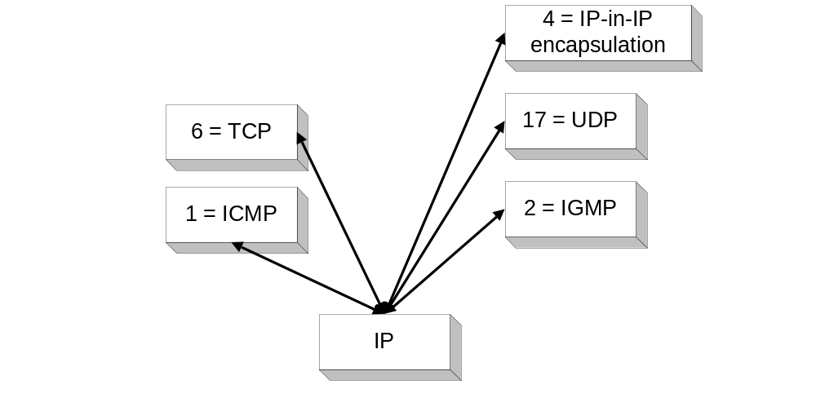
Fields of the IP Header
Protocol (1 byte):
    Specifies the higher-layer protocol.
    Used for demultiplexing to higher layers.
Header checksum (2 bytes): The IP checksum is a 16 bit 1's complement sum of all the 16 bit words in the IP header.

Slide 13
Fields of the IP Header
Options:
    Security restrictions
    Record Route: each router that processes the packet adds its IP address to the header.
    Timestamp: each router that processes the packet adds its IP address and time to the header.
    (loose) Source Routing: specifies a list of routers that must be traversed.
    (strict) Source Routing: specifies a list of the only routers that can be traversed.
Padding: Padding bytes are added to ensure that header ends on a 4-byte boundary

Slide 14
Maximum Transmission Unit
Maximum size of IP datagram is 65535, but the data link layer protocol generally imposes a limit that is much smaller
For example:
  Ethernet frames have a maximum payload of 1500 bytes→
  IP datagrams encapsulated in Ethernet frame cannot be longer than 1500 bytes
The limit on the maximum IP datagram size, imposed by the data link protocol is called maximum transmission unit (MTU)
MTUs for various data link layers:
  Ethernet: 1500 FDDI: 4352
  802.3: 1492 ATM AAL5: 9180
  802.5: 4464 PPP: 296
What if the size of an IP datagram exceeds the MTU?
IP datagram is fragmented into smaller units.
What if the route contains networks with different MTUs?

Slide 15
Maximum Transmission Unit
Maximum size of IP datagram is 65535, but the data link layer protocol generally imposes a limit that is much smaller
Example:
  Ethernet frames have a maximum payload of 1500 bytes
  → IP datagrams encapsulated in Ethernet frame cannot be longer than 1500 bytes
The limit on the maximum IP datagram size, imposed by the data link protocol is called maximum transmission unit (MTU)
MTUs for various data link protocols:
  Ethernet: 1500 FDDI: 4352
  802.3: 1492 ATM AAL5: 9180
  802.5: 4464 PPP: negotiated

Slide 16
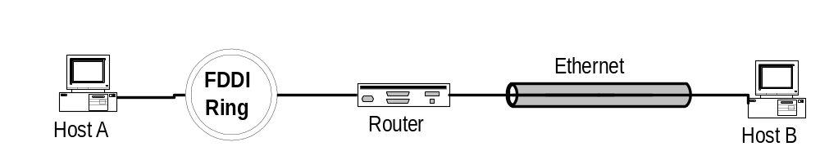
IP Fragmentation
What if the size of an IP datagram exceeds the MTU?
IP datagram is fragmented into smaller units.
What if the route contains networks with different MTUs?
MTUs: FDDI: 4352 Ethernet: 1500
Fragmentation:
  IP router splits the datagram into several datagram
  Fragments are reassembled at receiver

Slide 17
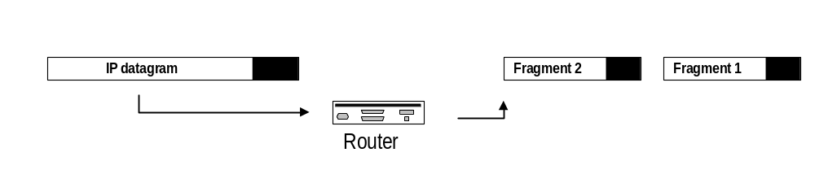
Where is Fragmentation done?
    Fragmentation can be done at the sender or at intermediate routers
    The same datagram can be fragmented several times.
    Reassembly of original datagram is only done at destination hosts !!

Slide 18
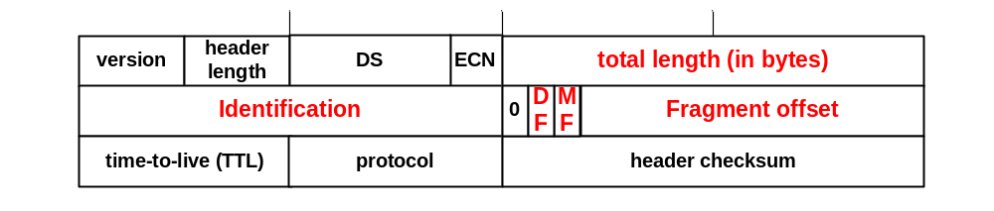
What’s involved in Fragmentation?
The following fields in the IP header are involved:
Identification When a datagram is fragmented, the identification is the same in all fragments
Flags
DF bit is set: Datagram cannot be fragmented and must be discarded if MTU is too small
MF bit set: This datagram is part of a fragment and an additional fragment follows this one

Slide 19
What’s involved in Fragmentation?
The following fields in the IP header are involved:
Fragment offset Offset of the payload of the current fragment in the original datagram
Total length Total length of the current fragment

Slide 20
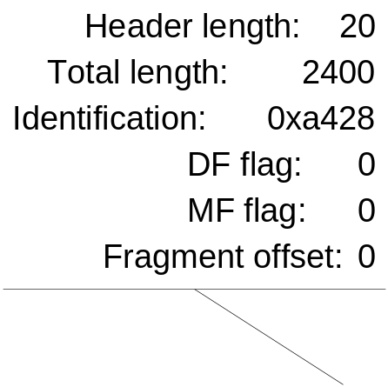
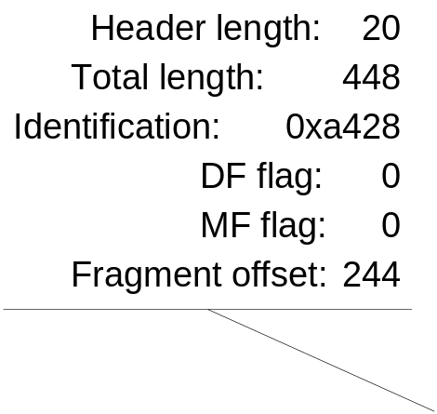
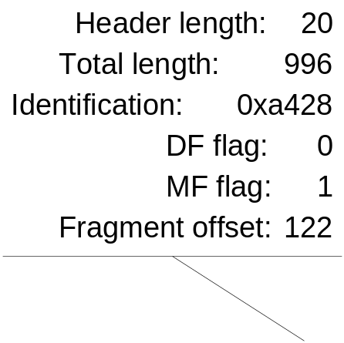
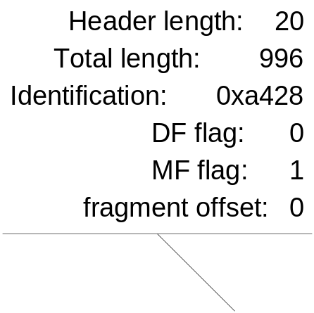
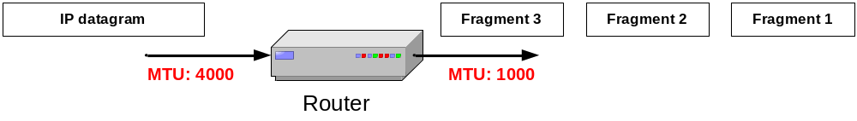
Example of Fragmentation
A datagram with size 2400 bytes must be fragmented according to an MTU limit of 1000 bytes (note IP header is 20bytes)
First Fragment:
MTU = 1000
Datagram = 2400 = 20 header + 2380 payload
MTU can carry 1000 – 20 (Header) = 980 data bytes
Fragments have to be multiple of 8 in size (2¹³).
So 980/8=122R4
Therefore carried payload will be 980-4=976 bytes
The first fragment will be 20 (Header) + 976 data = 996 in length.
Fragment offset will be 0 bytes.
Data remaining to be transmitted = 2380 – 976.
Offset of next datagram will be 976/8 = 122
Second Fragment:
Data remaining to be carried: 2380 – 976 = 1404 > 980 --> 976
The second fragment will be 20 (Header) + 976 data = 996 in length.
Fragment offset will be 122 bytes (size of 1st fragment payload).
Offset of next datagram will be 122 + 976/8 = 244
Third Fragment:
Data remaining to be transmitted = 2380 – 976 – 976 = 428
The 3rd fragment will be 20 (Header) + 428 data = 448 in length.
Fragment offset will be 244 bytes (size of 1st and 2nd fragment payloads).

