Slide 1
Visualization app Issues related to redundancy coding
Bartosz Kołakowski – team leader
Paweł Jastrzębski
Piotr Noga
Michał Mróz
Maksym Nowak

Slide 2
Project description
A tool supporting the teaching process - an application that visualizes issues related to redundant coding The application is to present: - the process of encoding selected redundant codes, - the process of decoding selected redundant codes, - encoding gain, - various issues related to the topic, - allow experiments to be carried out Aesthetically pleasing graphical interface

Slide 3
How the work was carried out
We were able to achieve the desired results because: - regular meetings to work on the project, - fast and accessible communication, - planning work before the implementation of tasks, - assigning tasks according to the capabilities of given people, - not completing tasks at the last minute, - regular meetings with the project supervisor (every 2-3 weeks) - writing documentation (including technical documentation)

Slide 4
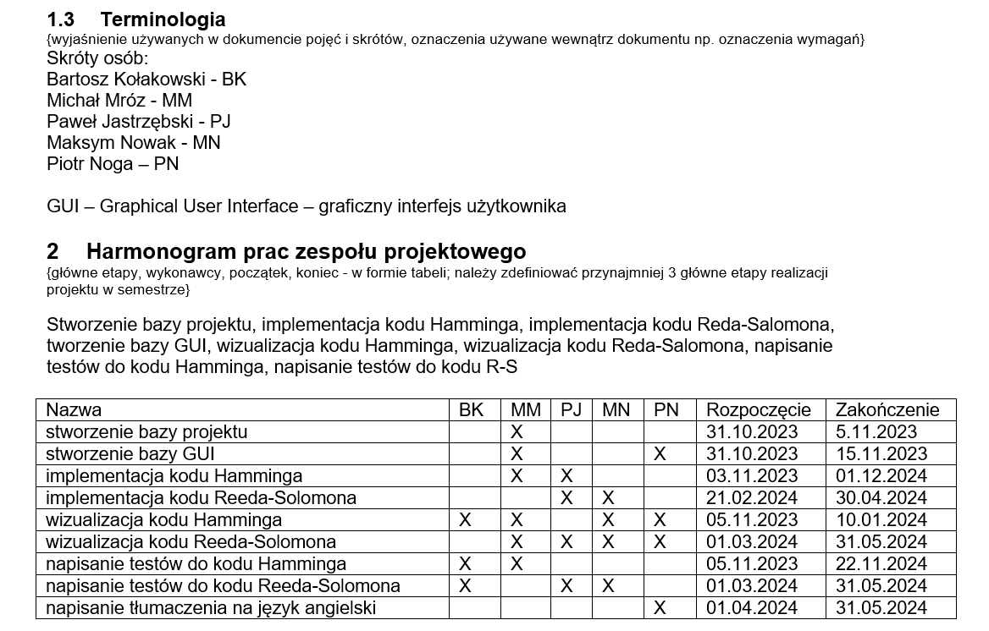

Slide 5
Results
Goals we achieved: - creating a project database, - creating a GUI database, - implementation of Hamming code, - visualization of Hamming code, - implementation of the Reed-Solomon code, - visualization of the Reed-Solomon code, - translation of the program into English, - writing tests

Slide 6






Environment
C++ language Qt framework Using Qt Modeling Language Google Test testing Using the Boost library Available on Windows

Slide 7
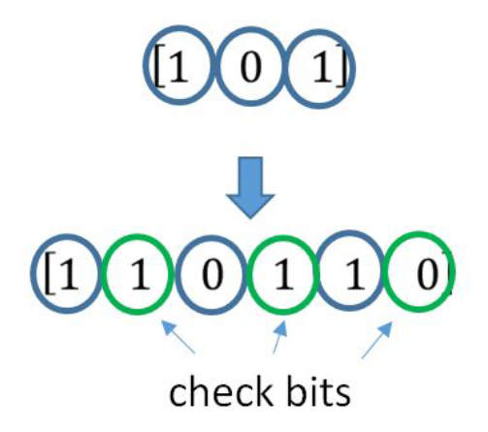
Redundancy coding
Intentional introduction of redundancy in the transmitted string in order to be able to detect and eliminate transmission errors dmin - the smallest distance between 2 code strings code (n, k), n - number of bits encoded k - number of data bits Code information content: R = k/n Detects v errors, v = dmin - 1 Corrects t errors, t = (dmin - 1) / 2 Hamming Code, Reed-Solomon Code, Reed-Muller, repetitive

Slide 8
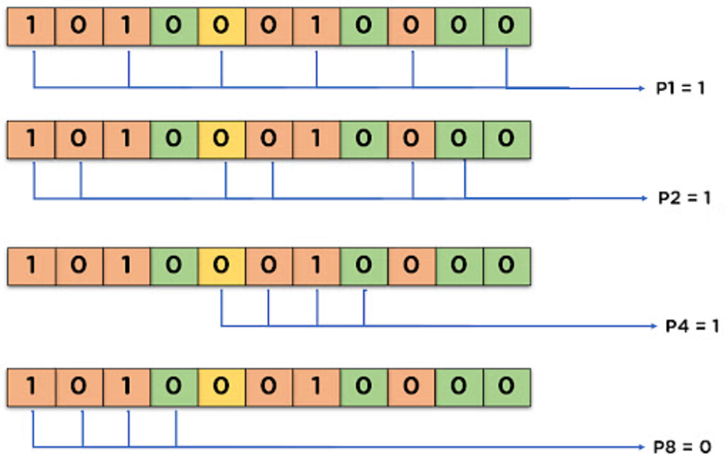
The Hamming Code
Hamming code – a linear correction code that allows you to detect 1 error at any position
Parity control bits used Extra parity bit allows 2 errors to be detected (not fixed) When decoding, counting XORs parity bits gives the syndrome In this implementation: Each bit of parity check is an XOR data on the position having "1" on the the right place in the national team Binary
Decimal representation of the syndrome indicates the position of the error

Slide 9
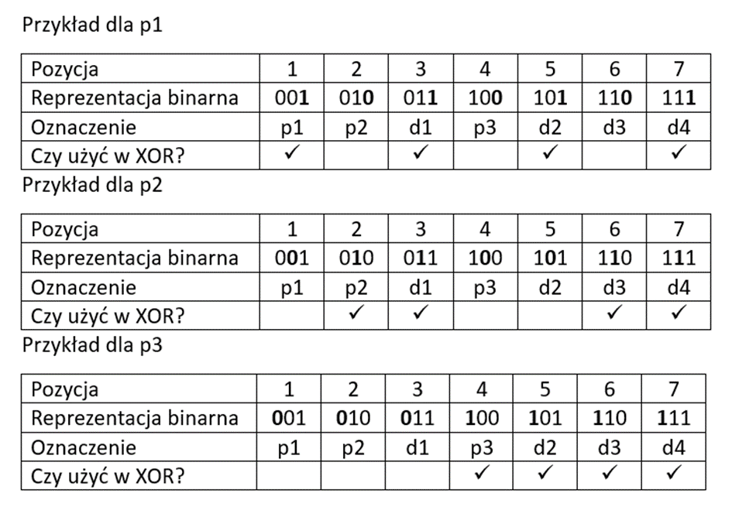

Slide 10
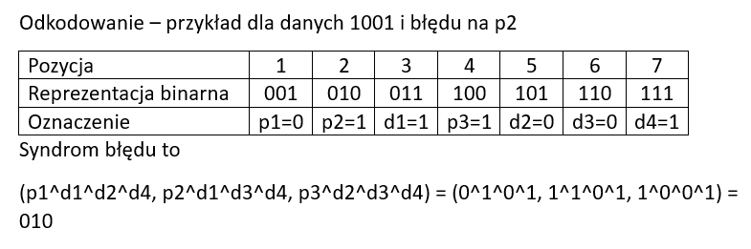

Slide 11
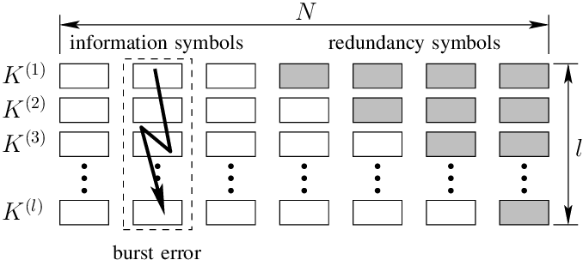
Reeda-Solomon Code

Slide 12
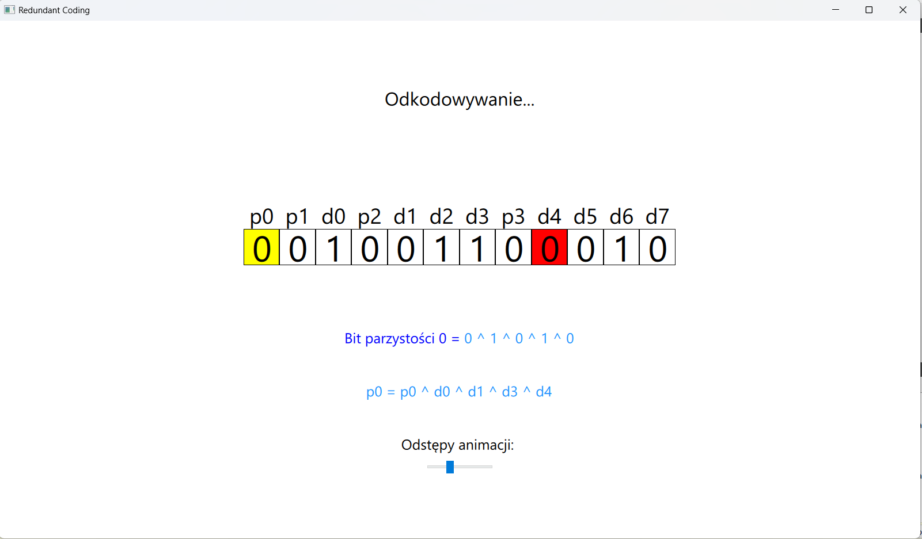
And now presentation of how the application works

Slide 13
What we learned from the project
We have increased our knowledge and skills in the field of: - group work, - communication in the team, - conflict resolution, - determining the division of tasks, - writing documentation, - selection of technology for the project

