Slide 1


Online Matching with Delays and Stochastic Arrival Times
Mathieu Mari, Michał Pawłowski,
Runtian Ren, Piotr Sankowski
Notes:
Mention that I will start with a motivation and then present the general problem and sketch our approach

Slide 2
Motivation
Simple example
Previous results
Model description
Algorithm and analysis
Generalizations

Slide 3





Motivation
Motivation
Platform

Slide 4


Motivation
Platform
Gaming cycle
1
log in
2
request

Slide 5





Motivation
Platform
Gaming cycle
1
log in
2
request
3
wait
4
get matched

Slide 6



Motivation
Platform
Gaming cycle
Cost types
1
log in
waiting time
2
request
$$t$$
3
wait
2
3
4
experience difference
$$e$$
4
get matched
5
play

Slide 7




Simple example
Information about players
Mary
Kyle
Sara
Jack
Ryan
Emma

Slide 8








Simple example
Information about players
$$e$$
?
$$t$$
Mary
Kyle
Sara
Jack
Ryan
Emma

Slide 9


Simple example
Information about players
Matching
$$e$$
1
E
J
M
K
2
R
S
$$t$$
3
Mary
Kyle
Sara
Jack
Ryan
Emma

Slide 10






Simple example
Information about players
Matching
Cost
$$e$$
1
E
J
M
M
K
K
2
R
S
$$t$$
3
waiting
time
experience difference
Mary
Kyle
Sara
Jack
Ryan
Emma

Slide 11
Simple example
Information about players
Matching
Cost
$$e$$
1
E
J
J
M
K
2
R
S
S
$$t$$
3
waiting
time
experience difference
Mary
Kyle
Sara
Jack
Ryan
Emma

Slide 12
Simple example
Can we do better?
Information about players
Matching
Cost
$$e$$
1
E
E
J
M
K
2
R
R
S
$$t$$
3
waiting
time
experience difference
Mary
Kyle
Sara
Jack
Ryan
Emma

Slide 13
Can we do better?
Information about players
Matching
Cost
$$e$$
1
E
J
M
K
2
R
S
$$t$$
3
waiting
time
experience difference
Mary
Kyle
Sara
Jack
Ryan
Emma

Slide 14


Can we do better?
Information about players
Matching
Cost
$$e$$
1
M
K
2
$$t$$
3
waiting
time
experience difference
Mary
Kyle
Sara
Jack
Ryan
Emma

Slide 15
Can we do better?
Information about players
Matching
Cost
$$e$$
1
E
J
M
K
2
R
S
$$t$$
3
waiting
time
experience difference
Mary
Kyle
Sara
Jack
Ryan
Emma

Slide 16


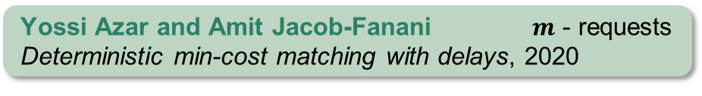

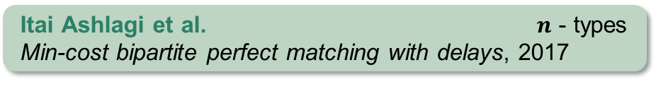

Is this the best approach?
• Previous results
Adversarial model
Balanced greedy
$$e$$
$O\left(m^{log⁡(1.5+ε)}\right)$ approximation
Yossi Azar and Amit Jacob-Fanani $m$ - requests
Deterministic min-cost matching with delays, 2020
Lower bound
$$t$$
$$Ω\left(\log{n}/\log{\log{n}}\right)$$
Itai Ashlagi et al. $n$ - types
Min-cost bipartite perfect matching with delays, 2017
Our result
stochastic arrival times → balanced greedy algorithm is constant-competitive

Slide 17














Model description
Metric space
Requests
$$e$$
request
type
time
$$x$$
$$t_{1}$$
$$z$$
$$w$$
$$x$$
$$z$$
$$t_{2}$$
$$y$$
$$w$$
$$t_{3}$$
$$y$$
$$t_{4}$$
$$t$$

Slide 18
















Model description
Metric space
Requests
Stochastic distributed arrivals
$$e$$
request
type
time
$$Y_{x}$$
$λ_{x}$
$$x$$
$$t$$
$$x$$
$$t_{1}$$
$$w$$
$λ_{y}$
$$y$$
$$Y_{y}$$
$$t$$
$$z$$
$$x$$
$$z$$
$$t_{2}$$
$$y$$
Stochastic centralised arrivals
$$w$$
$$t_{3}$$
$$λ$$
$$x$$
$$Y$$
$$t$$
$$y$$
$$t_{4}$$
$$y$$
$$t$$
$$t$$
Probabilistic properties
$$λ=λ_{x}+λ_{y}$$
$Y_{x}∼Exp\left(λ_{x}\right), { Y}_{y}∼Exp(λ_{y}),$ $\min\left(Y_{x},Y_{y}\right)∼Exp(λ)$
$$ℙ\left(Y_{x}=\min\left(Y_{x},Y_{y}\right)\right)= λ_{x}/\left(λ_{x}+λ_{y}\right)$$

Slide 19








Analysis • Key idea
Metric space
Radius
$$e_{1}$$
$$\frac{1}{λ_{x}}$$
$$w$$
$$z$$
$$x$$
$$y$$
distance from $x$
waiting time
$$e_{2}$$

Slide 20



Analysis • Key idea
Metric space
Radius
$$e_{1}$$
$$\frac{1}{λ_{x}}$$
$$w$$
$$z$$
$$x$$
$$y$$
distance from $x$
waiting time
$$e_{2}$$
$$ρ_{x}$$
Estimations
upper-bound greedy by $const⋅ρ_{x}$
lower-bound optimal by $const⋅ρ_{x}$

Slide 21




Generalizations
Non-linear delay functions
Penalties for clearing pending requests
$$d$$
$$d$$
every request needs to
be served
platform can pay
a penalty cost to clear some requests
$$t$$
$$t$$
Future directions
Multi-level aggregation
Online service
Facility location

Slide 22
Thank you!
Questions?

