Slide 1

Financial analysis
25.03.2024, Warsaw

Slide 2
Agenda
Macroeconomic European Environment
Oil & Gas Sector Analysis
Company Analysis
Financial Analysis
MOL Group - Valuation Analysis
25.03.2024 | Michał Poleszczuk

Slide 3
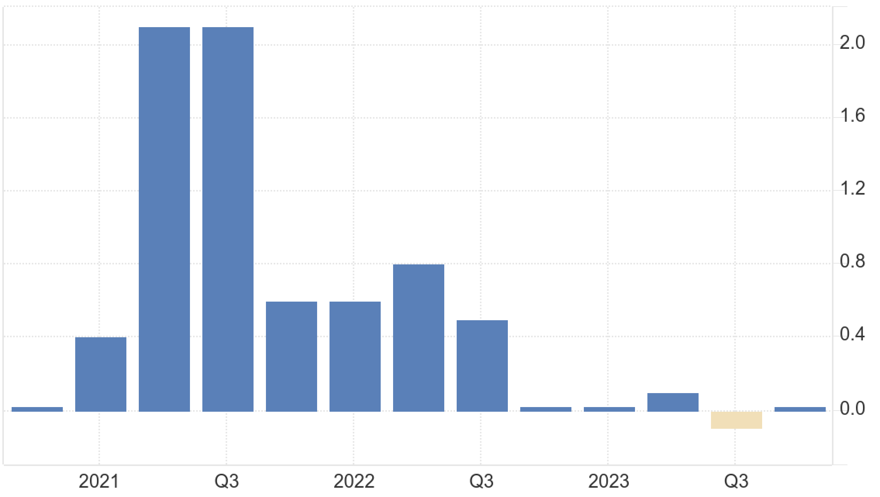
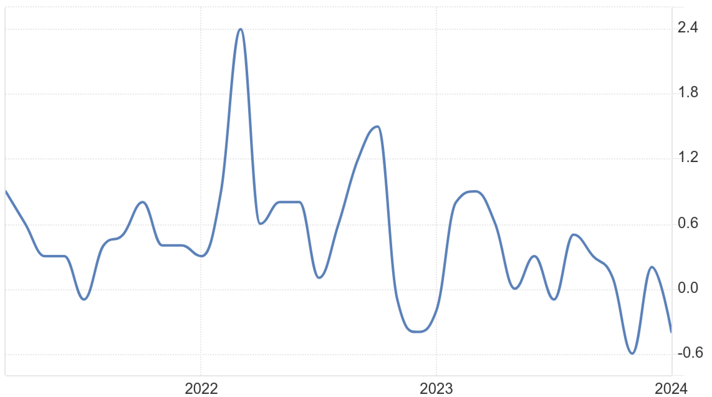
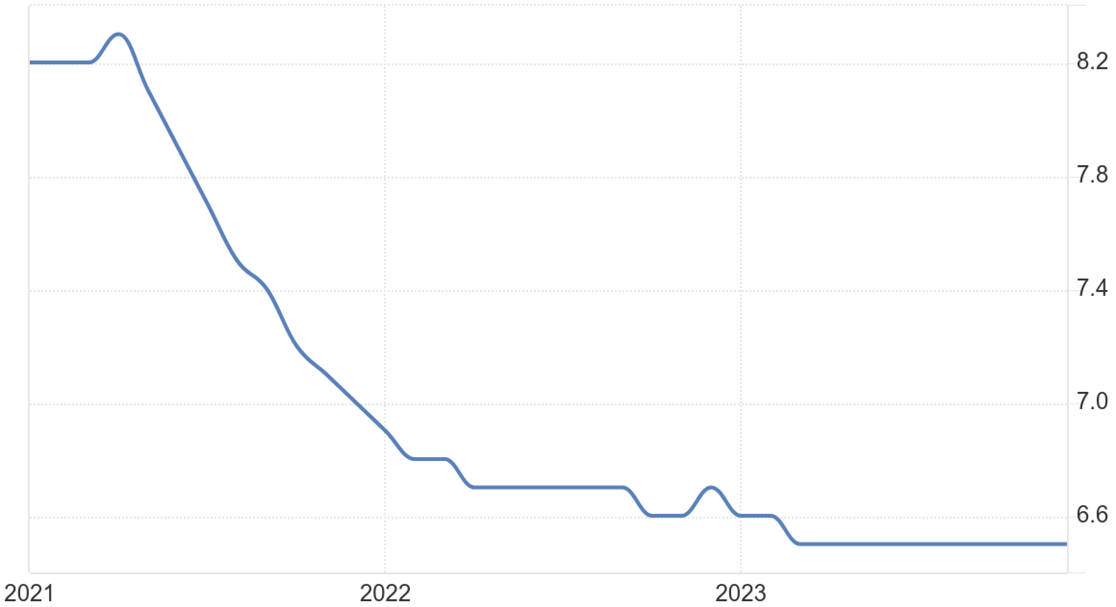




Macroeconomic Europen Environment
GDP Growth Rate
Inflation Rate
Unemployment Rate
*Source: EUROSTAT
*Source: EUROSTAT
*Source: EUROSTAT
POLITICAL
ECONOMICAL
SOCIAL
TECHNOLOGICAL
Regulatory Changes: EU’s ambitious climate policies, “Green Deal” and “Fit for 55” will significantly impact MOL operations
Geopolitical Tensions: war in Ukraine and emerging conflict in Israel affects variability of oil and gas prices globally
Government Stability: political landscape in CSEE is experiencing shifts with potential impact on MOL’s business operations
Trade Policies: EU’s CBAM (Carbon Border Adjustment Mechanism - 2023) imposes carbon price on fossil fuels
Energy Price Fluctuations: volatile oil prices as aftermath of COVID-19 and geopolitical tensions
Economic Growth: post-pandemic recovery rates in CSEE countries vary, influencing energy demand. Especially in transportation and industrial sectors
Access To Financing: tighter monetary policies introduced to combat inflations, lead to increased borrowing costs. This could mean higher interest expense for MOL
Exchange Rate Volatility: as MOL operates in several emerging markers, it is exposed to currency risk
Public On Fossil Fuels: significant shift in environmental awareness towards sustainability and reduction of footprint
Demographic Trends: urbanization in CSEE is changing mobility patterns. In urban areas there’s growing demand for EV
Consumer Preferences: consumers favor products and services with lower environmental impact. This trend is not only driving demand for electric vehicles but also for renewable energy sources
Workforce Dynamics: growing need for new skills, from renewable Energy tech to digital proficiency.
Advancements In Extractions: Enchanced Oil Recovery (EOR) made it possible to access previously unreachable reserves
Renewable Energy Tech: rapid decrease in costs of PV and wind technologies presents opportunities for MOL to diversify its energy portfolio
Digital Transformation: implementation of AI solutions can optimize MOL operational efficiency. From predictive maintenance of equipment to optimizing fuel supply chains
Electric Vehicles: global shift towards Evs creates a need for charging solutions
Cybersecurity: with choosing digital the risk of cyber threat grows

Slide 4
Oil & Gas Sector Analysis
Source: Kings Research
1
Market Size & Growth
2
Industry Life Cycle
3
Competitors
4
Customer Structure
→ The global Oil and Gas Market was valued at USD 6,585.54 billion in 2022
→ Projected to reach USD 8,568.72 billion by 2030, growing at a CAGR of 3.80% from 2023 to 2030
→ Despite challenges from renewable sources and environmental concerns, oil and gas remain dominant in the global energy mix
→ Currently, the oil and gas industry is in the Maturity stage, experiencing key trends like the transition to cleaner energy and operational excellence amid geopolitical and macroeconomic uncertainties
→ The industry is adapting through efficiency enhancements, environmental impact reduction, and diversification into renewable energy and carbon capture
→ Major players include Exxon Mobil Corporation, TotalEnergies, Shell plc, BP p.l.c., and Saudi Arabian Oil Co
→ Competitive strategies include partnerships, mergers & acquisitions, product innovations, and joint ventures
→ Expansion and investment in R&D and new manufacturing facilities are key focuses
→ The market is segmented into Residential, Commercial, and Industrial applications
→ Downstream segment (refining, processing, distribution) held the largest market share in 2022, essential for meeting global energy demands
→ The growth of offshore and onshore deployments, influenced by technological advancements and regulatory factors
Additional Key Insights
→ Natural Gas Demand Surge: As a cleaner alternative to coal and oil, particularly for power generation, industrial applications, and transportation
→ Renewable Energy Shift: The industry faces a restraint due to the global shift towards renewables, with increasing investments in sustainable technologies
Almost 60%!

Slide 5
Company Analysis
Source: MOL Annual Rep. 2022
Business Model
Product Specification
Company Strategy
1
2
Evo Fuels:
→ Engine Cleaning: MOL EVO fuels are designed to effectively clean and maintain engine cleanliness
→ Special Additive: unique EVOTECH formula, additive specifically developed for performance
Freshcorner Gastro:
→ Quality and Variety: quality coffee, food, daily groceries, and wide gastronomic selection
→ Expansion and Customization: Over 900 Fresh Corner outlets across the region
E-Charging Solutions:
→ Network Expansion: Collaborating in the NEXT-E consortium to install 250+ EV chargers across CEE highways, ensuring full access for electric vehicles
→ MOL Plugee: Increasing the presence of MOL Plugee-branded electric chargers at service stations
REVENUE GENERATION
Integrated Value Chain: from upstream production to downstream sales: refining, marketing, and retail
Diverse Products: sale of refined petroleum products, petrochemicals, LPG, and aviation fuels
Retail Services: Fresh Corner brand and MOL service stations
COST STRUCTURE AND INVESTMENT
CAPEX Allocation: allocates significant expenditures towards sustainable solutions
Operational Efficiency: continuous improvement in efficiency to enhance profitability.
Regional Supply Security
→ Adapting to New Realities: responded to the European energy supply crisis post-Ukraine war by ensuring continuous supply and diversifying crude sources
→ Technical Enhancements: developed a roadmap to increase alternative crude supply
→ Strengthening Partnerships: initiated efforts to bolster regional cooperation and energy security amidst European uncertainties
Transition Focus
→ Energy Transition Commitment: MOL is committed to the energy transition, aiming to reduce fossil fuel dependency
→ Strategic Pillars: producing more petrochemical feedstocks and developing consumer services away from traditional fuels
→ Investments in Diversification: expansion into synthetic rubber, polyol, propylene glycol production
Investments and Milestones
→ Polyol Plant Project: near-completion: largest organic investment in company history
→ Rijeka Refinery Upgrade: construction of a delayed coker, signifying progress in petrochemical value chain development
→ Recycling and Sustainability: acquired a significant player in mechanical recycling
FOR CUSTOMERS
3
4
VALUE PROPOSITION
High-Quality Energy: reliable energy products for industrial, commercial, and retail
Sustainable Practices: integrates sustainability into core operations
CUSTOMER SEGMENTS
Wide Customer Base: broad range from large industrial clients to individual consumers
Service Diversification: specialized services for different market segments, including aviation fuel supply and LPG distribution.
Wholesale
→ Diverse Portfolio: main-grade fuels and premium products for transport, industrial, heating, marine, and aviation sectors
LPG (Liquefied Petroleum Gas):
→ Versatile Energy: Offers LPG for various applications from household to industrial uses
*Annual turnover of around 900,000 tons, supplying to both petrochemical plants and end-users
Other
→ Petrochemicals: portfolio of high-quality polyolefin products
→ Black Procucts: Bitumen, HFO, Petrolcoke
FOR BUSINESSES
5
DISTRIBUTION CHANNELS
Extensive Network: utilizes extensive network for delivering products and services
Digital Platforms: leverages digital platforms for customer engagement and loyalty programs

Slide 6


Financial Analysis
*All numbers and calculations are based on the analysis conducted on the file: Financial-Analysis.xlsx
BALANCE SHEET
INCOME STATEMENT
Horizontal
Vertical
Horizontal
Vertical
Capital Expenditure Focus: PP&E up 14%, showing investment in growth and operations
Liquidity Management: Cash reduced by 25%, indicating strategic liquidity use
Debt Restructuring: Long-term debt up 52%, short-term down 57%, shifting to long-term finance
Strengthened Equity Position: Retained Earnings surged by 30%, contributing to a 13% overall rise in Total Equity, indicating improved profitability
Capital Assets Growth:
The significant increase in PP&E from 48% to 52% of total assets
Liquidity Utilization:
decrease in Cash from 7% to 5% of total assets suggests active use of liquid funds
Equity Enhancement: substantial rise in Retained Earnings up to 42% from 34% of total E&L, reflects retained profitability
Operations Profitability Decline: Profit from operations down 43% in FY2023 after a 65% increase prior year
Sales Fluctuation: Net sales contracted 4% in FY2023 after a 34% increase in FY2022
Cost Management: Raw material costs dropped 14% in FY2023, reversing a 26% rise in FY2022
Finance Expense Optimization: Finance expenses decreased 18% with gains in FY2023, indicating cost management efficiency
Raw Materials Efficiency: Decreased from 49% to 41% of sales, indicating improved cost management
Resale Focus: Cost of goods for resale up to 28%, suggests a shift in sales strategy
Profit Margin Pressure: Operating profit margin reduced to 8%, signaling tighter margins or cost increases
Rising Operational Costs: Other operating expenses grew to 8%, pointing to increased business activities
Key Insights:
The company exhibits a strong gross profit margin of 58.66%, indicating efficient control over production costs and a healthy markup on its products or services
A sound balance sheet is suggested by a current ratio of 1.32 and a quick ratio of 0.87, implying that the company has adequate resources to cover its current liabilities, although liquidity decreases when inventories are excluded
ROA of 7.15% and ROE of 13.13% indicate that the company is effectively utilizing its assets to generate profit

Slide 7
MOL Group – Valuation Analysis
USD mn
*expressed in USD mn

