Slide 2
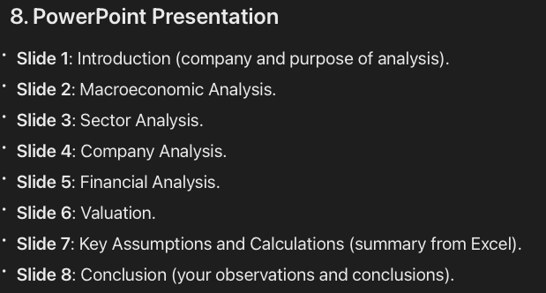

Slide 3
Introduction

Slide 4
Macroeconomic Analysis
Economic Situation: Research the economic conditions in the company's country and the CSEE region using the PEST method (Political, Economic, Social, and Technological factors).
Key Economic Indicators: Identify key economic indicators that impact the investment, such as GDP growth rates, inflation rates, interest rates, unemployment rates, and any relevant government policies.

Slide 5
Sector Analysis
Market Size and Growth: Analyse the current market size and expected future growth of the industry.
Industry Life Cycle: Determine the stage of the industry life cycle (introduction, growth, maturity, decline).
Competitors: Identify main competitors in the sector.
Customer Structure: Describe the structure of the customer base.

Slide 6
Company Analysis
Product Specification: Describe the company's products or services.
Business Model: Explain how the company makes money.
Competitive Advantages: Identify and elaborate on the company's competitive edges.
Company Strategy: Outline the strategic direction of the company.

Slide 7
Financial Analysis
Vertical and Horizontal Analysis: Conduct vertical and horizontal analyses of the company's three key financial statements (income statement, balance sheet, cash flow statement).
Ratio Analysis: Perform ratio analysis to assess financial health (e.g., profitability ratios, liquidity ratios, leverage ratios).
Financial Condition: Provide an assessment and commentary on the financial condition of the company.

Slide 8
Valuation
Income Approach (DCF): Use the Discounted Cash Flow method to estimate the company's value.
Market Multiples: Apply market multiples (e.g., P/E, EV/EBITDA) for valuation.
Transaction Multiples: Use transaction multiples if relevant data is available.
Other Methods: Include other valuation methods if applicable (e.g., Leveraged Buyout (LBO), Dividend Discount Model (DDM)), though these are not mandatory.

Slide 9
Key Assumptions and calculations

Slide 10
Conclustions

