Slide 1
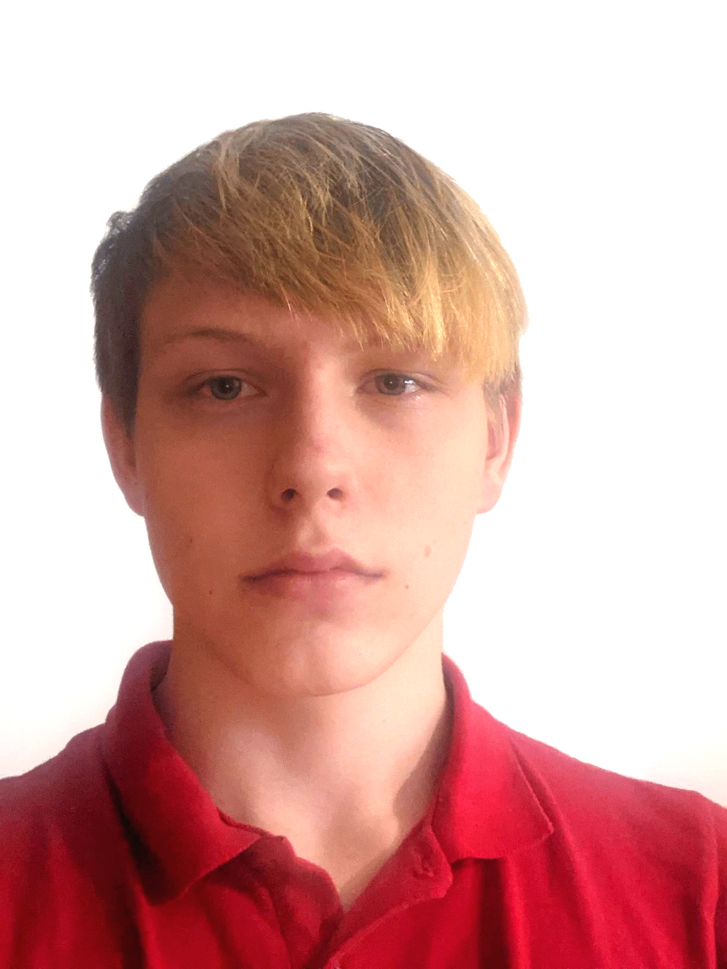
PROGRAMMING
CMGT Intake
2026-27
«Michał Rapciak»
«262607»

Slide 2

As an applicant at Breda University of Applied Sciences for the Creative Media and Games Technologies (CMGT) undergraduate programme you are required to provide evidence that demonstrates your current level and other factors required for pre-selection assessment and potential interview. The course is taught in English, so all submissions must be in English.
With the evidence you present here teachers should obtain a clear and comprehensive overview of your current state of progress as well as your general attitude and performance as a student and as an aspiring professional game developer.
This presentation is intended to provide you with a well-structured and organised format for doing this effectively. Please follow the directions on each slide to help ensure you supply the information required. Please do not spend time formatting the style of the presentation. Only insert extra slides where it says you can otherwise use the space, word count and font size provided. Also be sure to add your details where requested (for example on the first slide).
Make sure to read the assignment carefully (to be found in section B). Evidence needs to be provided in this presentation as well as during the interview (if applicable).
How To Use
This Template

Slide 3
A
Education information
Leaving Certificate @ St. Paul’s Secondary School, Monasterevin, Co. Kildare, Ireland
Hon. B.S.c Computer Games Development @ SETU Carlow – 1st Year finished, 2nd Year incomplete
Have you studied at a Technasium? - No

Slide 4
B
Programming Intake Assignment – Brief
Overview
This programming assignment assesses your suitability for our educational program. Don't worry if this is your first experience with programming and game development - we've provided resources to help you succeed.
Getting Started Tutorial: https://www.3dgep.com/cpp-fast-track-1-getting-started
We strongly recommend following this tutorial series step-by-step from start to finish. This will take time and dedication, but it's essential preparation.
Important: The PowerPoint template for submitting your assignment becomes available through 'My Online Application' as you follow the application procedure.

Slide 5
B
Programming Intake Assignment – Brief (continued)
Assignment Requirements
Core Requirements
Theme: Your game must be based on the theme “Transform”
Interpret this theme literally (changing shape, evolving objects) or abstractly (shifting perspectives, metamorphosis, etc.)
Programming Language: Must be written in C++
Graphics: Must include graphical gameplay (not text-only)
4. Your Own Work: The game must be your original creation
  You may use the tutorial template as a starting point
  External libraries are allowed
  Game engines are NOT allowed (no Unity, Unreal Engine, etc.)
Development Options
Option 1: Tutorial Template
Use the template from the tutorial series mentioned above
Option 2: SFML
Simple and Fast Multimedia Library: https://www.sfml-dev.org/
  Well documented with clear tutorials: https://www.sfml-dev.org/tutorials/2.5/
  Perfect for 2D games and graphics
Assets and Resources
  Art Assets: You may use existing images, 3D models, audio files, or simple shapes (circles, rectangles, etc.)
  Assessment Focus: You will be graded on code quality, not artistic assets
  Asset Sources: Example free assets available at https://itch.io/game-assets
  Attribution: Clearly state any external source code, tutorials, or assets you use

Slide 6
B
Programming Intake Assignment – Brief (continued)
Technical Requirements
Development Environment
  Must compile using Visual Studio Community (free): https://visualstudio.microsoft.com/vs/community/
  Test in both Debug and Release modes
Code Quality
Well-structured and organized
Properly commented to explain your logic
Easy to read and understand
Game Instructions
  Include a readme.txt file explaining:
    How to play the game
    Which keys/buttons to use
    Any special instructions

Slide 7
B
Programming Intake Assignment – Brief (continued)
Submission Requirements
What to Submit
Complete Project Zip File containing:
  All source code files (.cpp, .h, etc.)
  All assets (images, sounds, etc.)
  All dependencies and libraries (see critical note below)
  Project files (Visual Studio solution/project files)
  readme.txt with game instructions
PowerPoint Presentation (template provided in application portal)
🚨 CRITICAL: Including Dependencies
If you use SFML or any external libraries:
You MUST include the library files in your zip
Include both the header files (.h) and library files (.lib/.dll)
Your project should compile and run without requiring us to download anything extra
Common mistake: Forgetting to include SFML files, causing compilation errors
💡 Best Practice: Install Dependencies in Your Project Folder Instead of installing SFML system-wide, install it directly in your project folder:
Create a folder like MyGame/SFML/ or MyGame/libs/SFML/
Extract SFML files into this folder within your project
Set up your Visual Studio project to look for libraries in this local folder
This ensures everything is self-contained and included when you zip your project

Slide 8
B
Programming Intake Assignment – Brief (continued)
Why this works better:
  Guarantees all dependencies are included in your zip file
  Avoids path issues on different computers
  Makes your project completely portable
  Eliminates the most common submission problem
Before Submitting:
  Extract your zip file to a completely new folder
  Try to compile and run your game from this fresh location
  If it doesn't work, you're missing dependencies
  Fix the issue and test again
Testing Your Submission
  Test your zip file before uploading
  Extract to a new location on a different computer if possible
  Ensure the game compiles and runs in both Debug and Release mode
  Upload the zip file at the same time as your PowerPoint
Resources for Beginners
If you're new to programming, we recommend:
Online Tutorial: https://www.3dgep.com/cpp-fast-track-1-getting-started
Recommended Book: "Beginning C++ Through Game Programming (4th Edition)" by Michael Dawson
ISBN: 9781305109919
Available at: https://books.google.nl/books?id=pd0OBAAAQBAJ
Builds strong C++ foundation (though doesn't cover graphics)

Slide 9
B
Programming Intake Assignment – Brief (continued)
What We're Looking For
We understand most of you are new to programming. Here's what will make your submission stand out:
Essential Elements
Complete submission that addresses all requirements
Clear evidence of effort - we want to see that you've been genuinely engaged with the task and put in dedicated time
Fundamental programming concepts properly implemented (variables, loops, conditions, functions)
Working game that compiles and runs without errors
Going Above and Beyond
Extra features you've added beyond the basic requirements
Self-directed learning - evidence you've explored topics or techniques not covered in the tutorials
Iterative improvement - showing you've tested, refined, and improved your code through multiple versions
Creative problem-solving - finding solutions to challenges you encountered
What Success Looks Like
You can explain the choices you made in your code
Your game demonstrates understanding of basic programming principles
You've shown curiosity by experimenting with additional features or techniques
There's evidence you've learned from mistakes and improved your approach
Remember: We do NOT expect commercial-quality games. We're looking for evidence that you can learn, adapt, and apply programming concepts effectively.

Slide 10
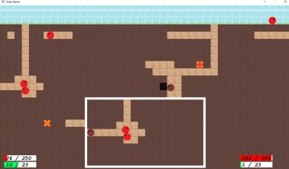
B
Programming Intake Assignment – Brief (continued)
Example Project
"Ants" - An example project from a previous year
Questions?
If any instructions are unclear, please contact us immediately. We're here to help you succeed!

Slide 11
B
Programming Intake Assignment – Brief (continued)
Submission Checklist
Before submitting your assignment, make sure you can check off every item:
✅ Game Requirements
[ ] Game theme is based on "Transform"
[ ] Written in C++ (no game engines used)
[ ] Has graphical gameplay (not text-only)
[ ] Compiles successfully in Visual Studio Community
[ ] Runs without errors in both Debug and Release mode
[ ] Includes readme.txt with game instructions and controls
✅ Code Quality
[ ] Code is well-structured and organized
[ ] Code includes helpful comments explaining your logic
[ ] Variable and function names are clear and meaningful
[ ] No major compilation warnings
✅ Complete Submission Package
[ ] All source code files (.cpp, .h, etc.) included
[ ] All assets (images, sounds, etc.) included
[ ] All dependencies and libraries included (especially SFML if used)
[ ] Visual Studio project/solution files included
[ ] Everything is in a single zip file
✅ Testing Your Submission
[ ] Extracted zip file to a completely new folder
[ ] Successfully compiled from the new location
[ ] Game runs correctly from the new location
[ ] Tested both Debug and Release configurations
[ ] No missing files or broken dependencies
✅ Documentation and Attribution
[ ] readme.txt clearly explains how to play
[ ] All external assets, libraries, or code are properly attributed
[ ] Any tutorials or resources used are acknowledged
✅ Final Check
[ ] PowerPoint presentation completed (from application portal)
[ ] Both zip file and PowerPoint ready to upload simultaneously
[ ] Game represents your best effort and demonstrates learning
Good luck!

Slide 12
B
Programming Intake Assignment – Summary
Did you already have experience with programming? If so, did you use C++ before?
I’ve made small mods for games since a young age, and I’ve studied Comp. Games Dev at SETU Carlow for 2 years using C++ and SFML Libraries in Visual Studio, as well as some basic Assembly.
How much time did you spend on the assignment? Give a rough estimate.
I have spent roughly 100 hours into the project.
What learning resources did you use?
I mostly used the SFML website to stay up-to-date with the new 3.0 version of SFML. For general programming issues and errors, I looked at similar problems found on Stack Overflow and did testing. I also used my old school projects and code as inspiration, although I had to re-write and re-imagine those old systems and functions to work in SFML 3.0 and be more efficient.

Slide 13
B
Programming Intake Assignment – Game Description
My game is a classic approach on a rogue-like shooter genre. You play as an angel who fell down to hell and lost his powers. By taking down demons, you can use their souls to upgrade your spells (to help you free their souls more easily), or upgrade yourself (to survive in hell longer). Depending on your play style and upgrades, you slowly transform to your angel glory or become one of the demons.

Slide 14
B
Programming Intake Assignment - Media
<Replace this text with a screenshot or video clip of your game in action>

Slide 15
B
Relevant Portfolio, Skills & Knowledge
Please use this space to add examples of your best work from your portfolio, study or work history that are relevant to game development or the discipline you are applying for.
You can also include:
A list of skills & knowledge relevant to game development or becoming a successful student.
Activities you currently do to prepare yourself for our study & future in game development.
Links to examples of your work or portfolio website (but most important information should be in this presentation).
Insert up to 7 slides here. Images are allowed with a maximum of 200 words per slide.

Slide 16
B
Relevant Portfolio, Skills & Knowledge
Please use this space to add examples of your best work from your portfolio, study or work history that are relevant to game development or the discipline you are applying for.
You can also include:
A list of skills & knowledge relevant to game development or becoming a successful student.
Activities you currently do to prepare yourself for our study & future in game development.
Links to examples of your work or portfolio website (but most important information should be in this presentation).
Insert up to 7 slides here. Images are allowed with a maximum of 200 words per slide.

Slide 17
B
Relevant Portfolio, Skills & Knowledge
Please use this space to add examples of your best work from your portfolio, study or work history that are relevant to game development or the discipline you are applying for.
You can also include:
A list of skills & knowledge relevant to game development or becoming a successful student.
Activities you currently do to prepare yourself for our study & future in game development.
Links to examples of your work or portfolio website (but most important information should be in this presentation).
Insert up to 7 slides here. Images are allowed with a maximum of 200 words per slide.

Slide 18
IMPORTANT:
Before uploading to ’My Online Application’ please rename this document using the following naming convention:
firstname_familyname_studentnumber_intake_2025-26.ppt
Thank you for participating in the intake for
CMGT Games @ Breda University of Applied Sciences
End of Presentation

