Slide 1
CREDIT MODEL STUDY / 16 OCT 2026
Credit modeling: defensible evidence
A reproducible portfolio audit of logistic regression and XGBoost
Signal, uncertainty and failure analysis
Data audit → controlled ablations → nested development CV →
calibration → interpretation
Historical test repeatedly inspected; excluded from every new experiment.
Development CV evidence • historical test excluded • docs/portfolio-audit.md
01 / 35
Notes:
Credit modeling: defensible evidence
A reproducible portfolio audit of logistic regression and XGBoost
Source: Development CV evidence • historical test excluded • docs/portfolio-audit.md
Local project artifact; see theory_guide.pdf for definitions and limitations.

Slide 2
CREDIT MODEL STUDY / 16 OCT 2026
The outcome is a stronger study, not a score claim
Both families have modest development signal. The evidence also shows overfitting and costly operating points.
GLASSBOX SELECTOR AP
BLACKBOX SELECTOR AP
DUMMY AP
0.131
0.131
0.061
Fold SD 0.033
Fold SD 0.010
Natural-prevalence reference
Outlier handling matters; additional feature removal is mixed.
Separate calibration repairs probability levels. Neither family has proven universal
superiority.
Development CV evidence • historical test excluded • docs/portfolio-audit.md
02 / 35
Notes:
The outcome is a stronger study, not a score claim
Both families have modest development signal. The evidence also shows overfitting and costly operating points.
Source: Development CV evidence • historical test excluded • docs/portfolio-audit.md
Local project artifact; see theory_guide.pdf for definitions and limitations.

Slide 3
CREDIT MODEL STUDY / 16 OCT 2026
Data provenance remains the main deployment
blocker
Binary labels are observed; a default horizon, decision dates and borrower identities are not documented.
Verified
Unresolved
3,000 rows / 183 defaults
Default event definition and horizon
218 configured raw predictors
Feature availability at decision time
No exact duplicate records
Repeated borrowers cannot be excluded
Historical 600-row exclusion frozen
No new external or temporal cohort
2,400 development rows / 146 defaults
No verified timestamps for temporal validation
Development CV evidence • historical test excluded • docs/portfolio-audit.md
03 / 35
Notes:
Data provenance remains the main deployment blocker
Binary labels are observed; a default horizon, decision dates and borrower identities are not documented.
Source: Development CV evidence • historical test excluded • docs/portfolio-audit.md
Local project artifact; see theory_guide.pdf for definitions and limitations.

Slide 4
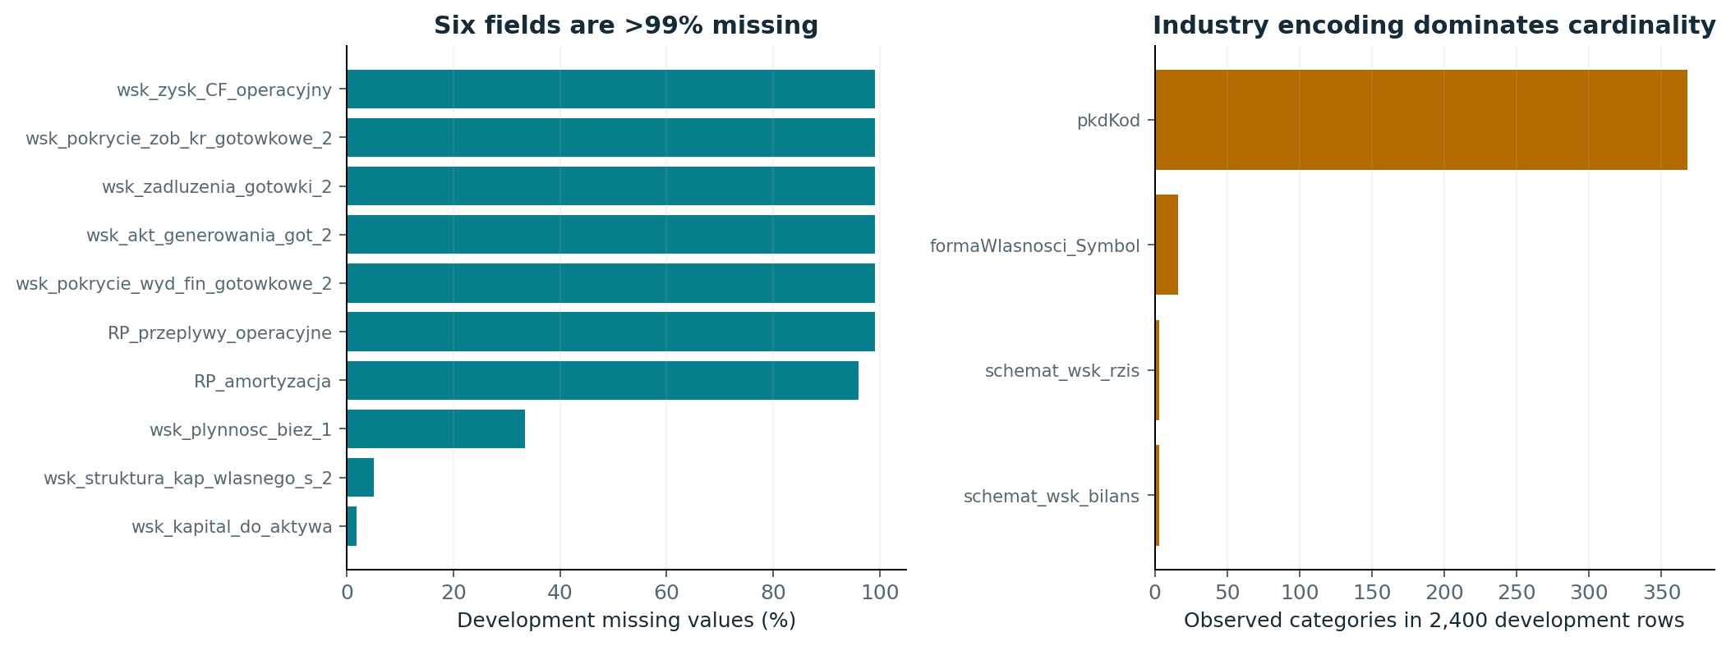
CREDIT MODEL STUDY / 16 OCT 2026
The audit found concrete quality problems
These are measured problems; near-zero denominators and post-outcome leakage remain hypotheses.
Development CV evidence • historical test excluded • docs/portfolio-audit.md
04 / 35
Notes:
The audit found concrete quality problems
These are measured problems; near-zero denominators and post-outcome leakage remain hypotheses.
Source: Development CV evidence • historical test excluded • docs/portfolio-audit.md
Local project artifact; see theory_guide.pdf for definitions and limitations.

Slide 5
CREDIT MODEL STUDY / 16 OCT 2026
Redundancy is real, but removal needs evidence
Eight exact duplicate field pairs; 66 numerical pairs with |Spearman rho| ≥ .98 on development data.
Example exact duplicates: wsk_ROS / wsk_rent_sprzedazy; wsk_koszty_przychody /
wsk_poziom_kosztow_operacyjnych.
Some ratios reach about 10^17; 1,014 infinite cells occur in the supplied full CSV.
Two coincident four-field profiles are not verified borrower IDs. No complete
borrower-aware split is supported.
Every raw field’s prediction-time availability remains explicitly unverified.
Development CV evidence • historical test excluded • docs/portfolio-audit.md
05 / 35
Notes:
Redundancy is real, but removal needs evidence
Eight exact duplicate field pairs; 66 numerical pairs with |Spearman rho| ≥ .98 on development data.
Source: Development CV evidence • historical test excluded • docs/portfolio-audit.md
Local project artifact; see theory_guide.pdf for definitions and limitations.

Slide 6
CREDIT MODEL STUDY / 16 OCT 2026
Historical evidence showed overfit before the test
Old training, validation and selected-CV results are diagnosis only; they do not select new models.
Historical configuration
Train AP
Validation AP
Selected CV AP
Logistic baseline
0.611
0.106
—
XGBoost baseline
0.991
0.186
—
Balanced L1 selection
0.298
0.140
0.137
Heavily regularized XGBoost
0.230
0.172
0.157
The old tree winner reduced variance and fitted signal. Investigate regularization and sampling, not test-tune.
Development CV evidence • historical test excluded • docs/portfolio-audit.md
06 / 35
Notes:
Historical evidence showed overfit before the test
Old training, validation and selected-CV results are diagnosis only; they do not select new models.
Source: Development CV evidence • historical test excluded • docs/portfolio-audit.md
Local project artifact; see theory_guide.pdf for definitions and limitations.

Slide 7
CREDIT MODEL STUDY / 16 OCT 2026
Repeated nested development CV
Two fixed repeats (42, 43) × three outer folds; three-fold inner AP selection.
960 rows
320 rows
320 rows
800 rows
Fit and inner
Independent
Independent F2
Outer
search
sigmoid
threshold
development
assessment
≈58–59 defaults
≈19–20 defaults
≈19–20 defaults
≈48–49 defaults
All four roles are disjoint. This costs fitting data, but avoids sharing calibration and threshold labels.
Random stratification is a documented limitation, not a substitute for missing borrower/time metadata.
Development CV evidence • historical test excluded • docs/portfolio-audit.md
07 / 35
Notes:
Repeated nested development CV
Two fixed repeats (42, 43) × three outer folds; three-fold inner AP selection.
Source: Development CV evidence • historical test excluded • docs/portfolio-audit.md
Local project artifact; see theory_guide.pdf for definitions and limitations.

Slide 8
CREDIT MODEL STUDY / 16 OCT 2026
A small set of explicit experiment families
All ablations use the same outer roles; feature settings are selected inside inner folds.
Question
Controlled comparison
Imbalance
Unweighted vs balanced logistic; identical tree candidates with fold weights
Extreme values / scaling
1%/99% train-only clipping; robust vs standard scaling after clipping
Missing / rare data
Indicators off; sparse-field cutoffs; rare-level pooling
Feature selection
L1; raw-field Spearman redundancy; whole-field supervised top-k
Tree search
Matched rate/tree-count paths, moderate complexity controls, frozen references
Development CV evidence • historical test excluded • docs/portfolio-audit.md
08 / 35
Notes:
A small set of explicit experiment families
All ablations use the same outer roles; feature settings are selected inside inner folds.
Source: Development CV evidence • historical test excluded • docs/portfolio-audit.md
Local project artifact; see theory_guide.pdf for definitions and limitations.

Slide 9
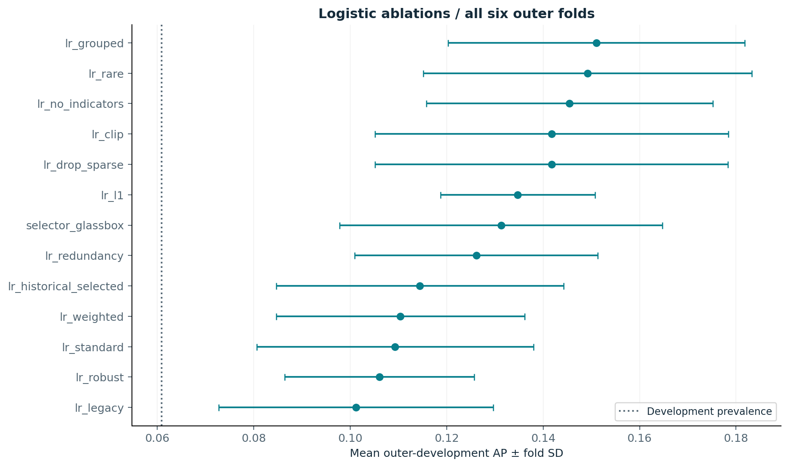
CREDIT MODEL STUDY / 16 OCT 2026
The full logistic ablation table is retained
Mean ± SD over six outer folds. SD is descriptive; these folds are dependent.
Development CV evidence • historical test excluded • docs/portfolio-audit.md
09 / 35
Notes:
The full logistic ablation table is retained
Mean ± SD over six outer folds. SD is descriptive; these folds are dependent.
Source: Development CV evidence • historical test excluded • docs/portfolio-audit.md
Local project artifact; see theory_guide.pdf for definitions and limitations.

Slide 10
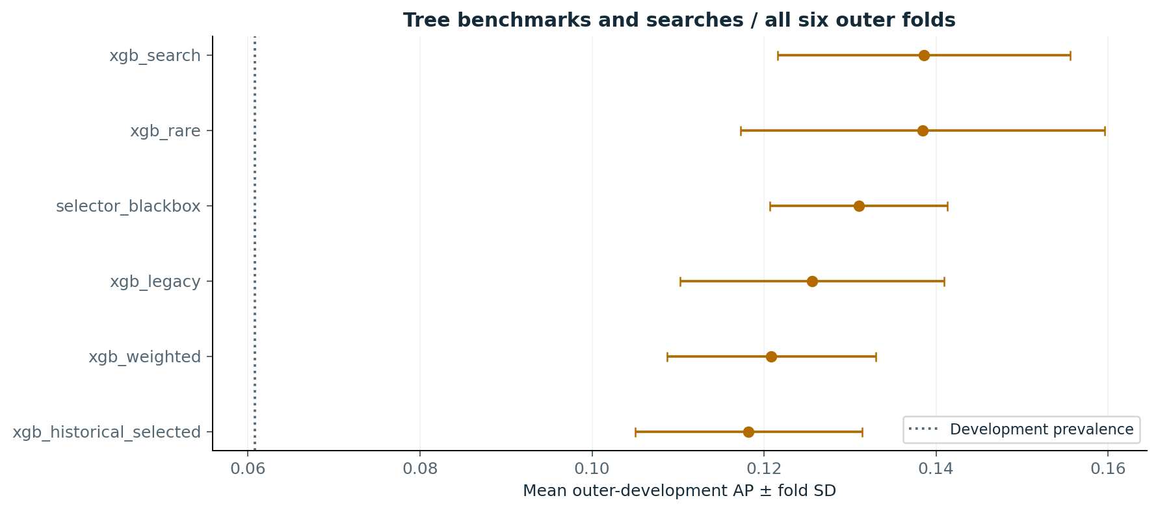
CREDIT MODEL STUDY / 16 OCT 2026
Trees: moderate controls, matched search paths
No early stopping: tree counts are inner-selected. Weighted and unweighted searches share eight candidates.
Development CV evidence • historical test excluded • docs/portfolio-audit.md
10 / 35
Notes:
Trees: moderate controls, matched search paths
No early stopping: tree counts are inner-selected. Weighted and unweighted searches share eight candidates.
Source: Development CV evidence • historical test excluded • docs/portfolio-audit.md
Local project artifact; see theory_guide.pdf for definitions and limitations.

Slide 11
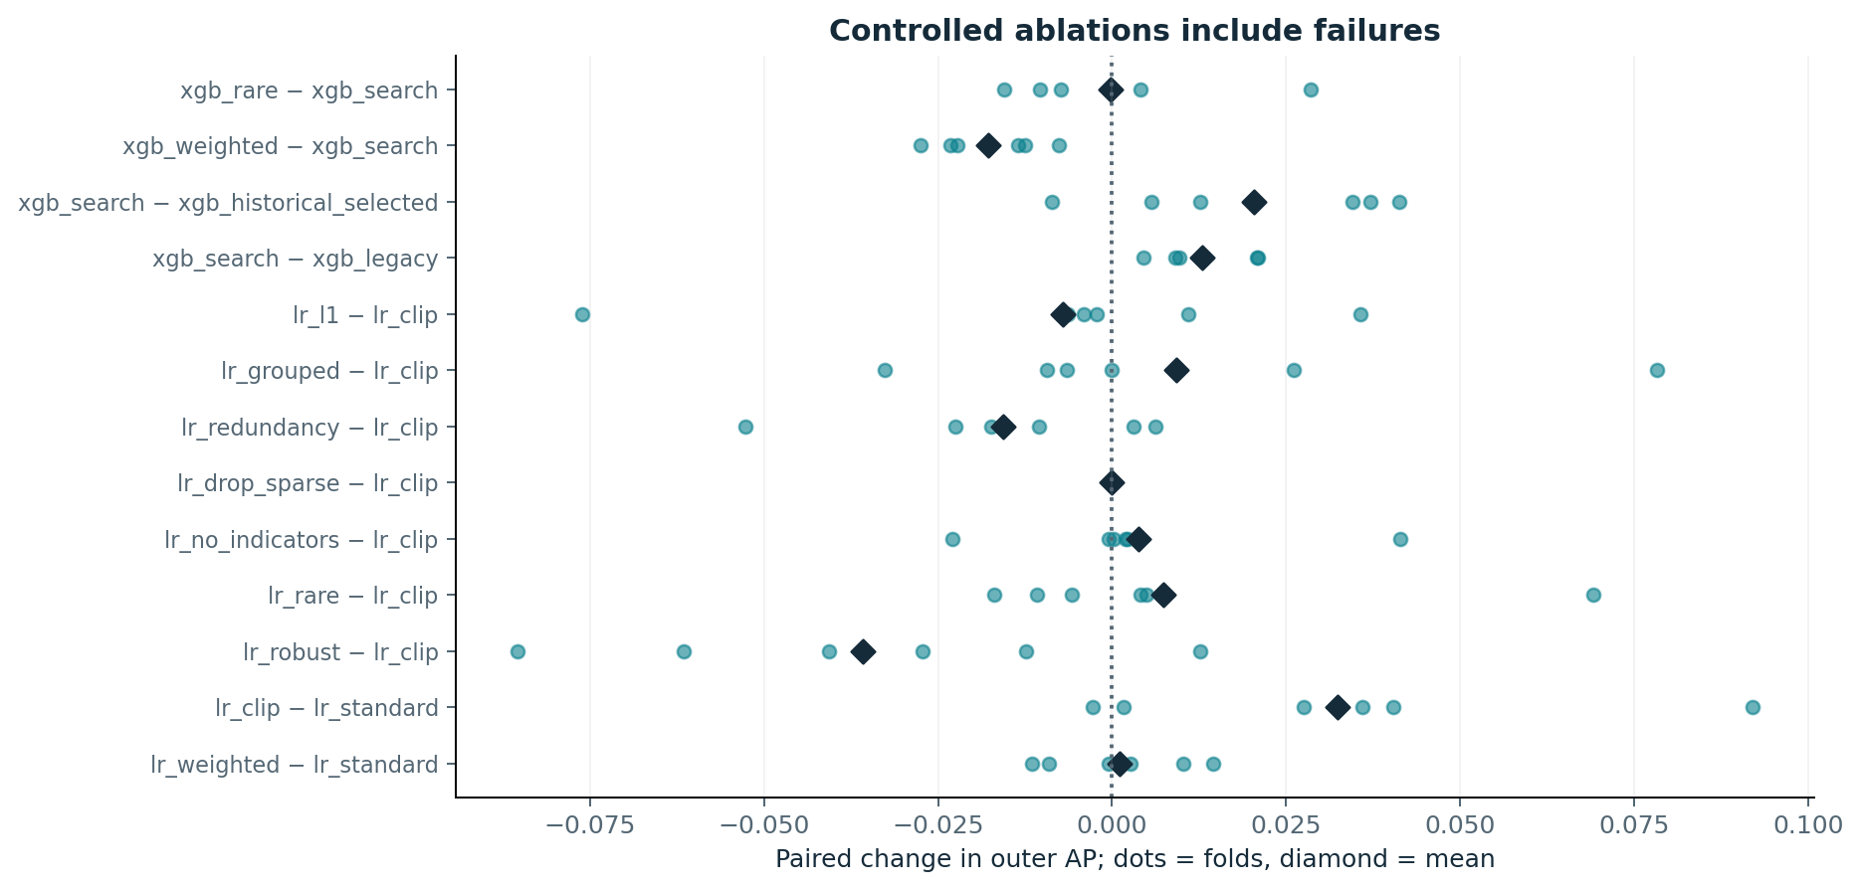
CREDIT MODEL STUDY / 16 OCT 2026
Paired changes include negative findings
Dots show all six paired outer-fold AP changes; diamonds are means. No favorable seed was selected.
Development CV evidence • historical test excluded • docs/portfolio-audit.md
11 / 35
Notes:
Paired changes include negative findings
Dots show all six paired outer-fold AP changes; diamonds are means. No favorable seed was selected.
Source: Development CV evidence • historical test excluded • docs/portfolio-audit.md
Local project artifact; see theory_guide.pdf for definitions and limitations.

Slide 12
CREDIT MODEL STUDY / 16 OCT 2026
Feature selection is not automatically an
improvement
Whole raw fields preserve one-hot groups; dimensions and active sets vary across training folds.
Recipe
Raw fields
Dimensions
Active coeff.
AP
lr_clip
218.0
494.5
494.5
0.142
lr_rare
218.0
251.5
251.5
0.149
lr_drop_sparse
215.0
488.5
488.5
0.142
lr_redundancy
160.7
435.3
435.3
0.126
lr_grouped
91.7
145.0
145.0
0.151
lr_l1
218.0
494.5
22.5
0.135
Development CV evidence • historical test excluded • docs/portfolio-audit.md
12 / 35
Notes:
Feature selection is not automatically an improvement
Whole raw fields preserve one-hot groups; dimensions and active sets vary across training folds.
Source: Development CV evidence • historical test excluded • docs/portfolio-audit.md
Local project artifact; see theory_guide.pdf for definitions and limitations.

Slide 13
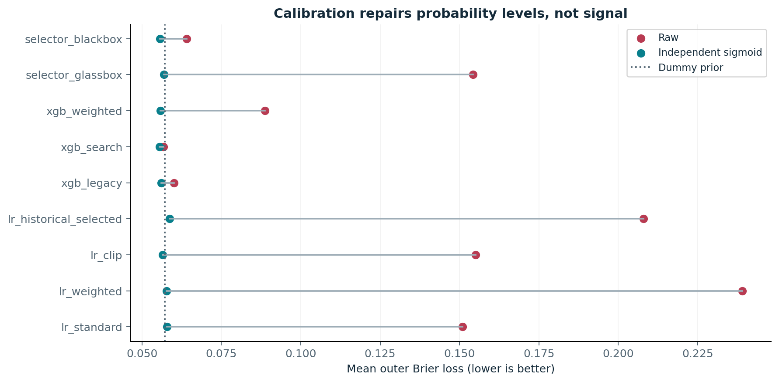
CREDIT MODEL STUDY / 16 OCT 2026
Calibration is a separate probability experiment
A regularized monotone sigmoid fits natural-prevalence rows independently of model fitting and thresholds.
Development CV evidence • historical test excluded • docs/portfolio-audit.md
13 / 35
Notes:
Calibration is a separate probability experiment
A regularized monotone sigmoid fits natural-prevalence rows independently of model fitting and thresholds.
Source: Development CV evidence • historical test excluded • docs/portfolio-audit.md
Local project artifact; see theory_guide.pdf for definitions and limitations.

Slide 14
CREDIT MODEL STUDY / 16 OCT 2026
A fitting diagnosis: the intercept was penalized
Adaptive follow-up, reported separately. It uses the same folds and C grids; it is not independent confirmation.
liblinear penalizes its synthetic intercept. Very small C can pull even an unweighted score
toward 0.5.
L2 follow-up: lbfgs with an unpenalized intercept, with and without clipping.
L1 follow-up: same solver, with intercept_scaling=100 to weaken the intercept penalty.
Clipped L2 raw Brier: liblinear 0.155 → lbfgs 0.057.
Development CV evidence • historical test excluded • docs/portfolio-audit.md
14 / 35
Notes:
A fitting diagnosis: the intercept was penalized
Adaptive follow-up, reported separately. It uses the same folds and C grids; it is not independent confirmation.
Source: Development CV evidence • historical test excluded • docs/portfolio-audit.md
Local project artifact; see theory_guide.pdf for definitions and limitations.

Slide 15
CREDIT MODEL STUDY / 16 OCT 2026
Primary procedure-level results
Each family chooses its recipe by inner AP only. These are development estimates, not a new test result.
Procedure
AP ± SD
ROC-AUC
Brier
Log loss
dummy
0.061 ± 0.001
0.500
0.0571
0.229
glassbox
0.131 ± 0.033
0.659
0.0570
0.226
blackbox
0.131 ± 0.010
0.706
0.0556
0.215
Sigmoid outputs shown. The adaptive intercept study is separate; it does not replace these planned estimates.
Development CV evidence • historical test excluded • docs/portfolio-audit.md
15 / 35
Notes:
Primary procedure-level results
Each family chooses its recipe by inner AP only. These are development estimates, not a new test result.
Source: Development CV evidence • historical test excluded • docs/portfolio-audit.md
Local project artifact; see theory_guide.pdf for definitions and limitations.

Slide 16
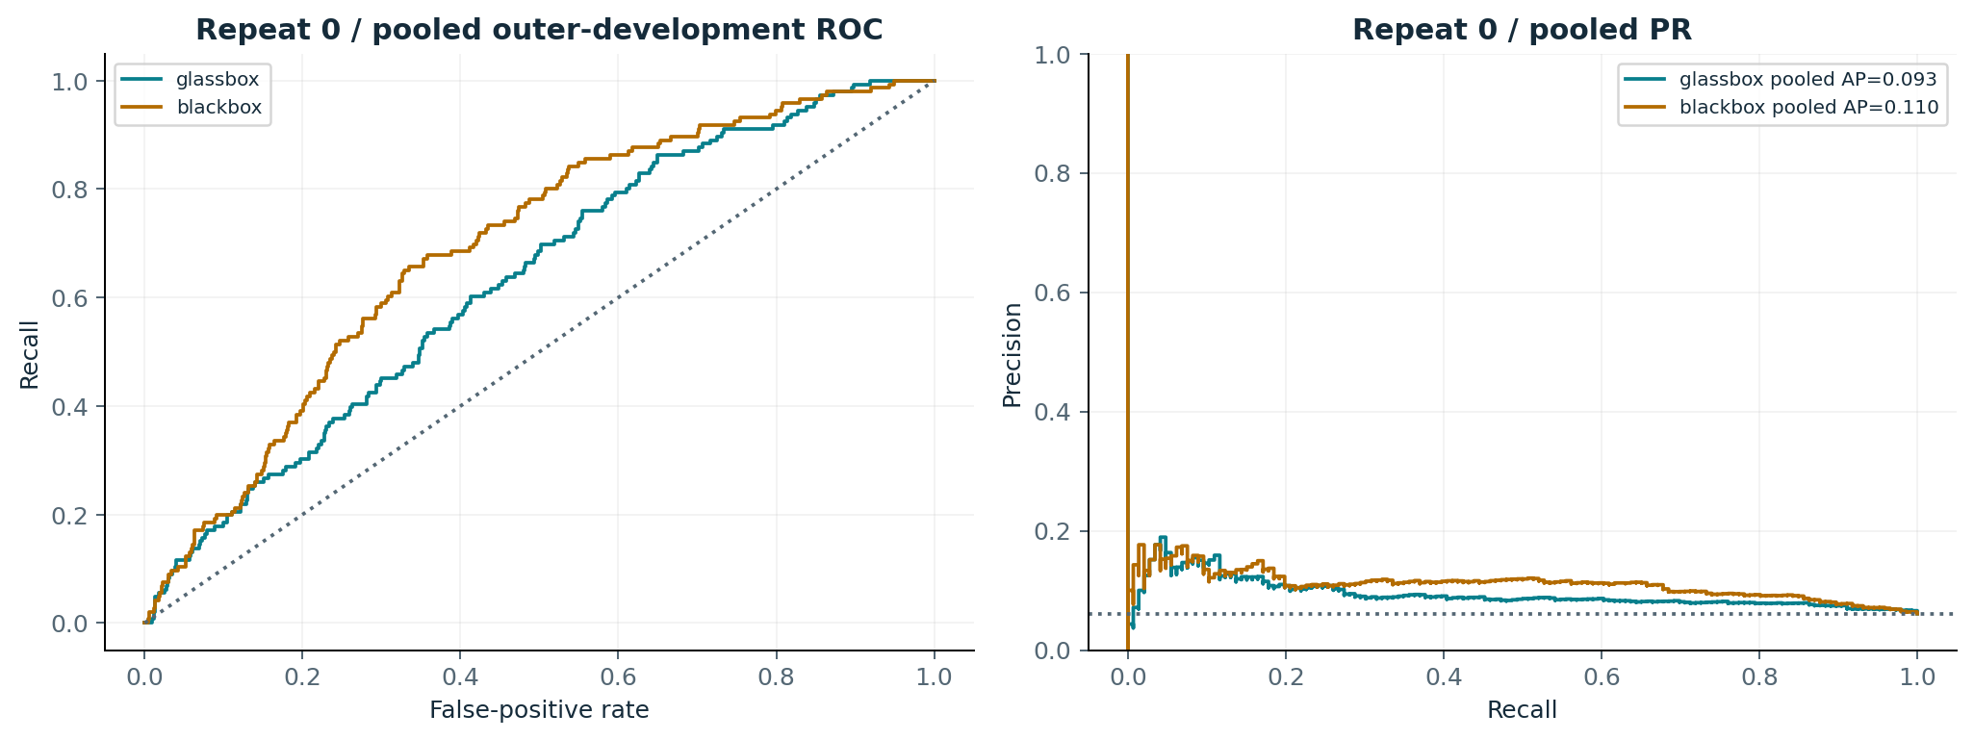
CREDIT MODEL STUDY / 16 OCT 2026
Ranking curves need scope
Repeat 0 pooled outer-development scores. Pooled AP and mean fold AP are different summaries.
Development CV evidence • historical test excluded • docs/portfolio-audit.md
16 / 35
Notes:
Ranking curves need scope
Repeat 0 pooled outer-development scores. Pooled AP and mean fold AP are different summaries.
Source: Development CV evidence • historical test excluded • docs/portfolio-audit.md
Local project artifact; see theory_guide.pdf for definitions and limitations.

Slide 17
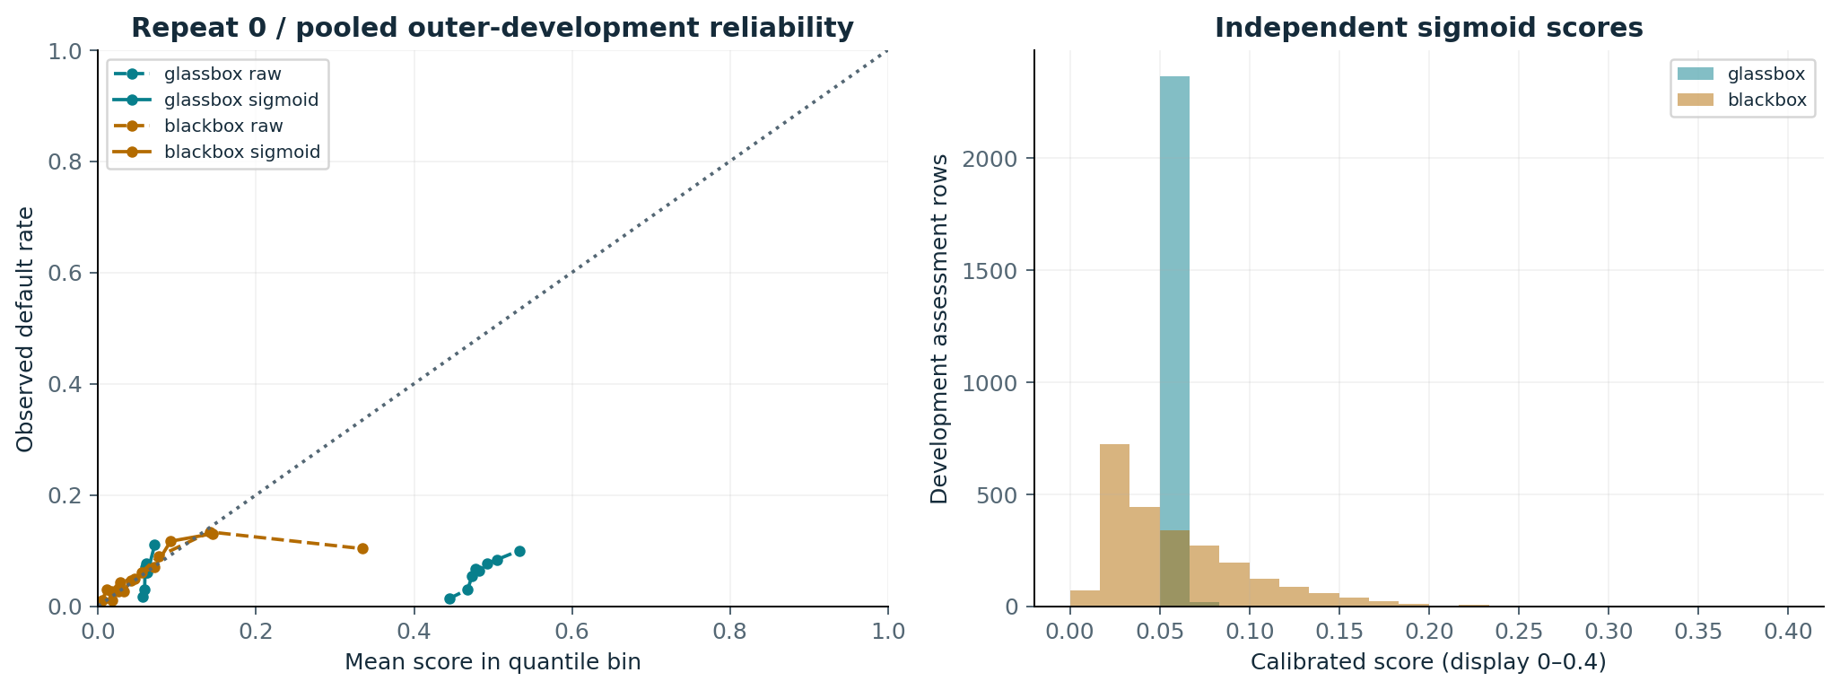
CREDIT MODEL STUDY / 16 OCT 2026
Probability reliability remains uncertain
Repeat 0 pooled outer-development predictions; the fitted calibration subsets contain only ≈20 defaults each.
Development CV evidence • historical test excluded • docs/portfolio-audit.md
17 / 35
Notes:
Probability reliability remains uncertain
Repeat 0 pooled outer-development predictions; the fitted calibration subsets contain only ≈20 defaults each.
Source: Development CV evidence • historical test excluded • docs/portfolio-audit.md
Local project artifact; see theory_guide.pdf for definitions and limitations.

Slide 18
CREDIT MODEL STUDY / 16 OCT 2026
F2 thresholds still create substantial workload
F2 is a stated recall preference, not a monetary cost model. Values are outer-fold means.
Procedure
Precision
Recall
FP / 800
Flagged
dummy
6.1%
100.0%
751.3
100.0%
glassbox
8.4%
67.0%
362.0
49.3%
blackbox
10.2%
65.4%
290.5
40.3%
lr_lbfgs_clip
10.1%
54.0%
238.8
33.1%
Last row is the adaptive follow-up. No threshold was selected from the historical test or outer labels.
Development CV evidence • historical test excluded • docs/portfolio-audit.md
18 / 35
Notes:
F2 thresholds still create substantial workload
F2 is a stated recall preference, not a monetary cost model. Values are outer-fold means.
Source: Development CV evidence • historical test excluded • docs/portfolio-audit.md
Local project artifact; see theory_guide.pdf for definitions and limitations.

Slide 19
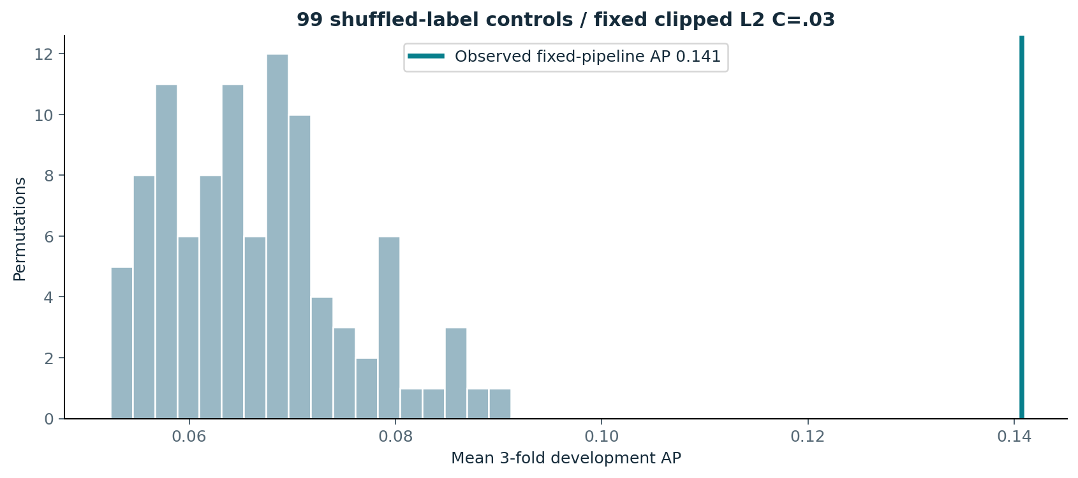
CREDIT MODEL STUDY / 16 OCT 2026
There is signal; no ceiling is established
Fixed clipped L2 C=.03, three-fold development CV, 99 shuffled-label controls.
Development CV evidence • historical test excluded • docs/portfolio-audit.md
19 / 35
Notes:
There is signal; no ceiling is established
Fixed clipped L2 C=.03, three-fold development CV, 99 shuffled-label controls.
Source: Development CV evidence • historical test excluded • docs/portfolio-audit.md
Local project artifact; see theory_guide.pdf for definitions and limitations.

Slide 20
CREDIT MODEL STUDY / 16 OCT 2026
Uncertainty rules out a strong winner claim
Original rows are paired across repeats in the bootstrap; model refitting is not included.
CONDITIONAL ΔAP INTERVAL
[-0.033, +0.033]
Tree selector minus logistic selector
Fold SD, repeat-level results and paired ablations are all retained.
The interval conditions on fitted predictions and prevalence; unknown borrower clustering
is not modeled.
Adaptive experimentation and future distribution shift require a new external / temporal
cohort.
Development CV evidence • historical test excluded • docs/portfolio-audit.md
20 / 35
Notes:
Uncertainty rules out a strong winner claim
Original rows are paired across repeats in the bootstrap; model refitting is not included.
Source: Development CV evidence • historical test excluded • docs/portfolio-audit.md
Local project artifact; see theory_guide.pdf for definitions and limitations.

Slide 21
CREDIT MODEL STUDY / 16 OCT 2026
Both families: strengths and costs
Interpretability does not compensate for poor probability estimates or incomplete data provenance.
Logistic regression
XGBoost
Strength
Signed additive margins; sparse variants
Nonlinearities and interactions
Weakness
Representation and extreme-value sensitivity
Overfit and tuning complexity
Probability issue
Weighting and intercept penalization
Small calibration sets; score shrinkage
Interpretation
Exact native terms; Linear SHAP
Gain has no direction; Tree SHAP
Observed limit
No clear family-level AP win
Low LIME fidelity in the studied model
Development CV evidence • historical test excluded • docs/portfolio-audit.md
21 / 35
Notes:
Both families: strengths and costs
Interpretability does not compensate for poor probability estimates or incomplete data provenance.
Source: Development CV evidence • historical test excluded • docs/portfolio-audit.md
Local project artifact; see theory_guide.pdf for definitions and limitations.

Slide 22
CREDIT MODEL STUDY / 16 OCT 2026
Expanded interpretation, without favorable-case
selection
Predeclared outer repeat 0/fold 0; recipe chosen by inner AP. No historical test explanations are added.
SHAP ROWS
SUCCESS / ERROR CASES
LIME FITS
800 / family
32 / family
192 total
All held-out rows in that outer fold
8 random TP, FP, FN, TN cases
3 seeds × 32 cases × 2 families
Three fit-only SHAP backgrounds test reference sensitivity.
Native/SHAP explain base log odds. LIME approximates base probability; calibrated
decisions are separate.
Development CV evidence • historical test excluded • docs/portfolio-audit.md
22 / 35
Notes:
Expanded interpretation, without favorable-case selection
Predeclared outer repeat 0/fold 0; recipe chosen by inner AP. No historical test explanations are added.
Source: Development CV evidence • historical test excluded • docs/portfolio-audit.md
Local project artifact; see theory_guide.pdf for definitions and limitations.

Slide 23
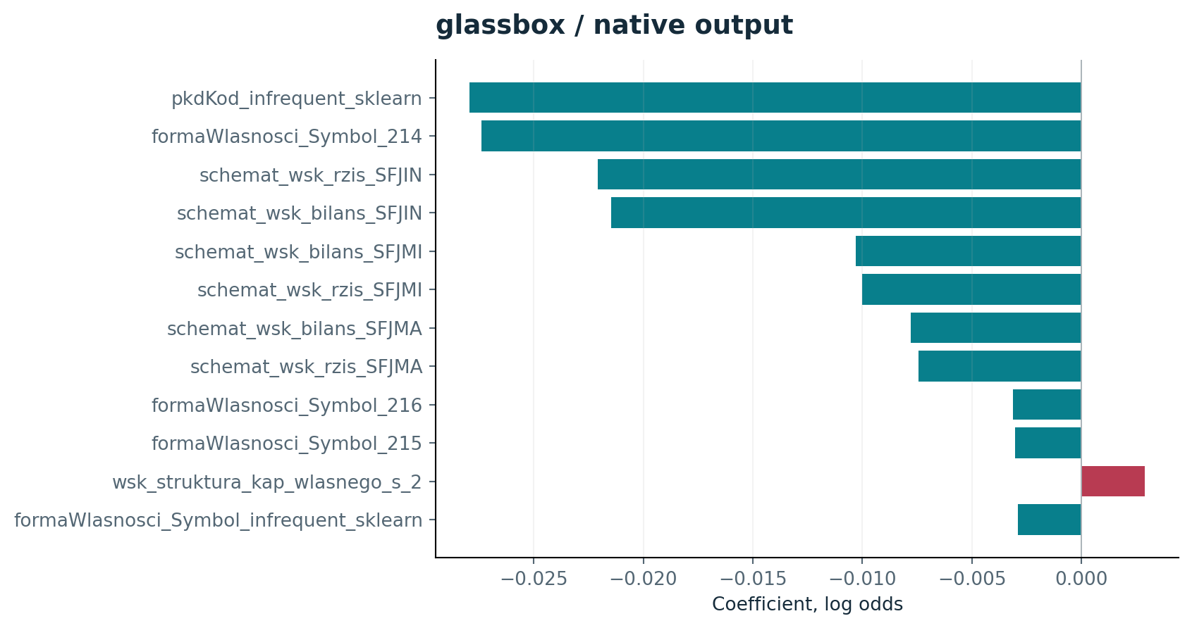
CREDIT MODEL STUDY / 16 OCT 2026
Native glassbox: actual fitted output
Coefficient signs describe the base logistic margin; tree gain is unsigned training split importance.
Development CV evidence • historical test excluded • docs/portfolio-audit.md
23 / 35
Notes:
Native glassbox: actual fitted output
Coefficient signs describe the base logistic margin; tree gain is unsigned training split importance.
Source: Development CV evidence • historical test excluded • docs/portfolio-audit.md
Local project artifact; see theory_guide.pdf for definitions and limitations.

Slide 24
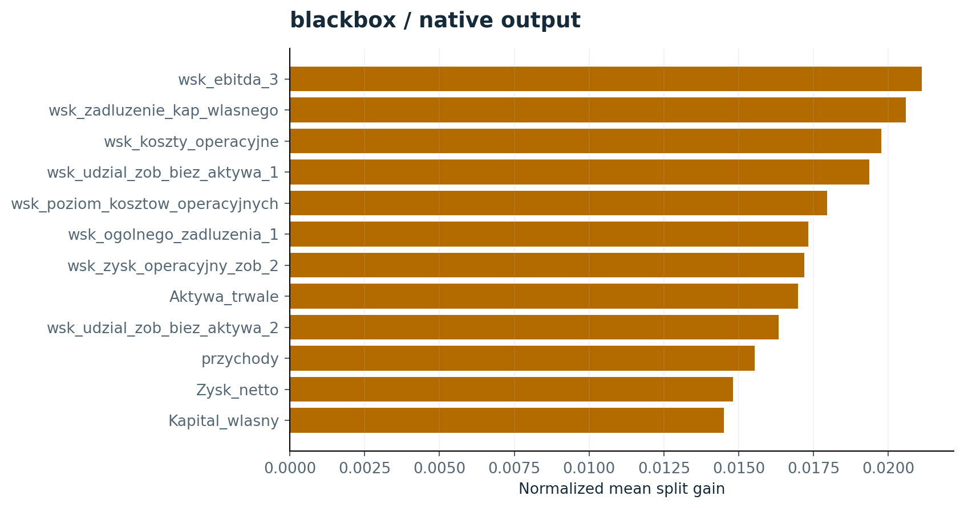
CREDIT MODEL STUDY / 16 OCT 2026
Native blackbox: actual fitted output
Coefficient signs describe the base logistic margin; tree gain is unsigned training split importance.
Development CV evidence • historical test excluded • docs/portfolio-audit.md
24 / 35
Notes:
Native blackbox: actual fitted output
Coefficient signs describe the base logistic margin; tree gain is unsigned training split importance.
Source: Development CV evidence • historical test excluded • docs/portfolio-audit.md
Local project artifact; see theory_guide.pdf for definitions and limitations.

Slide 25
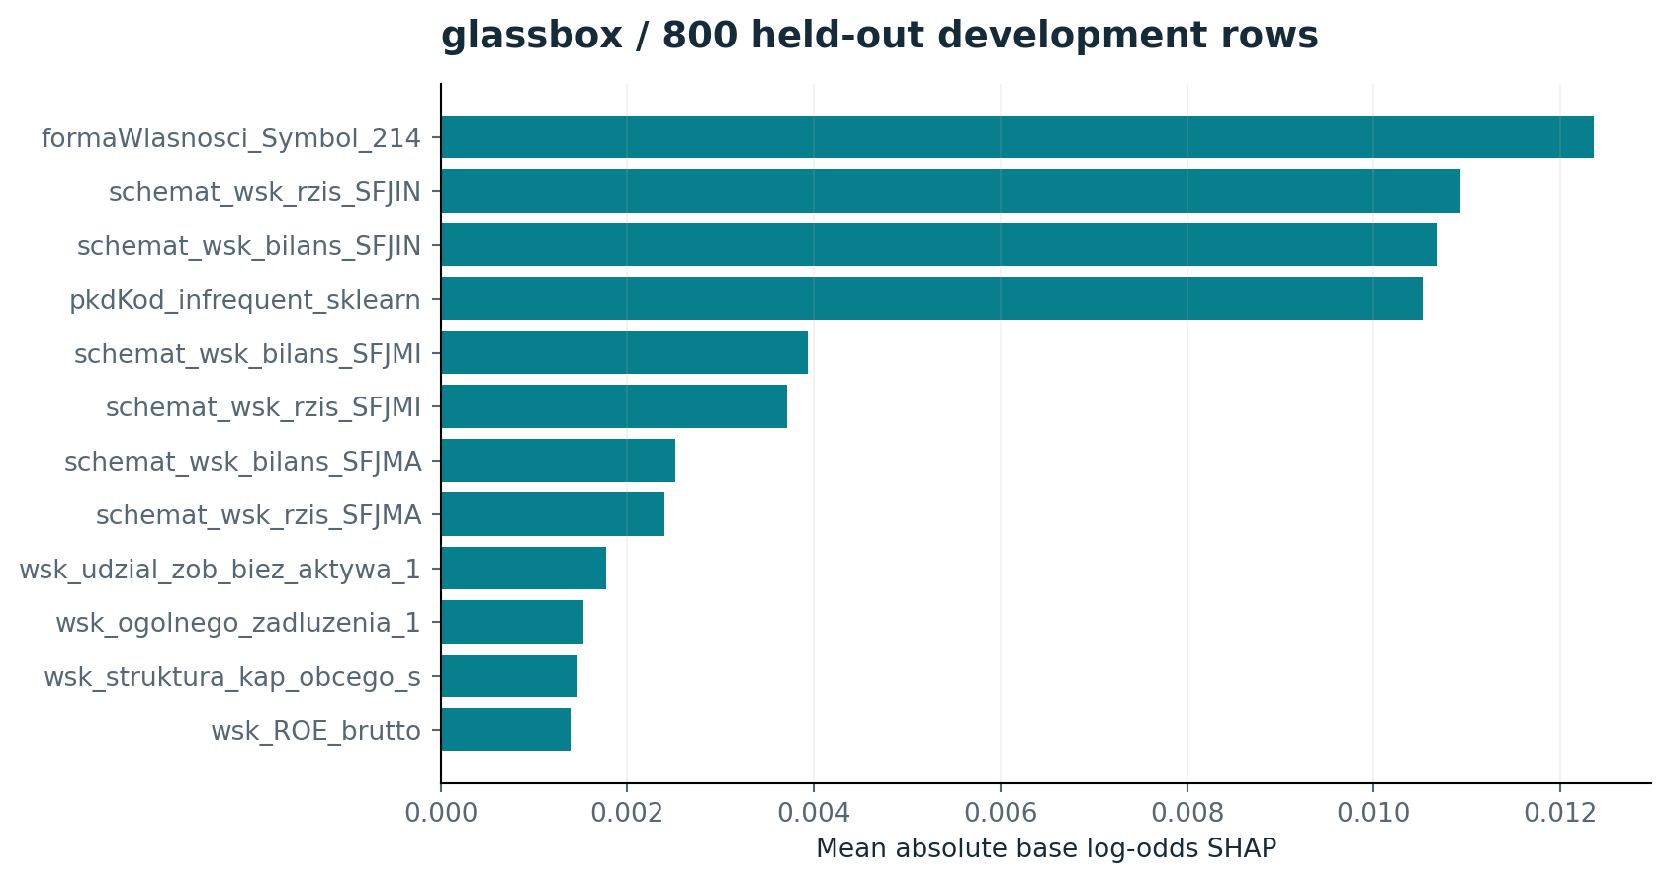
CREDIT MODEL STUDY / 16 OCT 2026
Global SHAP: glassbox, 800 development rows
Mean absolute base-log-odds attribution averaged across three training backgrounds.
Development CV evidence • historical test excluded • docs/portfolio-audit.md
25 / 35
Notes:
Global SHAP: glassbox, 800 development rows
Mean absolute base-log-odds attribution averaged across three training backgrounds.
Source: Development CV evidence • historical test excluded • docs/portfolio-audit.md
Local project artifact; see theory_guide.pdf for definitions and limitations.

Slide 26
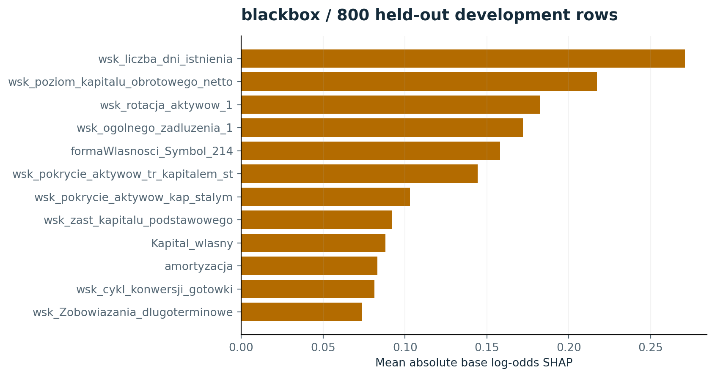
CREDIT MODEL STUDY / 16 OCT 2026
Global SHAP: blackbox, 800 development rows
Mean absolute base-log-odds attribution averaged across three training backgrounds.
Development CV evidence • historical test excluded • docs/portfolio-audit.md
26 / 35
Notes:
Global SHAP: blackbox, 800 development rows
Mean absolute base-log-odds attribution averaged across three training backgrounds.
Source: Development CV evidence • historical test excluded • docs/portfolio-audit.md
Local project artifact; see theory_guide.pdf for definitions and limitations.

Slide 27
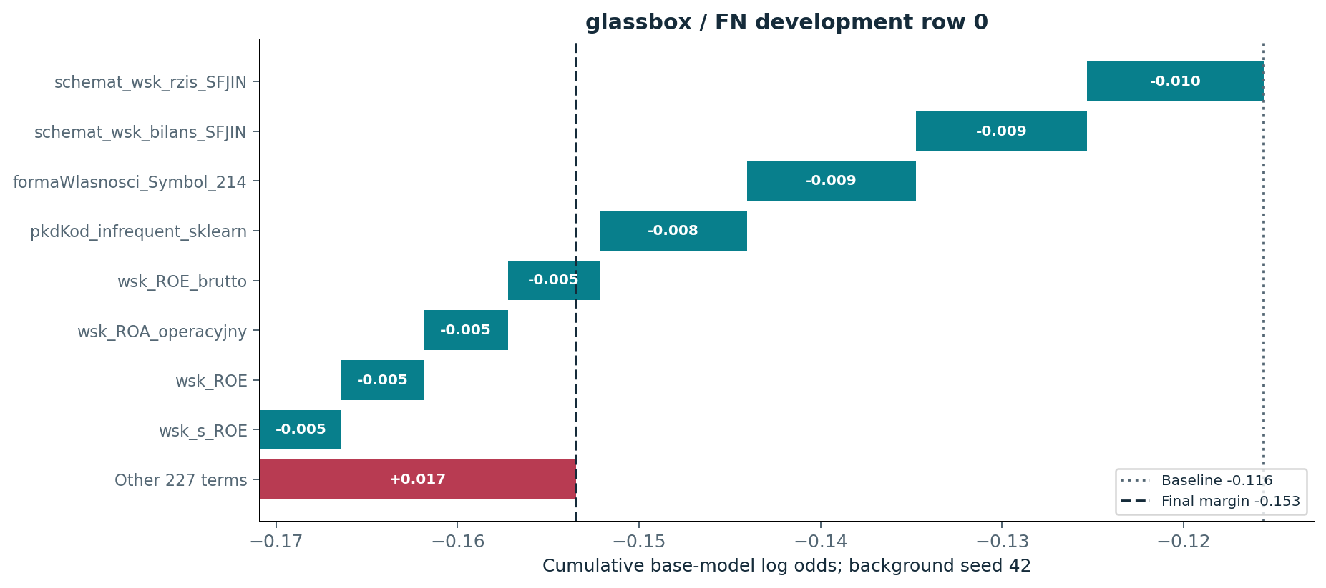
CREDIT MODEL STUDY / 16 OCT 2026
Error analysis: glassbox, a missed default
First randomly sampled FN in the fixed development fold; signed effects explain the base classifier.
Row 0: actual 1; base 0.4617 → sigmoid 0.0612 < t 0.0627.
Development CV evidence • historical test excluded • docs/portfolio-audit.md
27 / 35
Notes:
Error analysis: glassbox, a missed default
First randomly sampled FN in the fixed development fold; signed effects explain the base classifier.
Source: Development CV evidence • historical test excluded • docs/portfolio-audit.md
Local project artifact; see theory_guide.pdf for definitions and limitations.

Slide 28
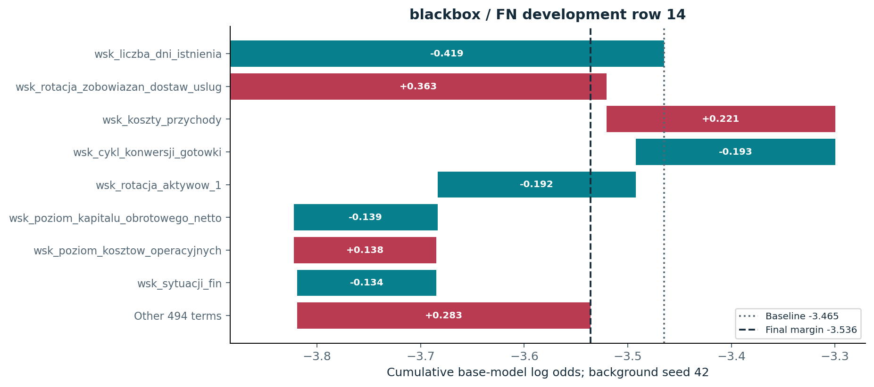
CREDIT MODEL STUDY / 16 OCT 2026
Error analysis: blackbox, a missed default
First randomly sampled FN in the fixed development fold; signed effects explain the base classifier.
Row 14: actual 1; base 0.0283 → sigmoid 0.0443 < t 0.0541.
Development CV evidence • historical test excluded • docs/portfolio-audit.md
28 / 35
Notes:
Error analysis: blackbox, a missed default
First randomly sampled FN in the fixed development fold; signed effects explain the base classifier.
Source: Development CV evidence • historical test excluded • docs/portfolio-audit.md
Local project artifact; see theory_guide.pdf for definitions and limitations.

Slide 29
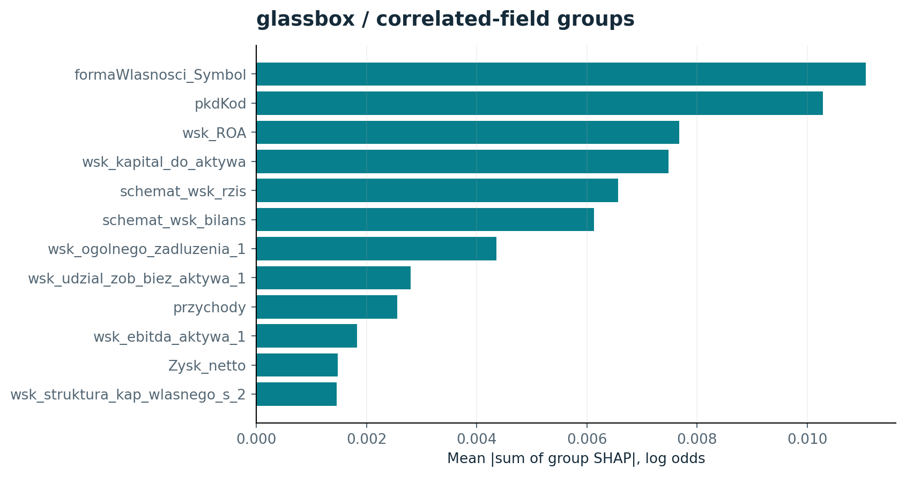
CREDIT MODEL STUDY / 16 OCT 2026
Correlated fields can redistribute credit
Fit-only correlation groups sum signed SHAP terms before taking mean absolute magnitude.
Development CV evidence • historical test excluded • docs/portfolio-audit.md
29 / 35
Notes:
Correlated fields can redistribute credit
Fit-only correlation groups sum signed SHAP terms before taking mean absolute magnitude.
Source: Development CV evidence • historical test excluded • docs/portfolio-audit.md
Local project artifact; see theory_guide.pdf for definitions and limitations.

Slide 30
CREDIT MODEL STUDY / 16 OCT 2026
Explanation stability has several meanings
Background stability does not establish retraining stability, causal validity or subgroup fairness.
Family
SHAP top-10 Jaccard
SHAP rank correlation
LIME selected-15 Jaccard
glassbox
1.000
0.970
0.984
blackbox
0.879
1.000
0.587
Active/retained raw-field Jaccard across all six fitted folds is also exported for every recipe.
Development CV evidence • historical test excluded • docs/portfolio-audit.md
30 / 35
Notes:
Explanation stability has several meanings
Background stability does not establish retraining stability, causal validity or subgroup fairness.
Source: Development CV evidence • historical test excluded • docs/portfolio-audit.md
Local project artifact; see theory_guide.pdf for definitions and limitations.

Slide 31
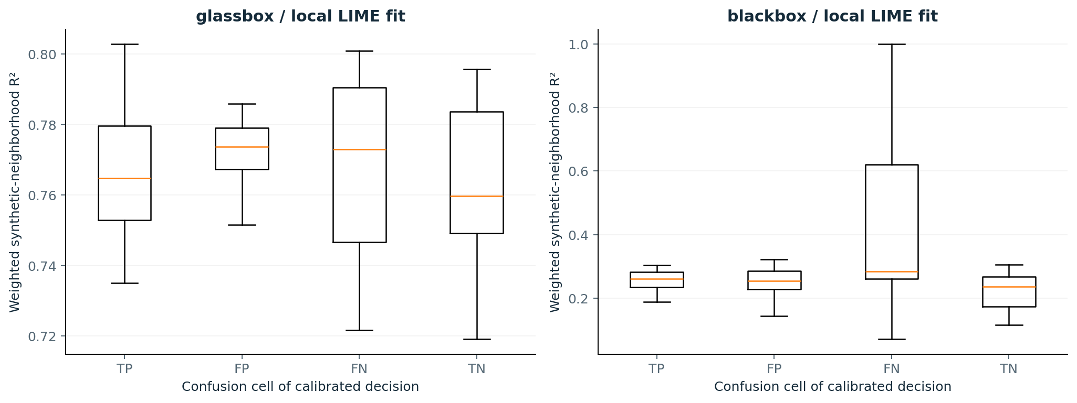
CREDIT MODEL STUDY / 16 OCT 2026
LIME fidelity is weak for this tree model
32 cases/family × 3 seeds × 2,000 perturbations; synthetic-neighborhood R² is not held-out faithfulness.
Development CV evidence • historical test excluded • docs/portfolio-audit.md
31 / 35
Notes:
LIME fidelity is weak for this tree model
32 cases/family × 3 seeds × 2,000 perturbations; synthetic-neighborhood R² is not held-out faithfulness.
Source: Development CV evidence • historical test excluded • docs/portfolio-audit.md
Local project artifact; see theory_guide.pdf for definitions and limitations.

Slide 32
CREDIT MODEL STUDY / 16 OCT 2026
Successes and errors are all retained
Balanced confusion-cell sampling is illustrative; it is not a population-weighted case distribution.
Family
Cell
Cases
Median base
Median sigmoid
blackbox
FN
8
0.025
0.041
blackbox
FP
8
0.065
0.074
blackbox
TN
8
0.015
0.029
blackbox
TP
8
0.115
0.107
glassbox
FN
8
0.470
0.062
glassbox
FP
8
0.476
0.063
glassbox
TN
8
0.466
0.062
glassbox
TP
8
0.481
0.064
Development CV evidence • historical test excluded • docs/portfolio-audit.md
32 / 35
Notes:
Successes and errors are all retained
Balanced confusion-cell sampling is illustrative; it is not a population-weighted case distribution.
Source: Development CV evidence • historical test excluded • docs/portfolio-audit.md
Local project artifact; see theory_guide.pdf for definitions and limitations.

Slide 33
CREDIT MODEL STUDY / 16 OCT 2026
Reproducibility is part of the result
Every new saved model and every role boundary was checked; historical artifacts were preserved.
126 saved base models: assessment predictions and metrics recomputed after
loading.
19 tests, including outer-label isolation and portable historical exclusions.
Cold refits: two complete recipes, six folds, both calibration modes reproduce saved
predictions.
Tracked plan, fold tables, failures, runtimes, environment, hashes and code snapshots;
PDFs remain local.
Development CV evidence • historical test excluded • docs/portfolio-audit.md
33 / 35
Notes:
Reproducibility is part of the result
Every new saved model and every role boundary was checked; historical artifacts were preserved.
Source: Development CV evidence • historical test excluded • docs/portfolio-audit.md
Local project artifact; see theory_guide.pdf for definitions and limitations.

Slide 34
CREDIT MODEL STUDY / 16 OCT 2026
What would make this deployment evidence?
Implemented: rigorous local development study. Proposed: external validation and operational design.
Obtain borrower identifiers, dates, target horizon and verified prediction-time feature
lineage.
Use appropriate group/time development splits, then assess a genuinely new cohort.
Define error costs, review capacity, subgroup checks and monitoring ownership.
Validate recalibration and explanation stability under refitting and distribution shift.
Development CV evidence • historical test excluded • docs/portfolio-audit.md
34 / 35
Notes:
What would make this deployment evidence?
Implemented: rigorous local development study. Proposed: external validation and operational design.
Source: Development CV evidence • historical test excluded • docs/portfolio-audit.md
Local project artifact; see theory_guide.pdf for definitions and limitations.

Slide 35
CREDIT MODEL STUDY / 16 OCT 2026
Evidence and methods
Technical report, theory guide and compact machine-readable evidence accompany this presentation.
docs/portfolio-audit.md and docs/evidence/portfolio_v1: complete evidence and limitations.
config/portfolio.yaml: planned study; portfolio_intercept.yaml: labeled adaptive follow-up.
Primary sources: scikit-learn CV/scoring/calibration; XGBoost; SHAP (Lundberg & Lee); LIME
(Ribeiro et al.).
Local reports/portfolio_v1: presentation, theory PDF, technical-report PDF, charts and
validation previews.
Development CV evidence • historical test excluded • docs/portfolio-audit.md
35 / 35
Notes:
Evidence and methods
Technical report, theory guide and compact machine-readable evidence accompany this presentation.
Source: Development CV evidence • historical test excluded • docs/portfolio-audit.md
Local project artifact; see theory_guide.pdf for definitions and limitations.

