Slide 1

View compilation in DotVVM 2.5
Michal Tichý
https://github.com/MichalTichy/DotVVM-Meetup-DotvvmStatusPage-Demo

Slide 2
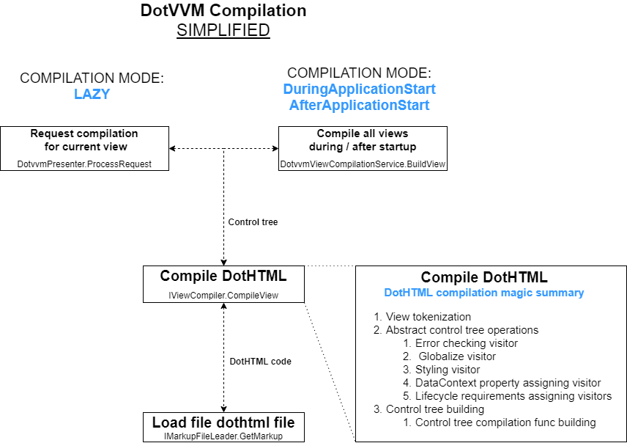

Slide 3

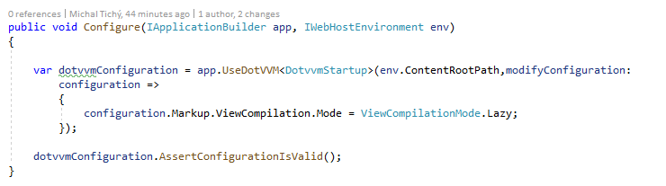
View compilation modes
Lazy
DuringApplicationStartup
AfterApplicationStartup

Slide 4
DEMO
View compilation modes

Slide 5
View compilation modes
Lazy
Views are compiled when first request to given page is handled.
Ideal for development and small applications.
DuringApplicationStartup
View are compiled during application startup.
Application does not respond to incoming requests until compilation is done.
Ideal when using slot swapping on azure. Slots are swapped after view compilation is done.
AfterApplicationStartup
Views are compiled after application startup.
Application starts handling incoming requests. Views are compiled in the background.
Compilation can be postponed.
Ideal for production environment where slot swapping is not used.

Slide 6
Compilation Status Page
Part of DotVVM Contrib
https://github.com/riganti/dotvvm-contrib
Compilation status page
_diagnostics/status
Compilation status page API
_diagnostics/status/api

Slide 7
DEMO
Compilation Status page + API

